Slide 1
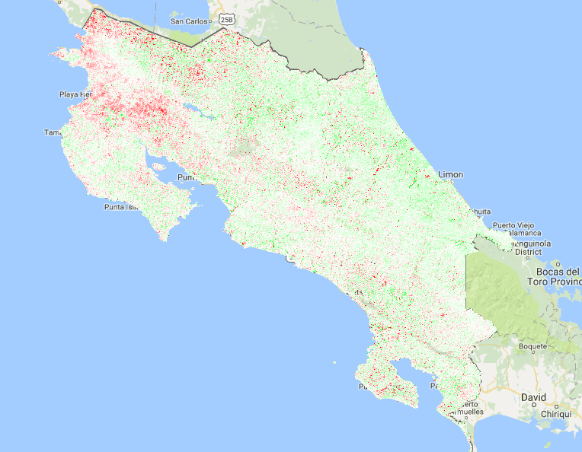
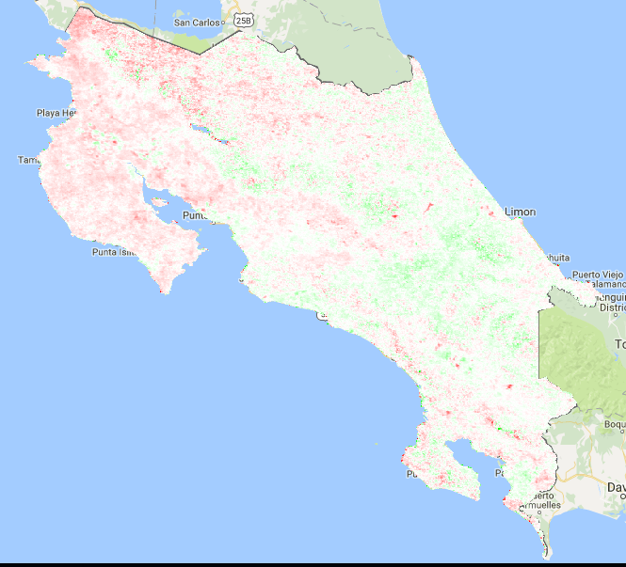
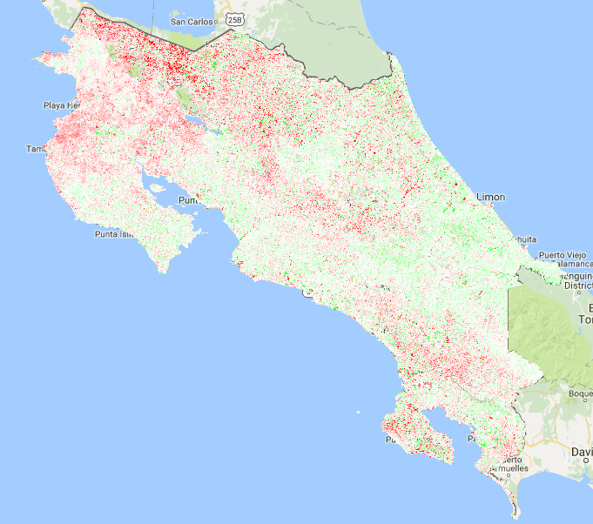
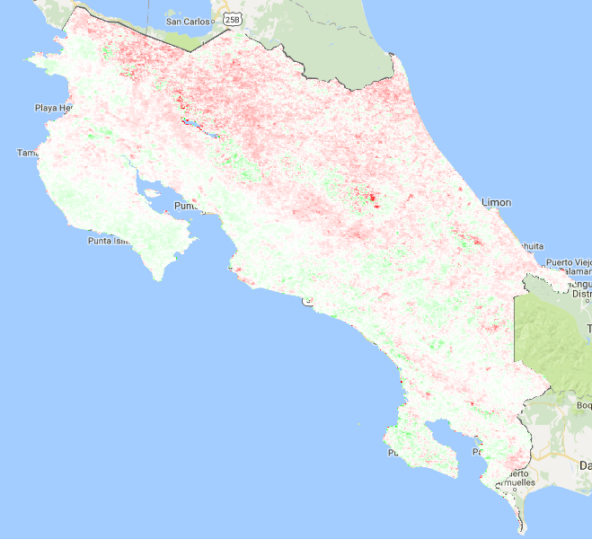
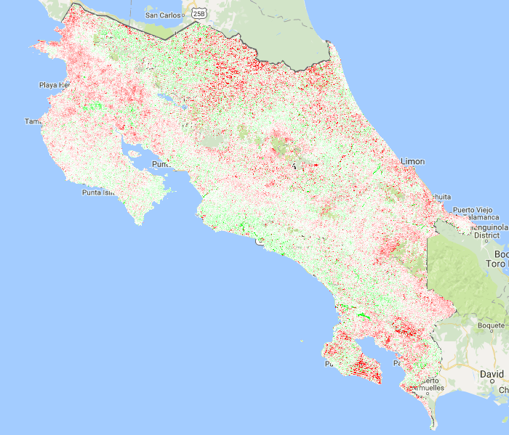
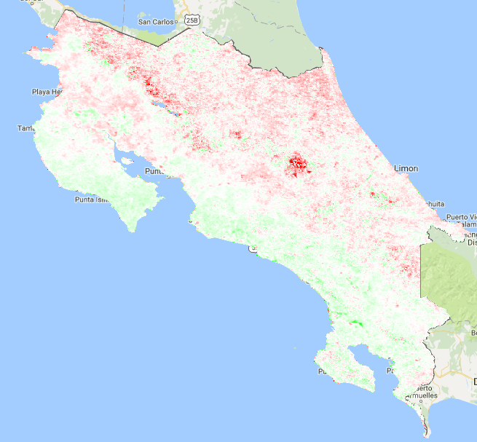
Analyzing Advantages of ECOSTRESS Data as a Tool for Drought Detection and Water Management Practices
Abstract
Earth Observations
El Niño Southern Oscillation (ENSO) conditions in 2015 have caused inadequate and unpredictable measures of rain throughout Central America. Costa Rica is located near the geographic center of the Central American drought, and loss of harvest due to inadequate rainfall is driving farmers to seek methods for mitigating effects of drought. To optimize available water resources, remote sensing methods can be used for the implementation of site-specific management strategies. The Normalized Difference Vegetation Index (NDVI) and evapotranspiration (ET) are currently used to measure changes in vegetative landscape characteristics but yield different spatial and temporal results concerning drought detection. The derivation of these datasets from Landsat versus MODIS imagery introduces further disparity. This project addressed the drought detecting capabilities of NDVI, and compared whether Landsat or MODIS, if either, is successful in providing a product that can identify vegetative trends from fine-scale landscapes in near-real time. The ECOsystem Spaceborne Thermal Radiometer on Space Station (ECOSTRESS) is scheduled to be launched to the International Space Station (ISS) in 2018 and will provide an ET product that advances the spatial and temporal coverage individually supplied by Landsat and MODIS. Using the Priestly-Taylor Jet Propulsion Laboratory (PT-JPL) model, this project used simulated ECOSTRESS data to assess the benefits ECOSTRESS will provide over existing datasets in both monitoring and mitigating vegetative responses to water and heat stress.
Terra - MODIS
Landsat 7 ETM+
Objectives
Address the drought detecting capabilities of NDVI
Compare NDVI when derived from both Landsat and MODIS imagery
Discover what ECOSTRESS will provide that existing drought identification capabilities cannot
Study Area
Project Partners
0
50
100km
EARTH University, Costa Rica
Results
Landsat 7
MODIS Terra
Costa Rica
2013 Anomaly
Agriculture and Forest
Study Period
Baseline: 2003-2012
Drought years: 2013, 2014, 2015
Costa Rica Agriculture II
Methodology
Landsat as a tool
NDVI
2014 Anomaly
Monitoring Drought: Spatial and Temporal Comparisons
MODIS as a tool
NDVI
ECOSTRESS as
a tool
Evapotranspiration
Calculate average NDVI values for the baseline period, and identify total area less than baseline for each drought year
Calculate each drought year anomaly by subtracting the baseline from average NDVI for each pixel
Identify timing of droughts and recoveries, as well as the quantity and pattern of drought events
Conclusions
2015 Anomaly
Spatial and temporal analyses between Landsat NDVI and MODIS Terra NDVI varied dramatically
Evapotranspiration may be a better index for determining the onset, duration, and location of drought events
ECOSTRESS data will overcome the inconsistencies between each satellite by combining high spatial and high temporal resolution
Acknowledgements
Dr. Christine Lee (JPL, California Institute of Technology)
Dr. Joshua Fisher (JPL, California Institute of Technology)
Dr. Johan Perret (EARTH University, Costa Rica)
Dr. Glynn Hulley (JPL, California Institute of Technology)
Greg Halverson (JPL, California Institute of Technology)
Laura Jewell (JPL, California Institute of Technology)
National Forest Financing Fund (FONAFIFO, Costa Rica)
This material is based upon work supported by NASA through contract
NNL11AA00B and cooperative agreement NNX14AB60A.
Team Members
David Comer
Team Lead
Sol Kim
Ian Heming
Katherine Cavanaugh
Jet Propulsion Laboratory – Fall 2016

