Slide 1
Navajo Nation Climate II
Monitoring Drought Conditions in the Navajo Nation Using NASA Earth Observations
Cheryl Cary (Project Lead)
Anton Surunis
Michael Gao
Sophie Turnbull-Appell
Vickie Ly
Notes:
Introductions…
Hi I’m Cheryl, I’m Vickie, I’m Michael, I’m Anton, and I’m Sophie (Something along those lines)
And we’re the Navajo Nation Climate II team.
Our projects is titled: Monitoring Drought Conditions in the Navajo Nation Using NASA Earth Observations

Slide 2
Background Information
The Navajo Nation is the largest Native American territory in the country for land area and population (US Census 2010)
65,700 km2 area at intersection of Arizona, New Mexico and Utah
174,000 residents
Study area, including HUC 8 watershed boundaries
Notes:
The Navajo Nation is the largest Native American territory in the United States in both land area and population size, with an area of 65,700 square kilometers, and approximately 174,000 residents.
The study area, outlined in the dashed box in the image on the right, was defined by a buffer around the grey shaded USGS Hydrologic Unit Code 8 boundaries that intersected with the Navajo Nation seen in red.

Slide 3
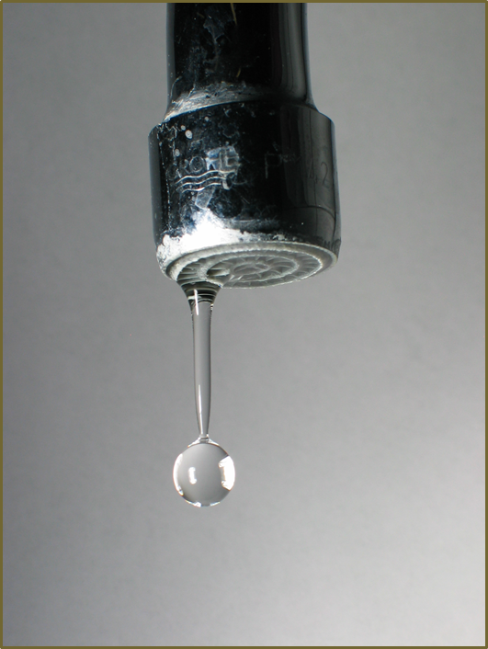
Community Concerns
70,000+ tribe members without direct access to water in homes
Drought in the Navajo Nation since 1994
Average temperatures increasing while average rainfall and snowpack decreasing
Image Credit: Wikipedia
Notes:
Image: http://upload.wikimedia.org/wikipedia/commons/5/58/Dripping_faucet_1.jpg
Geographically, the location of the Navajo Nation is inherently arid and dry,
The Navajo Nation has been in a drought since 1994, and declared a state of emergency in 2013
~buffer sentence~
Approximately one third of the population within the Nation lacks access to potable water in their homes. This problem is exacerbated by increasing average temperatures, and decreasing precipitation and snowpack due to climate change. These climate trends, and their impact on Nation communities puts pressure on drought monitoring and water management

Slide 4
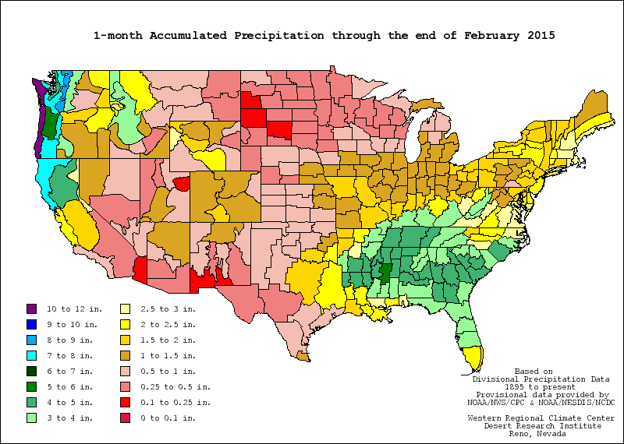
Drought Monitoring
Standardized Precipitation Index (SPI)
Shows abnormally wet/dry periods of time
Calculated by the WRCC
Image Credit: WRCC
Notes:
Currently the Navajo Nation uses the Standardized Precipitation Index to monitor drought on reservation land. The SPI is a probability based indicator of abnormally wet and dry time periods based on historical precipitation trends specific to the area. The Nation uses an SPI calculated by the Western Regional Climate Center, but this is based on state level climate divisions, and is not representative of the varying landscape and climates within Nation boundaries.

Slide 5
Drought Monitoring
WRCC SPI: Navajo Nation vs. West Virginia
West Virginia:
Only 88% of the area of the
Navajo Nation, but twice as many SPI
values
Navajo Nation:
96% of area in three SPI values
Notes:
Using the WRCC classification, the majority of the Nation receives only one SPI Value, and 96% of the Navajo Nation fall into just 3 climate divisions. Comparatively, the State of West Virginia has approximately the same area, but twice the amount of Climate Divisions

Slide 6
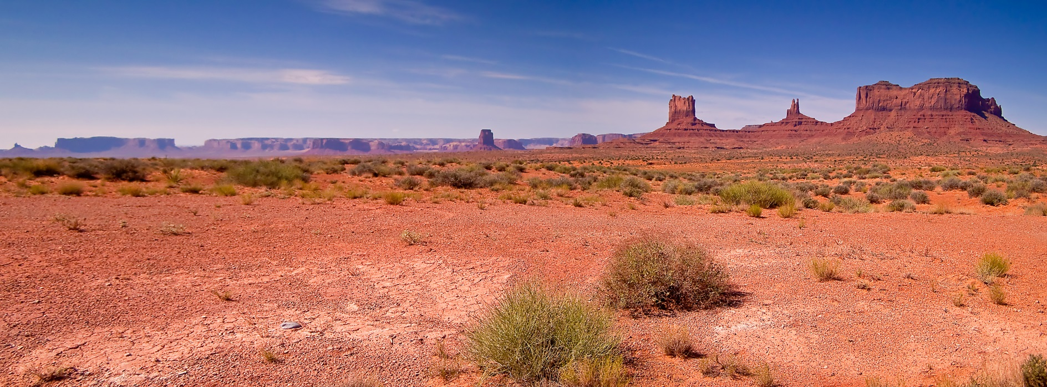
Project Partners
Navajo Nation Department of Water Resources: Water Management Branch
Navajo Technical University
Image Credit: Jim Lawrence
Notes:
Image: https://www.flickr.com/photos/focusonnature/4062309456/in/photolist-7bYp5d-7bY9dE-7bGv3e-7bGwGR-7bV7gy-7cht5F-7bTuKK-7bLjMh-7bTx8g-7bTB62-7bGwe2-7bTAnT-7bXnny-7bXkKG-7bXk19-EzMCd-5vqtCK-7cQHfR-uhiFDA-7cqyQd-8BHVaV-EzMD3-7bQz5B-5vquEK-EZ45Q-EtkLt-5E3uvH-8PzmyW-8PwitF-8PzjS9-8PyUVf-KePb3-EmsUe-8PyWy5-8PzhLh-8Pw74g-8Pz8Zm-8Pz6Aw-8Pz4b5-8Pz1tN-8PyYhw-7nCHnW-7jkUbg-5pFZyy-7buKps-7buGsS-7bsTMf-7njofa-7bqVjv-7buCXA
The team here at Ames partnered with the Navajo Nation Department of Water Resources, and the Navajo Technical University to see how we can help alleviate this lack of information using NASA Earth Observations.

Slide 7
First Term Objectives
Examine role of NASA Earth Observations in Navajo Nation drought monitoring
Create geodatabase of historical climate data
Research methods to develop Standardized Precipitation Index (SPI) geoprocessing package
Image Credit: NASA/Goddard Space Flight Center/Reto Stöckli
Notes:
Image: https://www.flickr.com/photos/gsfc/4426654941/in/photolist-7KaLhV-awVaEv-awXT4q-er1F4L-hXS1Um-7KeF1y-rBrMEF-8Hrda9-jzm1fa-eWXcrN-p1XuhG-kY5Rcf-oWv5Tp-dyKuX4-7Gc6C3-jZQr7r-dNWFvz-dyR2S9-7FDBma-9unbvZ-pzW58P-cCg8gy-b61xdH-nC7Cmf-oUvy98-brGx3Y-9y5sEm-dyYdst-dz4FV1-mbEUhd-r1Semf-8YYj7m-oUtH6C-hyzMyT-dyCPdf-nciSBX-7LM7YP-9ZSYDL-nkCsrR-dTG44v-cE76Ss-cLPjX1-btRFYj-doVbmQ-doxMo1-eq5qCT-eq5qHk-nkCbvp-ptrCNk-fEd9Hv
During the First term of this project we focused on creating a geodatabase of drought-related NASA Earth Observation data, and researching different methods to create a tool that would allow the Navajo Nation department of water resources hydrologists to calculate an SPI for a user specified area like an agency

Slide 8
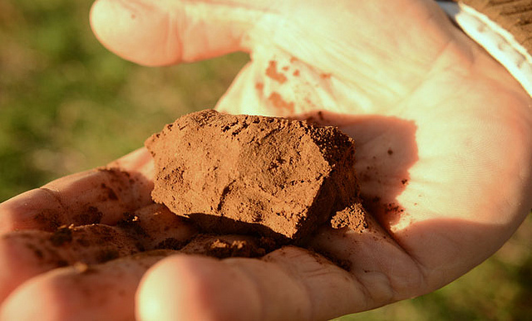
Second Term Objectives
Create a tool that calculates SPI rasters from historical precipitation data, and subsequently produces an average SPI over a user specified area
Compare drought intensity over time to other climate variables such as deep soil moisture
Image Credit: USDA
Notes:
Image: https://www.flickr.com/photos/usdagov/8466251260/in/photolist-opH3wq-dU8Kmm-pHnjhU-dU8Kxj-dU38EH-oPTbLr-oN78ux-oN6qH4-p5k3K4-ncVp5J-jsjuS6-oN6JpY-p5ym59-p5iDkk-p5yYc2-oN5LqF-oN53Z6-p3wZcL-oN5Nkc-bjzTSC-chVt65-chVtQo-chVtBU-chVsxU-chVtX3-chVu5o-fdy8hV-e5g3Ub-fdy8iT
This term our team focused on creating this SPI tool, paying special attention to user needs in order to produce a tool that will be of use to the Navajo Nation for years to come. We also decided to look at other climate variables to see if any individual variables show drought intensity comparable to the way SPI does.

Slide 9
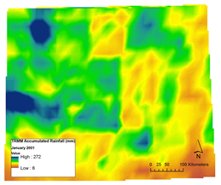
Tool Data
PRISM (Parameter-elevation Relationships on Independent Slopes Model)
Accumulated monthly precipitation, 1901-2013
TRMM (Tropical Rainfall Monitoring Mission – Precipitation Radar)
Accumulated monthly precipitation, 2000-2014
GPM (Global Precipitation Monitor IMGER data products)
Accumulated monthly precipitation, 2014-present
Photo for GPM
Notes:
We created two geodatabases from two separate sources with which to calculate SPI values. The first source was the Parameter-elevation Relationships on Independent Slope Model. We used PRISM for historical modeled precipitation data dating back to 1901 and continuing through 2013. This was to give us a historical baseline of average rainfall amounts to be able to compare against recent rainfall amounts.
The second source was the Tropical Rainfall Monitoring Mission, satellite’s Precipitation Radar. We used this for relatively recent to current observed precipitation data, from 2000-2015. This was to give us the modern values of precipitation to compare against historical trends.

Slide 10
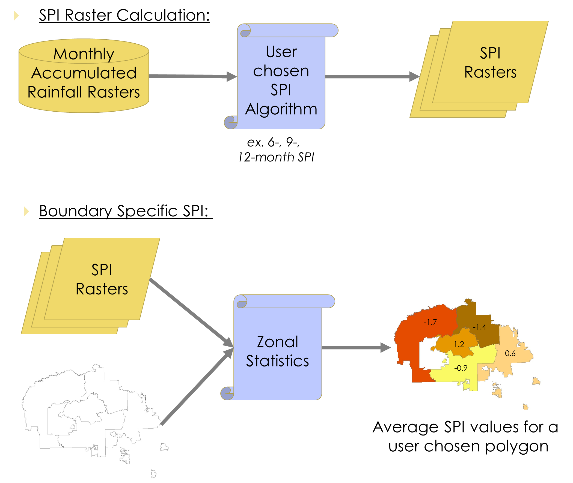
Tool Methodology

Slide 11
Research Data
SPI rasters
Displaying drought intensity in the Navajo Nation over time
NLDAS
Deep Soil Moisture (100-200cm)
Evaporation data
Transpiration data

Slide 12
Tool Results
Tool!
User Interface!
(Maybe a short screencast of tool in use)

Slide 13
Research Results
How drought intensity compares to other climate variables.
Do certain variables reflect specific types of drought, such as deep soil moisture reflecting “agricultural” drought (24 month SPI)

Slide 14
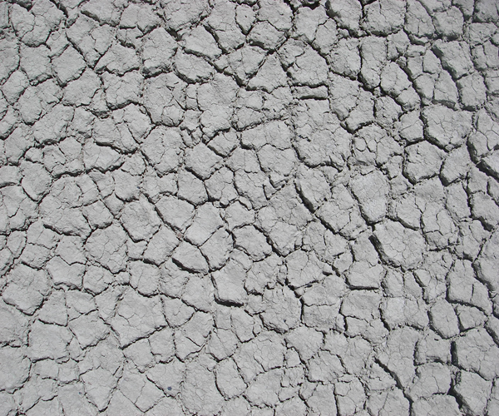
Benefits of Research
Navajo Nation SPI
Water management decisions
Understanding of drought regime changes
Insight into best resource allocation
Image Credit: Wikipedia

Slide 15
Limitations

Slide 16
Future Work

Slide 17
Advisors
Dr. Jaw W. Skiles, NASA Ames
Dr. Venkat Lakshmi
Partners
Navajo Nation Department of Water Resources: Water Management Branch
Navajo Technical University
Others
Amber J. Kuss, MSc., Bay Area Environmental Research Institute (BAERI)
Andrew Nguyen, NASA DEVELOP National Program
Chippie Kislik, NASA DEVELOP National Program
Clayton Sodergren, NASA DEVELOP National Program

