Slide 1


DEVELOP National Orientation (2023)
Module 10. Leadership Styles

Slide 2


Leadership Styles
What is leadership?
There are 4 leadership roles:
                Designated Leadership
                Self Leadership
                Active Followership
                Peer Leadership
By The Way
Fellows consider all of these factors when selecting DEVELOP teams!
At any time in DEVELOP, you can be a leader, but only sometimes will you be a “designated leader.”
Notes:
Before we talk about leadership styles, we need to understand the four leadership roles of designated leadership, self leadership, active followership, and peer leadership.
The designated leader is the head architect in a group and guardian of the group process. They can delegate tasks and decisions, but can’t abdicate responsibility or accountability. This is not your project lead...It can be, but in the day-to-day of DEVELOP, there is no hierarchy on the team….
Self leadership is leadership through character and judgment. All members lead by virtue of who they are and how they influence others, not just the positions they hold, and this has a huge influence on group dynamics. This includes taking responsibility for yourself, being kind and inclusive of others, and helping the group….
Active followership is when group members show good leadership by following the leadership of others, participating in the group process, modeling good team behavior, and supporting the leader by engaging and respecting others.
Peer leadership is when each person sees what needs to be done and takes the initiative to do it, without a hierarchy. This also works best when members communicate general expectations and clarify who is responsible for what. If something needs to be done, do it, and if others aren’t pitching it, talk about it.

Slide 3
Leadership Styles
What is leadership?
There are 4 leadership roles:
                Designated Leadership
                Self Leadership
                Active Followership
                Peer Leadership
By The Way
Fellows consider all of these factors when selecting DEVELOP teams!
At any time in DEVELOP, you can be a leader, but only sometimes will you be a “designated leader.”
Notes:
It’s important to be aware of all of these roles because you’ll hold some form of each of them over the next 10 weeks. Each one of you will lead at some point. You’ll engage with your partners, ask questions in your science advising meetings, provide updates to Fellows and you’ll learn how to work and communicate with members of your team—which is why we also talk about personality types. And as you go forward and think about this, it’s also important to note that self leadership—how you carry yourself—and peer leadership—how you take initiative in a group—are the most important in DEVELOP teams. (There are only finite, non-continuous, instances during the term that require designated leadership leadership and, therefore, active followership).

Slide 4
Jamboard:
Align yourself on the continuum—the middle is out of bounds!
Water
Wind
X
“I hesitate to state my own opinions. I put others before myself pretty consistently. I’m very flexible. You probably don’t really know where I stand on issues, or what I think about you, unless you ask very directly.”
“I state my opinions freely and take stands easily. People know exactly what I think, feel, and want. I’m an open book, and you don’t even have to read the words because I tell them to you.”
Notes:
https://jamboard.google.com/d/1GO0YWHG3lovGwXAuE6j131rTlGB5X1pNAJLekUDwNag/edit?usp=sharing

Slide 5
Cool
Cucumber
“Emotionally, I’m a cool cucumber. I don’t get flustered by anything.”
Jamboard:
Align yourself on the continuum—the middle is out of bounds!
X
Hot
Tamale
“Emotionally, I’m a red hot tamale. I’m passionate and not afraid to tell people how I feel about everything.”
Notes:
Without moving from their place on the left/right continuum from the last slide, ask people to align themselves on the vertical continuum.
https://jamboard.google.com/d/1GO0YWHG3lovGwXAuE6j131rTlGB5X1pNAJLekUDwNag/edit?usp=sharing

Slide 6
Cool Cucumber
Water
Wind
X
“I hesitate to state my own opinions."
“I state my opinions freely.”
Hot Tamale
Notes:
https://jamboard.google.com/d/1GO0YWHG3lovGwXAuE6j131rTlGB5X1pNAJLekUDwNag/edit?usp=sharing

Slide 7
“I’m a cool cucumber.”
Analysts &
Architects
Drivers
X
“I hesitate to state my own opinions."
“I state my opinions freely.”
Relationship
Masters
Spontaneous
Motivators
“I’m a hot tamale.”
Notes:
**Refer to slides 6-9 in the Jamboard for descriptions of each style. Be sure to note pros and cons of each style.**
https://jamboard.google.com/d/1GO0YWHG3lovGwXAuE6j131rTlGB5X1pNAJLekUDwNag/edit?usp=sharing

Slide 8
Leadership Styles
Discussion (10 min)
Do you have another comfortable quadrant?
What quadrant is the hardest for you to be in?
What are situations when another style is essential?
Notes:
It’s important to be aware of all of these roles because you’ll hold some form of each of them over the next 10 weeks. Each one of you will lead at some point. You’ll engage with your partners, ask questions in your science advising meetings, provide updates to Fellows and you’ll learn how to work and communicate with members of your team—which is why we also talk about personality types. And as you go forward and think about this, it’s also important to note that self leadership—how you carry yourself—and peer leadership—how you take initiative in a group—are the most important in DEVELOP teams. (There are only finite, non-continuous, instances during the term that require designated leadership leadership and, therefore, active followership).

Slide 9
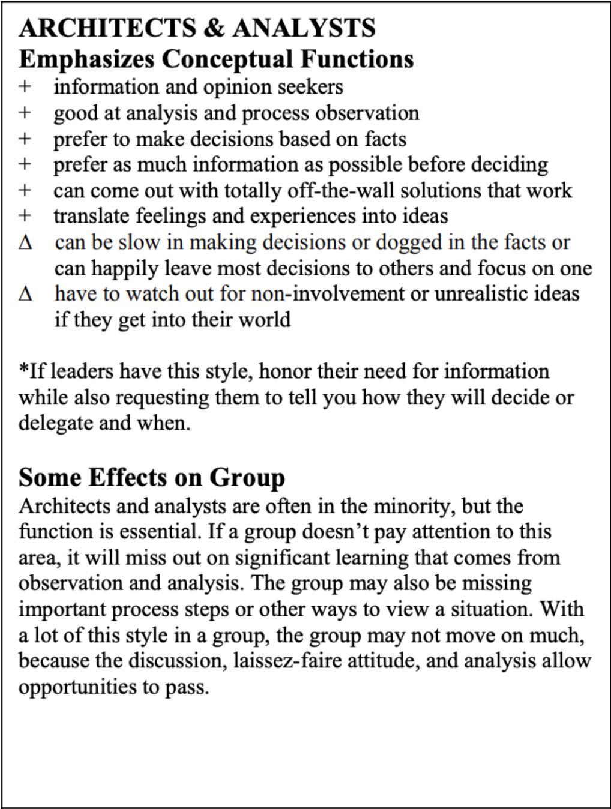
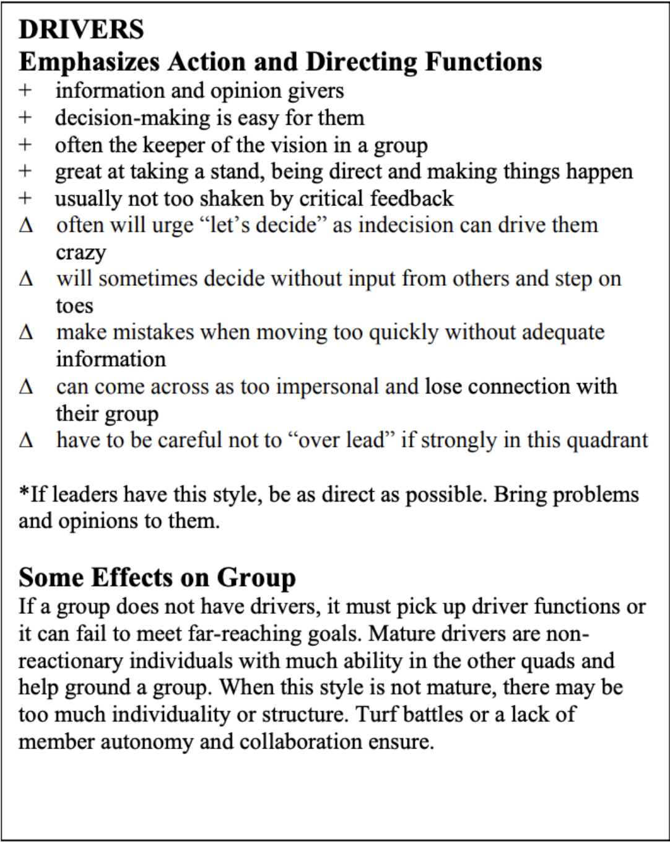
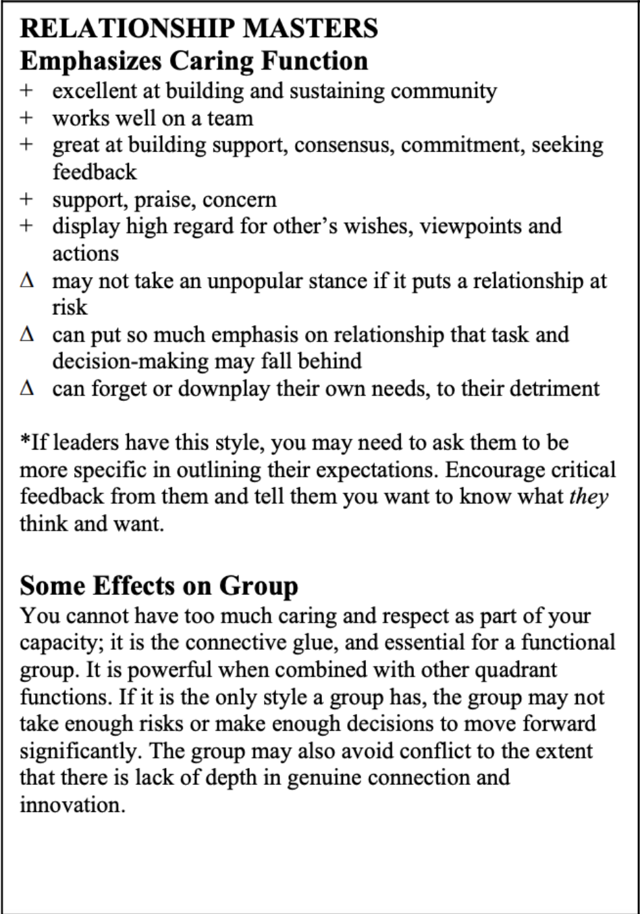
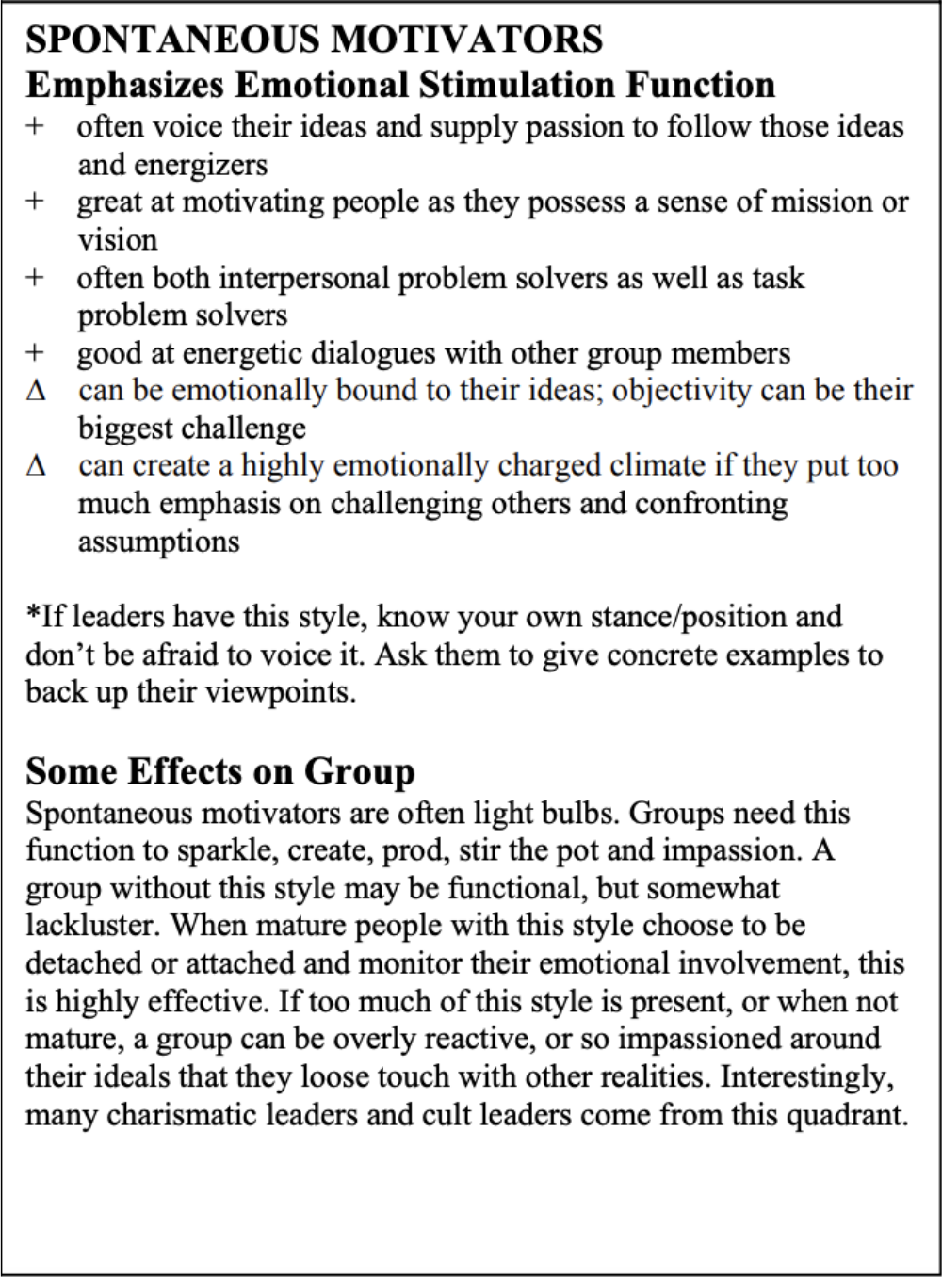
Leadership Styles
Teams with a Project Lead
What style and role fits a Project Lead?
Hint: Any of them!
Within each leadership role, it’s important to consider your default leadership style.
Notes:
Your “default leadership style” is the one you naturally trend towards and the one you are most comfortable in. DEVELOP is made up of all leadership styles and the same is true of Project Leads. What’s most important about recognizing your default style, is that it also makes you think about what style is least comfortable to you. A good leader is someone who can flow between leadership styles depending on the situation. And any DEVELOPer—not just the Project Lead—can be a good leader.

Slide 10
Leadership Styles
Project Leads: Common Misconceptions
Project Leads do not…
Do more work or work more hours than other team member
  Project Leads are also participants and have the same participant role, just different tasks within the role
Tell team members what to do each day
  Project Leads are in charge of project organization. This means occasional delegation, but it does not mean daily oversight. If they need to delegate, they should checking in with the team about who wants to do what, then helping keep the team accountable as they work.
Pick up all slack if other team members are struggling
  DEVELOP isn’t always easy! Your team should be communicating together about work loads and supporting each other when things get stressful.
By the way:
Project Leads are not the designated leader.
Notes:
Many teams within DEVELOP have a Project Lead. It’s important that everyone—team members, Fellows, and project leads themselves—are aware of what this means and doesn’t mean. Above all else, it’s important to remember that PLs are still participants and it’s not an elevated role within the team. In other words, PLs are not the designated leader of the team.

Slide 11
Leadership Styles
The responsibilities of a Project Lead
Project Leads do…
                Serve as the primary point of contact, team liaison
                Write and send emails on behalf of their team (varies by node)
                Provide project/team updates to Fellows
                Ensure the team completes and submits all deliverables on time
                Foster a productive team dynamic and work environment
                Empower and support team members
Important!
Project Leads responsibilities can vary by node. Check with your Fellow to make sure everyone is on the same page.

Slide 12
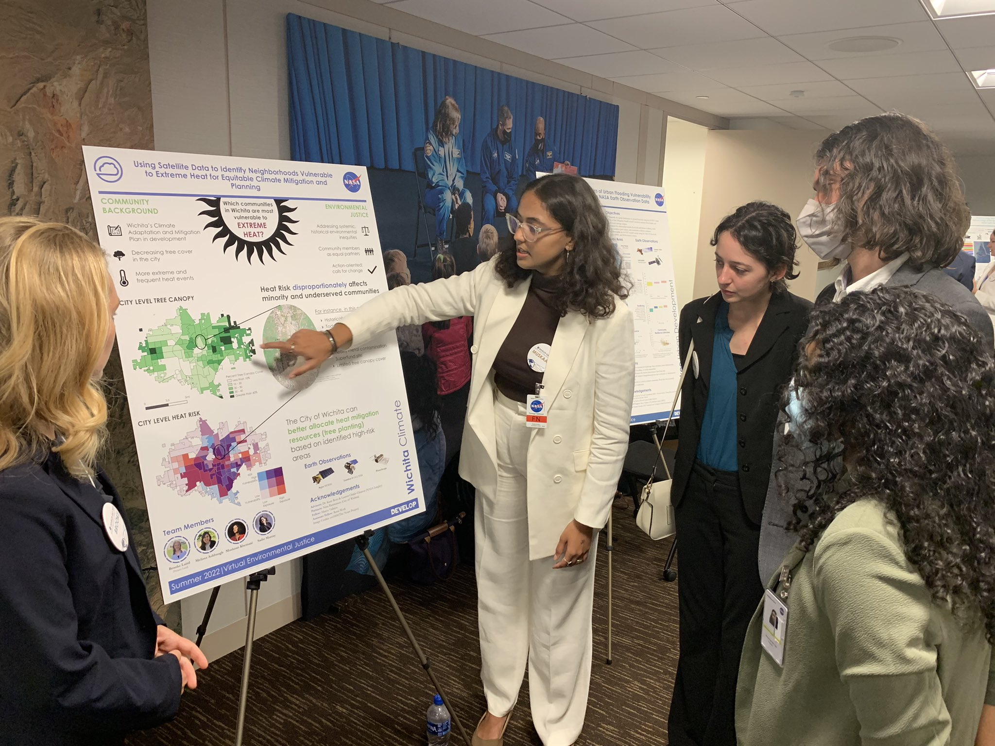
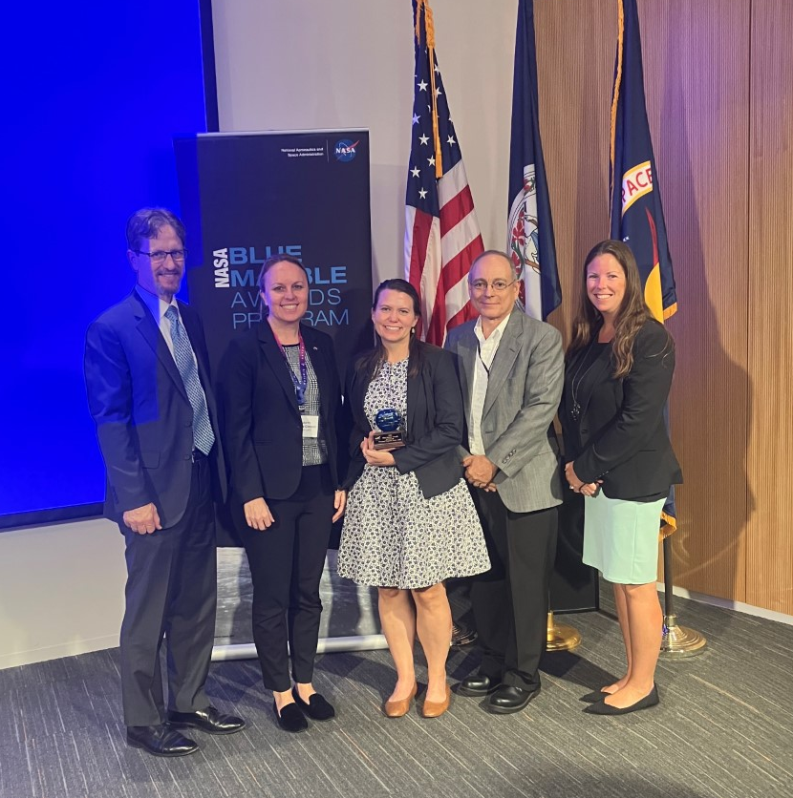
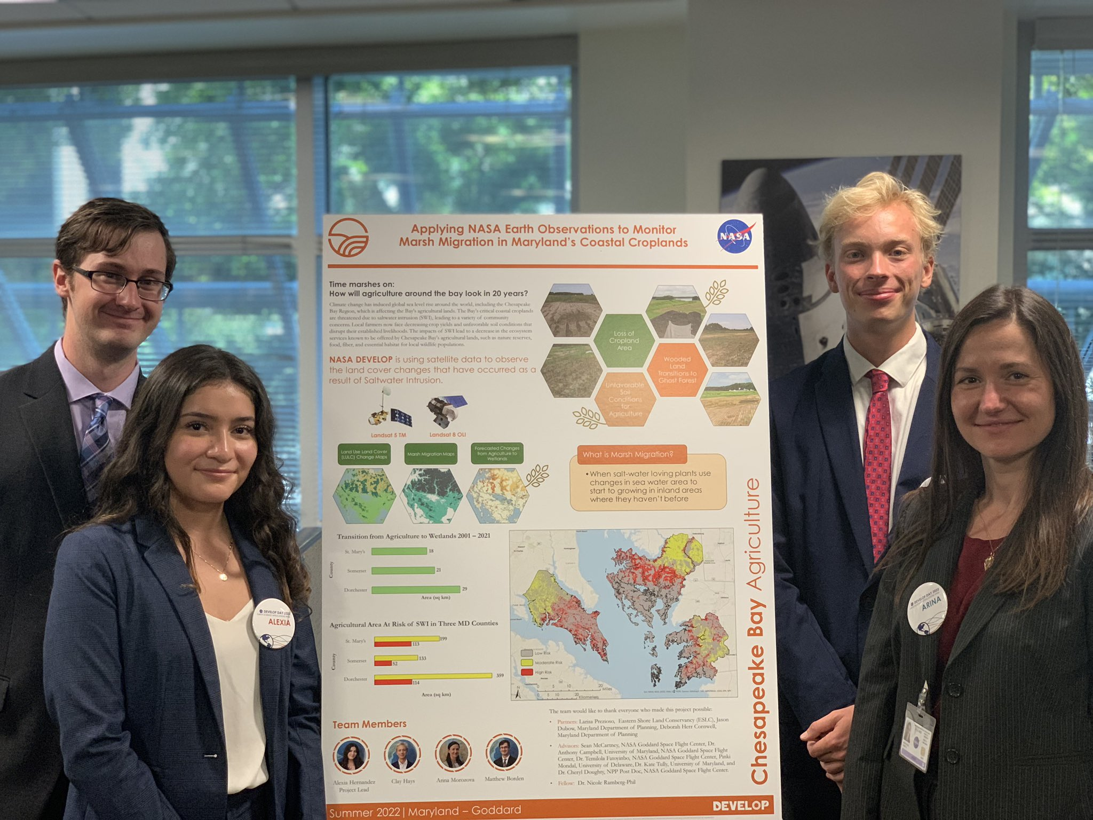
Leadership Styles
As a DEVELOPer, you are a leader!
All styles are key aspects needed in leadership and functional groups
Leaders come from all quadrants
Lead with a style that fits you, fits the situation, and fits the group
Notes:
No matter if it’s your first term or your fourth term, you are at DEVELOP because you are a leader. As you learn how to work with your team members and execute your project, it’s imperative to not lose sight of what it means to be a leader within DEVELOP.
All styles are key aspects needed in leadership and functional groups
Leaders come from all quadrants
Lead with a style that fits you, fits the situation, and fits the group

Slide 13
“I see what isn’t happening here and I’ll do it.”
You are acting as a leader when you take part in creating the world you want to see.

