Slide 1
Marin County Wildland Fires
Examining Fuel Load and Land Cover Change to Inform Fire Prevention and Suppression Decisions in Marin County, CA
Suhani Dalal• Katera Lee • Chandler Ross • Gabriel Rosenstein
California - Ames | 2023
Notes:
[Speaker]:
Hello everyone! We are the Marin County Wildland Fires team located out of Ames Research Center. [introductions]
We are excited to talk a little bit about our project today, thank you for joining us.

Slide 2
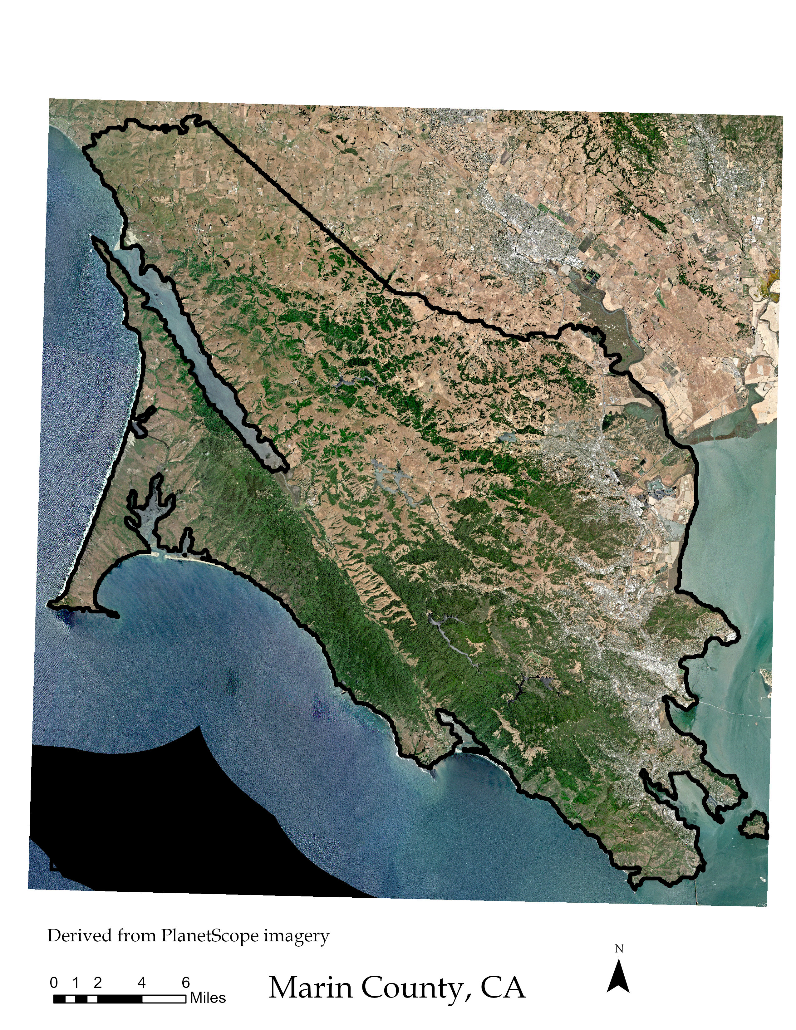
Marin County, CA
Marin County
Located between the Pacific Ocean and the San Francisco Bay, directly north of San Francisco
Study Period
May – November; 2018 – 2022
Marin County, CA
0
1
2
4
6
Miles
Basemap: 2022 PlanetScope Imagery
Notes:
[Speaker]:
Marin County is located in northern California, approximately 30 miles north of San Francisco. Fire in the county has been historically excluded for upwards of one hundred years in most areas. In our project, we focused on Marin County's fire season which occur from May to November. Our study period spans 5 years, as we wanted to best represent changes in the land cover and other environmental indices that can result in different fire risks.
Image Credit: © Planet Labs PBC {2022}. All rights reserved.

Slide 3
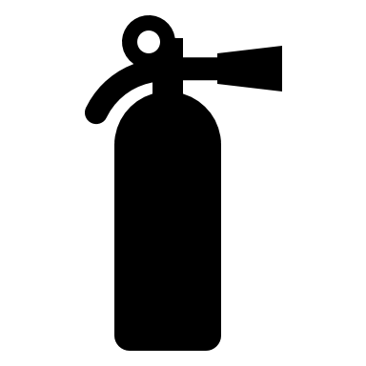

Project Partners
Marin County
Fire Department
FIRE Foundry
Notes:
[Speaker]:
Our project partners with the Marin County Fire Department and FIRE Foundry. The Marin County Fire Department who seeks to use the data from this DEVELOP project to make more informed decisions on areas for fire suppression activity and better understand the conditions of the area. FIRE Foundry is a workforce development program based in Marin County that aims to induct citizens into fire-related careers.
Image credits ———————————————————————————————————
Microsoft suite

Slide 4
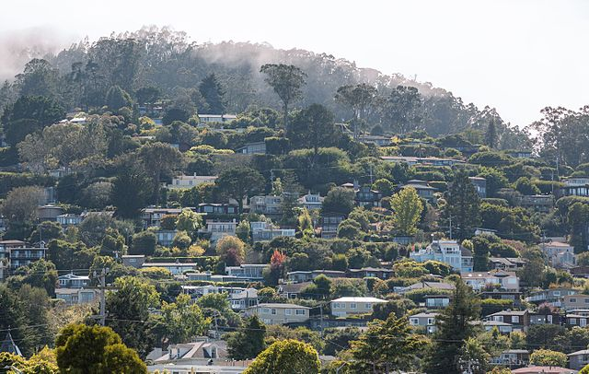
Community Concerns
People in surrounding areas are at higher risk
Proximity to infrastructure damage
Destruction of natural areas
Source: Tony Webster, Wikimedia Commons
Notes:
[Speaker]:
Individuals living in fire-prone areas within Marin County are at risk during high-severity fires and may require reliable transportation methods that are not blocked by the fire. Additionally, fires can result in property damage and can be especially harmful for individuals in areas without a vast network of evacuation roads. Lastly, high-severity fires pose a detriment to the natural areas and damage vegetation growth, increasing air pollutants in the atmosphere.
------------------------------Image Information Below ------------------------------
•Image Credit: Tony Webster
•Image Source: https://commons.wikimedia.org/wiki/File:Sausalito_Hills,_California_(28859571971).jpg
Licensed under the Creative Commons Attribution-Share Alike 2.0 Generic license.

Slide 5




Objectives
Fuel Load Maps
Use various vegetation indices to determine the load and density of fuel for wildfires
Notes:
[Speaker]:
Our first objective was to gather data on fuel loads as a wildfire’s severity and spread is largely determined on how much fuel is available for it to burn. There are many different fuel metrics that can be devised from remote sensing data, which we will cover shortly.
Image Credit----------------------------------------------
Microsoft PowerPoint Icons

Slide 6
Objectives
Fuel Load Maps
Land Cover Maps
Identify the aspect, slope, elevation, and land cover types across study period
Notes:
[Speaker]:
Our next objective was to create land cover maps that describe and classify the topography of Marin County, such as knowing what areas are herbaceous versus grassland. We also created aspect, slope and elevation maps which help track the movement of fires and can predict where fires could be more severe.
Image Credit----------------------------------------------
Microsoft PowerPoint Icons

Slide 7
Objectives
Fuel Load Maps
Land Cover Maps
Vegetation Moisture Maps
Utilize high resolution ECOSTRESS data to examine soil and vegetation moisture parameters
Notes:
[Speaker]:
Another important data layer was moisture, as moist vegetation is much less likely to burn than dry vegetation. These moisture levels vary significantly over time and across different locations in the county.
Image Credit----------------------------------------------
Microsoft PowerPoint Icons

Slide 8
Objectives
Fuel Load Maps
Land Cover Maps
Vegetation Moisture Maps
Utilize high resolution ECOSTRESS data to examine soil and vegetation moisture parameters
Fire Suppression Model
Input all factors associated with wildfire risk severity into a complete model in ArcGIS Pro that can guide fire suppression decision making
Notes:
[Speaker]:
Using all these data layers, we hoped to create a model that identified potential areas of high fire severity in order to guide Marin County’s fire suppression efforts. In particular, our partners wanted to receive information about where they could build fire lines to stop the advances of an active fire. Fire lines should be built on flat land such as a ridgeline, in areas with low potential fire severity to reduce the risk of spread and danger to firefighters, ideally connected to anchor points that will not burn such as roads, waterbodies, or barren land.
Image Credit----------------------------------------------
Microsoft PowerPoint Icons

Slide 9
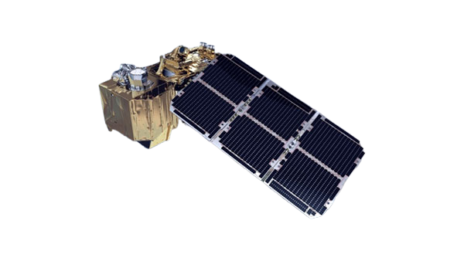
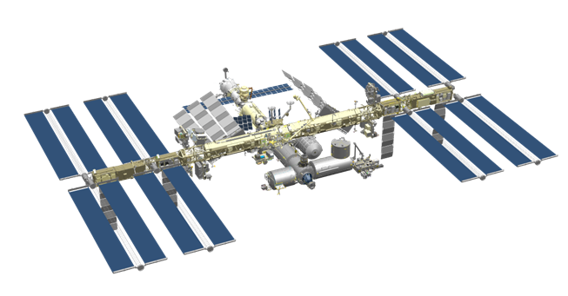

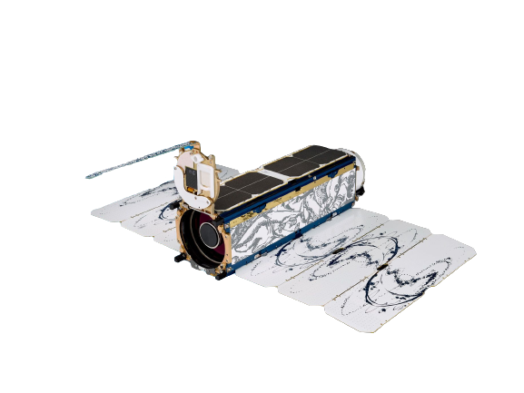
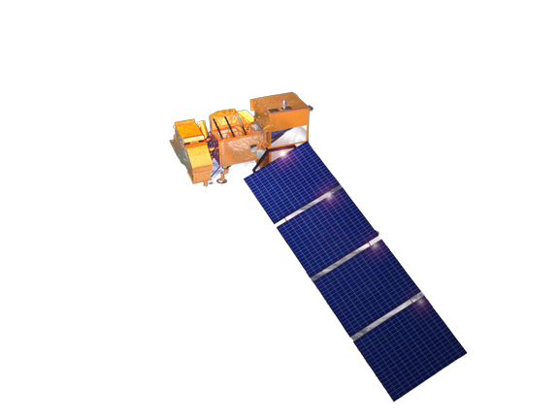
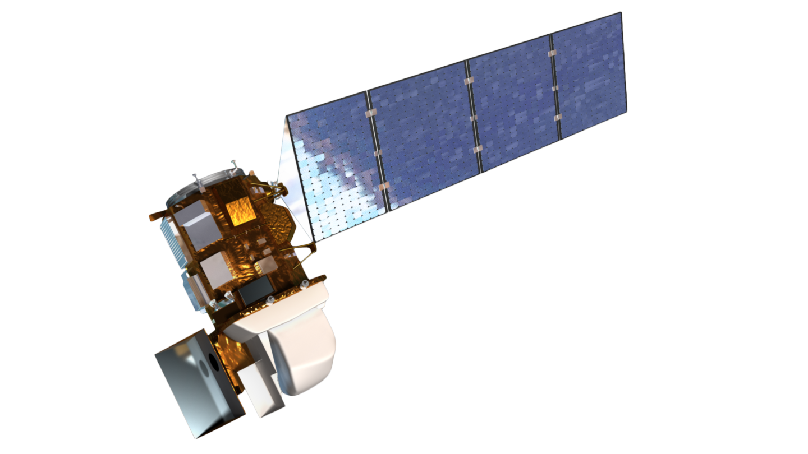

Earth Observation Platforms and Sensors
Sentinel 2-A MSI
International Space Station (ISS)- ECOSTRESS
PlanetScope DOVE
Landsat 7 ETM+ and Landsat 8 OLI & TIRS
LiDAR
Satellite Image Credits: NASA, Planet Labs PBC Other Image Credits: Microsoft Powerpoint Icons
Notes:
[Speaker]:
Here are all of the NASA and non-NASA Earth Observations platforms and sensors used for this research.
We have ECOSTRESS for evapotranspiration data and that is located on the ISS. Additionally from NASA, we have Landsat 7 and 8. Some of our other data sources include LiDAR, which had our elevation data and Sentinel 2-A, which was used for our land cover classification.
International Space Station Image Credit, public domain: https://images.nasa.gov/details-200623_ISS_1
Landsat 7 Image Credit, public domain: https://landsat.gsfc.nasa.gov/article/successful-maneuver-spells-beginning-of-the-end-for-landsat-7/
Landsat 8 Image Credit, public domain: https://landsat.gsfc.nasa.gov/article/landsat-data-continuity-mission/
LiDAR Image Credit: Microsoft PowerPoint Icons
Sentinel 2-A Image Credit, public domain: https://sentinels.copernicus.eu/web/sentinel/user-guides/sentinel-2-msi/overview
Image Credit: Microsoft PowerPoint Icons
PlanetScope Image Credit: Planet Labs PBC used with Permission

Slide 10
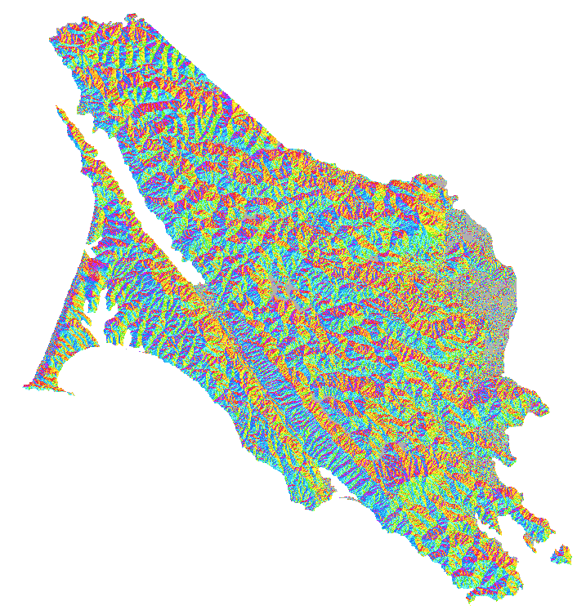
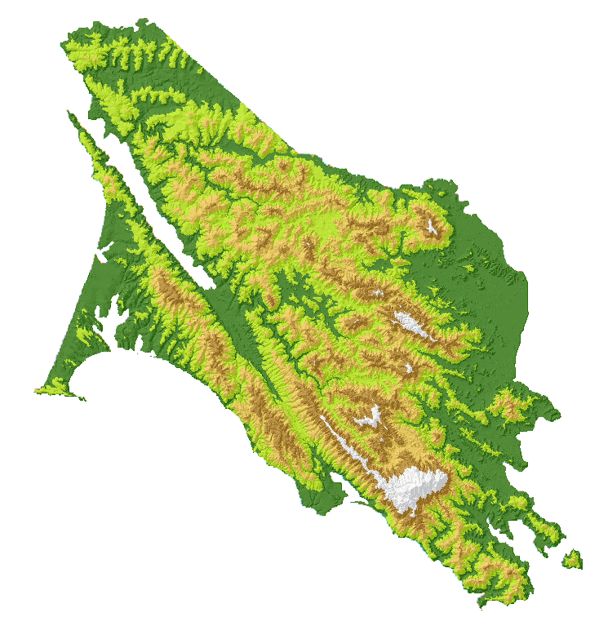
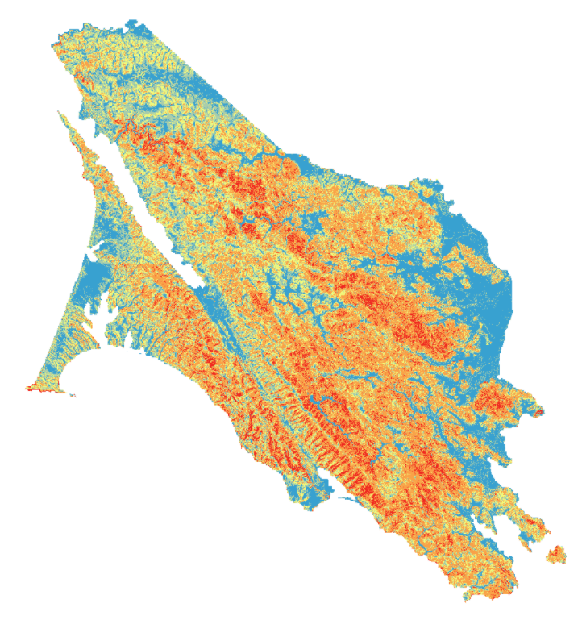
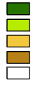
Data Processing: Topography
Flat
North
Northeast
East
Aspect
Southeast
South
Southwest
West
Northwest
North
Elevation
Slope
< 231 ft
< 15
< 517 ft
< 25
< 872 ft
< 40
< 65
< 1376 ft
< 90
< 2577 ft
Notes:
From the LiDAR data, we got the digital elevation model and created elevation, aspect, and slope outputs as seen here.

Slide 11
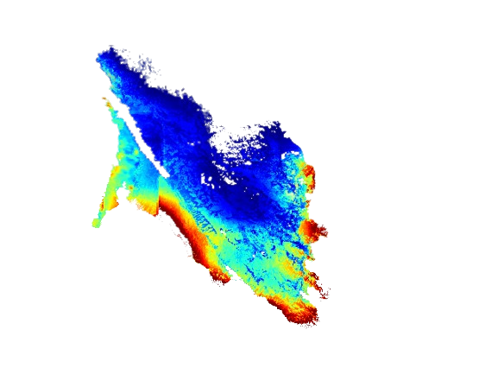
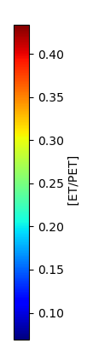
Data Processing: Moisture
1
ECOSTRESS:
WUE
0
Water Use Efficiency
AppEEARS
Image Processing
ESI
Evaporative Stress Index
Notes:
[Speaker]:
ECOSTRESS data was downloaded using NASA's Application for Extracting and Exploring Analysis Ready Samples, or Appears. Water use efficiency, or WUE, and evaporative stress index, or ESI, data were chosen inputs as they are drought indicators and are sensitive to fluctuations in vegetation health. Water use efficiency is defined as the ratio of the amount of carbon fixed in units of GPP per the amount of water lost in units of evapotranspiration. Low efficiency plants are typically found in regions that are in drought where more severe fires are likely. The evaporative stress index is calculated as the rate of evapotranspiration over the rate of potential evapotranspiration with a score of 0 or 1, 0 being full water stress and 1 being no water stress. These inputs were processed in Python to eliminate no value data and create visualizations for analysis.
Image credits ———————————————————————————————————
ECOSTRESS ET png [will sub for wue or esi]

Slide 12
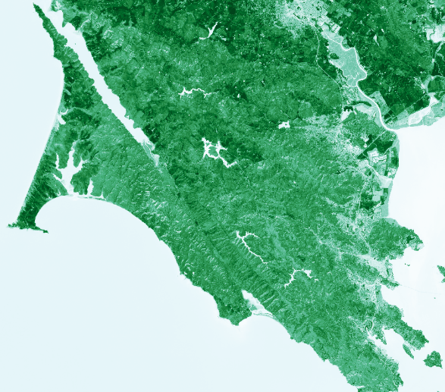
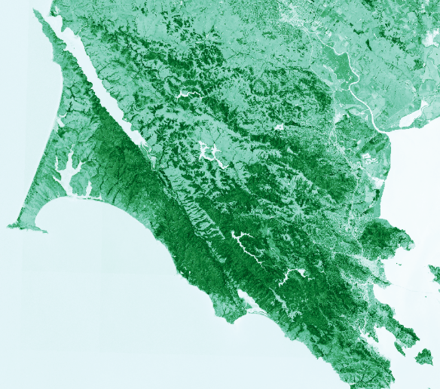
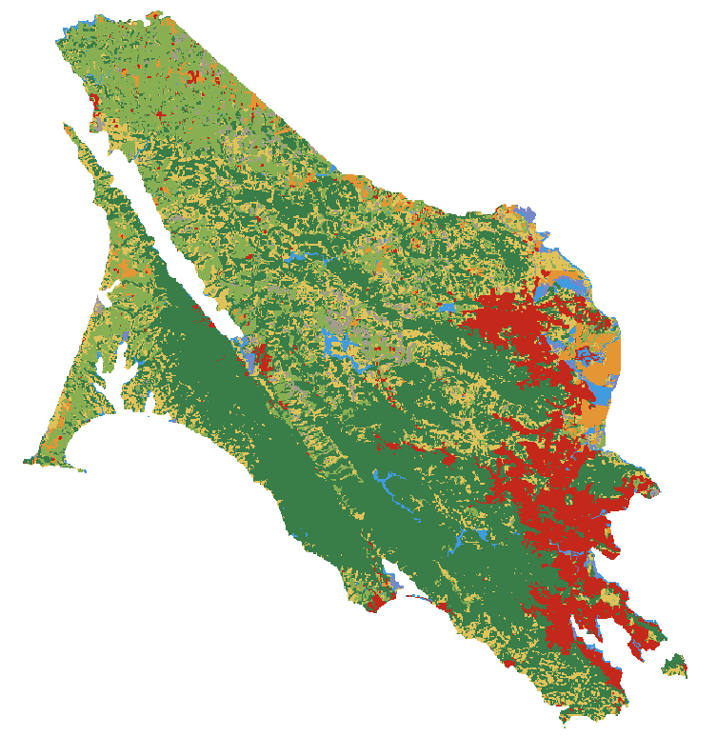
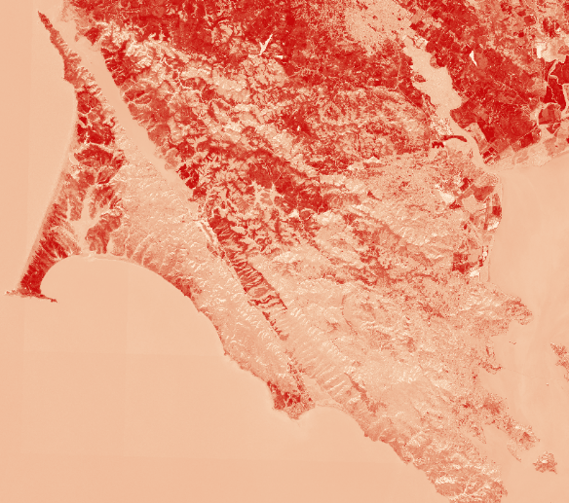
Data Processing: Landcover Fuels
Wet season NDVI (mid-November through mid-May)
Dry season NDVI (mid-May through mid-November)
NDVI
0.68
Gather Sentinel-2A images
Run Dynamic World code in GEE
Process annual composites in ArcGIS
-0.23
dNDVI
0.61
Landcover
Trees
Water
Grass
Barren
Built
Shrub / Scrub
-0.54
Crops
Flooded Vegetation
NDVI differential (wet season – dry season)
Notes:
[Speaker]:
For the land cover, we used Sentinel-2A imagery because of its 10 meter spatial resolution and we ran it through Dynamic World, which is a probability model that takes Sentinel-Imagery as training data to best associate with each land cover class.
For NDVI data, we similarly used Sentinel-2 data. After applying a cover mask to our study area, we generated composite NDVI values for wet and dry seasons. Dry season NDVI relates to biomass and available fuels while the NDVI differential relates to the quantity of herbaceous vegetation that grew during the wet season. By subtracting the dry season NDVI from the wet season NDVI, we create an NDVI differential value that tells us where dense vegetation from the wet season has dried out, leading to lots of dry fuels that can drive fire, typically in herbaceous or grassy areas.

Slide 13
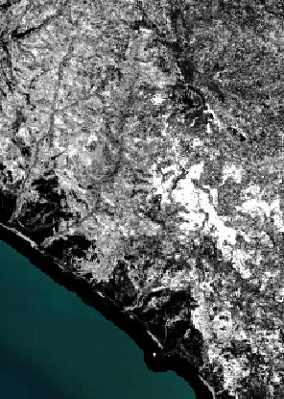
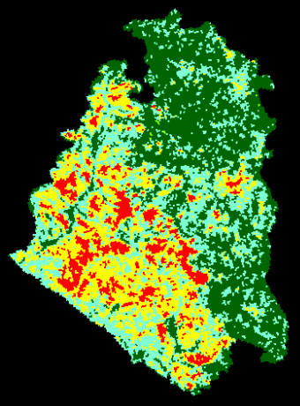

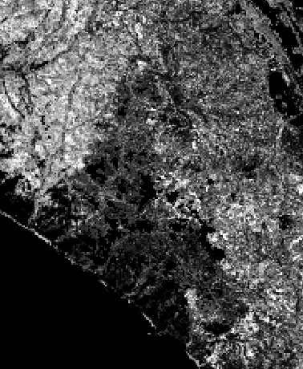
Data Processing: Forest Fuels
0%
Severity
Unburned
Ladder Fuel Density
Light
Medium
Severe
100%
Pre-fire ladder fuels
Fire perimeter burn severity
Canopy Bulk Density
Canopy Base Height
0%
Ladder Fuel Density
Ladder Fuel Density
Post-fire ladder fuels
100%
Canopy Height
Canopy Cover
Notes:
[Speaker]:
While we directly generated many data layers ourselves from direct earth observations, we used previously processed data for different fuel metrics in our model. Fuel metrics are difficult and time intensive to create and most forest fuel metrics do not significantly change year over year outside of a disturbance so it is typically for fire scientists to develop fuel layers on data that is a few years old. The four canopy data layers (height, bulk density, cover, and base height) were derived from LANDSAT by the LANDFIRE program, a collaboration between the Department of Agriculture and the Department of the Interior, while the ladder fuel density required LiDAR data that was gathered by Marin County in 2019. Our ladder fuel data came from a 2019 LiDAR mission, but in 2020 a significant wildfire burned in Marin County. We therefore had to reduce the original ladder fuel data on the left based on the burn severity values within the fire perimeter in the middle. High severity areas in red were reduced to zero, while medium and low severity areas were reduced by 2/3rd and 1/3rd, respectively, resulting in new ladder fuel data on the right. Although we did not have to perform this calculation on other fuel layers since they date from after the fire, other fuel data such as canopy cover or canopy bulk density can be similarly updated after a future fire.

Slide 14
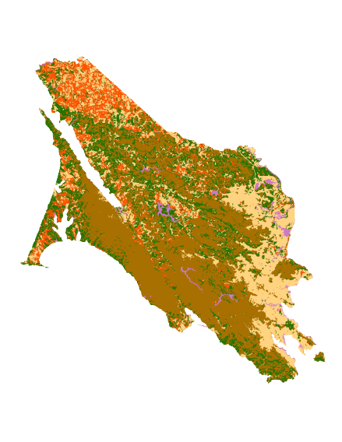
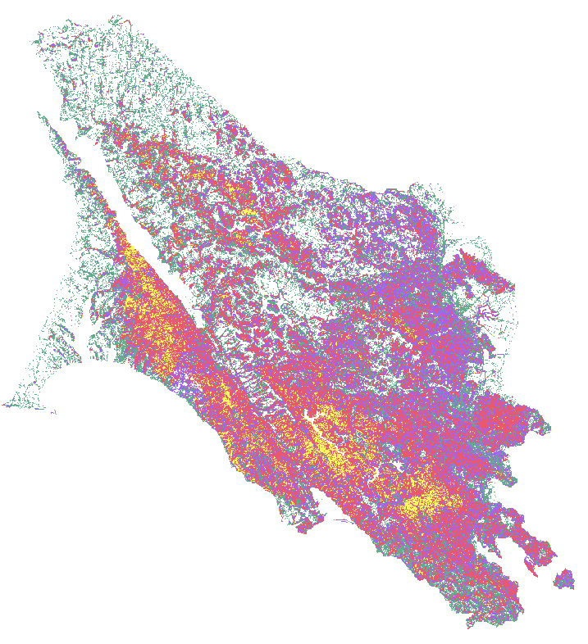
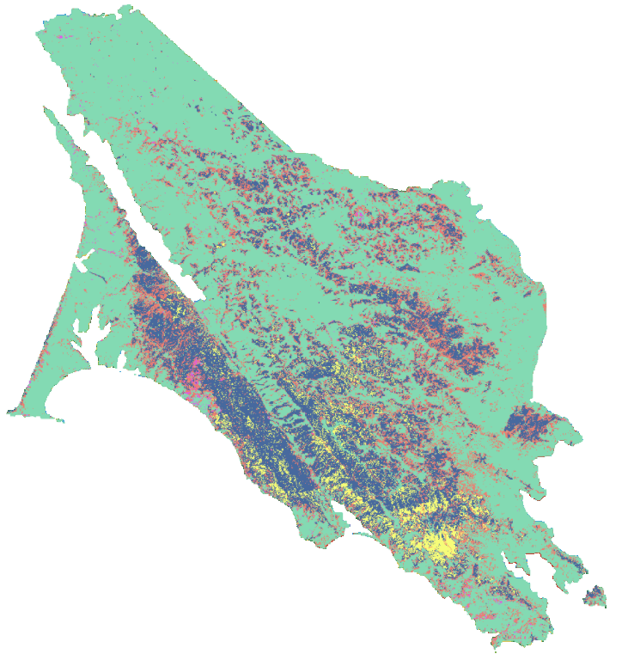

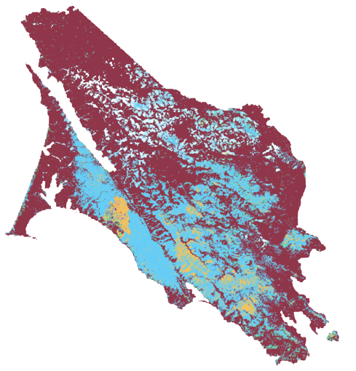
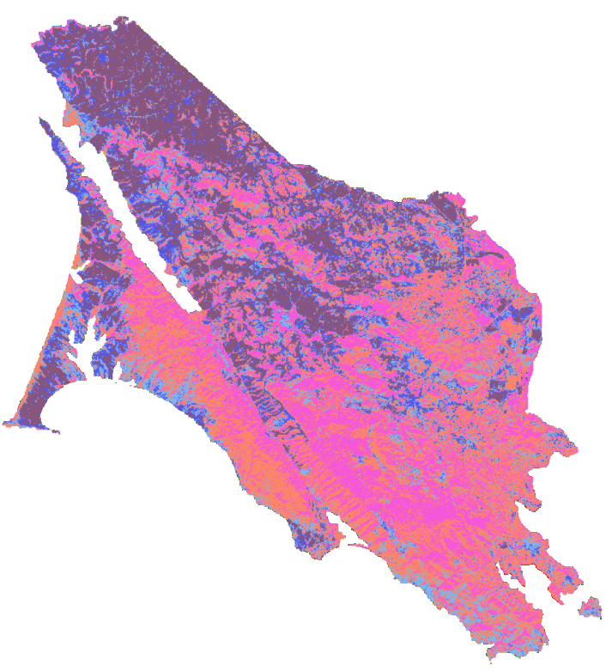
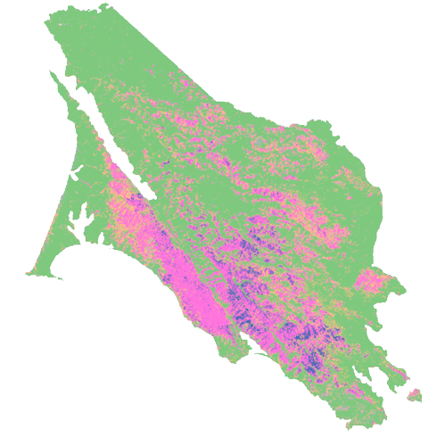
Fuels
Landcover
Ladder Fuel Density
Canopy Cover
Water / Snow / Ice
Flooded vegetation/
Bare / Built / Crops
Unforested
Unforested
Grass
0.01-0.05 kg/m³
0-25% Cover
Trees
0.06-0.1 kg/m³
30-45% Cover
Shrub and scrub
0.11-0.21 kg/m³
50-65% Cover
0.22-0.34 kg/m³
70-85% Cover
Unforested
-1-0
10+ meters
Unforested
0-.1
7-10 meters
0.01-0.05 kg/m³
.1-.2
.01-3 meters
0.06-0.1 kg/m³
.2-.3
3-7 meters
0.11-0.21 kg/m³
.3+
0.22-0.34 kg/m³
Canopy Base Height
Canopy Bulk Density
NDVI Differential
Notes:
[Speaker]:
Displayed here are all of the fuel-related inputs of our fire model. The left 4 inputs are taken from 2019 through 2020 and updated to show 2022 fuel conditions. The land cover and NDVI differential inputs were taken from 2022.

Slide 15
Data Analysis
Canopy Cover
Canopy Base Height
Elevation
Canopy Bulk Density
Slope
WUE
Land Cover
Canopy Height
Aspect
ESI
dNDVI
Ladder Fuels
Topography
Moisture
Fuels
Canopy Metrics
Notes:
[Speaker]:
After reprojecting, clipping, and resampling data layers as necessary, we input them into three separate models to determine fire severity. We chose to do three models because we didn't want to rely on a single methodology to determine fire risk. Each of our models utilizes slightly different sets of data layers but here is an example from our suitability model of how the data layers are organized into different categories.

Slide 16
Model 1: FlamMap
Topography
FlamMap
Flame Length
Canopy Metrics
Reclassify
Fuels
Flame Length:
1: 0 ft
2: 0-4 ft
3: 4-8 ft
4: 8-11 ft
5: >11 ft
Fire Severity
Weather
Notes:
[Speaker]:
The traditional fire model utilized FlamMap, a software often used by fire agencies to determine what areas are susceptible to fire. As this model was simple to run and a bit of an industry standard, we wanted this to be a baseline to improve upon with our other two models. To run the model, we inputted topography, fuels, canopy cover, and weather variables. We then ran the FlamMap model, classified the flame lengths into 4 categories, and outputted the fire severity. The classes were based on at what flame length could fire managers reasonably create a fire line. From 0-4 ft hand crews could be used, from 4-8 ft equipment can be used (dozers, plows, and retardant aircraft, from 8-11 ft control efforts are probably ineffective due to probably crowning and spotting, and above 11 ft control efforts at the fire head are ineffective.

Slide 17
Model 2: Suitability
Topography
Weighted Suitability Model
Moisture
Reclassify
Fire Severity
Topography: 20%
Moisture: 30%
Fuels & Canopy Metrics: 50%
Fuels
Canopy Metrics
Notes:
[Speaker]:
The suitability analysis model is a simple yet effective way to determine what burns. We reclassified each data layer from 1-5, with 1 as low fire severity and 5 as high fire severity based on the scientific literature and then performed a weighted suitability analysis. The element that gives this power is the transparency of the model. We assigned a 20% weights to topography, 30% for moisture, and 50% for fuels. Marin County FD is able to see the inputs and their assigned weights and determine if they make sense. If adjustments need to be made, the model can be easily adjusted.

Slide 18
Model 3: Machine Learning
Topography
Topography
Topography
Landsat DNBR
Convolutional Neural Network
Preprocessing
Training
Moisture
Topography
Topography
Fire Severity
Fires
Notes:
[Speaker]:
Our last model employed the U-NET convolutional neural network. The inputs for the model included elevation, slope, and aspect data which were downloaded from NASADEM's reprocessed Shuttle Radar Topography Mission, WUE and ESI data came from ECOSTRESS, and raw 7 band tiffs from level 2 landsat data.
In order to acquire enough fire data for the model to train on, we expanded our temporal range to 2013-2022 for the machine learning model and included fires from Sonoma County – an adjacent county that closely resembles Marin's environment. The inputs first were reprocessed to ensure they were projected and scaled uniformly, and normalized to reduce variance for the model to make clearer predictions. The difference normalized burn ratio, computed with the normalized difference of the near infrared and shortwave band , was calculated for the landsat imagery to measure fire severity. The model outputs a fire severity image based on this algorithm that can be used to identify areas where fire has the propensity of greater damage to the area.

Slide 19
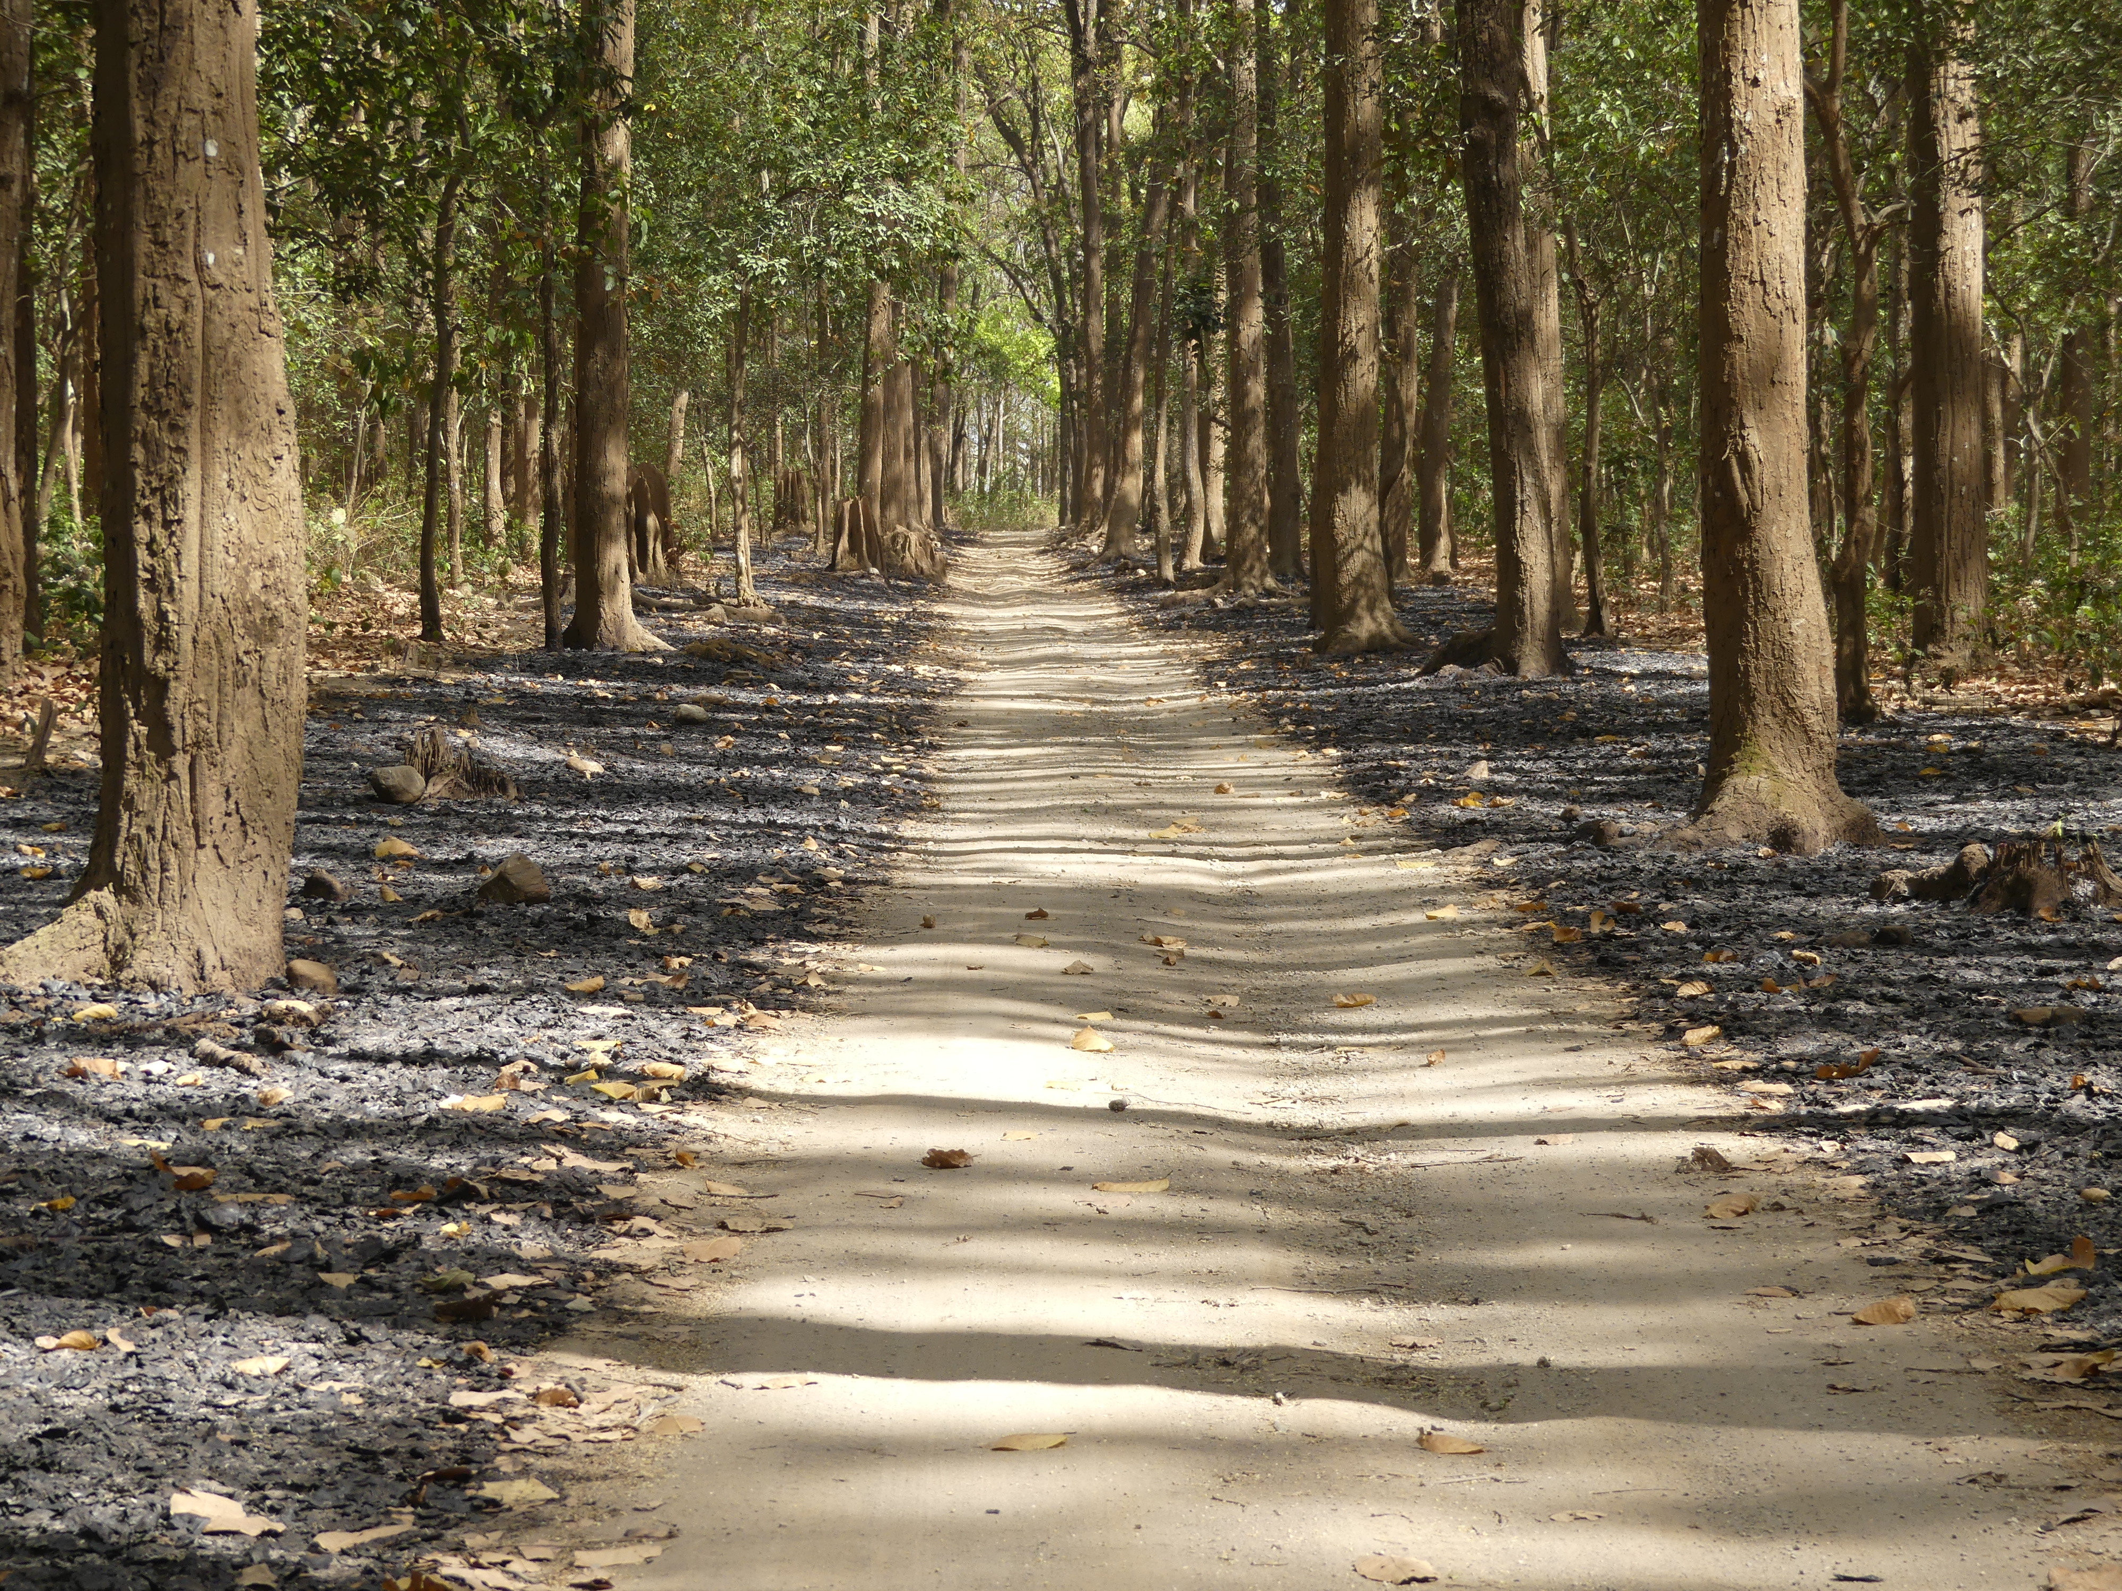
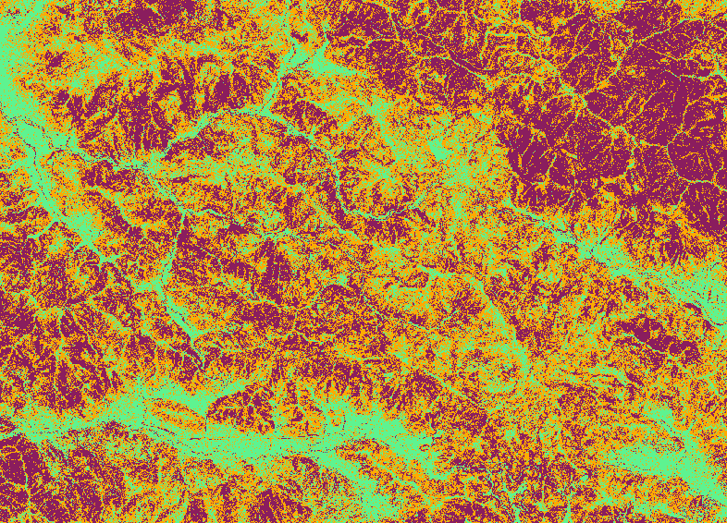
Methodology: Fire Lines
Steep slope: 30°-90°​
Mild slope: 15°-30°​
"Flat": 0°-15°
Image Credit: A. J. T. Johnsingh, WWF-India and NCF
Notes:
[Speaker]:
A fire line is built to remove all potential fuel sources to prevent a fire from spreading any further, the image shows an idealized version of one. Built by hand or sometimes with bulldozers, fire lines are best built on flat ground and through land that is not pre-disposed to intense fire. We developed an algorithm that classified slope as either flat, mild, or severe and then merged fire severity values from our previous models to score the feasibility of fire line construction at each point. Permissible slope values for fire lines were provided by our partners at Fire Foundry.
Fireline image credit: Creative Commons Attribution-Share Alike 3.0 Unported https://commons.wikimedia.org/wiki/File:Fire_line_Ramnagar_FD_AJT_Johnsingh_P1100623.JPG

Slide 20
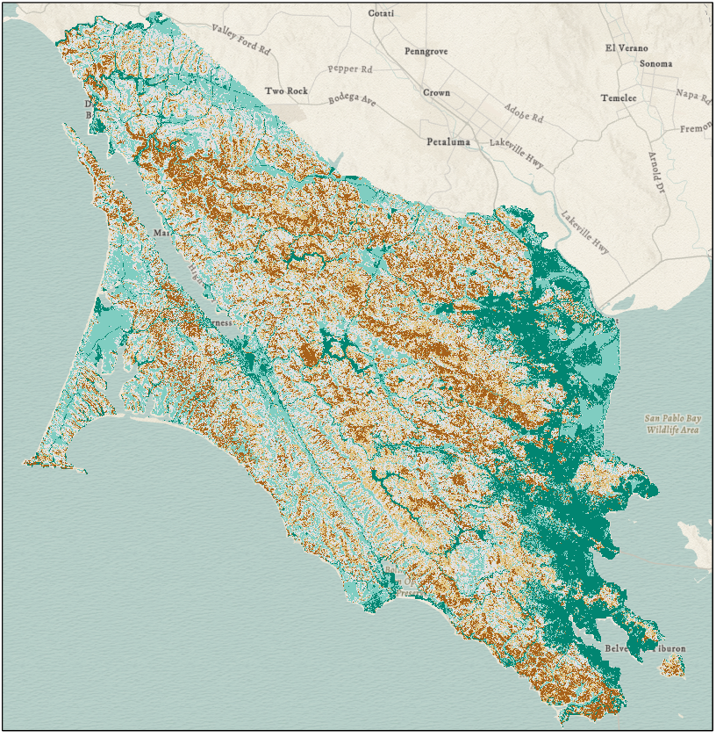
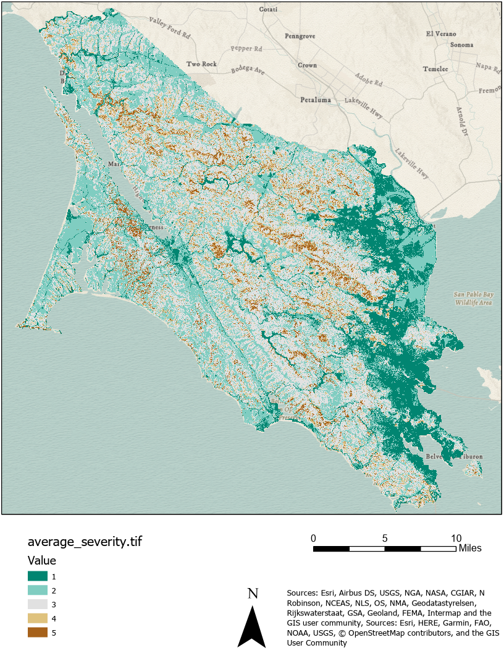
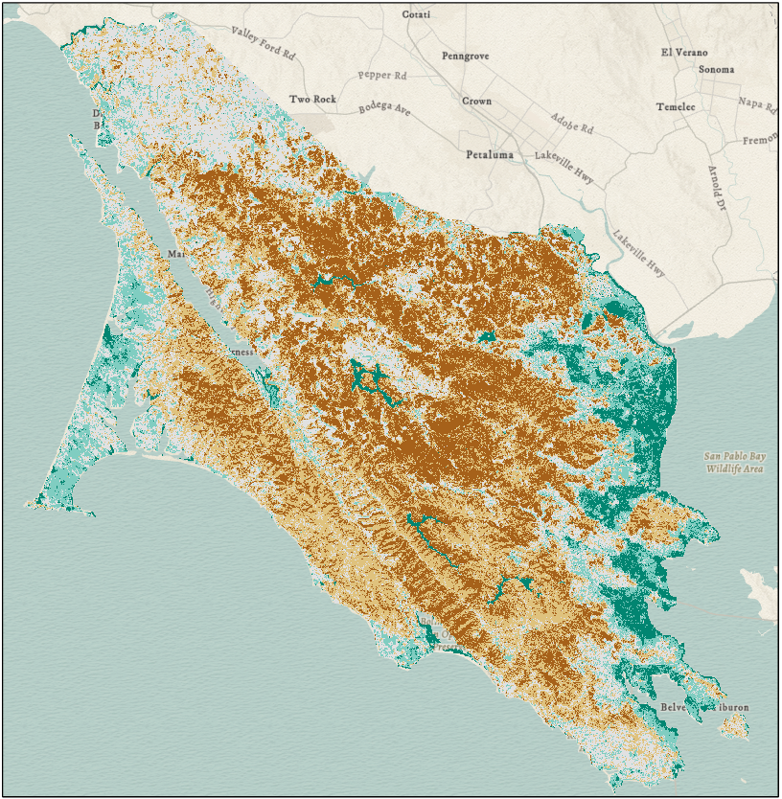
Results: Severity Models
FlamMap Severity
Suitability Severity
Flame Length
Severity Level
0 ft
1
0-4 ft
2
4-8 ft
3
8-11 ft
4
>11 ft
5
5
10
Miles
5
10
Miles
Notes:
We had three fire severity outputs. One from the FlamMap model, suitability model, and the ML model. The
Current Class Percentages of Area
FlamMap:
1: 15% 2: 23% 3: 30% 4: 17% 5: 15%
Suitability:
1: >0% 2: 11% 3: 65% 4: 24% 5: >0%
Update:
1: >0% 2: 4% 3: 33% 4: 62% 5: >0%
ML

Slide 21
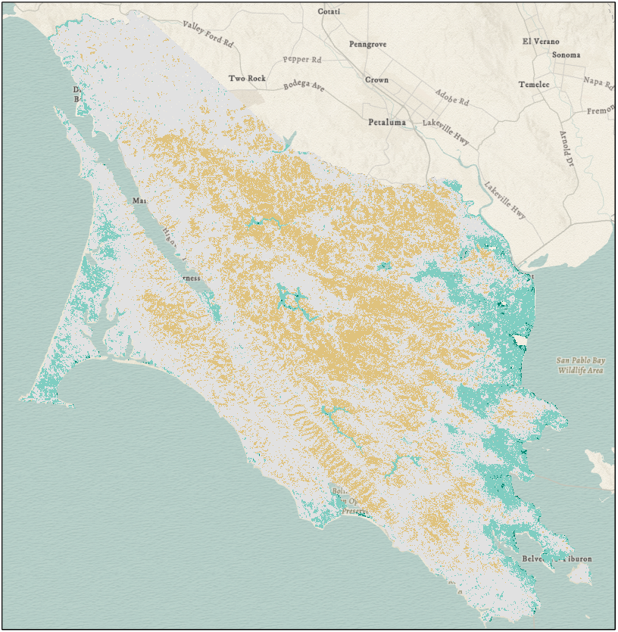
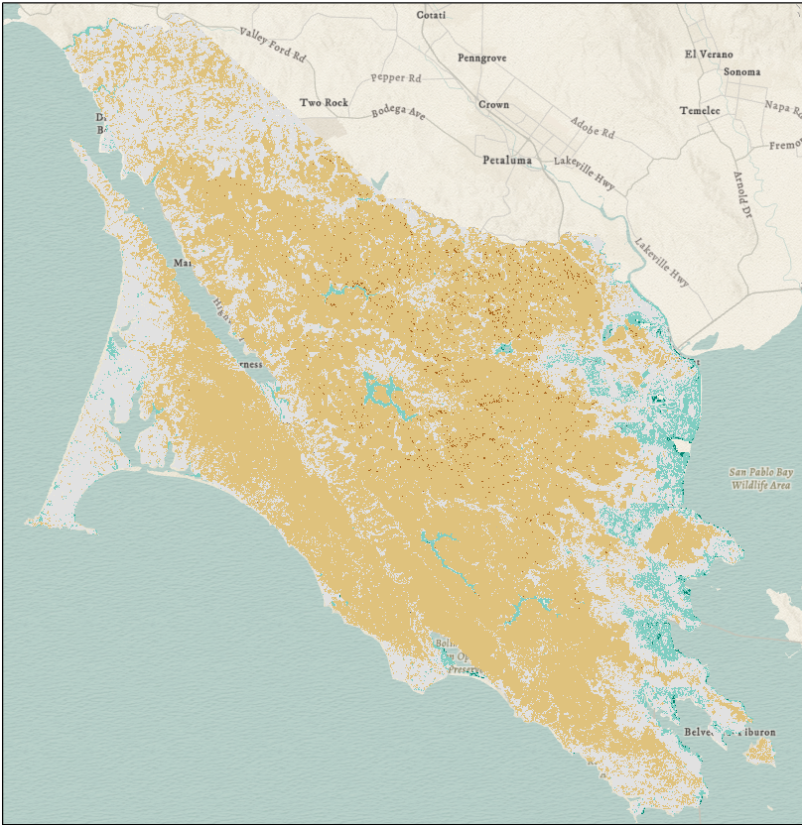
Results: Severity Models
Machine Learning Severity
FlamMap Severity
Suitability Severity
Flame Length
Severity Level
Normalized Burn Severity
0 ft
1
0 ft
0-4 ft
2
0-4 ft
4-8 ft
3
4-8 ft
8-11 ft
4
8-11 ft
>11 ft
5
>11 ft
5
10
5
10
Miles
Miles
Notes:
We had three fire severity outputs. One from the FlamMap model, suitability model, and the ML model. The
Current Class Percentages of Area
FlamMap:
1: 15% 2: 23% 3: 30% 4: 17% 5: 15%
Suitability:
1: >0% 2: 11% 3: 65% 4: 24% 5: >0%
Update:
1: >0% 2: 4% 3: 33% 4: 62% 5: >0%
ML

Slide 22
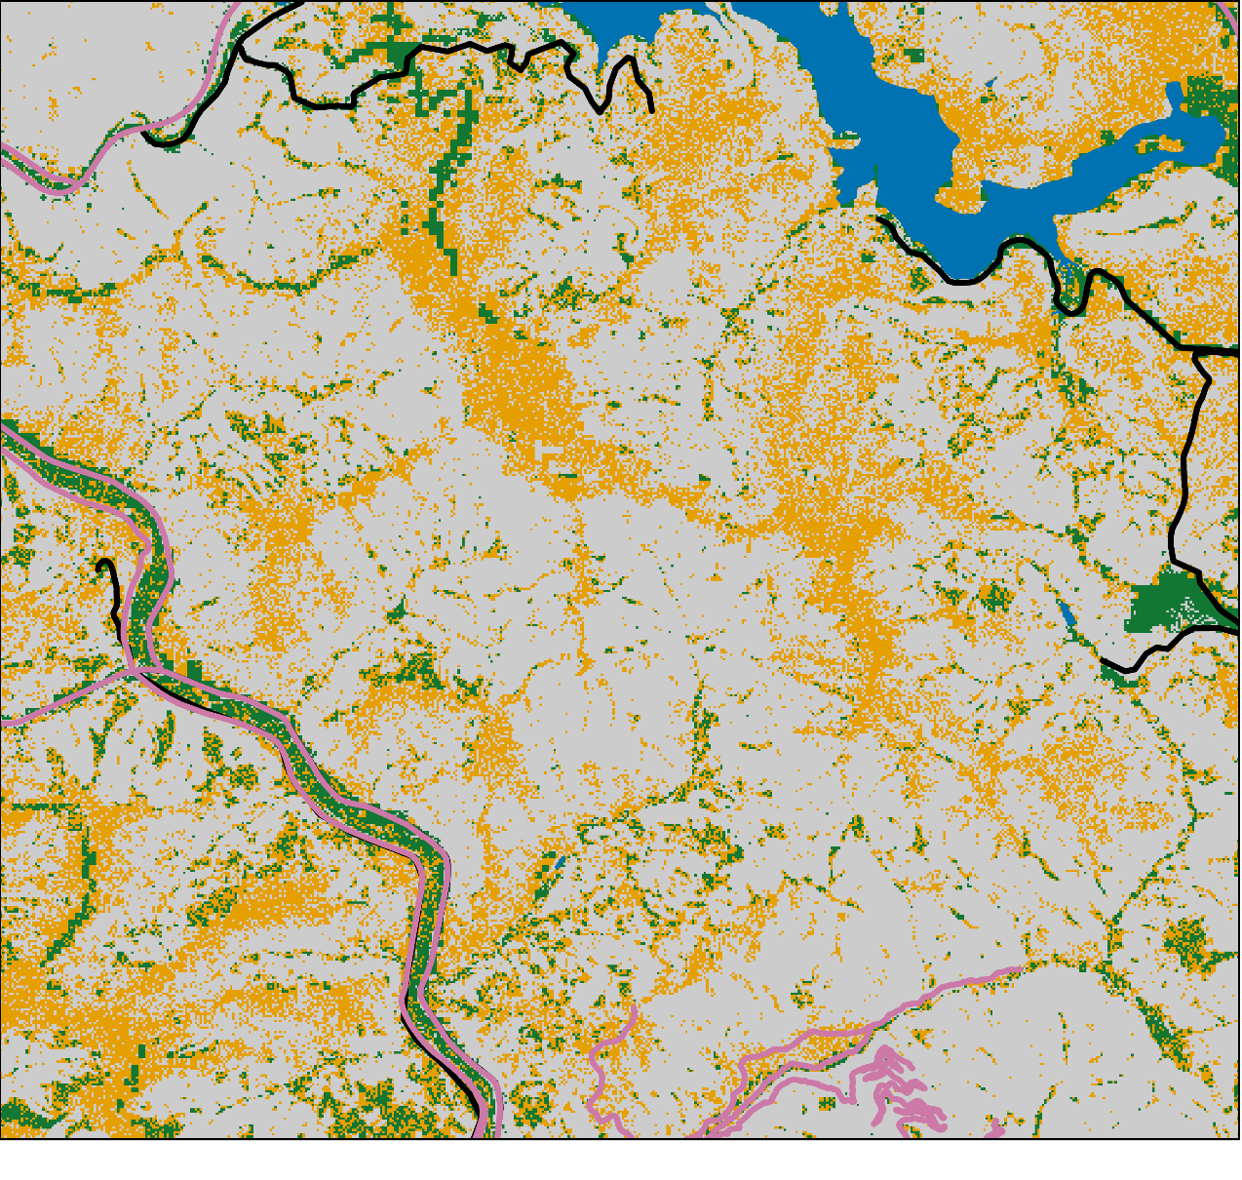
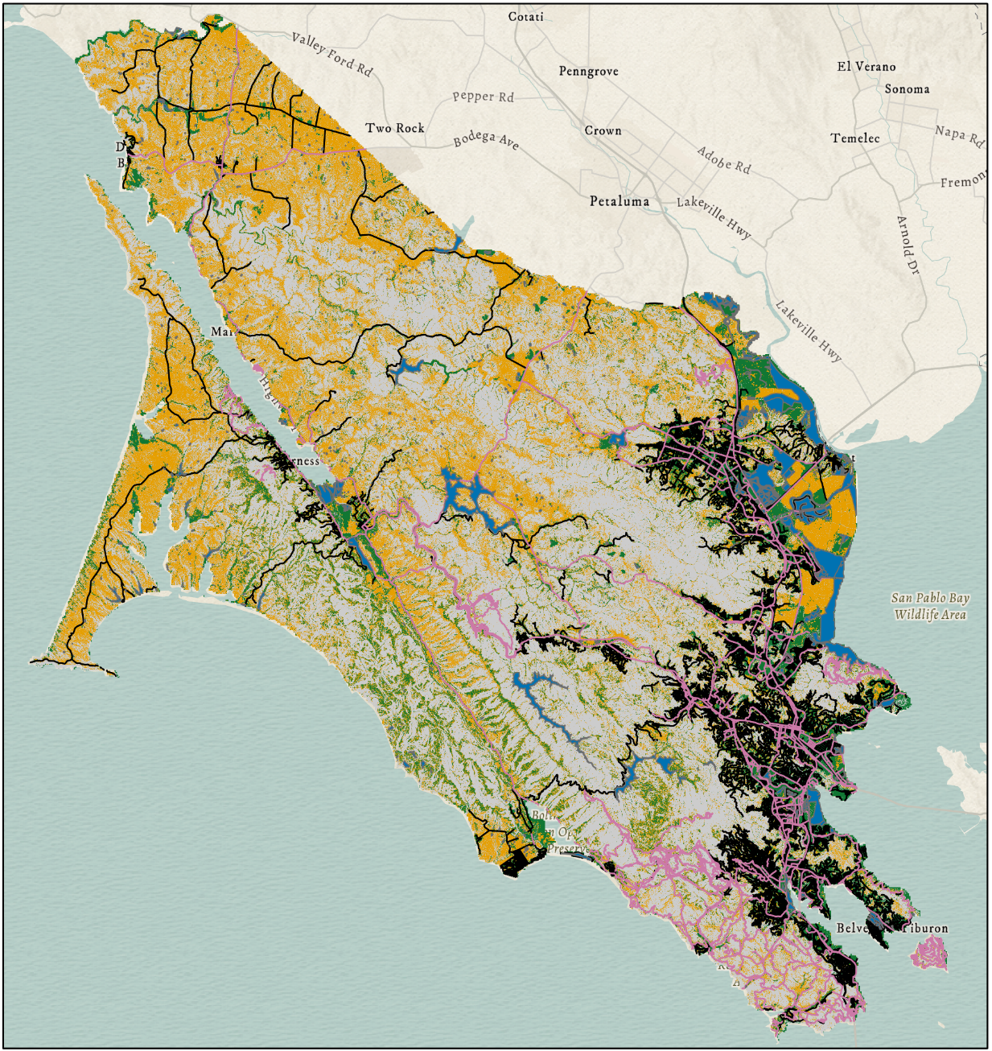

Results: Fireline Model
1 Mile
Fireline Potential
Roads
Easy
Trails
Medium
Water
Difficult
Notes:
[Speaker notes]:
Overlaying slope with fire severity model outputs helps us identify idealized areas for building fire lines. Important features that buffet fire lines, such as trails, roads, and waterbodies are shown here, with the flattest and most fire-safe regions in green and more sloped or fire-prone regions in yellow. A single pixel is wide enough for an effective fire line. The inset map shows an area where firefighters could use the map to identify a flat and low fire severity corridor for a fire line that links a road and trail and hopefully impedes the progress of a fire. This fireline model was generated using flammap predictions of fire severity but our team generated versions of this fireline model using all three fire severity models as inputs.

Slide 23


Errors and Uncertainties
Data Limitations
Model Uncertainties
Notes:
[Speaker]:
Data products vary in terms of release date and accuracy, while satellite temporal and spatial resolution cannot capture the variability that occurs in Marin County’s microclimates.
FlamMap Model
Based on suite of standardizations and assumptions that may not hold for Marin County or can vary spatially and temporally, e.g. elliptical fire spread, unburnable urban / built environmental, constant fuel moisture, etc.
Suitability Model
Weights and rankings of data inputs based on literature and expert opinion, not site specific data.
Model classes are derived from natural data breaks and not based on differences on real-world fire suppression feasibility like FlamMap
Machine Learning Model
Fire Line Model
Validation is difficult across all models due to infrequent fire history in the region
With the machine learning model there are a few points that can be cause for uncertainty. First, as there were very few fires to train data on in Marin County and respective of our study period, the model's temporal range was expanded to a range from 2013 to 2022 and included fires in Sonoma County, Marin's neighbor county with a similar environment. This implementation could have led to some inaccuracies while training the data for the model. Another uncertainty is due to the nature of using this type of machine learning model that can be seen as a black box in that it can be unclear how the algorithm is truly performing with the data and what exact changes would produce better results.
Fire models make a prediction that is based on all of the user inputs. Results can greatly vary from model to model, and without more training data or other methods of validation, there are some pieces of uncertainty that the model has. In addition, some of our inputs were taken from the most recent data releases which may not update as frequently or consistently.
Validation is difficult because so few fires in the area.
FlamMap is based on standardized fire model and does not incorporate Marin specific values.
Microclimatic variation is difficult to capture because of insufficiently small temporal or spatial resolution in satellite data.
Suitability model classes are based on natural data breaks and do not necessarily align with meaningful fire-fighting differences in real world situation.
Concerns exist for accuracy of fuel data from LANDFIRE, while LiDAR data may not be continually updated in the future.
FlamMap:
Assumptions FlamMap:
Assumes elliptical fire spread
Crown fires not as accurate as ground fires
Assumes all fuels smaller than 7.6 cm (100 hr fuels)
Urban not considered flammable
Doesn’t model large fires well
Assumes constant wind speed, wind direction, and fuel moisture
Burns the entire landscape at once so doesn’t account for fire spread or changing weather

Slide 24
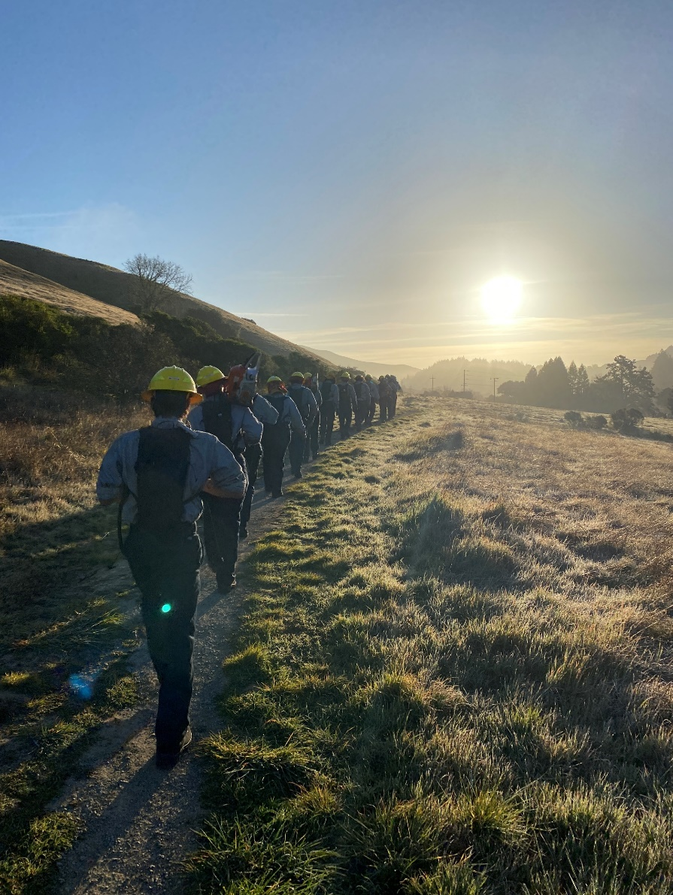
Conclusions
A fusion of satellite and ground LiDAR data, focused on moisture, fuels, and topography can be used to quantify fire severity in Marin's unique environment of microclimates
Model comparisons can be used to understand the various algorithms for computing fire severity in relation to a region​
A feasible approach is combining the outputs of the fire severity models with fire line & slope data for the fire line model
Image Credit: Fire Foundry
Notes:
[Speaker]:
Image credit: Fire Foundry: https://twitter.com/FireFoundry/status/1620855675948498965/photo/1
The suitability model overpredicts high fire severity overall compared to FlamMap. This suitability model tends to predict higher severity in forests and lower severity in grasslands. High moisture, especially in the form of WUE, drives lower severity predictions compared to FlamMap. Practitioner knowledge is key to understanding fire in Marin County due to the small sample size of wildfires in the region.

Slide 25




Future Work
Locate areas for fire lines beyond Marin County
Validate input parameters
Incorporate additional parameters into the fire model
Design a workshop for FIRE Foundry
Notes:
[Speaker]:
Since this is a short term feasibility project, it would be best to expand our study area beyond Marin County, while validating our input parameters. In addition, we hope that with the next term there can be room to add in additional parameters related to human values such as property and additional trails, while incorporating potential weather influences to the model with other NASA earth observations. Lastly, this project aims to offer insight of remote sensing application in the field of fire research to FIRE Foundry.

Slide 26
Partners
FIRE Foundry
  Josh Dimon
Marin County Fire Department
  Graham Groneman
NASA DEVELOP
  Lisa Tanh (NASA DEVELOP Ames Research Center Fellow)
Science Advisors
  Dr. Jake Dialesandro (Santa Clara University)
  Dr. Juan Torres-Pérez (NASA Ames Research Center)
  Britnay Beaudry (NASA Ames Research Center)
Includes copyrighted material of Planet Labs PBC. All rights reserved.
This work utilized data made available through the NASA Commercial Smallsat Data Acquisition (CSDA) program.
Notes:
The team would like to take a moment to acknowledge and thank everyone who made this project possible, including our partners, science advisors, and fellow.

