Slide 1
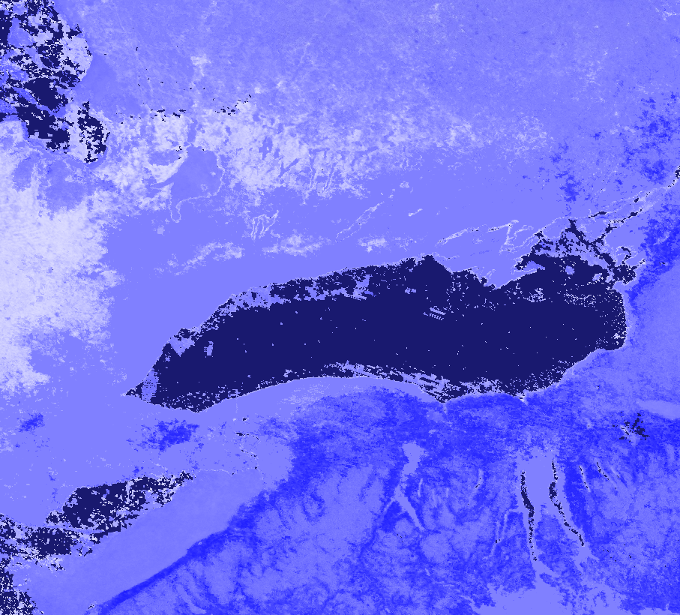
LAKE ONTARIO DISASTERS
Employing NASA Earth Observations in the Greater Toronto Area to Improve Flood Preparedness for Coastal Communities
Tyler Hennessee
Isaac Gamoran
Meryl Kruskopf
Elizabeth Swanson
Arizona – Tempe | Spring 2019
Notes:
Speaker: (introductions)
Hello.
Thank you all for joining us today.
I’m Tyler Hennessee. I graduated last year from the University of Vermont with degrees in Geography and Animal Sciences, and I like hiking.
Hi I’m Isaac Gamoran. I grew up in suburbs of Chicago, and I recently graduated this past May from Macalester College in St. Paul Minnesota with a degree in Geography and Urban Studies.
My name is Meryl Kruskopf and I am originally from Portland. I received my degree in Environmental Engineering from Cornell University in 2016 and since then have done a number of different things including spending two summers working at Yosemite National Park.
I’m Elizabeth Swanson, I’m from Tempe, and I recently graduated from Arizona State University this past December.
Our project looked at flooding in the Lake Ontario Watershed. During April and May of 2017, the Greater Toronto Area saw extreme precipitation, rising lake levels to heights breaking records set during the 1800s. We set out to investigate how certain variables affect flooding and support flood preparedness in the region.
Image Source: Image created by team from MODIS data.

Slide 2
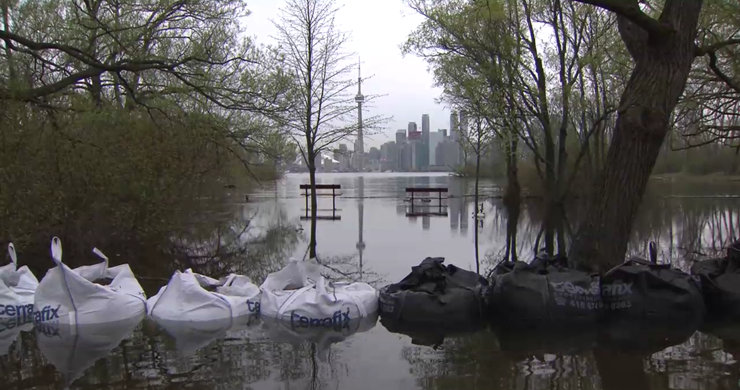
Image Source: City of Toronto
Notes:
Isaac: This project was motivated by severe flooding that occurred in the Toronto area in May of 2017. The image above shows the Toronto Islands inundated with water from Lake Ontario. This was not a stand-alone event; flooding has been and continues to be the most frequent natural disaster in Canada.
Image source: Provided by the City of Toronto (Permission from partner)

Slide 3
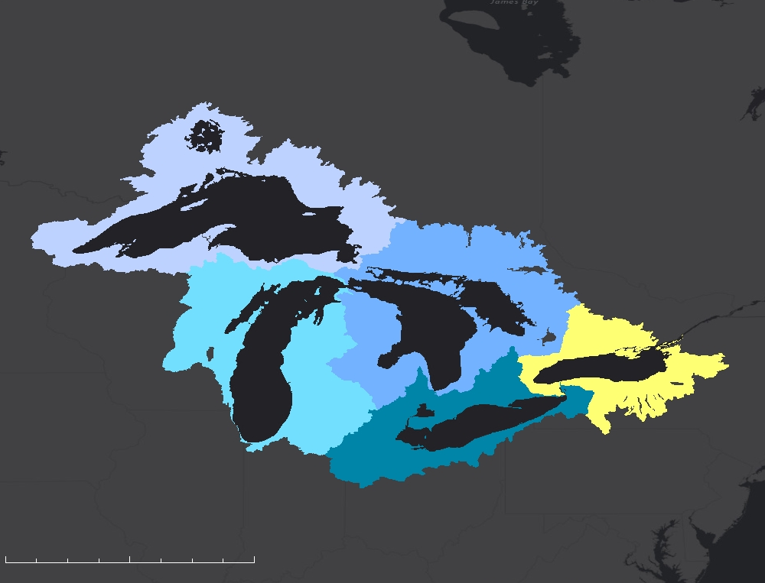
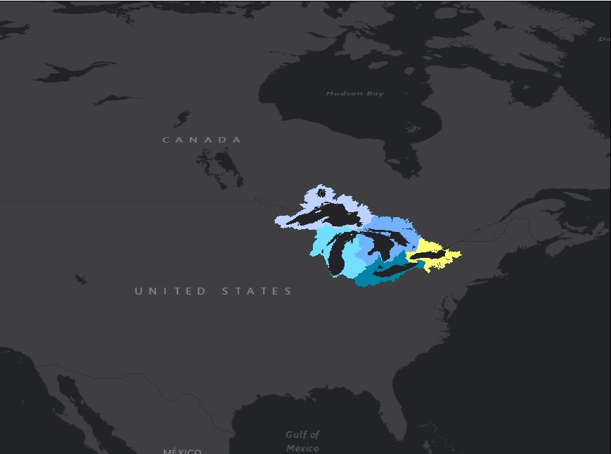
STUDY AREA
CANADA
UNITED STATES
Great Lakes Watershed
Focused on Lake Ontario and the Greater Toronto Area
GREATER TORONTO AREA
Study Period: March 2000 to February 2019
N
Lake Ontario Watershed
Lake Superior Watershed
0
230
460
Lake Michigan Watershed
miles
Lake Huron Watershed
Lake Erie Watershed
Notes:
Elizabeth:
Our study area this term was the Greater Toronto Area. Toronto is Canada’s largest city, with an urban area of over 6.4 million people. We analyzed the impact of climatic variables in Great Lakes Basin on the Greater Toronto Area for our study period. The project looked at monthly data from April 2015 through February 2019. Available data used in calculations ranged in time from March 2000 – 2019.
Image Source: Study area map created on Google Earth Engine; created by team

Slide 4
COMMUNITY CONCERNS
PUBLIC HEALTH
ECONOMIC
ENVIRONMENT
Images Source: City of Toronto-Bluffer’s Park Ward 36
Notes:
Elizabeth:
As mentioned, over the past 10 years, Toronto has been struck by multiple severe flooding events. Two major floods occurred in Toronto on July 8, 2013, and in April and May of 2017. Flooding poses a major challenge; the event negatively impacts public health, economic growth, and the environment. Flooding can bring in hazardous materials affecting species found within and around the lake and ultimately cause habitat loss.
In the image above, incoming water eroded the shoreline in the Bluffer’s Park neighborhood of Toronto.
Image Source 1: “Financial impacts resulting from high lake water levels in waterfront parklands”; General Manager, Parks Forestry and Recreation; January 5, 2018. City of Toronto. (Permission from partner)
Image Source 2: “Financial impacts resulting from high lake water levels in waterfront parklands”; General Manager, Parks Forestry and Recreation; January 5, 2018. City of Toronto. (Permission from partner)

Slide 5
PARTNERS
City of Toronto, Office of Emergency Management (OEM)
City of Mississauga, Community Services Department, Environment Division
Great Lakes and St. Lawrence Cities Initiative (GLSLCI)
Conservation Authorities:
Credit Valley Conservation (CVC)
Toronto & Region Conservation Authority (TRCA)
Notes:
Elizabeth: The team partnered with the City of Toronto Office of Emergency Management, the City of Mississauga Community Service Department, the Great Lakes and St. Lawrence Cities Initiative, the Credit Valley Conservation, and the Toronto and Region Conservation Authority.
Image Source 1: Made using PowerPoint icons; (Created by Team)

Slide 6
OBJECTIVES
Create a flood extent map for the Toronto area
Analyze trends in precipitation, snow cover, and soil moisture
Provide our partners with data to understand historic flooding events
Notes:
Elizabeth: The team partnered with the City of Toronto Office of Emergency Management, the City of Mississauga Community Service Department, the Great Lakes and St. Lawrence Cities Initiative, the Credit Valley Conservation, and the Toronto and Region Conservation Authority.
Image Source 1: Made using PowerPoint icons; (Created by Team)

Slide 7
TWO END PRODUCTS
Land Classification
FLOW Google Earth Engine Tool
Notes:
Elizabeth: Over the course of this term, we created two end products in order to realize our project objectives: land classification maps to determine flooding and the FLOW tool to visualize data and observe relationships between the variables of precipitation, soil moisture, snow cover, and elevation.

Slide 8
Greater Toronto Area
Land Classification
Sentinel-1 C-SAR
Sentinel-2 MSI
Notes:
Meryl: So starting with land classification maps…
Image Source: Google Earth Engine (GEE)

Slide 9
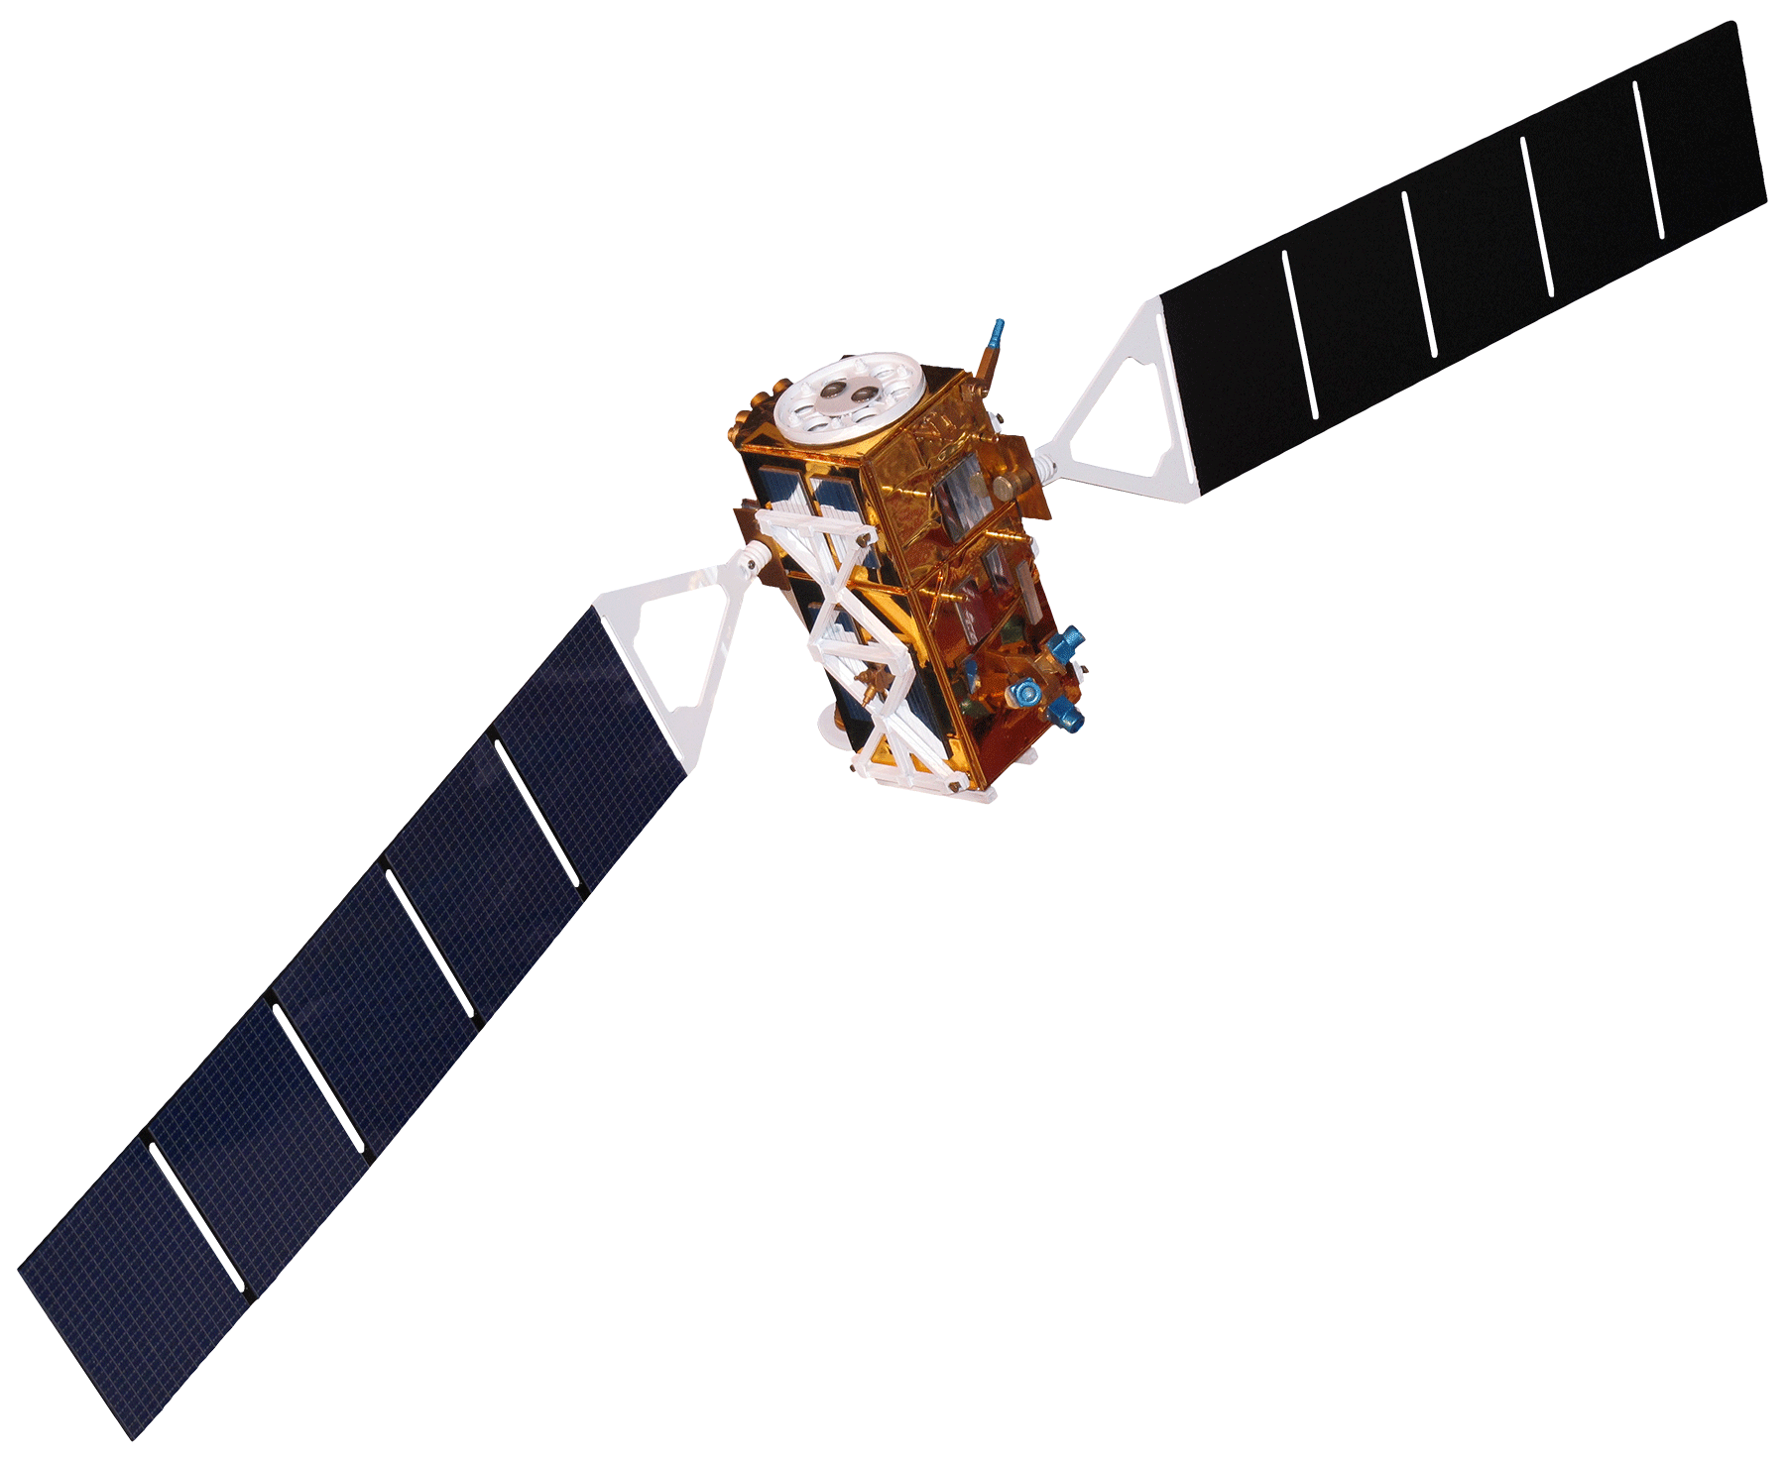
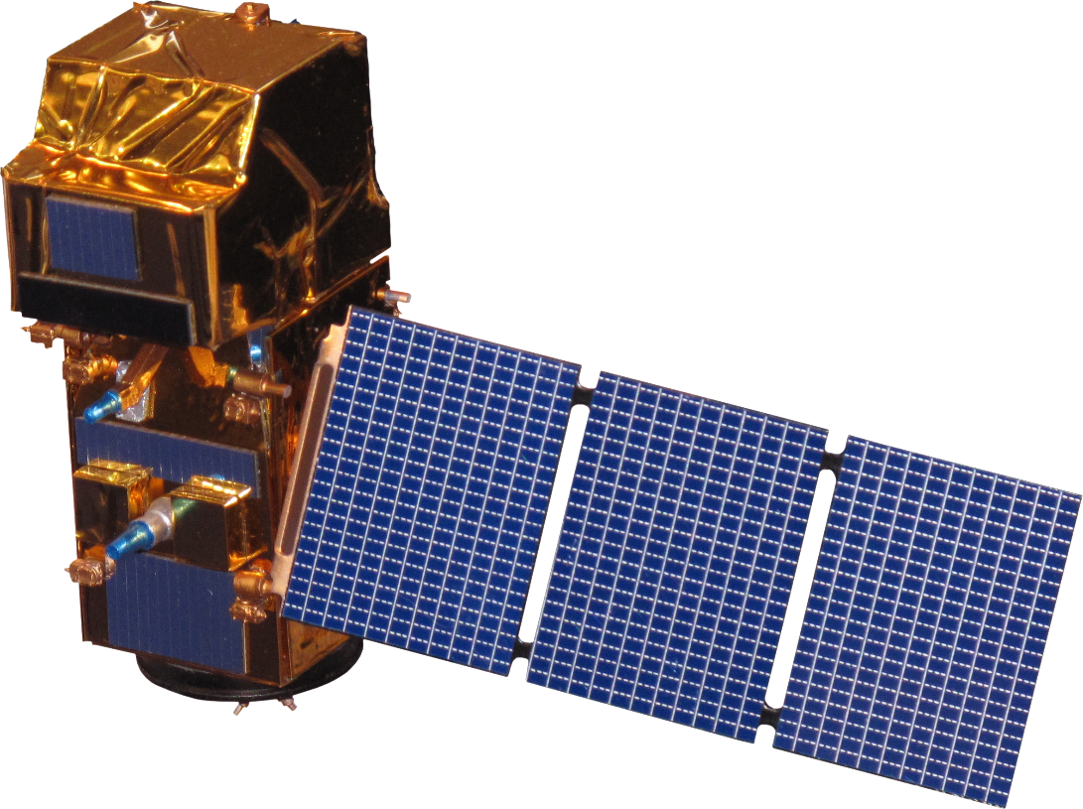
Sentinel-2 Multispectral Instrument
EARTH OBSERVATIONS
Sentinel-1
C-band Synthetic Aperture Radar
Notes:
Meryl: We used data from both the Sentinel 1 and 2 satellites.
Image Source: http://www.devpedia.developexchange.com/dp/index.php?title=List_of_Satellite_Pictures

Slide 10
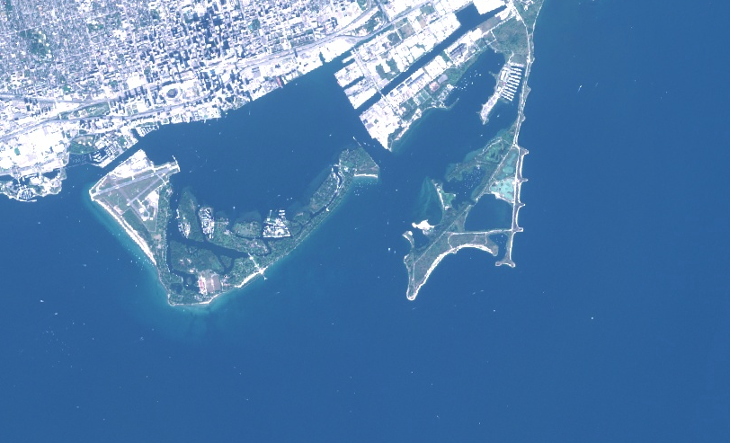
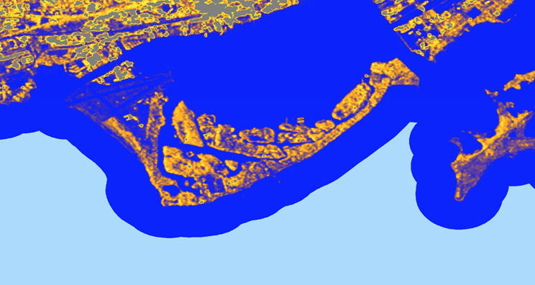
Optical vs Radar
red, green, blue
near infrared
short wave infrared 1
short wave infrared 2
Normalized Difference Vegetation Index (NDVI)
Normalized Difference Water Index (NDWI)
Modification Normalized Difference Water Index (MNDWI)
Vertical Vertical (VV) polarization
Vertical Horizontal (VH) polarization
VV/VH polarization
Notes:
Meryl: Each of these satellites carry sensors that give us uniquely different information. Sentinel-1 carries an active radar sensor that operates in the C- band or microwave range. This frequency both penetrates clouds and provides us a view of the earth during the night which results in a reliable source of data under all conditions. This radar transmits and receives polarized light so the data it provides is backscatter strength which translates to ‘surface roughness’. Sentinel-2 carries a Multispectral instrument providing optical data such as red, green and blue bands but also expands into the shortwave infrared.

Slide 11
METHODOLOGY
Sentinel-2 MSI
Sentinel-1 C-SAR
Non-Flood Image
Flood Image
Variable Selection (R)
Random Forest Classification
Notes:
Meryl: Utilizing both Sentinel 1 and 2 data is especially important when mapping during flood conditions which, as you can imagine, correlate to high cloud cover. The Sentinel 1 image on the right is a VH visualization of the Toronto Islands containing VV, VH, VV/VH bands. The image on the left is from Sentinel 2 and in addition to containing optical bands contain calculated Normalized Differences. The goal was to provide as many bands as possible so that we could experiment with the Random Forest Classification. The end result was four classified images using both presence absence and surface classification during flood and non-flood time periods. If you are unfamiliar with Random Forest Classification, it is method of supervised classification that uses decision trees to classify each pixel based on the provided variables.

Slide 12
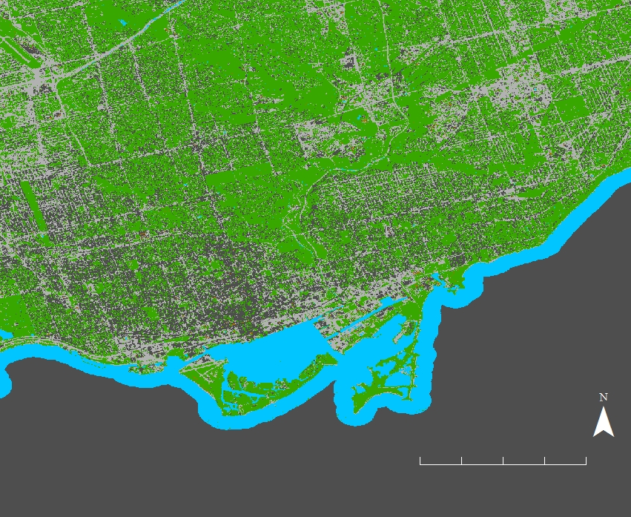
LAND CLASSIFICATION VIA RANDOM FOREST
Random Forest Variable Input
SWIR2
MNDWI
VV
VH
200 points of training data
30% for testing
N
N
0
2
4
0
2
4
Miles
Miles
Non-Flood Time Period
WATER
Flood Time Period
Sentinel-1 C-SAR
VEGETATION
Sentinel-1 C-SAR
PAVED ROADS
Sentinel-2 MSI
BUILDINGS
78% Expected Accuracy
36% Expected Accuracy
Notes:
Meryl: This is the result of running Random Forest using 4 different classes. In the above images the non-flooded image has a 78% expected accuracy while the flooded image has a 36% accuracy. If you run the same model but without SAR data, the non-flooded image is only 50% expected accuracy.
Image Source 1: Google Earth Engine; Sentinel-1 C-SAR; Sentinel-2 MSI

Slide 13
BINARY CLASSIFICATION VIA RANDOM FOREST
Random Forest Variable Input
SWIR2
MNDWI
VV
VH
200 points of training data
30% for testing
0
4
N
N
0
4
Miles
Miles
Non-Flood Time Period
Flood Time Period
Sentinel-1 C-SAR
WATER
Sentinel-1 C-SAR
Sentinel-2 MSI
VEGETATION
100% Expected Accuracy
100% Expected Accuracy
Notes:
Meryl: This is the result of the binary classification. I do not believe that this classification is 100% accurate but that is the result of the confusion matrix provided by Google Earth Engine.
Image Source 1: Google Earth Engine; Sentinel-1 C-SAR; Sentinel-2 MSI

Slide 14
ERRORS & UNCERTAINTIES
Effectiveness of training data for supervised classification depends on: # of points, size of region, variation of land type in region chosen, and manual point creation (human error)
Variable selection
Notes:
Meryl: Much of the uncertainty in the result comes from the inputs to the Random Forest Classification. The accuracy of the training data that informs the classification varies depending on the number of points, where the points are placed and the size of the region the model is applied to and trained on, human error during creation of training data (mis-assignment). In addition variable selection largely determines the success of the model. We used a package in R that ranks variables on importance. We selected our variables based on importance, low correlation with existing selected variables, and existing knowledge of what bands identify water. Lastly the temporal resolution and spatial resolution of the satellite data limits the resolution of the result.

Slide 15
FUTURE WORK
Produce a flood extent map by subtracting images
Improve Sentinel-2 cloud masking to enable the use of optical data during flood scenarios
Notes:
Isaac:
This project provided a stepping stone for many future ideas. A few of them include:
Merging optical and radar data to produce an actual flood extent map using land classification
Improving Sentinel-2 cloud masking to enable the use of optical data during flood scenarios
Looking at SRTM and Water Level Data. Here we wanted to compare water levels to digital elevation models (DEMs) to determine where flooding could occur.
Using inferential statistics to evaluate the FLOW tool results

Slide 16
FLOW TOOL
Flooding in the Lake Ontario Watershed Google Earth Engine Data Viewer
GPM IMERG
Terra MODIS
SMAP
SRTM
Notes:
Tyler: The other product we created during this term was the Great Lakes Basin Data viewer that was created using GEE. The four NASA Earth Observations used were GPM IMERG, SMAP, SRTM, and Terra MODIS. Our partners desired an easy way to visualize and understand the data from these satellites, so we programmed a user interface, or UI, in order to assist them.
Image Source: Google Earth Engine (GEE)

Slide 17
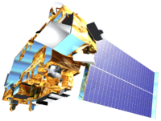
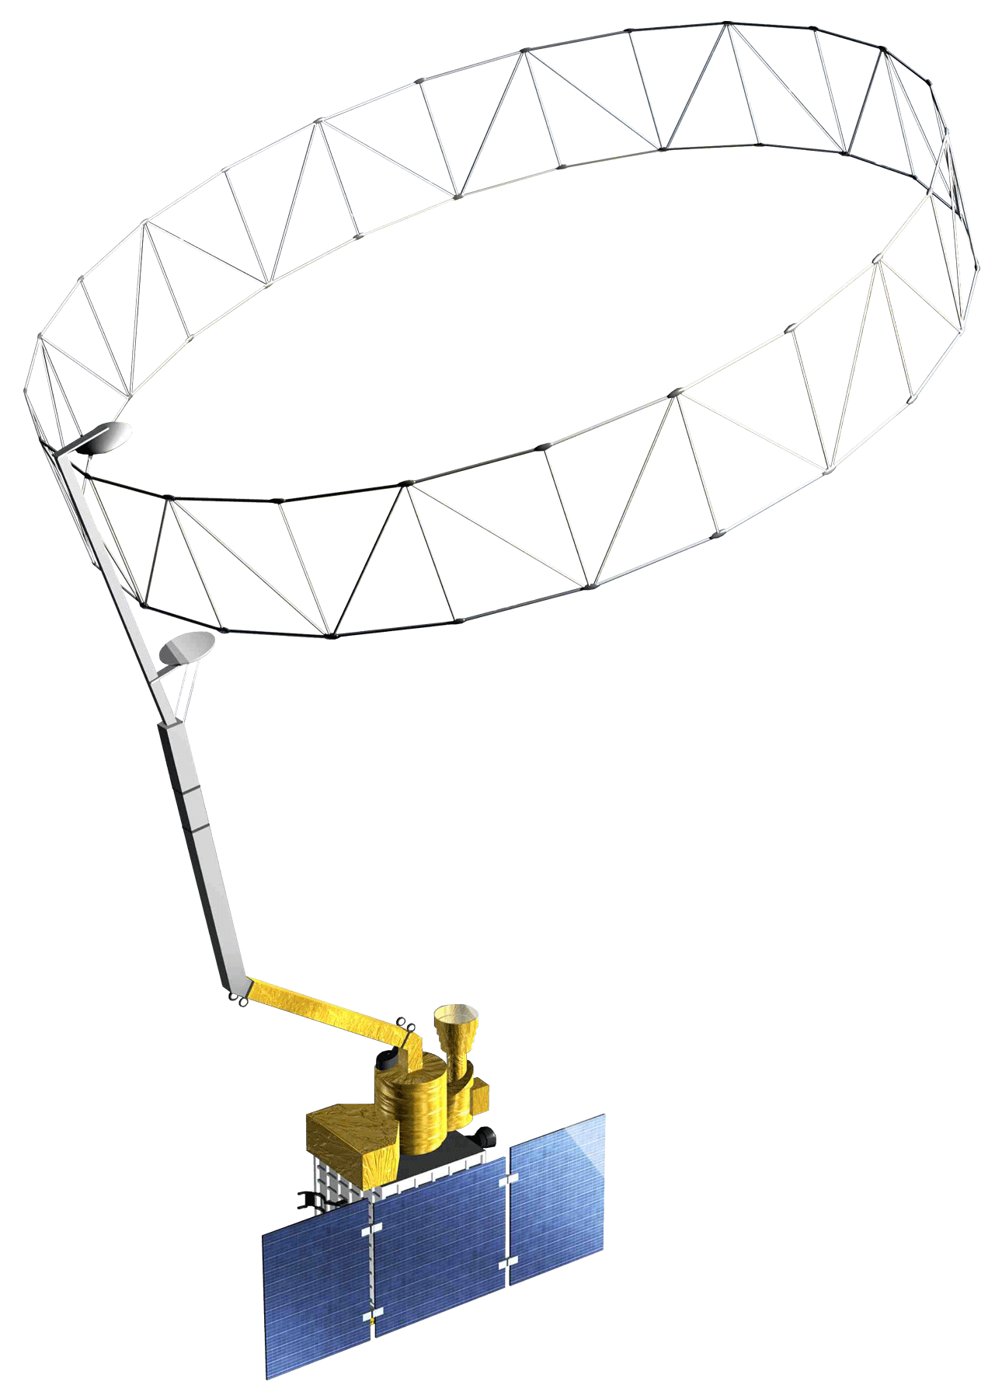
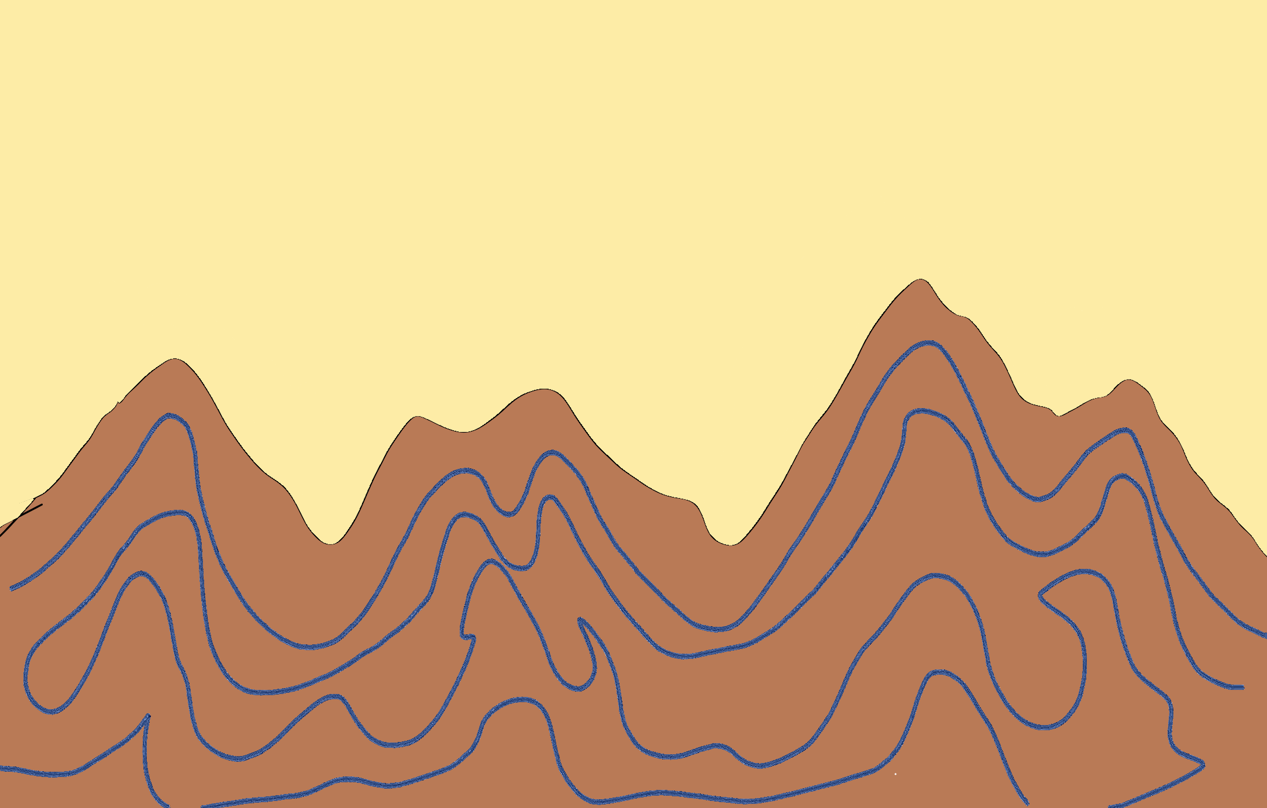
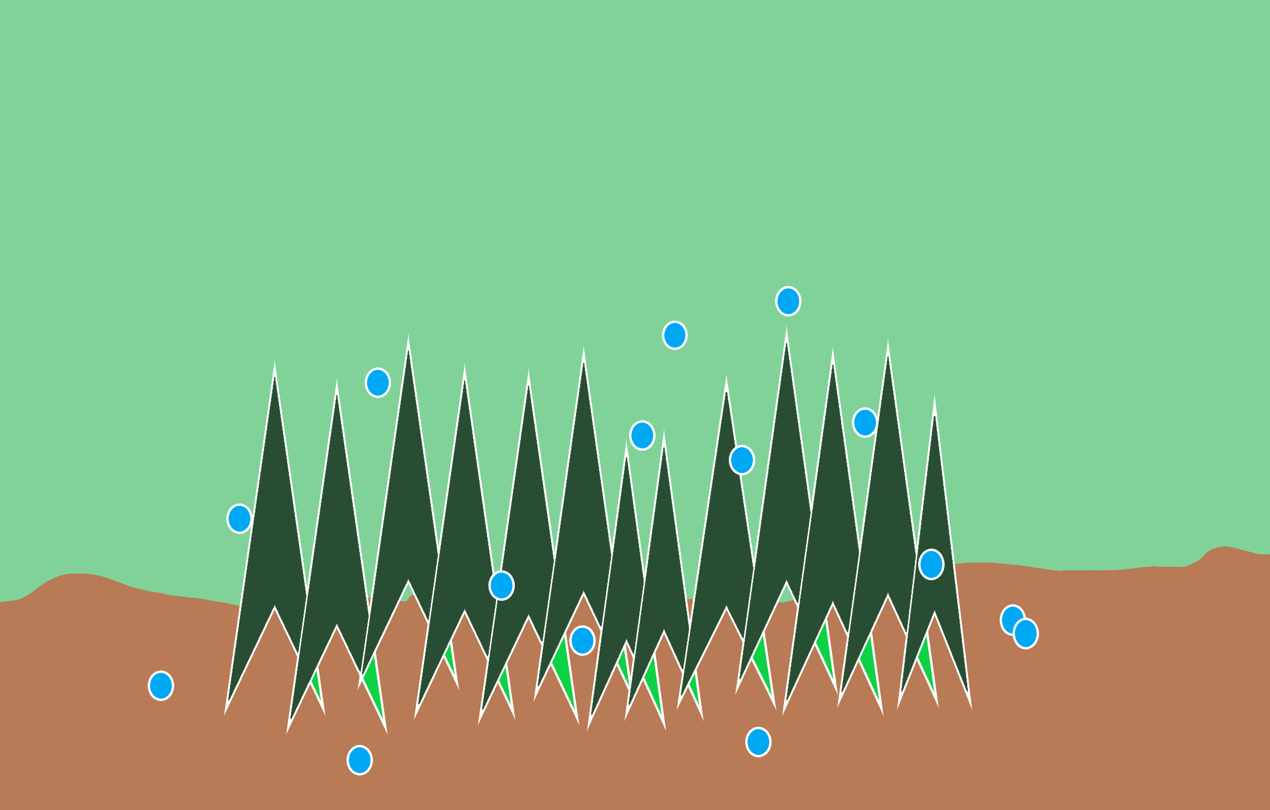
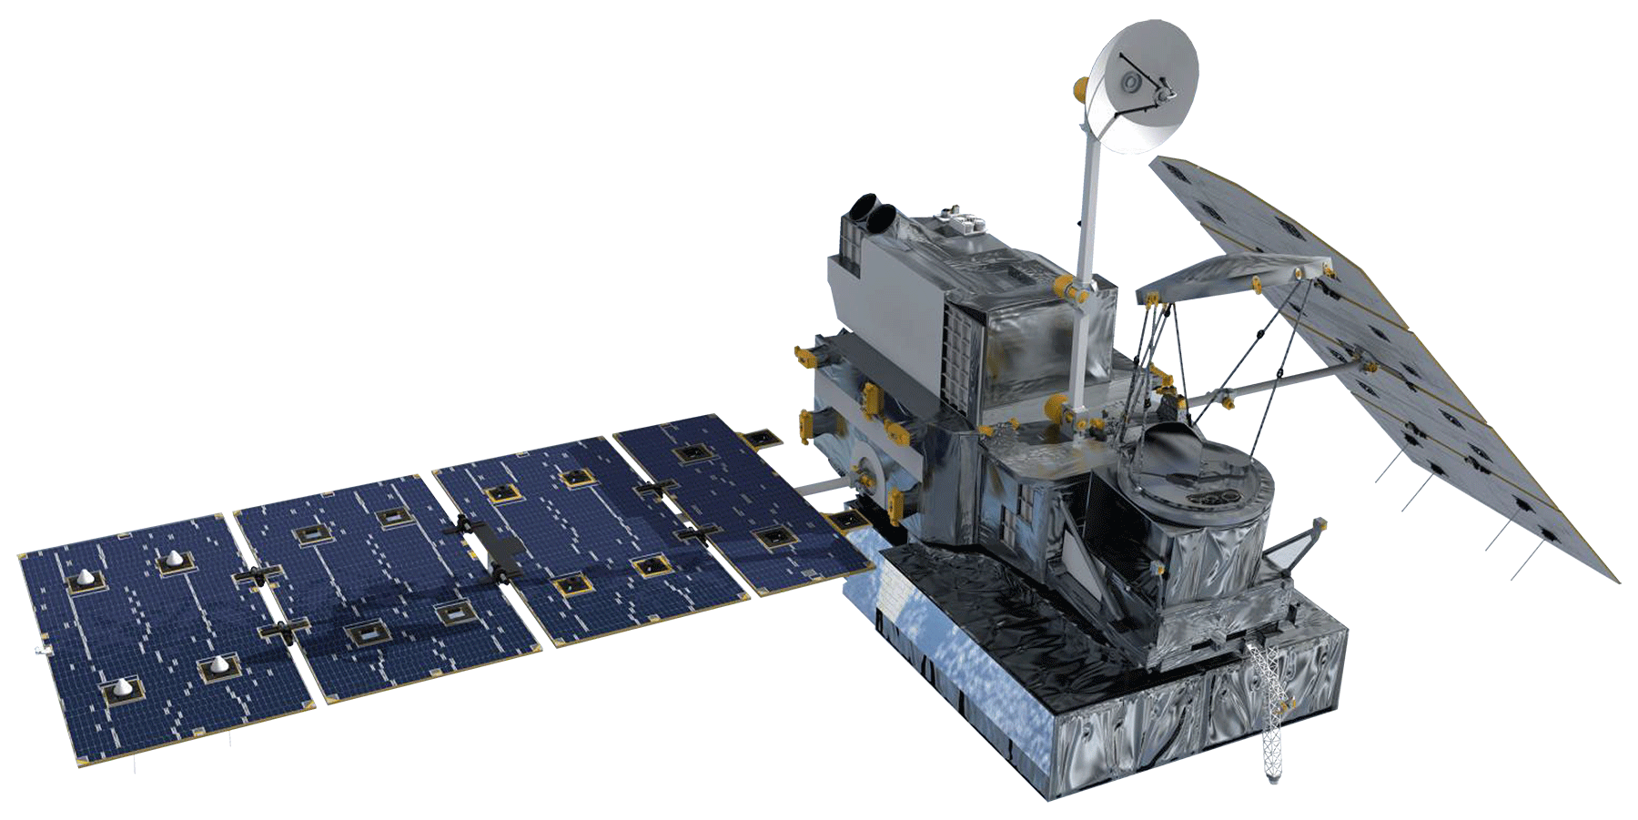
Terra MODIS
Moderate Resolution Imaging Spectroradiometer
SMAP
Soil Moisture Active Passive
Terra MODIS
SMAP
Sentinel-2 MSI
EARTH OBSERVATIONS
NASA
National Aeronautics and Space Administration
GPM IMERG
Global Precipitation Measurement Integrated Multi-Satellite Retrievals for GPM
SRTM
Shuttle Radar Topography Mission
SRTM
Sentinel-1 C-SAR
GPM IMERG
Notes:
Speaker: In order to create the FLOW tool, we used the following satellites:
Terra MODIS data was used for snow cover
SMAP data was used for soil moisture
GPM data was used for precipitation
SRTM data was used for digital elevation maps (DEMs)
Image Source: http://www.devpedia.developexchange.com/dp/index.php?title=List_of_Satellite_Pictures

Slide 18
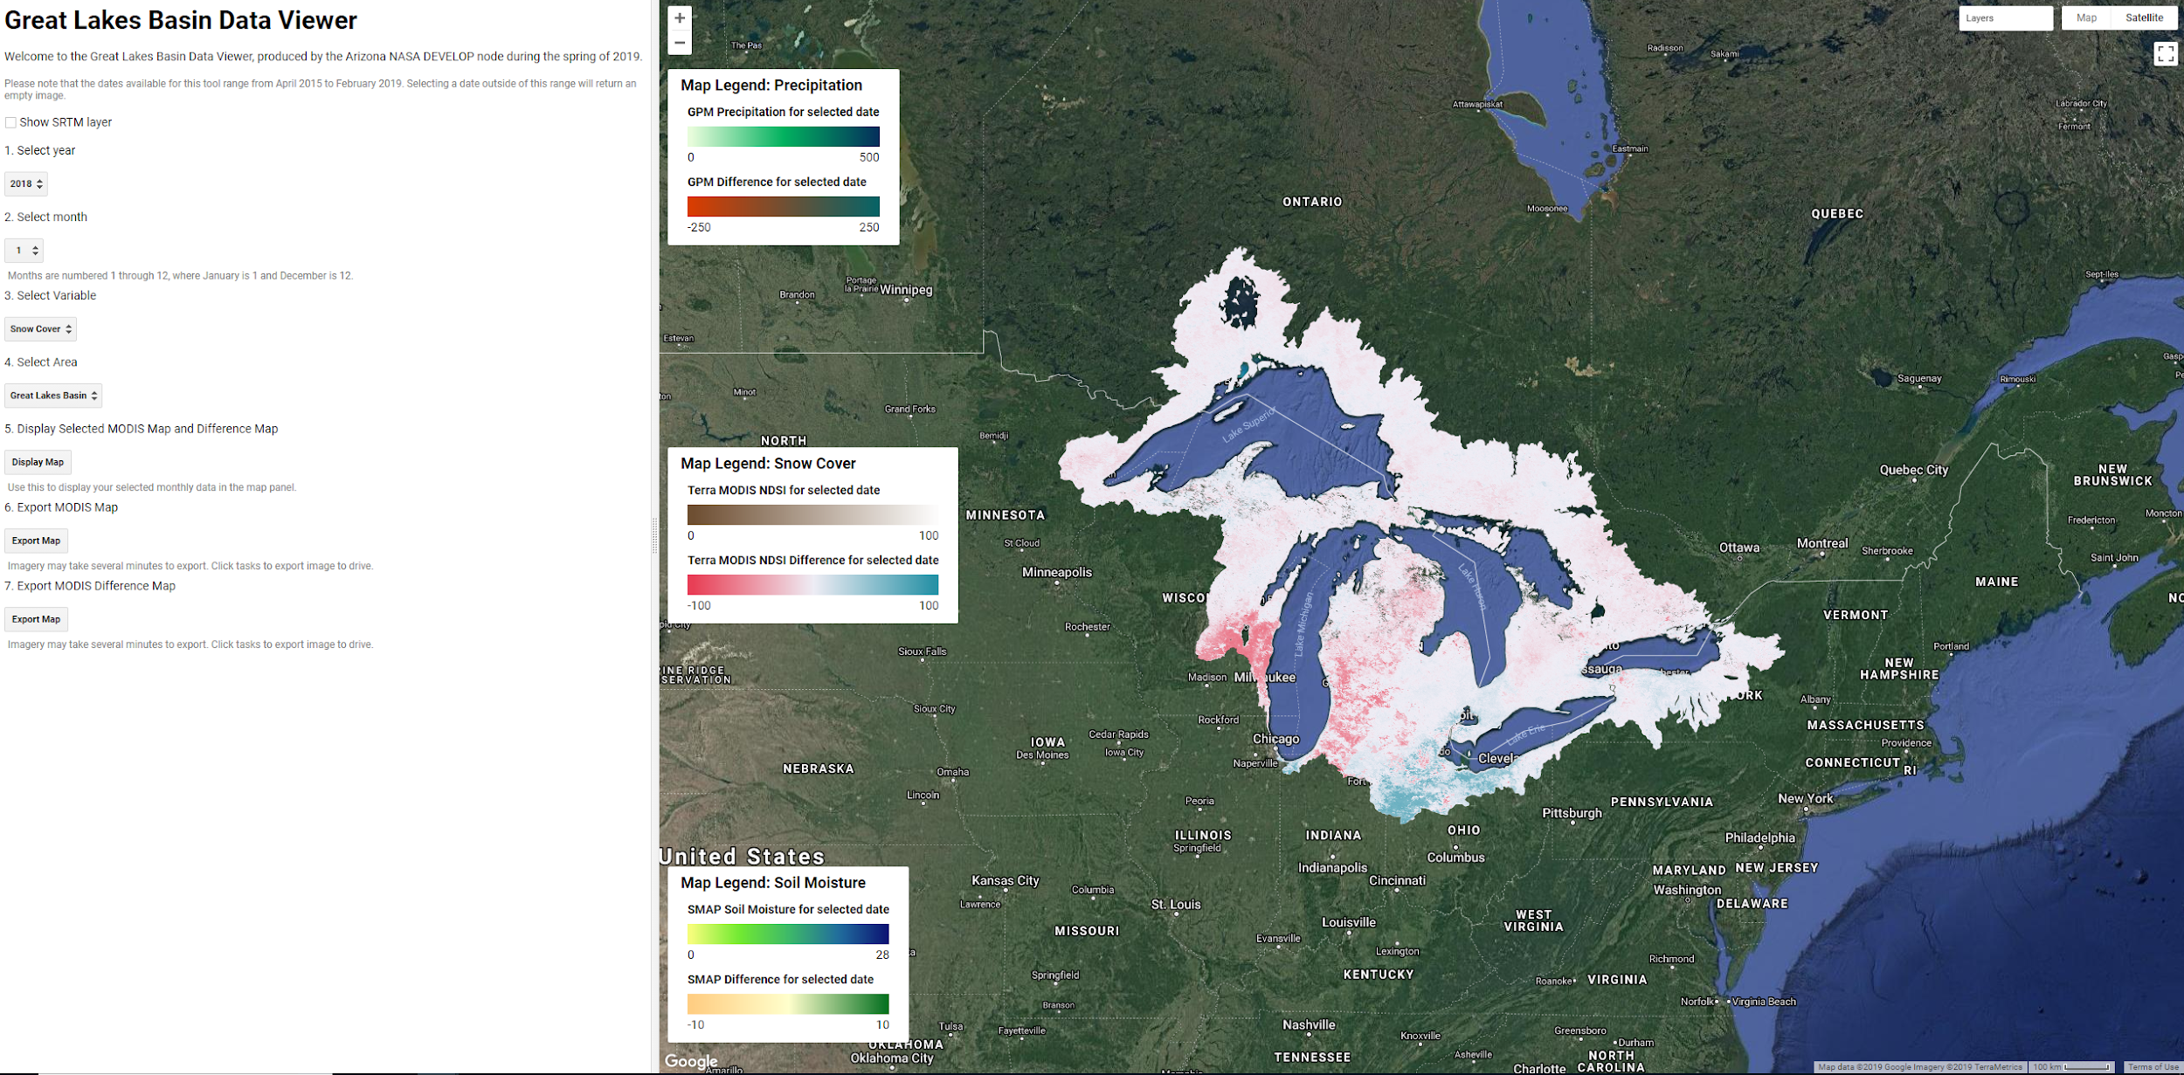
USER INTERFACE
1. Select Year
2018
2. Select Month
1
3. Select Variable
Snow Cover
4. Select Study Area
Great Lakes Basin
5. Display Map
Display Map
6. Export Data
Export Data
Notes:
Tyler: This is the user interface that we programmed in Google Earth Engine. The user is able to set the year from 2015 to 2019, and then choose the month, variable, and study area. To the right of the menu, there are different legends displayed for each of the variables, as well as the output map where the user sees the results.
Image Source: Google Earth Engine; (Created by team).

Slide 19
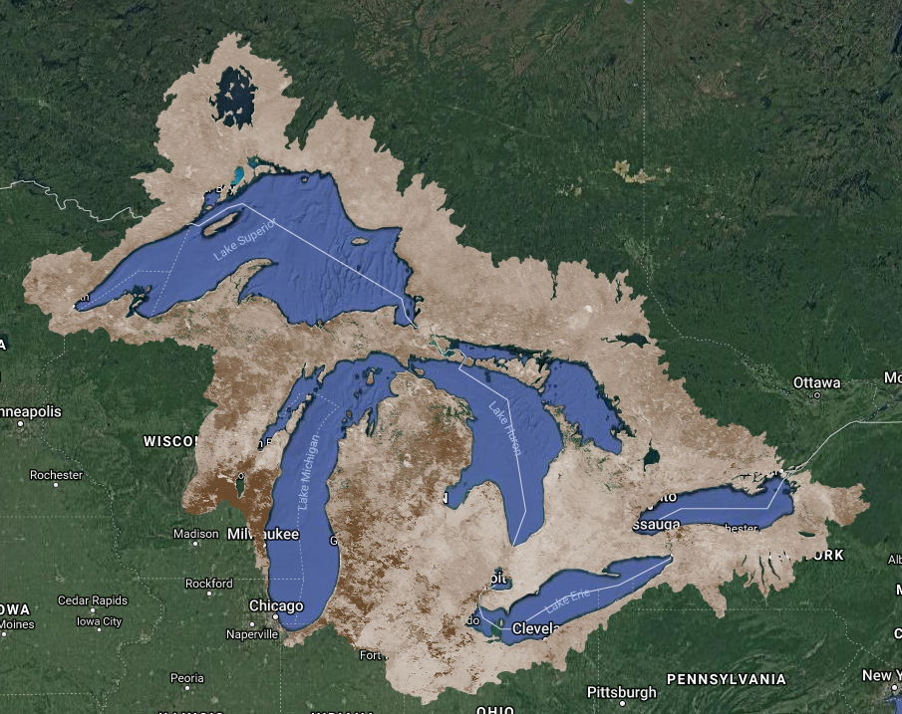
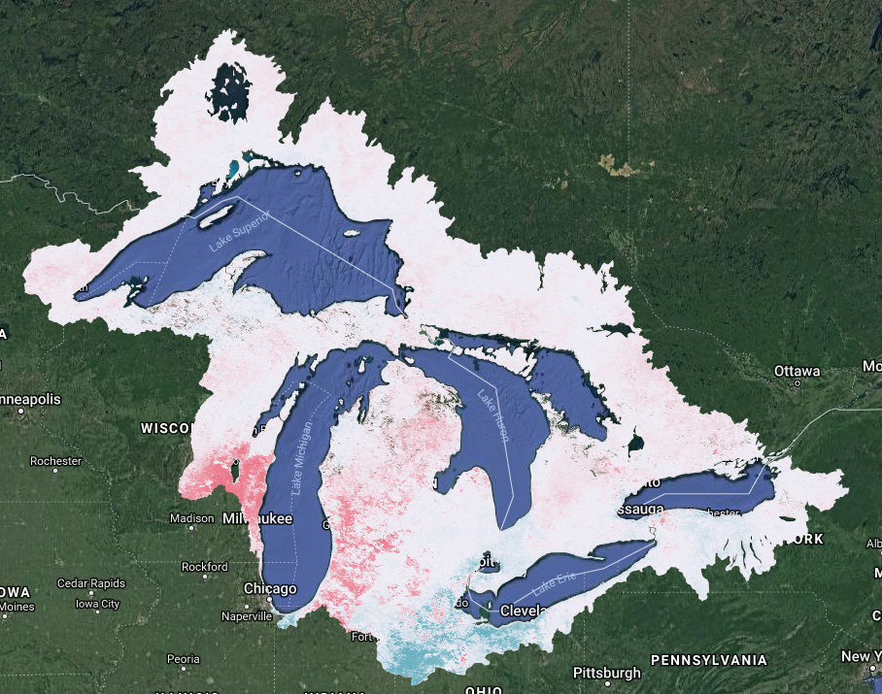
METHODOLOGY
Visualized the variables of precipitation, snow cover, and soil moisture
Deviation from normal during flooding months
Snow cover for January 2018
Snow cover deviation from normal for January 2018
Notes:
Tyler: We programmed the tool to show values for precipitation, snow cover, and soil moisture for a user-specified month and year, as well as the difference of that date from normal. The image on the lower left shows snow cover where dark brown represents areas of no snow, and light brown represents areas with the most snow. Normals for the time period were calculated using median values by pixel for the month across all available data for each satellite. These values were then subtracted from the user-specified month to calculate the deviation from normal. On the lower right, we have an image that represents the deviation from normal during January 2018. Areas that are red show less snow than normal, areas that are white show areas with the usual amount of snow, and areas that are blue have more snow than normal.
Image Source: Google Earth Engine; (Created by team).

Slide 20
FIGURES & GRAPHS
May 2017: 209 mm (8.23 in)
Notes:
Tyler: We also produced charts with the FLOW tool for the study period of April 2015 to February 2019. This chart shows the difference from normal for the GPM IMERG values of the Great Lakes Basin, shown in red, and the Lake Ontario Watershed, shown in blue. The red circle highlights the flooding in May of 2017.
Image Source: Produced by team

Slide 21
FIGURES & GRAPHS
Notes:
Tyler: Here you can see the normalized difference snow index values for the study period. There was less snow than normal leading up to the May 2017 flood.
Image Source: Produced by team

Slide 22
FIGURES & GRAPHS
Notes:
Tyler: And this chart represents soil moisture values. You can see how high the soil moisture was following the May 2017 flooding, reacting to the large amounts of precipitation during this time.
Image Source: Produced by team

Slide 23
ERRORS & UNCERTAINTIES
The FLOW tool is not predictive
Normal values used to calculate difference were based off of available data
Extreme flooding events visible, but minor flooding events not apparent
Notes:
Tyler: It’s important to note that this tool is not perfect- it was produced in ten weeks and there’s a lot of room for improvement. Some of the important things to note are that the FLOW tool is not predictive. It does not guarantee that a flood will occur at a given time or place; it simply displays how some, not all, of the variables that contribute to flooding have behaved over the study months. Additionally, the normal values we used to calculate the difference from normal were based off of the satellite data available to us. The data availability ranges between four years to nineteen years, and these values are not indicative of climatological normals. Finally, while it is easy to see the extreme flooding event in May of 2017, other minor flooding events were not represented

Slide 24
FUTURE WORK
Using inferential statistics to evaluate the FLOW tool results
Using water levels and stream gauges to understand how these variables impact the flows into and out of the lake
Notes:
Isaac:
This project provided a stepping stone for many future ideas. A few of them include:
Merging optical and radar data to produce an actual flood extent map using land classification
Improving Sentinel-2 cloud masking to enable the use of optical data during flood scenarios
Looking at SRTM and Water Level Data. Here we wanted to compare water levels to digital elevation models (DEMs) to determine where flooding could occur.
Using inferential statistics to evaluate the FLOW tool results

Slide 25
CONCLUSIONS
Demonstrated feasibility of Google Earth Engine for land classification using random forest for an image with optical and radar data
The FLOW tool illustrated precipitation and soil moisture were greater than normal during the flooding in 2017
Notes:
Isaac: Overall, this project demonstrated the feasibility of Google Earth Engine for land classifications combining both optical and radar data. Additionally, the project identified some of the contributing factors that led to the flooding in May of 2017. There was significant precipitation during May of 2017, which impacted soil moisture for that month and the two months following. Notably, precipitation values were recorded at 209mm or 8.23in more than normal during May 2017, while soil moisture increased during the months of May, June, and July of 2017, peaking at 5.9mm greater than normal during July of 2017.

Slide 26
NASA DEVELOP Arizona – Tempe Node Leadership: Erika Higa (Center lead) and Megs Seeley (Assistant Center Lead and Geoinformatics Fellow)
Science Advisors: David Hondula (Arizona State University) and Cedric Fichot (Boston University)
Niagara Falls Disasters Team: Oyut Amarjargal, Eric Deutsch, Christie Fleming, and Celeste Gambino
City of Toronto: Garrett Christie, Tyler Griffin, and Maria Yung
City of Mississauga: Teresa Chan, Samer Inchasi, Teresa Burgess-Ogilvie, Muneef Ahmad, and James Silburn
GLSLCI: Melissa Soline
CVC: Christine Zimmer
TRCA: Victoria Kramkowski
This material contains modified Copernicus Sentinel data (2015-2019), processed by ESA
Notes:
Isaac: Here is a list of people and organizations we would like to thank.

Slide 27
THANK YOU!
Notes:
Isaac: Thank you! Any questions?

