Slide 1
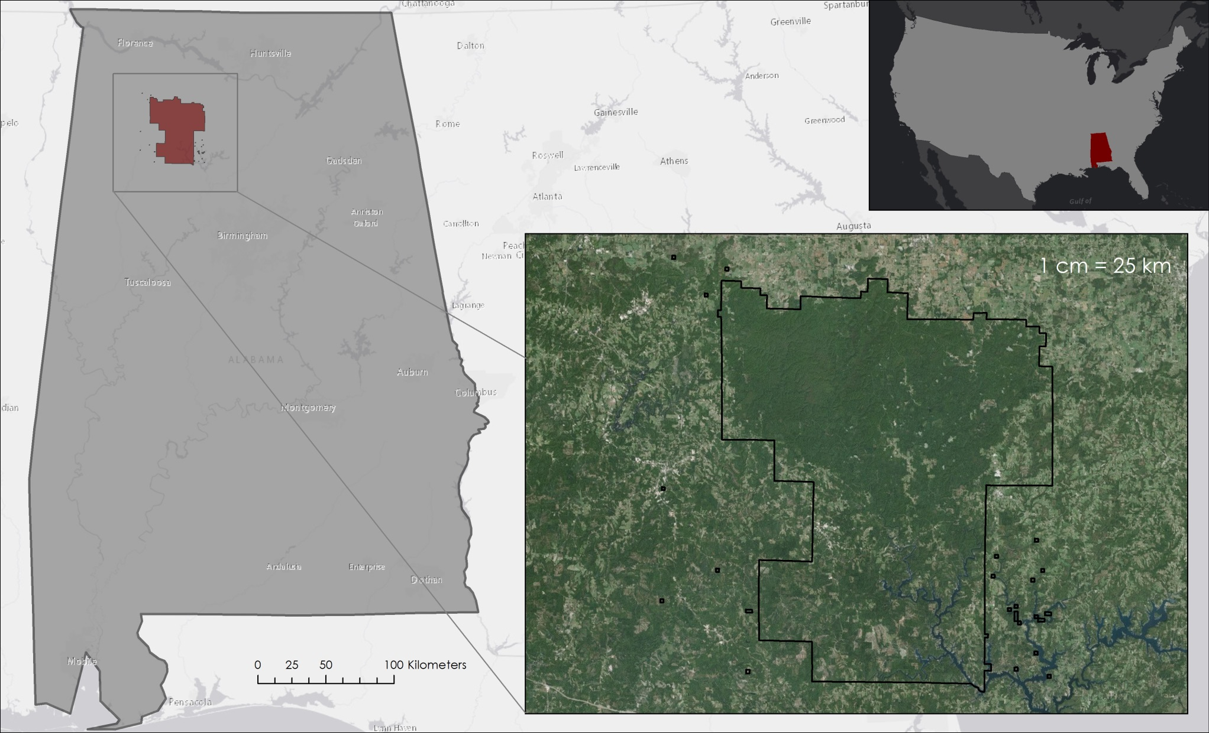
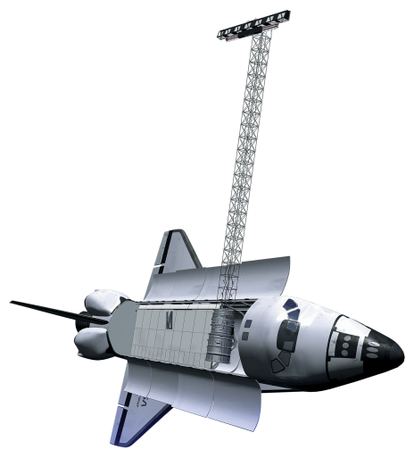


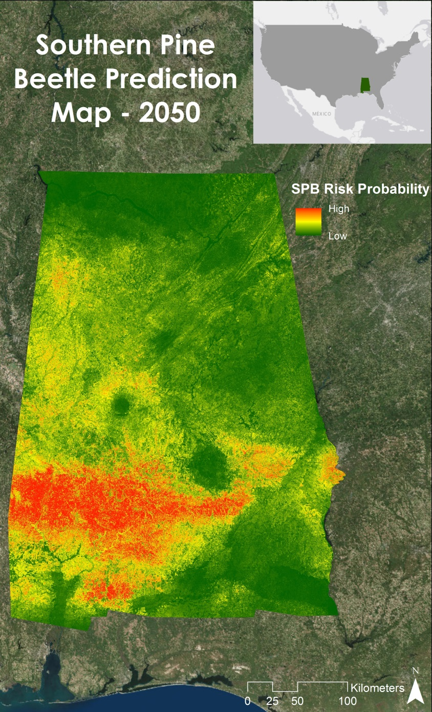
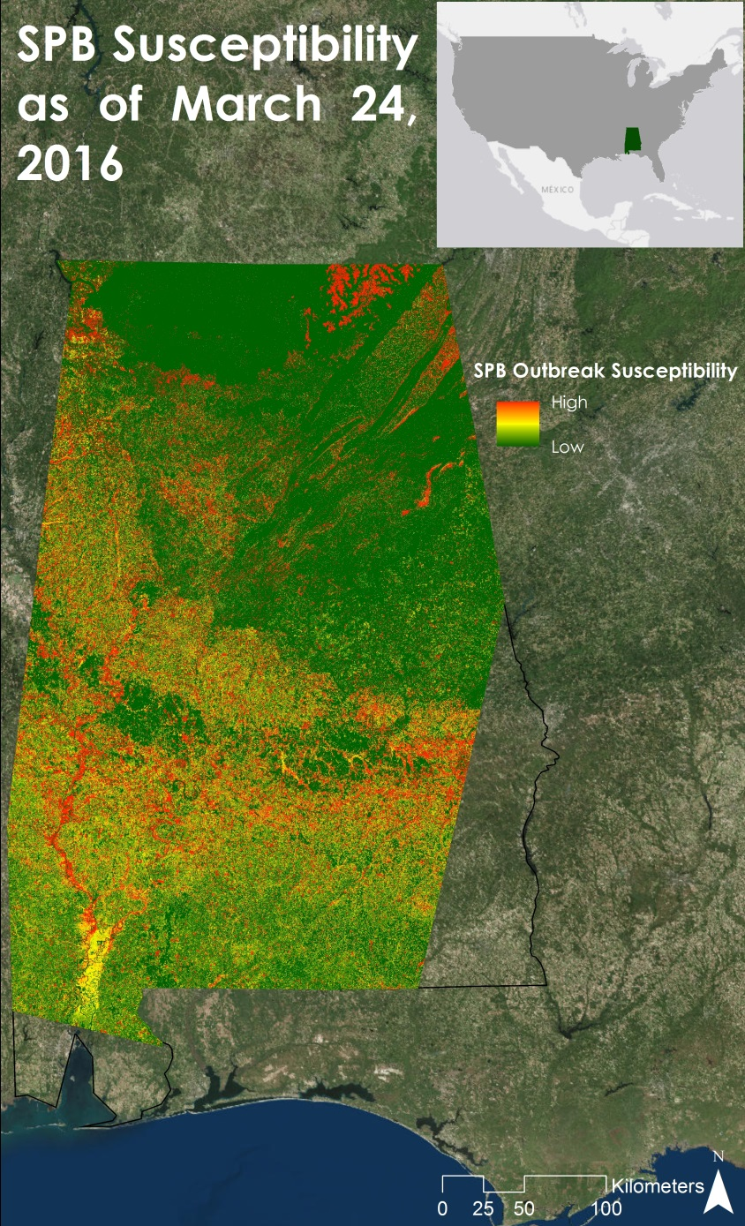


Alabama Ecological Forecasting
Assessing Southern Pine Beetle Epidemics in Alabama’s Bankhead National Forest using NASA Earth Observations
Ryan Schick (Project Lead), Maggi Klug, Kelsey Herndon, Leigh Sinclair
DEVELOP National Program at NASA Marshall Space Flight Center
Abstract
Objectives
The Southern Pine Beetle (SPB), Dendroctonus frontalis, is an opportunistic species that attacks stressed trees weakened by drought, storm damage, or fire. In 2000, about 18,600 acres of pine forest were damaged throughout Bankhead National Forest due to SPB. The United States Department of Agriculture (USDA) Forest Service currently uses expensive manned aerial surveys, such as aerial photography and Light Detection and Ranging (LiDAR), as well as Moderate Resolution Imaging Spectroradiometer (MODIS) ForWarn and Forest Disturbance Monitor data to help with mitigation efforts. This project used remotely sensed data to identify SPB infested areas throughout Alabama and determine outbreak patterns. Landsat 5 Thematic Mapper (TM) and Landsat 8 Operational Land Imager (OLI) were used to derive a Normalized Difference Vegetation Index (NDVI) and a Green-Red Vegetation Index (GRVI) to show vegetation health. Shuttle Radar Topography Mission Version 2 (SRTM-v2) Digital Elevation Models (DEMs) were used to understand how elevation and slope affect SPB susceptibility. In situ SPB data and future environmental variables were analyzed using the Princeton University Maximum Entropy model (MaxEnt) to assess areas susceptible to a SPB outbreak by creating a SPB Prediction Map for 2050. Additionally, this project determined where mitigation efforts should be focused by creating a Near Real-Time SPB Susceptibility Model. A Historic Southern Pine Beetle Coverage Map was created to understand patterns of previous attacks. The USDA Forest Service used these methodologies and maps to reduce costs and time associated with SPB suppression in Bankhead National Forest and Alabama.
Map previous beetle infestations to determine areas affected by the Southern Pine Beetle (SPB)
Assess current and future forest susceptibility of SPB outbreaks to help determine where suppression efforts should be focused
Create a near real-time model to continually assess the ongoing risk of SPB outbreaks
Study Area
Methodology
1
Historic Southern Pine Beetle Coverage Maps
2
In situ data [SPB locations] + Point Density Tool [ArcMap 10.3]
Southern Pine Beetle Prediction Map
In situ data [SPB locations]  SPB outbreak thresholds [Green Red Vegetation Index, Normalized Difference Vegetation Index, future climatic variables] Princeton University Maximum Entropy Model
3
Near Real-Time Southern Pine Beetle Susceptibility Model
Earth Observations
Landsat 8 [Green Red Vegetation Index, Normalized Vegetation Health Index]  LandFire data [tree species]  Python
Results
STRM-v2
Landsat 5
Landsat 8
SPB Prediction Map
Conclusions
Historic Southern Pine Beetle Maps showed the majority of SPB attacks occurred in southwestern Alabama.
Most of the concentrated outbreaks occurred in the southwestern part of the state.
Few SPB outbreaks occurred in or near Bankhead National Forest from 2010 to 2015.
The Southern Pine Beetle Prediction Map showed southwest Alabama was at greatest risk in 2050.
The southwestern portion of Alabama sees attacks more frequently and the density of outbreaks is higher.
As of March 24, 2016, the northeastern portion of Bankhead National Forest is susceptible to a SPB outbreak.
Historic SPB Coverage Maps
Near Real-Time
SPB Susceptibility Map
Team Members
Acknowledgements
Project Partners
Dr. Jeffery Luvall - NASA at the National Space Science Technology Center
Dr. Robert Griffin - University of Alabama in Huntsville
Dave Casey, Dr. John Nowak, Dr. Chris Asaro – USDA Forest Service
Tim Klug - University of Alabama in Huntsville Graduate Research Assistant
Kel Markert – SERVIR Graduate Research Assistant
Daryl Ann Winstead - NASA DEVELOP National Program
Alabama Forestry Commission
USDA Forest Service
Kelsey Herndon, Maggi Klug, Leigh Sinclair, Ryan Schick
NASA Marshall Space Flight Center

