Slide 1
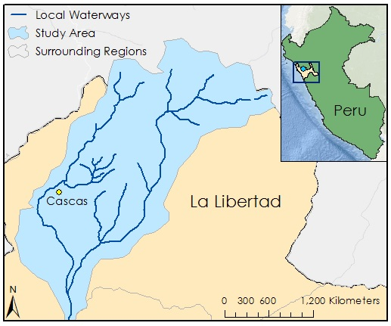

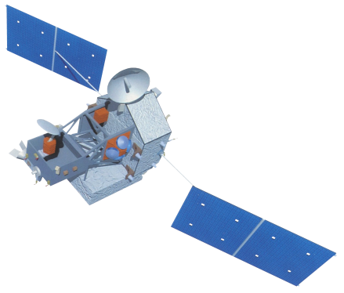
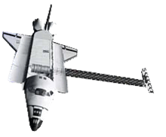
Peru Disasters II
Identifying and mapping flood prone regions in the La Libertad Region of Peru using NASA's Earth Observation Systems
William Wilson (Project Lead), Grant Bloomer, Allison Daniel, Anthony Donzella, Josh Hammes
Abstract
Objectives
Improve upon the resources necessary to provide a preliminary flood risk analysis
Produce historic and predictive flood maps utilizing NASA’ s Earth observation satellites and mathematical models for requested area within the La Libertad Region of Peru
Obtain a successful calibration of the CREST 2.0 model
Study Area
Methodology
Shapefile of Study Area
DIVA-GIS
Digital Elevation Model
Flow Direction Map
HydroSHEDS
Flow Accumulation Map
Rainfall Data
Evapotranspiration Data
SRTM
HydroSHEDS
METRIC
TRMM
Earth Observations
TRMM
SRTM
Terra
Results
Conclusions
.
Team Members
Project Partners
Acknowledgements
William Wilson (Project Lead)
Grant Bloomer
Allison Daniel
Anthony Donzella
Josh Hammes
Water For People
Instituto Nacional de
Defensa Civil del Peru (INDECI)
Dr. Kenton Ross, Science Advisor (NASA DEVELOP)
Dr. DeWayne Cecil, Science Advisor (Global Science and Technology Inc. )
Ms. Melanie Salyer, Mentor (NASA DEVELOP)
Lance Watkins, Geoinformatics Team (NASA DEVELOP)
Dr. Xinyi Shen, Hydrometeorology and Remote Sensing Laboratory (University of Oklahoma)
Manabendra Saharia, Graduate Research Assistant (University of Oklahoma)
Jordan Bates, Wise Center Lead (NASA DEVELOP)
Wise County Clerk of Court’s Office

