Slide 1
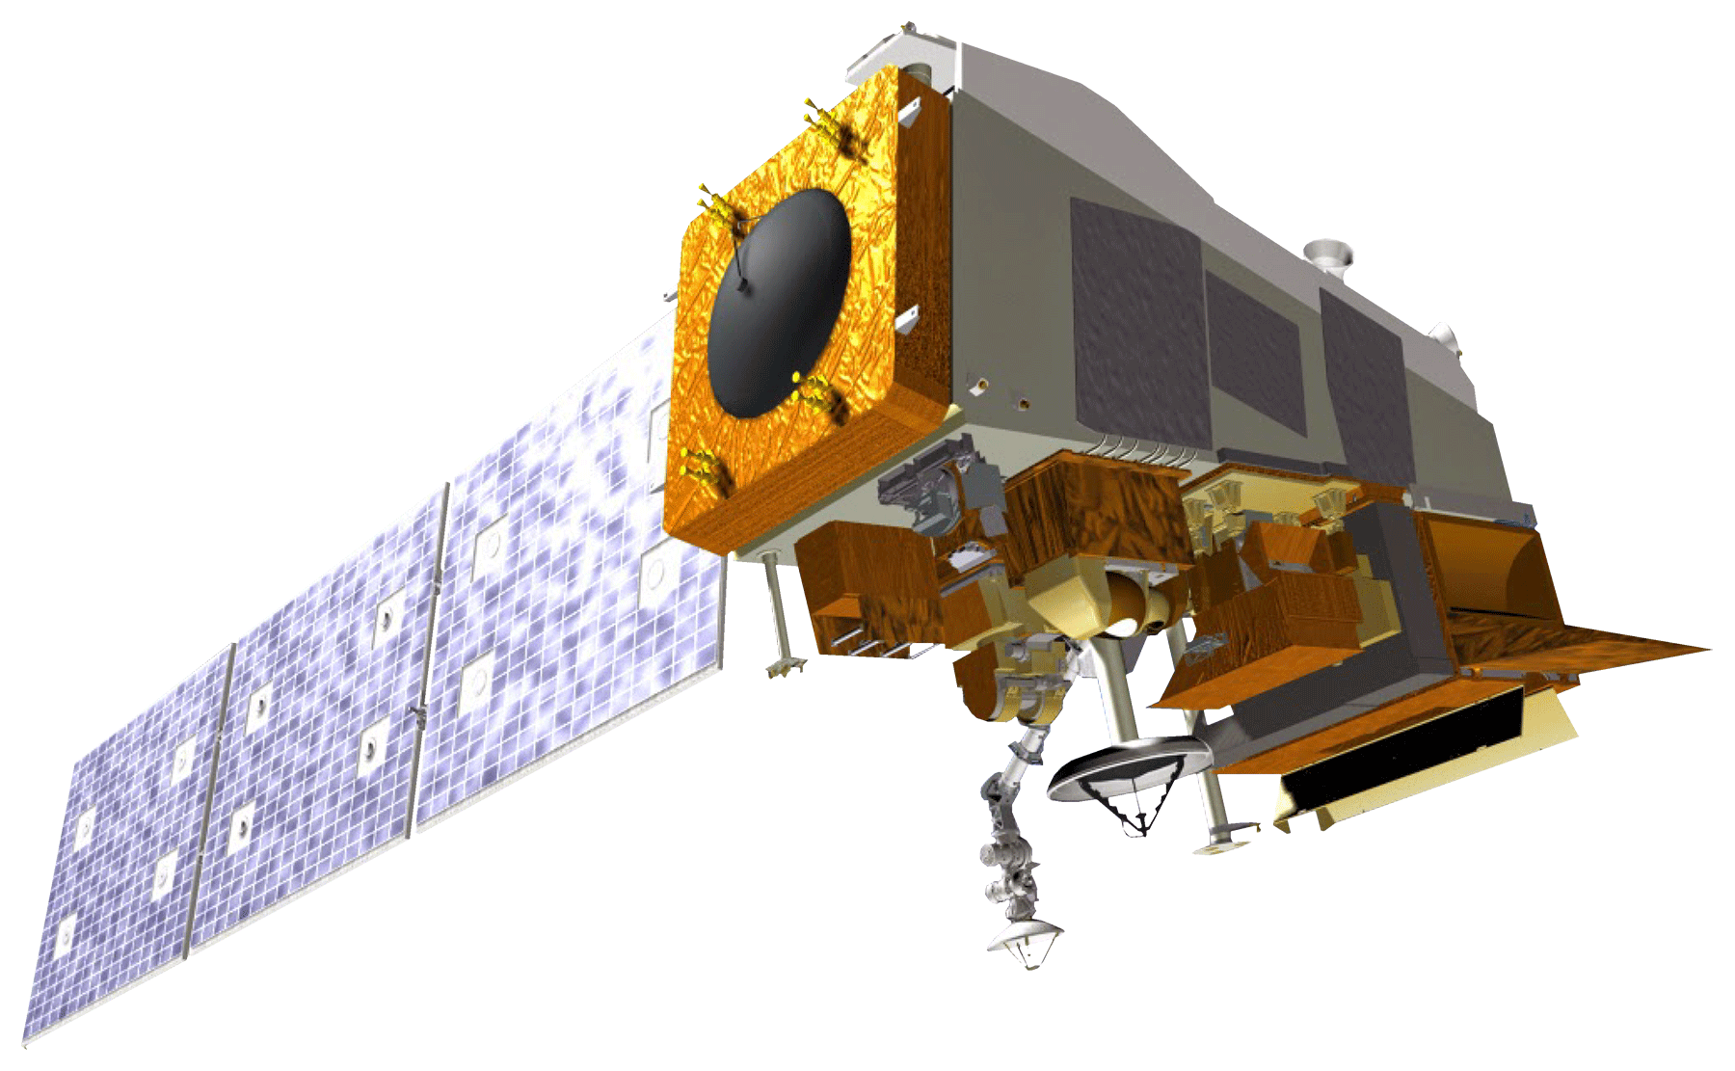
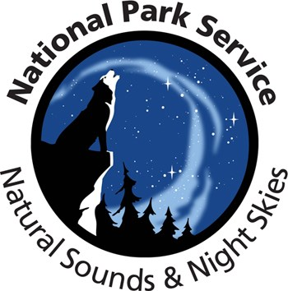
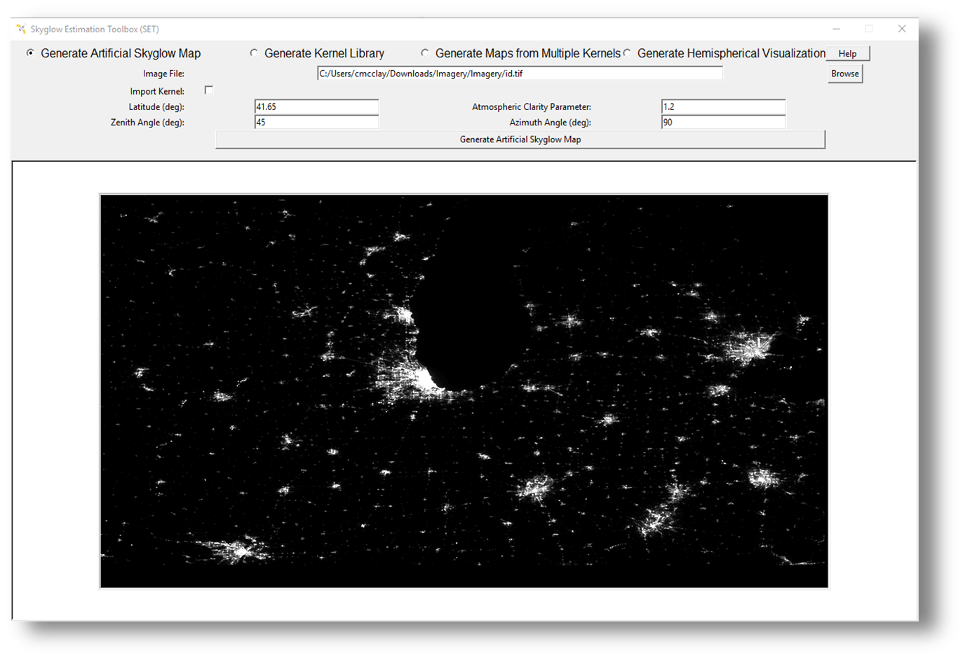
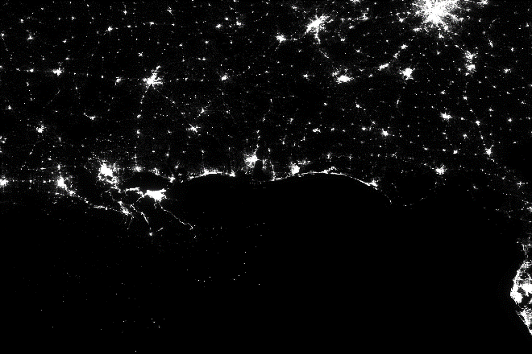
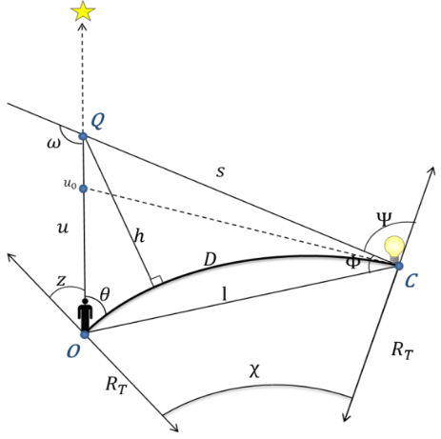
Estimating Skyglow to Assist in the Management of Light Pollution in US National Parks
Abstract
Objectives
US Urban Development III
The expansion of cities and infrastructure networks has raised concerns regarding the impact of growing artificial light pollution on wildlife and human well-being. In addition to degrading night skies for aesthetic viewing, this ‘skyglow’ interferes with ecosystems by disrupting plant life, animal behavior, and human circadian rhythms. In partnership with the National Park Service (NPS), this project created a tool to facilitate the estimation of skyglow in national parks. To conduct this work, the team used the Skyglow Estimation Toolbox (SET), a Python-based program that calculates artificial skyglow by applying a model of light propagation to visible light radiance imagery from the Suomi National Polar-orbiting Partnership (NPP) Visible Infrared Imaging Radiometer Suite (VIIRS) Day/Night Band (DNB). A previous group enhanced SET’s abilities and created a graphic user interface, and the current team focused on finalizing and validating SET. By comparing skyglow estimations from SET for select parks with the NPS’s ground truth data, the team confirmed that the two showed a tight linear correlation for most parks, and that SET outputs closely aligned with NPS data after adding a simple calibration factor. The team trained NPS officials to use SET and produce 3D hemispheric brightness maps for six parks and three additional regions to visualize the prevalence of light pollution.
Finalize the Skyglow Estimation Toolbox (SET) in Python to ensure proper functioning by fixing code errors and running tests.
Validate SET with data from six national parks and compare the results with in situ measurements to assess accuracy and its ability to perform across diverse geographies.
Generate 3D hemispheric artificial brightness maps of parks to showcase the tool’s abilities and provide a useful resource for the national parks in their efforts to manage light pollution.
Create a comprehensive training system for SET, including written instructions and a recorded webinar, to ensure proper installation and implementation for future use.
Earth Observations
Suomi NPP VIIRS DNB
Project Partners
Results
3D Hemispheric Visualizations
0
High
National Park Service, Natural Sounds & Night Skies Division
20
Yellowstone
Arches
40
Study Area
60
80
0
20
1. Yellowstone National Park
2. Arches National Park
3. Scotts Bluff National Monument
4. Buffalo National River
5. Gulf Islands National Seashore
6. Indiana Dunes National Park
7. Shenandoah National Park
Zenith
Scotts Bluff
Shenandoah
1
1
40
Sky Brightness
3
6
2
60
2
3
80
7
4
0
N
4
5
20
Indiana Dunes
Gulf Islands
40
5
6
60
Low
7
80
-150
-100
-50
0
50
100
150
-150
-100
-50
0
50
100
150
0
400
800
1600
Validation
Azimuth
Methodology
Data
Pre-Processing
SET
3D Hemispheric Maps
Analysis
R² ⁼ 93%
Validate SET values compared to NPS in-situ data
Acquire Suomi NPP VIIRS DNB Data
Kernel
R² =55%
Generate hemispheric visualizations of light pollution
SET
Filter out noise by calculating a median image and clipping to study area
Run Skyglow Estimation Toolbox (SET)
NPS
SET
1
Conclusions
VIIRS Imagery
Kernels
2D Maps
3D Hemisphere
SET’s 3D hemispheres align well with NPS ground-truth data for most parks, with R² values around 0.9, once we exclude a problem point at zenith 80º, azimuth 180º.
Limitations exist for areas with high snow cover, extensive water, high-latitude regions. Accuracy is lower for Scotts Bluff and Yellowstone around the horizon.
The hemispheric visualizations can facilitate communication with other agencies or the public on the impact of light pollution.
404.8
0
Acknowledgements
Team Members
Kenton Ross, PhD, NASA Langley Research Center
Sharolyn Anderson, PhD, Physical Scientist, National Park Service, Night Skies Division
Li-Wei Hung, PhD, Research Scientist, National Park Service, Night Skies Division
Neil Carter, PhD, Assistant Professor, University of Michigan
Sydney Neugebauer, NASA DEVELOP Virginia - Langley Center Lead
Past DEVELOP Contributors: Maximilian Ioffe, Julia Hink, Tyler Jameson, Charlie McClay, Margaret Mulhern, Manda Au, Ian Brastow, Veronica Warda, Ryan Avery, Steven Chao, Stanley Yu, Benjamin Marcovitz, Aubrey Hilte, Christine Stevens, Eric White
Rachel Luo
Project Lead
Sarah Parker
Charlotte Rivard
Elise Turrietta
Virginia – Langley | Summer 2019

