Slide 1
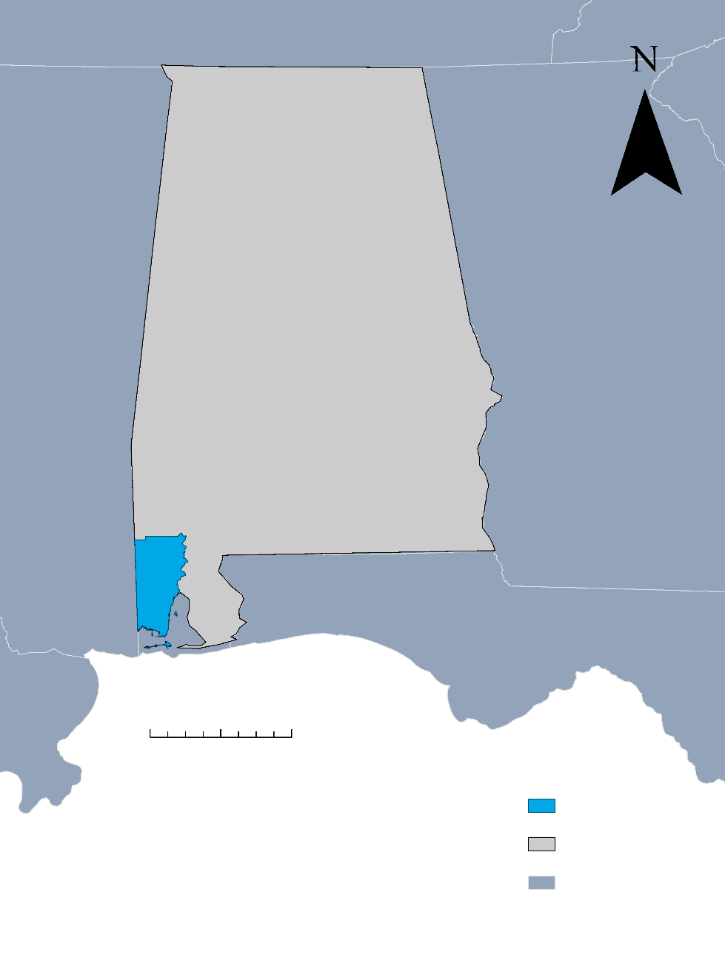
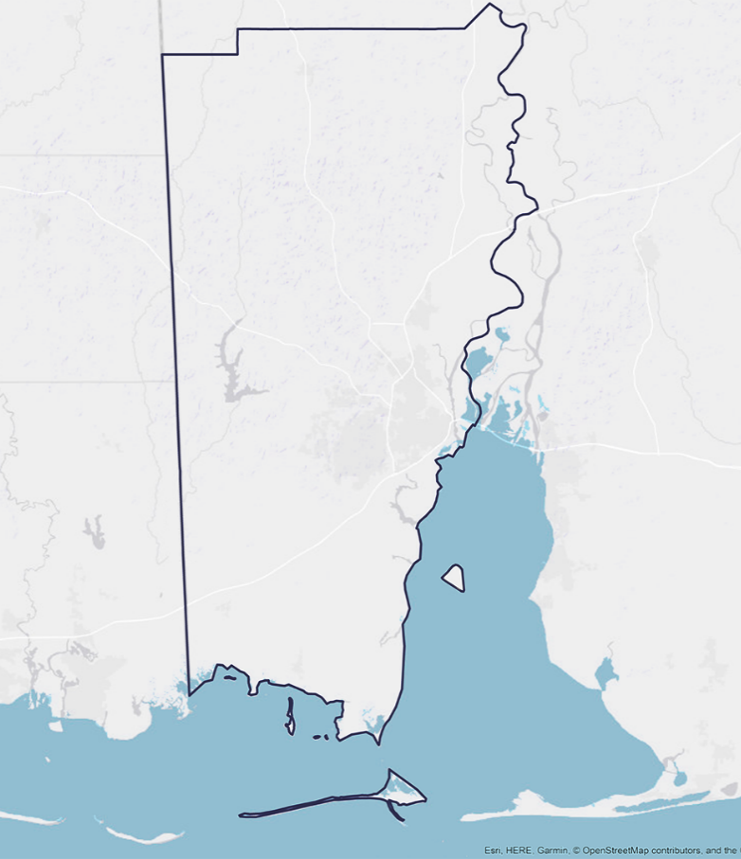
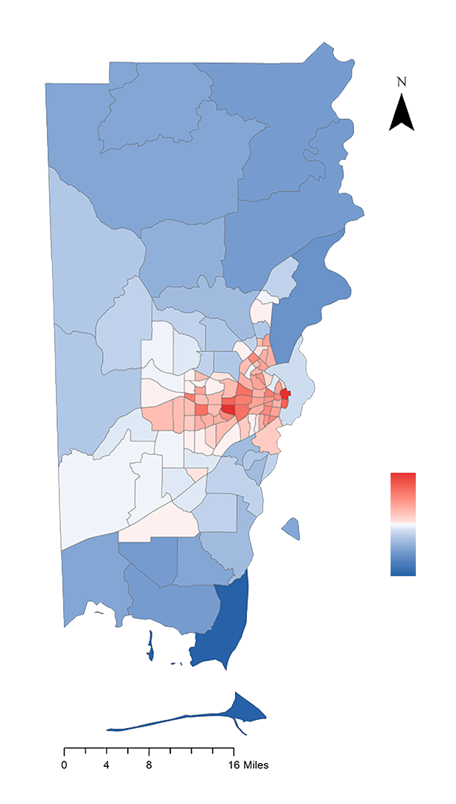
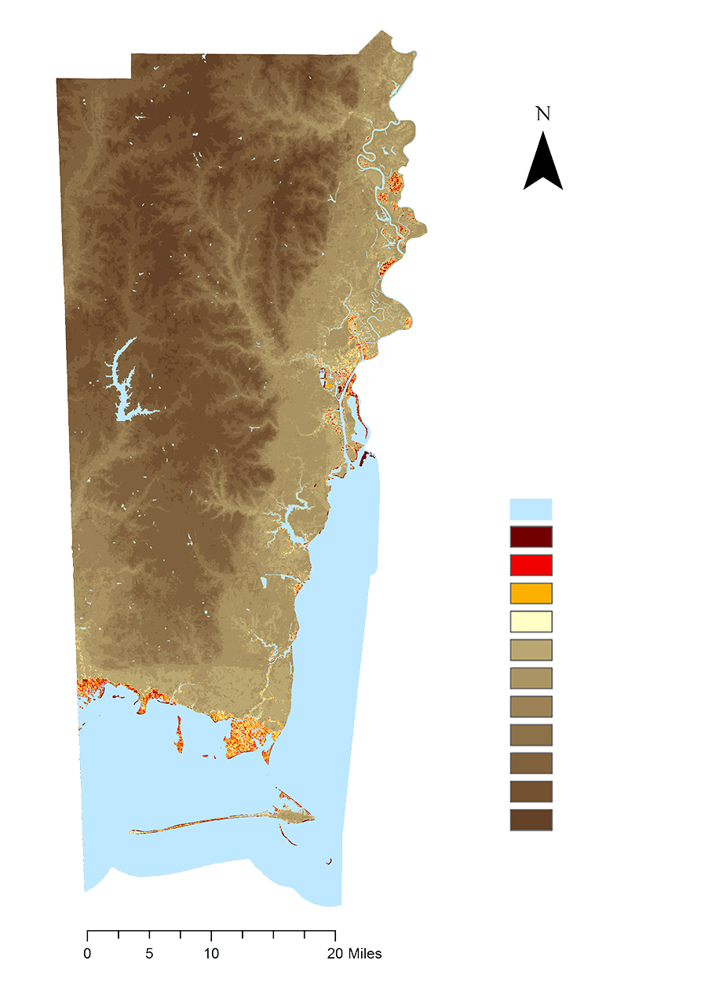
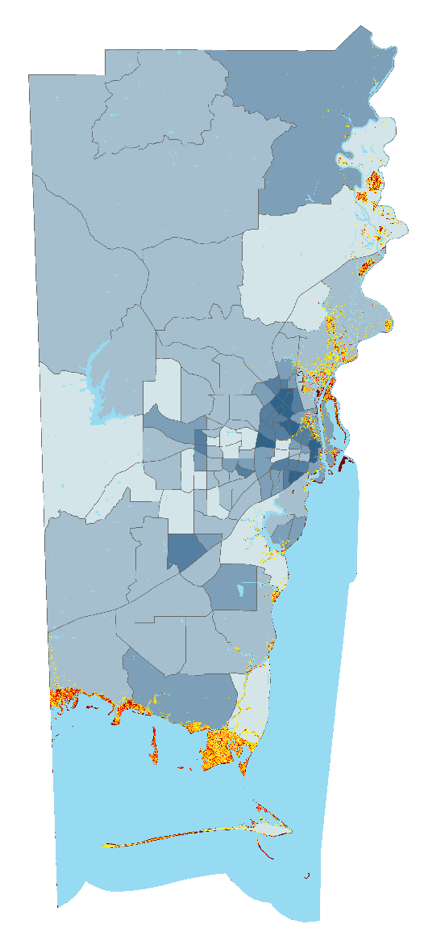
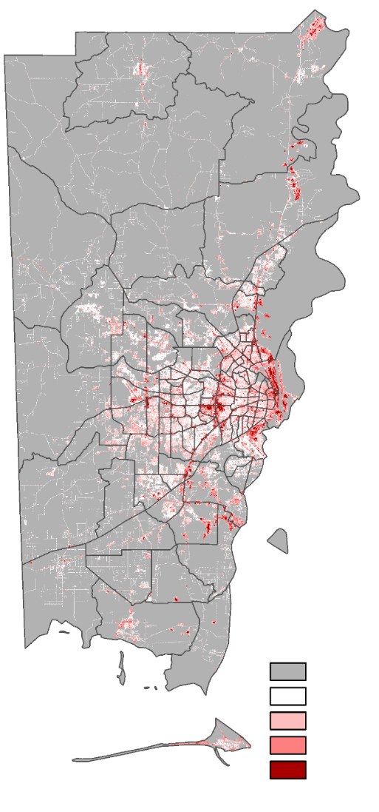

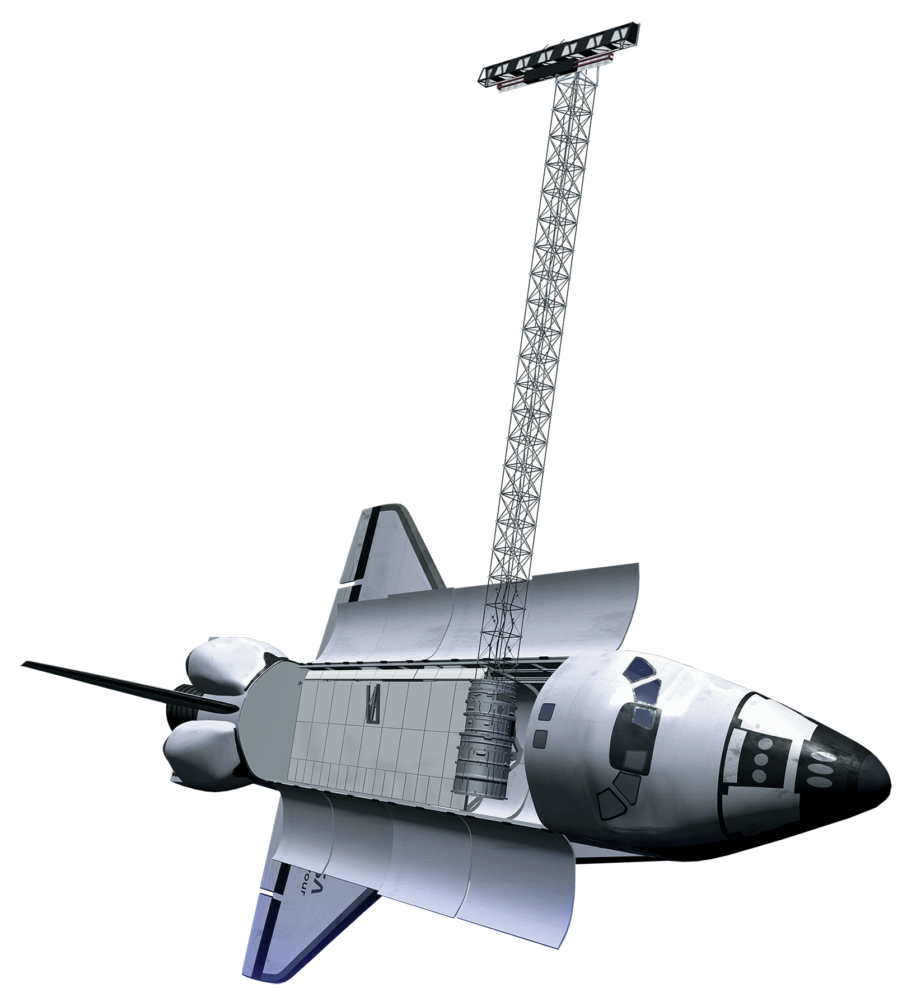
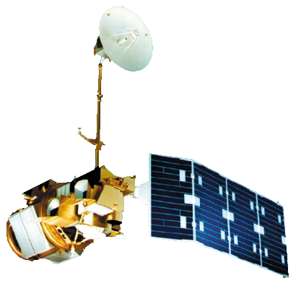

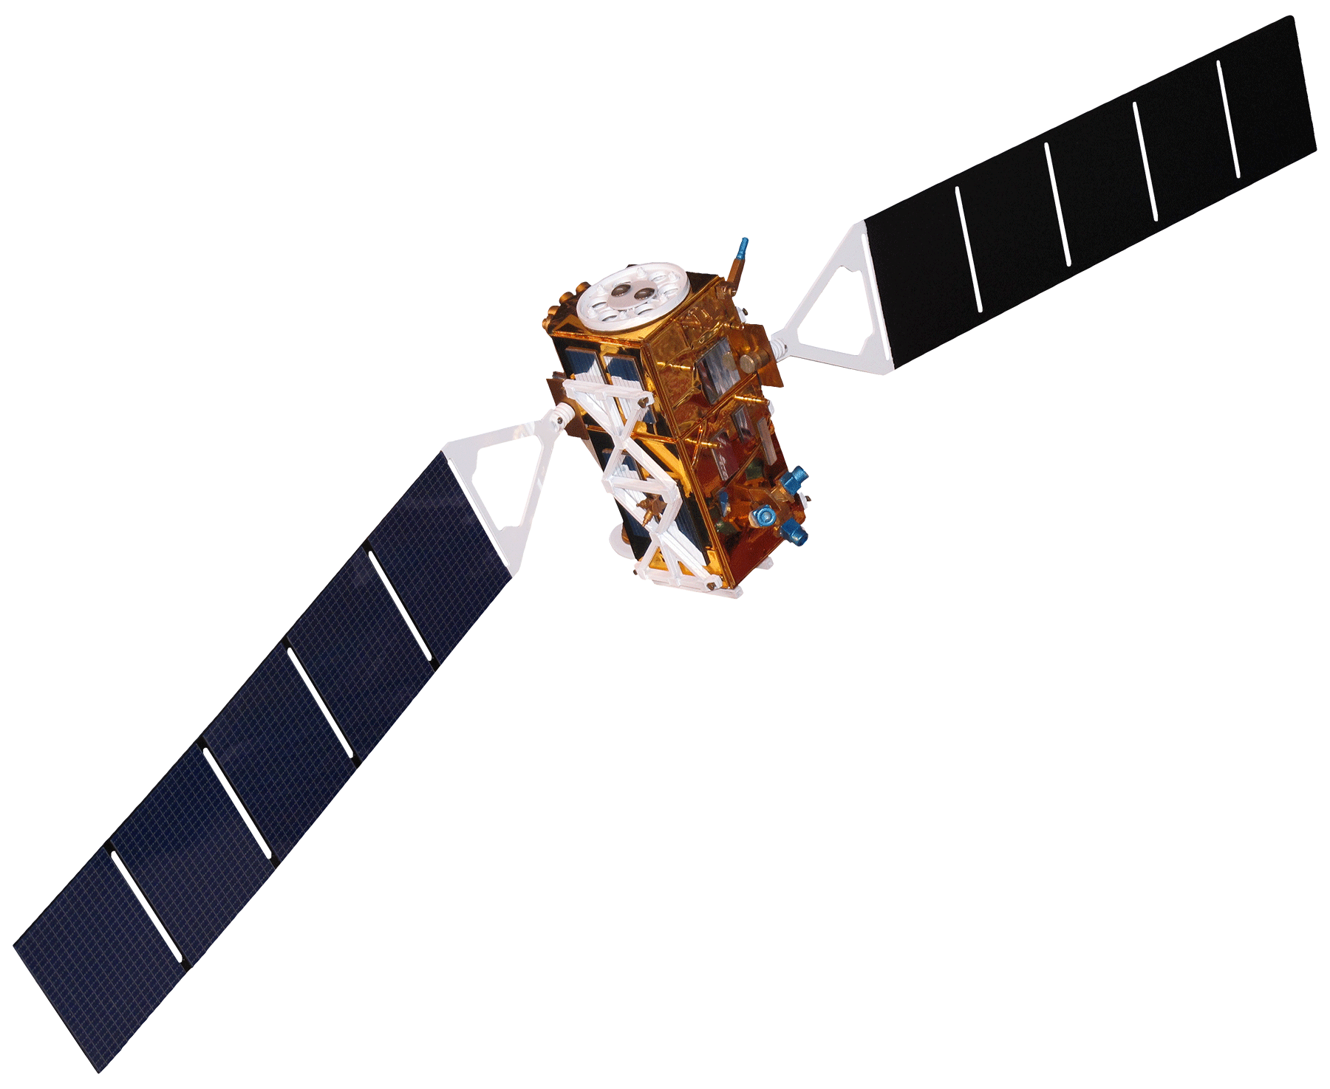

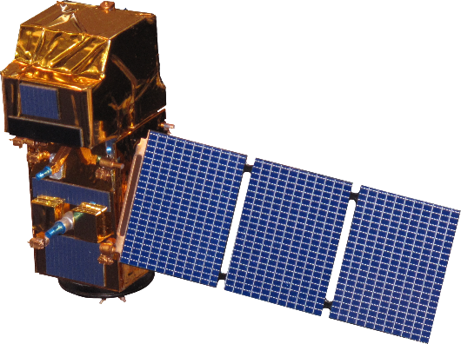

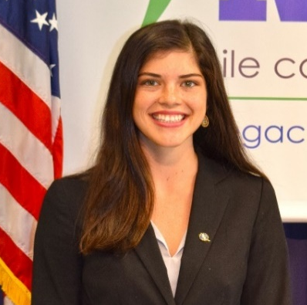
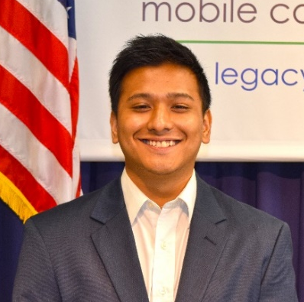
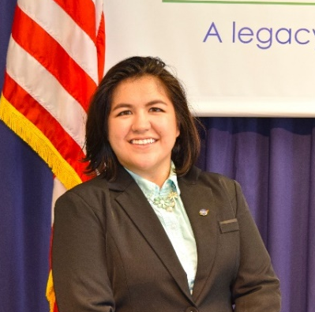
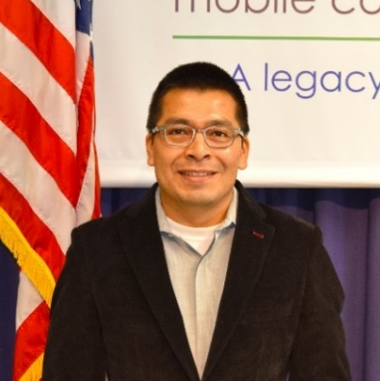
Evaluating Urban Heat Islands and Flooding to Enhance Green Infrastructure Initiatives in Coastal Communities in Mobile, Alabama
Abstract
Study Area & Period
Mobile Urban Development
This project utilized satellite Earth observations to assess locations in Mobile County, Alabama, that are vulnerable to the urban heat island effect (UHI) and flood impacts. Our partner, Groundwork Mobile County (GWMC), and other local entities need information on UHIs and flooding risk to develop mitigation strategies for reducing such threats. To locate communities with UHI impacts between 2005 and 2019, our team used Landsat 5 Thematic Mapper (TM), Landsat 8 Thermal Infrared Sensor (TIRS) and Terra Moderate Resolution Imaging Spectroradiometer (MODIS) to evaluate land surface temperature. Low elevation areas susceptible to flooding were distinguished using Shuttle Radar Topography Mission (SRTM) data. The team assessed flash flood vulnerability with Sentinel-1 C-band Synthetic Aperture Radar (C-SAR) and LiDAR elevation data. Lastly, the team processed data from Landsat 5 TM and Landsat 8 Operational Land Imager (OLI) to compute the Normalized Difference Vegetation Index (NDVI) and compared that with Sentinel-2 Multispectral Instrument (MSI) data to evaluate impervious surface area and thus, the increase in urban development over time. A Social Vulnerability Index (SoVI) was produced for Mobile County based on a five-point scale, comparing demographic characteristics with UHIs and flood potential. To compute social vulnerability maps, the team retrieved data from the Agency of Toxic Substances and Disease Registry (ATSDR) dataset. Of the 114 census tracts, 11 tracts showed high risk for both flooding and extreme urban heat. Our project provided GWMC with end products that help in planning mitigation strategies for reducing flood risks and UHI effects.
N
Citronelle
Prichard
MS
GA
Wilmer
Saraland
Mobile
Theodore
0
80 Mi
FL
Mobile County, AL
April 2005 and April 2019
Mobile County
Alabama
0
5
10 Mi
Results
Dauphin Island
N
Elevation
in meters
Aggregated Social Vulnerability
Water
0
1
2
3
4 – 10
11 – 20
21 – 30
31 – 40
41 – 60
61 – 80
81 – 120
0 – 1 (Lowest Risk)
1 – 2
2 – 3
3 – 4
4 – 5 (Highest Risk)
Objectives
Produce risk maps that illustrate Mobile County’s vulnerability to flash flooding and UHI effects, identifying impervious surface areas prone to increased runoff during flash flood events.
Demonstrate potential of GIS and remote sensing techniques and capabilities for aiding work by GWMC to help support planning within the study area.
Elevation in meters
Mean Land
Surface Temperature
Water
0
1
2
3
95° F
70° F
Methodology
0
10
20 Mi
0
10
20 Mi
0
10
20 Mi
Landsat 5 TM & Landsat 8 TIRS
Added zonal temp. mean per census tract with SoVI shapefile
Accuracy Assessment with Terra MODIS data
Urban Heat Assessment
SRTM &
Sentinel-1 C-SAR
Flash Flood Scenarios overlaid over Digital Elevation Model
LiDAR Visualization
Flood Extent Analysis
Land Use Type
Created Index 1 & Index 2
Merged
Index 1: (Census data) &
Index 2 ( UHI + Flood Risk)
Aggregated index
Socioeconomic and Demographic Risk Evaluation
No Development
SoVI/Census
Open Development
Low Development
National Land Cover Dataset
Calculated Impervious Surface Change over time & Before/After
Medium Development
Impervious Index
Impervious Surface Evaluation
0
5
10
20 Mi
High Development
Landsat 5 TM, Landsat 8 OLI & Sentinel-2 MSI
NDVI over study period
Conclusions
11 of 114 census tracts showed socioeconomic vulnerability based on extreme urban heat and flooding.
A total of 10,503 acres (1% of Mobile County by area) of vegetation and barren land were lost to urban development from 2001 to 2016.
The elevation model identified several low-lying areas at risk within Mobile County, AL. However, project maps did not show significant flooding during the flash flood event from August 3, 2018.
Prichard, which is north of the City of Mobile, has a high concentration of impervious surfaces alongside several high-risk social vulnerability demographics, making it highly suspectable to the effects of UHI and flooding.
Earth Observations
SRTM
Landsat 5 TM
Landsat 8 OLI/TIRS
Project Partners
Sentinel-1 C-SAR
Terra MODIS
Sentinel-2 MSI
Groundwork USA, Groundwork Mobile County
Team Members
Acknowledgements
Joe Spruce, Science Advisor, Science Systems and Applications, Inc.
Dr. Kenton Ross, Science Advisor, NASA Langley Research Center
Bernard H. Eichold II, M.D., Dr. P.H., Mentor, Mobile County Health Department
Madison Murphy, Center Lead, NASA DEVELOP Alabama – Mobile & Marshall Nodes
Larissa Graham, Project Lead, Groundwork Mobile County
Eldon Blancher, PhD, BCES, Groundwork Mobile County
Ray Richardson, Groundwork Mobile County
Lydia Stanley
Project Lead
Arman Bajracharya
Kelly Dunn
Filoteo Gomez-Martinez
Alabama – Mobile | Summer 2019

