Slide 1
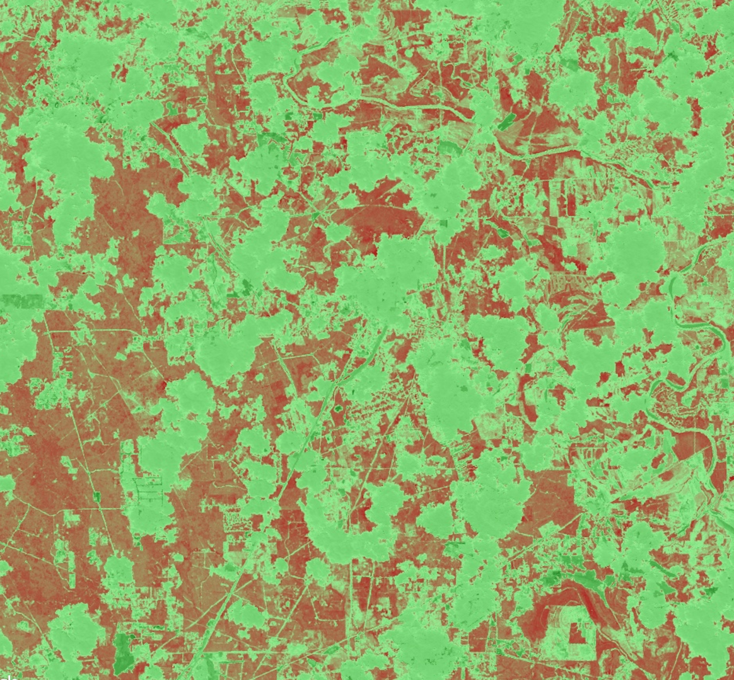
Texas Water Resources
Analyzing Drought-related Impacts on Urban Tree Inventory Conditions and Recovery in Texas
Anna Stamatogiannakis
Millie Smith
Nick Roberts
Sally Ross
North Carolina – NCEI | Spring 2019
Notes:
We are the 2019 Spring DEVELOP team from NCEI, and this term we worked on Texas Water Resources. Our project focused on analyzing the impacts that the historic 2011 Texas drought had on urban tree inventories in Austin and Houston and how these trees have recovered.
Image source: DEVELOP team website image

Slide 2
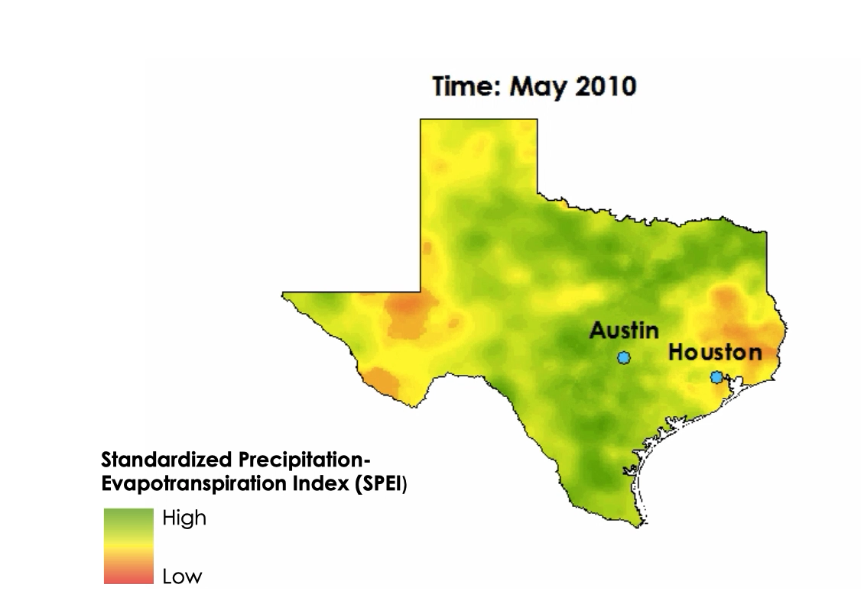
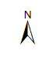
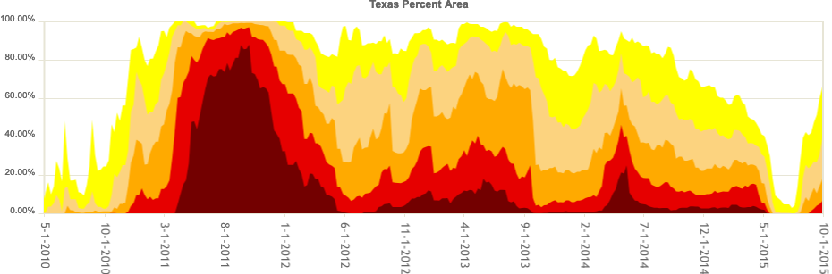
Background
Texas Percent Area
by US Drought Monitor Category
100%
80%
60%
40%
20%
0%
Exceptional Drought
Extreme Drought
Severe Drought
Moderate Drought
Abnormally Dry
None
2010
2011
2012
2013
2014
2015
Notes:
In 2011, Texas experienced its worst drought in recorded history. The US Drought Monitor designated more than 80% of Texas as experiencing “exceptional drought” during the worst period of spring 2011 through the beginning of 2012, as you can see in the time series depicted here. As a result, the state experienced severe agricultural loss, wildfires, and widespread tree mortality.
The SPEI data shown here provide further context to the impacts of the drought.
SPEI graph source: Created by DEVELOP team, derived from SPEI data
SPEI animation: Created by DEVELOP team, derived from SPEI data
Drought monitor image source: https://droughtmonitor.unl.edu/Data/Timeseries.aspx (Public Domain)

Slide 3
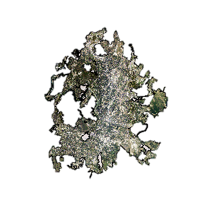
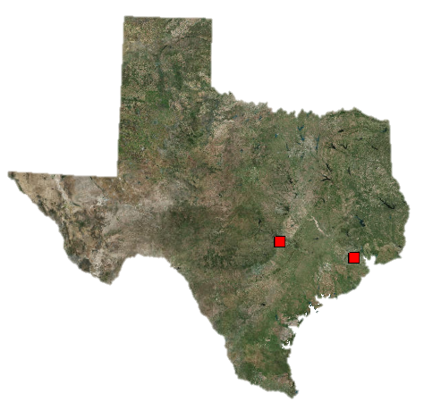
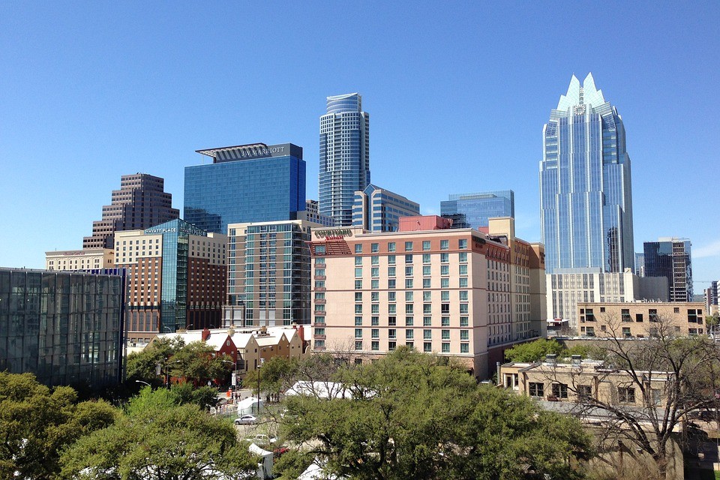
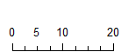
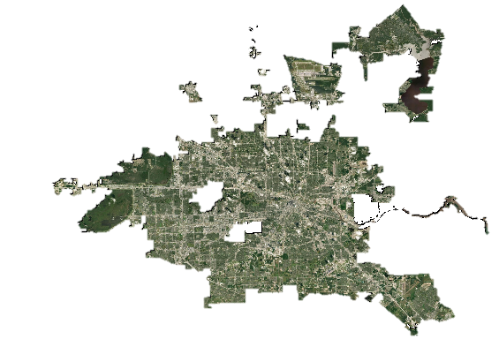
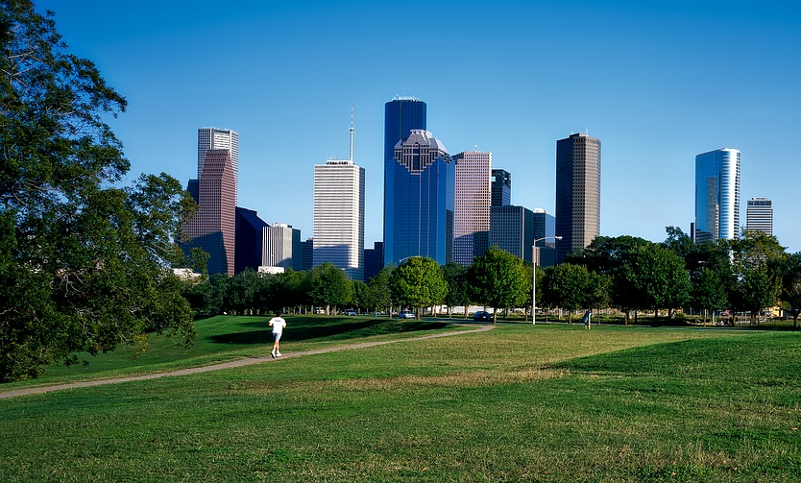
Study Area
Austin
Texas
0 10 20
Credit: Kate Baucherel
km
Houston
Credit: Pixabay
Notes:
Our study areas were the cities of Austin and Houston, Texas, which are subtropical climates with high land development. Our team was particularly interested in the undeveloped green areas, as we focused on the urban forests of each city. Our time period of interest was centered around capturing the response to the devastating 2011 drought which was the worst in Texas’ recorded history. We therefore focused on the years 2010 to 2018 to show the immediate effects of the drought, as well as trends in recovery.
Study Area Image Source: Created by DEVELOP team
Austin Image Source: https://pixabay.com/photos/austin-texas-austin-tx-texas-1756159/ (Creative Commons)
Houston Image Source: https://pixabay.com/photos/houston-texas-city-urban-cityscape-1631453/ (Creative Commons)

Slide 4
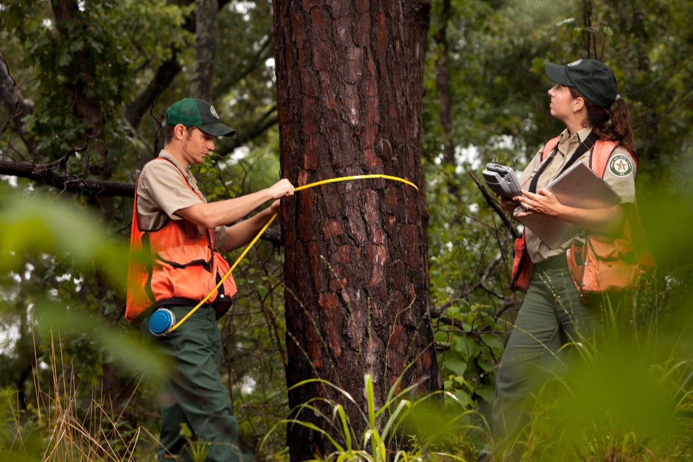
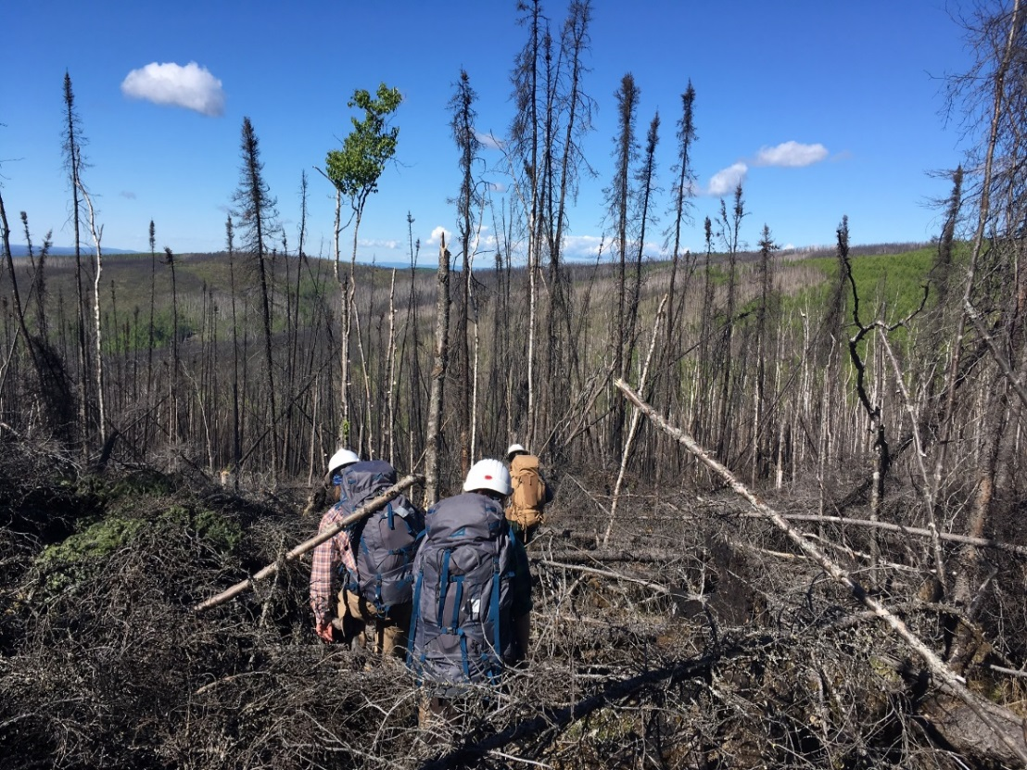
Partners
Texas A&M Forest Service (TFS), Sustainable Forestry Department
USDA Forest Service, Southern Research Station Threat Assessment Center
Credit: TFS
Credit: US Forest Service
Notes:
Our partners for this project were the Texas A&M Forest Service , Sustainable Forestry Department, who manage forests in the state of Texas, and the USDA Forest Service, Southern Research Station Threat Assessment Center.
Left Image Source: https://tfsweb.tamu.edu/content/landing.aspx?id=19864 (Given permission by partner)
Right Image Source: https://www.fs.usda.gov/pnw/projects/pnw-fia-interior-alaska-inventory (Public domain)

Slide 5
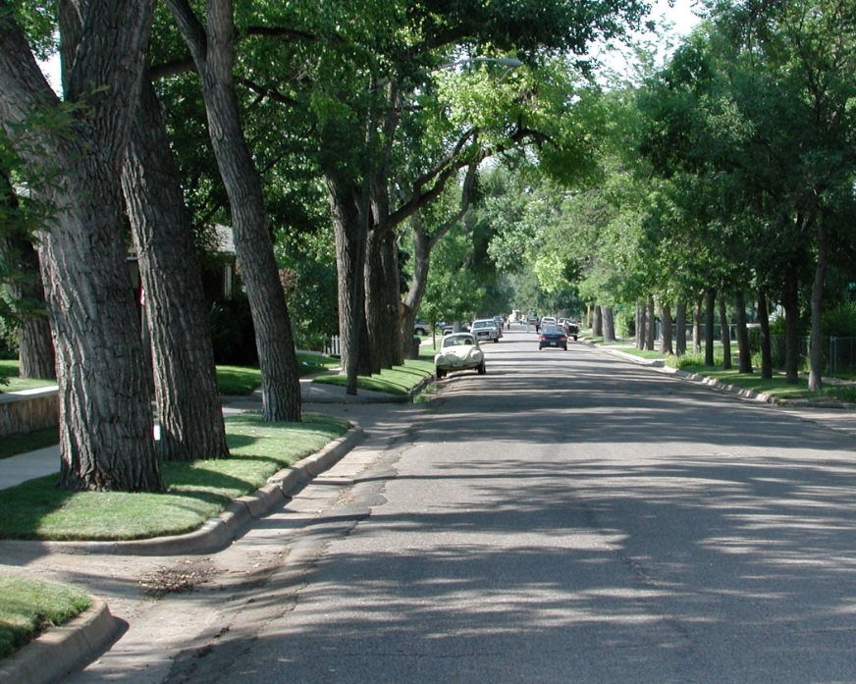
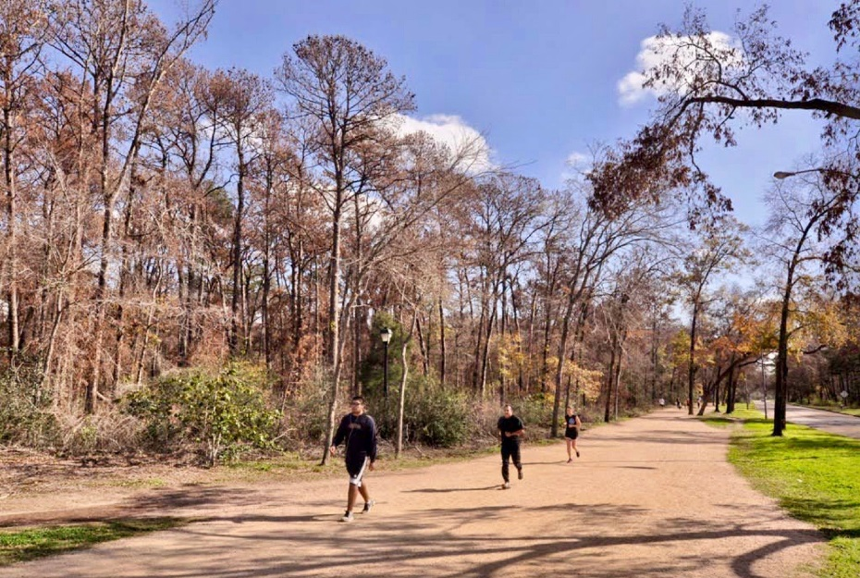
Community Concerns
Value of the Urban Tree Canopy (UTC):
  Ecosystem services: improved air, soil, and water quality
  Quality of life: heat reduction, noise abatement, aesthetics
  Economics: energy cost reductions
Costs of dead trees:
  Falling limbs
  Increased susceptibility to fire
  Economic burden of removal
Credit: USDA
Credit: TFS
Notes:
So why should we care about how drought affects urban tree inventories? There are several good reasons: urban trees provide a myriad of ecosystem services, such as improving air quality, soil quality, and water quality. They also improve the quality of life for city residents. Urban trees are shown to reduce the urban heat island effect, making areas less vulnerable to heat waves, and can reduce the spread of noise. The natural beauty of urban forestry has even shown to have positive psychological effects on residents. Urban trees are also economically important, for every 100 million trees in the US, over $2 billion is saved in energy costs alone.
When urban trees die, they can pose a significant hazard to public safety, as dead trees are at a higher risk of falling, dropping limbs, or contributing to the spread of fires. Additionally, these dead trees are costly to remove. Following the 2011 drought, Texas spent approximately $560 million to remove dead urban trees and suffered an estimated $280 million dollar loss annually from their deaths.
Top Image Source: https://www.flickr.com/photos/usdagov/31749503340/in/photostream/ (Public Domain)
Bottom Image Source: https://tfsweb.tamu.edu/uploadedFiles/FRD/PestManagement/Diseases/OW%20Suppression%20Project%202013%20-%20%20Billings.pdf (Given permission by partner)

Slide 6
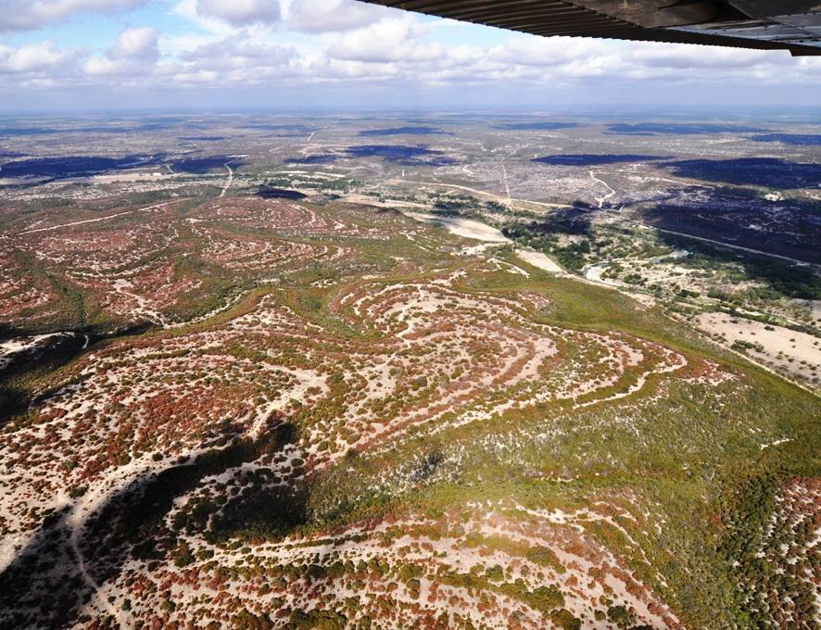
Objectives
Employ NASA Earth observations (EO) and National Oceanic and Atmospheric Administration (NOAA) drought indices to monitor drought impacts
Analyze the response of UTC cover in Austin and Houston to drought using unsupervised classification methods
Investigate the relationship between Normalized Difference Vegetation Index (NDVI) anomalies and canopy mortality
Credit: TFS
Notes:
Our objectives for this study were to demonstrate how remote sensing information can be used to make useful conclusions about how tree mortality rates responded to widespread drought, as well as to find a connection between vegetation indices such as NDVI and tree mortality. Our overarching goal was to present our partners with a succinct and replicable methodology for estimating tree mortality using satellite data.
In an effort to preserve this information and maintain it in a publicly available space, we created a story map in order for members of the public to explore and learn more about the 2011 drought.
Aerial Image Source: TFS https://tfsweb.tamu.edu/uploadedFiles/FRD/PestManagement/Diseases/OW%20Suppression%20Project%202013%20-%20%20Billings.pdf (Given permission by partner)

Slide 7

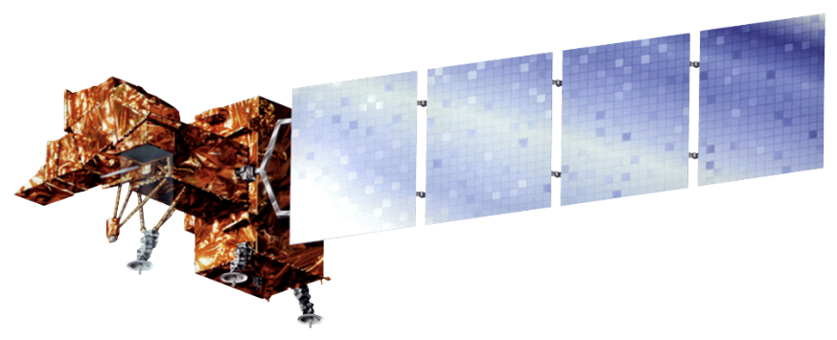

Earth Observations
Landsat spatial resolution: 30 meters
Landsat temporal resolution: 16 days
Landsat 5 Thematic Mapper (TM)
Landsat 8 Operational Land Imager (OLI)
Landsat 7 Enhanced Thematic Mapper Plus (ETM+)
Notes:
For this project, we utilized data from Landsat 5 Thematic Mapper, Landsat 7 Enhanced Thematic Mapper Plus, and Landsat 8 Operational Land Imager. We chose these Earth Observations due to their fine spatial resolution (30m x 30m) and their wide spanning dates of operation (1984 – present combined). Landsat data was specifically used for calculation of NDVI anomalies.
Image Credits: NASA (Public Domain)

Slide 8
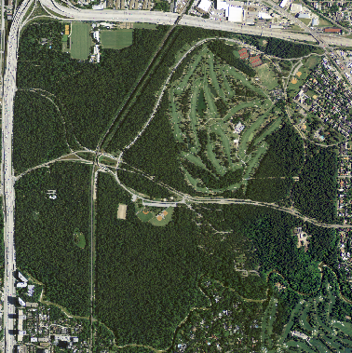

Ancillary Data
Credit: USGS EarthExplorer
Credit: Aleksander Markin
USDA National Agriculture Imagery Program (NAIP)
  1-m high resolution imagery
  Acquired for the continental US every two years during the agricultural growing season
Notes:
Images from the National Agriculture Imagery Program (or NAIP) were used to identify Urban Tree Canopy. We selected NAIP imagery because it is acquired at a 1-m ground sample distance. This high resolution allowed us to visualize and distinguish the Urban Tree Canopy.
Left Image Source: Raw NAIP imagery for Memorial Park in Houston, TX. Acquired from USGS EarthExplorer. https://earthexplorer.usgs.gov/ (Public domain)
Right Image Source: https://www.flickr.com/photos/aviamarkin/4251354810/in/photolist-7tFiES-9ksioU-GL6z2K-dTij21-nZ2kja-eApFa2-awMAeh-dTcGva-a3MdHs-cfdygQ-33yqAY-aAPUi6-o6qSug-7pGmre-aQQ5xz-KNrSZU-f3oice-3bCVMv-2cD2iGQ-HjVbn7-d6fTB9-TmhHnc-8fyrkt-dTijpY-eAqhAx-dTikzA-9AGQCK-gL597p-cf66rm-eApH46-eAtrhG-cf66ms-dLxm9t-dTik7y-5CvYWY-SkBni-em4jjd-ekWBuM-7kseiT-bZhgdL-fYzyKP-ZvHoAS-cqPKkG-9ksiyA-aa6sRW-dTiiCs-4xgTCw-9kpg8M-faf2wY-9EehLb/ (Creative Commons)

Slide 9
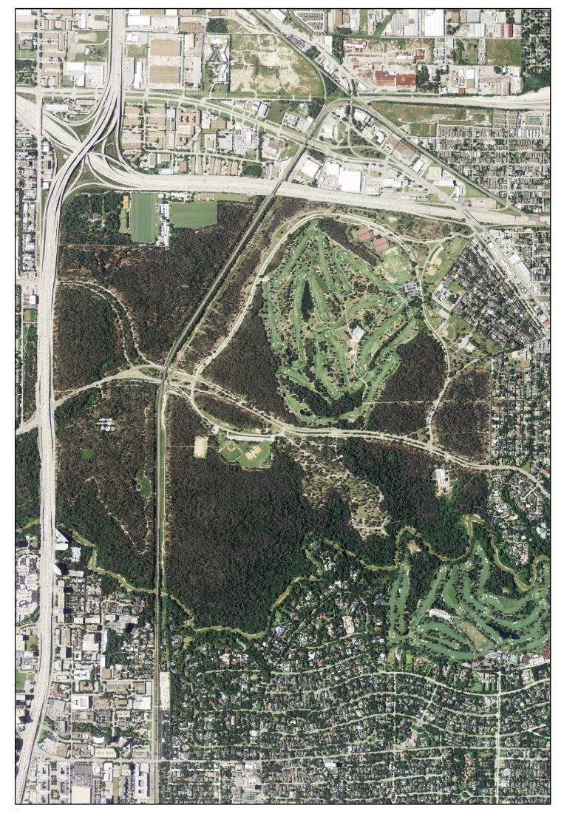
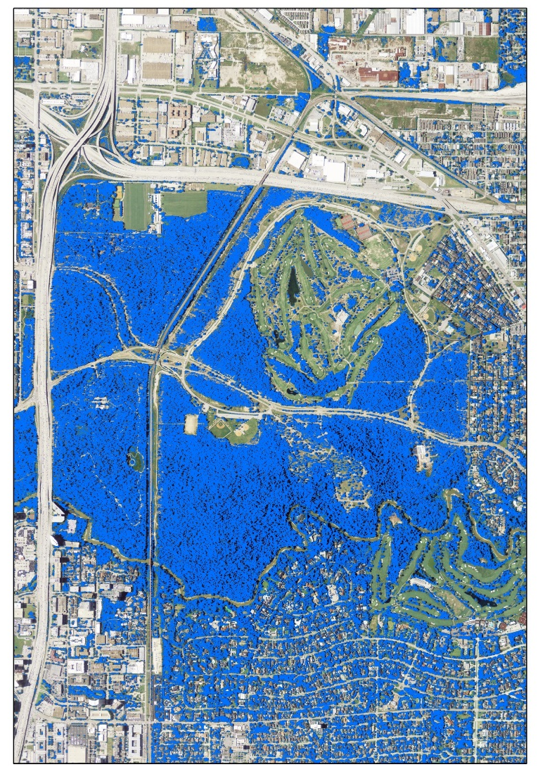
Methodology: Tree Cover Isolation
Mosaic NAIP imagery from 2010 and calculate NDVI
Create “texture layer” to differentiate grass from trees
Run unsupervised classification with NDVI layer, texture layer, and bands 1-4 of NAIP imagery
Create tree canopy layer
0 0.5 1 2
km
Notes:
Our first step in determining tree mortality was to acquire city-wide high resolution data for both the pre- and post-drought period. We got this from the USDA National Agriculture Imagery Program (NAIP) collection of aerial imagery, collected in 2010 and 2012 for all of Texas. We then used this data to create high resolution images of Houston and Austin for 2010 and 2012. An example of this imagery is shown on the right.
We used these high resolution imagery collections to calculate Normalized Difference Vegetation Indexes for each city in 2010. Then, to better distinguish between tree canopy and healthy grass or shrub coverage, we calculated the focal statistics for each city in 2010. Using a 7x7 window corresponds roughly to the area of a mature tree crown.
Using the NDVI and focal statistics, we then performed iso cluster unsupervised classifications. After visually interpreting each class, we reclassified the output to create a raster representing the total extent of tree coverage for each city in 2010, which is shown in blue.
Image source: DEVELOP team created map

Slide 10
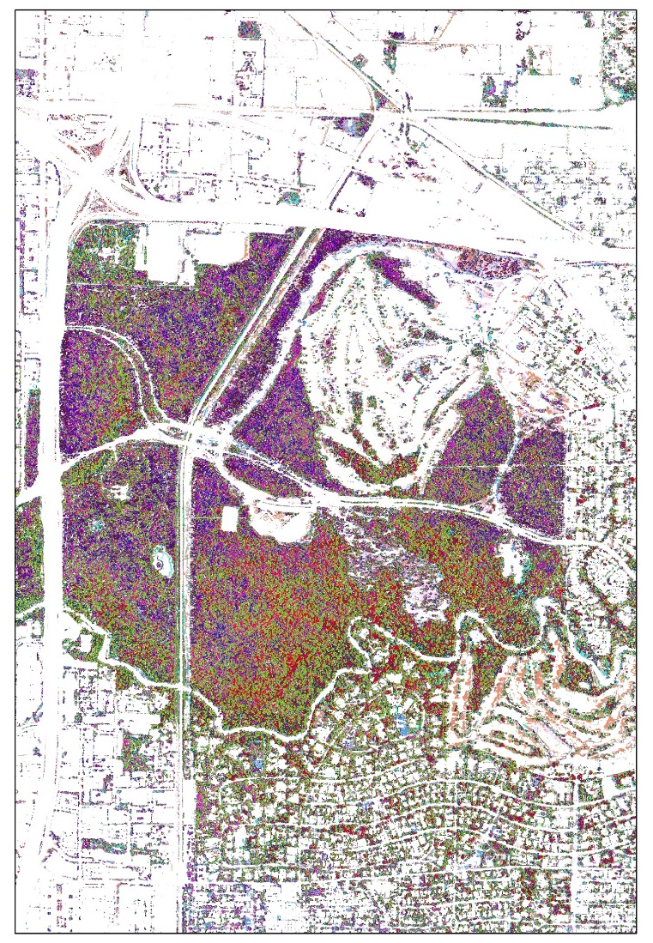
Methodology: Mortality Detection
Apply 2010 tree cover layer to 2012 NAIP imagery
Run a separate unsupervised classification on both 2010 NAIP imagery and 2012 NAIP imagery
  Visually distinguish between dead and live canopy
Reclassify dead/live canopy to create a “percent mortality” layer
0 0.5 1 2
km
Notes:
Following the creation of the tree cover mask for 2010, these mask layers were applied to the 2012 high resolution imagery. This limited the extent of the 2012 images to areas we knew were tree canopy. We then performed another unsupervised classification of Houston and Austin in both 2010 and 2012 by visually interpreting differences in canopy reflectance in the near infrared band. The image on the right shows the results of an unsupervised classification of just the tree canopy layer.
We visually inspected each class from the unsupervised classification and determined whether it was “dead canopy” or “live canopy”. Then, we reclassified areas of dead canopy to equal 100, and areas of live canopy to equal 0, which gave us a “percent mortality” layer.
Image source: Created by DEVELOP team

Slide 11
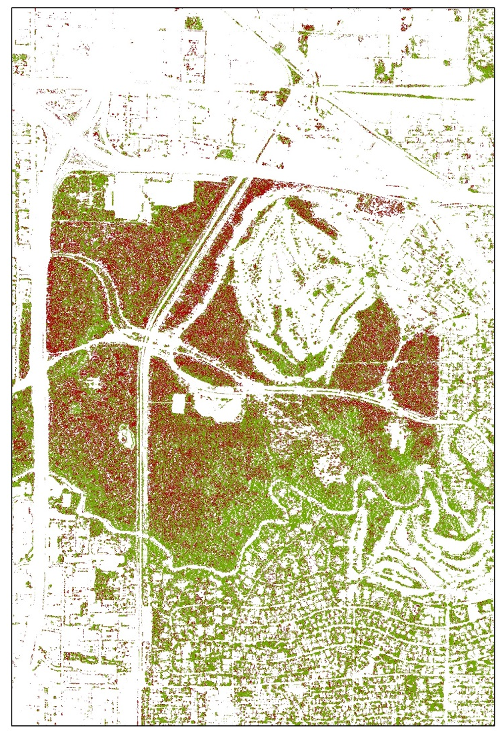
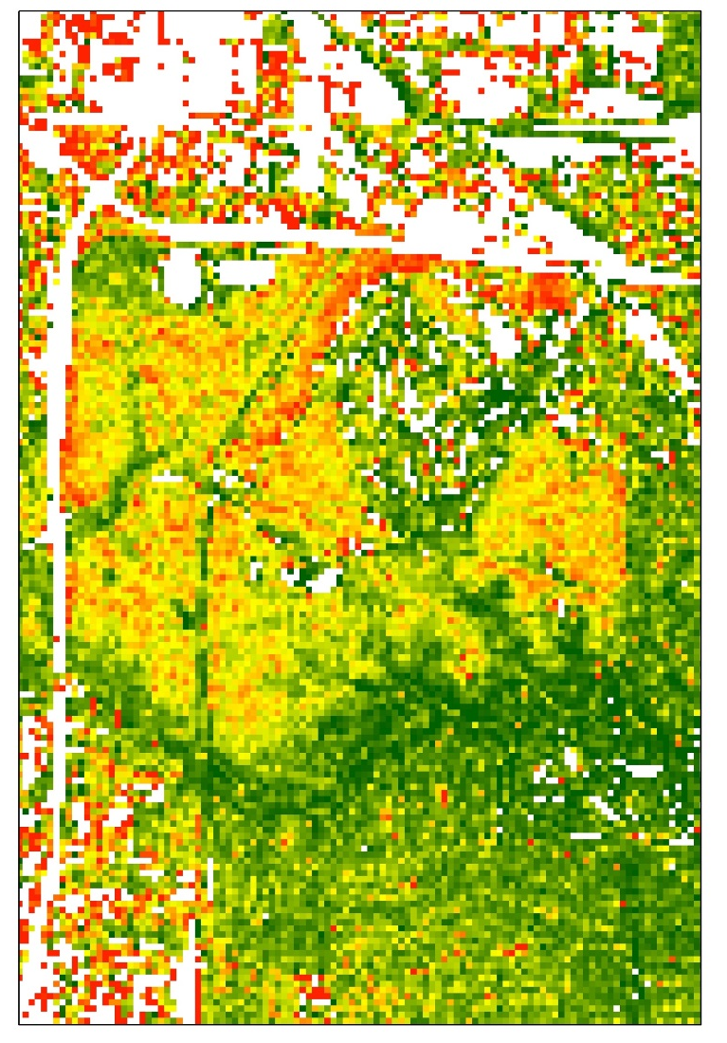
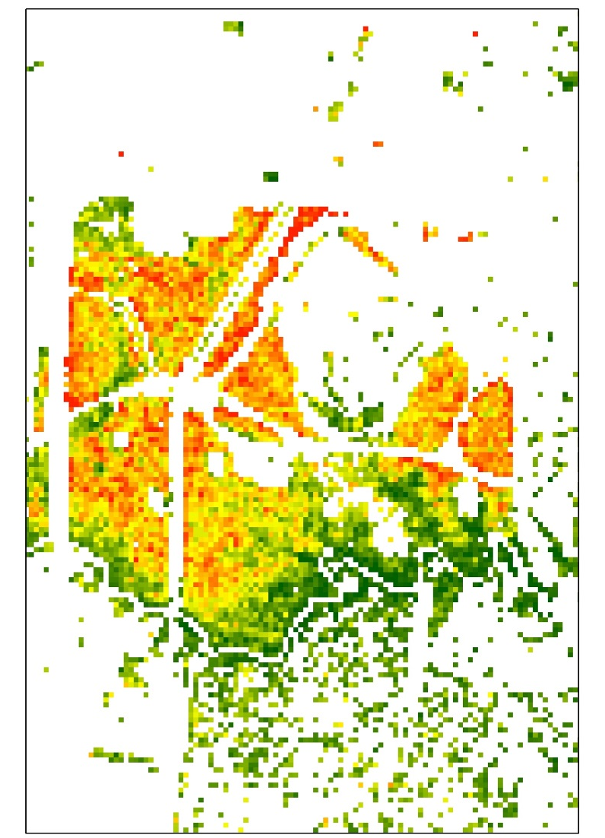

Methodology: Landsat Aggregation
Filter for areas with 50% or greater forest cover
Aggregate to 30 m resolution
Dead Canopy
0 0.5 1
High: 100
0 0.5 1
High: 100
0 0.5 1
Live Canopy
km
Low: 0
km
Low: 0
km
Canopy Mortality Map (1 m)
Percent Mortality Map (30 m)
Not Filtered for Density
Percent Mortality Map (30 m)
Filtered for Density
Notes:
With the tree mortality map now created, we aggregated the 1 m resolution up to 30 m in order to more easily compare to Landsat data. When scaling up from 1 m to 30 m, more areas of the city were represented, including things like buildings and pavement, which would skew our model. Thus, we only selected for areas of the 30 m percent mortality layer that were at least 50% forested.
Image source: Created by DEVELOP team

Slide 12
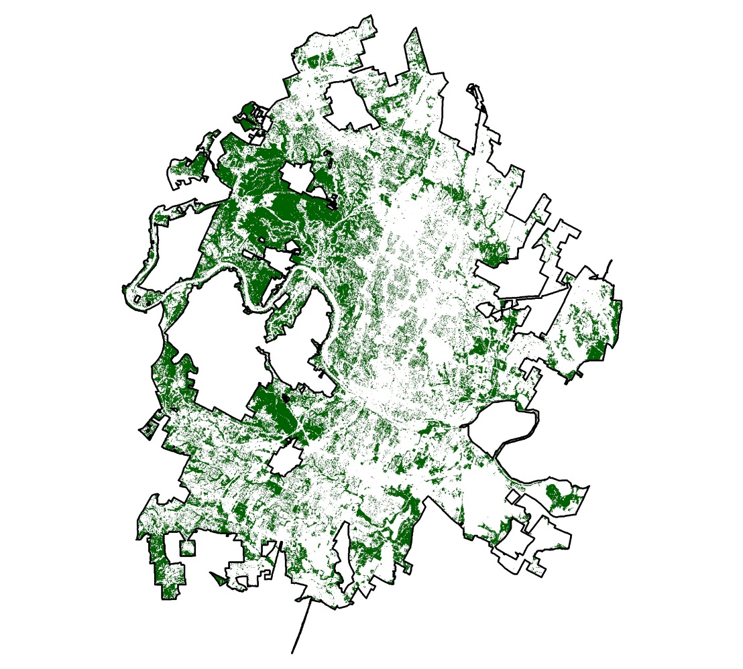
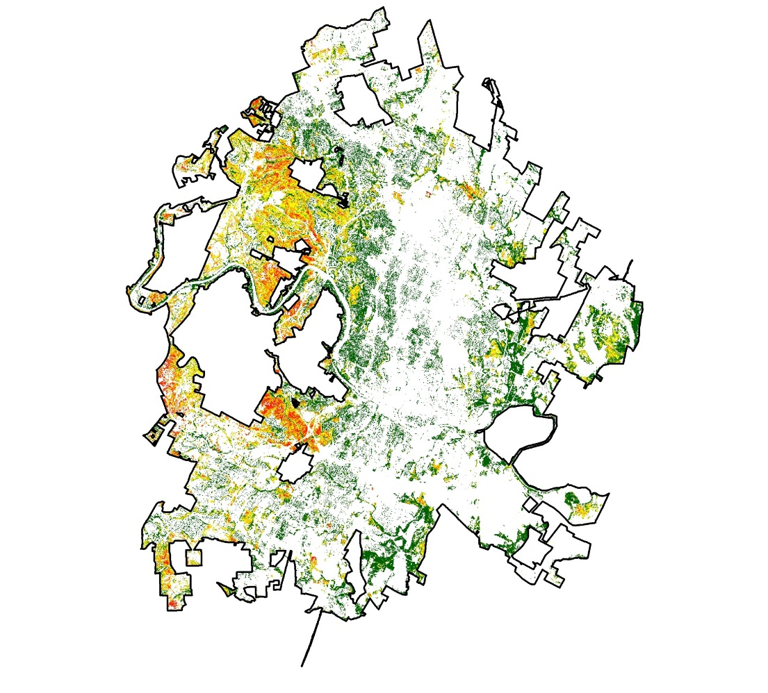

Results
Percent Mortality at 30-meter Resolution – Austin
Percent Mortality
0 - 10
10 - 25
25 - 50
50 - 75
75 - 100
2010
2012
Notes:
Here are our results for the 30 meter resolution aggregation of canopy mortality for Austin, TX. The percent canopy mortality is displayed on a color gradient from green to yellow to red, where green areas are areas of high density healthy canopy cover and red areas are areas of high density canopy mortality. As you can see, there is a significant increase in areas of canopy mortality. We estimate that overall tree mortality in Austin grew from 1.75 percent in 2010 to almost 20 percent (19.64 percent) in 2012. This shows just how drastically the mortality rates changed between pre- and post-drought periods.
Image Credits: Created by the DEVELOP team

Slide 13
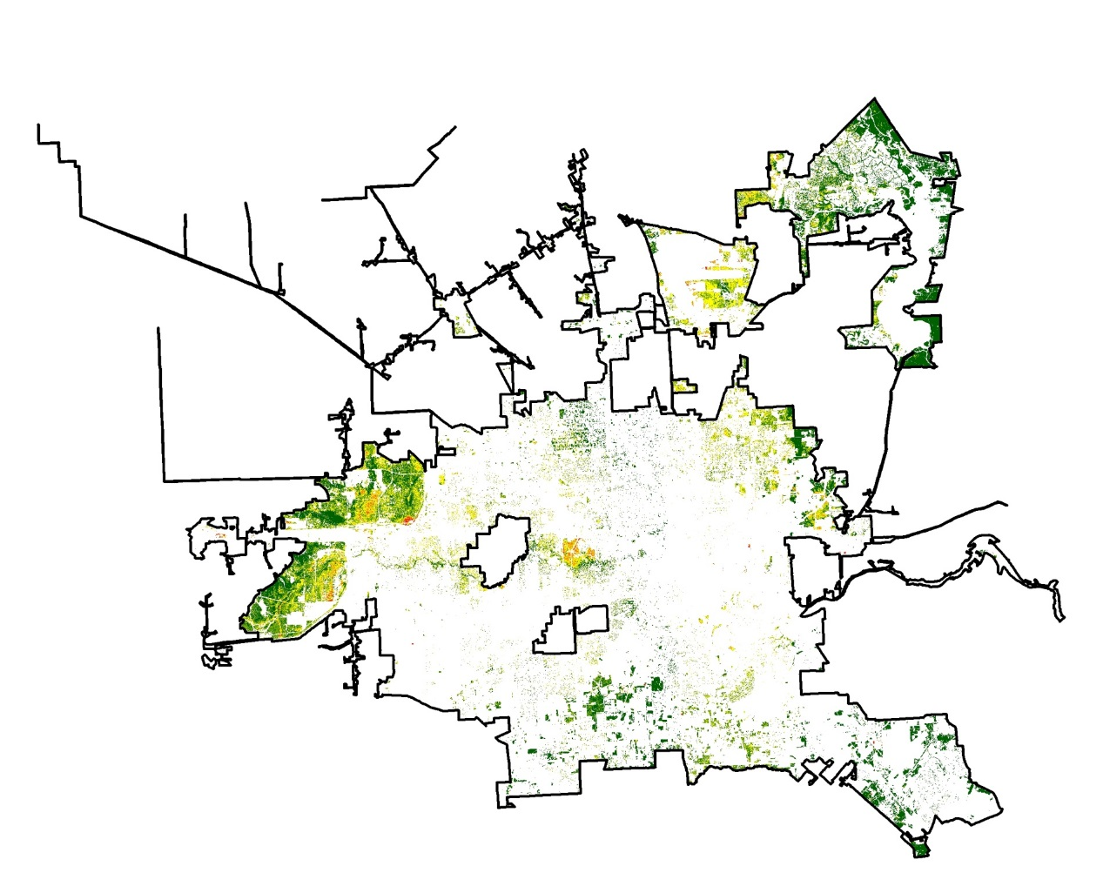
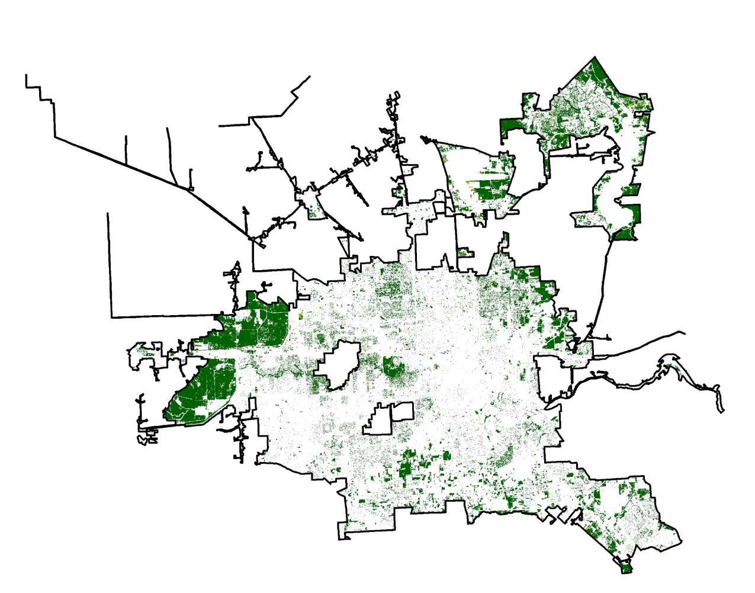
Results
Percent Mortality at 30-meter Resolution – Houston
Percent Mortality
0 - 10
10 - 25
25 - 50
50 - 75
75 - 100
2010
2012
Notes:
Similar to Austin, Houston also experienced a significant increase in canopy mortality rates from the pre- and post-drought periods. We estimated that the overall canopy mortality increases from about 2 percent (1.99 percent) in 2010 to nearly 20 percent (19.56 percent) in 2012. The similarity in overall increase in canopy mortality rates between the 2 cities suggests the trees in both cities have a similar response to drought events.
Image Credit: Created by the DEVELOP team

Slide 14
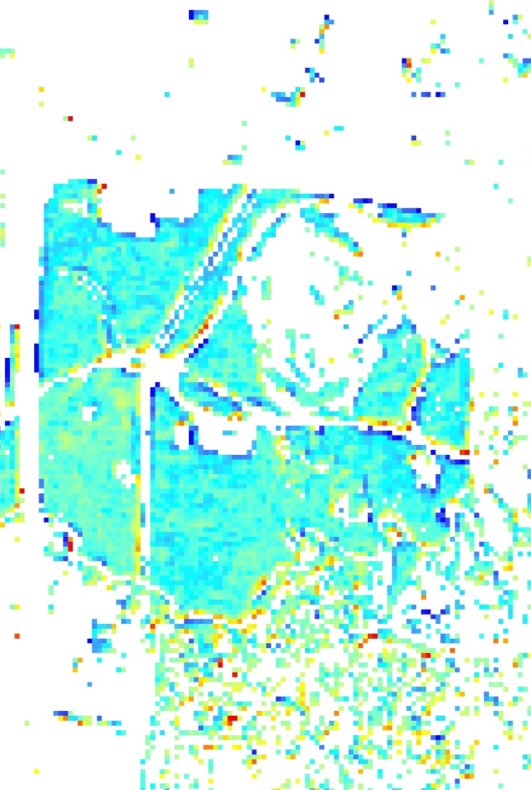

Methodology: NDVI Anomalies
Relationship between Landsat derived product and NAIP derived canopy mortality
Anomaly:
  Current – Normal
Normalized Anomaly:
  (Current – Normal) / Normal
High: 0.61
0 0.5 1
Low: -0.70
km
Notes:
In addition to the 30 meter resolution Percent Canopy Mortality maps, our team also calculated NDVI anomalies for the cities of Austin and Houston in order to assess the relationship between canopy mortality rates and Landsat derived vegetation indices.
In order to calculate the anomalies for each city, we first calculated monthly NDVI norms for each city from a 30 year historical norm spanning 1986 to 2016. We then acquired Landsat imagery acquired during the same time period as the collection period of NAIP imagery in each city in both 2010 and 2012 and calculated NDVI for each image. The historical norm was then subtracted from the NDVI scores for each city for both 2010 and 2012 to yield NDVI anomalies for both the pre- and post-drought period for each city.
We also calculated the Normalized NDVI anomalies for each city for both 2010 and 2012 by taking the NDVI anomalies and dividing them by the historical norms.
These NDVI anomalies and Normalized NDVI anomalies were used as inputs into our predictive model, which we’ll discuss a little later.
Image source: Created by DEVELOP team

Slide 15
Methodology: Model Creation
Regression Model: | Sampling Method: | Anomaly Input:
Linear Regression | Simple Random Sample | Simple NDVI Anomaly [Current - Normal]
Logistic Regression | Stratified Random Sample | Normalized NDVI Anomaly [(Current – Normal) / Normal]
Notes:
In creating our model, we experimented with a number of combinations of regression models, sampling methods, and anomaly inputs in order to create the most accurate canopy mortality prediction model.
In terms of regression models, we fitted the data to both linear regression models and logistic regression models. We decided logistic regression modelling would be a be better fit for our data because it can be used to predict the probability of binomial variables like canopy mortality. Logistic regression is also capped at 0 and 1, which makes sense when predicting percent canopy mortality, as a result above 1 would imply over 100 percent canopy mortality and a result below 0 would imply negative percent canopy mortality.
In terms of the sampling method, we experimented with simple random sampling to select data used for training and testing of data. In a simple random sample, we randomly selected 70 percent of all combined data from 2010 and 2012 from both cities to use in model testing, then used the remaining 30 percent of data points to test the model and evaluate its accuracy. In stratified random sampling, on the other hand, we first grouped the data by percent mortality by increments of 10 percent, meaning all data from 0 to 10 percent mortality was grouped together, etc. We then took the same number of random samples from each grouping, meaning that all rates of mortality are equally represented in the model training data. The remaining data was then used as test data. We chose stratified random sampling because upon evaluation of simple random sampled models vs stratified random sampled models, stratified models performed better.
In terms of the type of anomaly used to create the model, we chose to use simple NDVI anomalies as opposed to normalized NDVI anomalies because in paired model comparisons, we found that models using simple NDVI anomalies performed more highly

Slide 16
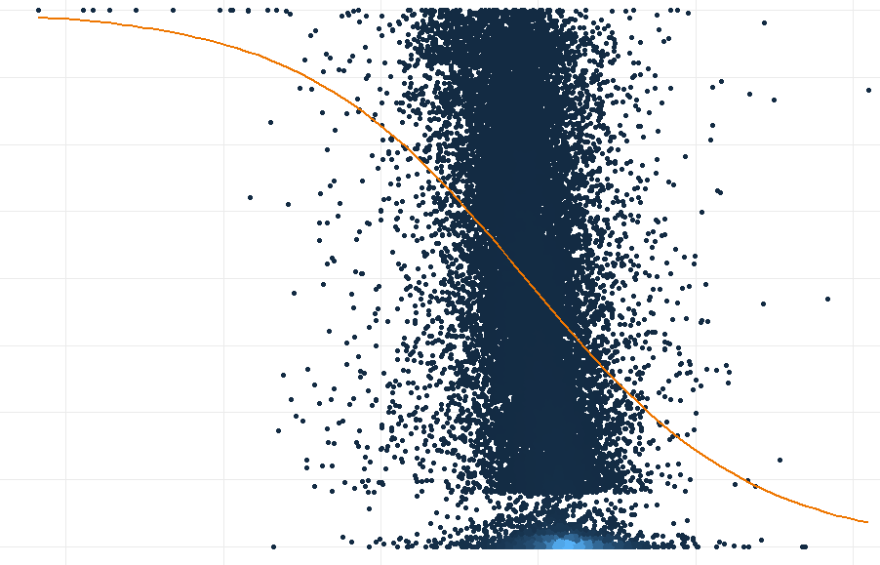
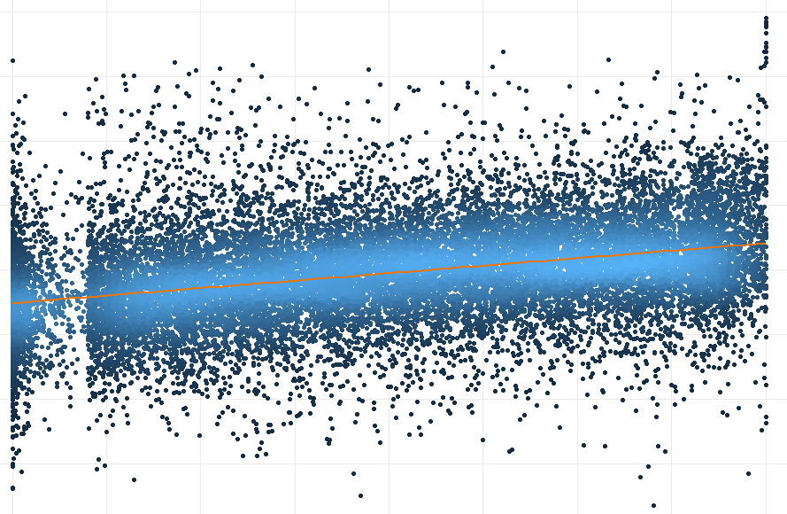

Results
Prediction Model of % Canopy Mortality
Predicted vs. Observed % Mortality Rates
50 100
0 50 100
Predicted
Percent
Density
High
Low
-0.5 0 0.5
0 50 100
NDVI Anomalies
Percent
Notes:
Here is a visualization of our resulting model, which uses logistic regression, stratified random sampling, and simple NDVI anomalies. Out of the 4 models we created, this performed best in the prediction of percent canopy mortality. As you can see, the model is capped at 0 and 100 percent canopy mortality and has a generally negative relationship with NDVI anomalies. This is what we would expect, as negative NDVI anomaly values indicate poorer vegetative health, which would result in increased rates of canopy mortality. However, as you can see in the plot of observed versus predicted mortality rates, there is a tendency for the model to predict within the range of 40 to 50 percent canopy mortality, which leads to overestimation of canopy mortality in areas that are really healthy and underestimate mortality in areas of severe canopy mortality.
Image source: Created by DEVELOP team

Slide 17
Errors/Limitations
Model Input (Classification) Limitations
  Limited point selection for tree canopy accuracy assessment
  No validation of tree mortality (due to lack of in situ data)
  Assumption that the tree canopy stays constant from 2010 to 2012
  Scan line errors from Landsat 7 – less data available
Model Use Limitations
  Only applicable to summer months because observations used came from May and June
  NDVI can change from factors such as drought, pest/disease, wildfires, urban development, etc.
Notes:
As mentioned throughout the presentation, there are several errors and limitations to our work. Due to the rapid feasibility nature of our project, we had a limited point selection for the tree canopy accuracy assessment. We only looked at 100 points to assess if they were accurately classified as tree or not tree. Additionally, due to a lack of in situ data for our period of interest, we could not validate our assessment of tree mortality. It is difficult to determine whether a tree is actually dead or not from purely looking at aerial imagery. Due to the rapid feasibility nature of the program, we also assumed that the tree canopy stayed constant from 2010 to 2012. Finally, due to scan line errors from Landsat 7, the model has a limited selection of data to work off of, which could affect accuracy.
Our model is limited in use as well. Firstly, it is only applicable to the summer months because the NAIP imagery was collected in May/June, during a time when greenness is at its peak. Additionally, NDVI can change for many reasons other than drought, such as pest/disease, wildfires, urban development, etc. Therefore, we cannot isolate drought-induced mortality with this model.

Slide 18
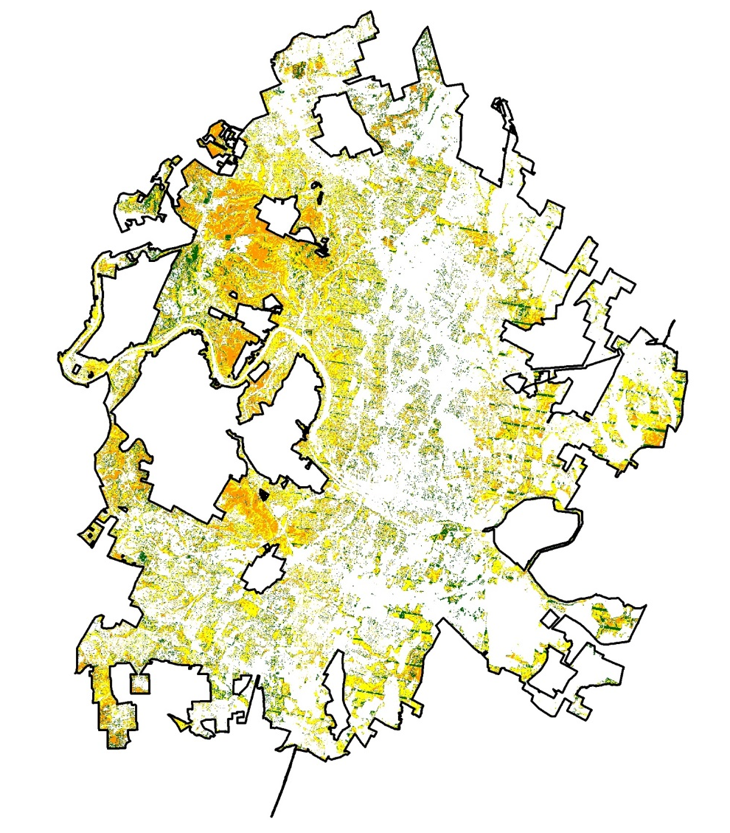
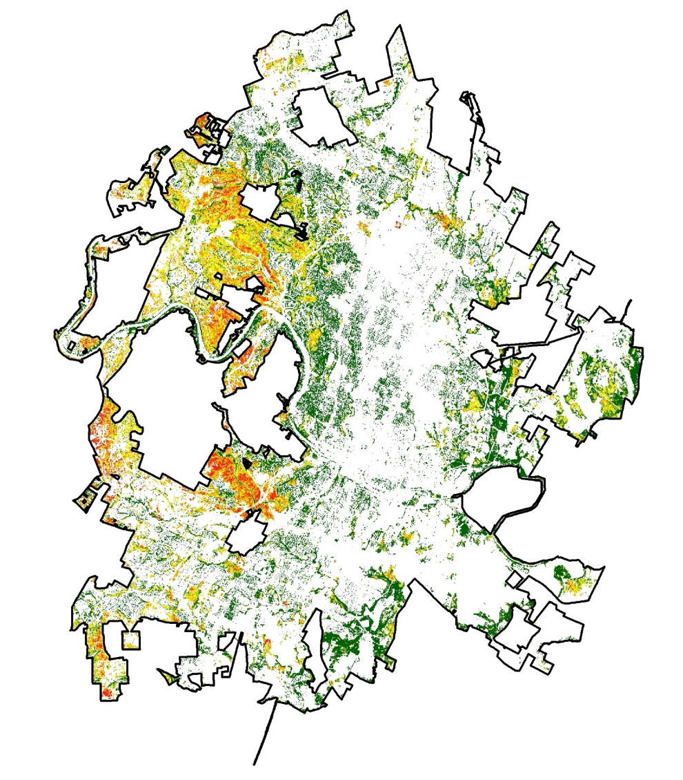
Conclusions
Austin Model-Derived Percent Mortality (2012)
Our model generally overpredicts mortality, but it performs best for moderate values
TFS can use our model and methods as a jumping off point to further explore the relationship between NDVI anomalies and changes in tree canopy cover
Remote sensing is a valuable tool in urban forestry due to its high temporal resolution – changes in NDVI can be frequently monitored
Percent Mortality
0 - 10
10 - 25
25 - 50
50 - 75
75 - 100
0 5 10
km
Notes:
In conclusion, we found that our model generally overpredicts mortality, but it performs best for moderate values. As you can see on the right, the model-derived percent mortality generates many more areas in the mid-mortality yellow range.
This model will be provided to TFS, who can use it in conjunction with our methodology to further explore the relationship between NDVI anomalies and changes in tree canopy cover in Austin, Houston, or other cities.
We also found that remote sensing is a valuable tool for urban forestry due to its high temporal resolution. Unlike NAIP, which is only acquired every two years, Landsat is available every 16 days, which allows for more real-time monitoring of NDVI changes.
Image Credit: Created by DEVELOP team

Slide 19
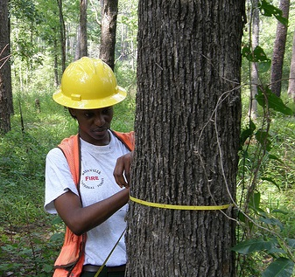
Future Work
Validate the model with high quality ground truth data
Incorporate higher resolution satellite imagery
  For example, for drought events occurring in 2015 or later, Sentinel (10-m resolution) data can be used as a model input
Test other vegetation indices or climate indices such as SPEI
Incorporate data from other cities/regions
Credit: US Forest Service
Notes:
A main component of possible future work would be to validate the model with high quality ground truth data such as the Forest Inventory and Analysis data. We had access to some urban tree inventory datasets, but they were missing data for our period of interest. Validation with in situ data is key to strengthening the model.
Another option is to derive NDVI anomalies from a higher resolution satellite such as Sentinel. Since this drought occurred in 2011, before Sentinel was operational, this was not a possibility for us.
Finally, future work could involve including other vegetation indices or climatic parameters in the model to determine if there are stronger relationships with canopy mortality. Additionally, incorporating data from other cities/regions could make the model more widely applicable.
Image Source: https://www.srs.fs.usda.gov/compass/2015/07/29/forests-of-mississippi-2014/ (Public domain)

Slide 20
We are very grateful to our science advisors Dr. Jessica Matthews and Joe Spruce for their mentorship throughout the project, and to Center Lead Andrew Shannon for his guidance and direction. We also thank our partners Rebekah Zehnder, Burl Carraway, Lars Pomara, and Steve Norman for their expertise and insightful suggestions and comments.
Additionally, we would like to extend our thanks to the National Integrated Drought Information System (NIDIS), and to NOAA NCEI employees such as Michael Kruk, Alec Courtright, and many others for their help along the way.
Notes:
We could not have completed this project without the help of many people along the way, from our science advisors Dr. Jessica Matthews and Joe Spruce, to our Center Lead Andrew Shannon, as well as our partners Lars Pomar, Steve Norman, Rebekah Zehnder, and Burl Carraway. We owe the completion of this project to their expertise, guidance, and patience.
Additionally, we would like to show our gratitude to NOAA NCEI for hosting us and to NOAA NCEI staff such as Mike Kruk and Alec Courtright for providing us with advice and support along the way.

