Slide 1
San Francisco Bay Area Health & Air Quality
Maya Midzik
Using Aircraft and Ground-Based Observations to Monitor Methane and Improve a Greenhouse Gas Inventory Network for the San Francisco Bay Area
Joseph Abbate
Garima Raheja
Notes:
Your project VPS Image should be placed behind the top aperture shape. An example shape has been placed in this position for your reference. Delete the example VPS image, insert your image, right click your image and select the “Send to Back” option. Position and adjust the size of your image so that it lines up with the provided margin rulers.

Slide 2
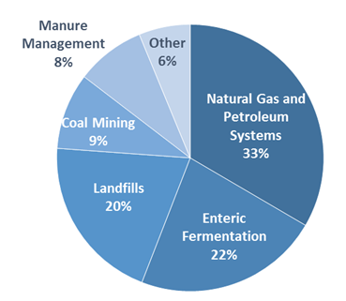
Background: Community Concerns
Methane (CH₄) emissions
Strong radiative forcing: Global Warming Potential (GWP) 25x carbon dioxide
Recent increases in concentration (2.5x pre-1750 levels)
Image Credit: US EPA
Notes:
Methane (CH₄ ) is a potent greenhouse gas. Pound for pound, it can absorb almost 25x as much energy as carbon dioxide over a hundred years.
The concentration of CH₄ in the atmosphere has been rising dramatically, with current tropospheric concentrations almost 2.5 times those of pre-1750 levels (Blasing 2016).
CH₄ is emitted from a variety of sources, including fossil fuel production, landfills, and livestock farms
Image: https://www3.epa.gov/climatechange/ghgemissions/gases/ch4.html

Slide 3
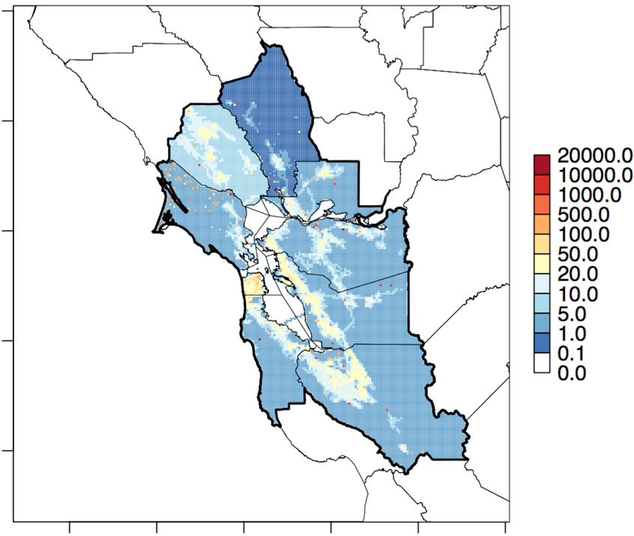
Background: Current Methane Monitoring
Bay Area Air Quality Management District (BAAQMD)
Regulates 9 counties
Uses bottom-up CH₄ emissions inventory
Estimates CH₄ emissions by sector and for total Bay Area
Emission Factor
Mg CH₄/cow
CH₄ emissions for Dairy Livestock
Image Credit: BAAQMD
Gridded total anthropogenic CH₄ emissions (Mg CH₄/yr)
Notes:
The Bay Area Air Quality Management District (BAAQMD) regulates air pollution within nine counties surrounding the San Francisco Bay
Currently, Bay Area CH₄ emissions are estimated using a bottom-up inventory method, combining local source sector totals and estimated emissions per unit factors.
For example- in order to estimate dairy emissions….USDA Cattle Inventory

Slide 4
Background: Current Methane Monitoring
Underestimating CH₄ emissions by a factor of 1.5-2
Emission Factor
Mg CH₄/cow
CH₄ emissions for Dairy Livestock
Image Credit: BAAQMD
Gridded total anthropogenic CH₄ emissions (Mg CH₄/yr)
Notes:
Recent atmospheric top-down estimates of CH₄ emissions for the U.S. have shown that emissions inventories such as BAAQMD’s may be largely underestimating true CH₄ emissions (Miller et al., 2013).
In particular, a recent study in the Bay Area used BAAQMD’s CO emission inventory and the slope of ambient local CH₄ to CO to demonstrate that BAAQMD’s emissions inventory may be underestimating CH₄ emissions by a factor of 1.5-2.0 (Fairley and Fischer 2015).
However, this study was conducted with data collected using gas chromatography, which is primarily used for measurement of volatile organic compounds (VOCs) and has low sensitivity for CH₄
There is significant interest in validating both the top-down and bottom-up emissions estimates, and identifying the causative factors resulting in the discrepancy between the two.

Slide 5
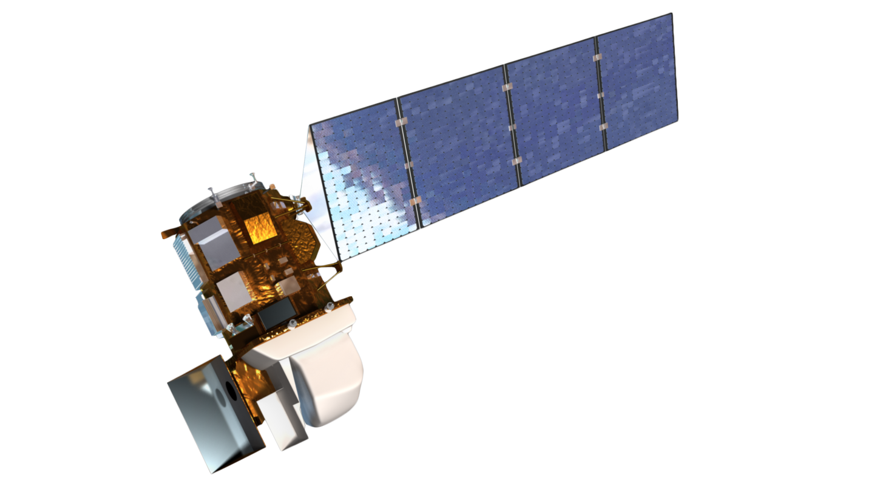
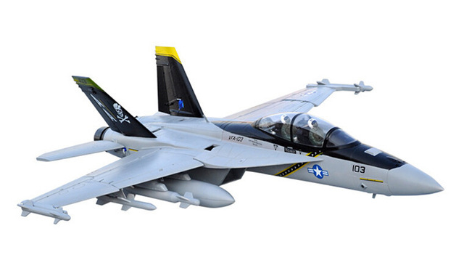
Background: Atmospheric Methane
Altitude (km)
Relative CH₄ Volume Mixing Ratio
800
Exosphere
400
200
Temp
Thermosphere
100
Mesosphere
80
60
40
Stratosphere
20
10
8
6
4
Troposphere
Planetary Boundary Layer (PBL)
2
1
-100
-60
-20
0
20
40
Temp (C)
Notes:
However, measuring local methane emissions isn’t easy.
Methane is a “well-mixed gas,” meaning that it is evenly distributed throughout earth’s lower atmosphere
Point out the layers of the atmosphere
The planetary boundary layer, or PBL, contains the part of the atmosphere closest to earth's surface.
Within the PBL, local enhancements of methane and other pollutants are temporarily “trapped,” but, above the PBL, methane is evenly distributed
This means that satellite sensors that orbit hundreds of kilometers above earth’s surface see not only local methane enhancements, but also methane that has been transported from far away sources over many years.
Luckily, airborne data can provide a better view of local methane emissions, as airplanes can fly low, below the PBL, recording local enhancements.

Slide 6
Background: Top-down methods
Alpha Jet Atmospheric Experiment (AJAX)
Measurements:
Ozone monitor
Meteorological Measurement System (MMS)
Cavity ring-down spectrometer
Methane
Carbon dioxide
Water vapor
Image Credit: NASA AJAX
Image Credit: Monet
Notes:
The Alpha Jet is a demilitarized aircraft shared between the H211 corporation and the NASA Ames Research Center through a Space Act Agreement (Hamil et. al., 2015).
It is outfitted with an ozone monitor (2B Technologies, Inc., Model 205), Meteorological Measurement System (MMS), and cavity ring-down spectrometer (CRDS, Picarro, Inc., Model G 2301-m), which uses three wavelengths in the infrared to measure atmospheric concentrations of greenhouse gasses including CH₄, carbon dioxide, and water vapor (CO₂ at 1603 nm, and CH₄ and H₂O at 1651 nm).

Slide 7
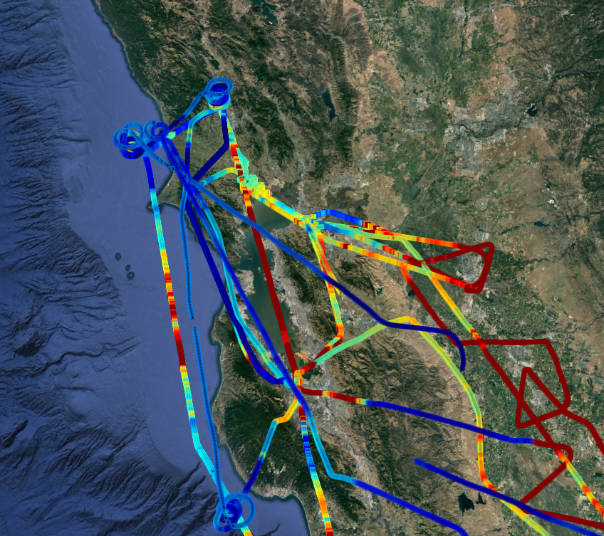
Background: Top-down methods
Alpha Jet Atmospheric Experiment (AJAX)
Associated with many campaigns: (OCO-2, EDGAR validation, GOSAT)
Flights in/out of ARC:
Low-altitude Bay Area coverage
Data previously unapplied- collected en route to larger campaigns
Image Credit: NASA AJAX
Image Credit: Monet
Notes:
The Alpha Jet Atmospheric Experiment (AJAX) is located at the NASA Ames Research Center, and conducts regular flights associated with multiple campaigns.
These campaigns include projects in support of NASA’s Orbiting Carbon Observatory (OCO-2), measurements to validate the Emission Database for Global Atmospheric Research (EDGAR) emissions inventory over the San Joaquin Valley, and an ongoing validation program for GOSAT (Greenhouse Gases Observing Satellite) .

Slide 8
Objectives
CH₄ Hotspot Map
Develop comprehensive spatially-resolved CH₄ map for the San Francisco Bay Area using NASA AJAX data
Locate and investigate CH₄ “hotspots” using anomalies detected by AJAX to pinpoint specific sites for further monitoring via upcoming BAAQMD Mobile GHG Measurement Network
CH₄
Trajectory Analysis
Notes:
Describe objectives

Slide 9
Objectives
CH₄ Hotspot Map
Develop comprehensive spatially-resolved CH₄ map for the San Francisco Bay Area using NASA AJAX data
Notes:
Describe objectives

Slide 10
Methods: CH₄ Hotspot Map
AJAX CH₄ Flight Data
Determine PBL for each flight
Identify areas of elevated CH₄
CH₄ Hotspot Map
Image Credit: AJAX
Notes:
Airborne CH₄ (ppmv), CO₂ (ppmv), and H₂O (%v) measurements (correlated with time and GPS stamps) from 165 AJAX flights over the Bay Area between 2011 and 2016 flights were obtained.

Slide 11
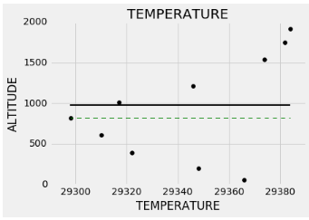
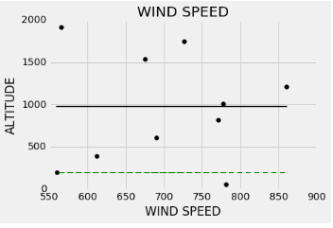
Methods: CH₄ Hotspot Map
AJAX CH₄ Flight Data
Determine PBL for each flight
Identify areas of elevated CH₄
CH₄ Hotspot Map
Image Credit: AJAX
Notes:
Airborne CH₄ (ppmv), CO₂ (ppmv), and H₂O (%v) measurements (correlated with time and GPS stamps) from 165 AJAX flights over the Bay Area between 2011 and 2016 flights were obtained.

Slide 12
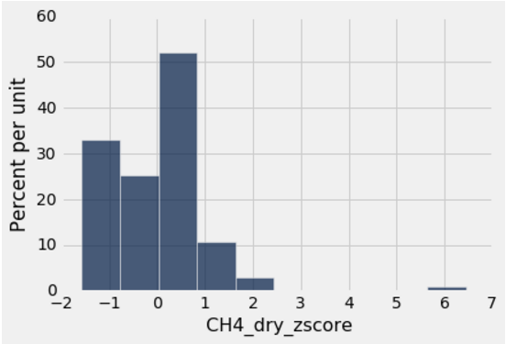
Methods: CH₄ Hotspot Map
AJAX CH₄ Flight Data
Determine PBL for each flight
Normalize CH₄ concentration by flight
CH₄ Hotspot Map
Notes:
Airborne CH₄ (ppmv), CO₂ (ppmv), and H₂O (%v) measurements (correlated with time and GPS stamps) from 165 AJAX flights over the Bay Area between 2011 and 2016 flights were obtained.

Slide 13
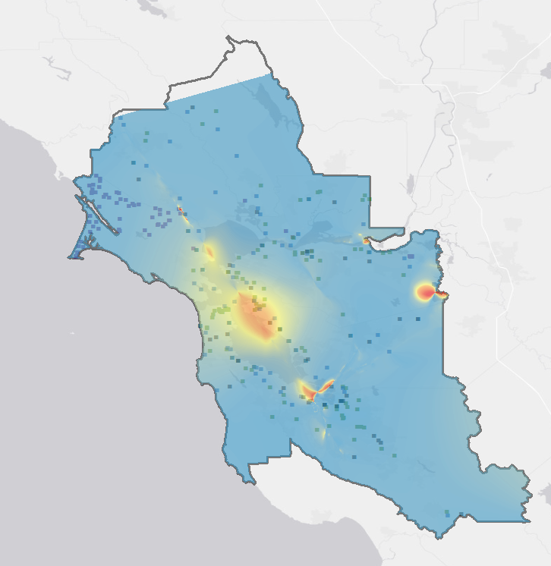
Results: CH₄ Hotspot Map
High: 2.663
AJAX CH₄ Flight Data
Low: 1.8275
Determine PBL for each flight
Identify areas of elevated CH₄
CH₄ Hotspot Map
Image Credit: AJAX
Notes:
Airborne CH₄ (ppmv), CO₂ (ppmv), and H₂O (%v) measurements (correlated with time and GPS stamps) from 165 AJAX flights over the Bay Area between 2011 and 2016 flights were obtained.

Slide 14
Trajectory Analysis
CH₄
Trajectory Analysis
Locate and investigate CH₄ “hotspots” using anomalies detected by AJAX to pinpoint specific sites for further monitoring via upcoming BAAQMD Mobile GHG Measurement Network
Notes:
Describe objectives

Slide 15
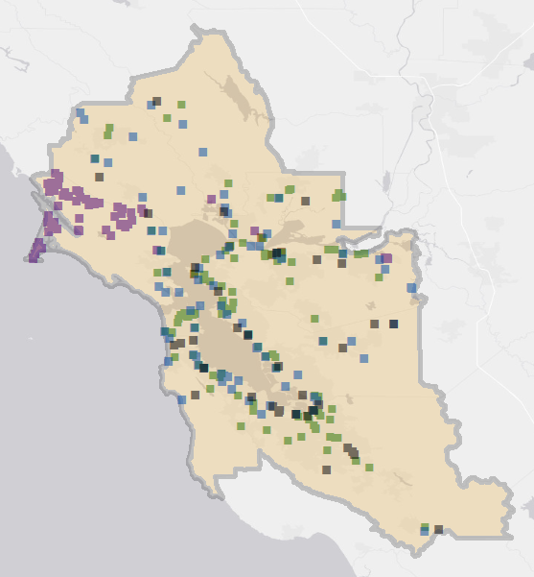
Methods: Trajectory Analysis
CH₄ Hotspot Map
Landfill
Water treatment
Power plant
Refinery
Dairy
BAAQMD GHG inventory
CH₄
Trajectory Analysis
Notes:
Backwards trajectory modeling was conducted from these case study hotspots using met data from ground-based and airborne platforms.
bulk transport trajectories were estimated to identify possible downwind sources of enhanced CH₄ plumes.

Slide 16
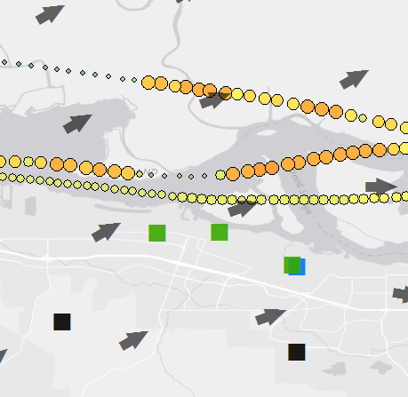
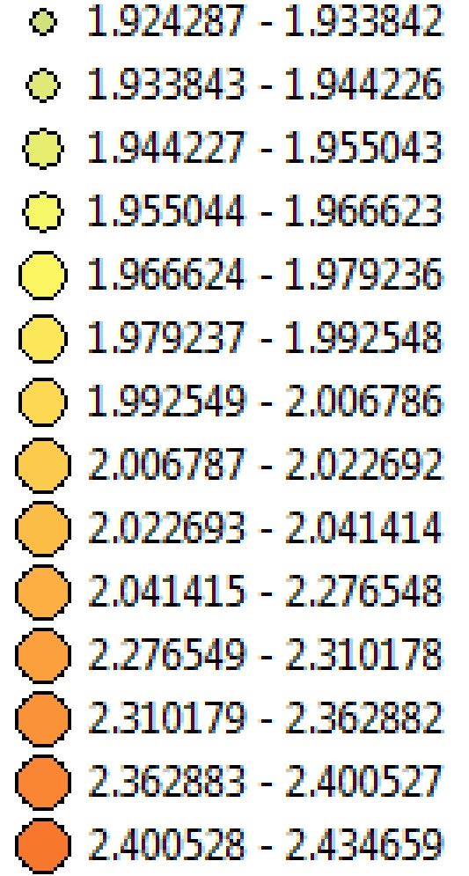
Results: Trajectory Analysis
CH₄ Hotspot Map
Landfill
Water treatment
Power plant
Wind direction
BAAQMD GHG inventory
CH₄
Trajectory Analysis
Notes:
Backwards trajectory modeling was conducted from these case study hotspots using met data from ground-based and airborne platforms.
bulk transport trajectories were estimated to identify possible downwind sources of enhanced CH₄ plumes.

Slide 17
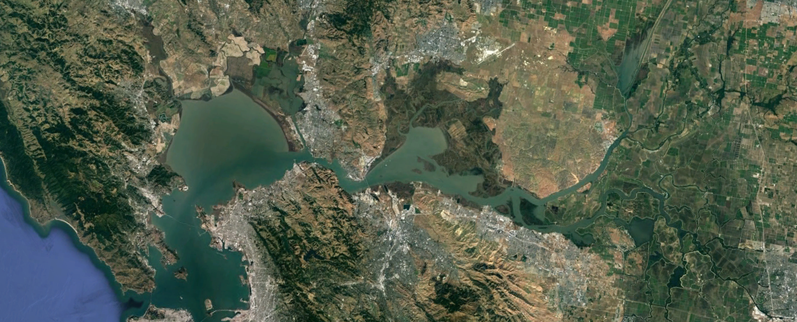
Conclusions
Image Credit: Planet Labs
Airborne in situ greenhouse gas concentration data from below the planetary boundary layer (PBL) can be utilized in understanding near-surface CH₄ concentrations
The San Francisco Bay Area has many CH₄ “hotspots” downwind of dairies, landfills, and areas of oil and gas production. A number of these sources are missing from the current BAAQMD bottom-up emissions inventory.
Notes:
Describe conclusions

Slide 18
Uncertainties and Future Work
Image Credit: Planet Labs
High uncertainties associated with trajectory analysis: give only an overview of possible emissions sources.
Future collaboration with BAAQMD’s GHG mobile monitoring van could better explore/identify these sources.
Targeted, low-altitude AJAX flights over the Bay Area for better coverage
More BAAQMD-AJAX collaborations to come!
Notes:
Image Source: http://commons.wikimedia.org/wiki/File:Claude_Monet_-_The_Magpie_-_Google_Art_Project.jpg

Slide 19
Bay Area Air Quality Management District
Dr. Abhinav Guha, Senior Air Quality Engineer
Dr. Phil Martien, Air Quality Engineering Manager
Ms. Abby Young, Climate Protection Manager
NASA Alpha Jet Atmospheric eXperiment
Dr. Laura Iraci, Dr. Josette Marrero,
Dr. Emma Yates, & Mr. Warren Gore
NASA Ames Research Center
Ms. Chippie Kislik, DEVELOP Center Lead
Ms. Vickie Ly, DEVELOP Assistant Center Lead
Notes:
Thanks!

