Slide 1
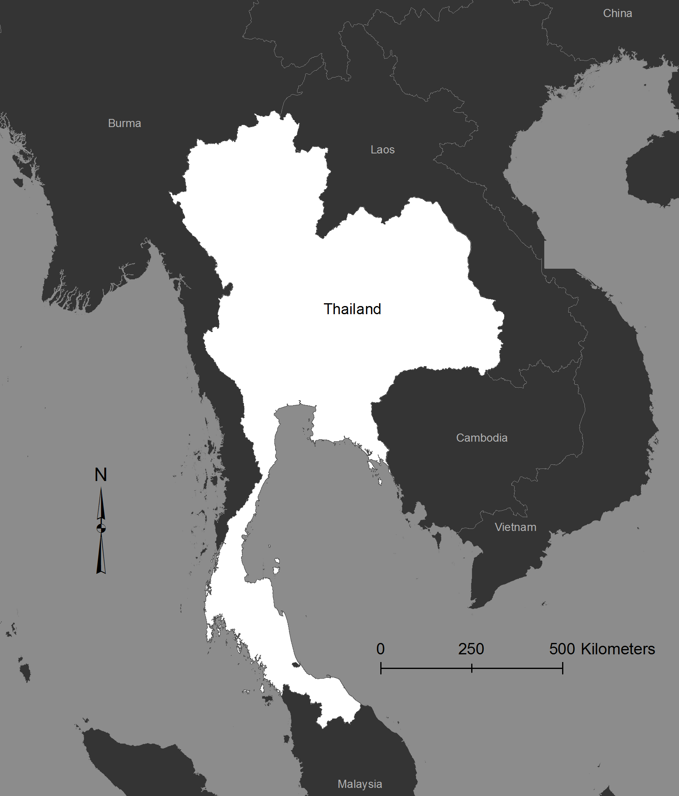
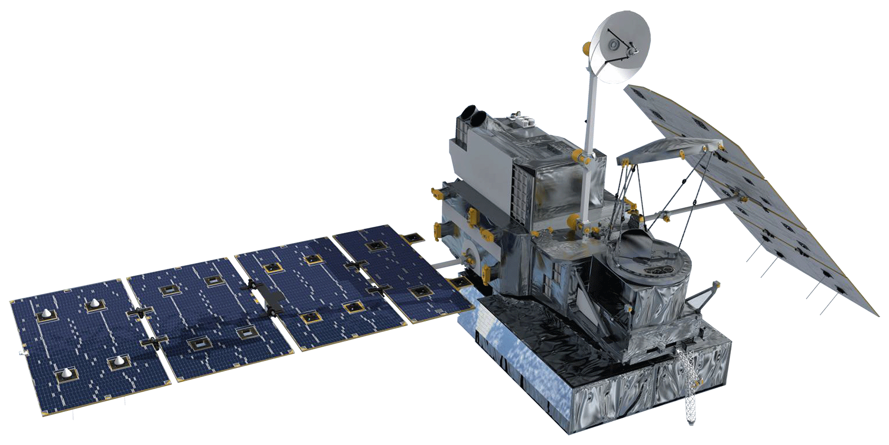
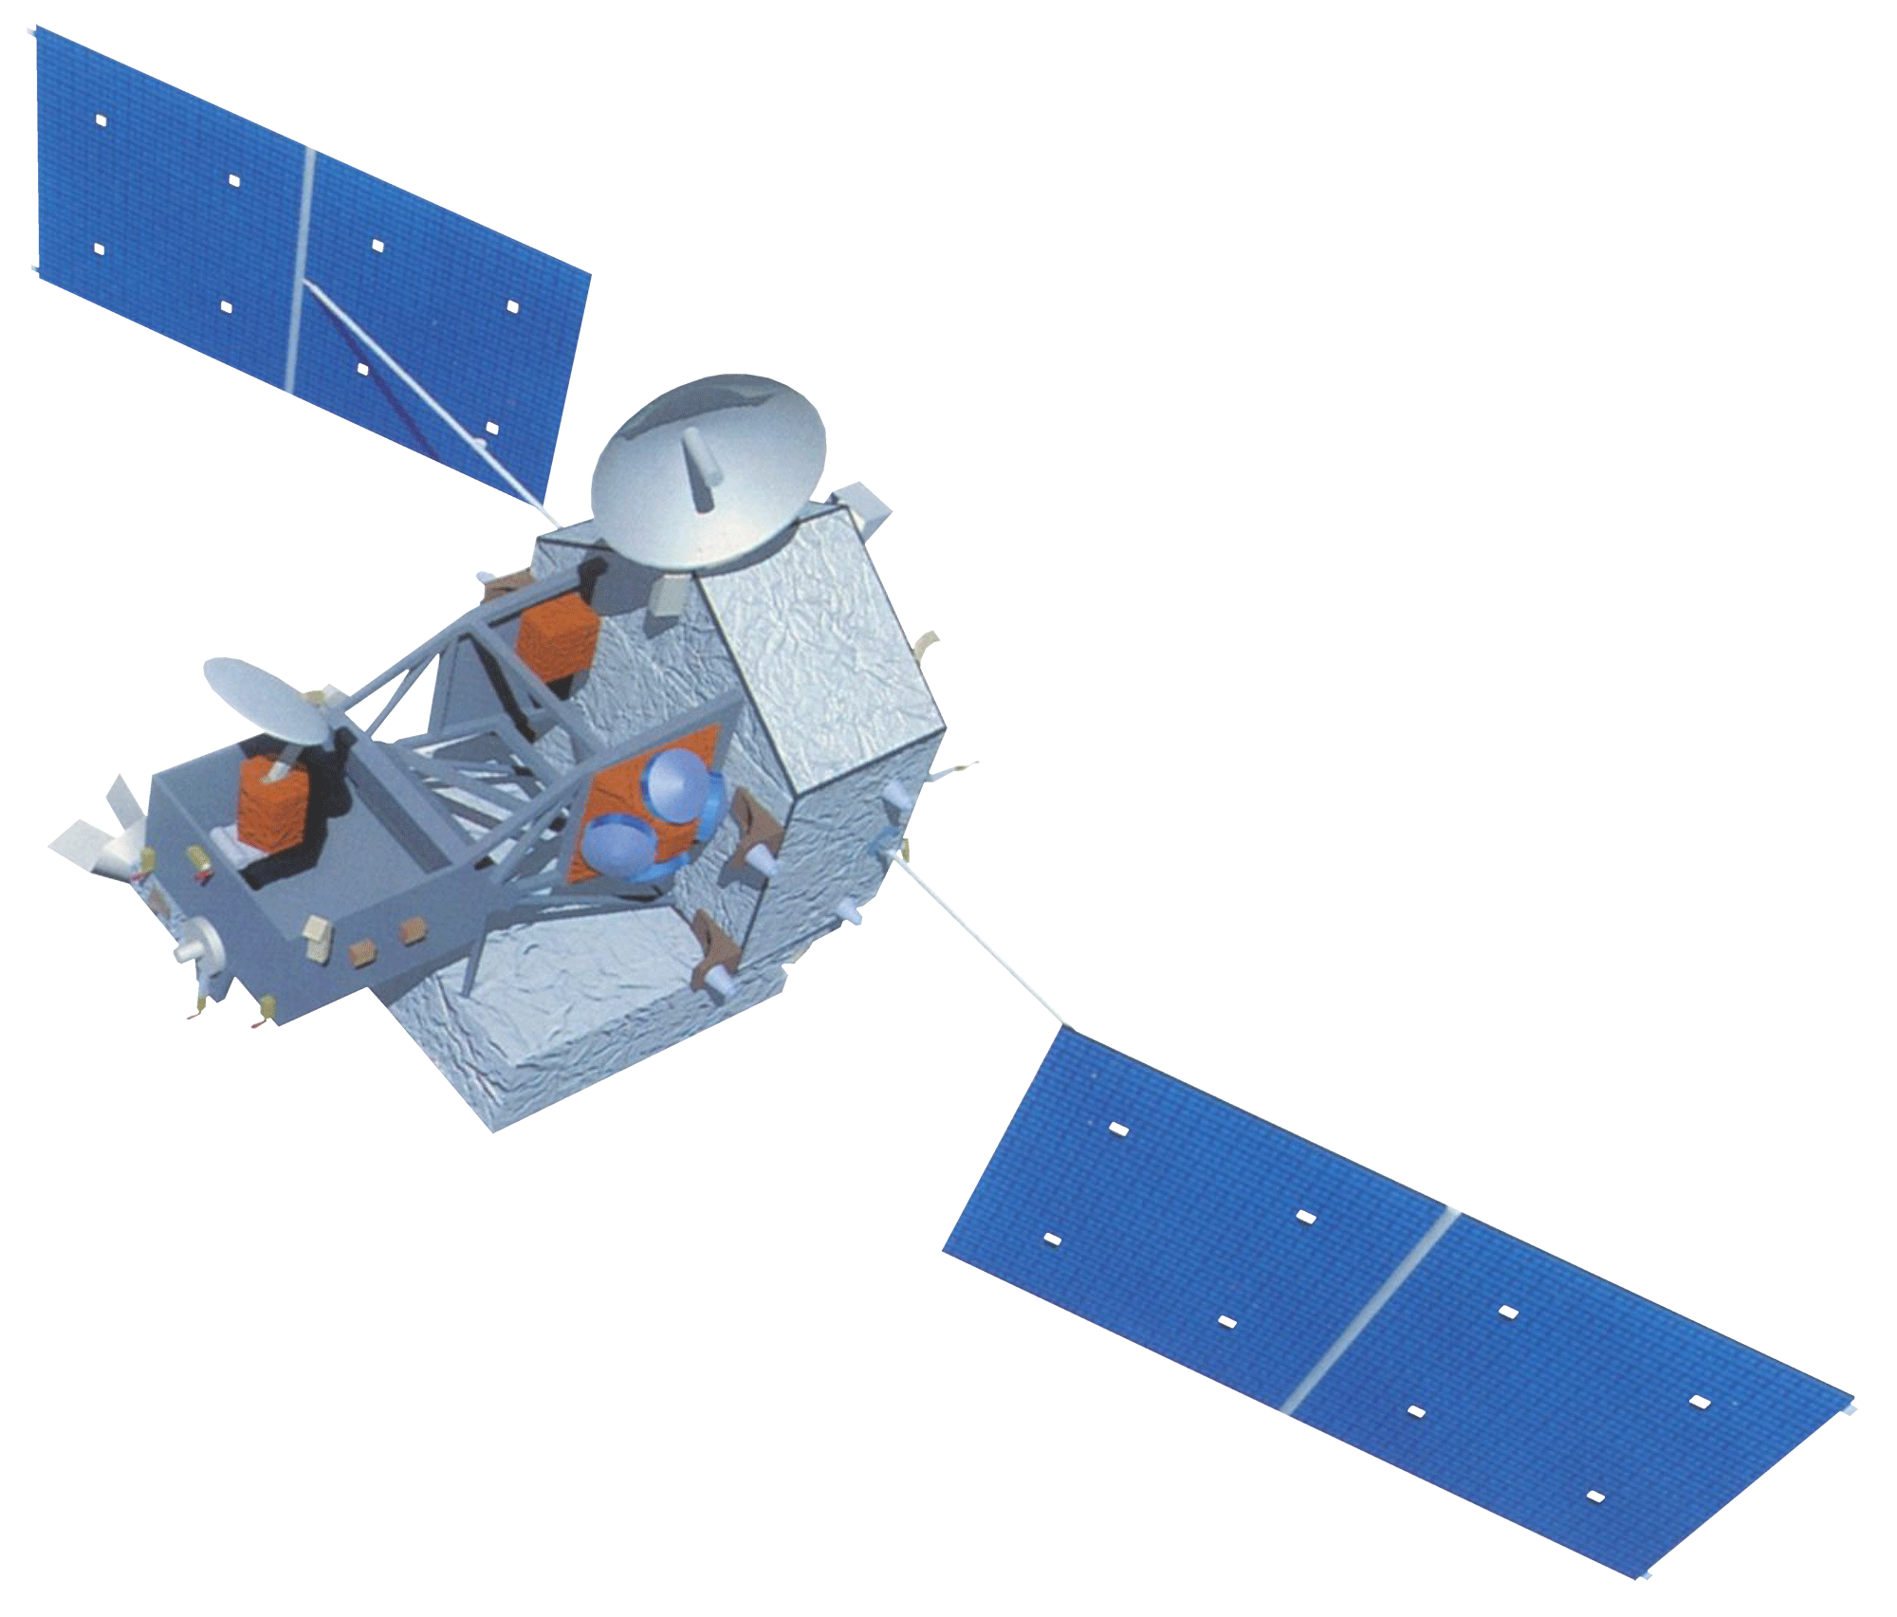
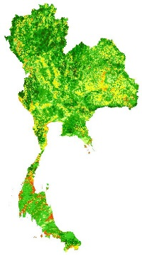
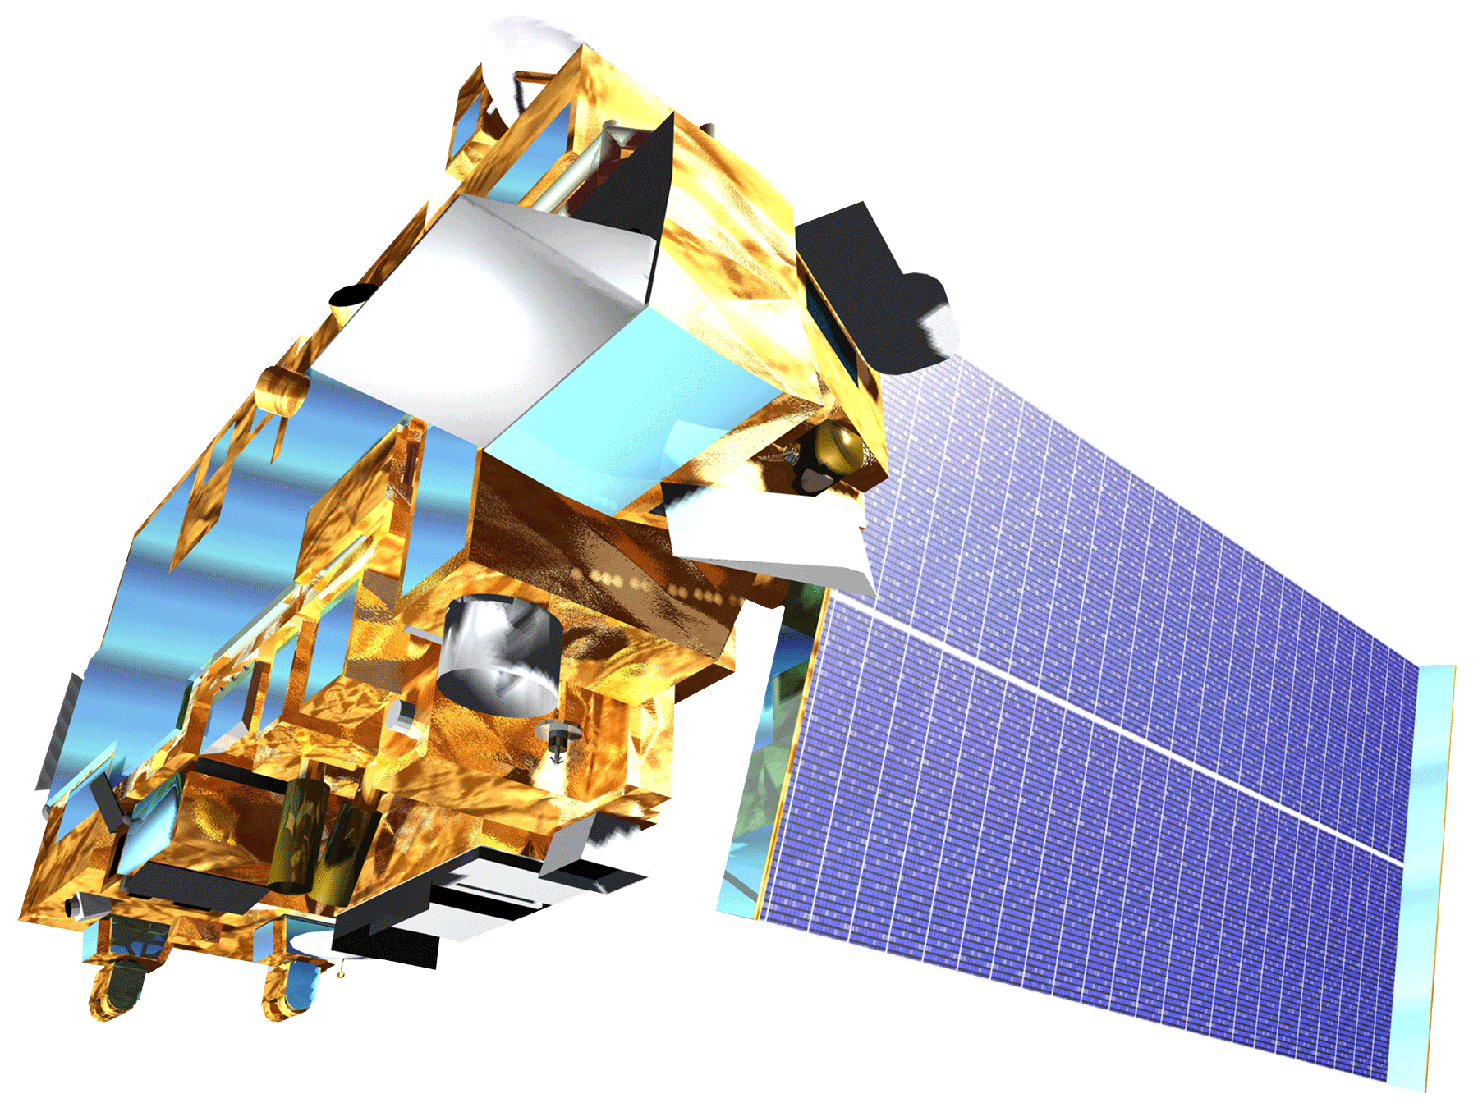
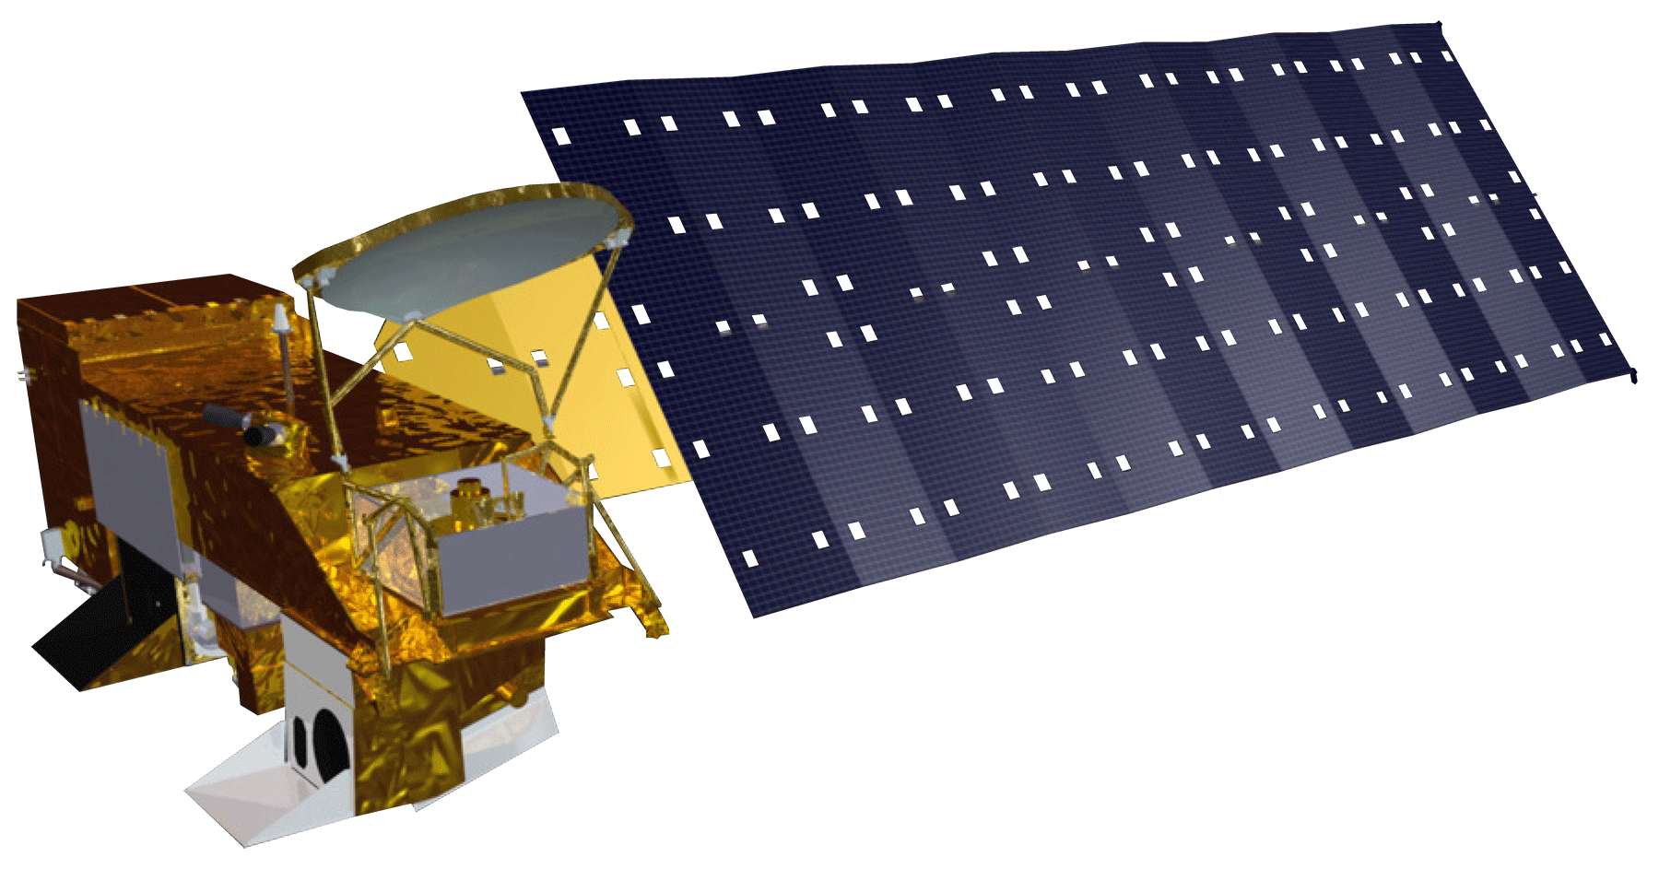
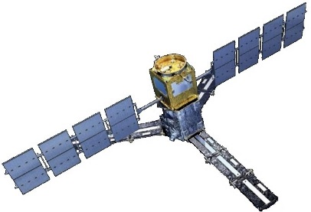
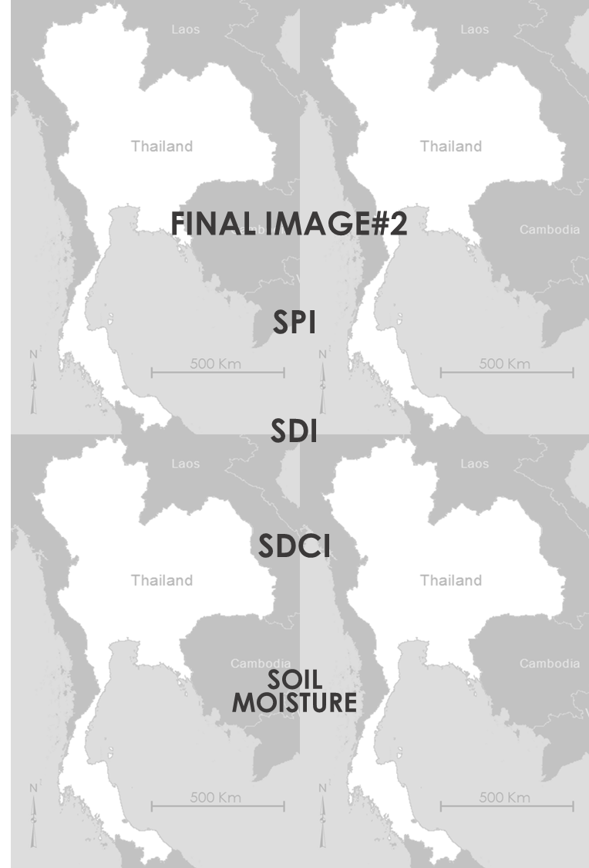
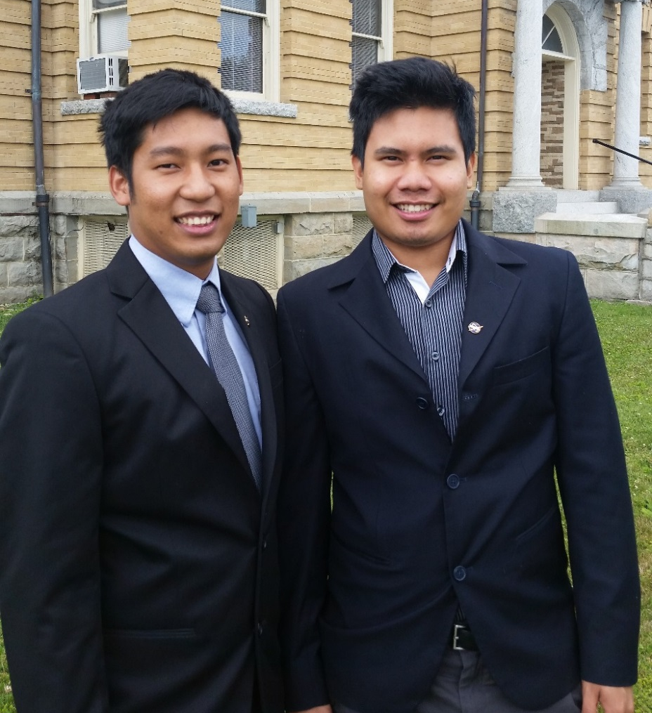
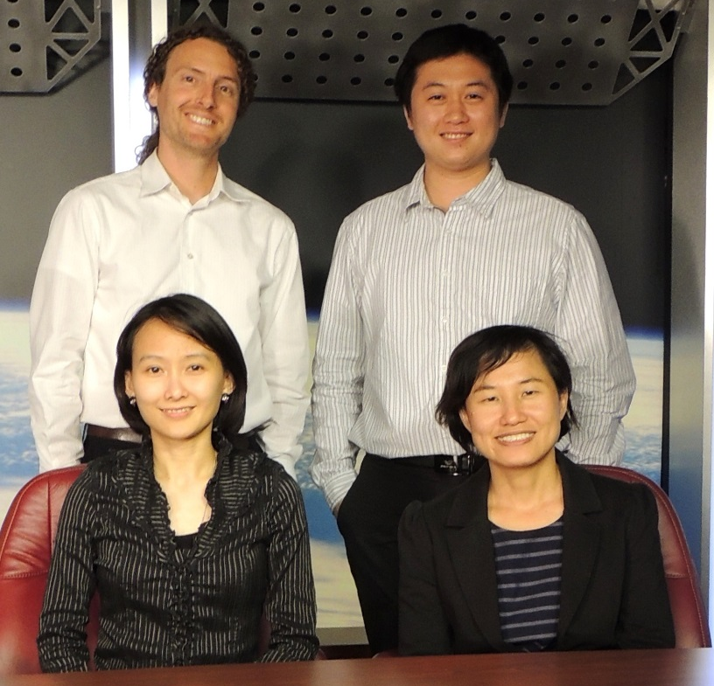
Thailand Disasters
Monitoring Risk and Extent of Drought for Enhanced Decision Making and Resource Allocation in the Kingdom of Thailand
Sean McCartney (Project Lead), Nobphadon Suksangpanya, Chisaphat Supunyachotsakul, Srisunee Wuthiwongyothin, Sahakait Benyasut, Thanapat Vichienlux
NASA DEVELOP
Abstract
Objectives
Keep this blank for now.
Body text point size should be at least 24.
Caption text point size should be at least 16.
Feel free to rename, move, and resize sections as needed.
Use 3 different drought indices to monitor meteorological, hydrological and agricultural drought in Thailand to assist in drought management and mitigation
Identify extreme drought anomalies based on a climatological baseline
Study Area
Methodology
GPM – GMI
30-min precipitation rate (mm/hr)
0.1°-Spatial Resolution
IMERG Level 3 product
Monthly Precipitation
Resampled to
0.1°-spatial resolution
Standardized Precipitation Index (SPI)
TRMM – TMI
Daily precipitation (mm)
0.25°-Spatial Resolution
3B42 Level 3 product
Scaled Drought Condition Index
(SDCI)
0.01°-spatial resolution
NDVI
0.01°-spatial resolution
MOD13A3 and MYD13A3 products
TERRA & AQUA
– MODIS
LST
0.05°-spatial resolution
MOD11C2 and MYD11C2 products
Streamflow Records
26 ground-based stations on the main streams and rivers
Monthly Streamflow (m³)
Streamflow Drought Index
(SDCI)
Earth Observations
Soil Moisture (%)
TRMM
SMOS – MIRAS
0.25°-Spatial Resolution
Palmer Model
AQUA
TERRA
GPM
SMOS
Results
Conclusions
Show and discuss February 2015 raster images of SPI, SDI, SDCI, and Soil Moisture over the Kingdom of Thailand.
Show plots of SPI, SDI, SDCI, and Soil Moisture at a specific region over time in each index and find drought anomalies to determine the cause and effects of drought.
Use bullets.
Use complete sentences with periods.
Team Members
Project Partners
Acknowledgements
Royal Thai Embassy
Asian Disaster Preparedness Center (ADPC)
SERVIR Mekong
Colin Doyle (NASA GSFC - USRA)
Dr. John Bolten (DEVELOP National Science Advisor)
Dr. Kenton Ross (DEVELOP National Science Advisor)
Dr. Dalia Kirschbaum (DEVELOP National Science Advisor)
Lance Watkins (DEVELOP)
Summer 2013 Great Plains Agriculture Team (DEVELOP)
Dr. Peter Cutter (ADPC)
L to R: Thanapat Vichienlux, Sahakait Benyasut
(Wise node)
Back L to R: Sean McCartney, Nobphadon Suksangpanya
Front L to R: Chisaphat Supunyachotsakul, Srisunee Wuthiwongyothin (Goddard node)
NASA Goddard Space Flight Center, Wise County and City of Norton Clerk of Court's Office

