Slide 1
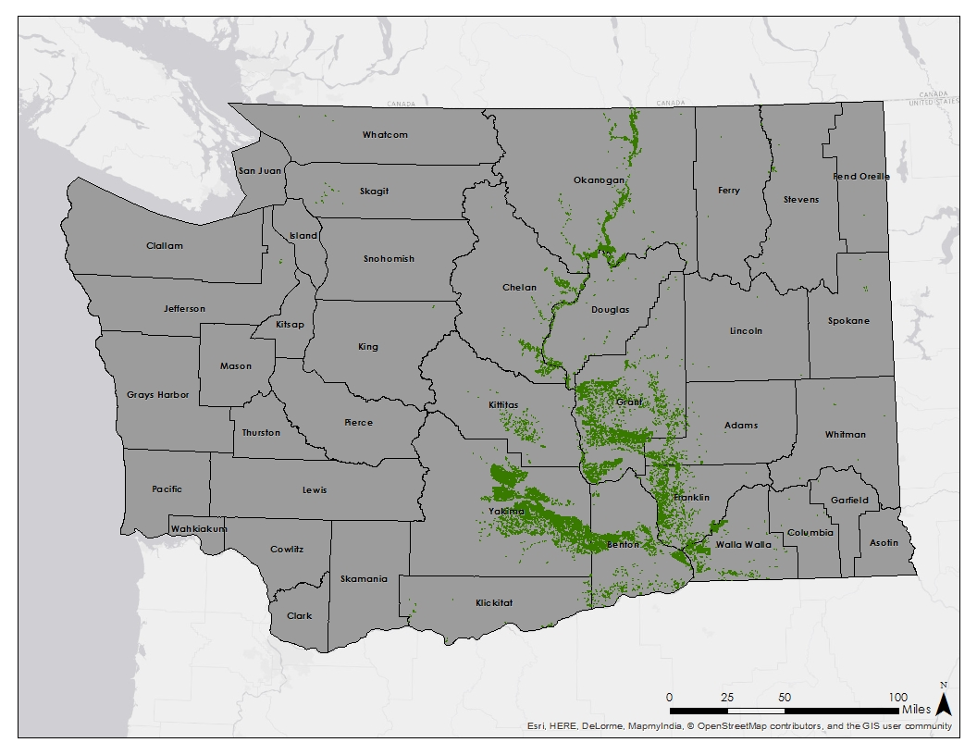
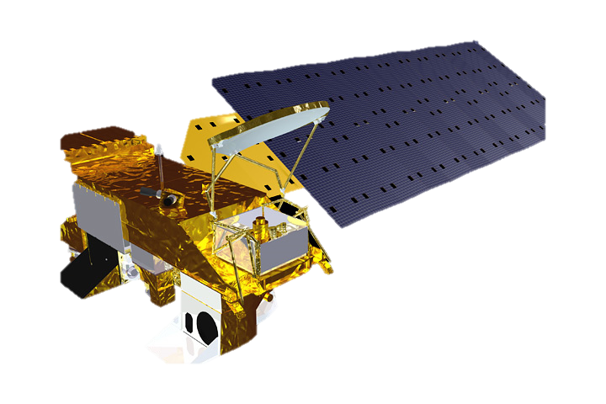
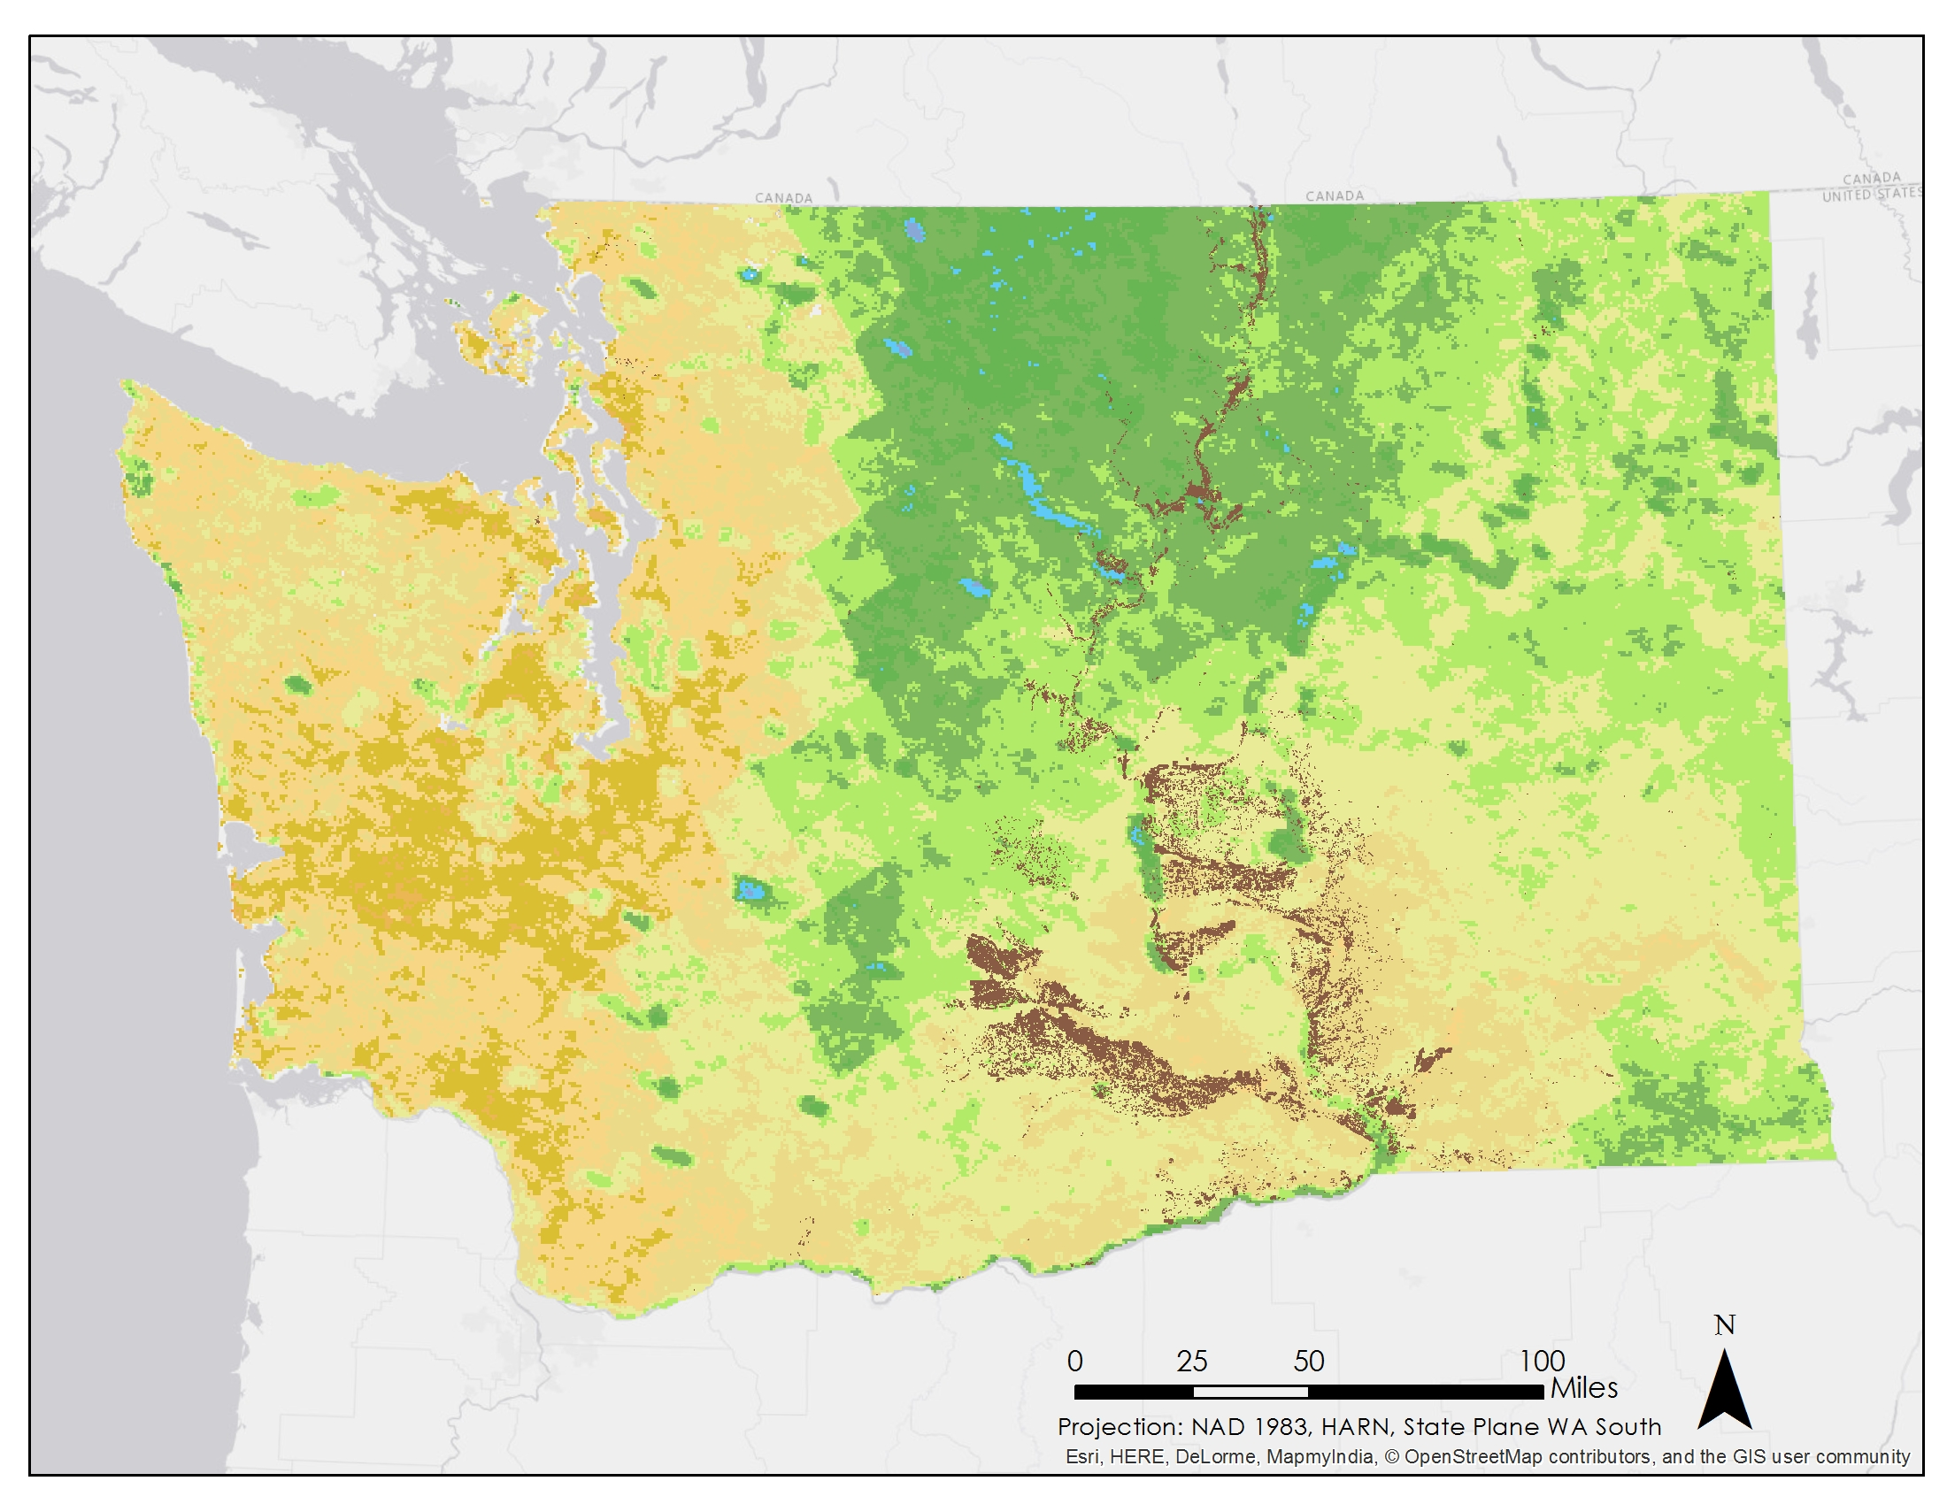
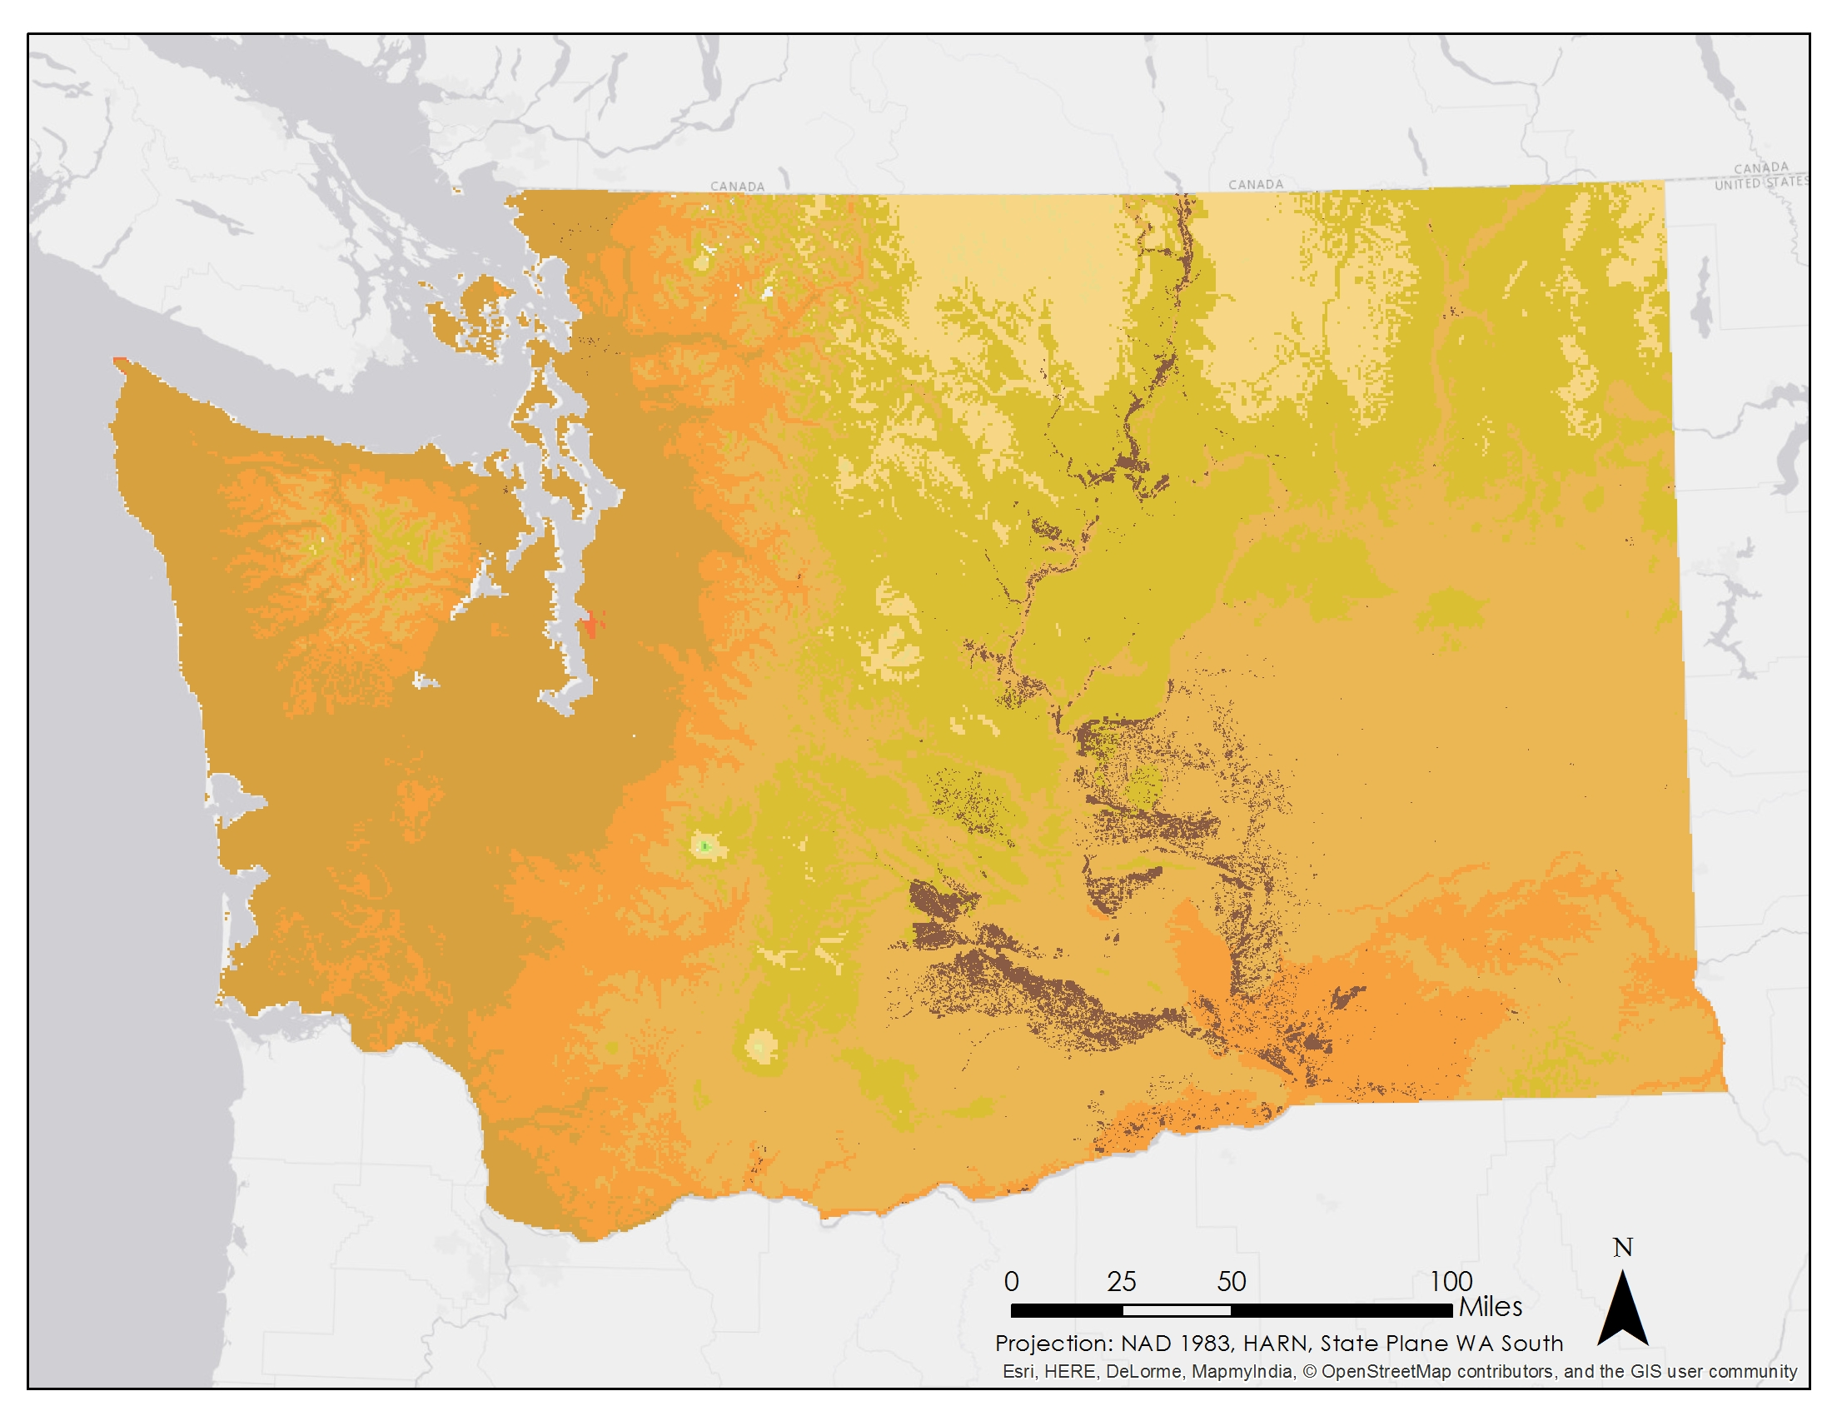
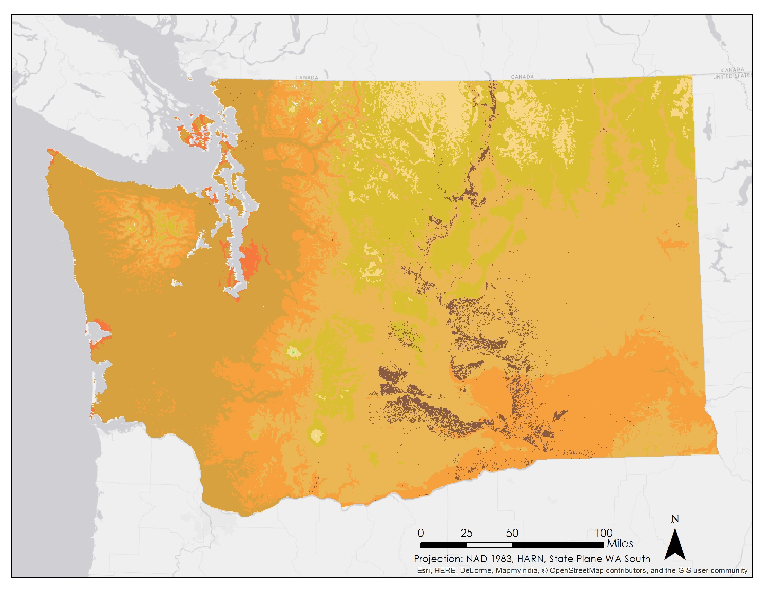
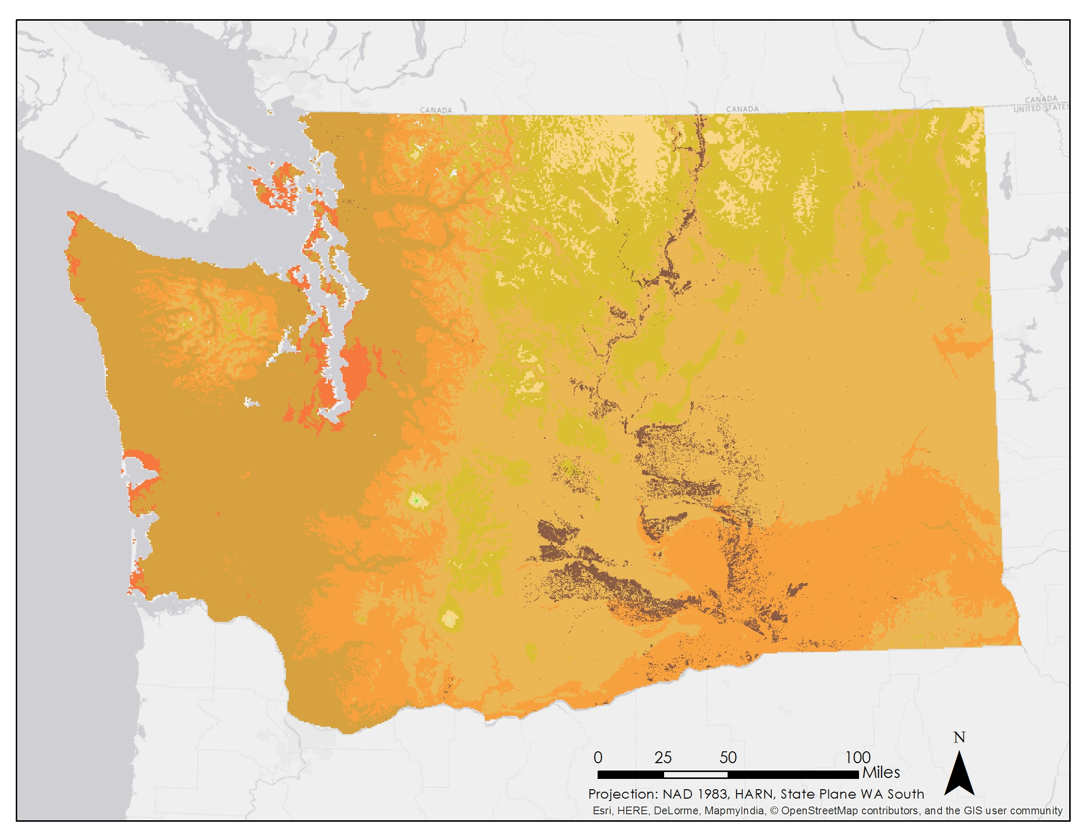
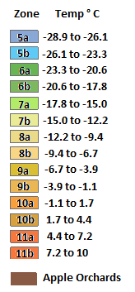
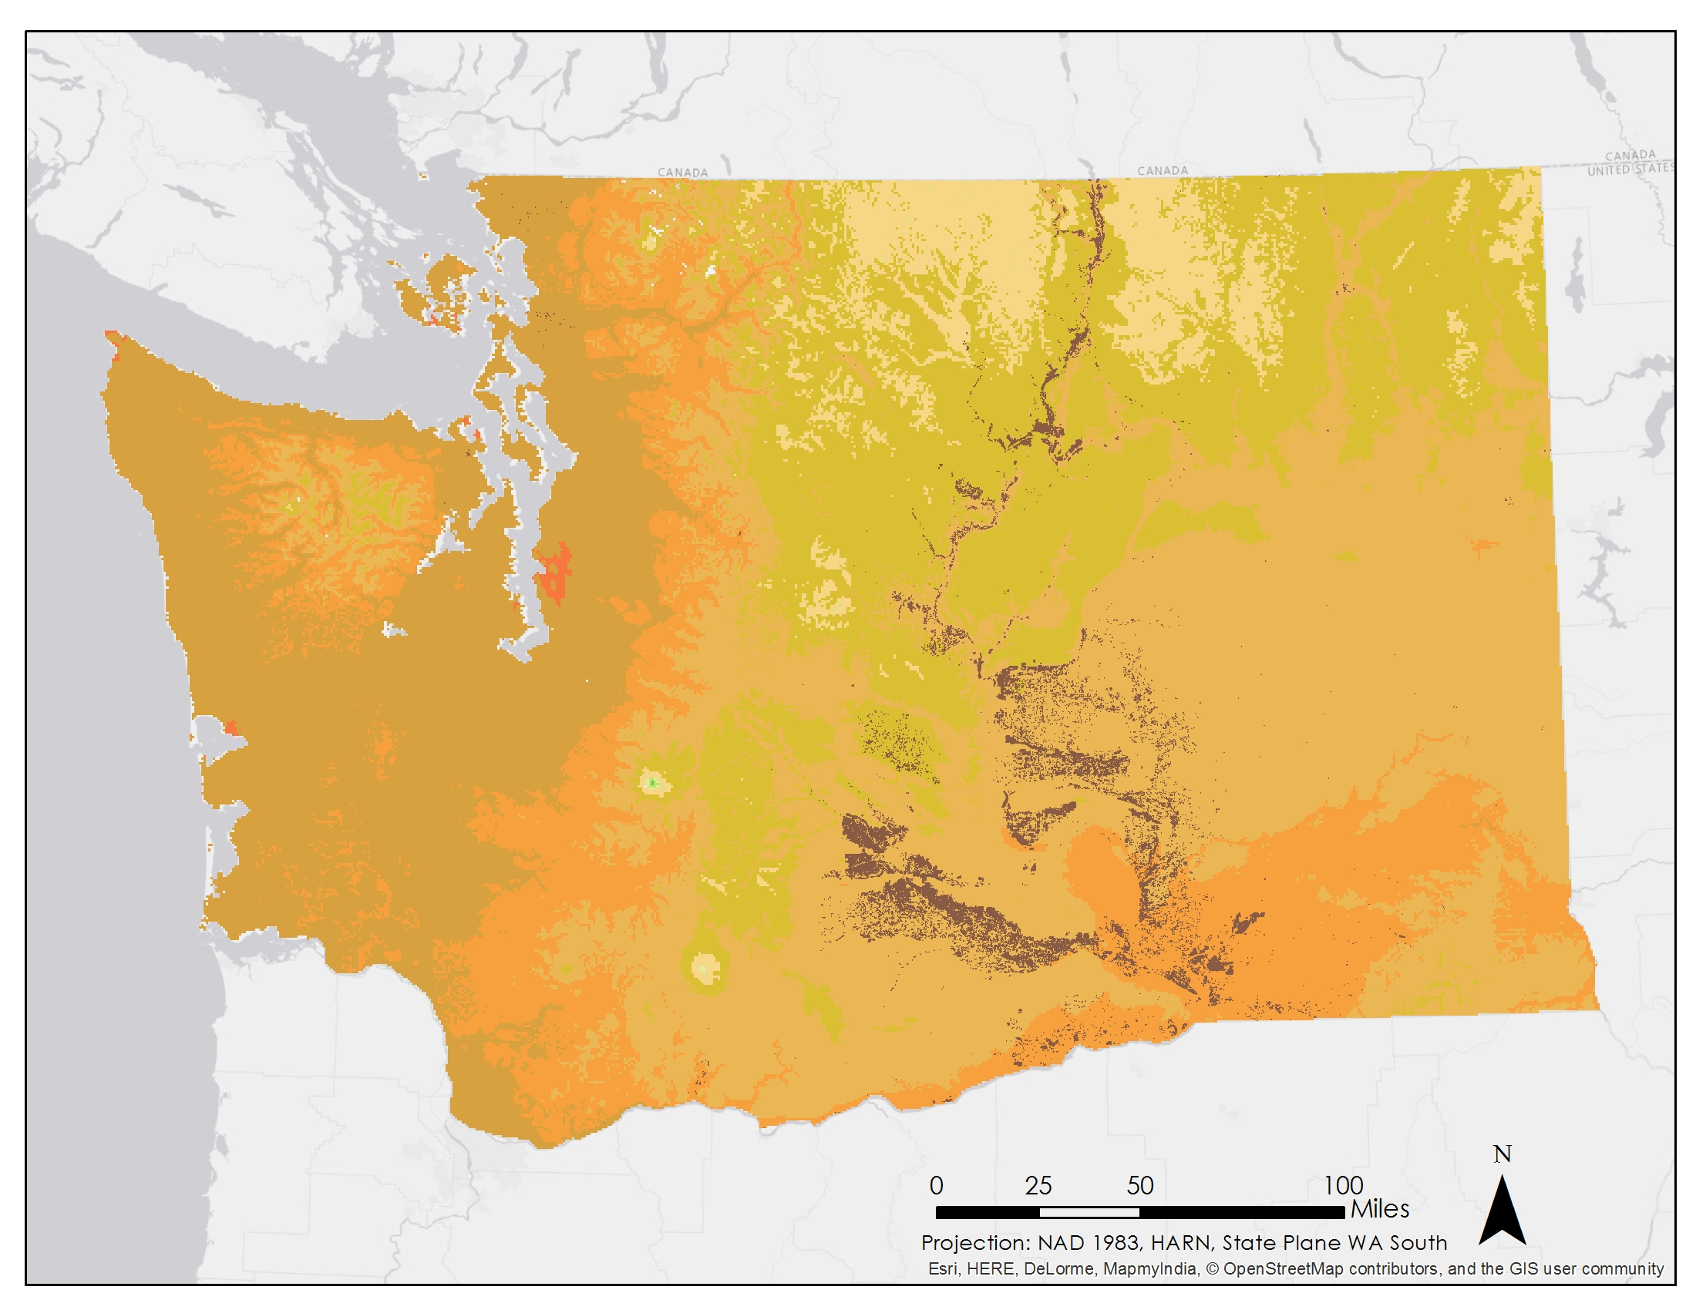
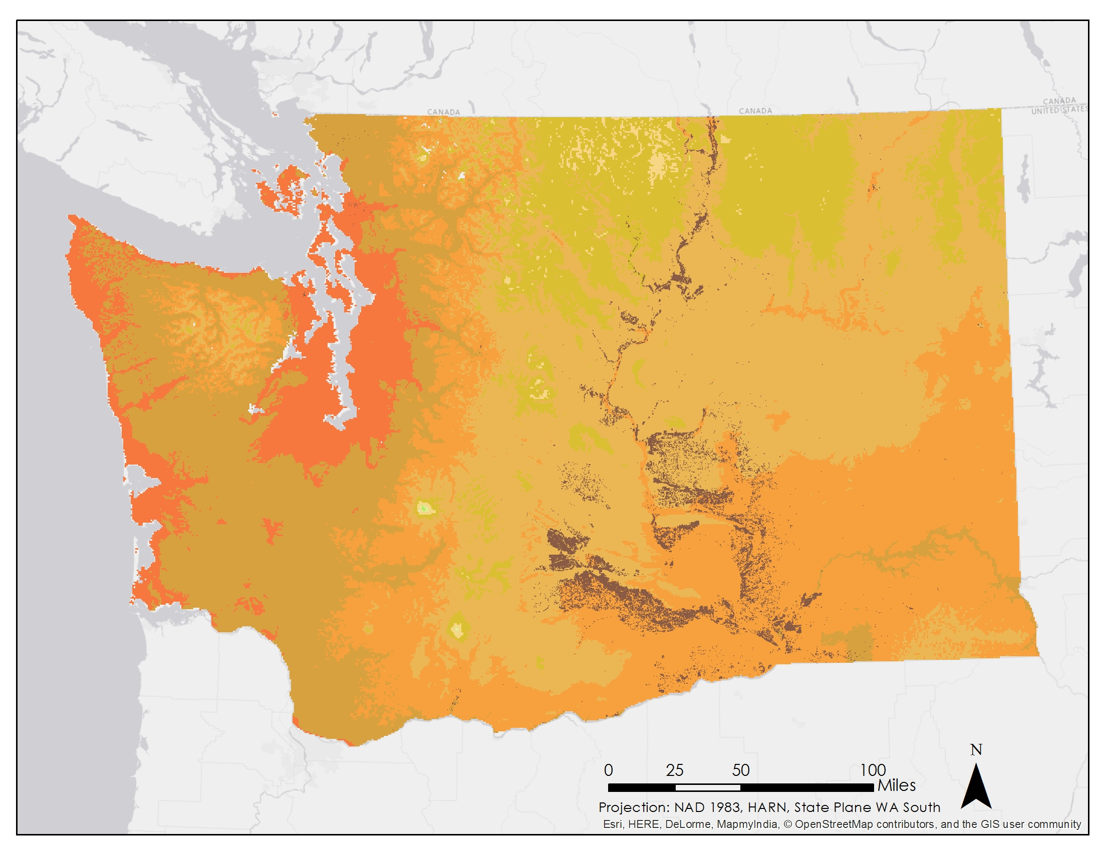
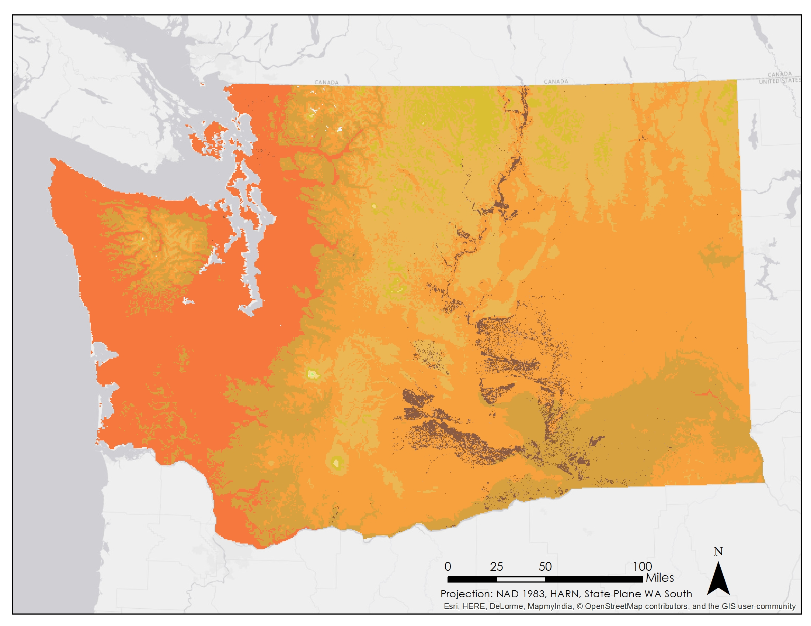
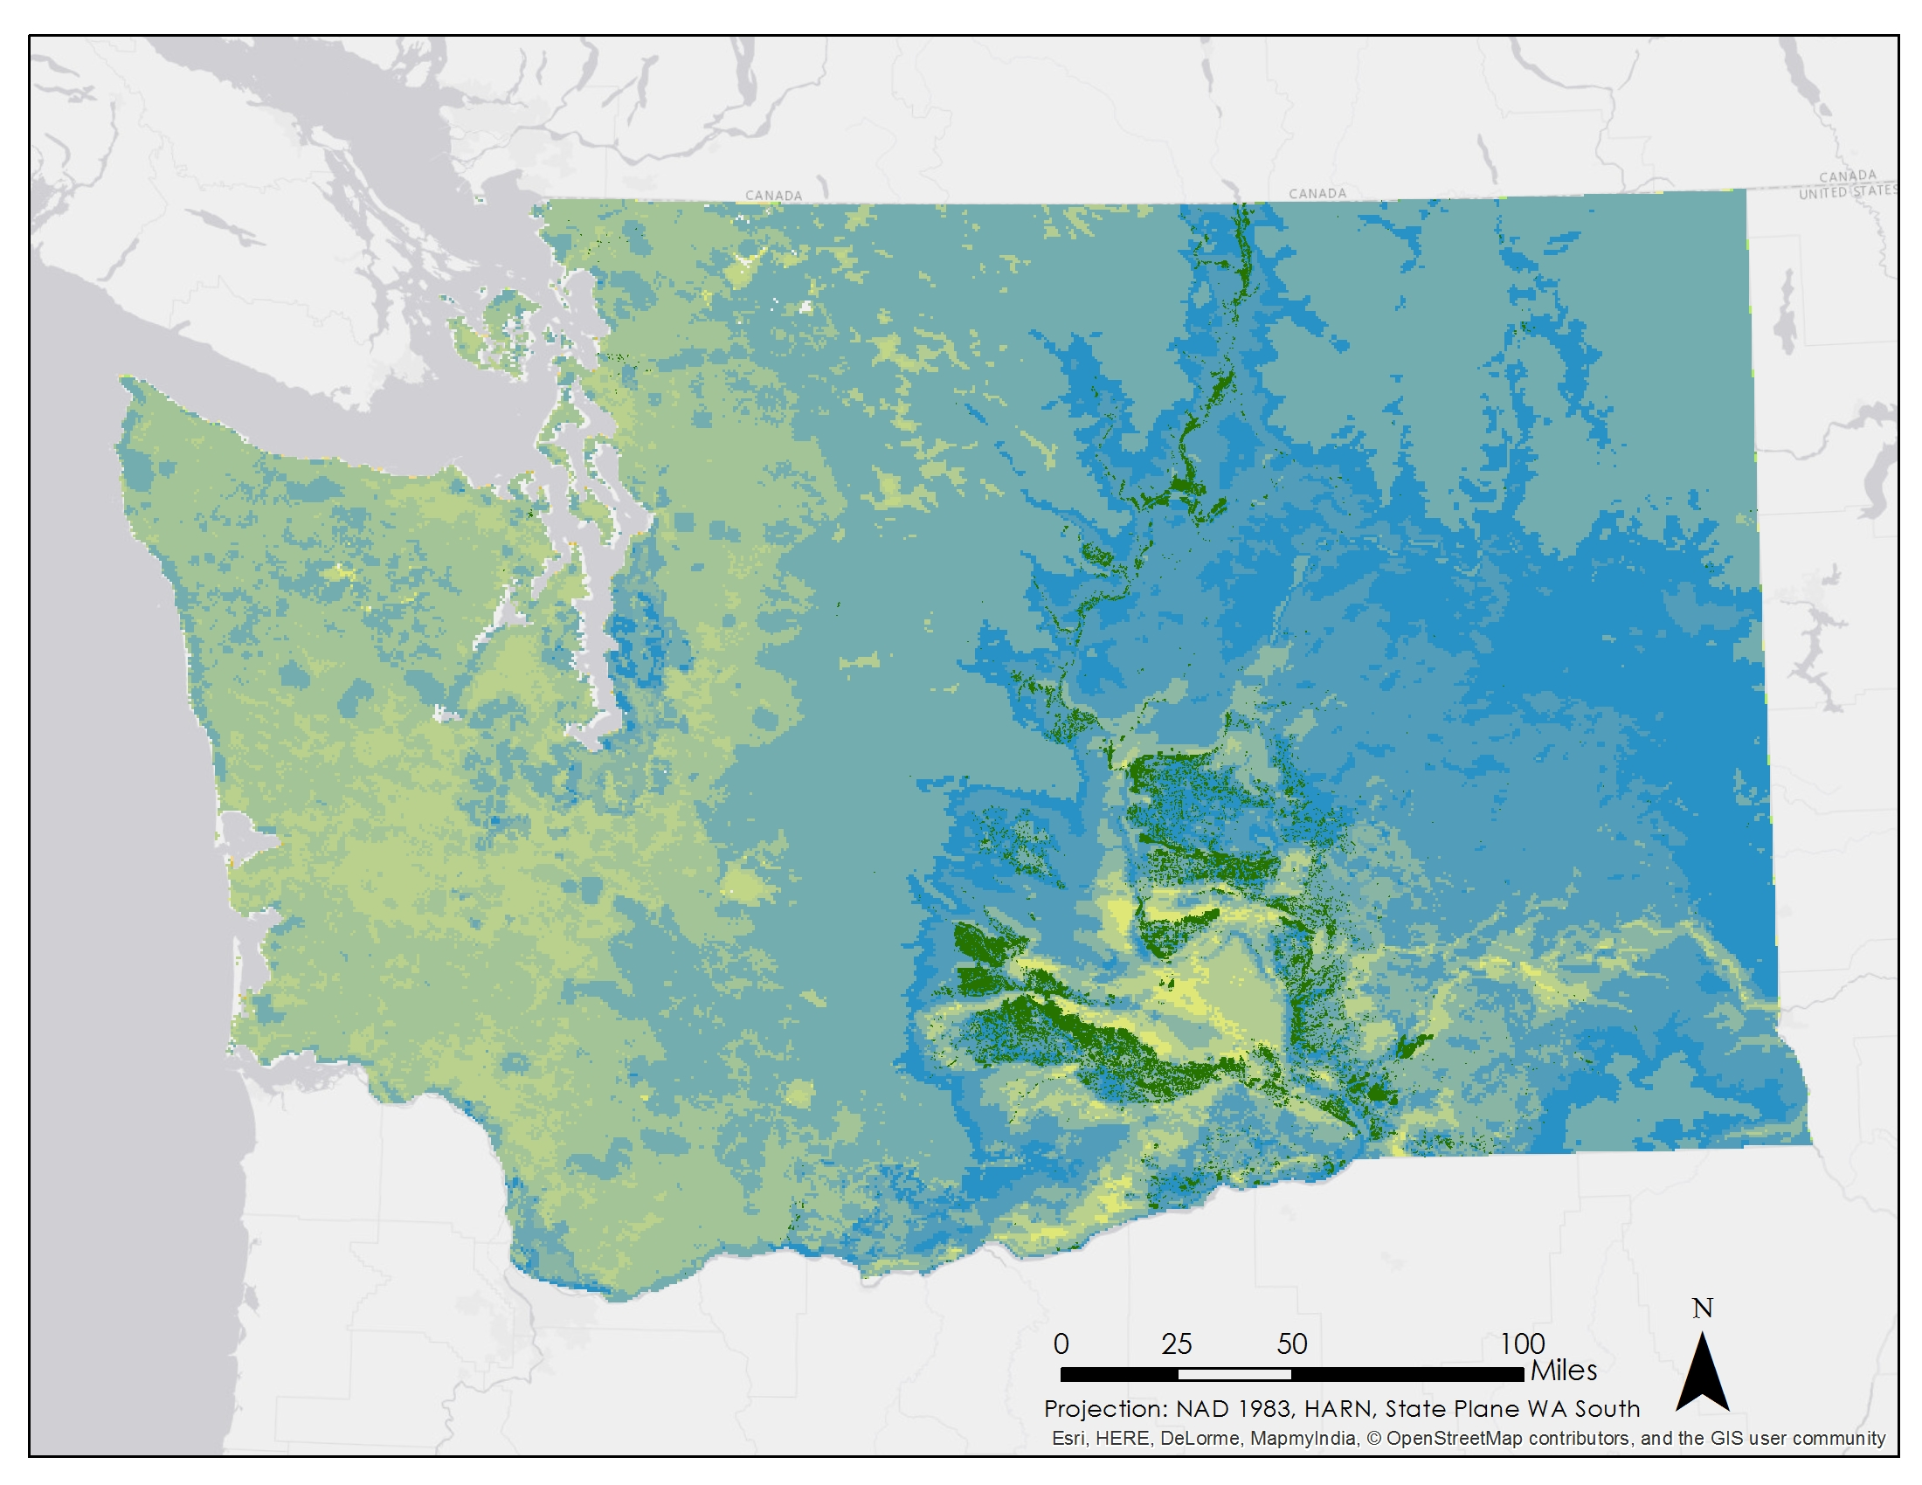
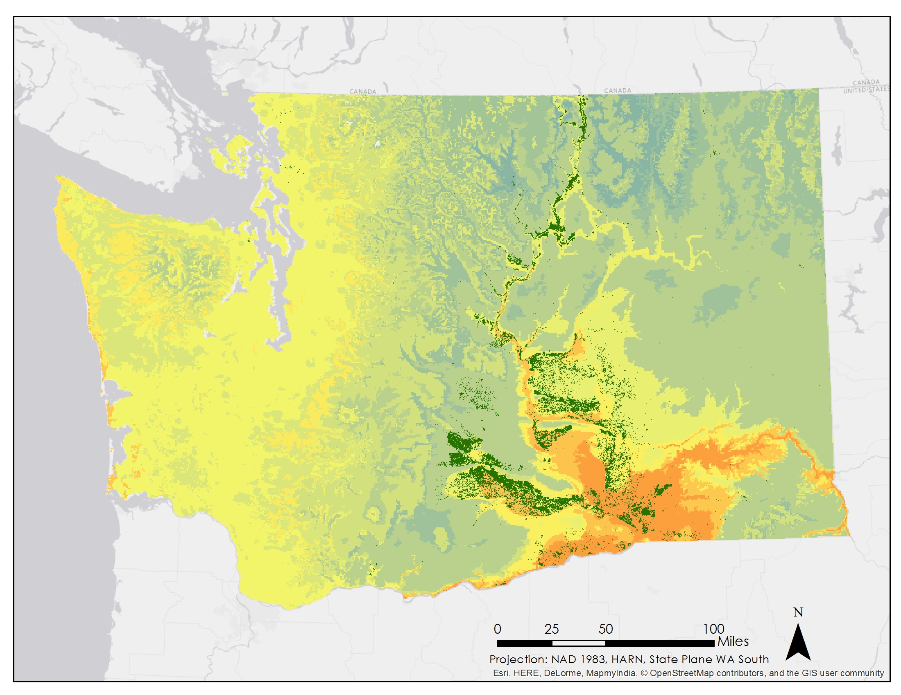
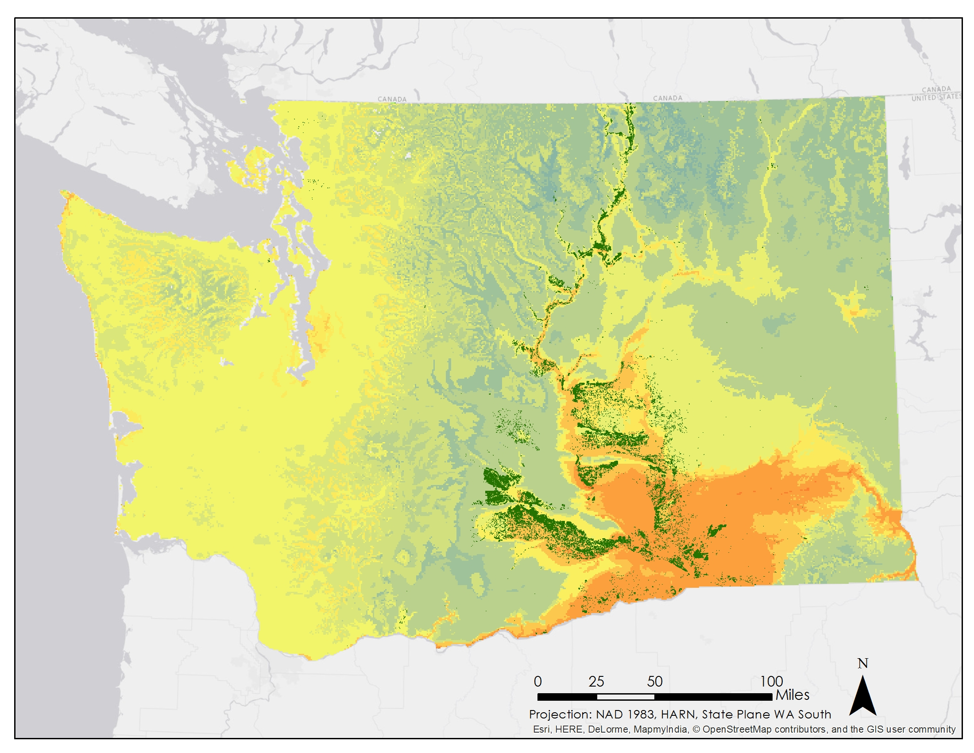
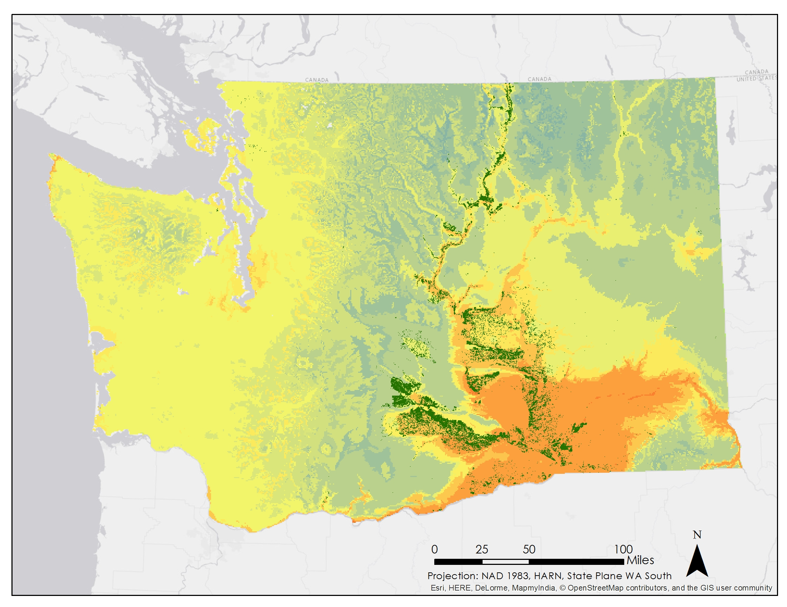
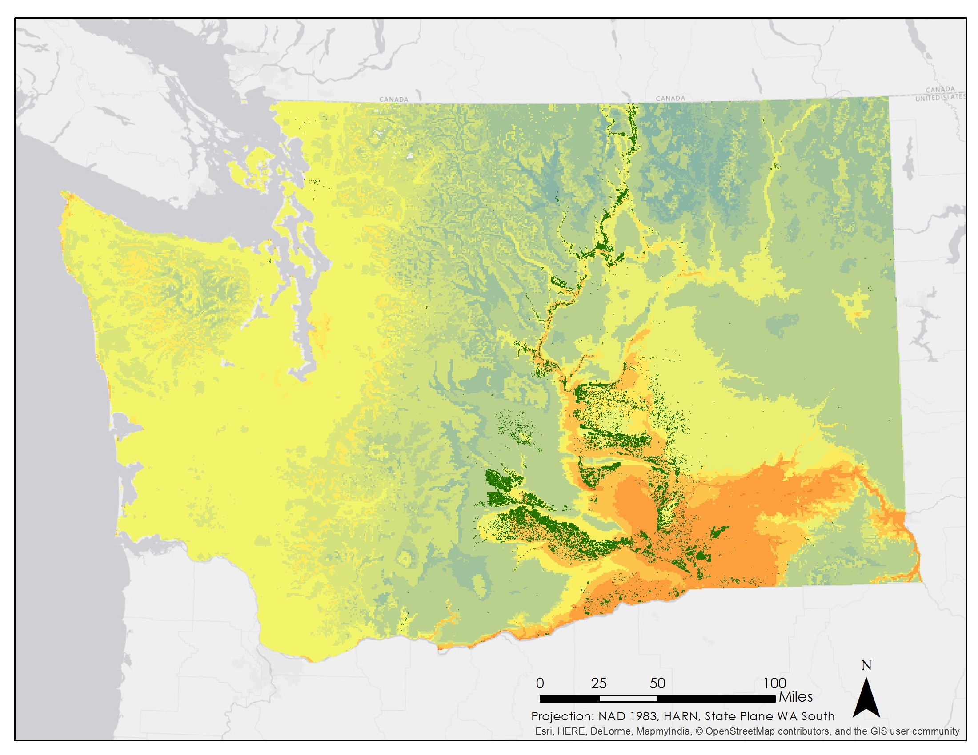
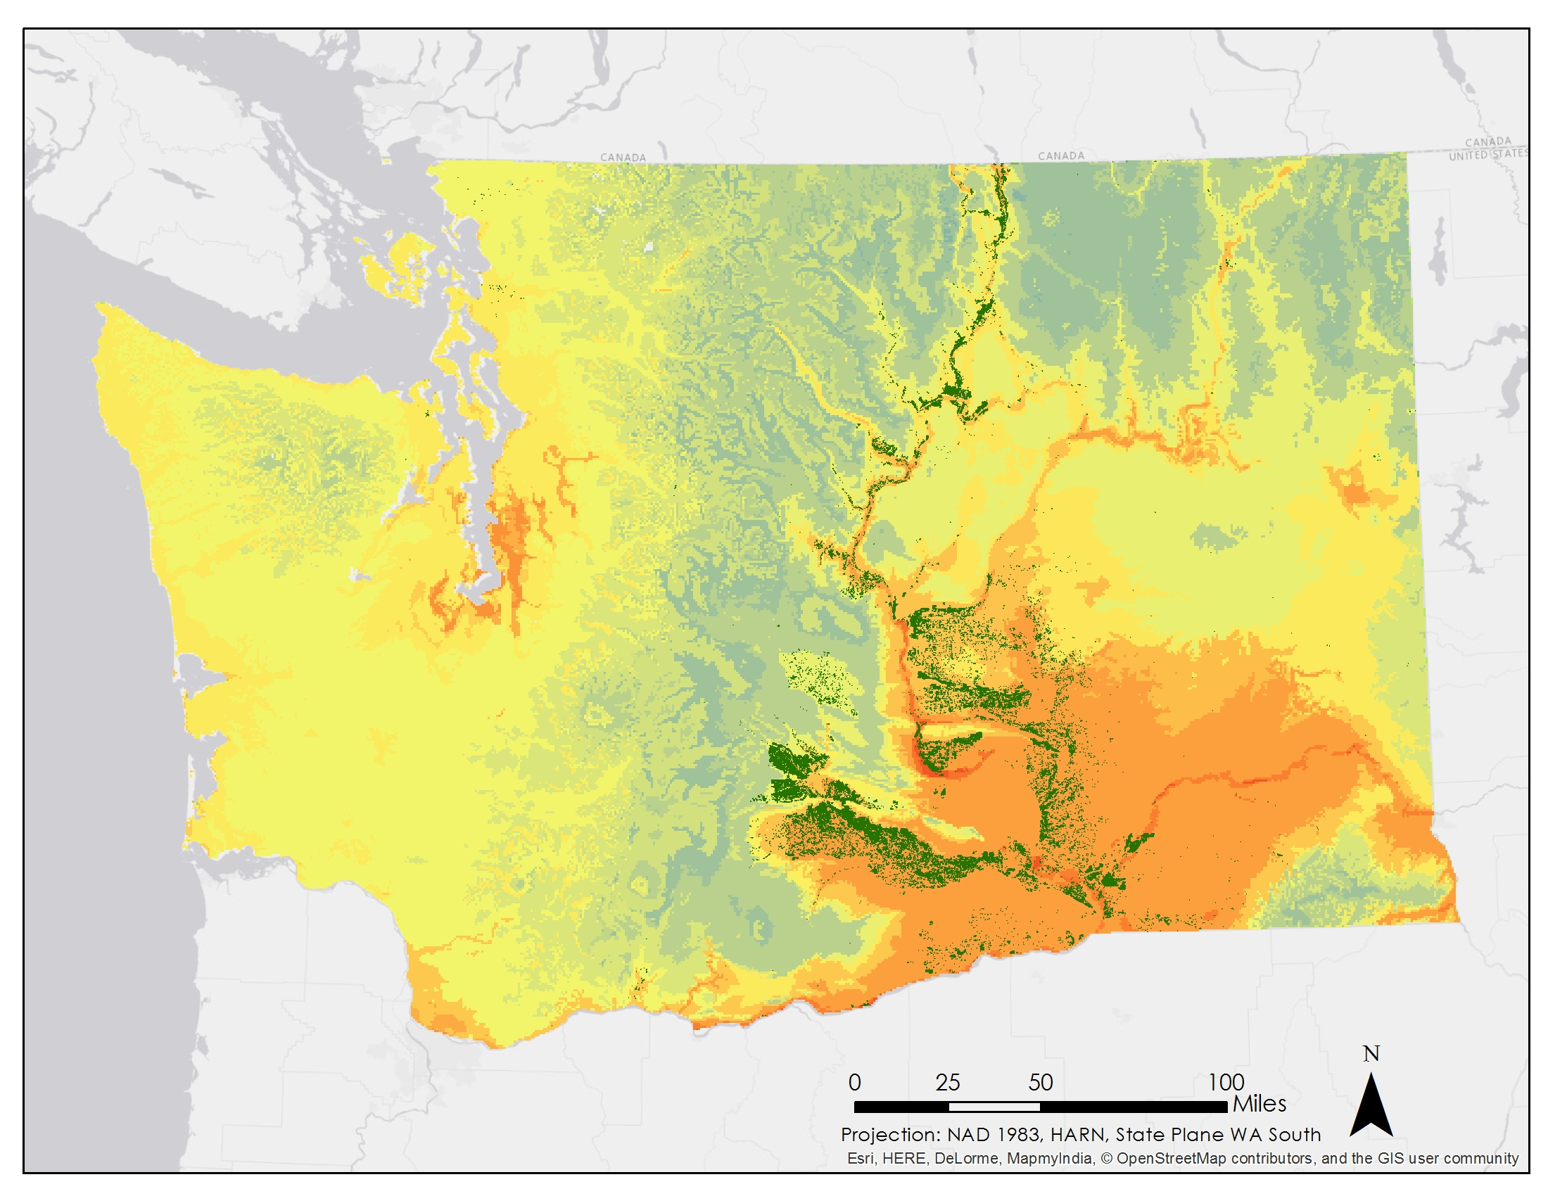
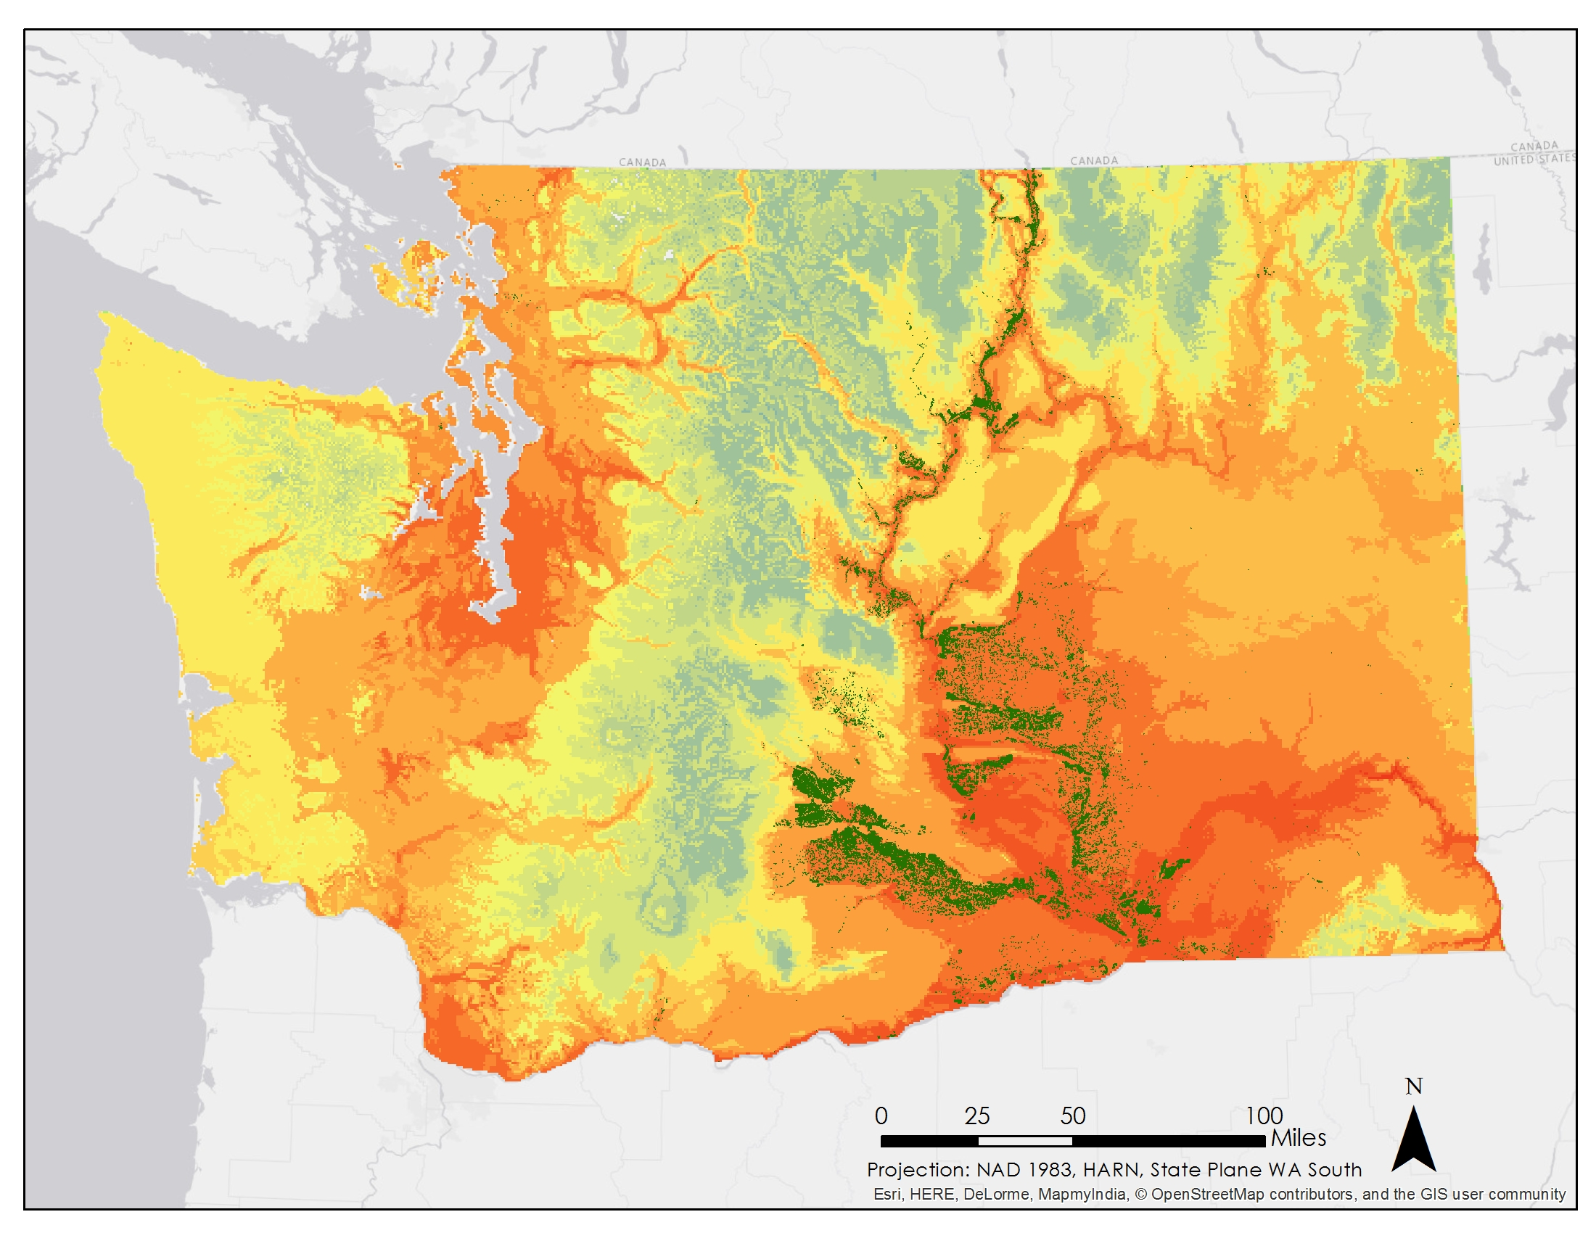

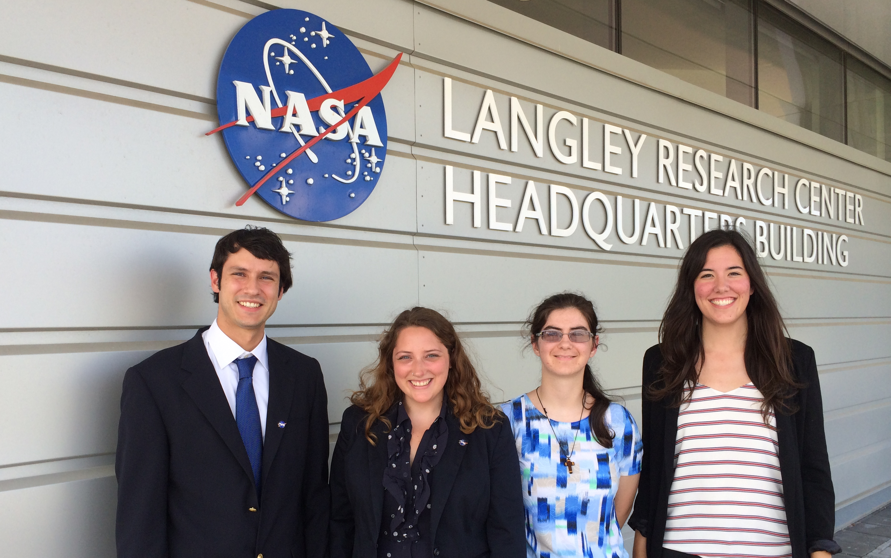

Northwest United States Agriculture III
Assessing current and future Plant Hardiness Zones for apple production in Washington State using climate models and NASA Earth observations
Madeline Ruid (Team Lead), Teresa Fenn, Matthew Mullen, Sarah Philbrick, James Hendrickson
NASA DEVELOP National Program at NASA Langley Research Center
Abstract
Objectives
Washington State produces 65% of the nation’s apples, adding 2.2 billion dollars to the nation’s economy. Washington’s warm, dry summers and cool, wet winters provide excellent conditions for apple growth. However, there is a strong likelihood that Washington’s suitability for apple farming could be altered by current and future climate change. Currently, the USDA determines which plant species will thrive in a particular location based on their Plant Hardiness Zone (PHZ) Map. Apples grow best when climate conditions match zones 5, 6, or 7. By creating maps of current and projected PHZs, apple growers will be able to decide both if it would be beneficial to move apple orchards in the upcoming decades and where the most suitable conditions will be located. Using Aqua MODIS Land Surface Temperature (LST) from 2002 to 2015, minimum temperatures per day and month were extracted to create a present-day PHZ map. Additionally, future climate model air temperature forecasts from the Coupled Model Intercomparison Project phase 5 (CMIP5) for 2040 to 2099 were used to determine future PHZs. Growing Degree Days (GDD) were also calculated to create orchard suitability maps. Since the ability of apple trees to thrive is dependent on GDDs, PHZs, and average growing season temperature, these maps provided further insight into which regions of Washington State may be suitable for apple orchards in the future. Final maps of current and forecasted PHZs will allow stakeholders to identify regions that are currently optimal for apple production, and see how those regions may move with forecasted climate change.
Create a current Plant Hardiness Zone (PHZ) map specific to Washington State
Forecast PHZs through 2095
Generate a current suitability map for apples in Washington State
Forecast the locations of suitable apple growing regions through 2095
Study Area
Methodology
Pre-
Processing
Download MODIS LST Data
Mosaic images
Estimate air temp from LST
Remove outliers
Rolling averages
Download Climate Model Data
Mask to study area
Convert data from K to C
Project data
Data Analysis
Plant Hardiness Zones
Suitability Maps
Find minimum value per year for each pixel and average from 2002-2015
Calculate GDD
Calculate avg growing season temp
Import PHZ
Classify into PHZ
Apply weights and classify into Suitability Regions
Earth Observations
Post Analysis
Accuracy Assessment
Change Analysis
Compare MODIS produced PHZ maps to PRISM produced PHZ maps to test accuracy of MODIS data
Quantifying degree of Plant Hardiness Zone change
Results
Aqua
2002-2015
2040 - 2049
2060 - 2069
2090 - 2099
Current Plant Hardiness Zone Map
Moderate Scenario PHZ Map
Moderate Scenario PHZ Map
Moderate Scenario PHZ Map
Conclusions
Extreme Scenario PHZ Map
Extreme Scenario PHZ Map
Extreme Scenario PHZ Map
Washington is currently well-suited to growing apples.
The moderate scenario shows conditions steadily worsening, becoming only marginally acceptable by 2095.
The extreme scenario shows conditions drastically worsening, becoming completely unfit by 2095.
The southern part of the state becomes unsuitable before the north.
By 2095, the only region that shows reasonable suitability is in the Cascades.
Current Suitability Map
Moderate Scenario
Moderate Scenario
Moderate Scenario
Extreme Scenario
Extreme Scenario
Extreme Scenario
Acknowledgements
Team Members
Dr. Kenton Ross
NASA DEVELOP National Program Science Advisor
Dr. Noel Baker
NASA Postdoctoral Program Fellow
Jeffry Ely
NASA DEVELOP Geoinformation Scientist
Emily Adams
NASA DEVELOP – Langley Center Lead
Dan Wozniak
NASA DEVELOP – Langley Assistant Center Lead
Northwest US Agriculture I, II
NASA DEVELOP – Fall 2014, Spring 2015
Project Partners
Dr. Michael Glenn
Appalachian Fruit Research Station
USDA- Agriculture Research Service
From left: Matthew Mullen, Sarah Philbrick, Teresa Fenn, Madeline Ruid
Not pictured: James Hendrickson
NASA Langley Research Center

