Slide 1
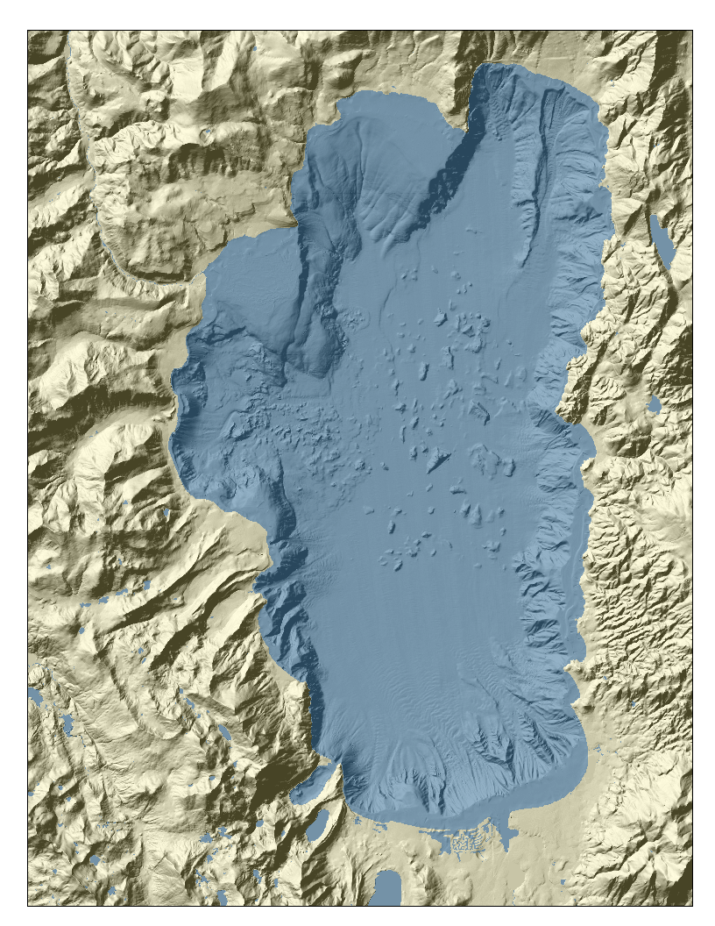
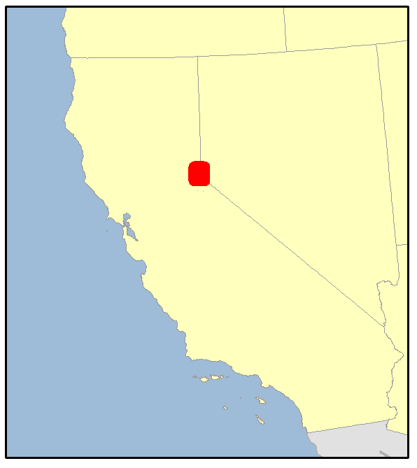
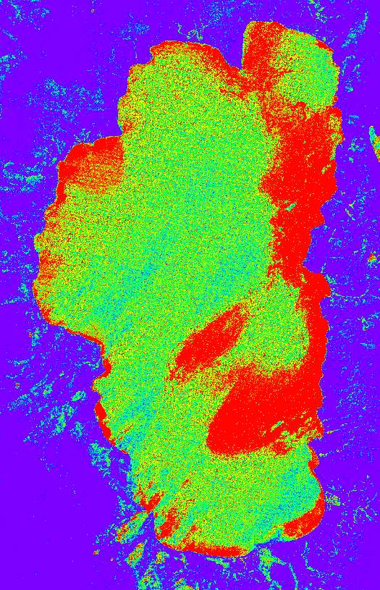
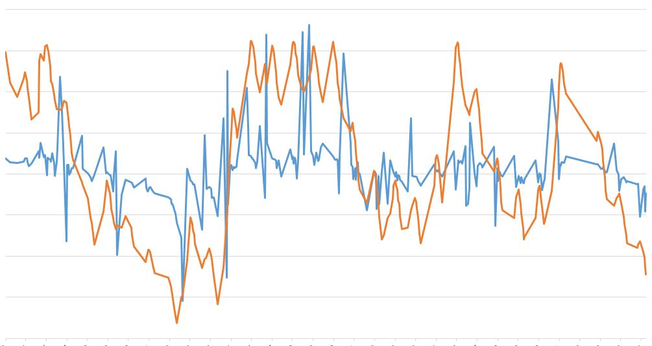
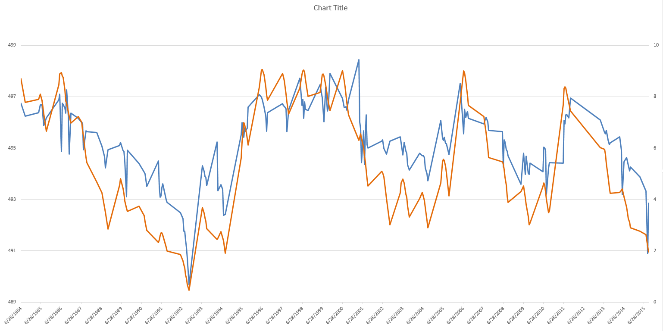
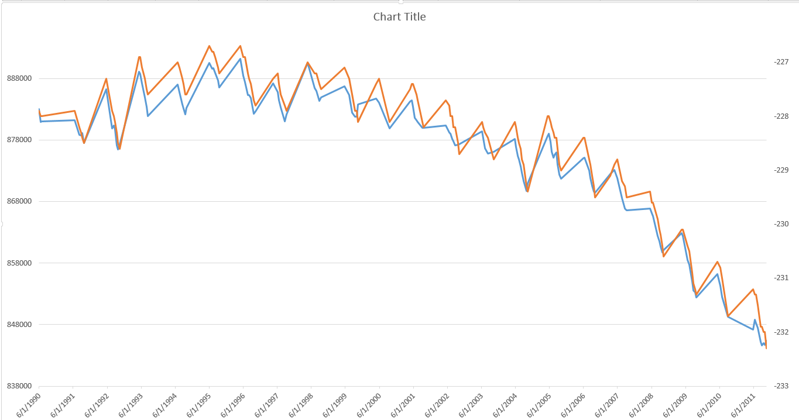
Lake Tahoe Water Resources
Creating an Algorithm for Global Continuous Lake Level Monitoring
using Landsat Imagery
Nolan Cate (Project Lead) , Anton Surunis, Chelsea Ackroyd
DEVELOP National Program at NASA Ames Research Center
Earth Observations
Objectives
Abstract
As global climate change continues to escalate and droughts become more frequent and severe, it becomes increasingly necessary to monitor and regulate available water resources. Lake Tahoe (CA/NV) is an important reservoir for tourism, local ecosystems, and drinking water. Its nearly 5 million annual visitors contribute at least $300 million to the local economy, making it one of California’s most popular attractions. Decreasing water levels are a concern for residents, the economy, and a number of endangered species that live on Lake Tahoe’s shores, such as the yellow cress. Current methods of monitoring lake levels, however, rely on depth gauges that require time-intensive fieldwork to retrieve data and are limited in their spatial coverage. Satellite imagery provides a far greater spatial extent while still providing regular measurements. Utilizing satellite imagery from the Landsat program, the Lake Level Automated Monitoring Algorithm (LLAMA) is a continuous detection lake level monitoring algorithm that uses a Modified Normalized Difference Water Index (MNDWI), thermal band analysis, and visible band reflectance values processed through Google’s cloud-based geospatial program, Earth Engine. In addition to a lake area measurement, LLAMA is able to show measurements of turbidity and algae levels over any given lake worldwide. Thus, LLAMA has the ability to provide water managers near real-time data regarding the turbidity, algae, and water levels for any lake or reservoir of sufficient size via Google Earth Engine.
Create a tool to allow LTBMU to continually monitor the level of Lake Tahoe and surrounding lakes
Prove that the tool is able to consistently measure lake turbidity
Make the tool effective for water managers worldwide by generalizing method of water detection
Landsat 4-5 (TM)
Study Area
Landsat 8 (OLI)
Methodology
Locate water body
Find pixels bright in the blue band
Discard pixels below freezing
Add pixels dark in infrared bands
Add pixels with high MNDWI
Calculate algae and turbidity
Output statistics
Results
These two graphs show the lake area LLAMA measures in blue and in situ gauge station measurements in orange.
The r values show the high correlation between the two datasets.
LLAMA is most accurate in lakes that do not have as steep of a basin, as more change can be seen in images.
Lake Tahoe r=0.814
Salton Sea r=0.992
Lake Area (pixels)
Gauge Height (ft)
Gauge Height (ft)
Lake Area (pixels)
Conclusions
Date
Date
Team Members
Project Partners
Water bodies with ideal conditions for LLAMA allow for direct measurements of lake level.
LLAMA may be used to monitor the trends in lake level over time.
Cloud-based computing is a promising avenue for the future of remote sensing and resource management.
Lake Tahoe Basin
Management Unit,
USDA Forest Service
Acknowledgements
Dr. Brian Coltin (NASA Ames Research Center)
Dr. Joey Keely (Lake Tahoe Basin Management Unit, USDA Forest Service)
Emily “Chippie” Kislik (NASA DEVELOP)
Victoria Ly (NASA DEVELOP)
Dr. Juan Torres-Pérez (Bay Area Environmental Research Institute)
(From left to right)
Anton Surunis, Chelsea Ackroyd, Nolan Cate
NASA Ames Research Center

