Slide 1
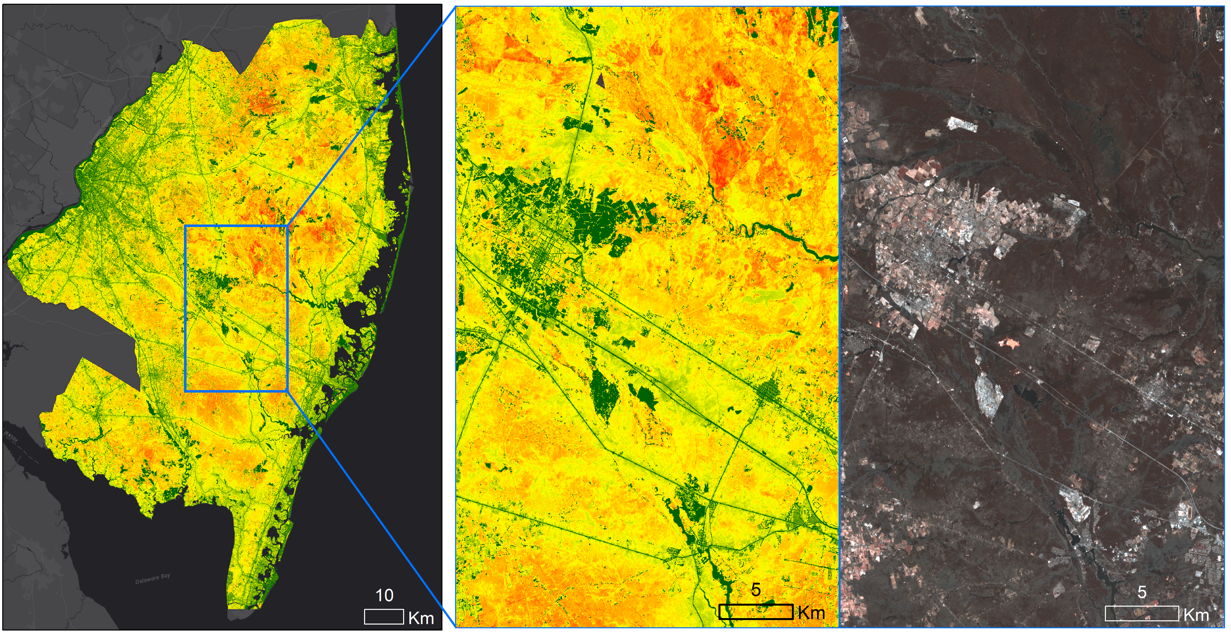
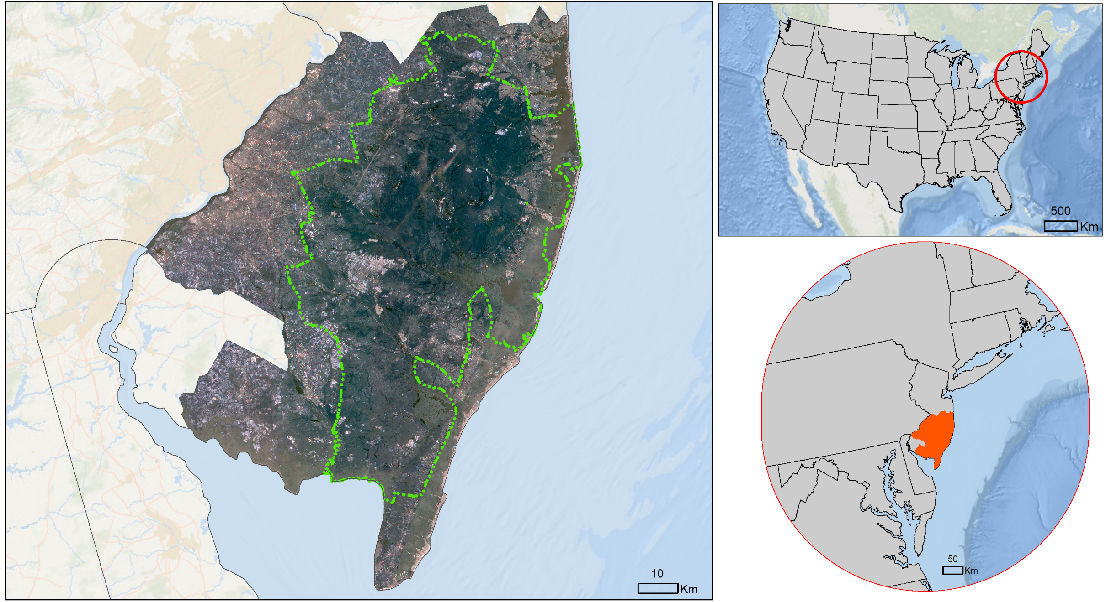

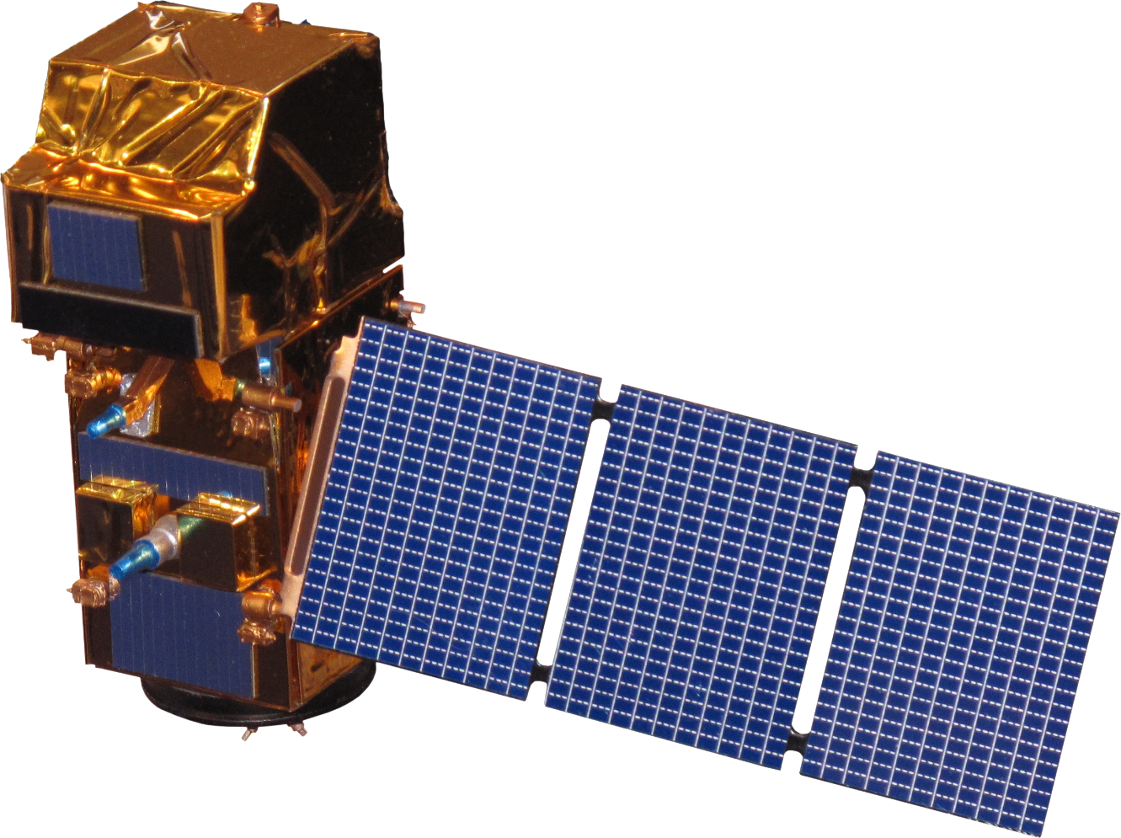
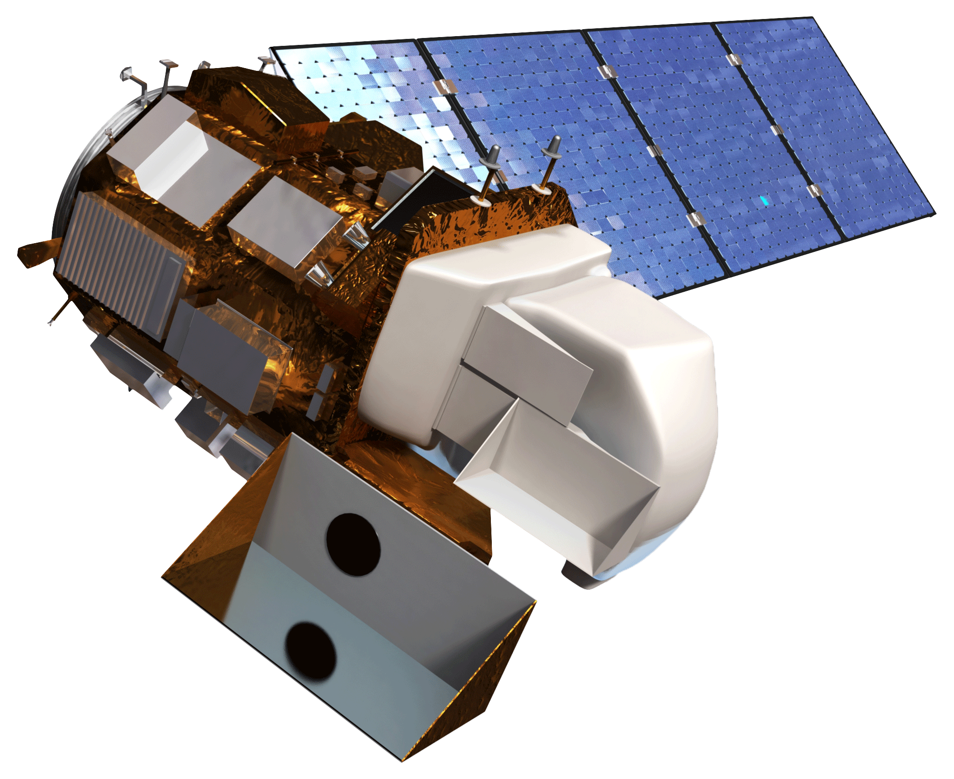





Identifying Optimal Regions within New Jersey’s Pine Barren Forest for Urban Development Based on Wildfire Risk and the Wildland Urban-Interface Theory
Abstract
Methodology
As New Jersey’s population increases, more of this population is relocating to the wildland-urban interface (WUI) of the south-central Pinelands region. Due to this increase in human activity coupled with local environmental conditions, local authorities are concerned about an increased possibility of wildfires that could damage both the area’s infrastructure and ecosystem. To counteract this risk, it is necessary to develop methods for accurate wildfire assessment and mitigation efforts. This project partnered with the New Jersey Pinelands Commission (NJPC) to develop a Fire Risk Assessment Tool that identifies areas with high fire risk based on land cover characteristics. The team incorporated vegetation indices derived from Landsat 8 Operational Land Imager (OLI) and Sentinel-2 Multi-Spectral Instrument (MSI), land-use classification derived from LANDFIRE data and elevation into a fuzzy logic model to generate a 30 x 30 m Fire Risk Assessment Map. The map was used to analyze fire susceptibility in the Pinelands WUI and to identify optimal areas for urban expansion. Fifty-three percent of the total area within the Pinelands WUI was classified as having a moderate fire risk, while high and extremely-high fire risk accounted for 13%. An estimated 200,000 acres of land with a low to moderate risk of fire were identified as areas that would be suitable for development. The results and maps produced will be used by the New Jersey Pinelands Commission to guide urban development planning and decision making.
Data Acquisition
  Data Processing
  Data Analysis
  End Products
Landsat 8 OLI & Sentinel-2 MSI
LandFire
TIGER
Ignition Sources
Pinelands WUI
  Clipping
  Reprojection
  Reclassification
  Euclidean Distance
  Fuzzy Logic Membership
  Fuzzy Overlay
  Fire Risk Assessment Tool and Map
  Fire Risk Analysis of the Pinelands WUI
Results
Fire Risk Assessment Map
Objectives
Classify fire risk throughout the study area and ensure the usability of the Fire Risk Assessment Tool by use by the New Jersey Pinelands Commission
Analyze fire risk in the Pinelands WUI to aid our partners in identifying suitable areas for urban development
Locate areas where our partners should apply fire mitigation efforts to minimize fire induced economic and infrastructure losses
Wharton State Forest
Hammonton
Hamilton Township
Project Partner
Fire Risk Analysis of the Pinelands WUI
New Jersey Pinelands Commission
Study Area
NY
MA
PA
NJ
CT
DC
DE
VA
MD
Pinelands
Management Area
Extremely Low
Low
Moderate
High
Extremely High
Study Area
Earth Observations
Conclusions
53% of the Pinelands WUI were classified as moderate to low fire risk areas, while only 13% were classified as high to extremely high fire risk areas.
Approximately 200,000 acres of the WUI would unsuitable for development based on fire risk.
The New Jersey Pinelands commission will use the Fire Risk Assessment Map for urban development decision-making and planning.
The Fire Risk Assessment Tool will be used by our partner to generate up-to-date fire risk maps in the future.
Sentinel-2
Multi-Spectral Instrument (MSI)
Landsat 8 Operational Land Imager (OLI)
Team Members
Acknowledgements
Dr. Jeffrey Luvall (NASA Marshall Space Flight Center)
Dr. Robert Griffin (University of Alabama in Huntsville)
Leigh Sinclair (University of Alabama in Huntsville/Information Technology and Systems Center)
Maggi Klug (University of Alabama in Huntsville)
Larry Liggett (New Jersey Pinelands Commission)
Gina Berg (New Jersey Pinelands Commission)
William Zipse (New Jersey Forest Fire Service)
Jeremy Webber (New Jersey Forest Fire Service)
Man Kumari Giri
Project Lead
Mercedes Bartkovich
Olivia Buchanan
Nicholas McVey
New Jersey Urban Development
Alabama – Marshall | Spring 2018

