Slide 1
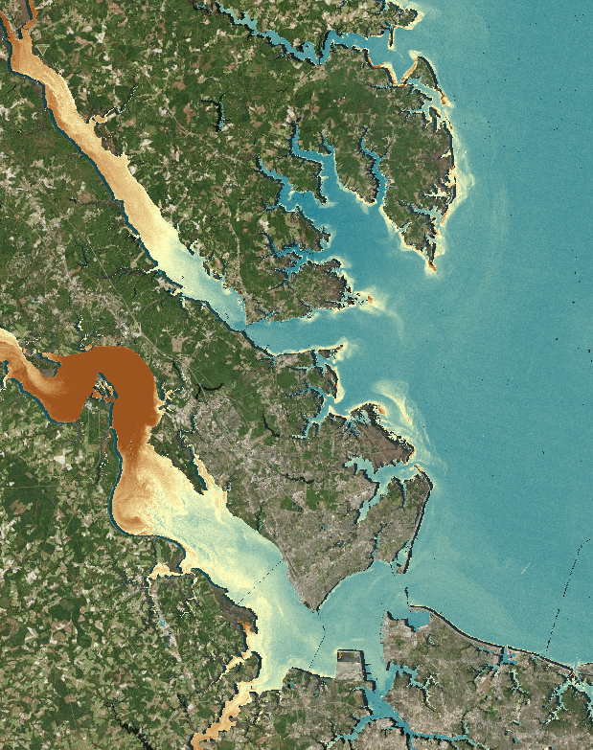
CHESAPEAKE BAY WATER RESOURCES II
Assessing Water Clarity to Identify Potential Areas of Submerged Aquatic Vegetation (SAV) in the Chesapeake Bay
Eli Simonson
Antonio Alvarado
Will Crowley
NASA Langley Research Center
2017 Summer
Notes:
We are the Chesapeake Bay Water Resources II Team *Introduce yourself (name, degree/field, school)*
Total Slides:
Eli – 8 slides
Antonio – 10 slides
Will – 13 slides

Slide 2
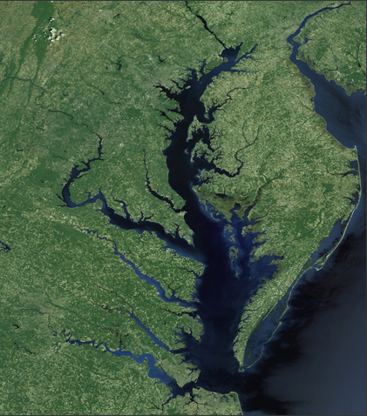
The Chesapeake Bay
Spans 64,000 miles of diverse ecosystems
Study Area: The Chesapeake Bay
Study Period: 2013 – 2017 (March – October)
Partners: Virginia Department of Environmental Quality & USGS Water Science Center
Image Credit: NASA GSFC Landsat/LDCM EPO Team
Notes:
Eli:
The Chesapeake Bay’s watershed spans 64,000 miles and hosts a diverse range of plants and animals. Submerged aquatic vegetation (SAV) in the Bay, also known as SAV, is particularly important because it provides valuable ecosystem services such as food and oxygen for aquatic wildlife to survive, and can therefore be used as an indicator of overall bay health.
For our project we partnered with the Virginia Department of Environmental Quality and the US Geological Survey to analyze water clarity and assist them with monitoring SAVs.
Image Source: https://www.visibleearth.nasa.gov/view.php?id=41423

Slide 3
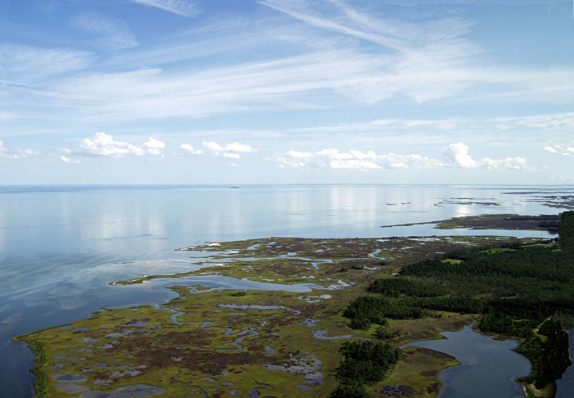
Community Concerns
Variations in water quality can have significant effects on SAV growth
Monitoring water quality is essential for health of the Chesapeake Bay
Virginia DEQ relies on in situ data to monitor water quality
Image Credit: Kay Moneymaker/Scenic Virginia
Notes:
Eli:
Why is this important? Variations in water quality can have significant impacts on SAV growth and stability. This is why monitoring efforts are put in place. To ensure that SAVs, along with the rest of the Bay, continue to stay in good condition.
Picture link: http://scenicvirginia.org/ngg_tag/chesapeake-bay/

Slide 4
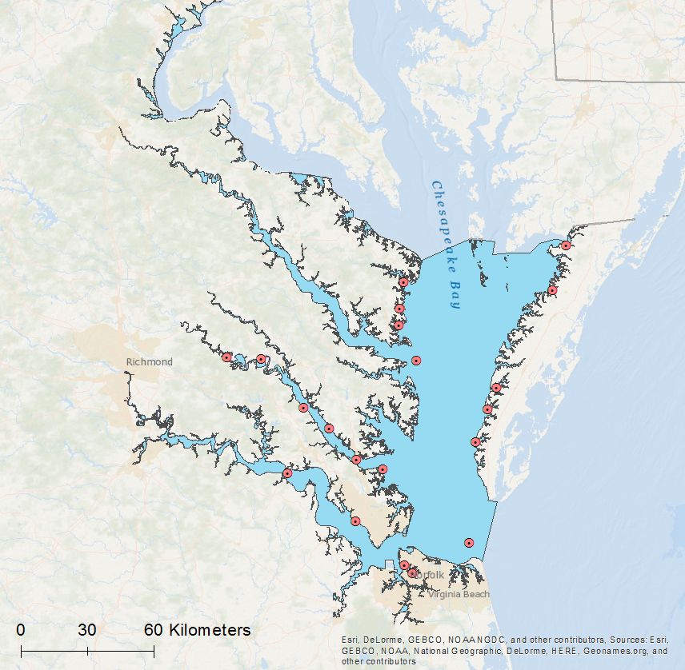
In Situ Observations
Chesapeake Bay & tributaries within Virginia
20 continuous monitoring stations measuring:
Temperature
Salinity
Chlorophyll
Turbidity
Continuous Monitoring Stations
VA Chesapeake Bay Study Area
Notes:
Antonio:
The Virginia DEQ’s current method of monitoring habitable areas for SAV relies on analyzing data and generating surface maps from continuous monitoring stations throughout the bay and its tributaries.
The primary locations of interest include the Rappahannock, York, and James Rivers as well as the southern bank of the Potomac River.

Slide 5
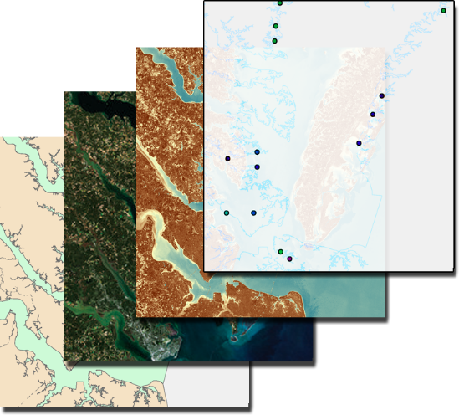
Objectives & Methodology - Term 1
Identify metrics to determine water quality in the Chesapeake Bay watershed
Create a model to track water turbidity using Landsat data
Monitoring station data points
Normalized Difference Turbidity Index
Landsat Surface Reflectance
Chesapeake Bay Study Area
Notes:
Eli

Slide 6
Analysis & Results – Term 1
Regressions Produced:
$$\text{NDTI}\text{ =} \frac{\text{(}\text{Red}\text{ − }\text{Green}\text{)}}{\text{(}\text{Red}\text{ + }\text{Green}\text{)}}$$
Landsat 5
y = 16.99 + 103.44*NDTI + 0.02*B1
Normalized Difference Turbidity Index
Landsat 8
y = 16.88 + 30.78*NDTI - 0.01*B1 - 0.01*B2
Analysis performed with Google Earth Engine
Notes:
Eli

Slide 7
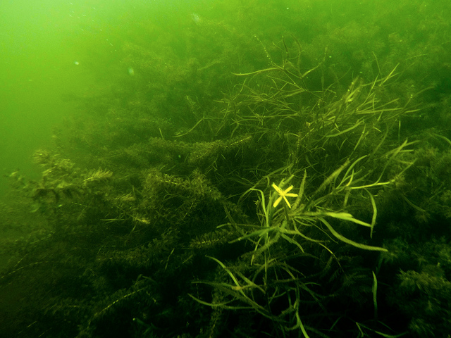
Project Objectives – Term 2
Determine feasibility of using remote sensing to monitor water clarity
Correlate and model satellite derived water clarity metrics
Expedite atmospheric correction process for satellite imagery
Produce annual water clarity maps
Image Credit: Will Parson/Chesapeake Bay Program
Notes:
Antonio:
In aiming to prove the effectiveness and feasibility of using satellite remote sensing to monitor water quality over the bay, the team correlated and modeled satellite derived water clarity metrics with continuous in situ monitoring data.
Annual Chesapeake Bay-wide and tributary Water Clarity Maps were produced for the partners identifying variations in turbidity.
Image Source: http://farm4.static.flickr.com/3843/32908906493_0cd1cd50dc_z.jpg

Slide 8
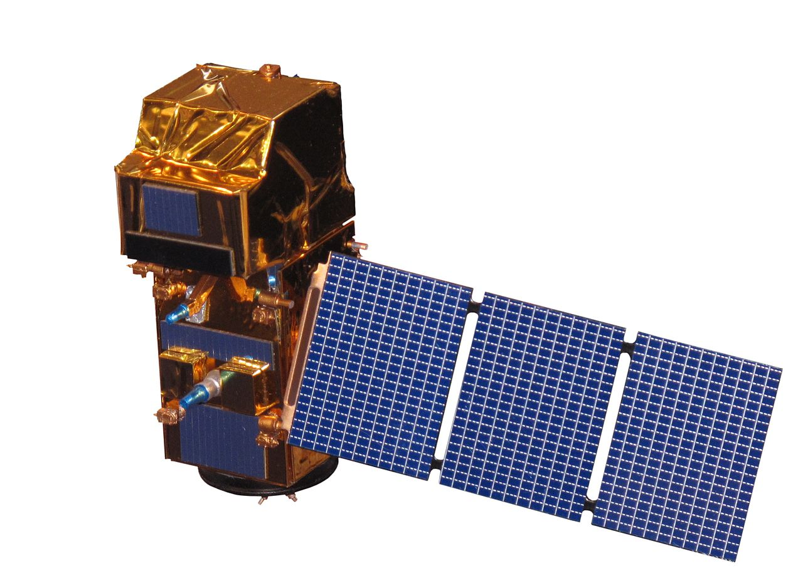
NASA & ESA Earth Observations
Landsat 8
Operational Land Imager (OLI)
2013 - 2017
Sentinel-2
MultiSpectral Instrument (MSI)
2015 - 2017
Notes:
Antonio:
Landsat 8 OLI and Sentinel-2 MSI were chosen to correlate with the in situ VIMS data. Landsat 8’s 30 meter spatial resolution Sentinel-2’s respective 10 meter spatial resolution made these satellites clear candidates for monitoring water quality over the Chesapeake Bay.

Slide 9
Methodology
Earth Observations Acquisition
Virginia Institute of Marine Science
Landsat 8 OLI
Sentinel-2 MSI
In Situ Continuous Monitoring Stations
Atmospheric Correction & Turbidity
Satellite vs In Situ Date Matching
Resulting End Products:
L8 and S2 Statistical Correlations
Chesapeake Bay Water Clarity Maps
Notes:
Antonio:
Once the earth observations and in situ data were acquisitioned, the satellite imagery was atmospherically corrected, where images were atmospherically corrected and algorithms measuring variations in turbidity were applied.
The data from the monitoring stations were matched with satellite flyover dates and times. Once matched, statistical correlations were conducted through regression analysis, and water clarity maps were produced utilizing the highest correlated turbidity algorithms.
Process A:
A.1: Earth Observations Acquisition, Remote Sensing Satellite Data
A.2: Retrieve Landsat 8 OLI and Sentinel-2 MSI satellite imagery
A.3: ACOLITE Processing, providing L8 and S2 output turbidity products
Process B:
B.1: VIMS Acquisition, Virginia Estuarine & Coastal Observing System
B.2: in situ continuous monitoring stations and cruise data
B.3: VIMS vs. EO Date Matching, to narrow in situ data to dates matching L8 and S2
Resulting End Products:
Statistical Correlations of L8 and S2 vs. VIMS data & Annual Chesapeake bay-wide and water clarity maps

Slide 10
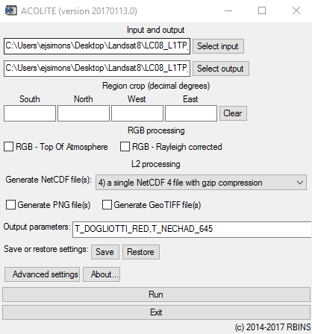
New Additions to the Methodology
ACOLITE is an atmospheric correction and processor for satellite imagery, including:
Landsat 8
Sentinel-2
Developed at the Royal Belgian Institute of Natural Sciences (RBINS)
ACOLITE allows simple and fast processing of L8 and S2A images for marine and inland water applications
Notes:
Eli

Slide 11
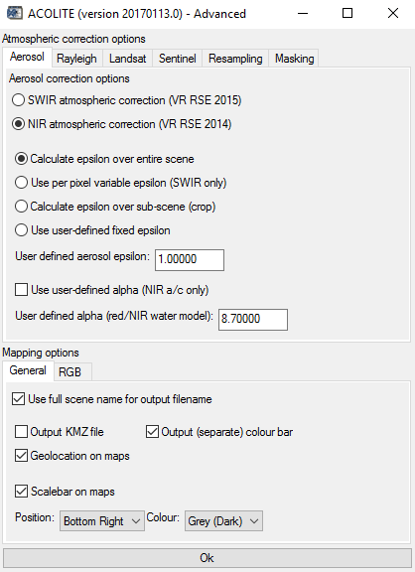
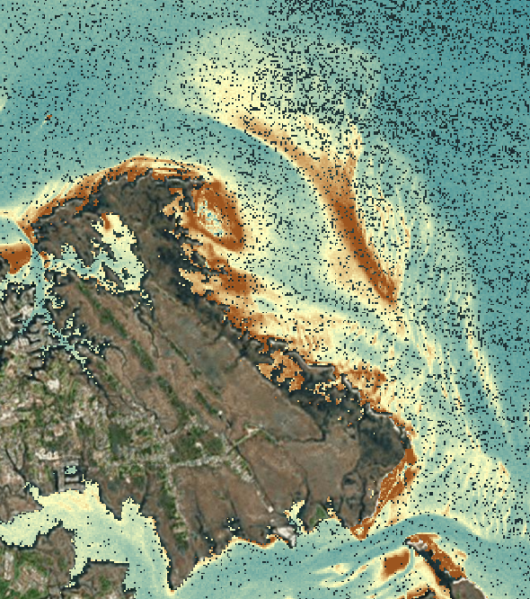
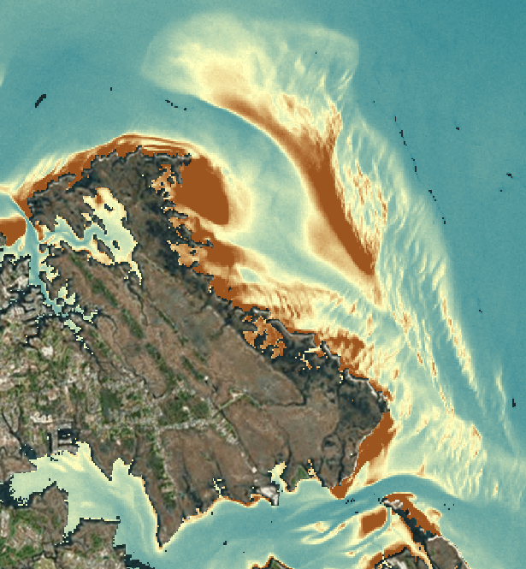
ACOLITE Advanced Settings
SWIR vs NIR atmospherically corrected ACOLITE products, derived from Landsat 8 imagery captured April 9th, 2017
Notes:
Antonio

Slide 12
ACOLITE Turbidity Algorithms
T_DOGLIOTTI_RED: red-band turbidity from (Dogliotti et al., 2015) using the 645 nm setting from their paper with the OLI 655 nm band or the MSI 665 nm band.
T_GARABA_645_LIN: turbidity from (Garaba et al., 2014) using the linear 645 nm model from their paper with the OLI 655 nm band or the MSI 665 nm band.
T_NECHAD_645: turbidity from (Nechad et al., 2009) using the 645 nm setting from their paper with the OLI 655 nm band or the MSI 665 nm band.
Single band retrieval algorithms relate turbidity and water reflectance at a predefined wavelength chosen by the user – In our case, the red band
Notes:
Eli

Slide 13
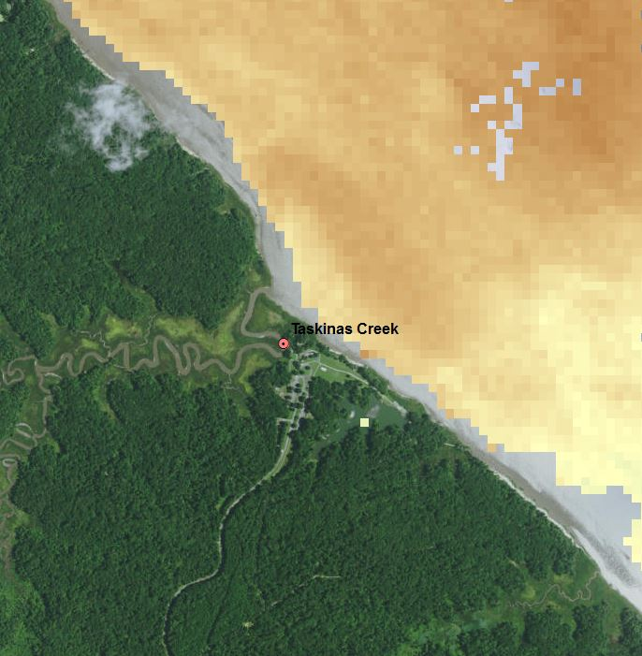
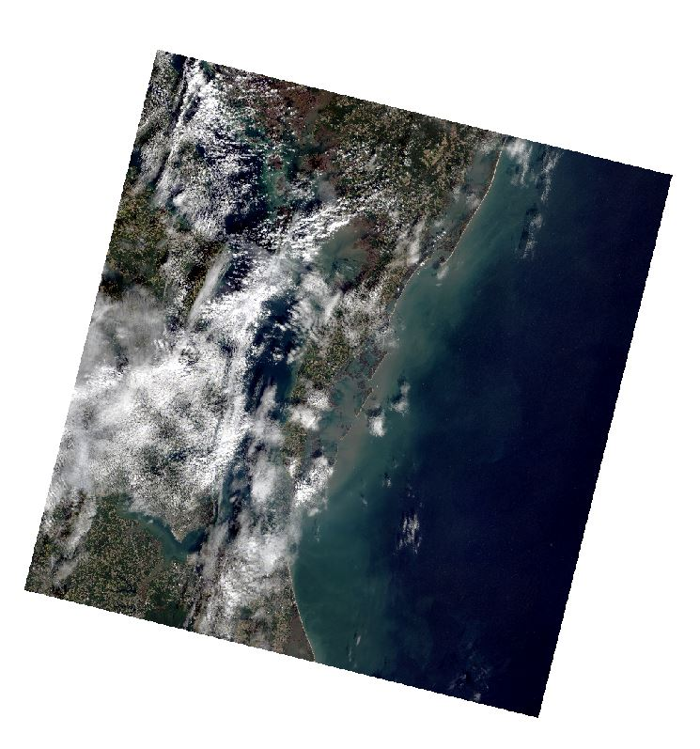
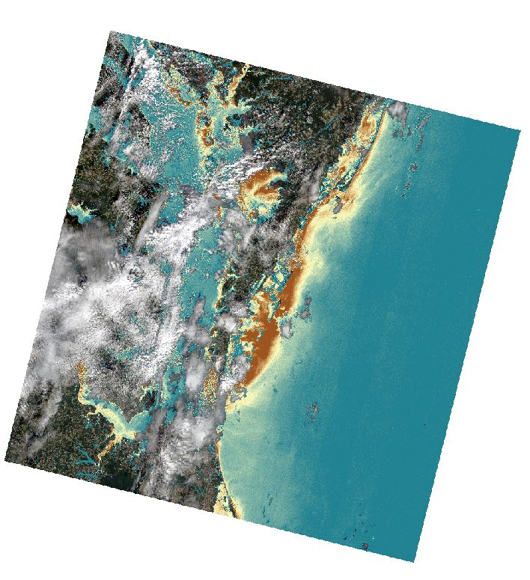
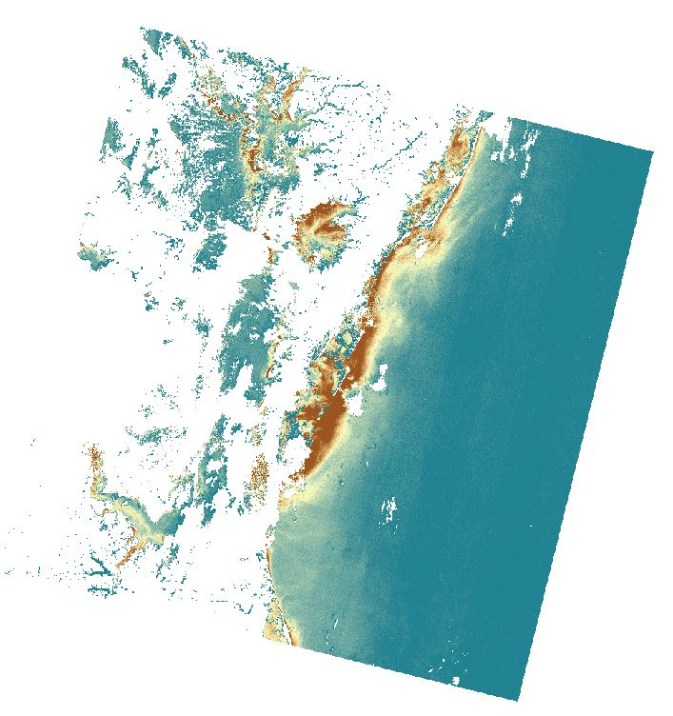
ACOLITE Output Limitations
Limited satellite data availability for imagery with heavy cloud cover
Limited satellite data availability around monitoring stations close to land/inland
RGB Overview with Cloud Cover
Turbidity Product over RGB with Cloud Cover
ACOLITE processed Turbidity Product
Notes:
Eli

Slide 14
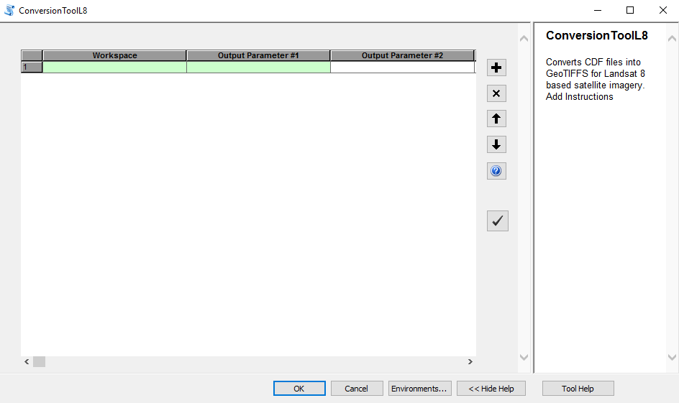
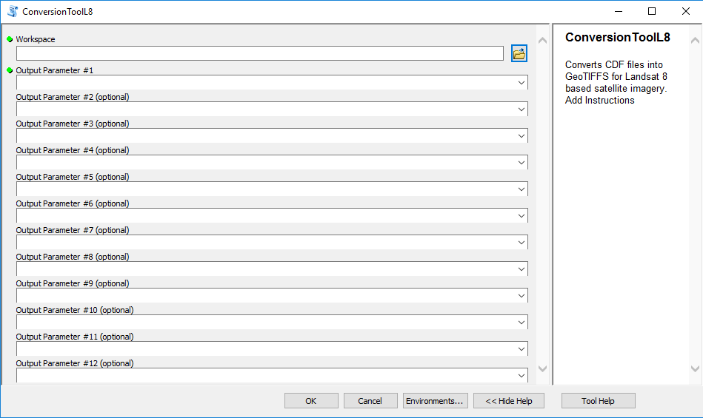
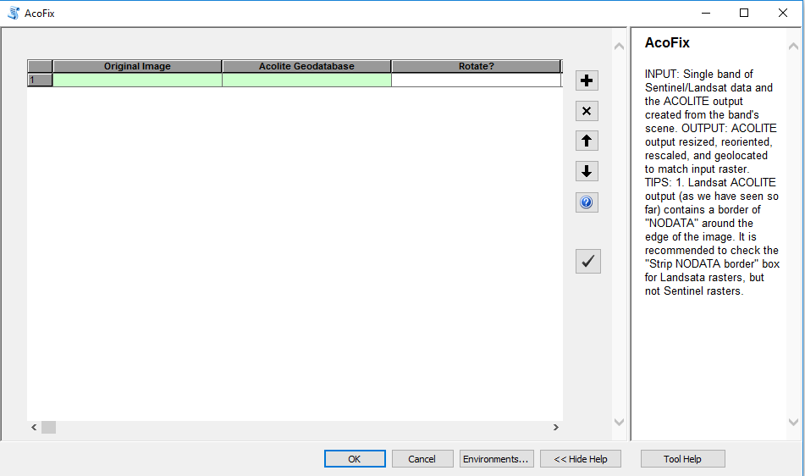
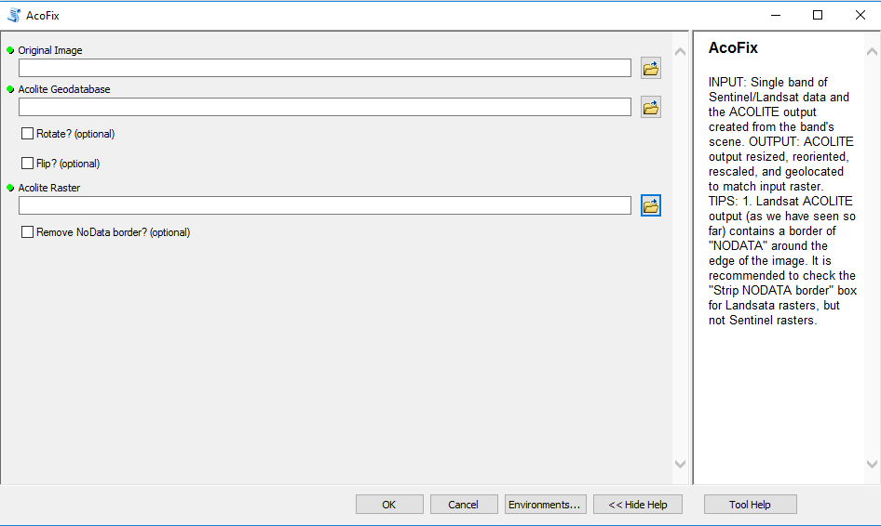
Python Scripts & ArcMap Tools
Notes:
Antonio

Slide 15
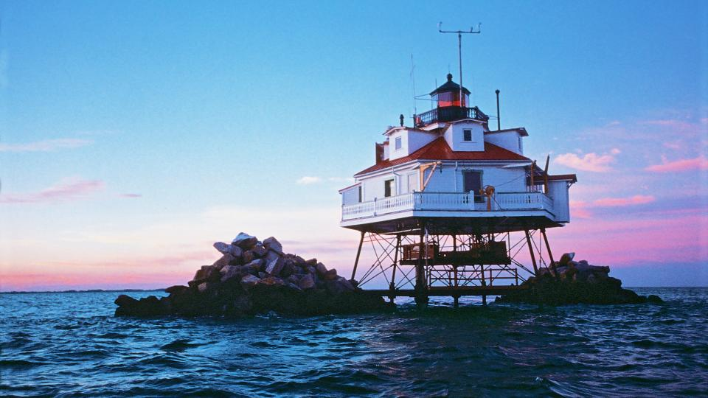
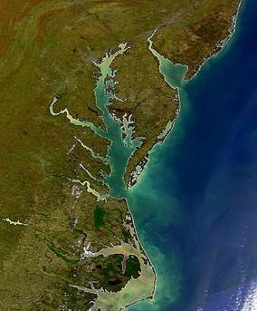
Analysis & Results
Image Credit: VisitMaryland.org
Image Credit: National Park Service
Notes:
William:
The overall analysis of the Chesapeake Bay requires many strong observations and analytical tools due to the bays complexity and diversity. There are many different water types, parameters such as depth and continuous monitoring station locations, or satellite interferences that make certain levels of bay-wide analysis problematic. Through majority of our findings, our team found that there is much promise in this research, and that continuing with future studies within the next couple years will be highly fruitful in this project.
Top right picture link:
http://www.visitmaryland.org/list/25-cant-miss-things-to-do-along-chesapeake-bay
Bottom left picture link: https://www.nps.gov/nr/testing/cultural_groups/Chesapeake_Bay_Gateways_and_Watertrails_Network.html

Slide 16
Statistical Correlations By Station
NIR Corrected by Station Statistical Analysis |  | ACOLITE Turbidity Products (R Values)
 |  | RRS Red | Dogliotti Red | Dogliotti Blended | Garaba | Nechad
Continuous Monitoring Stations | Cherrystone |  |  |  | 0.398
 | Ashland Circle |  |  |  |  | 0.949
 | Claybank |  | 0.174
 | Dividing Creek |  |  |  |  | 0.570
 | First Landing |  | 0.867 |  |  | 0.867
 | Gloucester |  |  |  |  | 0.332
 | Goodwin Island |  |  |  | 0.145
 | Hungars Creek | 0.903
 | Hunting Creek |  |  |  |  | 0.375
 | Indian Creek
 | Ingram Bay |  | 0.507
 | Jamestown Buoy |  |  | 0.732
 | James River |  |  |  |  | 0.562
 | Nassawadox Creek |  |  |  |  | 0.623
 | Norfolk Yacht |  |  |  |  | 0.466
 | Stingray Point |  | 0.984
 | Tallpines |  |  |  | 0.999
 | White House Landing |  |  |  |  | 0.198
 | Sweet Hall Marsh | 1.000
Best Combined Analysis
Station | Product
Cherrystone | Nechad
Tallpines | Nechad
Ashland Circle | Nechad
Dividing Creek | Nechad
Hunting Creek | Nechad
James River | Nechad
Nassawadox Creek | Nechad
Norfolk Yacht | Nechad
First Landing | Nechad/Dogliotti Red
Hungars Creek | Dogliotti Red
Sweet Hall Marsh | Dogliotti Red
Claybank | Dogliotti Red
Ingram Bay | Dogliotti Red
Jamestown Buoy | Dogliotti Red
Stingray Point | Dogliotti Red
NIR Corrected by Station Statistical Analysis |  | ACOLITE Turbidity Products (R Values)
 |  | RRS Red | Dogliotti Red | Dogliotti Blended | Garaba | Nechad
Continuous Monitoring Stations | Cherrystone | 0.275 | 0.257 | 0.257 | 0.398 | 0.385
 | Ashland Circle | N/A | N/A | N/A | 0.949 | 0.949
 | Claybank | 0.151 | 0.174 | 0.174 | 0.052 | 0.119
 | Dividing Creek | 0.104 | 0.100 | 0.100 | 0.484 | 0.570
 | First Landing | 0.861 | 0.867 | 0.867 | 0.861 | 0.867
 | Gloucester | 0.302 | 0.305 | 0.305 | 0.290 | 0.332
 | Goodwin Island | 0.036 | 0.054 | 0.050 | 0.145 | 0.030
 | Hungars Creek | 0.903 | 0.747 | 0.747 | 0.723 | 0.741
 | Hunting Creek | 0.960 | 0.263 | 0.263 | 0.323 | 0.375
 | Indian Creek | 0.448 | 0.466 | 0.466 | 0.492 | 0.503
 | Ingram Bay | 0.491 | 0.507 | 0.507 | 0.264 | 0.097
 | Jamestown Buoy | 0.670 | 0.725 | 0.732 | 0.677 | 0.731
 | James River | 0.241 | 0.393 | 0.393 | 0.414 | 0.562
 | Nassawadox Creek | N/A | 0.497 | 0.497 | 0.583 | 0.623
 | Norfolk Yacht | 0.102 | 0.126 | 0.126 | 0.080 | 0.466
 | Stingray Point | 0.984 | 0.984 | 0.984 | 0.961 | 0.950
 | Tallpines | N/A | N/A | N/A | 0.999 | 0.999
 | White House Landing | N/A | N/A | N/A | 0.193 | 0.198
 | Sweet Hall Marsh | 1.000 | 0.999 | 0.999 | 0.378 | 0.419
NO STATION AVAILABLE
NEGATIVE CORRELATIONS
POSITIVE CORRELATIONS
BEST POSITIVE CORRELATION
Notes:
William:
These are majority of our overall regression findings, where we matched our satellite data to the data from continuous monitoring stations, the main and most current method the Virginia department of environmental quality measures turbidity within the bay. At the top of the table you can see the turbidity products tested, like __,__,__, and towards the left are the monitoring stations. As you can see there is a lot going on with this table, yet if we focus on the stations with the highest regression values, the analysis becomes a little more clear. We realized that our best overall analysis was achieved through utilizing nechad for tributaries within the bay and dogliotti red for waters that were generally further away from the shore.

Slide 17
Overall Analysis
Best Analysis
Station | Product | Location Description
Cherrystone | Garaba | Open Water
Goodwin Island | Garaba | Shallow Water, Sandy Bottom, Clear Conditions
Tallpines | Garaba | Open Water in Basin, Close to Shore
Indian Creek | N/A | Near Dock, Shallow Water, Sandy Bottom
Ashland Circle | Nechad | Tucked In, Small Sandy Bottom
Dividing Creek | Nechad | Near Dock, Shallow Water
Gloucester | Nechad | Adjacent to VIMS Coastline, Near bridge and Land
Hunting Creek | Nechad | In Creek, No Bottom Effect
James River | Nechad | Near building, No Sandy Bottom
Nassawadox Creek | Nechad | In Creek, Small Sandy Bottom
Norfolk Yacht | Nechad | Tucked Away in Norfolk Marina, Adjacent to Bridge
White House Landing | Nechad | Far up on Pamunkey, Near Bridge, Lots of SSD
First Landing | Nechad/Dogliotti Red | Out in Open Bay Waters
Hungars Creek | RRS Red | In Creek, Little Bottom
Sweet Hall Marsh | RRS Red | Up in Pamunkey River, Off land
Claybank | Dogliotti Red | Out in York, No Bottom
Ingram Bay | Dogliotti Red | Shallow Clear, Constant Conditions, Coastal, Away from Shore
Jamestown Buoy | Dogliotti Blend | Out in James River, Open Water
Stingray Point | Dogliotti Red | Open Water, Mouth of Rhappahannok
Best Combined Analysis |  | Deleted Stations
Station | Product | Goodwin Island
Cherrystone | Nechad | Gloucester
Tallpines | Nechad | White House Landing
Ashland Circle | Nechad | Indian Creek
Dividing Creek | Nechad
Hunting Creek | Nechad
James River | Nechad
Nassawadox Creek | Nechad
Norfolk Yacht | Nechad
First Landing | Nechad/Dogliotti Red
Hungars Creek | Dogliotti Red
Sweet Hall Marsh | Dogliotti Red
Claybank | Dogliotti Red
Ingram Bay | Dogliotti Red
Jamestown Buoy | Dogliotti Red
Stingray Point | Dogliotti Red
Notes:
Will

Slide 18
Earth Observations vs. In Situ Data
In situ Measured Turbidity (NTU)
In situ Measured Turbidity (NTU)
Nechad Estimated Turbidity (FNU)
Dogliotti Red Estimated Turbidity (FNU)
Nechad: R = 0.5929
y = 1.3356x + 3.6444
Dogliotti Red: R = 0.5997
y = 1.2647x + 3.7365
Notes:
William:
Here is a more thorough display of our regression analysis of the top 2 products. On the right is our nechad turbidity product and on the left is our dogliotti red. Satellite data is measured in FNU which is directly comparable to turbidity data measured by continuous monitoring stations in NTU. Some interesting things to notice is that our regression model’s intercept is positive and the slope is close to one, this is important in noting the accuracy in receiving data with the least amount of linear transformations.

Slide 19
Combined Nechad and Dogliotti Red
Nechad and Dogliotti Red: R = 0.6727
y = 1.4605x + 2.6439
Notes:
Will

Slide 20
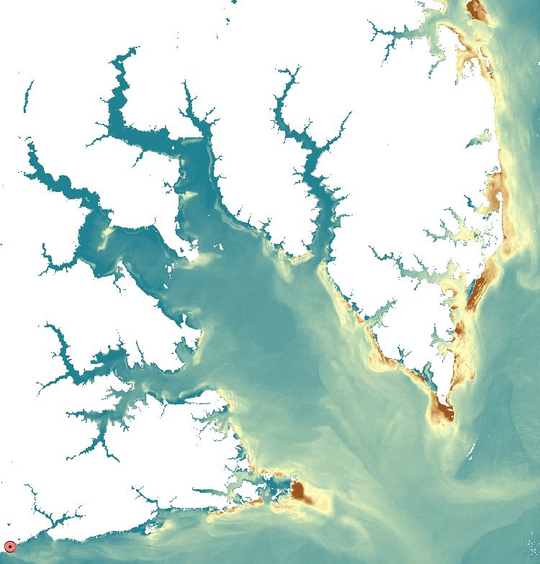
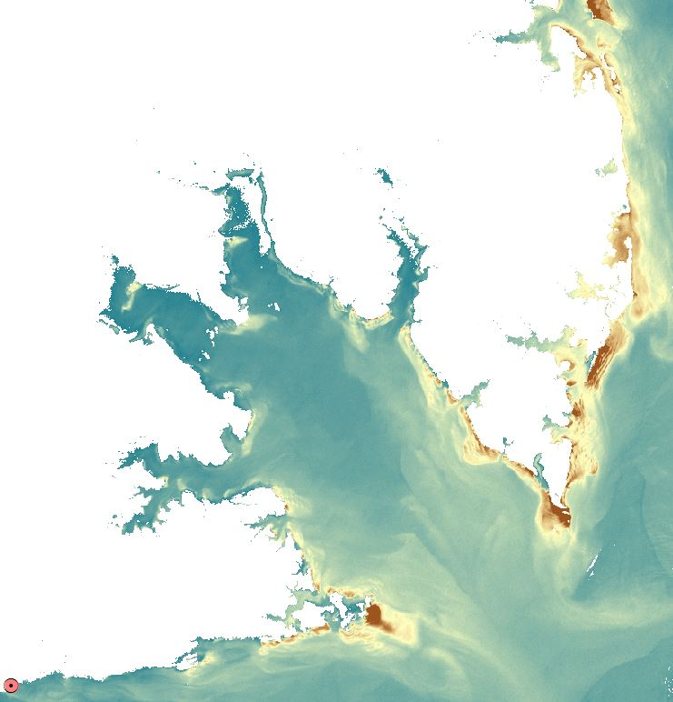
Nechad vs. Dogliotti Red: Tributaries
Turbidity Scale (FNU)
High: 15+
Low: 0
Gloucester Point
Gloucester Point
Landsat 8 Nechad Turbidity Product (07/19/13)
Landsat 8 Dogliotti Red Turbidity Product (07/19/13)
Notes:
William:
This is mobjack bay, an interesting example through much of our project. You can see with the nechad product on the right, we have more data to analyze and more accurate results compared to the dogliotti red product on the left that has trouble picking up the finer details of the bay’s tributaries.

Slide 21
Strength Coefficient
Strength Coefficient
Nechad | Cherrystone | 0.440 | T Dogliotti Red | Cherrystone | 0.279
 | Ashland Circle | 1.784 |  | Ashland Circle | N/A
 | Claybank | 0.159 |  | Claybank | 0.350
 | Dividing Creek | 1.824 |  | Dividing Creek | -0.021
 | First Landing | 0.993 |  | First Landing | 1.584
 | Gloucester | 1.456 |  | Gloucester | 1.424
 | Goodwin Island | 0.011 |  | Goodwin Island | -0.052
 | Hungars Creek | 1.450 |  | Hungars Creek | 1.468
 | Hunting Creek | 0.464 |  | Hunting Creek | -0.145
 | Indian Creek | 2.253 |  | Indian Creek | -2.404
 | Ingram Bay | -0.062 |  | Ingram Bay | 1.351
 | Jamestown Buoy | 1.938 |  | Jamestown Buoy | 3.047
 | James River | 2.189 |  | James River | 1.222
 | Nassawadox Creek | 1.408 |  | Nassawadox Creek | 0.911
 | Norfolk Yacht | 1.001 |  | Norfolk Yacht | 0.058
 | Stingray Point | 2.381 |  | Stingray Point | 3.056
 | Tallpines | 0.988 |  | Tallpines | N/A
 | White House Landing | 0.181 |  | White House Landing | N/A
 | Sweet Hall Marsh | 1.102 |  | Sweet Hall Marsh | 1.576
Notes:
Will

Slide 22
Strength Coefficient
Strength Coefficient Performance
Nechad |  |  | T Dogliotti Red
Top 3 | Stingray Point | 2.381 | Top 3 | Stingray Point | 3.056
 | James River | 2.041 |  | First Landing | 1.584
 | Jamestown Buoy | 1.806 |  | Sweet Hall Marsh | 1.576
Bottom 3 | Indian Creek | -2.100 | Bottom 3 | Indian Creek | -2.404
 | Goodwin Island | 0.011 |  | Hunting Creek | -0.145
 | Ingram Bay | 0.058 |  | Dividing Creek | -0.021
Strength Coefficient = $\frac{N^{′} ∗{ R}^{2}}{N} ∗100$
Where:
$N^{′}$ is the number of points matched at the specific station
$R^{2}$ is the coefficient of determination at the specific station
$N$ is the total points matched with the turbidity product
Notes:
Will

Slide 23
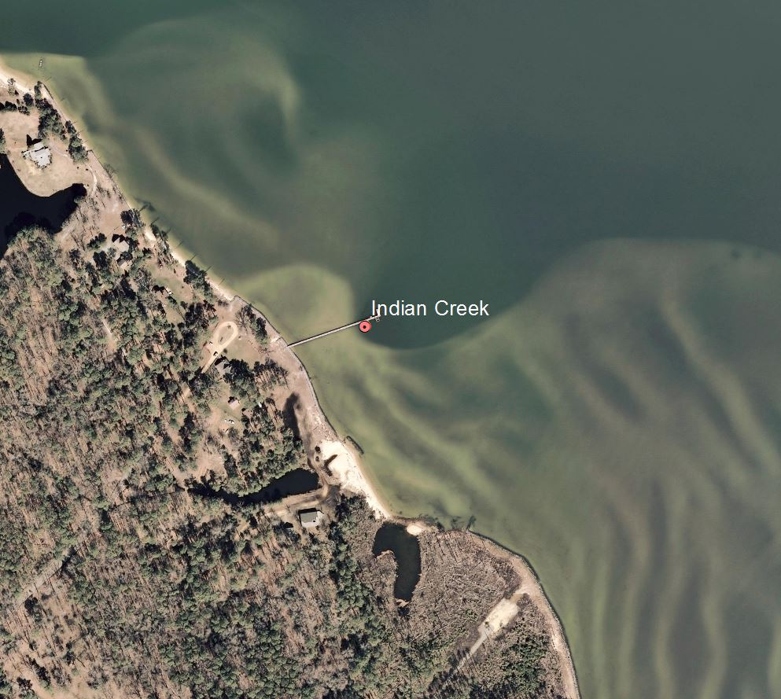
Strength Coefficient
Strength Coefficient Performance
Nechad |  |  | T Dogliotti Red
Top 3 |  |  | Top 3
Bottom 3 | Indian Creek | -2.100 | Bottom 3 | Indian Creek | -2.404
Notes:
Will

Slide 24
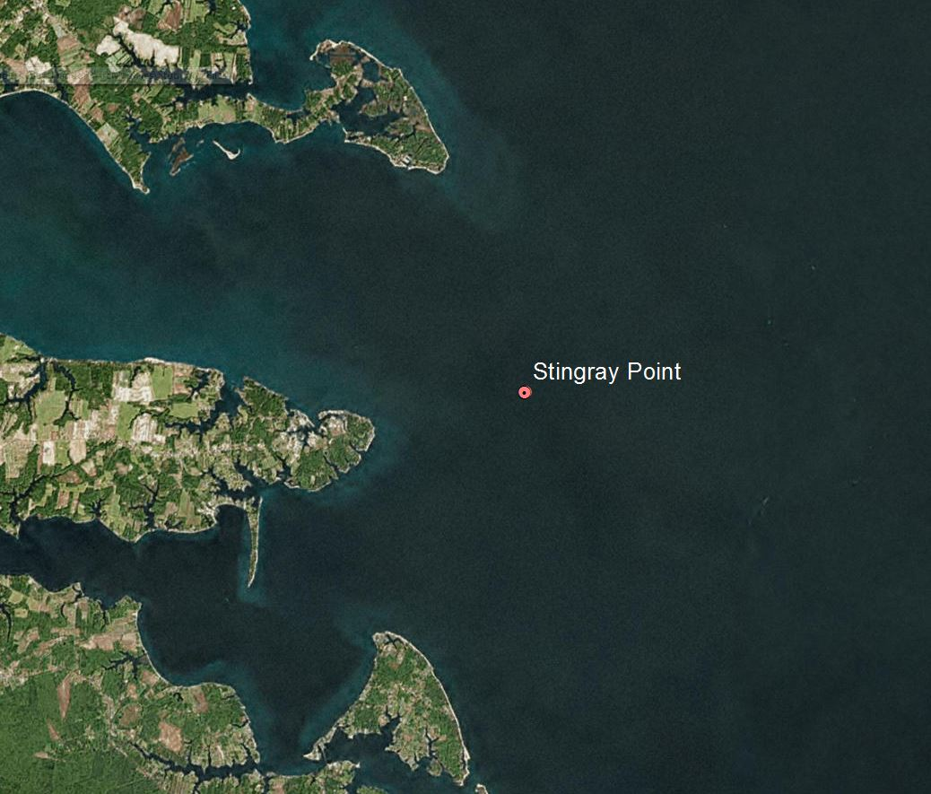
Strength Coefficient
Strength Coefficient Performance
Nechad |  |  | T Dogliotti Red
Top 3 | Stingray Point | 2.381 | Top 3 | Stingray Point | 3.056
Bottom 3 |  |  | Bottom 3
Notes:
Will

Slide 25
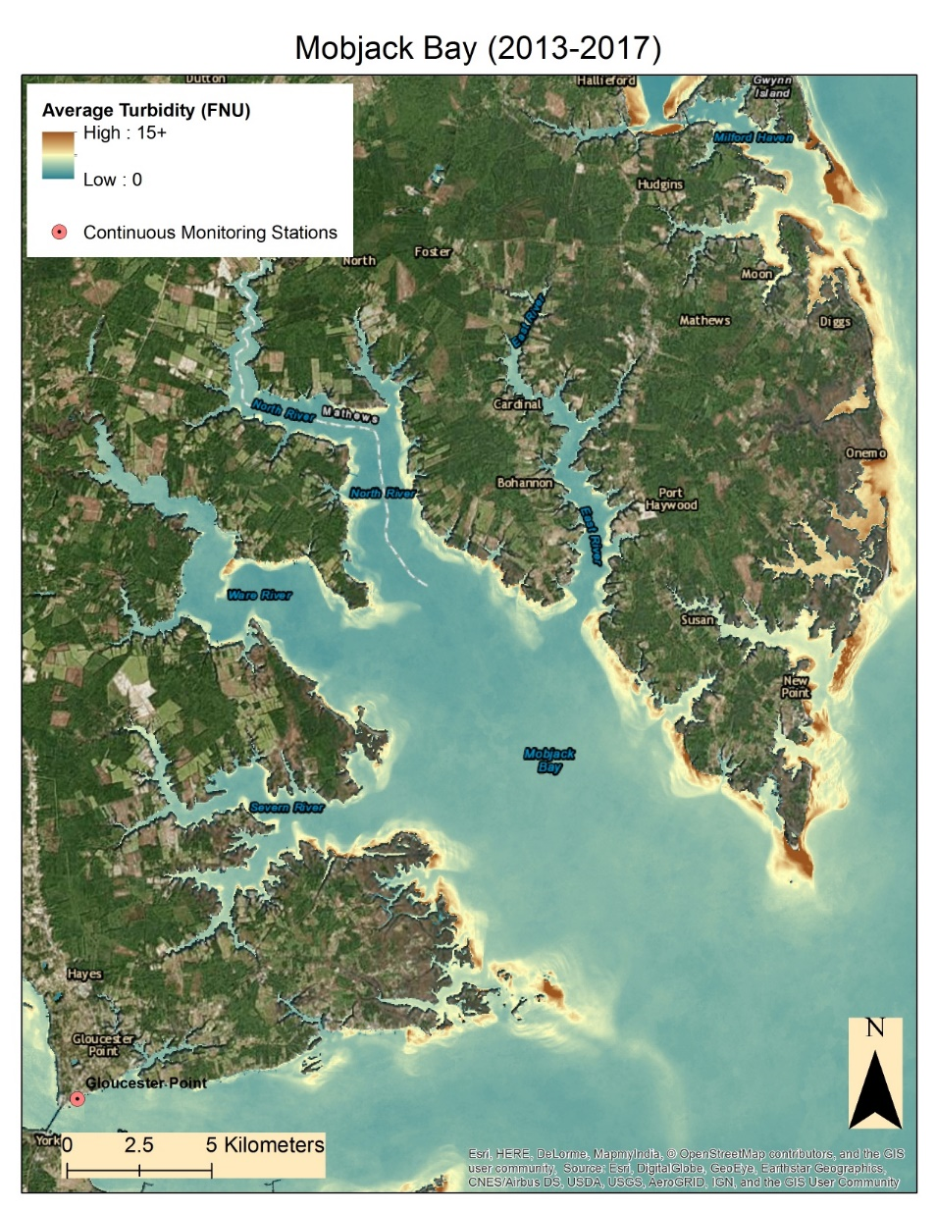
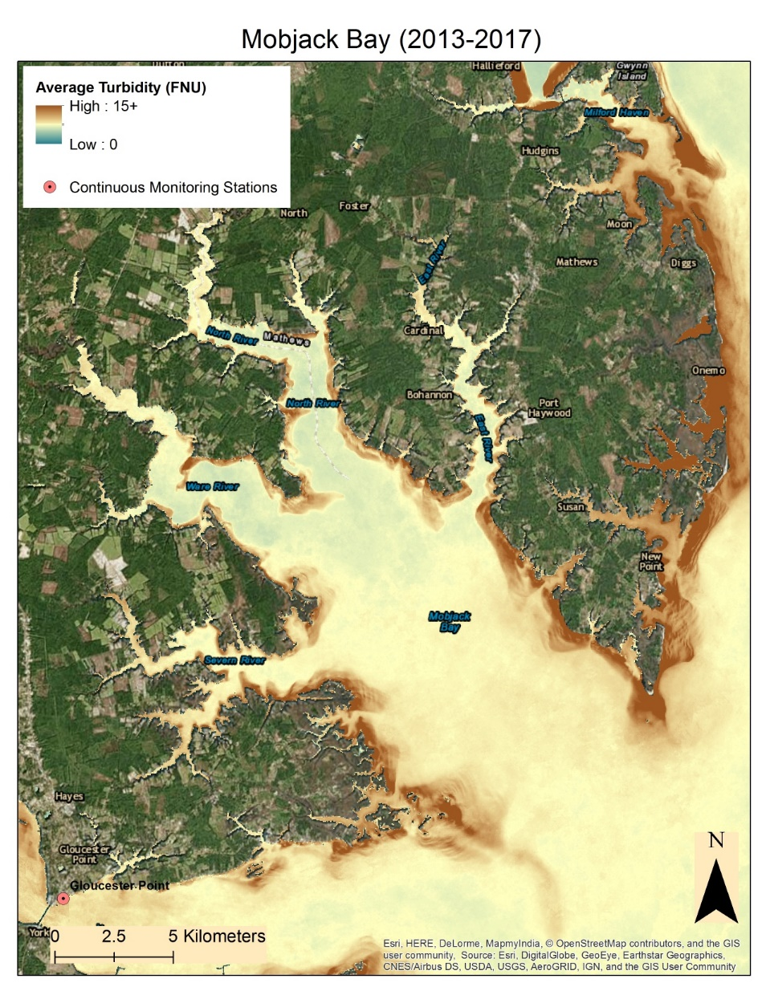
Empirical Correction Comparison
Average Turbidity = 2.42 FNU
Average Turbidity = 6.81 FNU
Original Dogliotti Turbidity Product
Empirically Corrected Dogliotti Turbidity Product
Notes:
Antonio

Slide 26
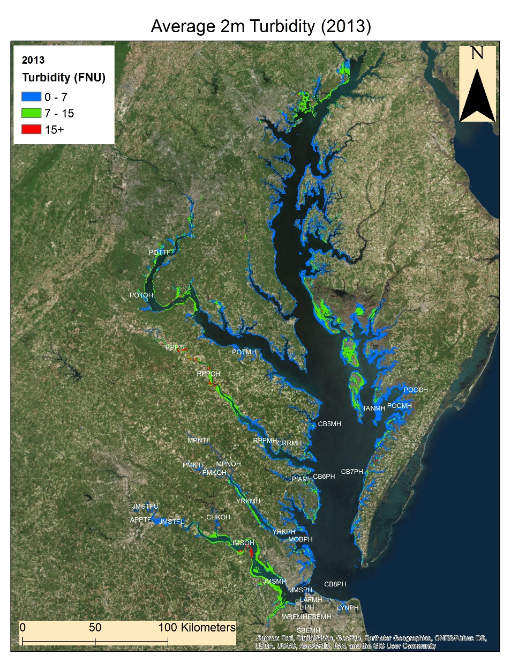
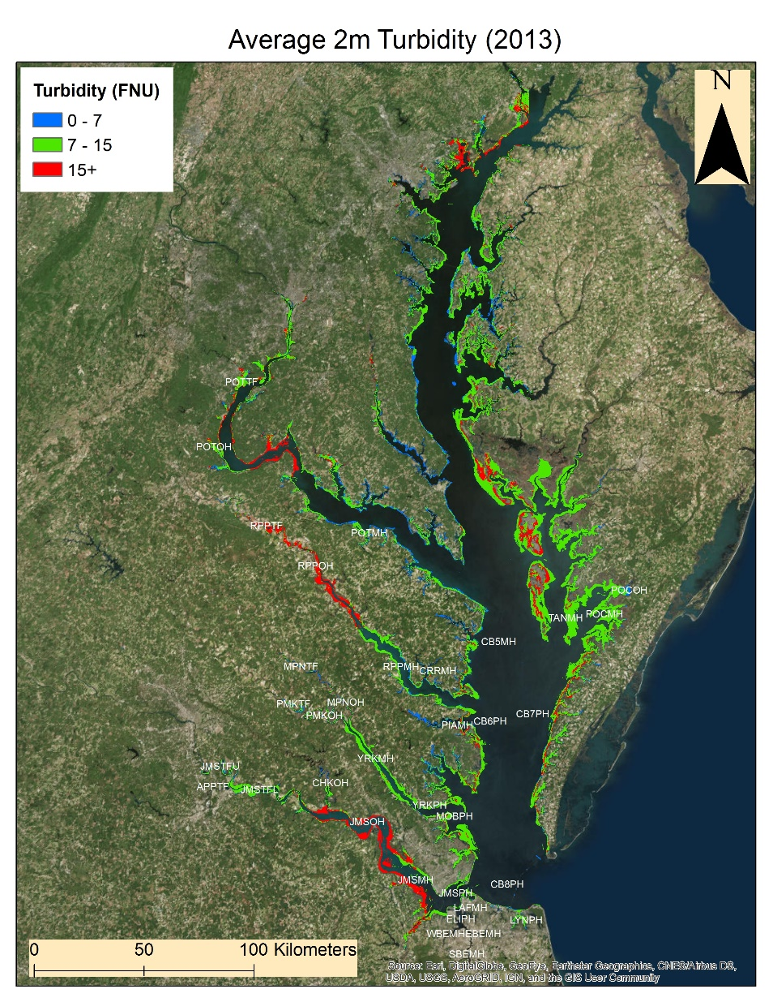
Empirical Correction Comparison 2m
Original 2m Nechad Turbidity Product
Empirically Corrected 2m Nechad Turbidity Product
Notes:
Antonio

Slide 27
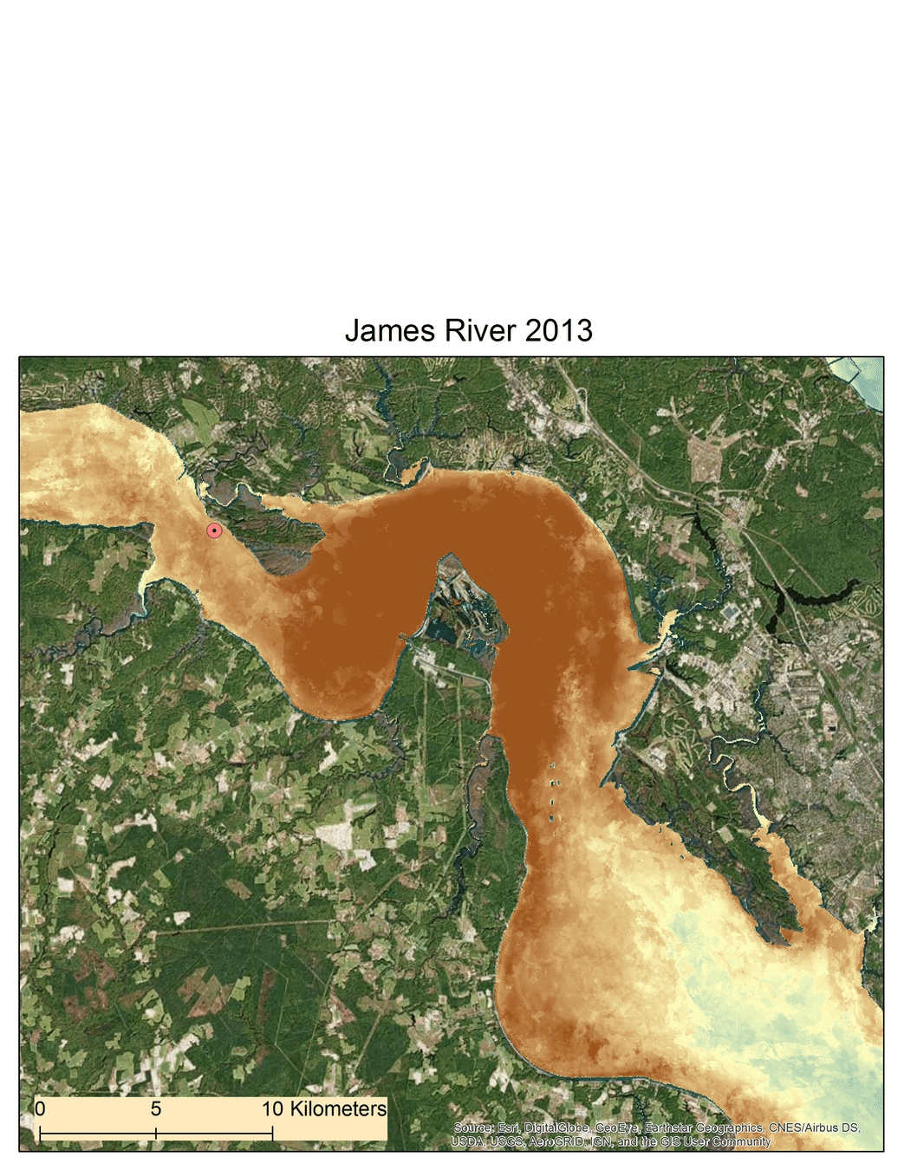
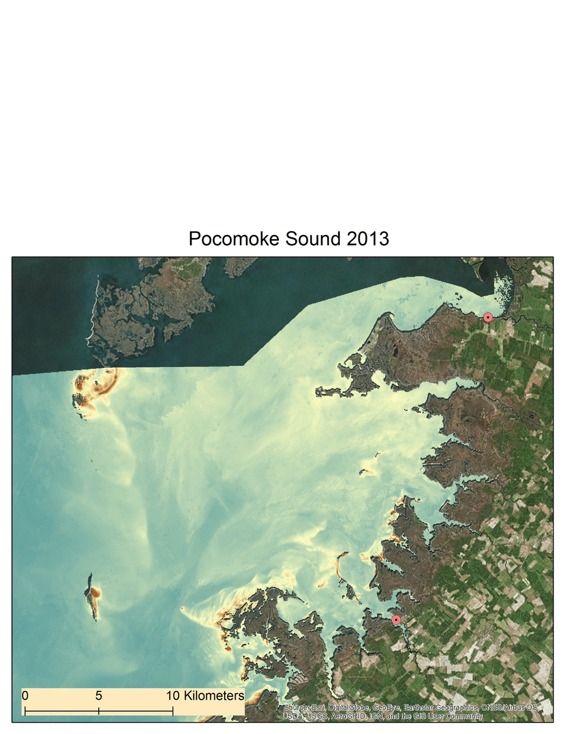
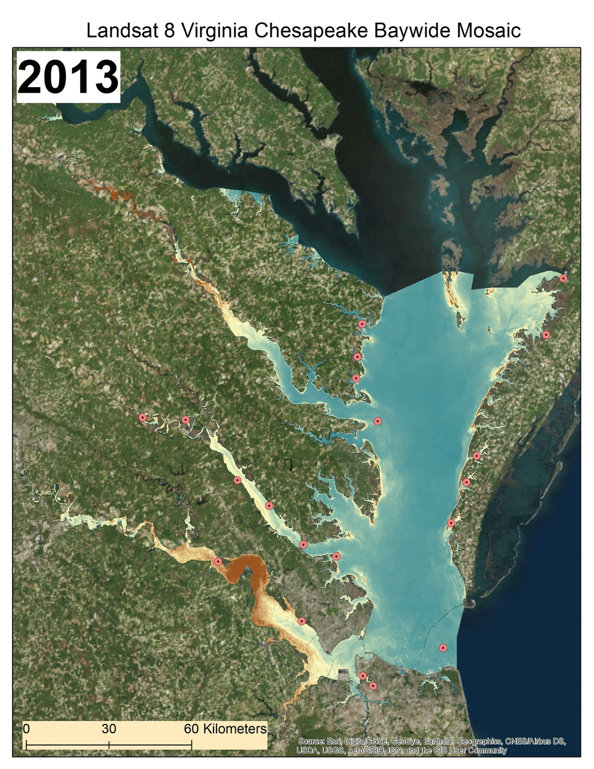
Annual Water Clarity Maps: Dogliotti Red
Notes:
Antonio:
Ok, so here we have our Landsat 8-based baywide water clarity time series using the aforementioned Dogliotti Red algorithm.
If we focus in on our study area of Virginia’s Chesapeake Bay watershed, we see a clearer view of the open waters of the bay have little to no significant variation in turbidity. However, the tributaries where monitoring stations are located show persistent variations in turbid activity throughout the 2013-2017 study period. The James River and Pocomoke Sound, are two areas displaying this interesting activity.
GIF will play in slideshow mode

Slide 28
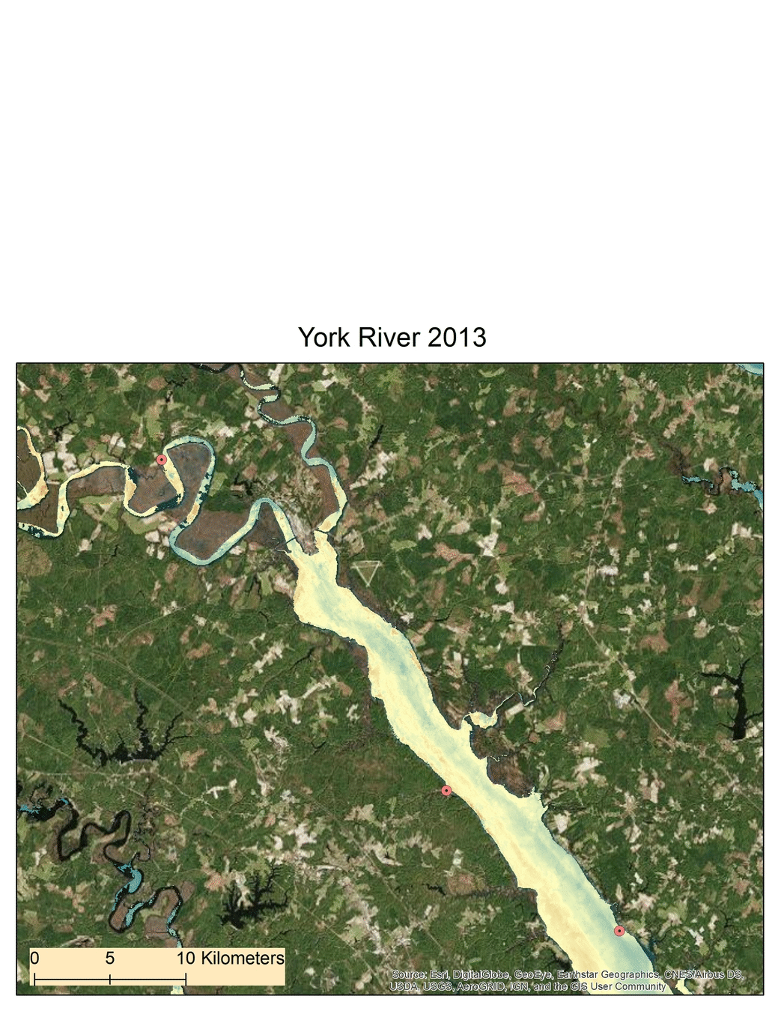
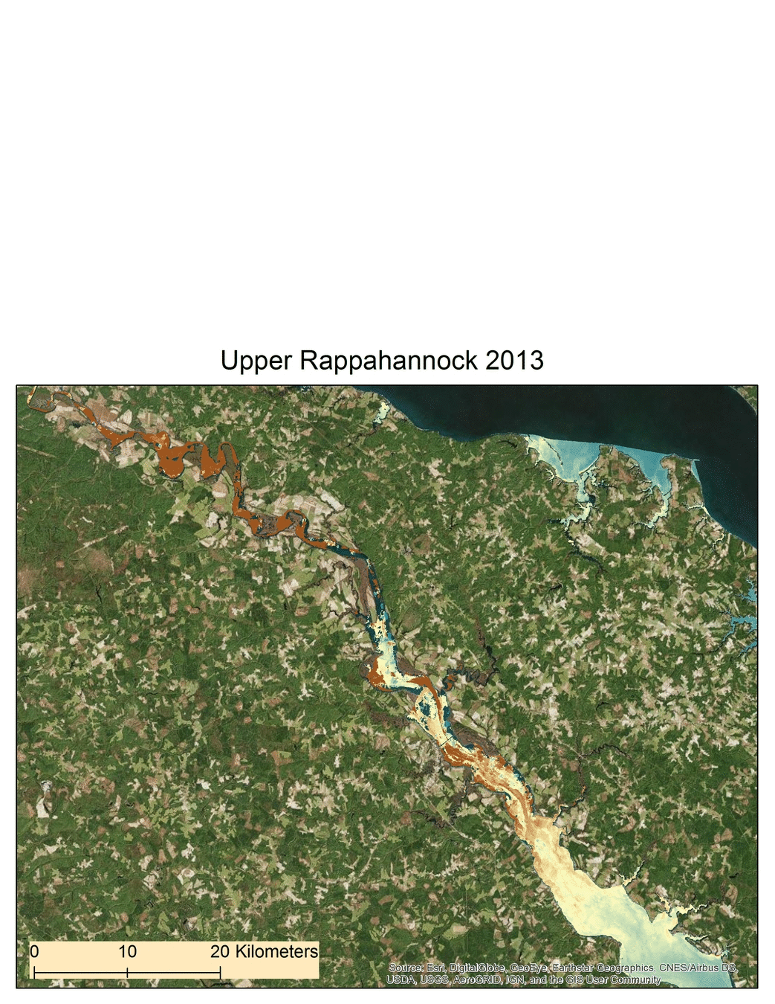
Annual Water Clarity Maps: Dogliotti Red
Notes:
Antonio:
Ok, so here we have our Landsat 8-based baywide water clarity time series using the aforementioned Dogliotti Red algorithm.
If we focus in on our study area of Virginia’s Chesapeake Bay watershed, we see a clearer view of the open waters of the bay have little to no significant variation in turbidity. However, the tributaries where monitoring stations are located show persistent variations in turbid activity throughout the 2013-2017 study period. The James River and Pocomoke Sound, are two areas displaying this interesting activity.
GIF will play in slideshow mode

Slide 29
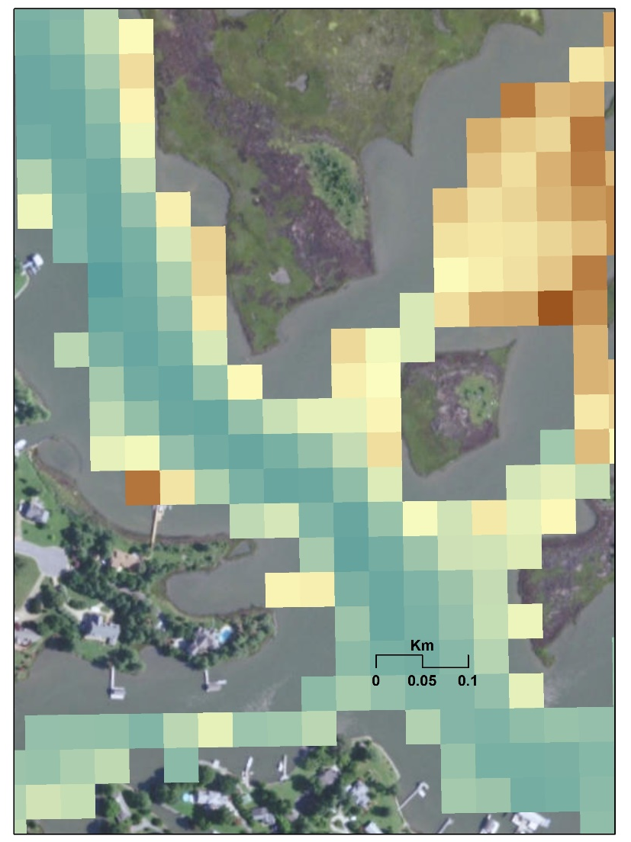
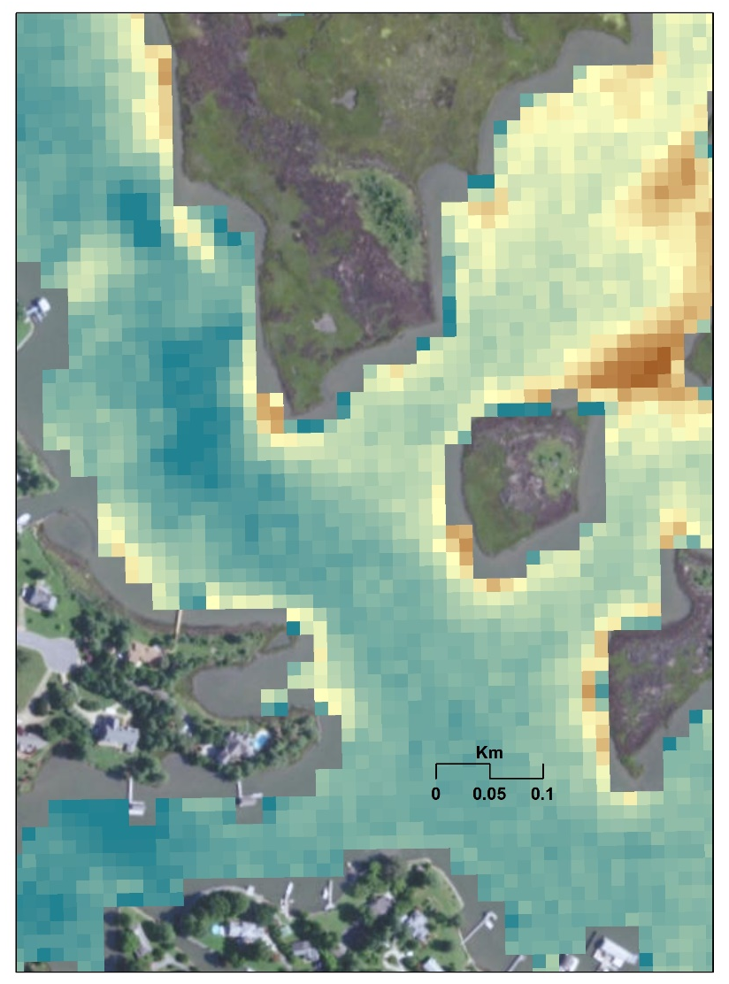
Sentinel-2: Spatial Resolution & Results
Dogliotti Red: R = 0.6672
y = 2.8667x + 8.577
Landsat 8 Dogliotti Red
Turbidity Product (03/24/17)
Sentinel-2 Dogliotti Red
Turbidity Product (03/17/17)
Notes:
Antonio:
When comparing spatial resolution between Landsat 8 and Sentinel-2 scenes through the Dogliotti Red algorithm, we see Sentinel-2’s finer 10 meter spatial resolution (right image), as compared to Landsat’s more general 30 meter spatial resolution (left image).
Sentinel-2’s potential to capture narrow areas with proximity to land makes it a useful tool for future assessment of water clarity. However, with a late 2015 launch date, its limited data archive produces strong, but indefinite correlations. We see that Sentinel-2 provided a satellite-high 0.6672 correlation, but was limited to half of the monitoring stations available for analysis.

Slide 30
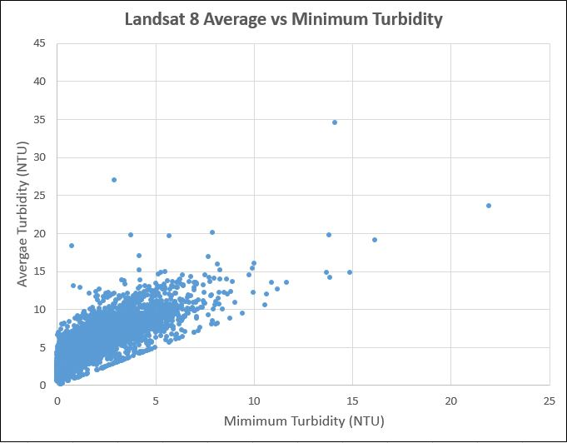
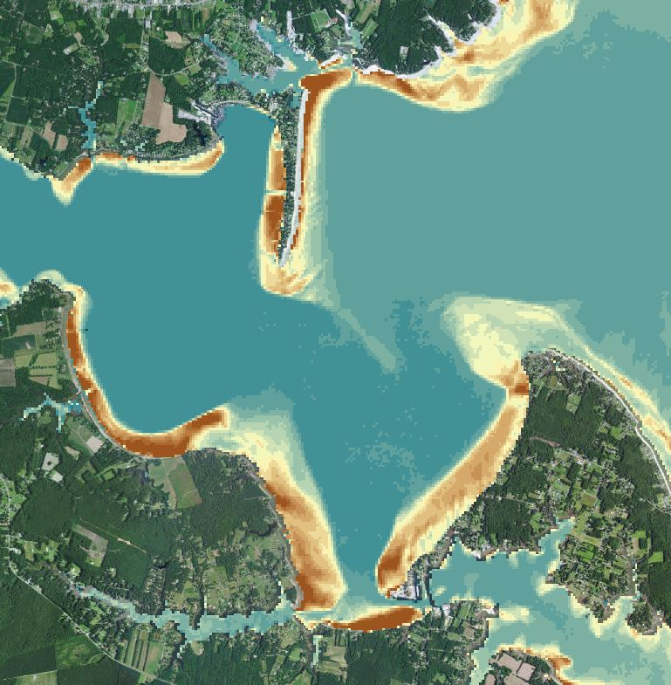
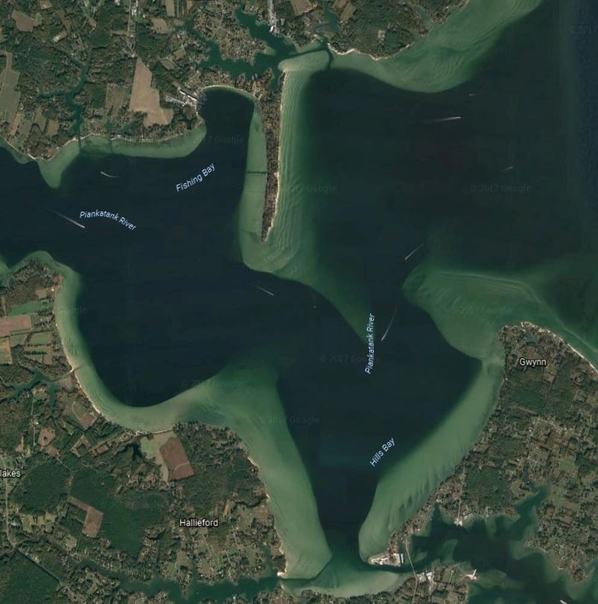
Identifying Bottom Effects
Piankatank River – ACOLITE turbidity product vs Google Earth imagery
Observed high satellite turbidity estimates over clear, shallow waters with sandy bottoms
Points with high average and high minimum turbidities can potentially be indicators of bottom effects
Notes:
Will

Slide 31
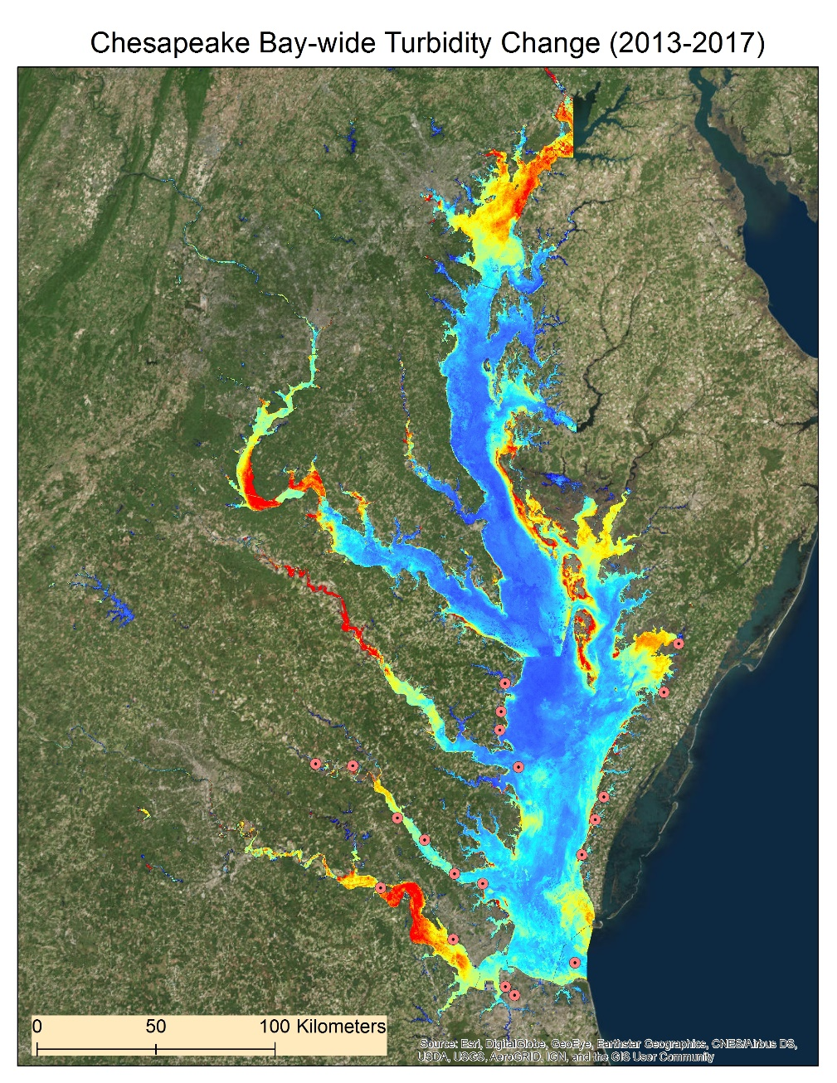
Baywide Turbidity Variation
Baywide Standard Deviation (2013 - 2017)
SD Scale (FNU)
High: 5
Low: 0
Standard deviation used to visualize variation & examine bottom effects
High SD + low Coefficient of Variation for turbidity potentially influenced by sandy bottoms
Notes:
William:
Change in turbidity over time (SD)
Helped us analyze and explain why the satellite potentially misread variables
Introduce CoV (SD/mean) and Sandy Bottom
Satellite picks up the bright sand and analyzes it as turbidity
We noticed that low CoV and a high SD tended to point toward a sandy bottom

Slide 32
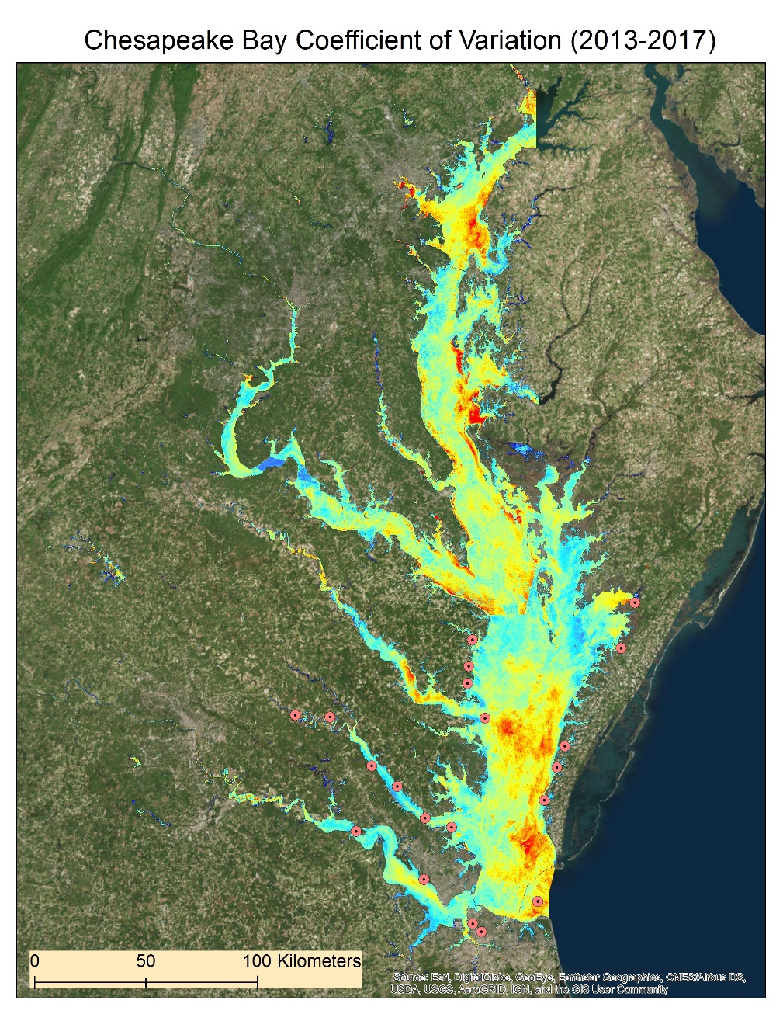
Landsat 8 SD vs. CoV
Baywide Standard Deviation (2013 - 2017)
Baywide Coefficient of Variation (2013 - 2017)
SD Scale (FNU)
CoV Scale (FNU)
High: 5
Low: 0
High: 1
Low: 0
Notes:
Will

Slide 33
Future Work
Finding effective methods to distinguish bottom effects
Utilizing satellite data from Landsat 5 and Landsat 7
Exploring different advanced settings within ACOLITE
Notes:
Eli:
Some difficulties arose when performing remote sensing over shallow waters. We noticed that our turbidity products were sensitive to clouds, pictured here (bottom), and proximity to land, pictured on the right
Overestimation of turbidity in clear, shallow areas with sandy bottoms was also a common recurrence. Future work should look for the best ways to distinguish these areas from others.

Slide 34
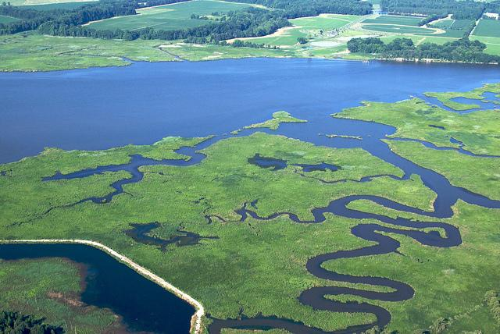
Conclusions
Landsat 8 was used to produced the most confident correlations with in situ data.
Dogliotti and Nechad: turbidity products provide the most accurate water clarity assessment
Models and maps produced can be applied in future monitoring to identify areas of high turbidity
Dogliotti Red over open waters
Nechad within tributaries
Image Credit: Environmental Protection Agency
Image Credit: Matt Rath/Chesapeake Bay Program
Notes:
Eli:
In conclusion, Landsat 8 provided the most confident correlations and is therefore the primary satellite used for our models. Sentinel-2 still provided promising results, and with its high spatial resolution, it has the ability to produce more detailed turbidity products
Overall, we found that the turbidity algorithms of Dogliotti and Nechad provided the best estimations of turbidity throughout the Chesapeake Bay
The models and maps produced can be used to identify areas of high turbidity and can provide insight for future monitoring of water and submerged aquatic vegetation.
Image Source: https://www.epa.gov/chesapeake-bay-tmdl

Slide 35
Acknowledgements
Science Advisor
NASA Langley Research Center:
Dr. Kenton Ross
Partners
Virginia Department of Environmental Quality:
Tish Robertson
USGS, Water Science Center:
Peter Tango
NASA DEVELOP
Center Lead: Emily Gotschalk
Previous Term Affiliates: Danielle Quick, Gregory Hoobchaak, Collin Henson, Cole Cowher, Amanda Clayton
Notes:
Eli:
We would like to thank the following individuals for their assistance on this project. Without them, this work would not have been possible.
NASA Symbol Source: https://www.nasa.gov/audience/forstudents/5-8/features/symbols-of-nasa.html
USGS Image Source: https://commons.wikimedia.org/wiki/File:USGS_logo.png

