Slide 1

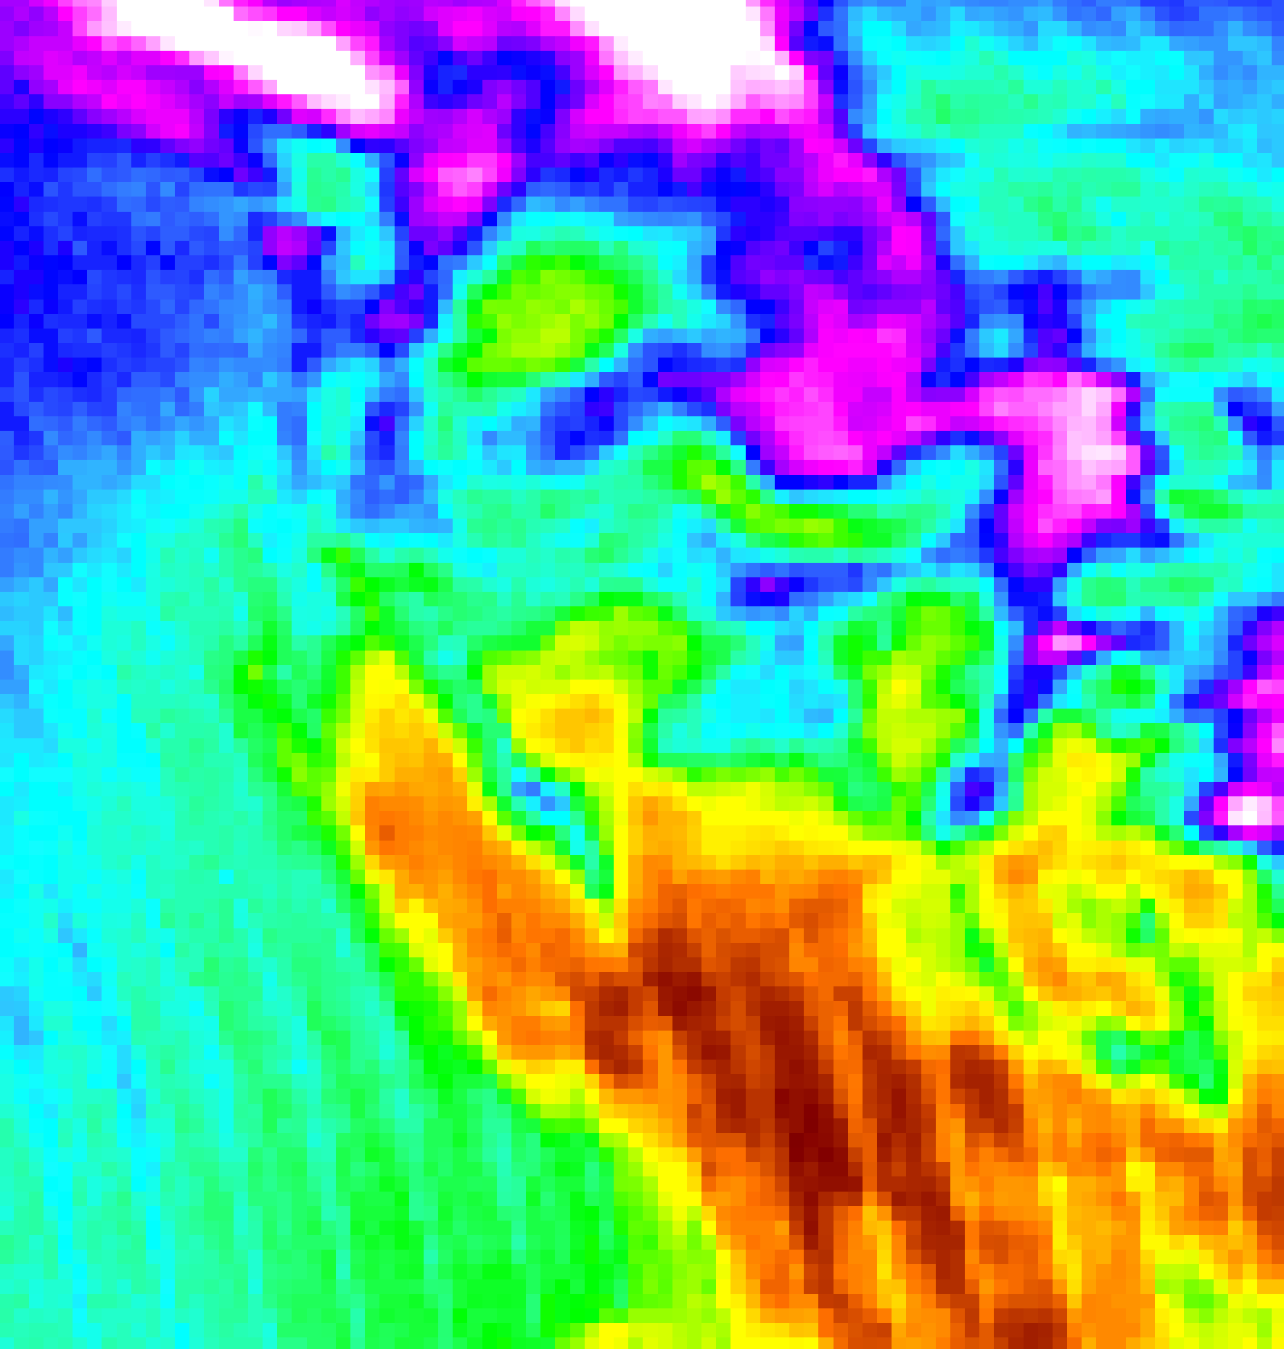

2018 Summer | Virginia - Langley
INTERMOUNTAIN WEST HEALTH & AIR QUALITY
Monitoring Regional Air Quality to Address Air Pollution in National Parks through the Application of NASA Earth Observations
Chet Warren (Project Lead)
Jared Goldbach Ehmer
Zachary Peloquin
Notes:
Chet: Good morning/afternoon everyone! My name is Chet Warren.
Zac: Hi my name is Zac Peloquin.
Jared: Hi my name is Jared Goldbach Ehmer.
Chet: Today we will be presenting to you how our team applied NASA Earth Observations to address air pollution in National Parks within the Intermountain Region of the United States.
--------------------------------------------------
Website image is the summed binary looks for each cell of OMI Aura NO2 L3 data for the study period. Note that all negative values were discarded to no data for each scene across the 13 years. One can notice trends of reduced looks in higher latitudes due to a combination of consistent cloud coverage as well as long-term snow reflectance.

Slide 2
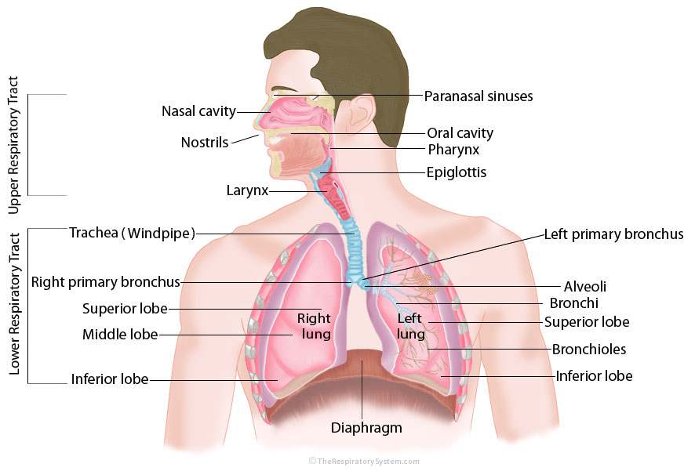
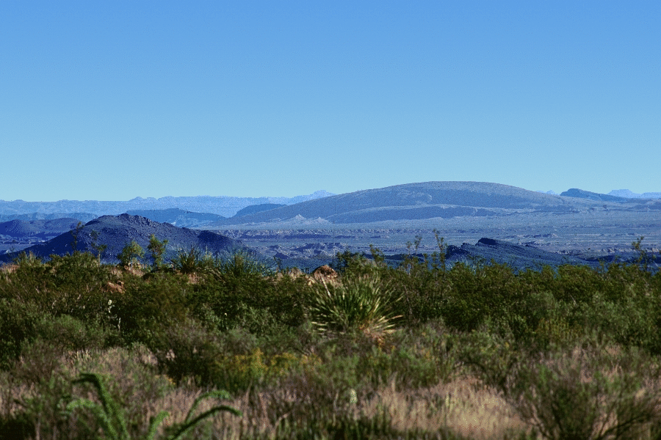
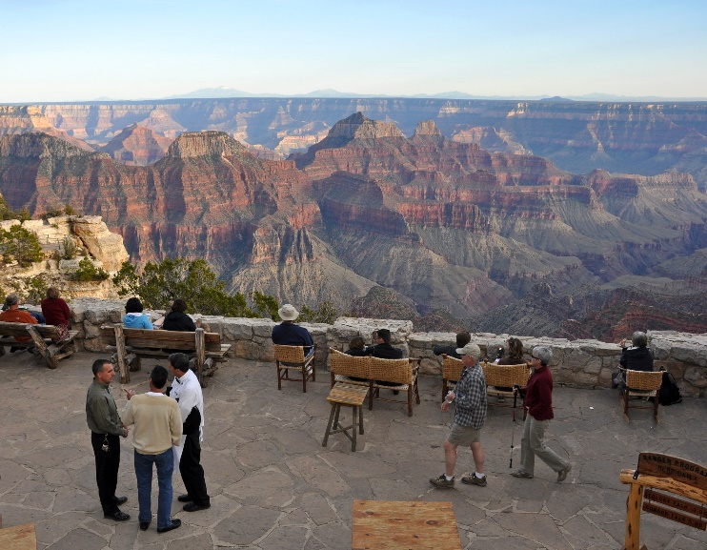
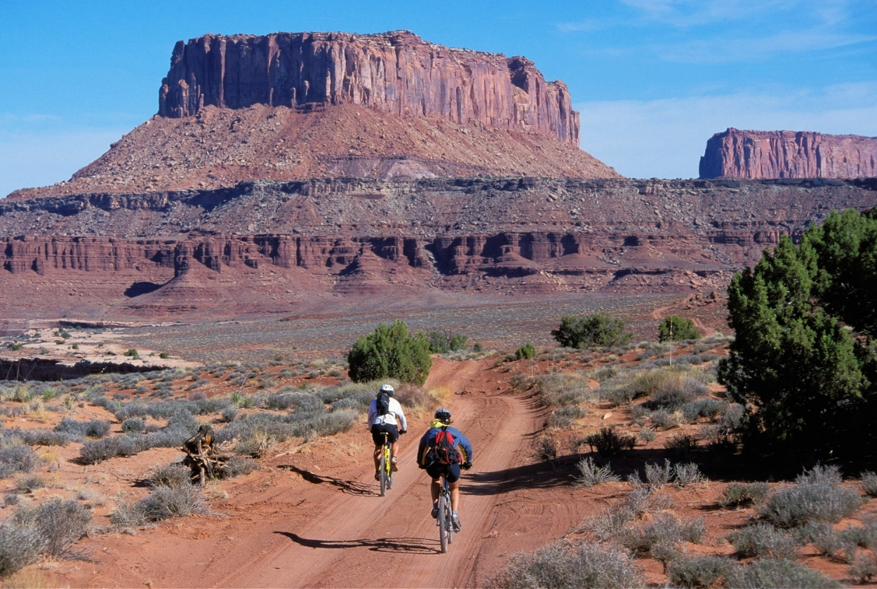
Atmospheric Pollutants
Harm human health
  Respiratory System Irritation
  Aggravate Asthma
Negatively impact Earth’s natural resources
  Ecosystem Health
  Visibility
Big Bend National Park, TX
Notes:
Zac:
Atmospheric pollutants have many negative impacts. They can negatively impact the respiratory health of humans and animals. Even triggering asthma in some people. Ecosystem health can be negatively impacted by heavy concentrations of pollutants leading to days of low visibility and poor air quality. Below is a time series of images transitioning from a day with good air quality and highly visibility to and day of poor air quality and low visibility in Big Bend National Park, Texas.
--------------------------
It is extremely important to protect human and ecological health as well as air quality in order to live healthier and have a beautiful plant. However, these continue to be harmed. Atmospheric pollutants like Nitrogen dioxide are huge contributors to these negative impacts. They can harm human health by causing respiratory irritations and aggravating asthma. Earth’s natural resources, such as visibility, can be impacted immensely. Below is a time series of images transitioning from a day with good air quality and highly visibility to and day of poor air quality and low visibility in Big Bend National Park, Texas.
Image of Respiratory Image: https://www.therespiratorysystem.com/
Visibility Images in Time Series: Credit to Debbie Miller

Slide 3

Partners & Community Concerns
National Park Service, Intermountain Region
  Debbie Miller, Air Resource Specialist
  Andrea Stacy, Air Resource Division
Mandated by Congress to protect:
  Park visitor health
  Ecological health of flora and fauna
  Preserve extensive vistas
Concern
  NO₂ negatively impacts human health and Air Quality Related Values (AQRVs)
  Sources of emissions not fully understood
  Limited amount of parks have monitoring programs to track air quality
Notes:
Zac:
For this project our team partnered with Debbie Miller, an Air resource specialist of the Intermountain Region, and Andrea Stacy of the Air resource Division of the National Park Service to address their concerns about NO2 and aid the National Park Service to uphold their legal mandates with regards to air quality related values such of soil, visibility, water and vegetation. The NPS does not have authority outside of the national parks and must work with local partners in our to reduce external impacts on the parks. This project is meant to help the National Park Service identify NO₂ sources and to enhance the monitoring programs already in place.
--------------------------
Our team partnered with Debbie Miller, the Air Resource Specialist for the Intermountain Region of the National Park Service, and Andrea Stacy, who works with the National Park Service Air Resource Division. The National Park Service is currently mandated by the Clean Air Act to protect park visitor health, the ecological health of flora and fauna, and to preserve the extensive vistas in the parks for the current and future generations. Protecting these natural resources is confounded by impacts of pollutants. One concern the National Park Service has is how nitrogen dioxide can negatively impact human health and Air Quality Related Values such as soil, visibility, water and vegetation. In addition, not only is there currently an incomplete understanding of exact point locations of NO₂ in areas surrounding the parks, but the NPS is limited in the number of monitoring programs they can implement to track air quality in parks.
NPS Image Source: https://en.wikipedia.org/wiki/File:US-NationalParkService-ShadedLogo.svg

Slide 4
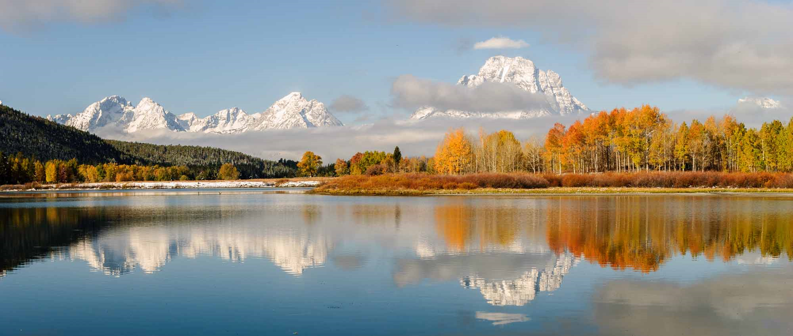
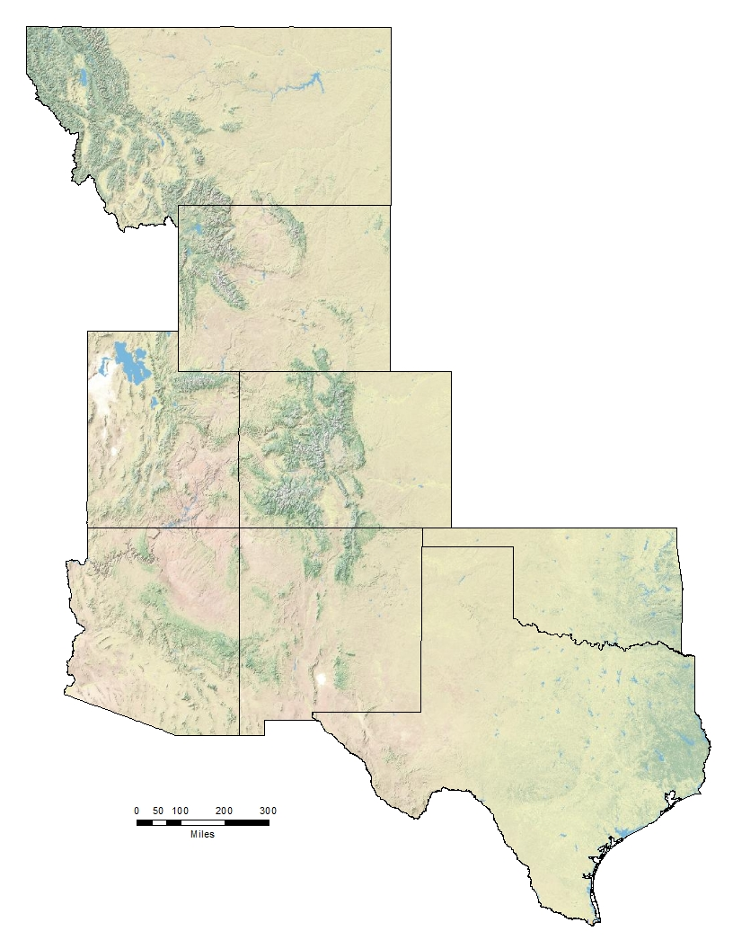
Our Study
Study Area / Period
  Intermountain Region
    AZ, CO, MT, NM, OK, TX, UT, WY
  January 2005 to December 2017
Objectives
  Assess historical patterns of NO₂ across the Intermountain Region
  Locate sources of NO₂ that are impacting the Intermountain Region to enhance intra-park monitoring
  Provide tools to protect national park resources and increase the understanding of visibility and atmospheric pollutants
Montana
Wyoming
Utah
Colorado
Arizona
New
Mexico
Oklahoma
Texas
0 50 100 200 300
Miles
Notes:
Jared:
To address their concerns, our team assessed historical patterns of NO₂ from 2005 to 2017. These trends enabled us to locate impacting sources of nitrogen dioxide to enhance intra-park monitoring throughout the entire region. This knowledge then allowed us to provide tools for our partners to better protect national park resources.
--------------------------------------------------------------
In order to address these concerns, our team analyzed nitrogen dioxide trends within the Intermountain region from 2005 to 2017. We assessed historical patterns of NO2 in this time period to locate and enhance an understanding of potential NO2 point sources. These determinations will build on current intra-park monitoring programs to expand the NPS’s predictive capabilities and fill in data gaps their limited monitoring programs have. Lastly, we wanted to provide tools for the National Park Service to protect the parks resources and increase the understanding of visibility and atmospheric pollutants.
Panorama image: Credit to Debbie Miller

Slide 5
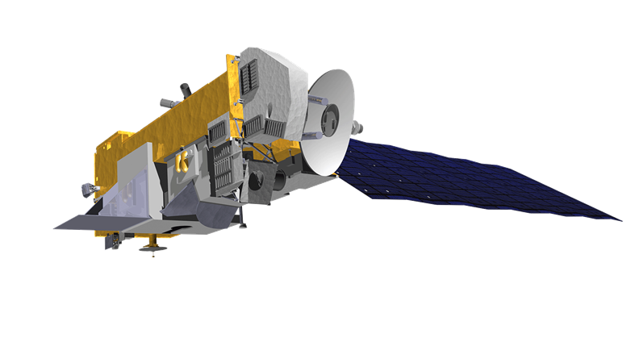
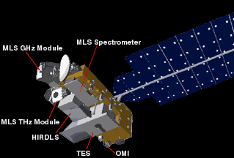
Earth Observations Used
Aura
  Launched July 15, 2004
  Part of the A-Train of satellites
  Observes chemistry and dynamics of Earth’s atmosphere
    Emphasis on upper troposphere and lower stratosphere
  Four Instruments Aboard
    Ozone Monitoring Instrument (OMI)
OMI
  Hyperspectral imaging spectrometer
  Tracks global ozone change and measures trace gases
    NO₂
Notes:
Jared:
In order to complete our objectives, our team utilized the NASA Earth Observation satellite Aura. Aura’s purpose is to observe the chemistry and dynamics of Earth’s atmosphere. One of the ways it does this is through the Ozone Monitoring Instrument or abbreviated to OMI. Our team employed OMI in order to generate recordings of nitrogen dioxide within the troposphere.
-------------------------------------------------------------------------
In order to complete these objectives and analyze nitrogen dioxide, our team utilized the NASA Earth Observation Satellite Aura. Launched July 15th 2004 as part of the A-train of satellites, its purpose is to observe the chemistry and dynamics of Earths atmosphere with emphasis on the upper troposphere and lower stratosphere.. Aboard Aura are four different instruments, one being the Ozone Monitoring Instruments, also known as OMI. As a hyperspectral imaging spectrometer, OMI measures global ozone change and trace gases through recording certain wavelengths. As a result of these sensitivities, the OMI sensor can also be used to generate recordings of NO2 products.
Aura Image: From DEVELOPedia
Aura Image with labeled sensors: https://en.wikipedia.org/wiki/Aura_(satellite)

Slide 6
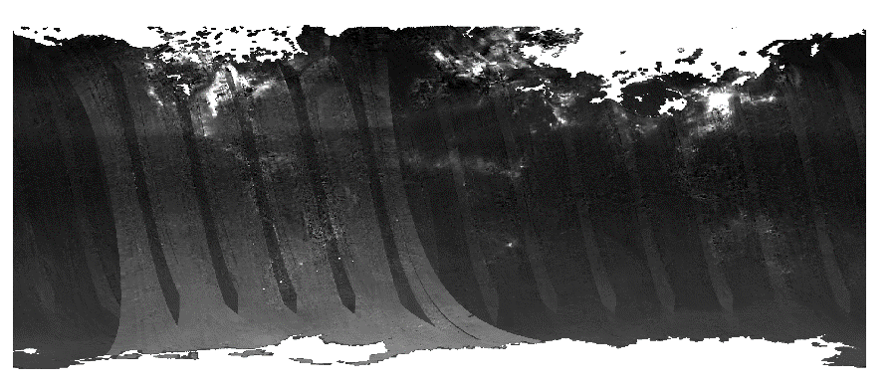
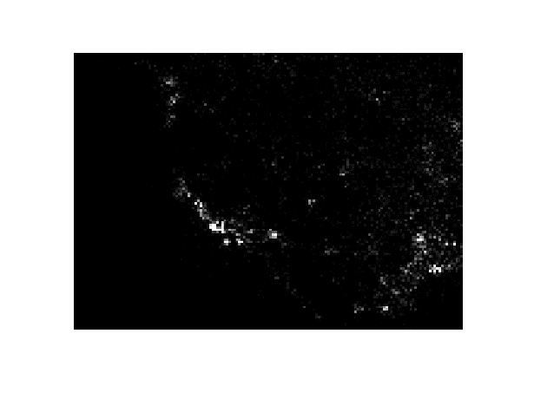
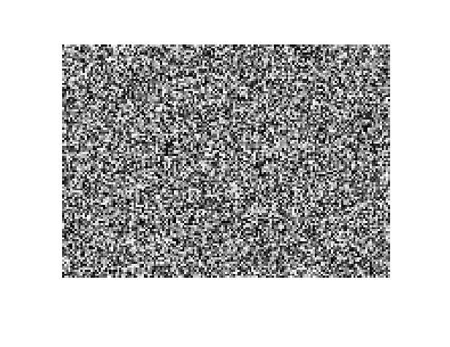
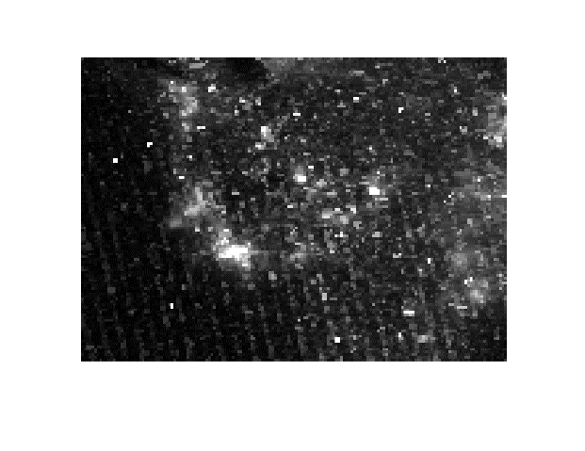
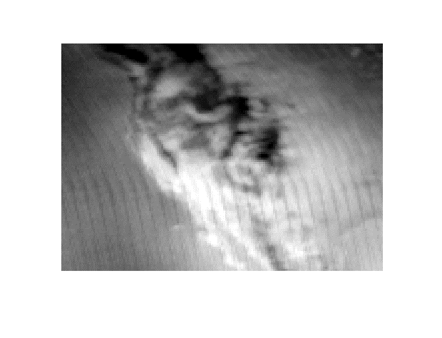
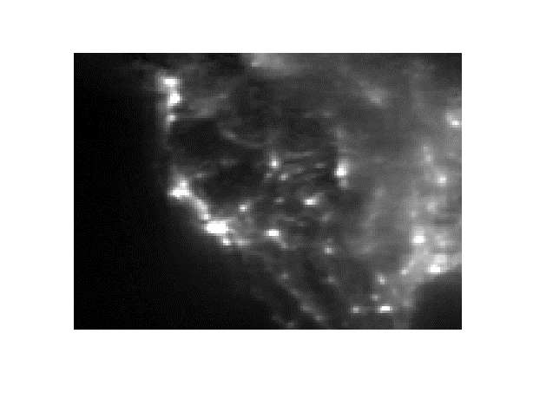
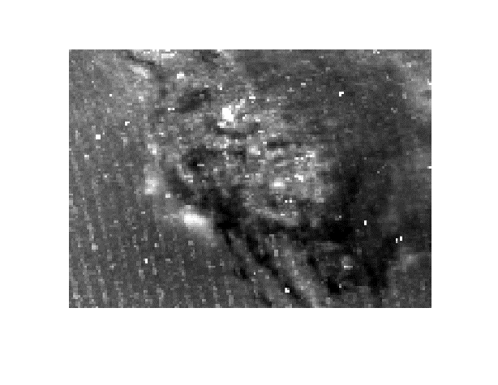
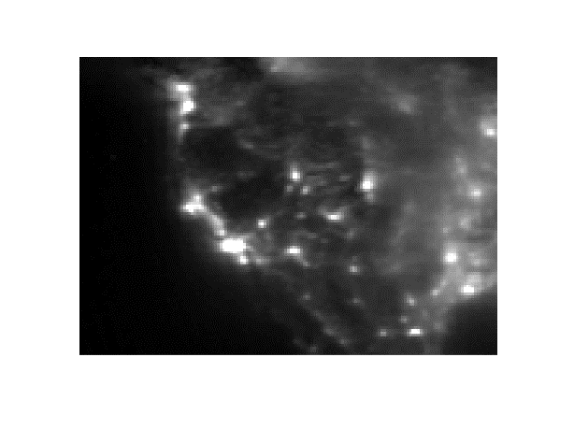
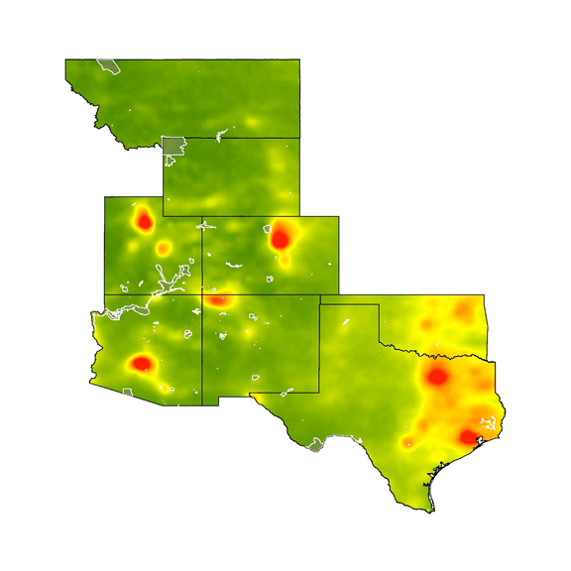
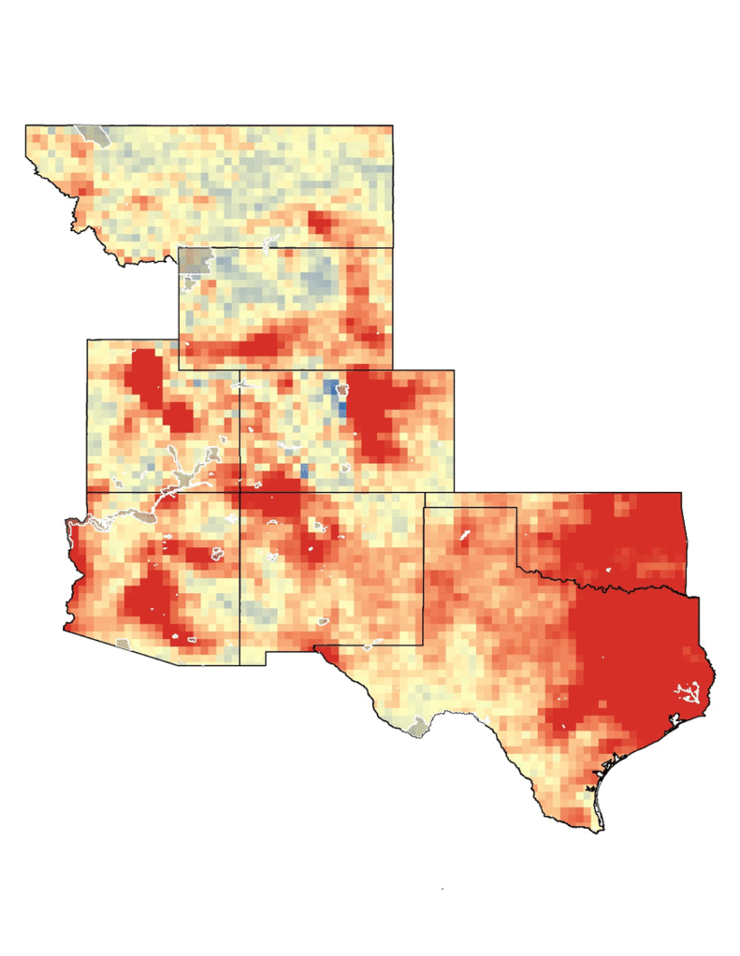
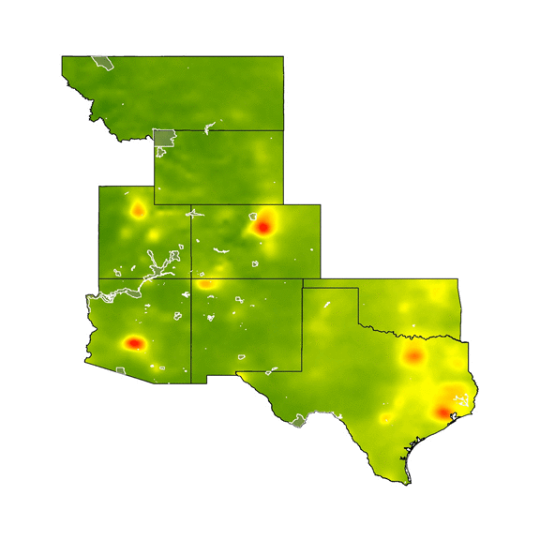
Methodology
Data Acquisition
Aura OMI Cloud-screened Tropospheric NO₂ Data
Data Processing
Data Analysis
Data Correlation Analysis
Trend Maps
Calculated Min, Max, Range, Mean, Median, Standard Deviation, Coefficient of Variation
Implemented Python
Projected and Masked Data
Visual Displays of Data Comparisons
EPA CASTNET Hourly NO₂ observation recordings
EGU NO_{x} Emission Reports
Notes:
Chet:
Our three step methodology began by acquiring OMI cloud screened tropospheric nitrogen dioxide data, hourly nitrogen dioxide recordings observed by EPA CASTNET monitors, as well as Electric Generating Unit nitric oxide emission reports. We then processed our data by implementing python. With this, we created our area of interest and calculated statistics for National Parks and States over the annual, seasonal, and monthly time periods. After everything was processed, analysis was run to find correlations between data and to create trend maps and other visual displays of data comparisons.
----------------------------------------------------
OMI/Aura data was retrieved from the GES DISC DAAC for the study period. We pulled down level 3 version 3 NO2 products. From these, we selected the data sublevel of daily Cloud-screened Tropospheric NO₂ data. Next we acquired the Environmental Protection Agency’s Clean Air Status and Trends Network (CASTNET) data for each year of the study period – we selected raw measurements for non-aggregated hourly observations. Another dataset the team acquired was the Intermountain region’s National Park Service’s electrical generating units, EGU, representing the reported pollutant levels emitted by power generating stations across the United States.
All data scenes were projected to NAD83 and masked to our broad area of interest before processing. To calculate statistics for the National Parks, Basins, and States, over the Annual, Seasonal, and Monthly time periods we used the python programming language to facilitate these 13 years of daily data. We calculated Min, Max, Range, Mean, Median, Standard Deviation, and Coefficient of Variation.
The resulting images were put into time series maps and graphs. At this point a data correlation analysis was run comparing the OMI satellite data with that of the EPA CASTNET and the NPS EGU.
GES DISC DAAC = Goddard Earth Sciences Data and Information Services Center Distributed Active Archive Center

Slide 7
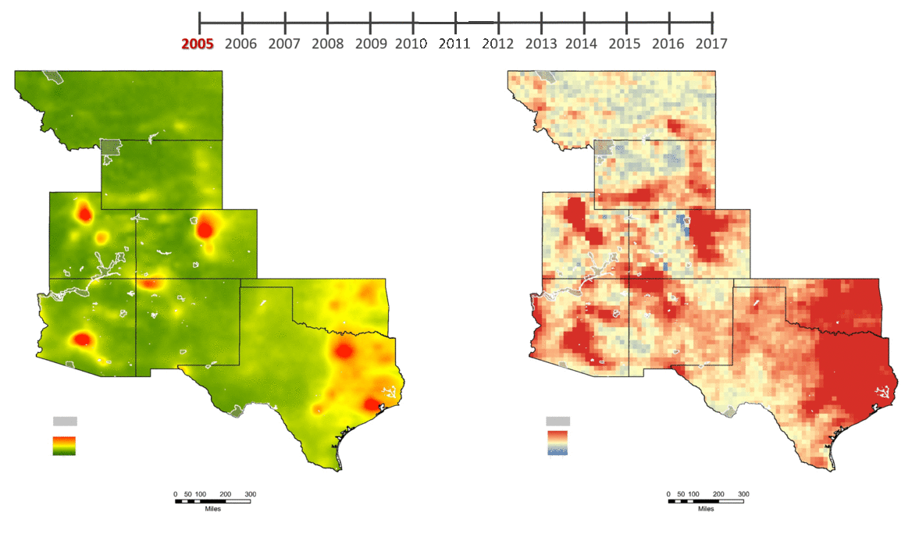
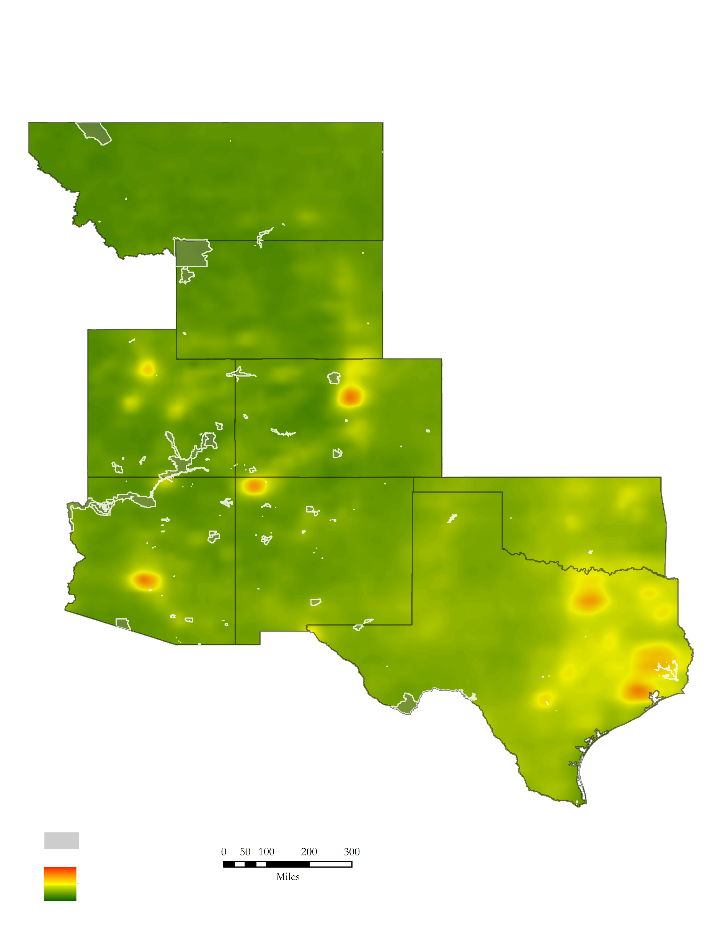
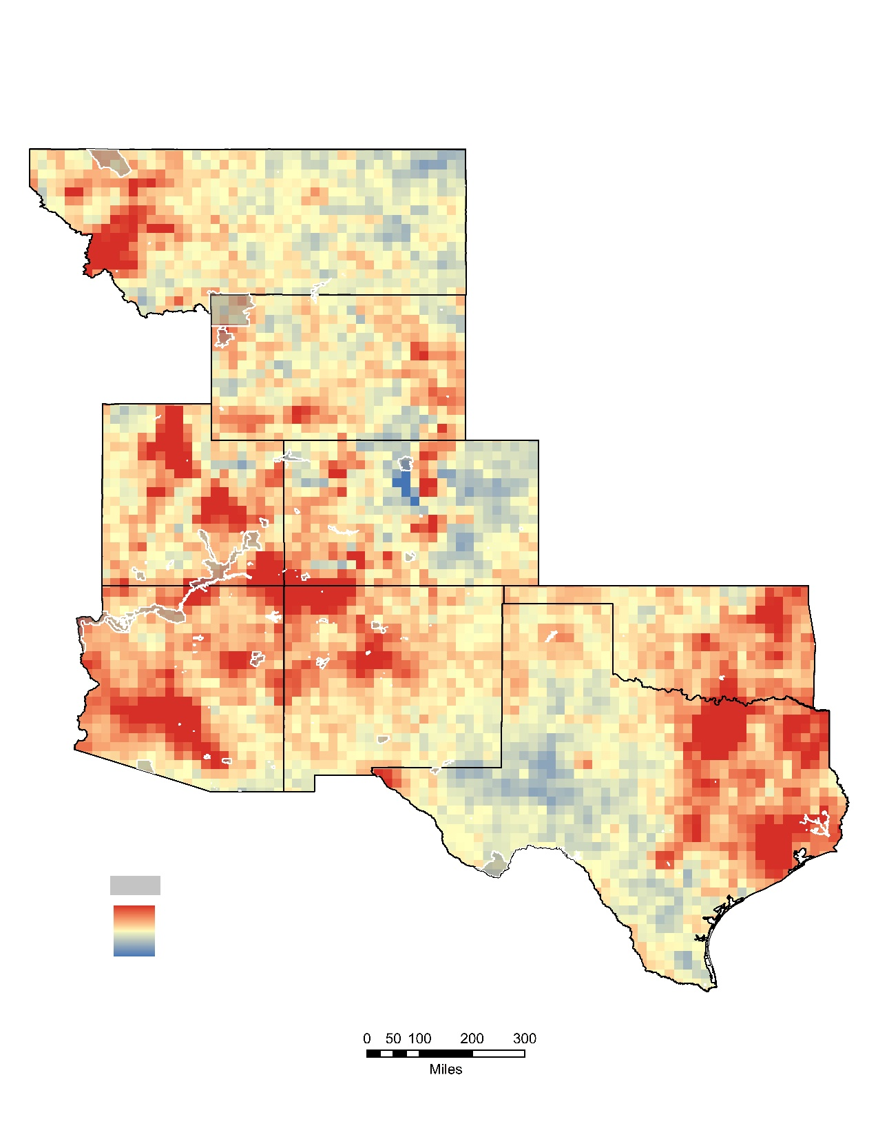
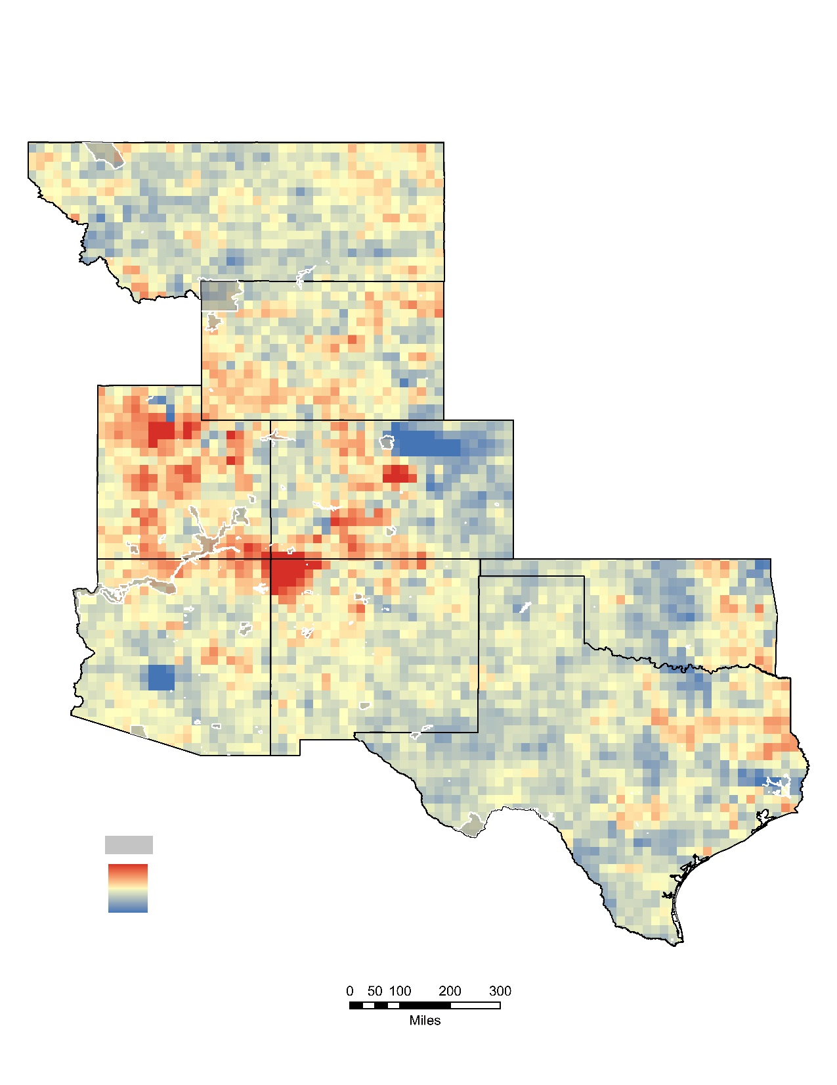
Annual Average and Anomaly
National Parks
National Parks
4 x 10¹⁵ Molecules/cm²
2.5 x 10¹⁴ Molecules/cm²
0 Molecules/cm²
-2.5 x 10¹⁴ Molecules/cm²
0 50 100 200 300
0 50 100 200 300
Miles
Miles
Notes:
Chet:
Annual Average and Annual anomaly maps were created to find areas of high and low nitrogen dioxide concentrations and discover how they vary over time. As you can clearly see in the annual average map to the left, areas of the highest concentrations are located around major cities. Over time you can see an obvious decrease in nitrogen dioxide throughout most of the region. The annual anomaly maps shows whether or not each pixels annual average is greater or less than its average for the entire period. While some pixels vary throughout, the overall trend shows that the pixels are greater in beginning and decrease to lower than their average in the end of the study period.
--------------------------------------------
During our data analysis process, we created annual average trend maps (GIF on the Right) for our region in order to see areas of nitrogen dioxide concentrations and how they fluctuate over time. We also created anomalies (GIF to the Left) presenting how each pixel in our region differentiates from its mean for the whole period over each year. Note the location of the national parks in grey with a white outline, especially those that are right next to high output plumes throughout the years. These areas tend to be around major cities and areas of heavy NOx emissions. The annual average trend maps were created by in taking each pixels daily value that was available and valid then taking the mean for each specific pixel. Evident in these maps, the average amount of nitrogen dioxide has decreased from 2005 to 2017. The annual anomaly maps show whether or not each pixels mean is below or above its average for the entire period. These maps were created by subtracting the annual mean data for each pixel by the pixels mean for the entire period.

Slide 8
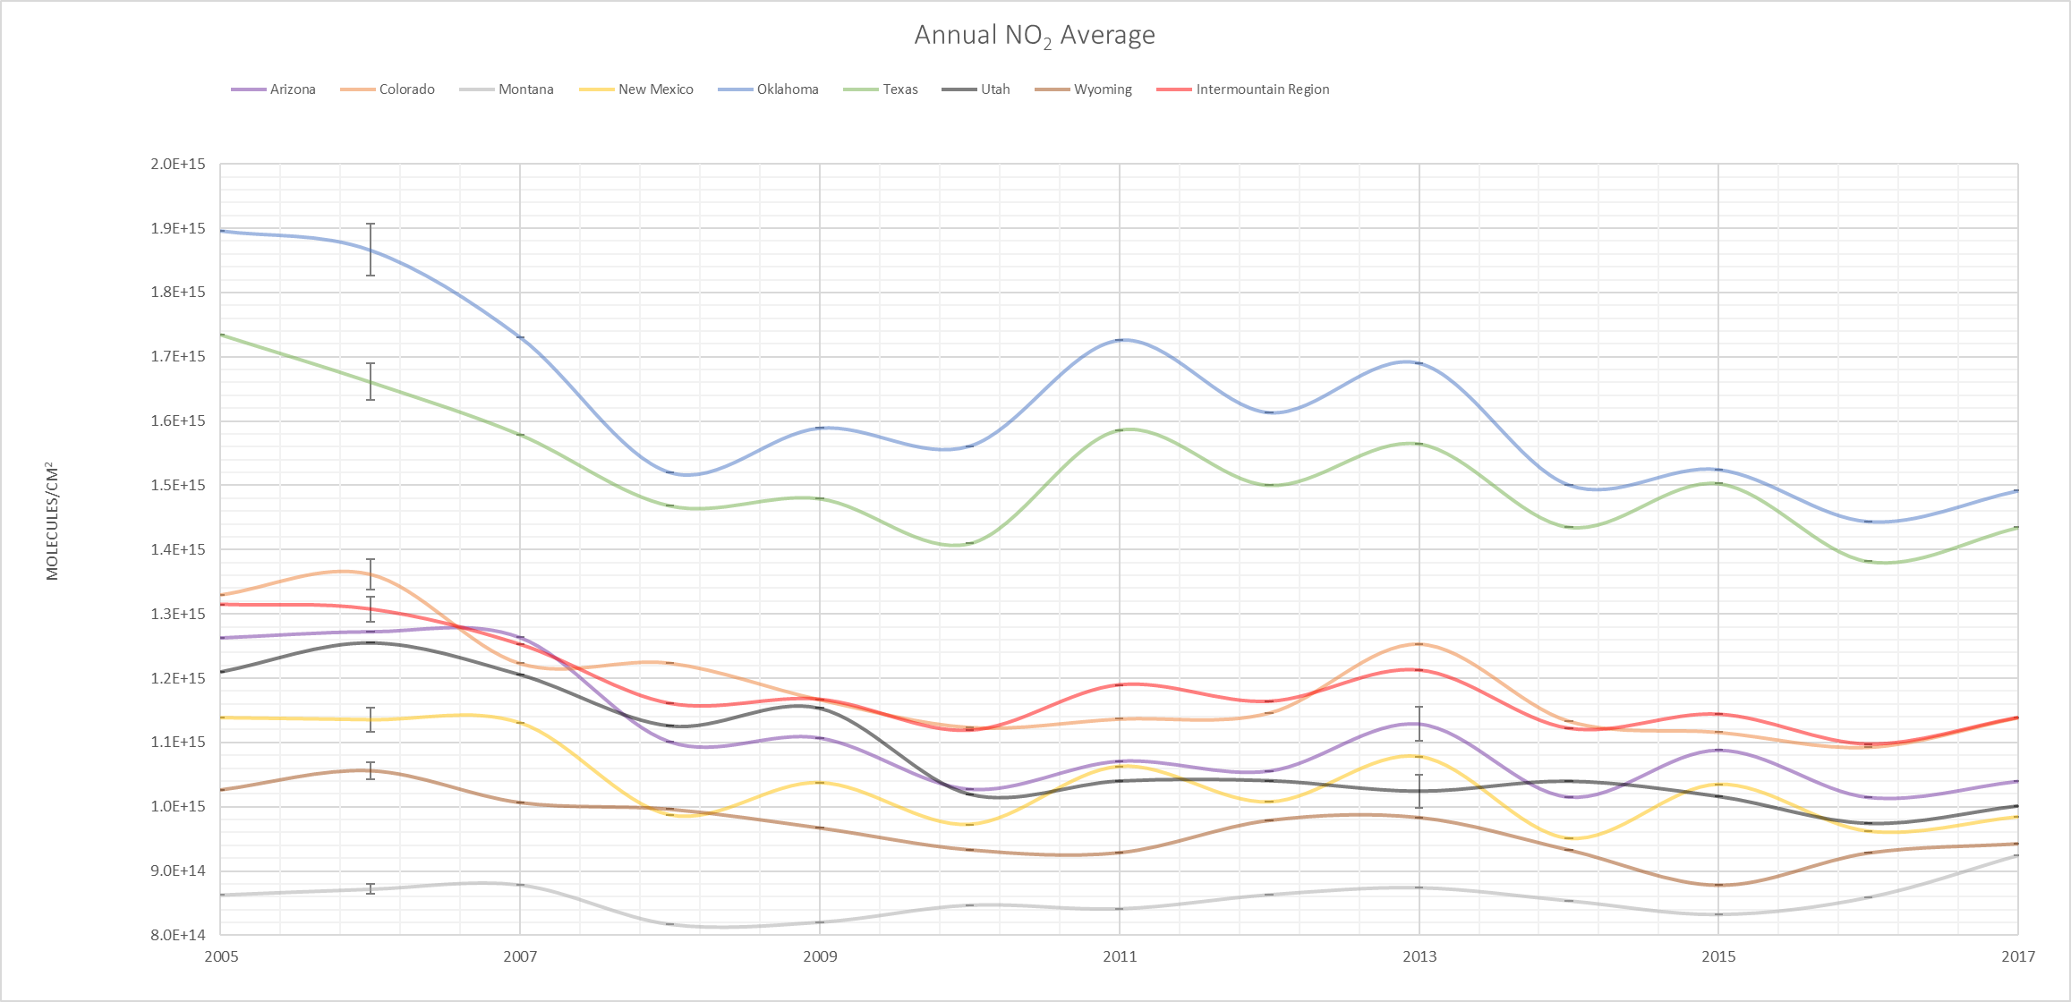

Annual NO₂ Trends
Arizona Colorado Montana New Mexico Oklahoma Texas Utah Wyoming Intermountain Region
2.0E+15
1.9E+15
1.8E+15
1.7E+15
1.6E+15
1.5E+15
1.4E+15
1.3E+15
1.2E+15
1.1E+15
1.0E+15
9.0E+14
8.0E+14
Standard Error
AZ: 9.2E+10
CO: 8.9E+10
MT: 3.3E+10
NM: 6.6E+10
OK:1.5E+11
TX: 9.9E+10
UT: 9.8E+10
WY: 5.6E+10
Int Mnt Reg: 9E+09
Molecules/cm²
Statistical
Significance
(98% CI):
AZ , CO, MT, NM,
OK, TX, UT, WY
2005 2007 2009 2011 2013 2015 2017
Notes:
Jared:
This graph visualizes nitrogen dioxide trends for the eight states over the study period. Overall, each state shows a statistically significant decrease in nitrogen dioxide concentrations under a 98% confidence interval. The only outlier being Montana, which showed a slight increase, due to what we believe to be an issue with the amount of valid data available in the early portion of our study period. Standard error has also been calculated and displayed, however the error bars are not noticeable on the graph due to their much smaller magnitude. Their values are presented on the right.
------------------------------------------------
In order to have a closer understand of trends and values, our team created graphs to compare data. This graph is showing the annual nitrogen dioxide trends for each state within the Intermountain region as well as the Intermountain Region it self. By looking at the graph, you are able to see that the entire Intermountain Region average of nitrogen dioxide across the time period has decreased. This is the case for every single state within the region, besides Montana. To the right of the graph we present the standard error for each state for a single year. Due to the differing magnitudes of measurements on the graph, we are unable to see the standard error bars. After completing this we calculated the statistical significance for each state and we confirmed that each state in the Intermountain region saw a statistically significant change from 2005 to 2017 with a 98% confidence interval.

Slide 9
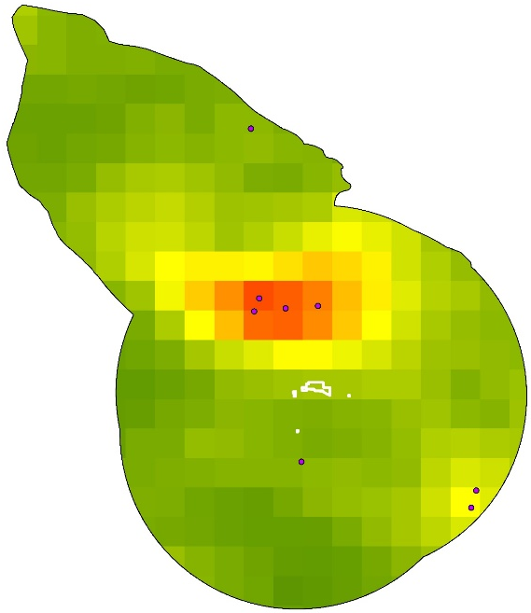
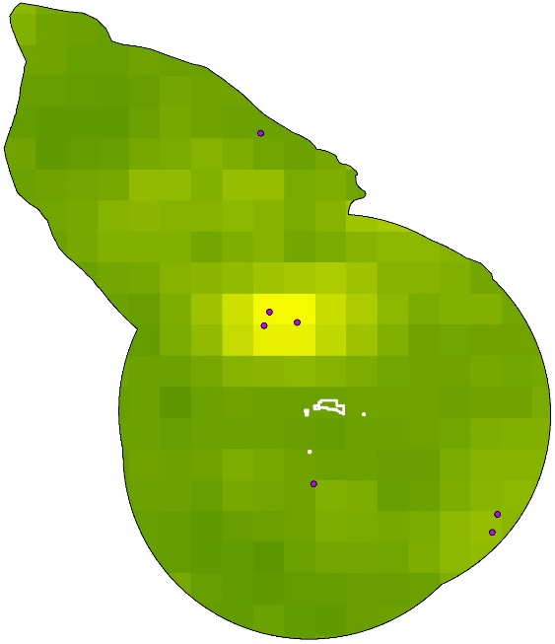
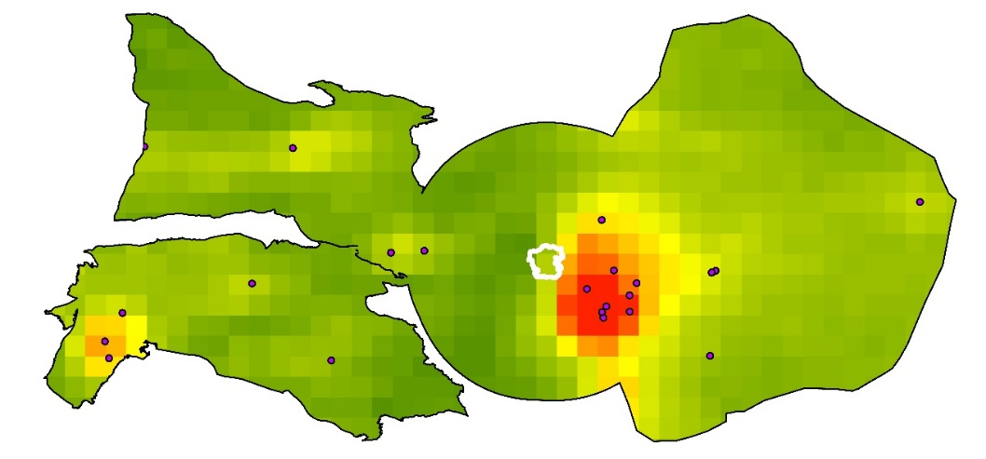
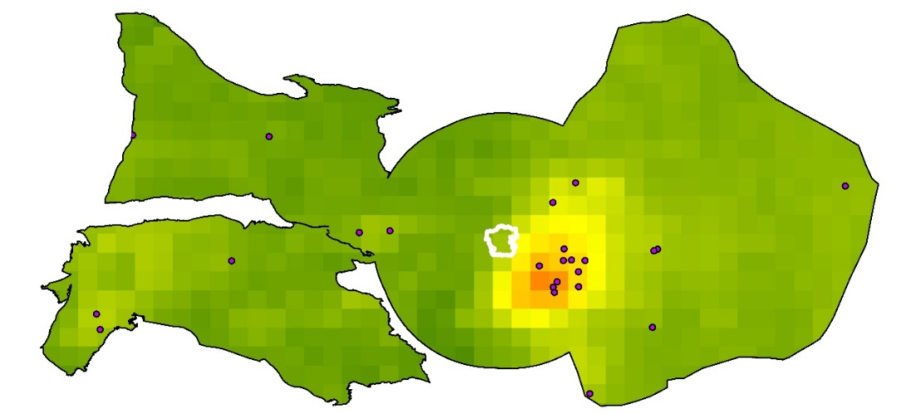
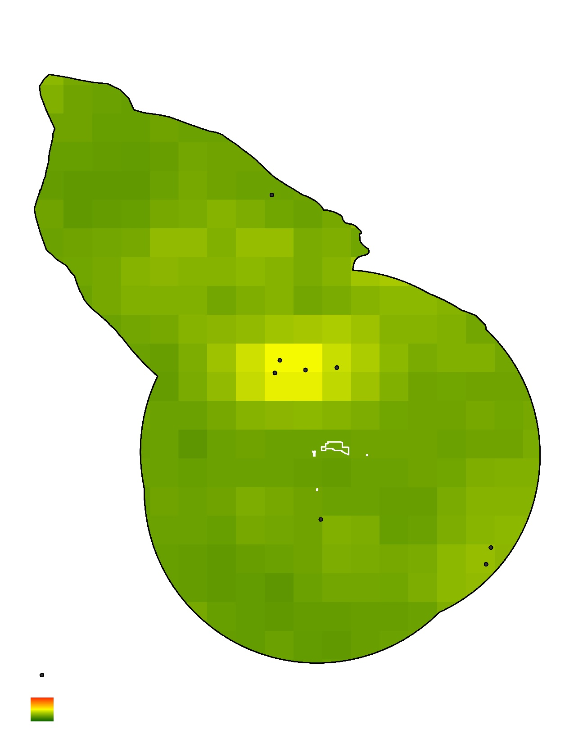

National Park/Shale Basin Results
2005
2017
Chaco Culture
National Historical Park
Chaco Culture
National Historical Park
Rocky Mountain National Park
Rocky Mountain National Park
2005
2017
Surrounding Shale Basins
EGU Emission Source
High (Molecules/cm²)
Low (Molecules/cm²)
Notes:
Jared:
Our partners had a particular interest in understanding trends over national parks and each of their surrounding shale basins. Represented here are Chaco Culture National Historical Park and Rocky Mountain National Park with their surround shale basins for the years 2005 and 2017. Much like the Annual Average maps for the region, there are obvious decreases in nitrogen dioxide surrounding these parks. However, the remaining concentrations in the area, are still high enough to have disproportionately negative impacts.
---------------------------------------------------------------------------
The annual average for 2005 and 2017 is displayed for National Park, Chaco Culture National Historical Park. The National Parks and Basins areas were generated and statistics calculated for them to determine if basins nearby parks were influencing their air quality. Note the placement of the EGU emission sources right next to the Chaco Culture National Historic Park. When comparing Chaco to other National Parks, we can see that it is one of the highest concentrations and through the study period it has one of the sharpest declines in NO2. Below we can see Rocky Mountain National Park and its surrounding shale basins. Much like Chaco Culture, there has been a decrease in nitrogen dioxide in its surrounding areas. The change observed in Chaco Culture had a statistically significant change over time with a 98% confidence interval however the change in Rocky Mountain was not significant.

Slide 10
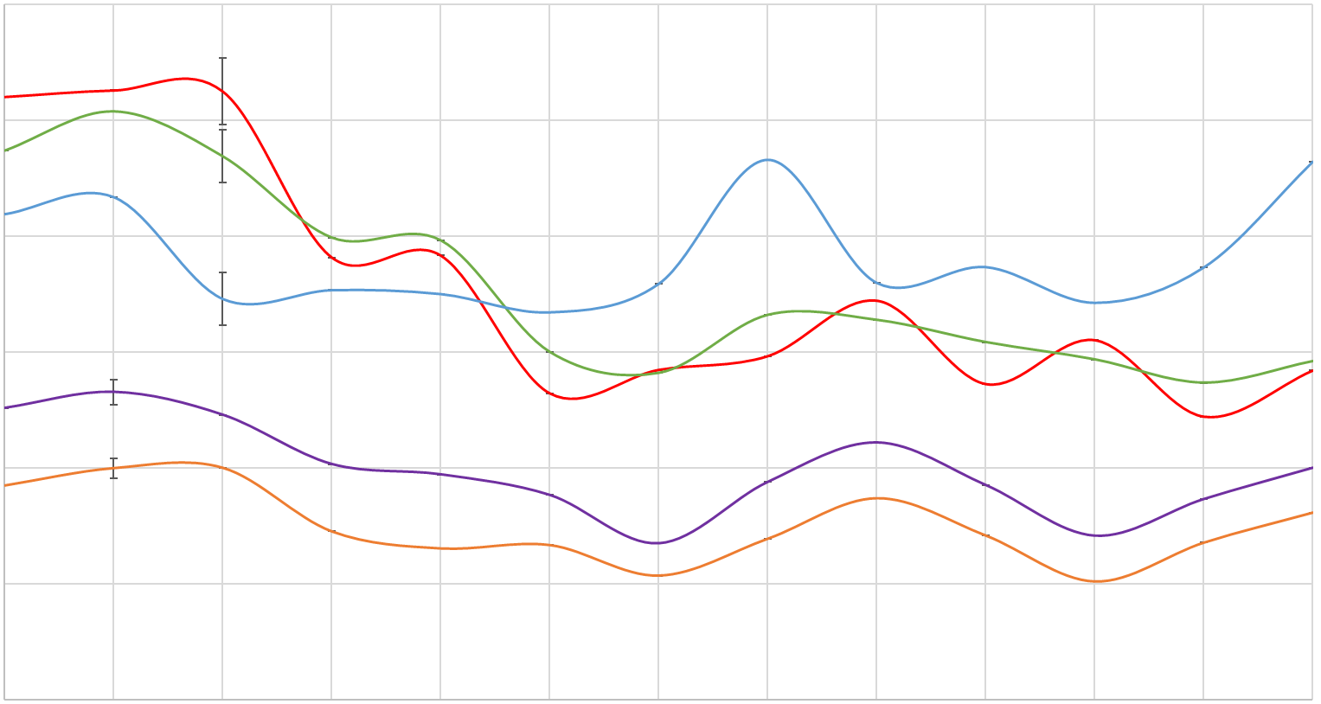
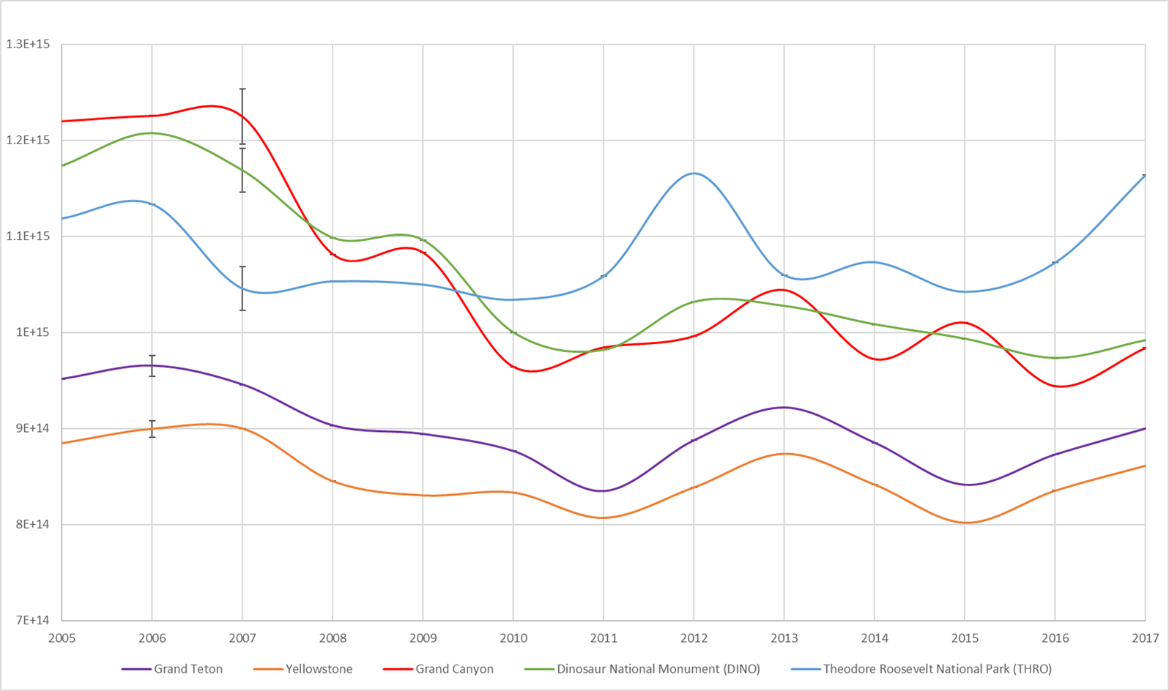
Annual NO₂ Trends – Focus Parks
1.3E+15
1.2E+15
1.1E+15
1.0E+15
9.0E+14
8.0E+14
7.0E+14
Standard Error
Grand Teton: 1.1E+13
Yellowstone: 8.8E+12
Grand Canyon:
2.9E+13
DINO: 2.3E+13
THRO:2.3E+13
Statistical
Significance
(98% CI):
Grand Teton, Yellowstone,
Grand Canyon, DINO, THRO
2005 2007 2009 2011 2013 2015 2017
Grand Teton Yellowstone Grand Canyon Dinosaur National Monument (DINO) Theodore Roosevelt National Park (THRO)
Notes:
Zac:
In addition to the previous park, our partners requested results for Grand Teton, Yellowstone, Grand Canyon, Dinosaur National Monument, and Theodore Roosevelt National Park. Each park shows a statistically significant change from 2005 to 2017, each park showed relatively consistent trends with that of the states the park is in.
--------------------------
When discussing with our partners, they had specific parks they wanted to have more analysis completed for, The five parks shown above are a few of them. This graph is displaying the annual trends over Grand Teton, Yellowstone, the Grand Canyon, Dinosaur National Monument, and Theodore Roosevelt National Park. All five of these park show a statistically significant changed from 2005 to 2017 with a confidence interval of 98%.

Slide 11
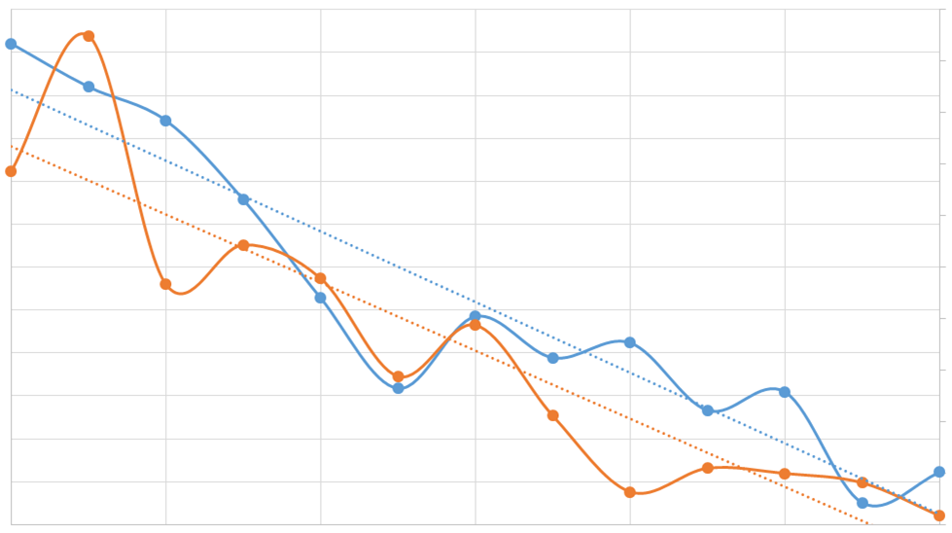
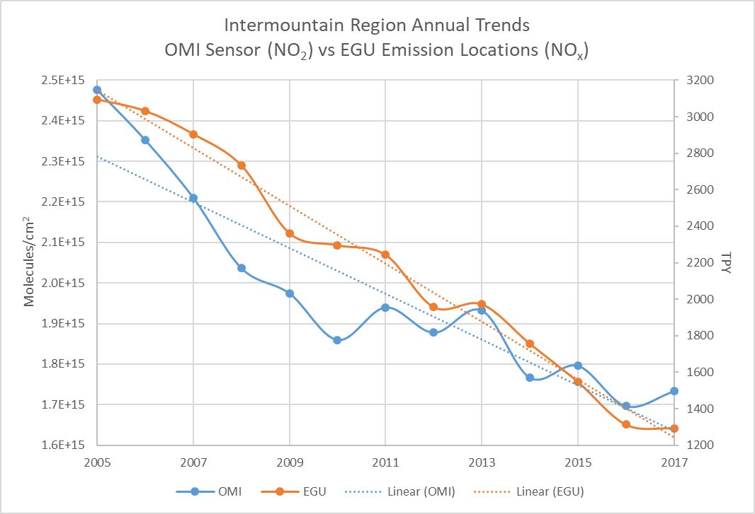
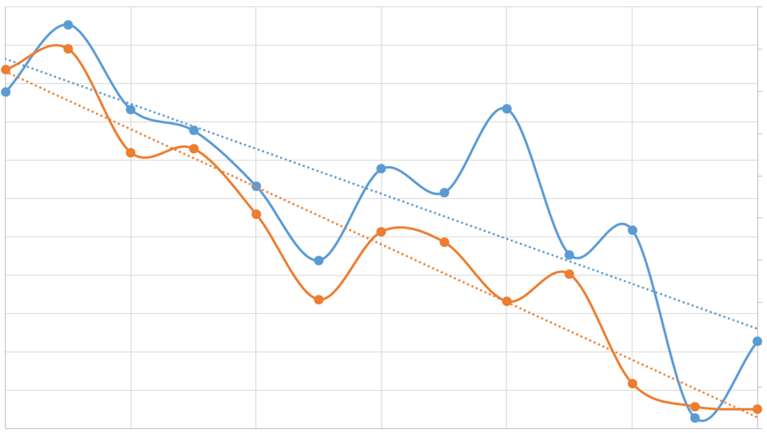
OMI vs. Ground Measurements
Arizona Annual NO₂ Trends
OMI Sensor vs EPA CASTNET Monitor
Monitor Info
Latitude: 32.204411
Longitude: -110.878067
Elevation: 789.91 m
2.3E+15
2.2E+15
2.1E+15
2.0E+15
1.9E+15
1.8E+15
1.7E+15
1.6E+15
1.5E+15
1.4E+15
1.3E+15
1.2E+15
1.1E+15
8
7.5
7
6.5
6
5.5
5
4.5
4
3.5
3
Intermountain Region Annual Trends
OMI Sensor (NO₂) vs EGU Emission Sources (NO_{x})
2.5E+15
2.4E+15
2.3E+15
2.2E+15
2.1E+15
2.0E+15
1.9E+15
1.8E+15
1.7E+15
1.6E+15
3200
3000
2800
2600
2400
2200
2000
1800
1600
1400
1200
Molecules/cm²
Parts per billion (ppb)
2005 2007 2009 2011 2013 2015 2017
Molecules/cm²
OMI Value EPA CASTNET Value
OMI Linear Trend EPA CASTNET Linear Trend
Tons per year (TPY)
Colorado Annual NO₂ Trends
OMI Sensor vs EPA CASTNET Monitor
Monitor Info
Latitude: 37.303890
Longitude: -107.484167
Elevation: 2361.35 m
2.0E+15
1.9E+15
1.8E+15
1.7E+15
1.6E+15
1.5E+15
1.4E+15
1.3E+15
1.2E+15
1.1E+15
1.0E+15
9.0E+14
2.8
2.6
2.4
2.2
2
1.8
1.6
1.4
1.2
1.0
0.8
2005 2007 2009 2011 2013 2015 2017
Molecules/cm²
OMI Value EGU Emission Value
Parts per billion (ppb)
OMI Linear Trend EGU Emission Linear Trend
2005 2007 2009 2011 2013 2015 2017
OMI Value EPA CASTNET Value
OMI Linear Trend EPA CASTNET Linear Trend
Notes:
Zac:
In order to validate the OMI observations, we used in situ measurements from the EPA and reported pollutant emissions from electrical generating units. Our main focus had to be on overall trends across our study period due to conflicting units. We acquired daily OMI NO2 measurements for exact point locations of EGU Emission sources and high elevation EPA CASTNET Monitors, we discovered that the correlation between OMI and ground measurement nitrogen dioxide data is very high showing downward trends along both data sets.
--------------------------
OMI nitrogen dioxide values can be difficult to analyze with ground stations due to there different ways of measuring. OMI measures nitrogen dioxide in molecules per centimeter squared showing the density of a column of air in the atmosphere. The graph to the left is a annual data comparison of Electrical Generating Unit (EGU) emissions of nitric oxide measured in tons per year to OMI nitrogen dioxide samples over that exact point location of the EGU sources. These trends show a strong correlation between trends in decreases for both datasets.
In the two graphs to the left, we are comparing hourly EPA CASTNET Monitor measurements of nitrogen dioxide at 1:00pm to OMI nitrogen dioxide samples over the exact point locations of the monitors. We were only able to complete this analysis for Arizona and Colorado as they are the only states within the Intermountain Region that with CASTNET monitors that offer hourly measurements of nitrogen dioxide. After annualizing our data, we created annual trend maps comparing the two data sets for each state, but discovered many inconstancies due to the different elevations of the monitors. In order to see the most accurate results and highest possible correlations between OMI data and CASTNET monitor data we analyzed the monitors at the highest and lowest elevations that had data for each year in our study period. By doing this, we discovered that the monitors at the highest elevations show the very similar trends in data and can be used against each other to see now nitrogen dioxide concentrations are decreasing over time.

Slide 12
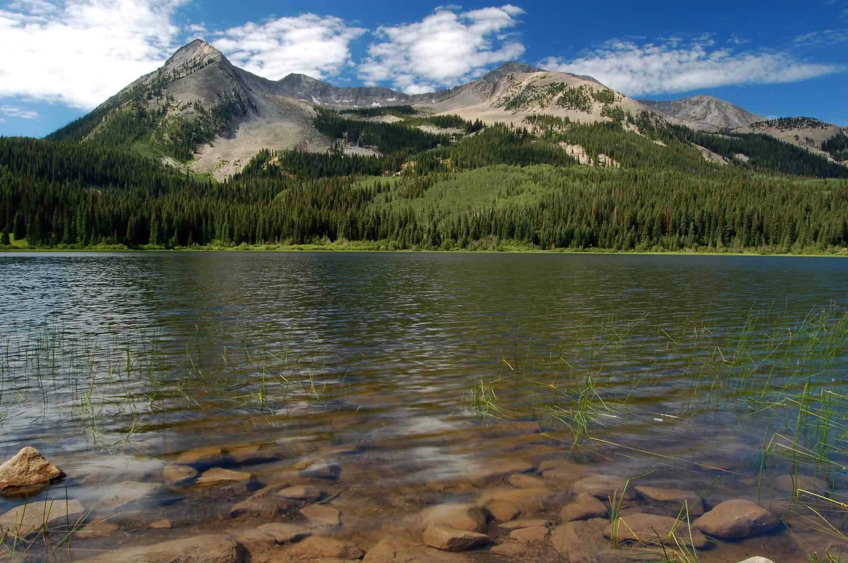
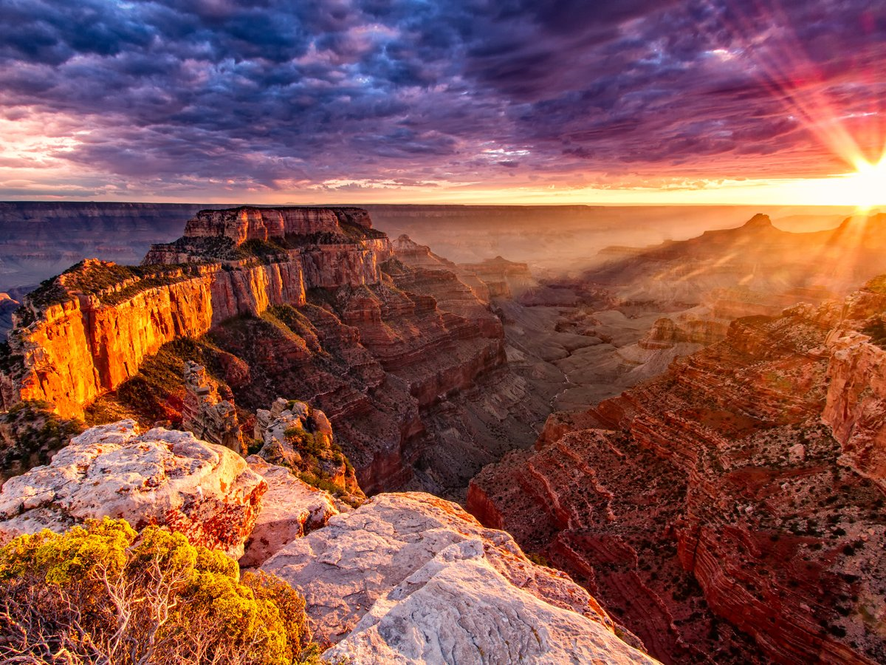
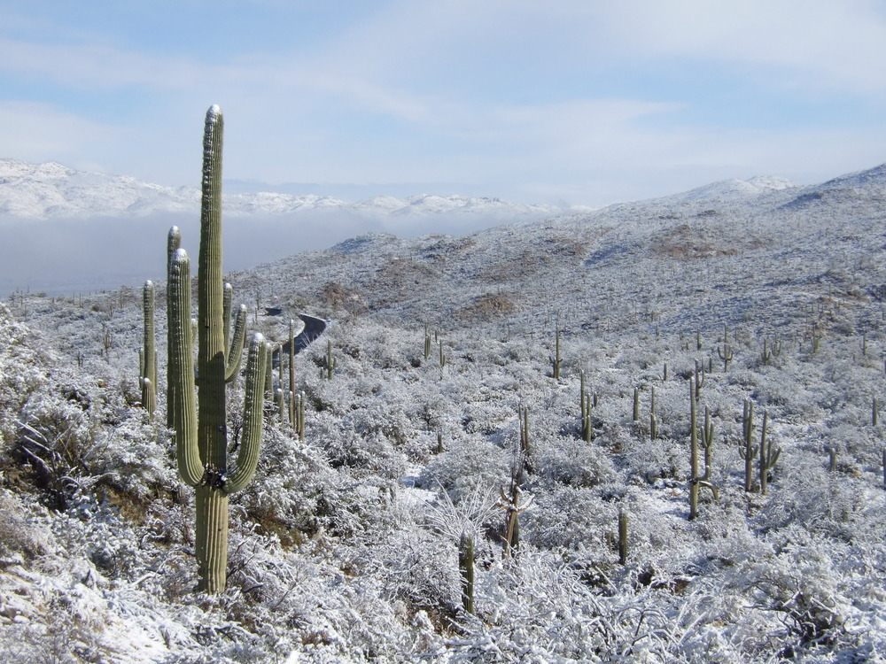
Conclusions
Within the Intermountain Region, from 2005 to 2017, there has been a decrease in NO₂ between the upper troposphere and lower stratosphere besides in Montana.
  All states had a statistically significant change
NO₂ concentrations are lowest in the Summer and highest in the Winter.
OMI NO₂ data can be compared to in situ ground measurements indirectly
  High correlation in trends between OMI NO₂ data and ground monitors at high elevations
Notes:
Chet:
In conclusion, our team determined that from 2005 to 2017, there has been a decrease in nitrogen dioxide across the Intermountain Region, besides in Montana. While not presented, we also found that seasonally, NO2 concentrations are lowest in the summer and highest in the winter. This is partially due to the thermal decomposition of nitrogen dioxide and there being more sunlight and heat in the summer than winter. While unable to directly compare, OMI and highly elevated ground measurement data show highly correlated trends when compared and can be used to base off of each other.
---------------------------------------------------
In conclusion, our team found that within the Intermountain region from 2005 to 2017, there has been a decrease in nitrogen dioxide between the upper troposphere and lower stratosphere besides in Montana. Seasonally, we discovered that the highest nitrogen dioxide concentrations are in the Winter and the lowest were in the Summer. Due to units, we were unable to directly compare ground station data to OMI data, but we did find that trends in highly elevated monitors and well correlated with those of OMI.
Image Source: Credit to Debbie Miller for all three images

Slide 13
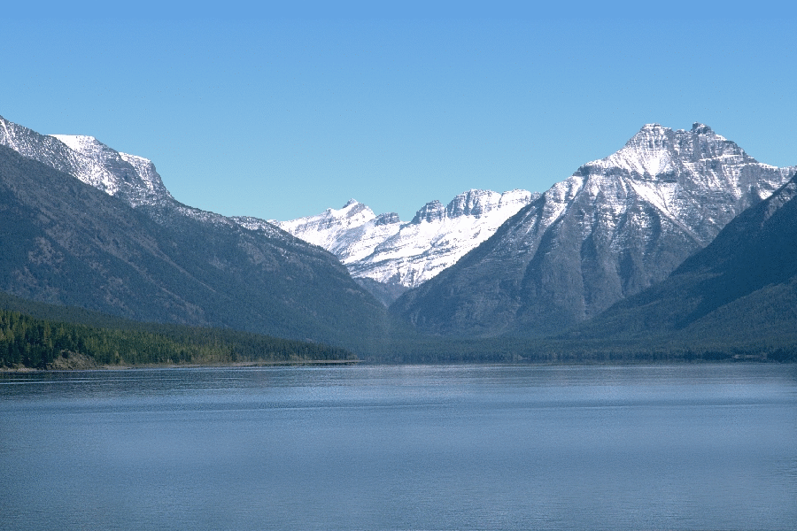
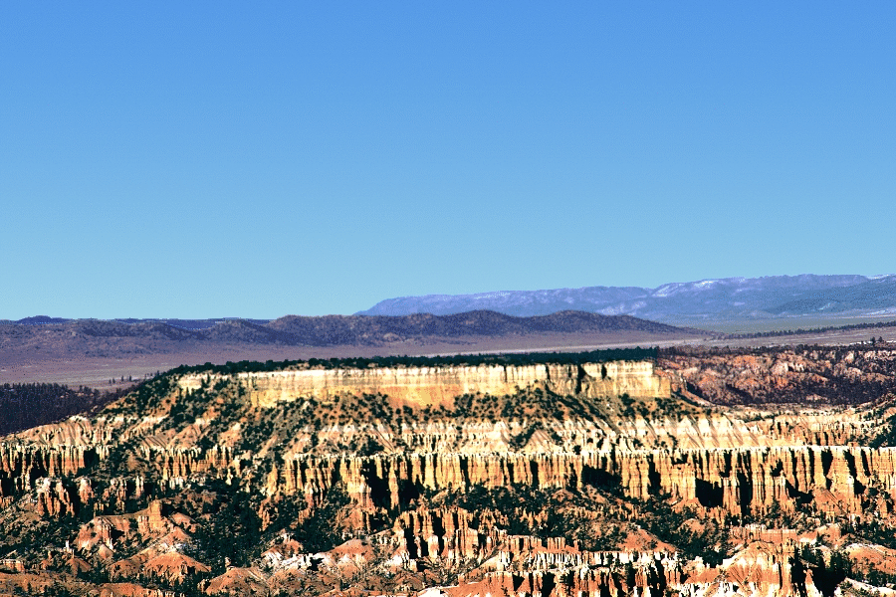
Future Work
Project will be continued in Fall 2018 NASA DEVELOP Term
  Build on our team’s results
  Focus on visibility as it is affected by aerosols
  Create tutorial to maintain the partner’s use of NASA Earth Observation data
Notes:
Chet:
This project will be continued into the Fall 2018 NASA DEVELOP term as a new team continues our partnership with Debbie Miller and Andrea Stacy to further build on our teams results, address visibility as it is affected by aerosols, and to create a tutorial to help our partners use NASA Earth Observation data.
----------------------------------------
In the Fall 2018 NASA DEVELOP term, our project will be continued as the next team partners again with Debbie Miller and Andrea Stacy. The team will build on our conclusions and results by validating our findings. They will be focused on studying visibility issues as it is affected by aerosols within the Intermountain Region. A main focus for the team will also be creating a tutorial for our partners to help them better understand and to learn how to use NASA Earth Observation data.
Image Source: Credit to Debbie Miller for all images

Slide 14

Acknowledgements
Project Partners
Debbie Miller, National Park Service Intermountain West Region, Air Resource Specialist
Andrea Stacy, National Park Service, Air Resources Division
Science Advisers
Dr. Bruce Doddridge, NASA Langley Research Center
Dr. Kenton Ross, NASA Langley Research Center
Team Members
Notes:
Chet:
Lastly, as a team we would like to acknowledge our partners Debbie Miller and Andrea Stacy as well as our Science Advisers Dr. Bruce Doddridge and Dr. Kenton Ross for all of their help and support.
---------------------------------------------
As a team we would like to acknowledge our partners Debbie Miller and Andrea Stacy. We would also like to acknowledge both of our science advisors that helped us extensively throughout, Dr. Bruce Doddridge and Dr. Kenton Ross.

