Slide 1
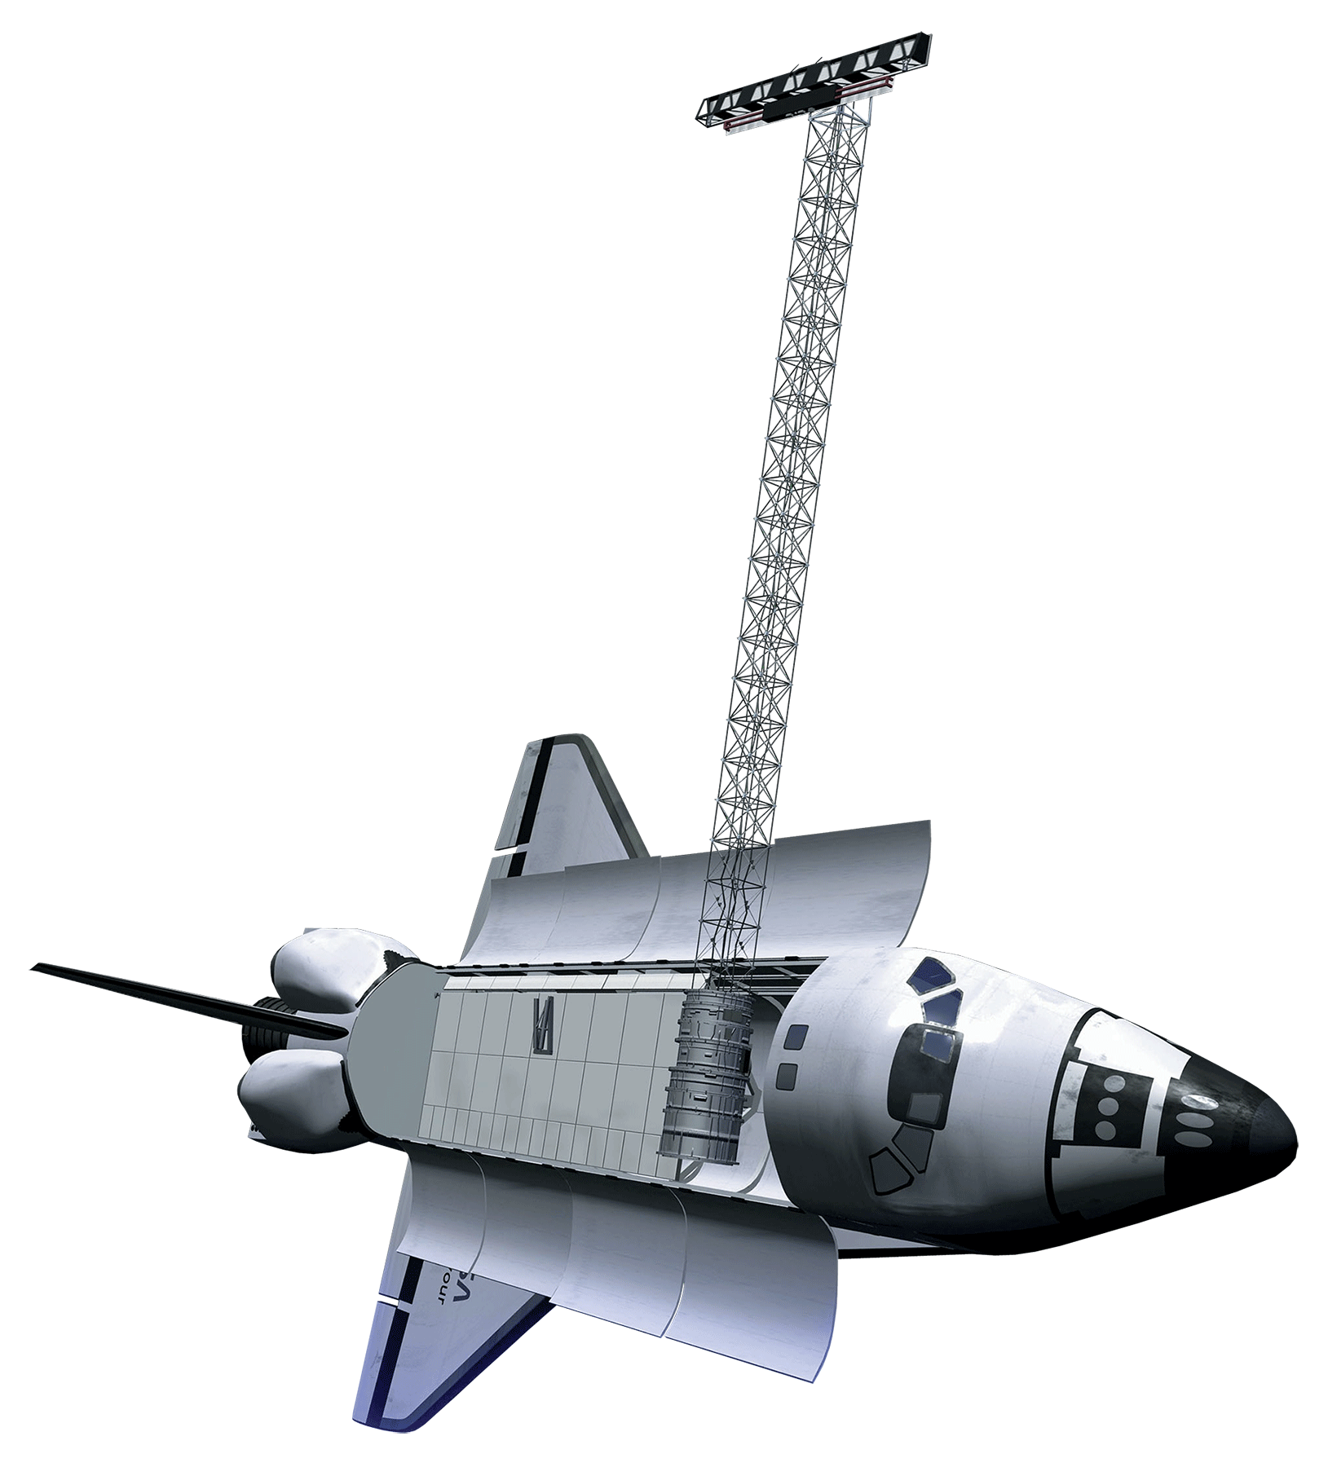
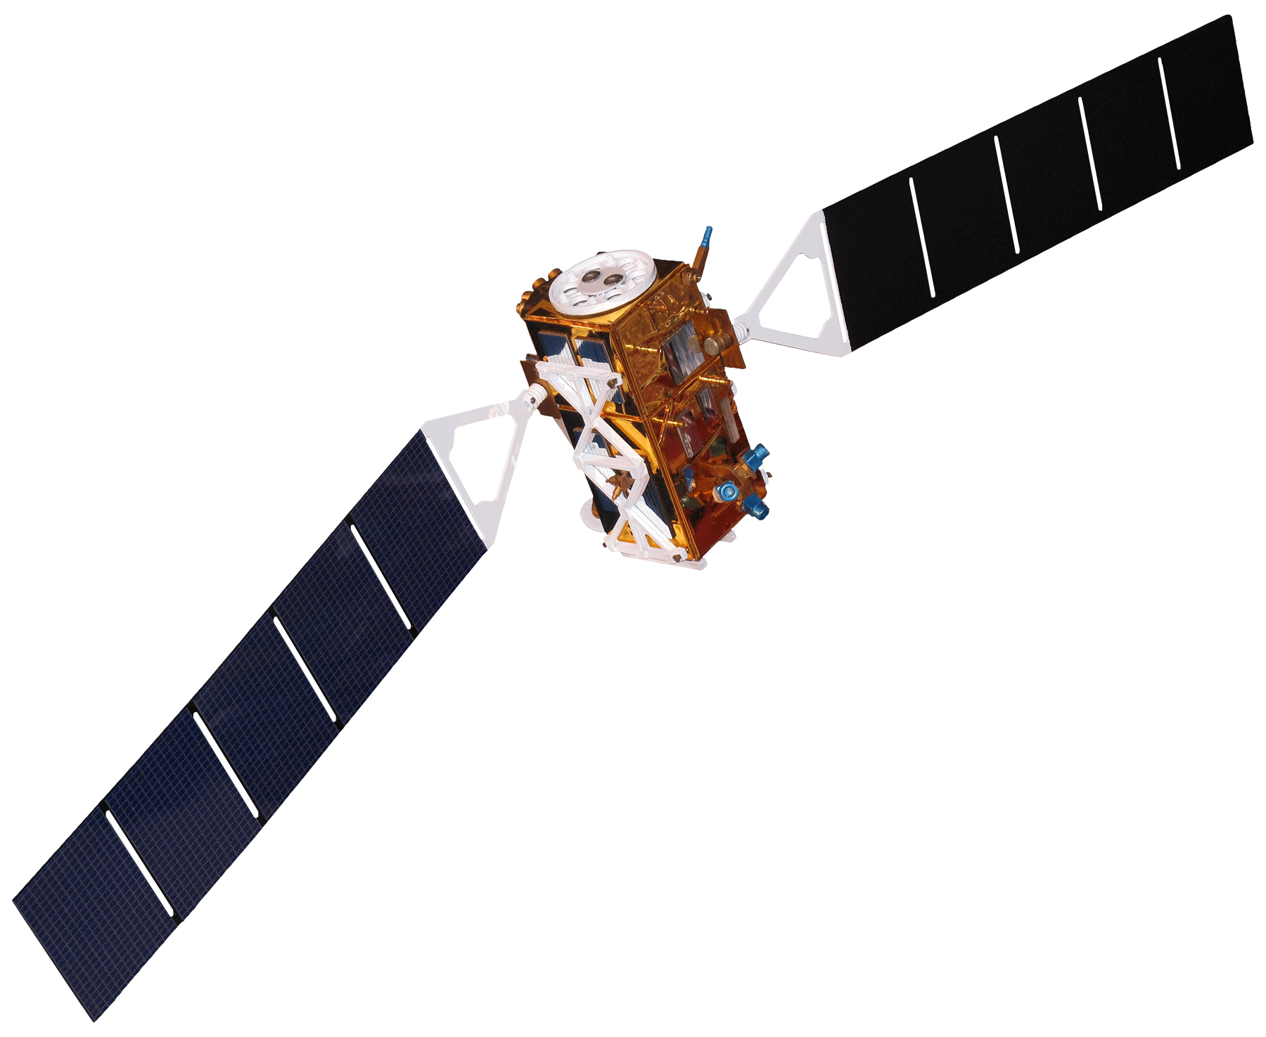
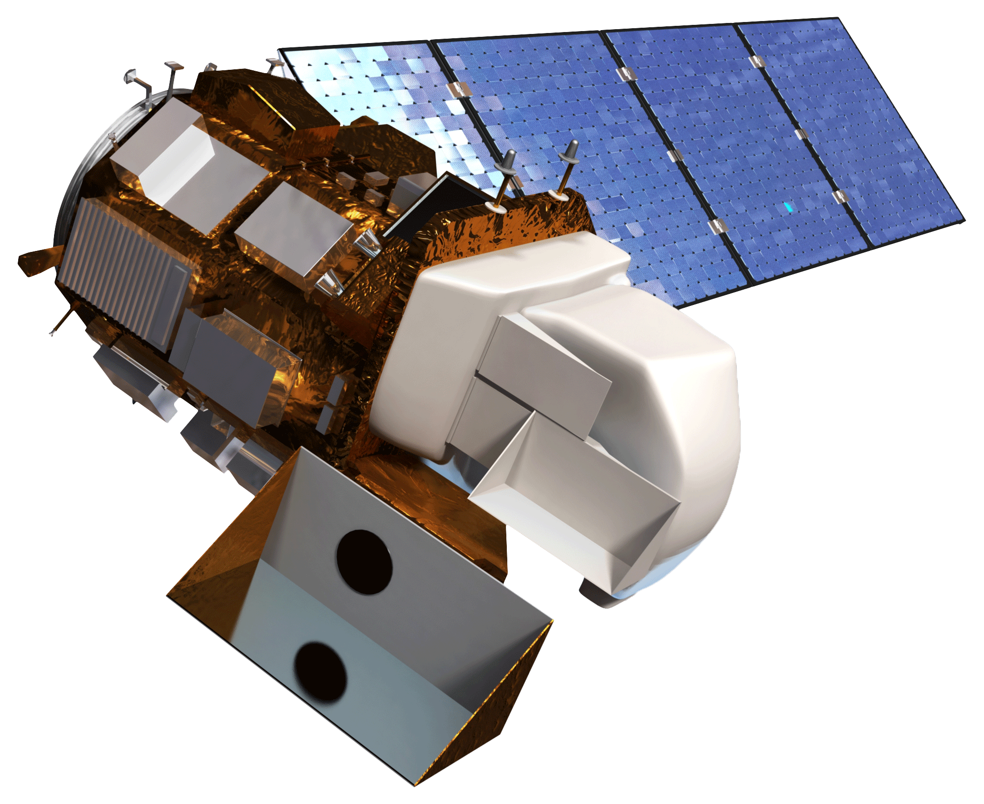
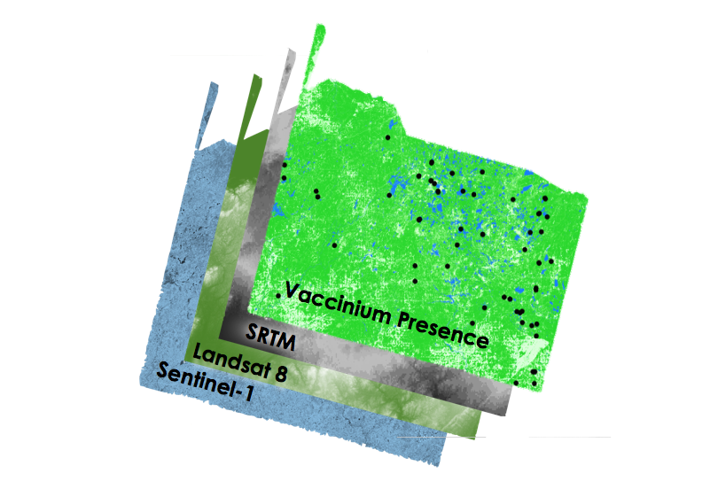
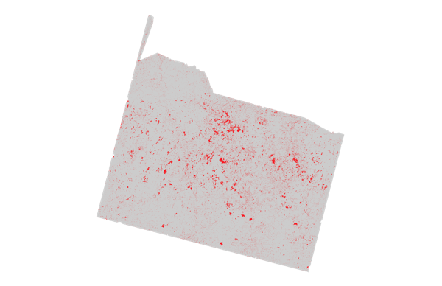
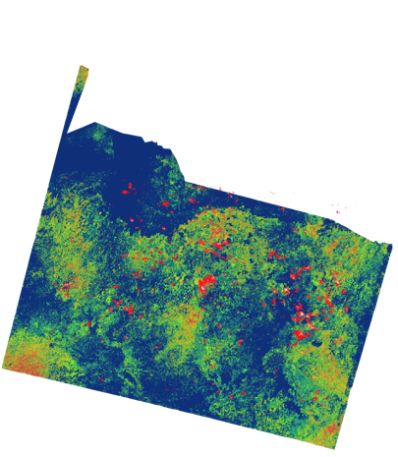
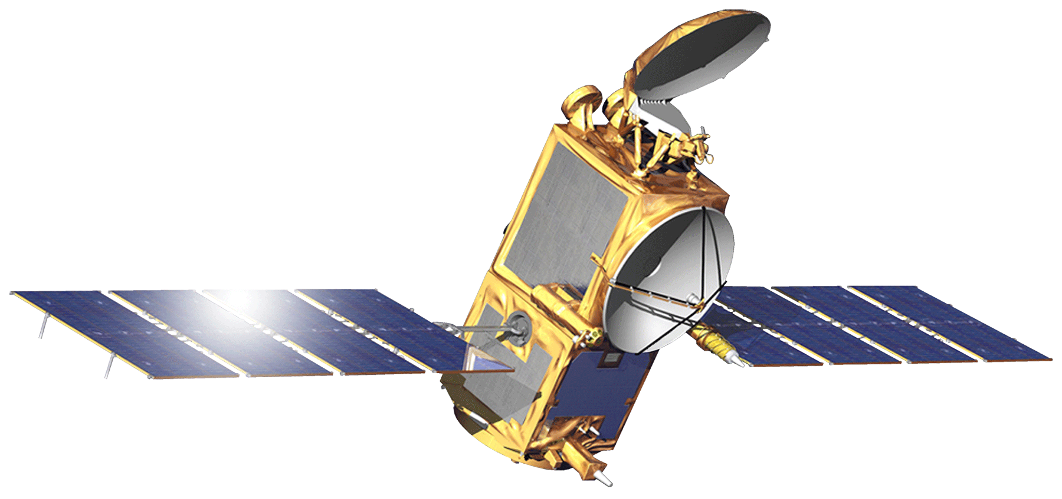

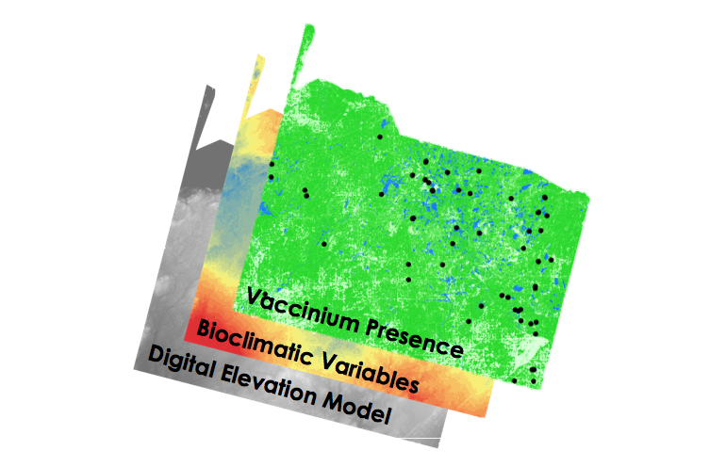
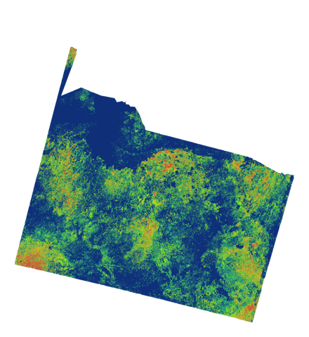

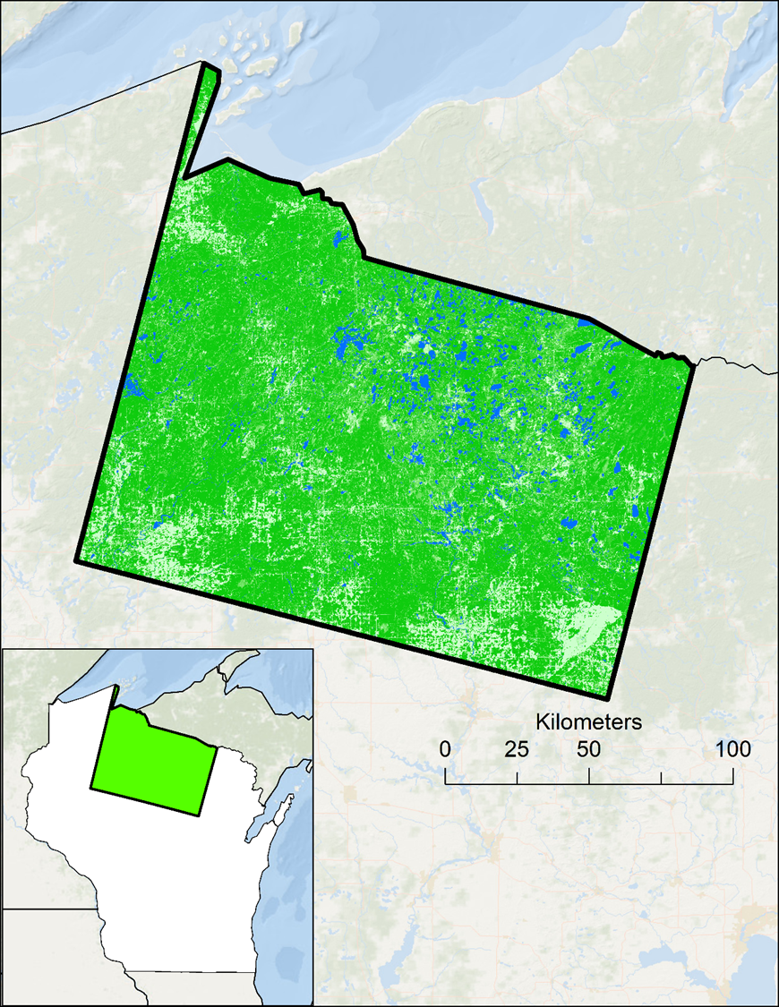
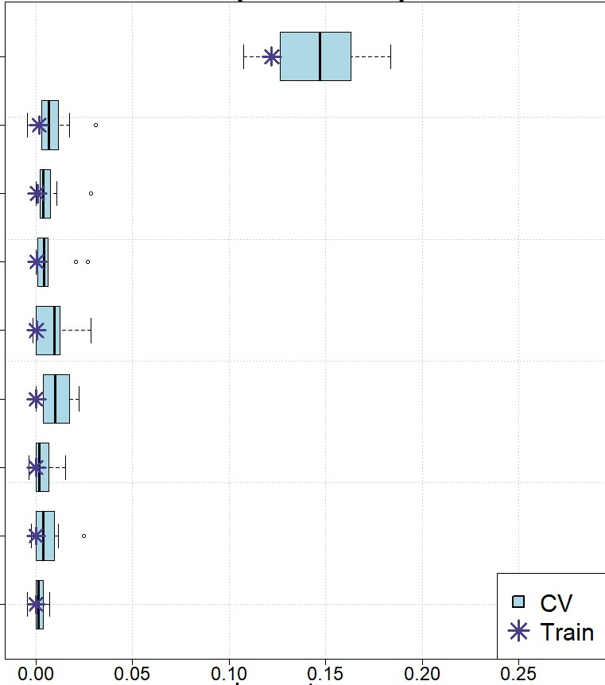
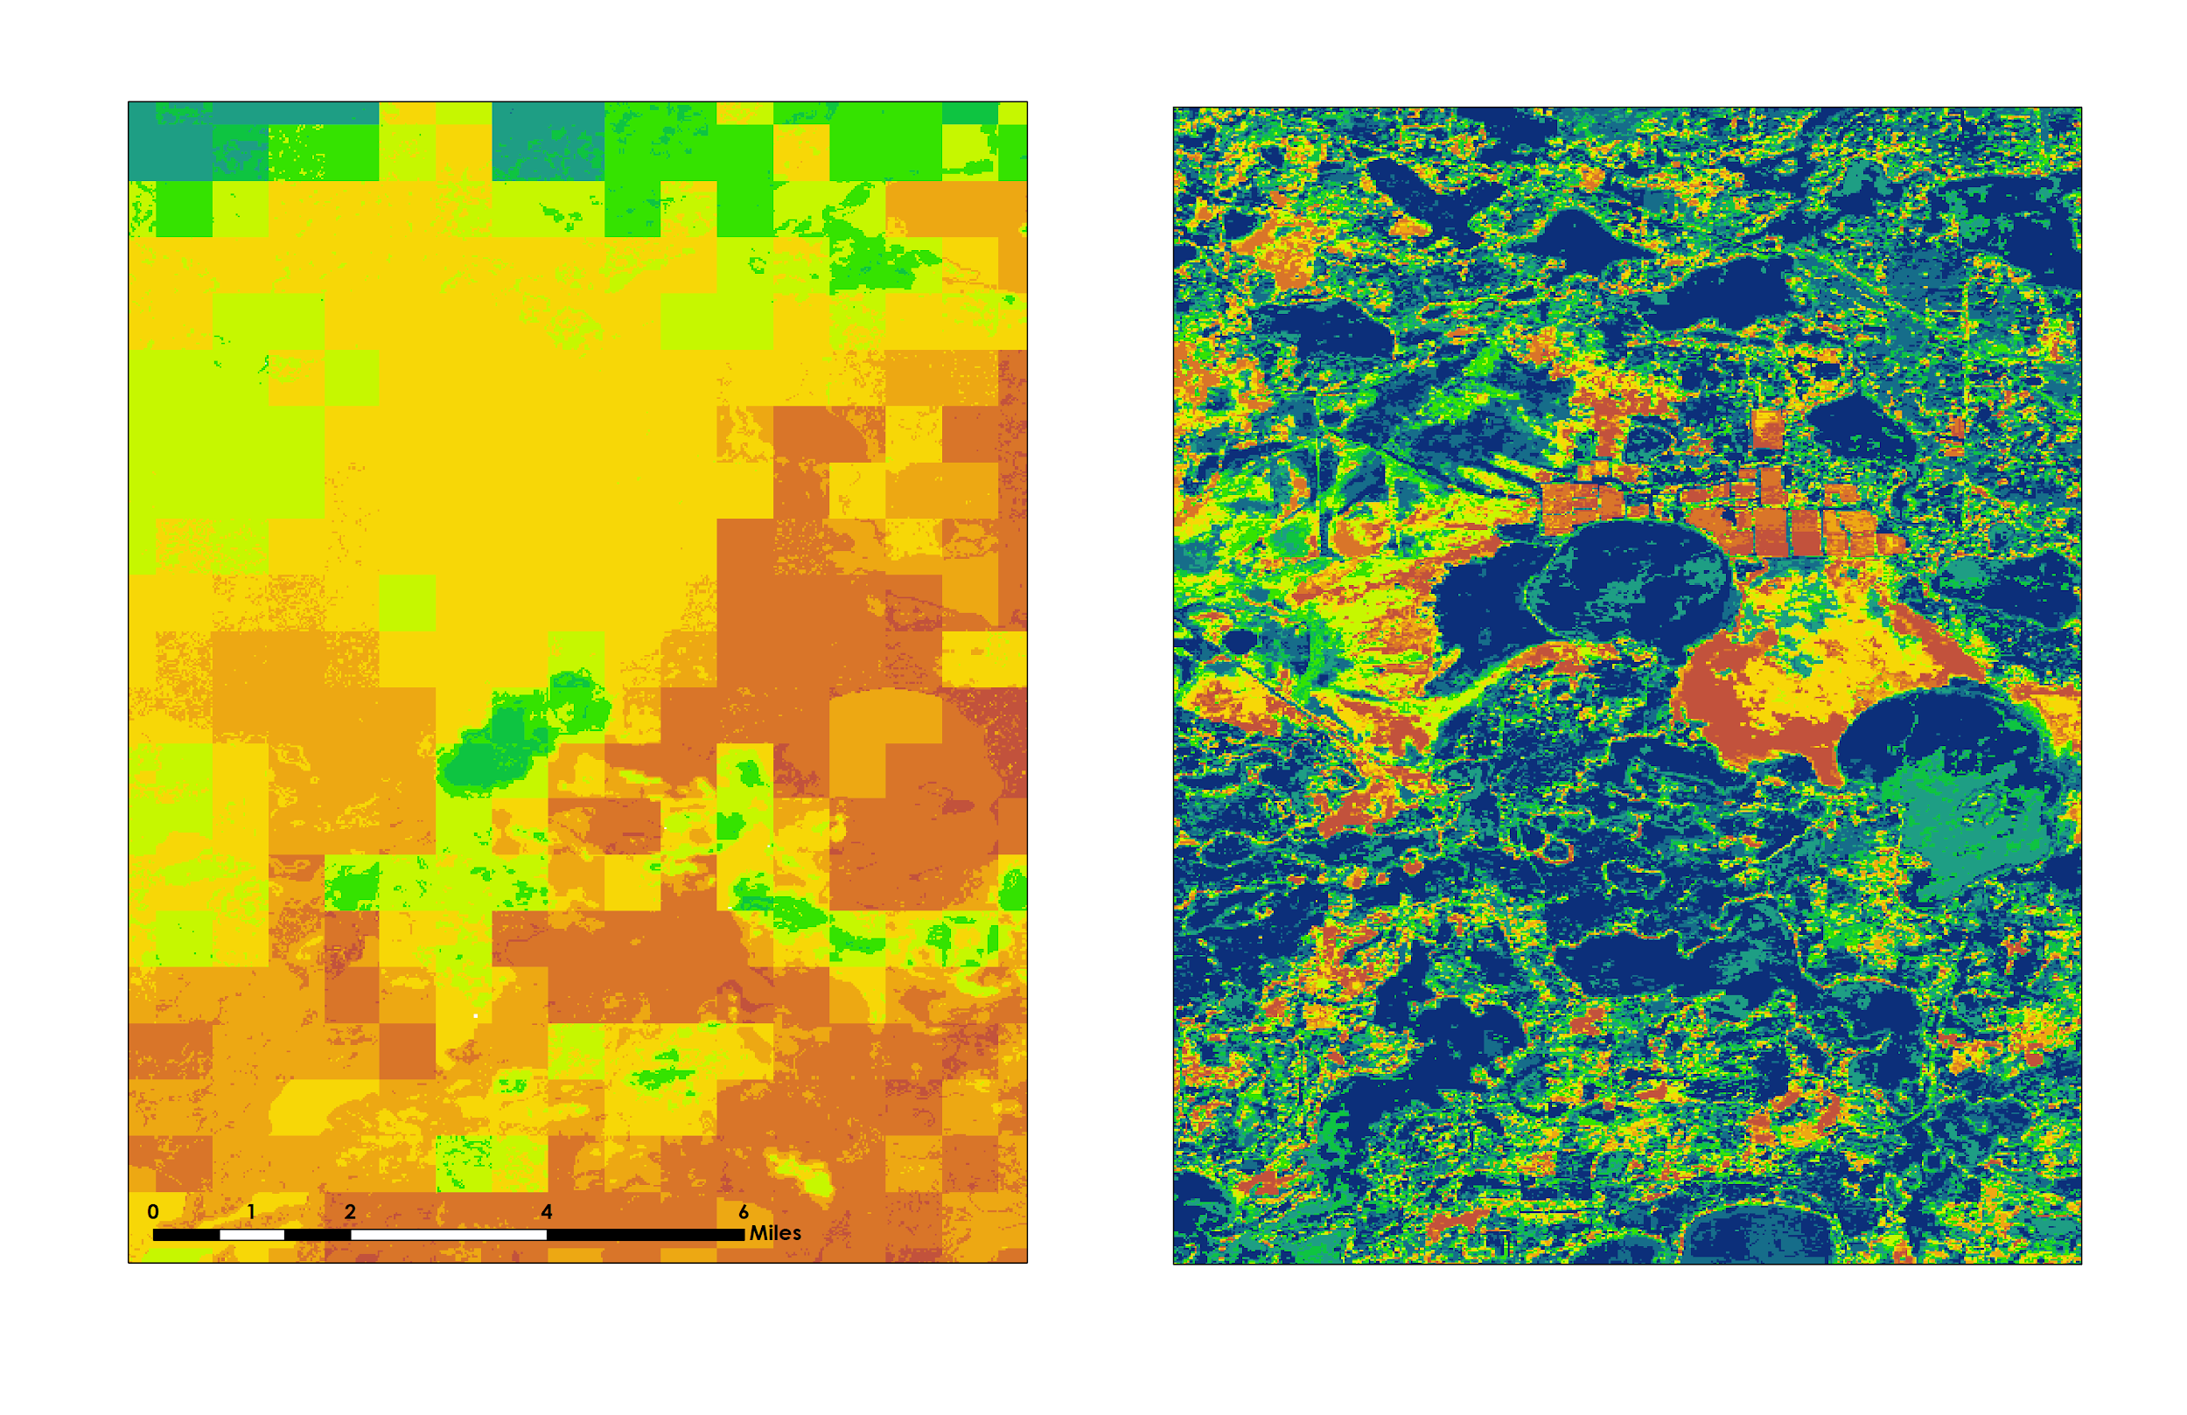



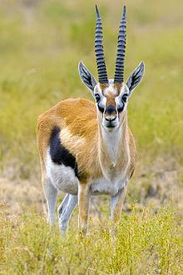

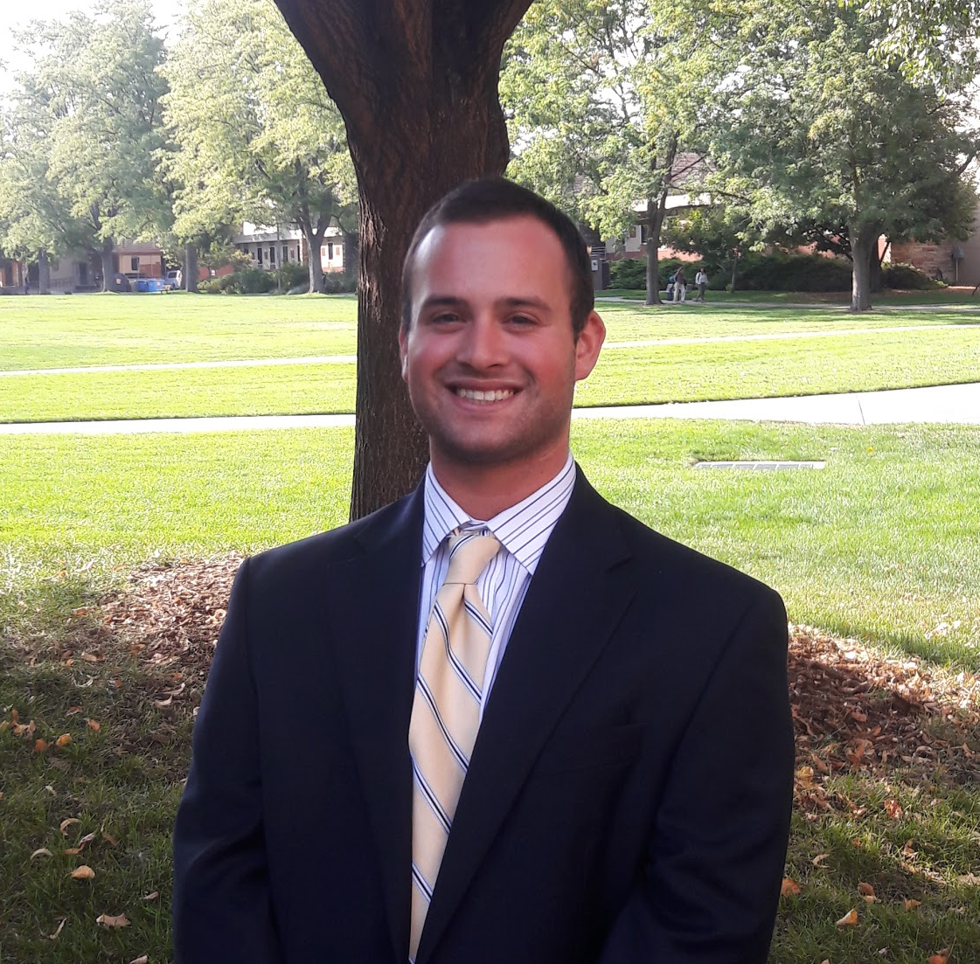
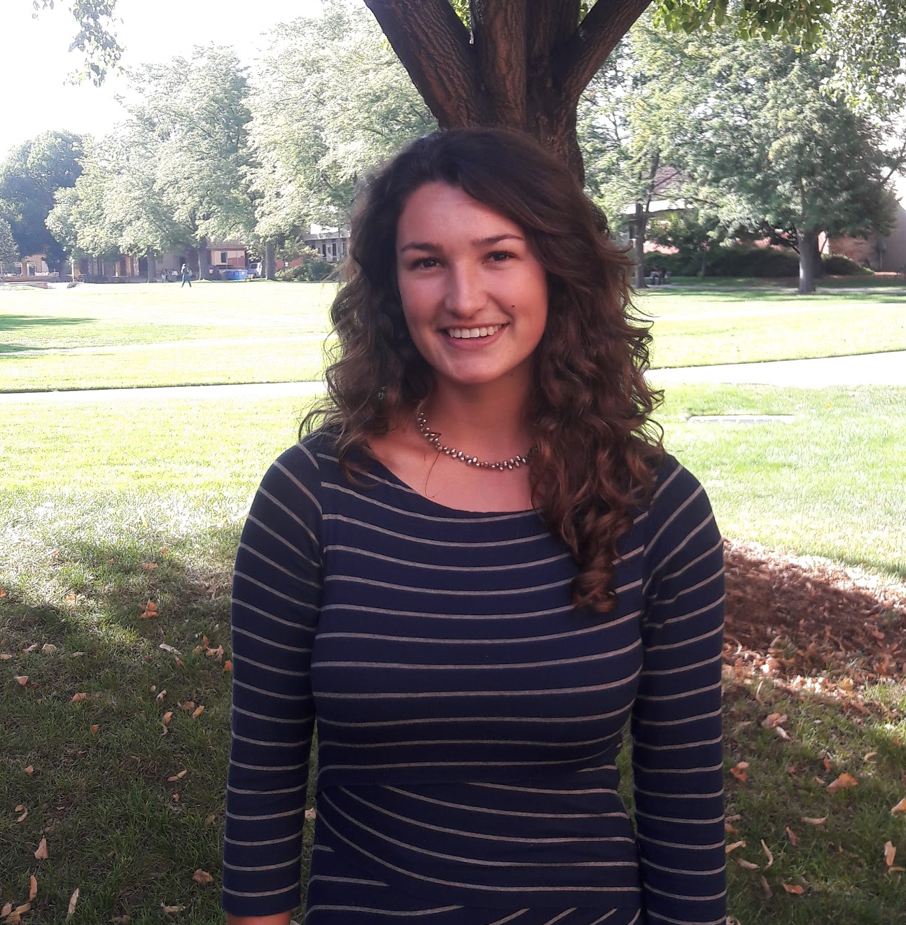
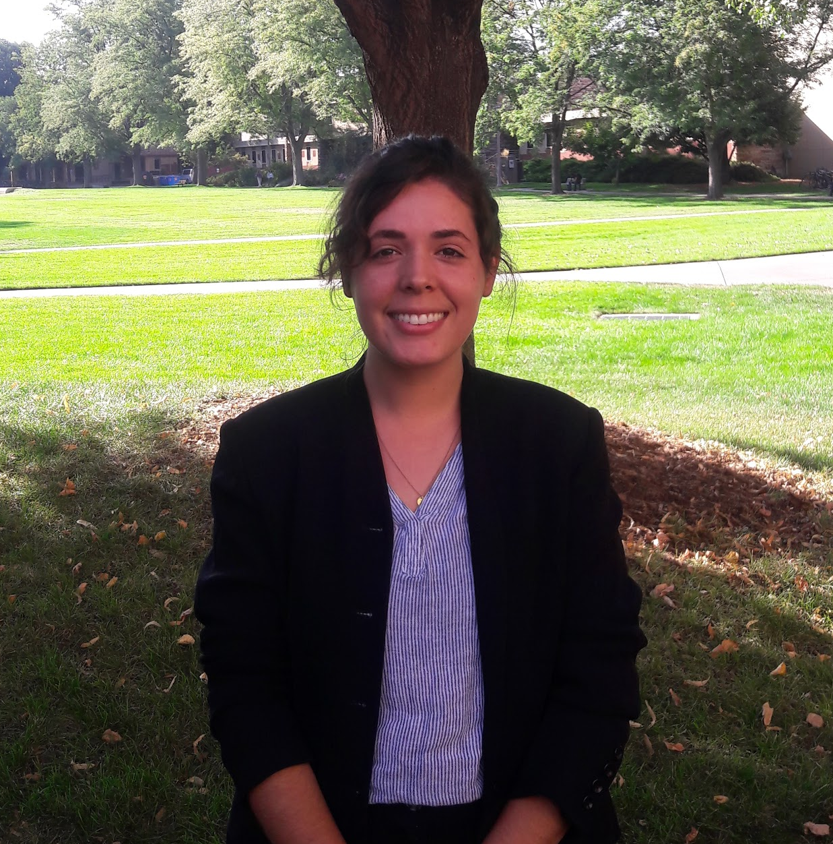

Employing NASA Earth Observations to Model Distributions of Crop Wild Relatives, in Support of USDA ARS Genetic Resource Conservation Efforts
Abstract
Earth Observations
Crop wild relatives (CWR) are genetically related to cultivated crops and function as repositories for genetic diversity. These plants have the potential to improve the yield, nutritional value, and resilience of crops, thereby buffering against widespread crop failure and supporting rural economic productivity. As such, our partners at the United States Department of Agriculture - Agricultural Research Service (USDA ARS) National Plant Germplasm System (NPGS) are tasked with preserving CWRs. This project focused on two species of the Vaccinium L. genus: Vaccinium oxycoccos (littleleaf cranberry), and Vaccinium macrocarpon (largeleaf cranberry). The species in this genus are critical to preserve both in situ and ex situ given their relatively low genetic diversity and scarcity in seed banks. Currently, the NPGS relies primarily on habitat distribution modeling approaches to predict suitable habitats for CWRs. In order to refine these modeling approaches, the NASA DEVELOP team incorporated Sentinel-1 Synthetic Aperture Radar, Shuttle Radar Topography Mission, and Landsat 8 Operational Land Imager (OLI) observations into the existing predictive strategies of the NPGS. Surface reflectance products from Landsat 8 OLI were successfully utilized to detect the habitat of our cranberry species. Similarly, we found that including spectral variables derived from these sensors considerably improved the statistical and geospatial outputs of habitat distribution models, a finding that can bolster the USDA ARS’s future conservation efforts of CWRs.
Landsat 8 OLI
SRTM
Sentinel-1 SAR
Methodology
Satellite Detection Modeling
Model Output
Integrated Model
Objectives
Data Input Layers
Habitat Distribution Modeling via SAHM
Model Output
Utilize Earth observations to detect largeleaf and littleleaf cranberry populations
Employ habitat distribution models and compare efficacy of model iterations
Integrate spectral variables into habitat distribution models
Study Area
Study Area: North Central Wisconsin
    Extent spans across roughly 24,750 square kilometers and ranges from 180 - 575 meters in elevation
Landscape: Fertile plains, sand and peat bogs, and mixed wetland forest (Wisconsin Historical Society, 2018)
Wetland and bog habitats across the state create ideal growing conditions for cranberry populations.
Wisconsin is the nation’s leading producer of cranberries (60% of national product)
Study Period: 2017
Results
Model Runs | MaxEnt |  |  |  | Random Forest
Variable Combination | AUC | TSS | Sensitivity | Specificity | AUC | TSS | Sensitivity | Specificity
WorldClim + Topographic | 0.92 | 0.67 | 0.77 | 0.90 | 0.99 | 0.91 | 0.96 | 0.95
ClimateNA + Topographic | 0.89 | 0.60 | 0.74 | 0.86 | 0.99 | 0.93 | 0.97 | 0.95
WorldClim + Topographic + NDMI | 0.96 | 0.81 | 0.90 | 0.91 | 0.99 | 0.90 | 0.93 | 0.97
ClimateNA + Topographic + NDMI | 0.95 | 0.79 | 0.888 | 0.91 | 0.99 | 0.91 | 0.95 | 0.97
No
Spectral Variables
Including
Spectral Variables
P25 R28
MI
Normalized Difference
Moisture Index
WI
Study Area
Precipitation of
Warmest Quarter
MN
State Boundaries
Precipitation of
Driest Month
Waterbodies
Mean Diurnal
Temperature Range
IA
100% Canopy Cover
Elevation
IL
0 % Canopy Cover
Mean Temperature
of Coldest Quarter
Project Partners
Temperature
Seasonality
Mean Temperature
of Wettest Quarter
Precipitation of
Wettest Month
Team Members
Above is an assessment of variable importance in our RandomForest model, with variables on the x-axis and importance on the y-axis.
(Left) RandomForest output with topographic and bioclimatic variables. (Right) RandomForest output with topographic, bioclimatic, and spectral variables.
Conclusions
Surface reflectance products from Landsat 8 were successfully utilized to detect the habitat of our cranberry species. Notably, we also detected vegetation such as sphagnum moss and other members of the Vaccinium genus, all of which are co-occurring species. The spatial output from this detection component aligned well with the habitat distribution models run in SAHM.
Considering the study area extent, spectral predictors provided higher explanatory power to habitat distribution models than standard bioclimatic variables of the same resolution (30m).
Evaluation metrics, both spatial and statistical, showed that RandomForest models produced more robust, accurate outputs as compared to MaxEnt models.
User-generated presence points consistently outperformed database-derived presence points in model outputs. This was because existing species presence data were not always optimal for capturing the unique spectral signature of the focal species.
Eli Simonson
Project Lead
Anastasia Kunz
Vanesa Martín
Nicole Pepper
Acknowledgements
We would like to thank our partners at the USDA and USFS for engaging with NASA DEVELOP to make this research possible. A special thanks to Tim Mayer (CO Node Center Lead), Nick Young (Science Advisor), and Dr. Colin Khoury (USDA ARS) for working closely with our team throughout this research project.
Wisconsin Agriculture & Food Security
Colorado – Fort Collins | Fall 2018

