Slide 1
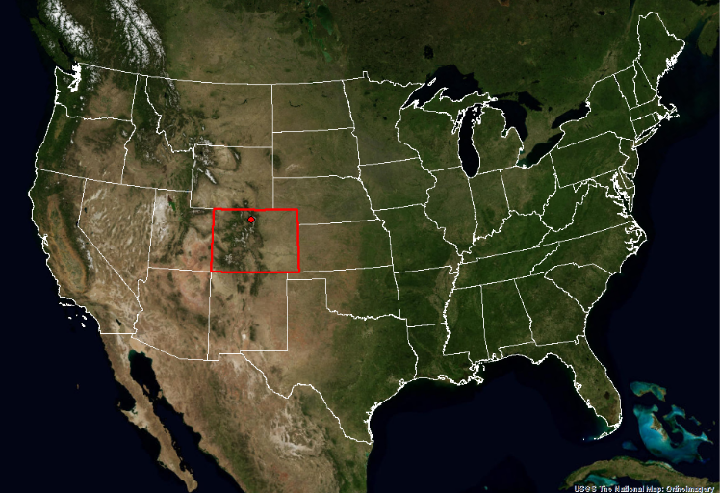
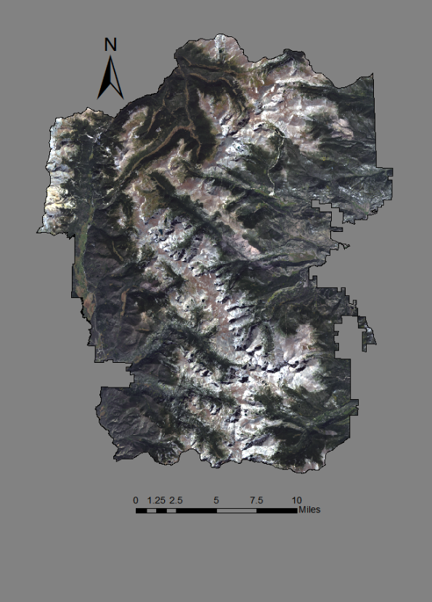
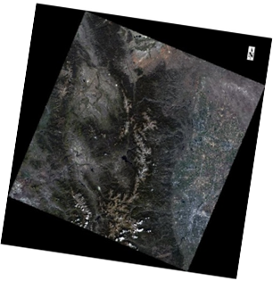
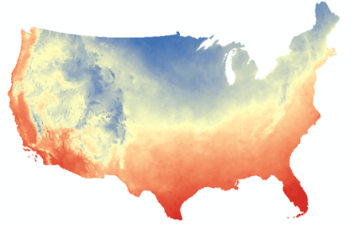
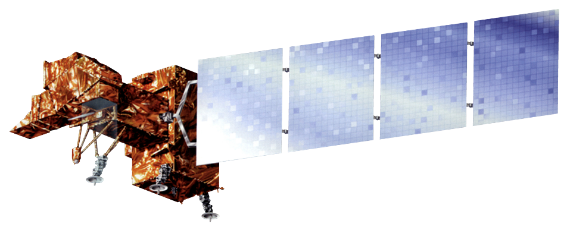
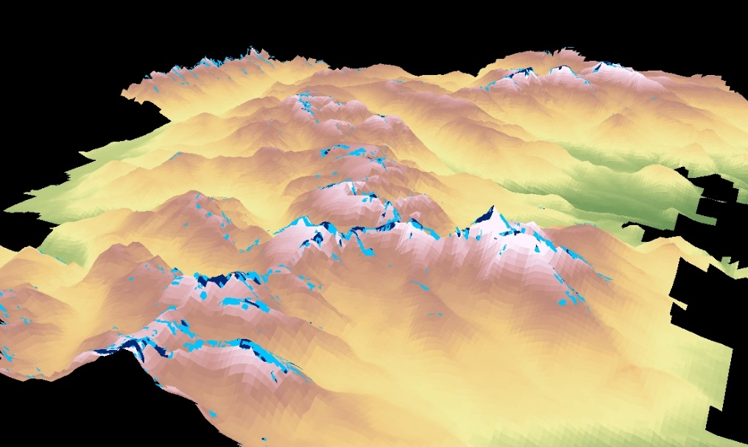
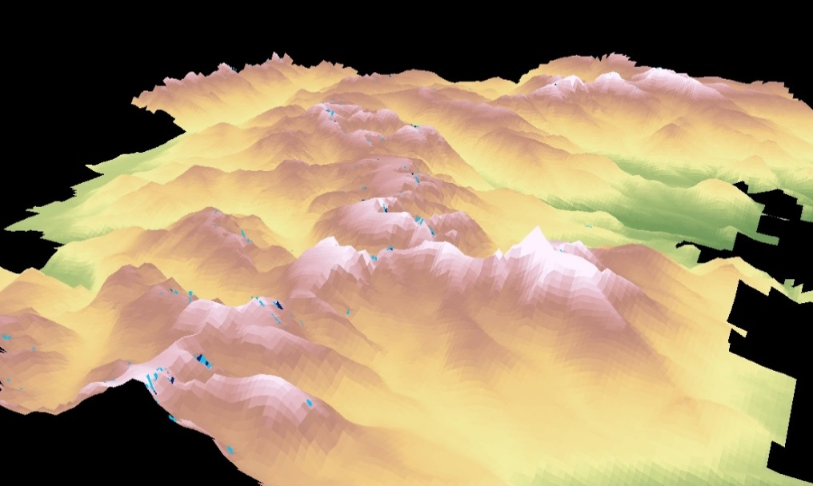
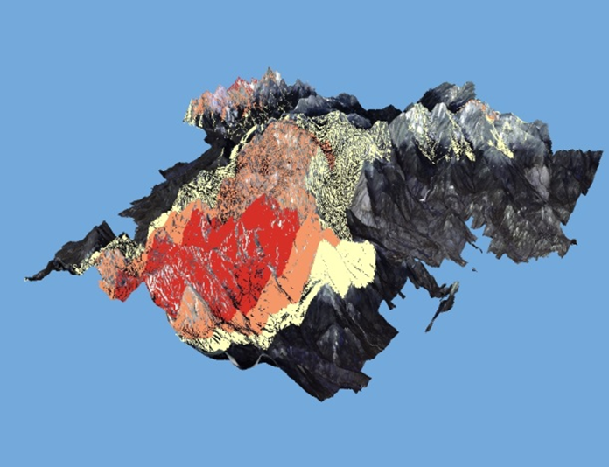
Discovering Archeological Sites by Utilizing NASA Earth Observations to Detect Changes in Snowpack Coverage in Intermountain National Parks
Abstract
Objectives
National parks in the northern U.S. Great Plains in the National Park Services' Intermountain region are experiencing snow and ice melt due to changes in climate. As the ice recedes, it has the potential to reveal previously undiscovered archaeological sites. Therefore, investigating the changes of Persistent Ice and Snow Cover (PISC) in this region is crucial to identifying archaeological sites. To address the changes of PISC, a two phase methodology was implemented: 1) map the PISC in the Rocky Mountain National Park, CO over the period from 1995 to 2015 using Landsat scenes; and 2) detect the changes of PISC over time. This research was a case study to document the retreat of PISC in the Intermountain national parks, namely Rocky Mountain National Park, by applying NASA Earth observations. This research can also aid in testing hypotheses about the drivers of human behavioral variability and support the National Park Service in its mission to protect and mitigate impacts of climate change to mountain cultural heritage resources.
Identify new ice patches previously unknown to Rocky Mountain National Park
Classify persistent ice and snow cover
Discover if El Niño/La Niña have an effect on Rocky Mountain National Park’s glaciers
Identify recently uncovered land for future archeological sites
Study Area
Methodology
Data Acquisition
Landsat scenes
Prism climate data
Persistent Ice and Snow Cover data
Rocky Mountain
National Park
Earth Observations
Classified Data
Classified Prism climate data and decided study years
Classified glacier/ice cover from Landsat scene using Normalized Difference Snow Index (NDSI)
Land Cover Change Detection
Detected glacier/ice cover changes from 1995 to 2015 using TerrSet Land Change Modeler
Landsat 5 Thematic Mapper (TM)
Landsat 7 Enhanced Thematic Mapper Plus (ETM+)
Landsat 8 Operational Land Imager (OLI)
End Products
Glacier/ice cover maps in 1995, 1999, 2000, 2014, and 2015
Land cover changes over study period
Northern Great Plains Water Resources
Conclusions
Results
Approximately 0.352 square miles of glaciers were found by the Landsat images that were not included in Rocky Mountain National Park’s field survey inventory. These previously unknown glacier patches are mainly distributed near Rowe Glacier and Moomaw Glacier.
In general, both glacier and ice field cover receded from 1995 to 2015.
1999 and 2014 were the peak years for glacier formation, while 2000 was the recession year in between. La Niña occurred during June 1998 to April 2001. It is assumed that La Niña accelerates the snow melting.
Snow and Ice Cover at Rocky Mountain National Park
1995
2015
Team Members
Project Partner
Intermountain Region
Anne Gale
Project Lead
Michael Brooke
Rocky Mountain National Park
Land Cover:
Free of ice or snow
Ice Field
Glacier
Amount of Change from Glacier to No Snow or Ice, 1995 to 2015
Xin Hong
Cody Vineyard
Acknowledgements
Dr. Kenton Ross, NASA DEVELOP National Program
Dr. DeWayne Cecil, NOAA NCEI, Global Science and Technology
David Selkowitz, USGS Alaska Center
Bob VanGundy, The University of Virginia’s College at Wise
Tom Lincoln, National Park Service
Kelly Stehman, National Park Service
Mike Bender, NASA DEVELOP National Program
Honorable J. Jack Kennedy, Jr., Mentor
Any opinions, findings, and conclusions or recommendations expressed in this material are those of the author(s) and do not necessarily reflect the views of the National Aeronautics and Space Administration. This material is based upon work supported by NASA through contract NNL11AA00B and cooperative agreement NNX14AB60A.
Level of Change:
Low
Medium
High
Wise County Clerk of Court’s Office – Summer 2016

