Slide 1
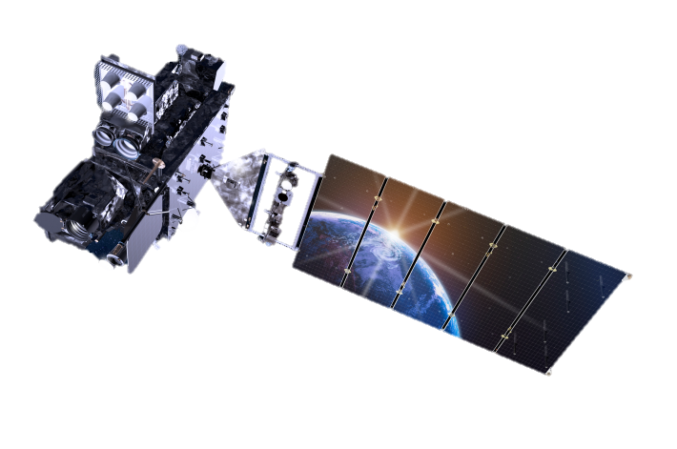
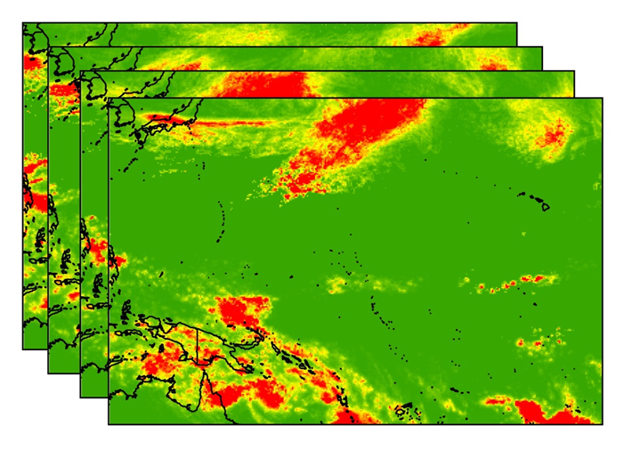
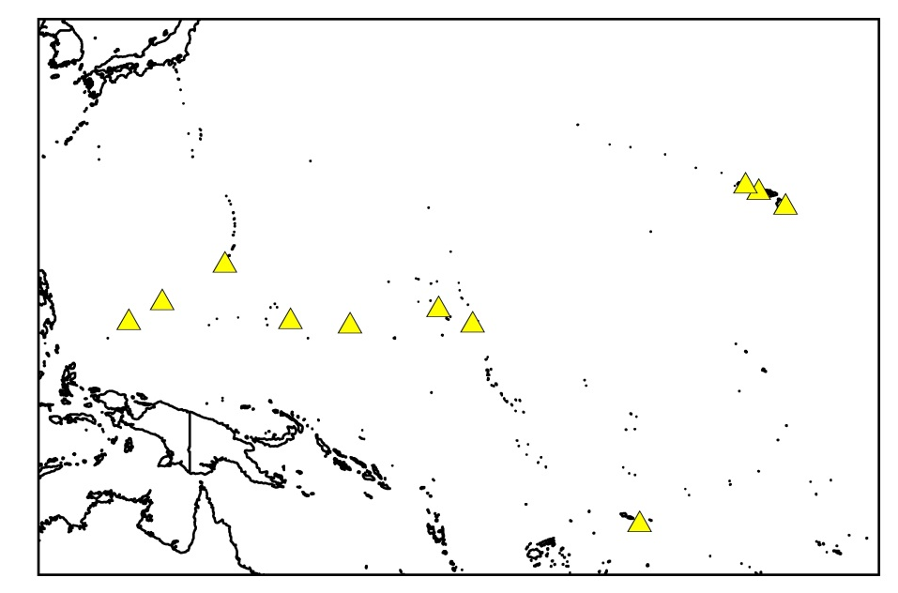
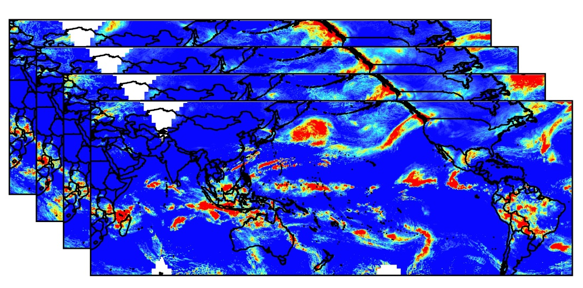
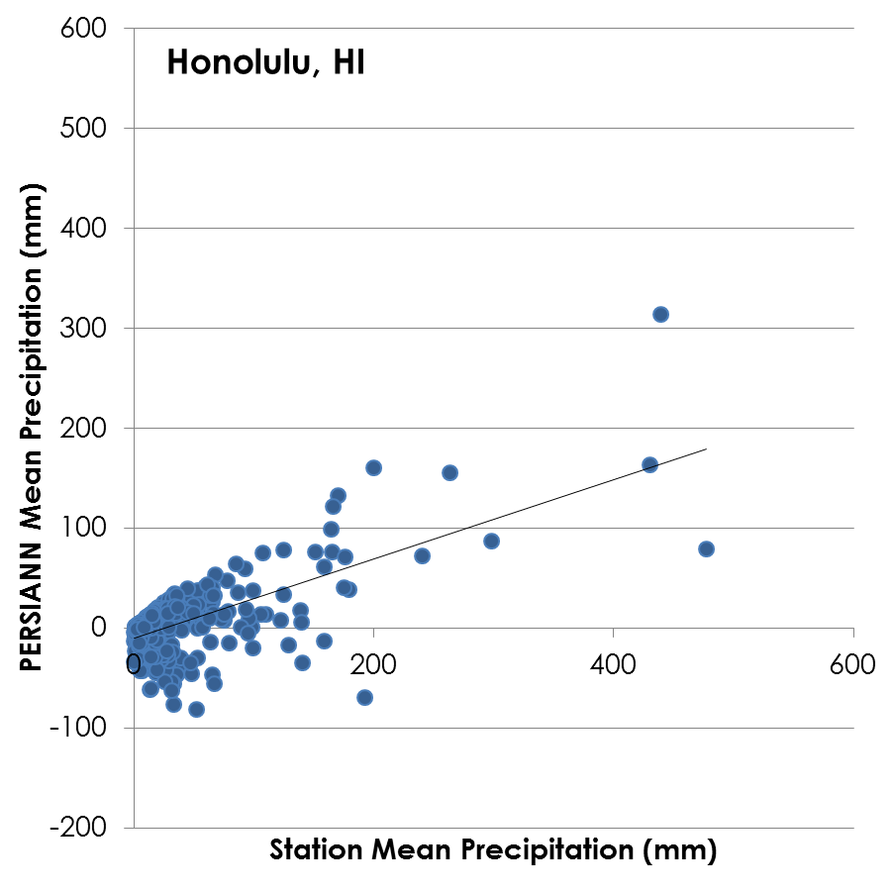
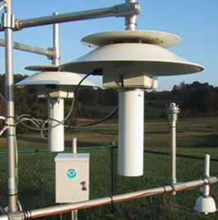
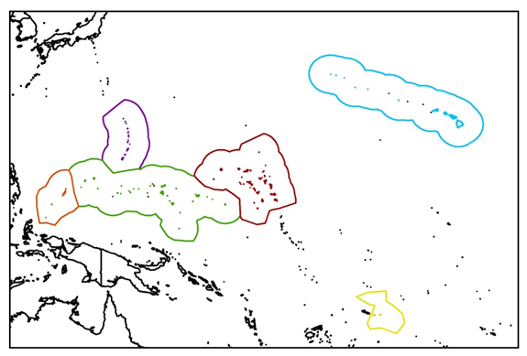
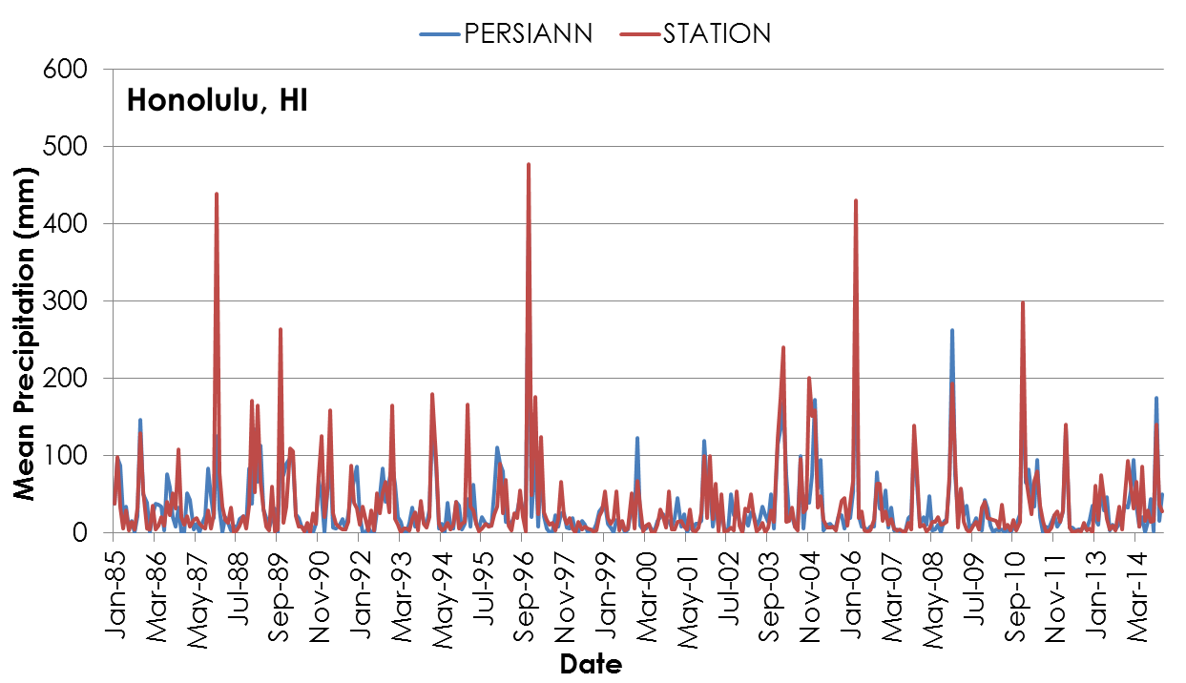
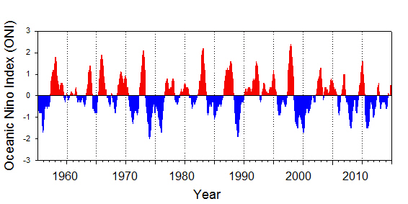
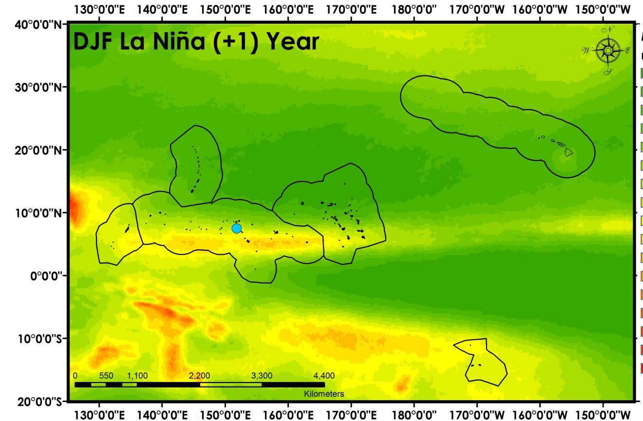
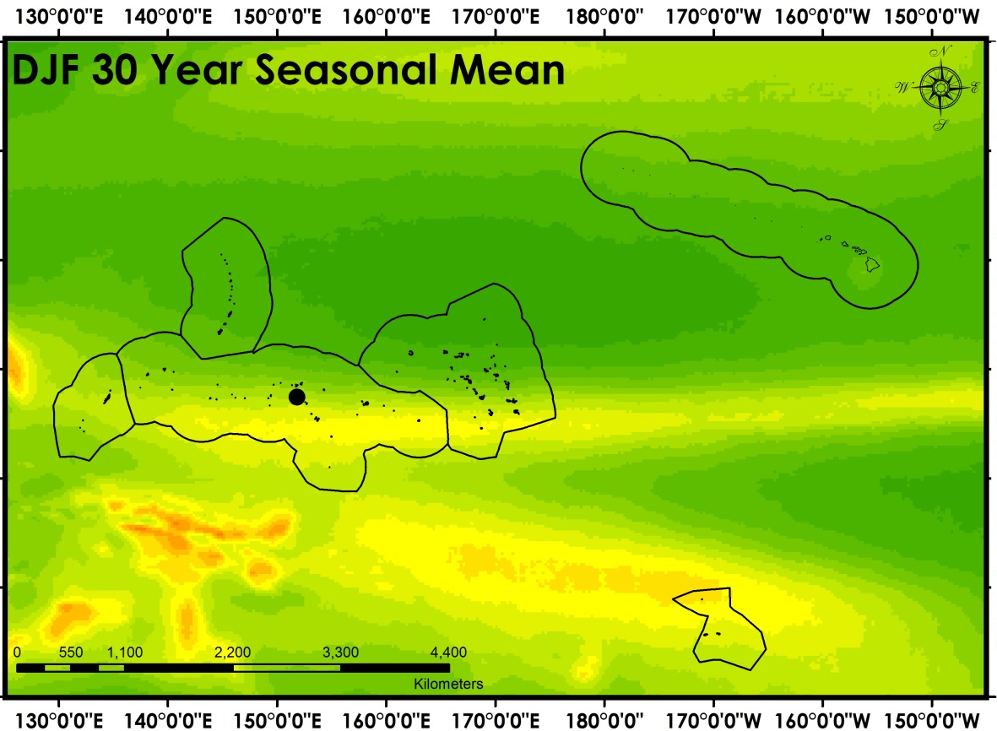
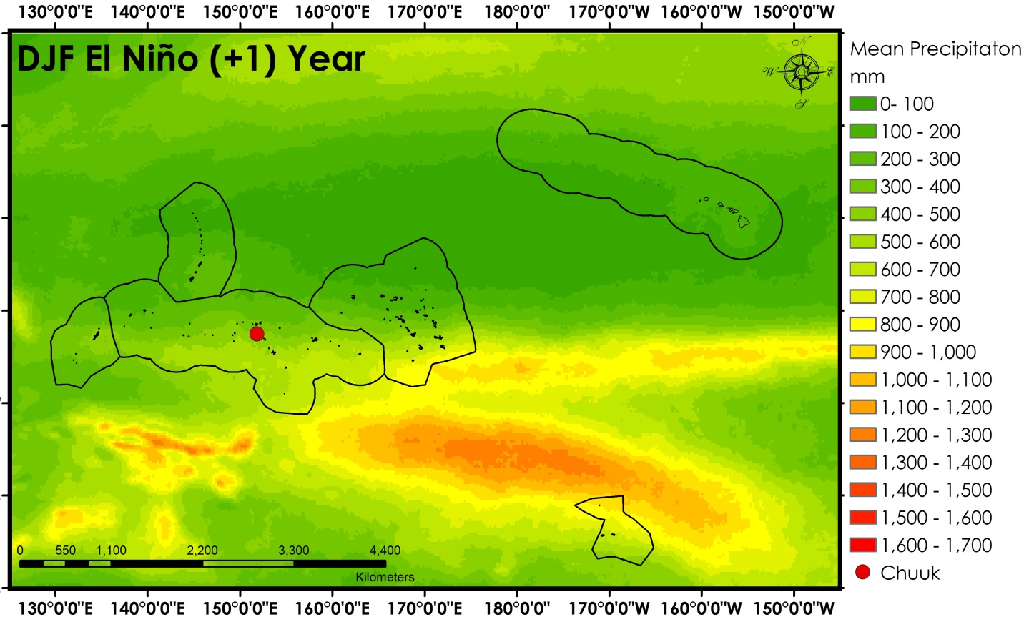
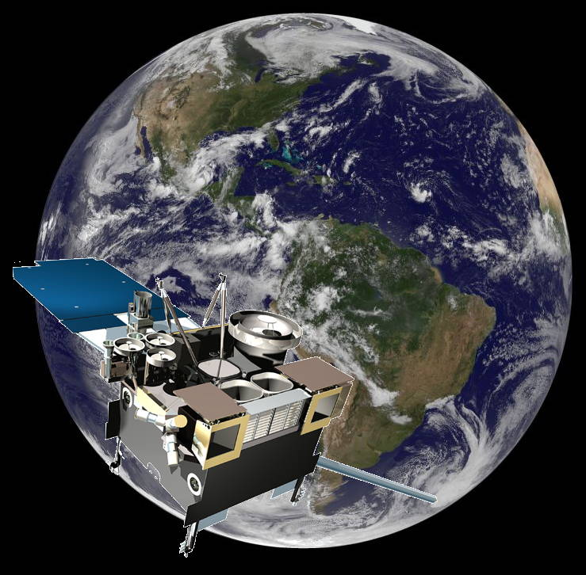
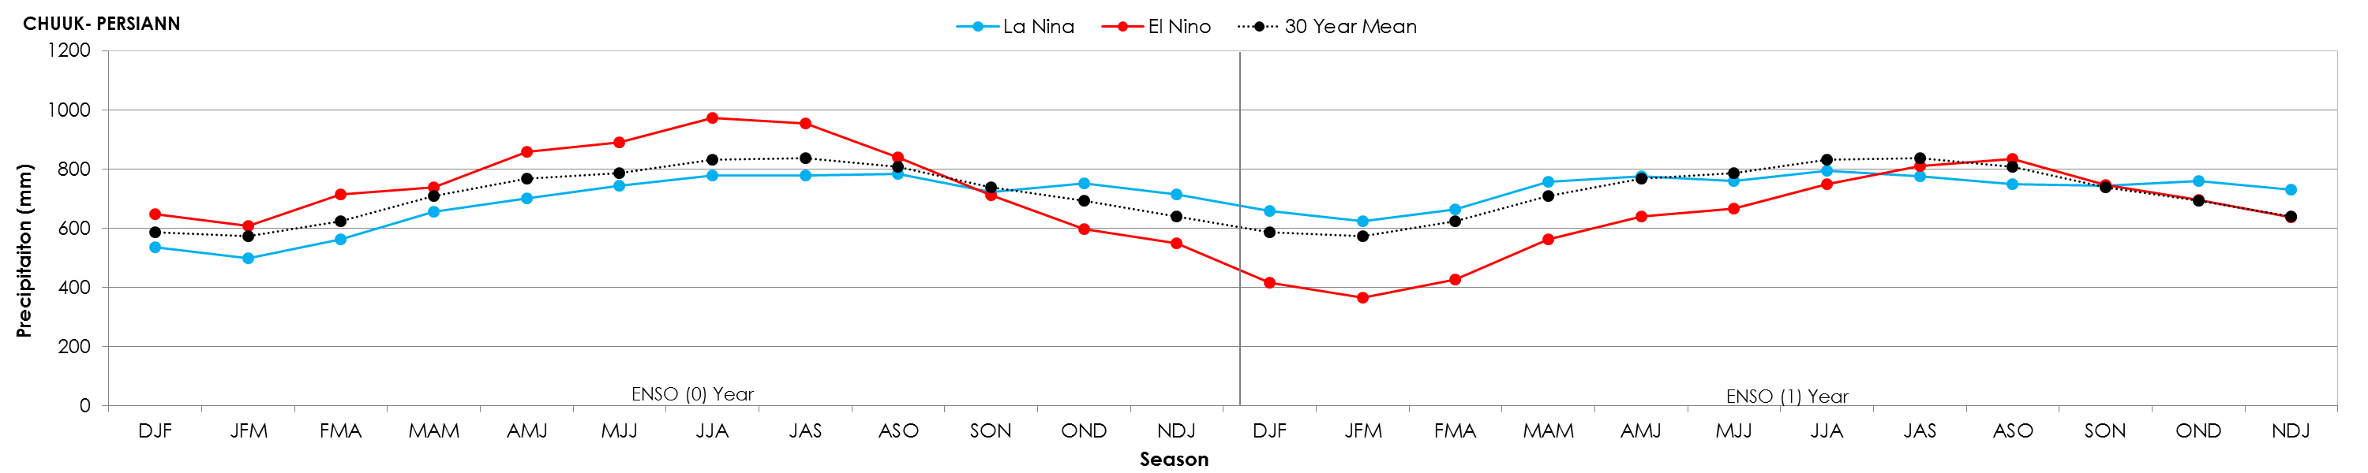
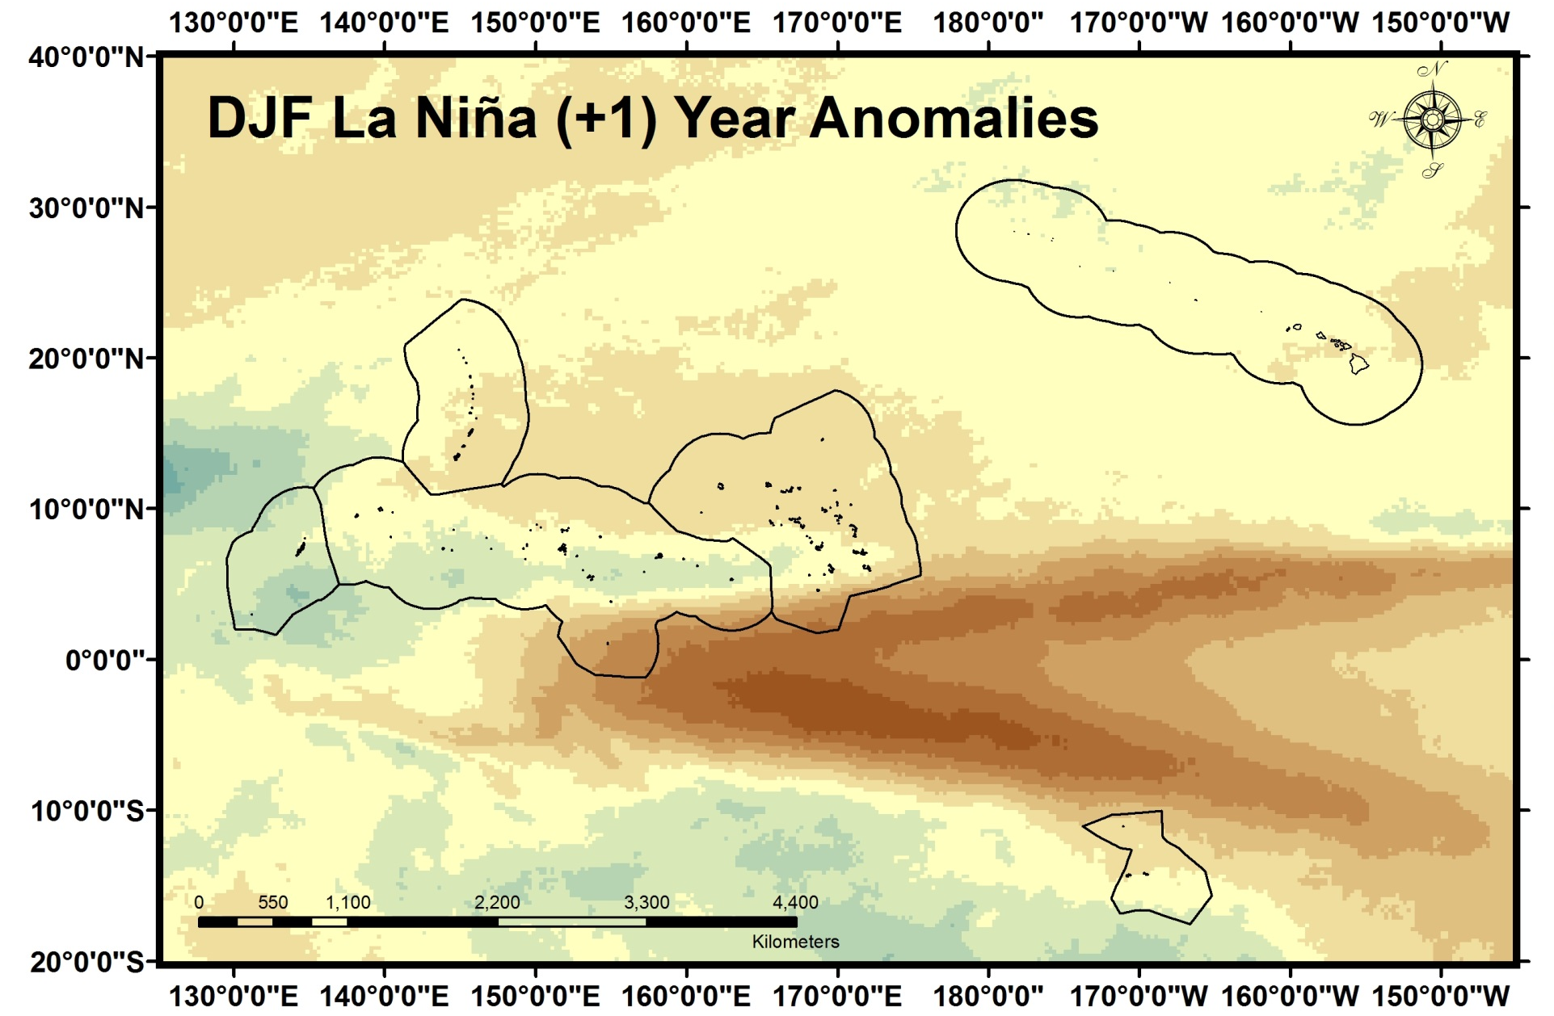
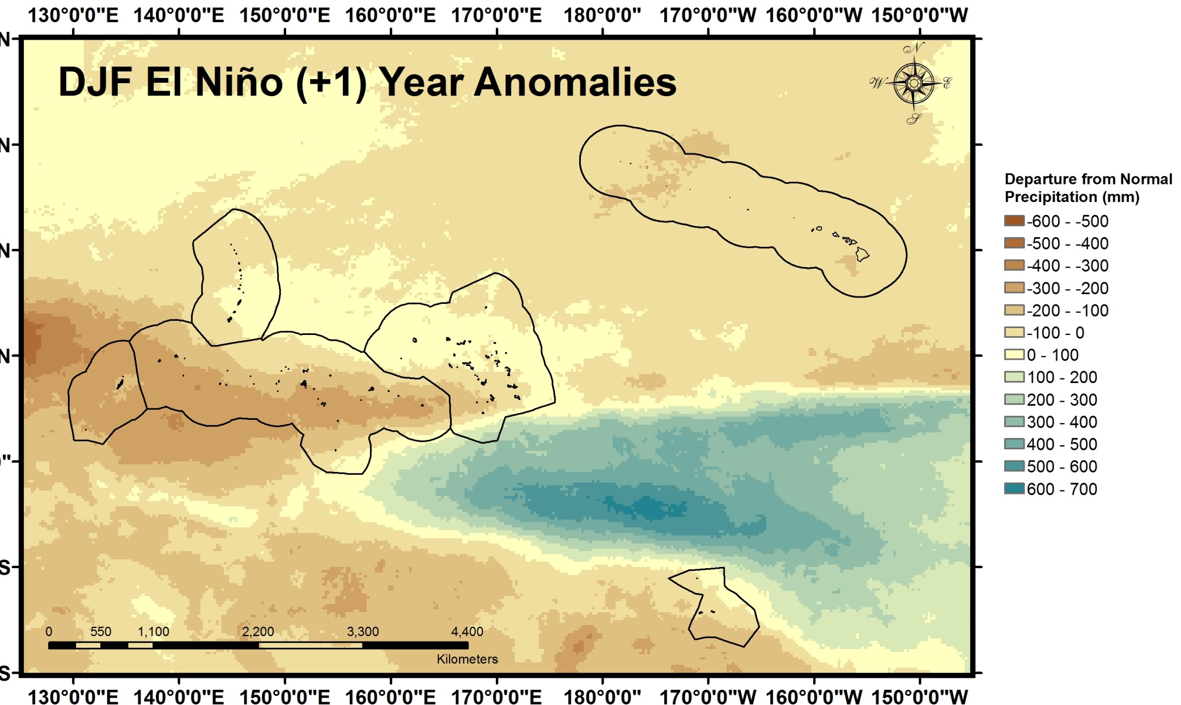
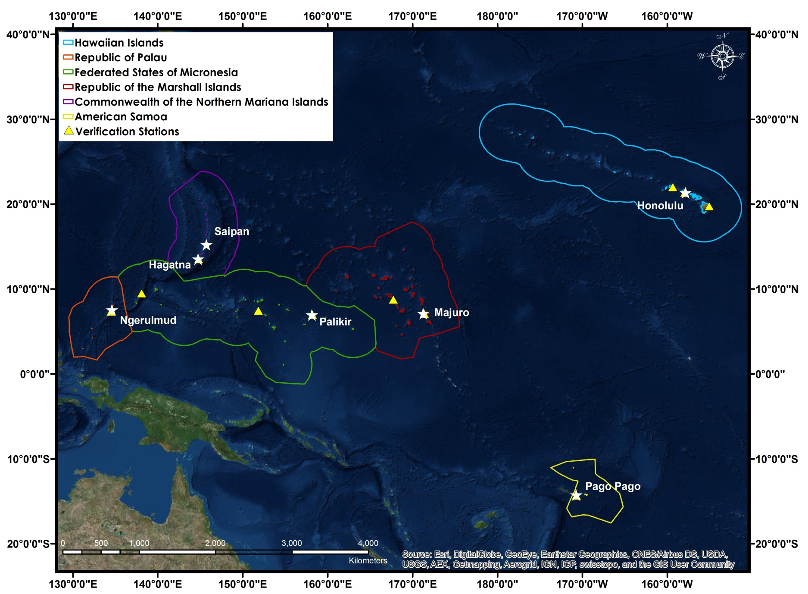
Pacific Water Resources
Using NOAA CDRs and Satellite Data to Connect Phases of the El Niño Southern Oscillation (ENSO) with Precipitation across Hawaii and the U.S. Affiliated Pacific Islands (USAPI)
Jessica Sutton¹, Nicholas Luchetti², Ethan Wright³, Michael Kruk⁴, and John Marra⁵
¹University of South Carolina, ² East Carolina University, ³University of North Carolina-Asheville, ⁴Pacific Water Resources Product Development, and ⁵NOAA Region Climate Services
Abstract
Methodology
There are over 2000 islands in the United States Affiliated Pacific Islands (USAPI), which are highly susceptible to extreme events such as drought and floods. A direct societal impact of these extreme events is the effect they have on fresh water resources, which are heavily dependent on precipitation. Precipitation distribution differs by sub-region, and are predominantly influenced by phases of the El Niño Southern Oscillation (ENSO). Forecasters currently rely on ENSO climatologies from sparse in situ station data to inform their precipitation outlooks. This project provided an updated ENSO-based climatology of long-term precipitation patterns for each USAPI Exclusive Economic Zone (EEZ) using the NOAA PERSIANN Climate Data Record (CDR) for the purposes of filling the spatial in situ station void. The PERSIANN CDR provided a 30-year record of daily precipitation at 0.25° resolution across the USAPI. Results indicate that while the PERSIANN precipitation accurately describes the monthly, seasonal, and annual trends, it under predicts the precipitation on the islands. The lowest mean seasonal precipitation during moderate to strong El Niño years occurred from January through April in all of the USAPI except the Hawaiian Islands and American Samoa. During moderate to strong El Niño years, the Inter Tropical Convergence Zone (ITCZ) shifts to the east, which cause drought in the Federated States of Micronesia, Palau, and the Republic of the Marshall Islands. Providing regional scale precipitation maps for the USAPI will lead to a better understanding of the likelihood of precipitation or drought occurring in their regions.
DATA PREPARATION & ANALYSIS
IN SITU VS. PERSIANN VERIFICATION
GLOBAL PERSIANN PRECIPITATION
MONTHLY
SEASONAL
YEARLY
NOAA STATIONS
LOCATIONS
sum
Daily 0.25° resolution
EXCLUSIVE ECONOMIC ZONES (EEZ)
Oceanic Niño Index (ONI)
Objectives
Results
Provide an updated ENSO based climatology (1985-2014) of long-term precipitation patterns for each USAPI using the NOAA PERSIANN Climate Data Record (CDR)
Conduct verification analyses with in situ precipitation data
Determine the relationship between PERSIANN CDR precipitation and the seven ENSO phases
Determine precipitation ranges for each USAPI Exclusive Economic Zone (EEZ) during the seven ENSO phases
Results
Earth Observations
GOES
Figure 2. Mean DJF PERSIANN precipitation for eight moderate to strong La Niña years (88/89, 95/96, 98/99, 99,00, 00/01, 07/08, 10/11, 11/12) (top left), 30 year normal (1985-2014)(top middle), and for the eight moderate to strong El Niño years (86/87, 87/89, 91/92, 94/95, 97/98, 02/03, 04/05,09/10)(top right). The Exclusive Economic Zones are shown outlined in black and the Chuuk NOAA station is highlighted using a colored circle which corresponds to the time series figure (bottom). The time series plot showing mean PERSIANN precipitation in Chuuk for each three month season for the eight moderate to strong El Niño years (red) and La Niña years (blue). The 30 year mean precipitation for each three month season is also shown (black).
Project Partners
Only use federal logos—no state or local government logos, or NGO logos.
Some logos are on DEVELOPedia.
Keep images and text ungrouped.
Study Area
Figure 3. PERSIANN precipitation anomalies for mean DJF for the eight moderate to strong La Niña years (88/89, 95/96, 98/99, 99,00, 00/01, 07/08, 10/11, 11/12) (left) and for the eight moderate to strong El Niños (86/87, 87/89, 91/92, 94/95, 97/98, 02/03, 04/05,09/10)(top right). The Exclusive Economic Zones are shown outlined in black.
Conclusions
Team Members
Use bullets.
Use complete sentences with periods.
Use a professional-looking photo.
Individual headshots are ok, if they aren’t pixelated and are all the same size.
Include a caption that states the team members’ names.
Acknowledgements
Include anyone who has helped you with the project.
Figure 1. Map of the study area with the Exclusive Economic Zones (EEZs) outlined, NOAA stations ( ), and capital cities ( ) highlighted for each U.S. Affiliated Pacific Island (USAPI) chain. This made map was made using the imagery basmap from ArcGIS.
NOAA National Centers for Environmental Information

