Slide 1
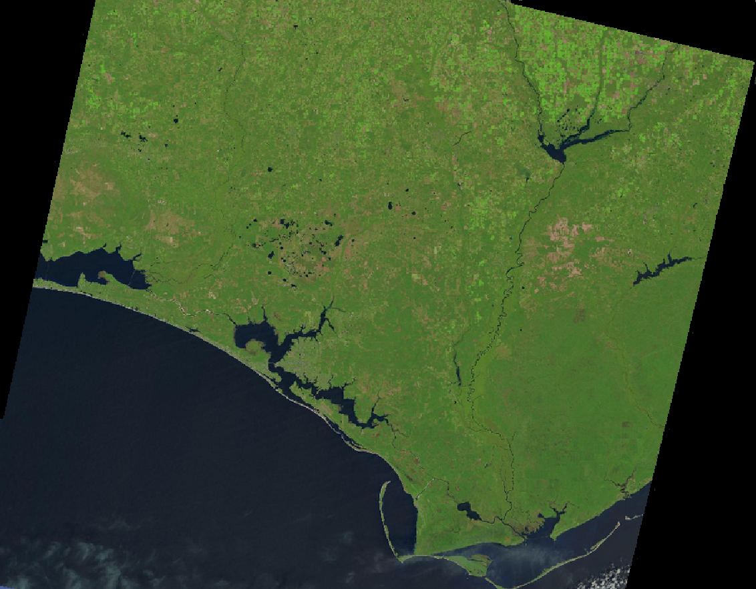
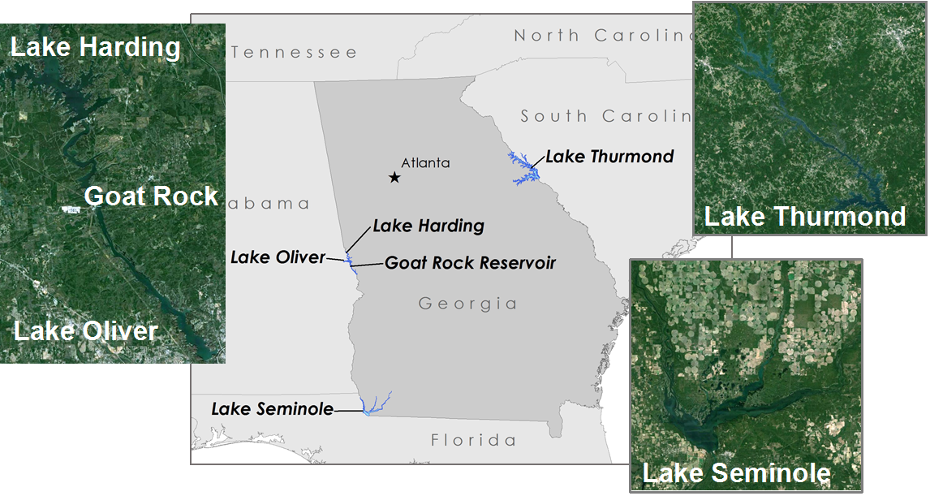
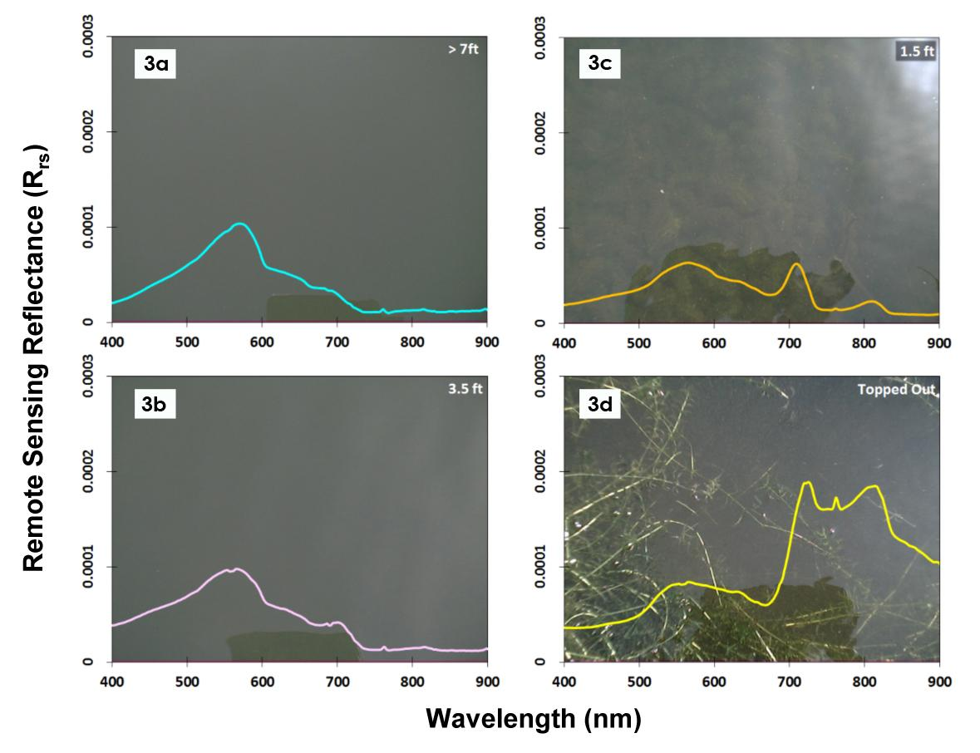
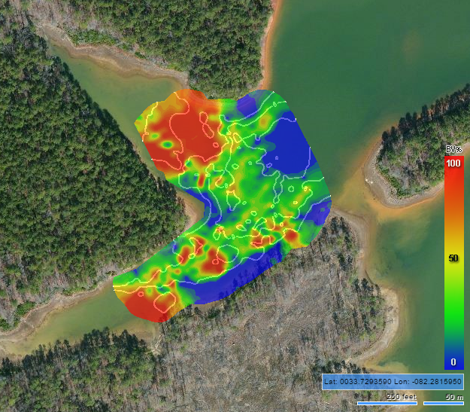
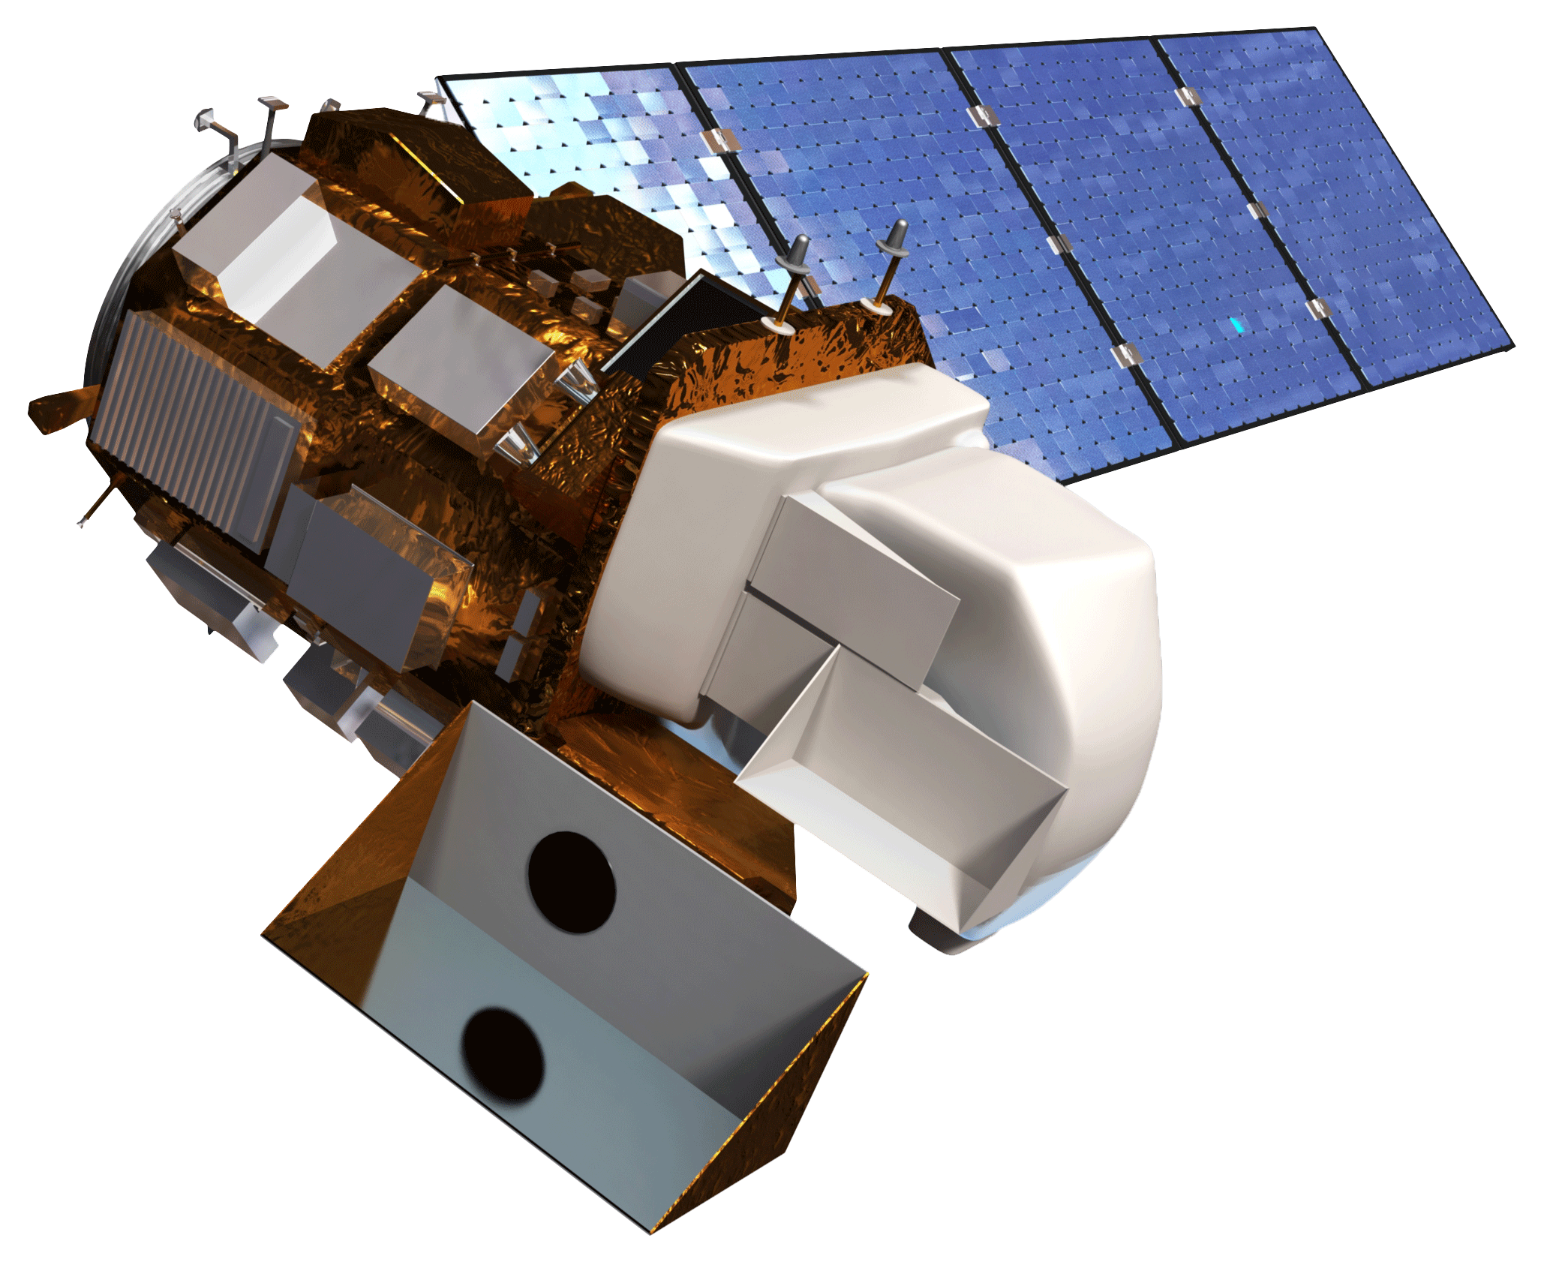
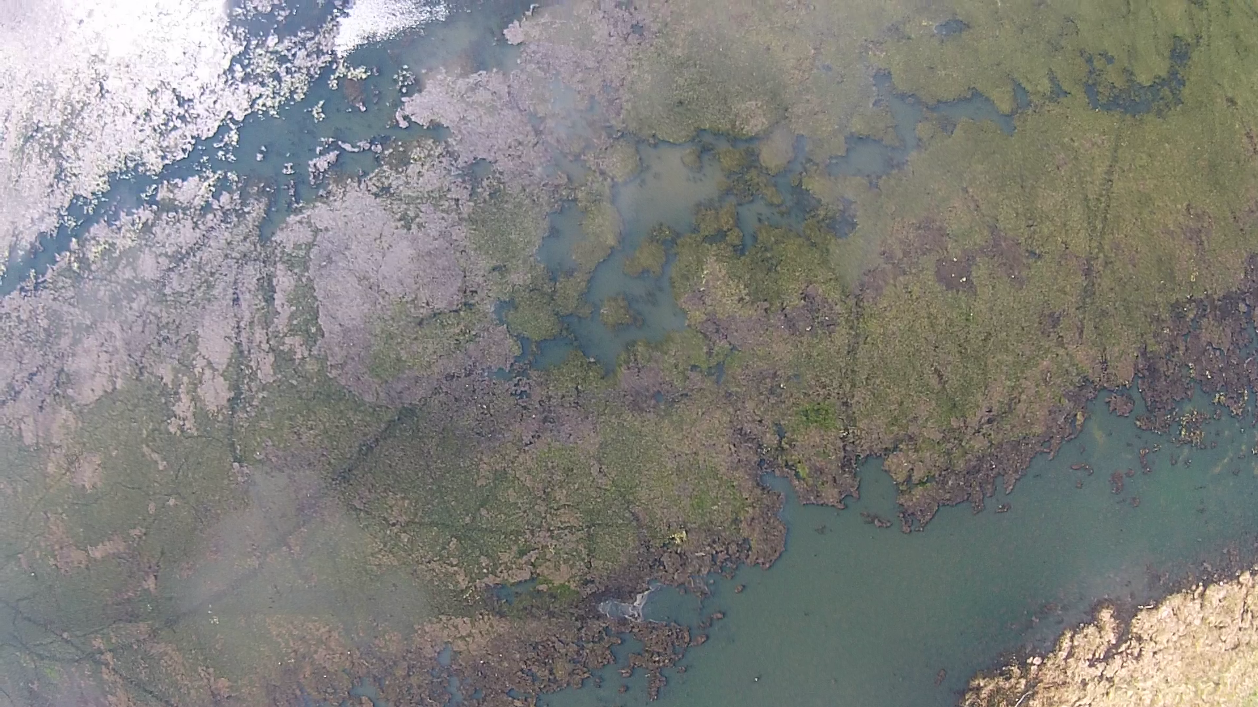
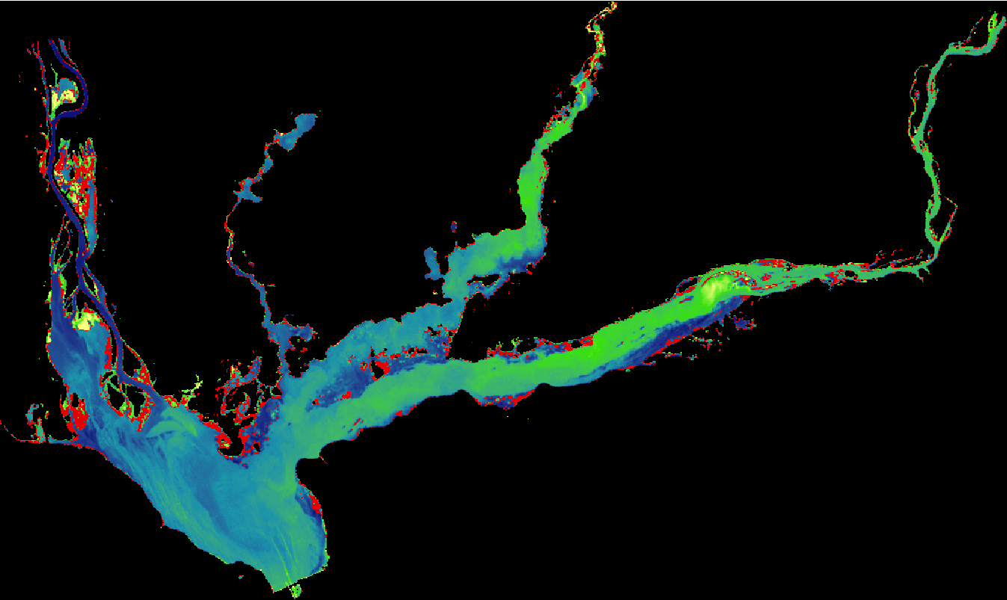
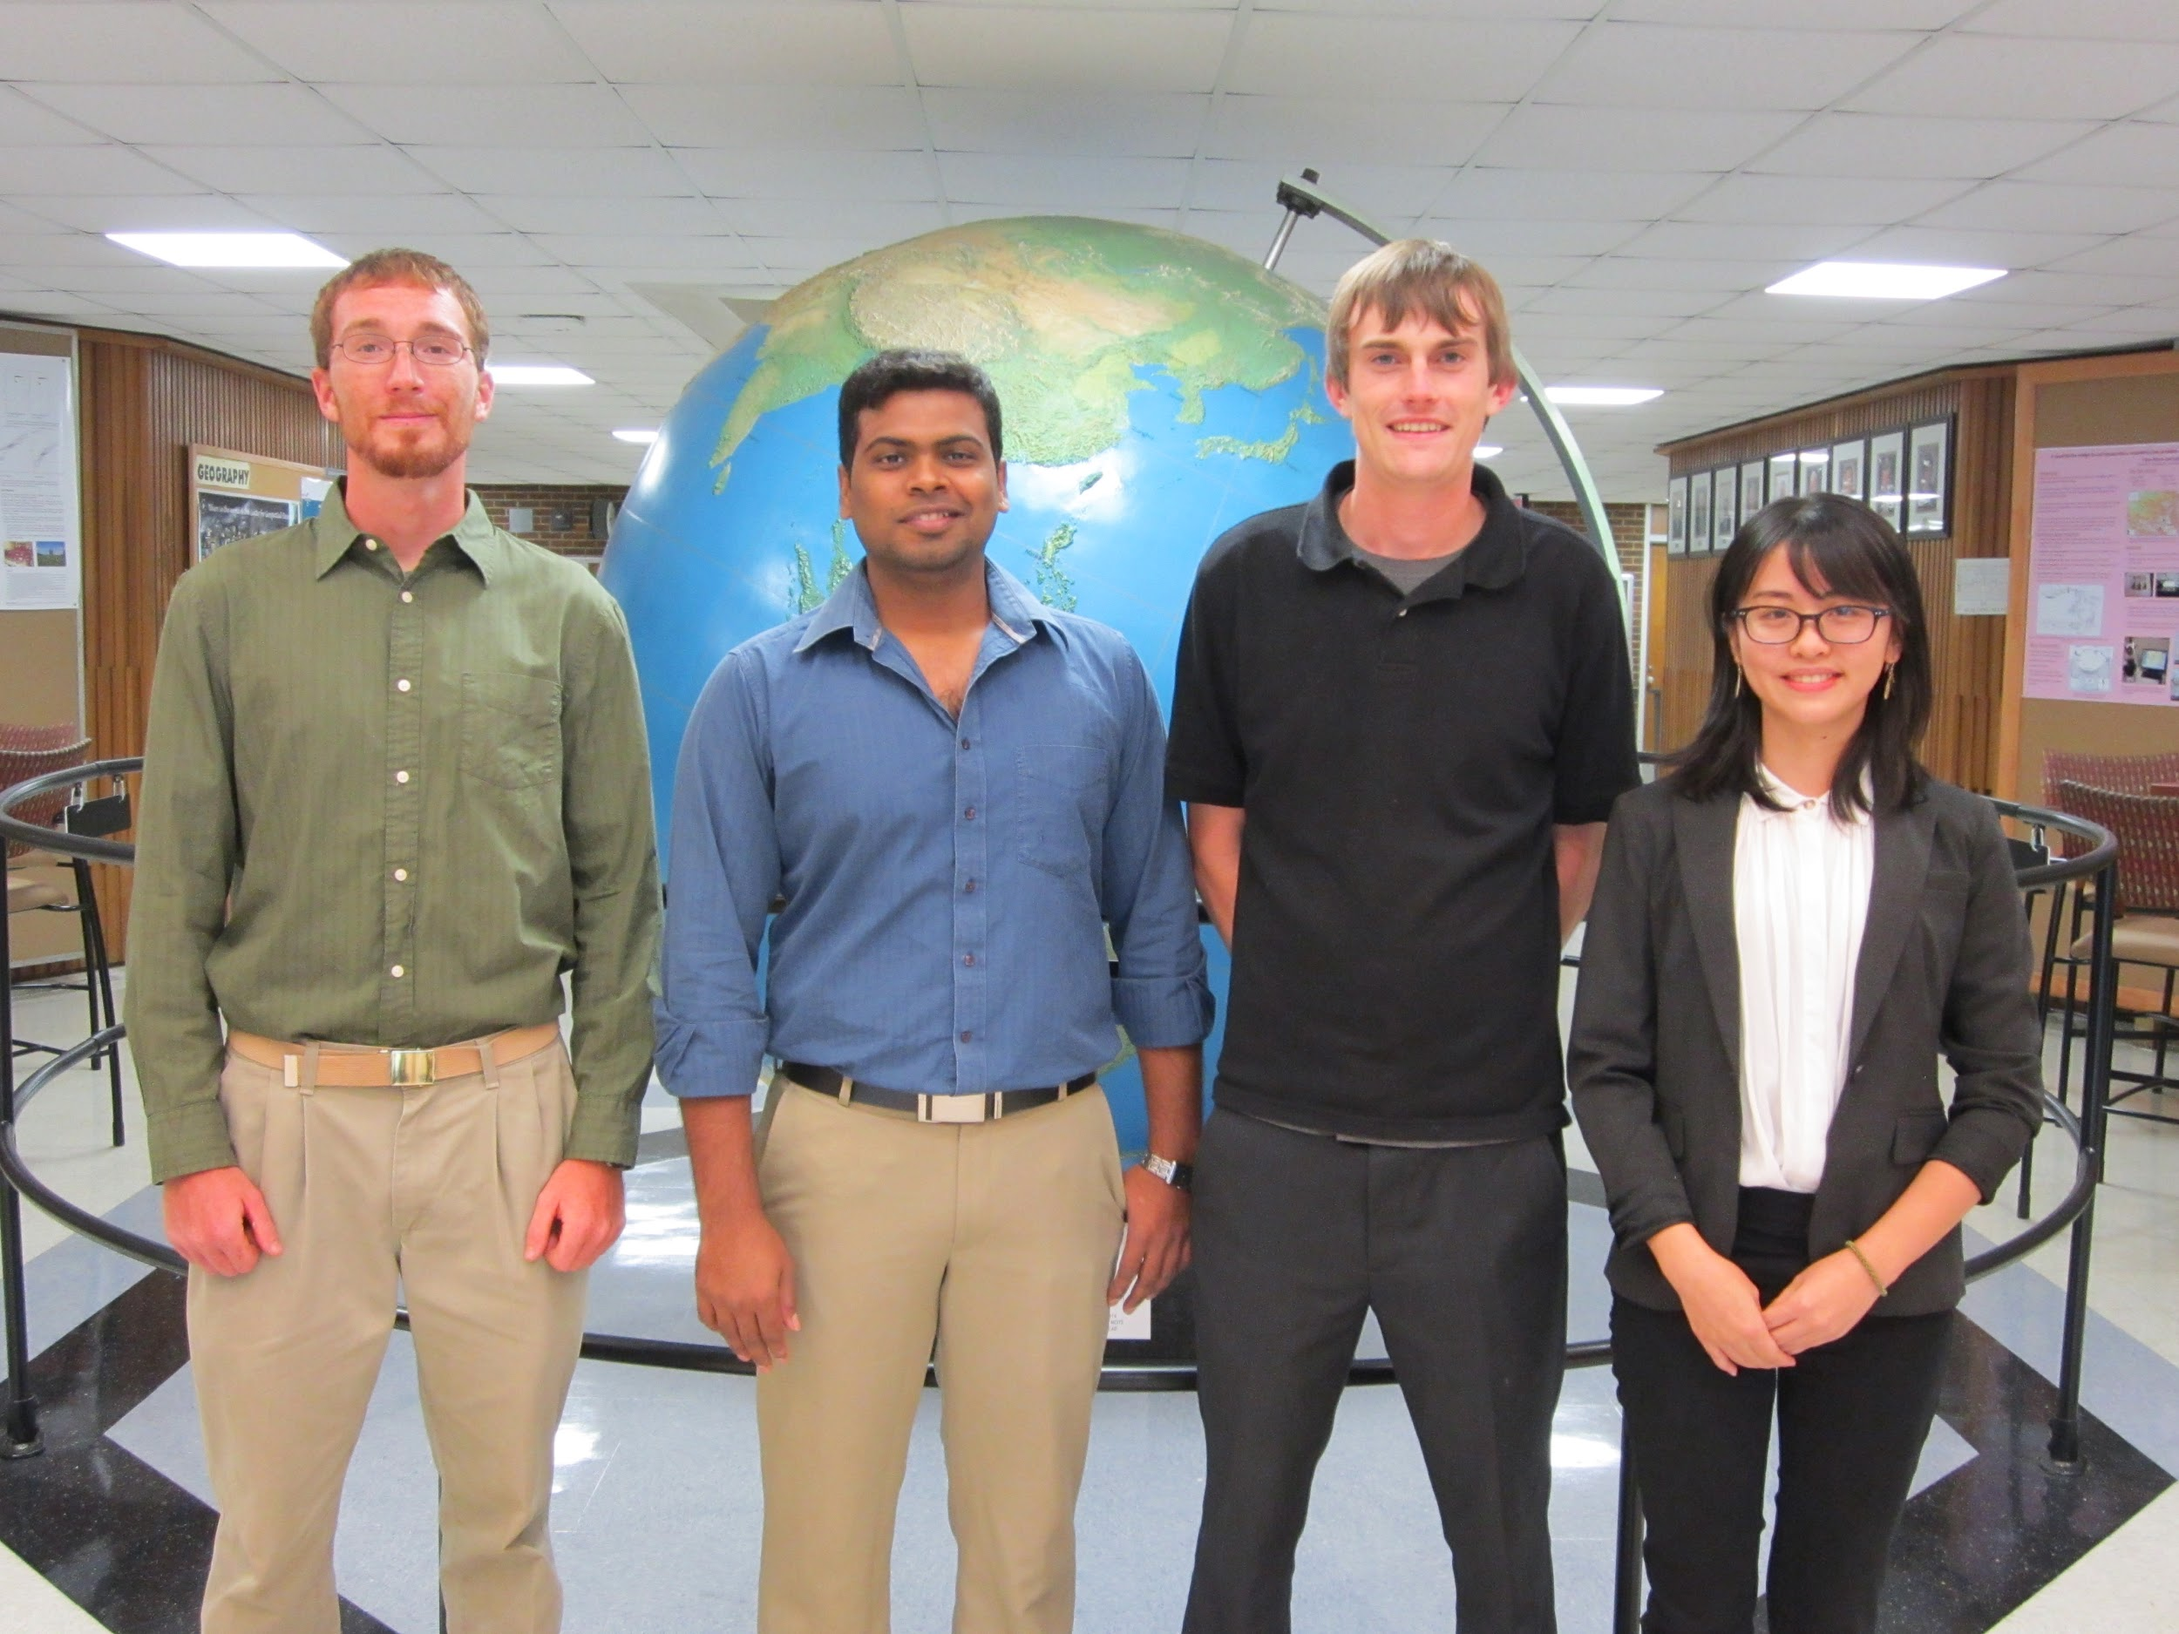
Southeast US Ecological Forecasting II
Using NASA Earth Observations to Map the Spatio-Temporal Distribution of Hydrilla vertiicillata
Benjamin Page (Project Lead), Brandon Hays, Pradeep Kumar Ragu Chanthar, Linli Zhu
The University of Georgia
Abstract
Objectives
Keep this blank for now.
Body text point size should be at least 24.
Caption text point size should be at least 16.
Feel free to rename, move, and resize sections as needed.
Utilize NASA’s Earth Observing System (EOS) to target and characterize the seasonal patterns of Hydrilla distribution in inland waters.
Quantify total area covered by topped-out/floating vegetation
Generate maps of photosynthetically active radiation (PAR) to locate potential hotspots for thriving submerged aquatic vegetation habitat
Create a predictive model to forecast future growth of Hydrilla
Methodology
Data Acquisition
Processing
Output
EOS Remote Sensing
Atmospheric Correction
NDVI
NDVI Overlaying Green Band
Landsat 8 OLI Imagery
Acolite
Study Area
In Situ Data
True Color Composite
Time Series
Hyper-spectral Data
Model Rrs against spectral profiles at varying depths
Unsupervised Classification
Classified Imagery
Secchi Disk Depth
Generate PAR maps
Earth Observations
Sonar
Model Rrs against Biovolume
Landsat 8 Operational Land Imager (OLI)
Model Training
Model Validation
Predictive Model
Drone Footage
Results
Conclusions
Figure 1. NDVI overlaying Landsat 8 Green Band
Team Members
Project Partners
Acknowledgements
Georgia Power
United States Army Corps of Engineers
J.W. Jones Ecological Research Center
Henry County Water Authority
We would like to thank our Science Advisors, Drs. Deepak Mishra and Susan Wilde, for their advice and guidance
Thanks to Brigette Haram of the Warnell School of Forestry for her help in collecting field data and her valuable knowledge of Hydrilla in our field site
We are grateful to Kenneth Boyd and Allen Dean of United States Army Corps of Engineers at Lake Thurmond for their help collecting field data
This project builds upon previous work done by the SEUS Ecological Forecasting I team:
Shuvankar Ghosh, Peter Hawman, Wuyang Cai, and Elizabeth Dyer
Brandon Hays, Pradeep Kumar Ragu Chanthar, Benjamin Page, Linli Zhu
The University of Georgia

