Slide 1
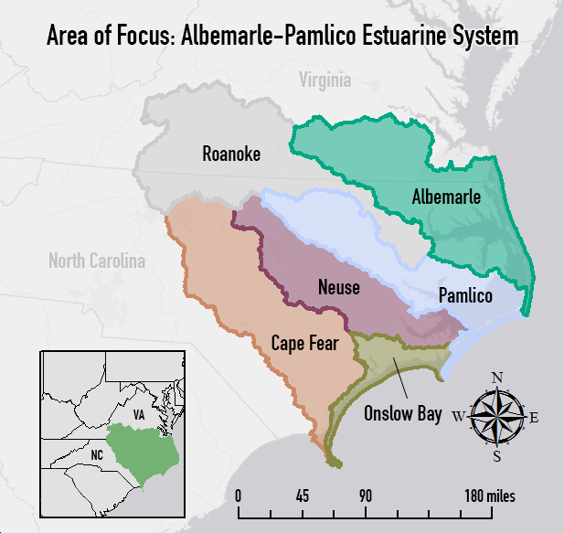

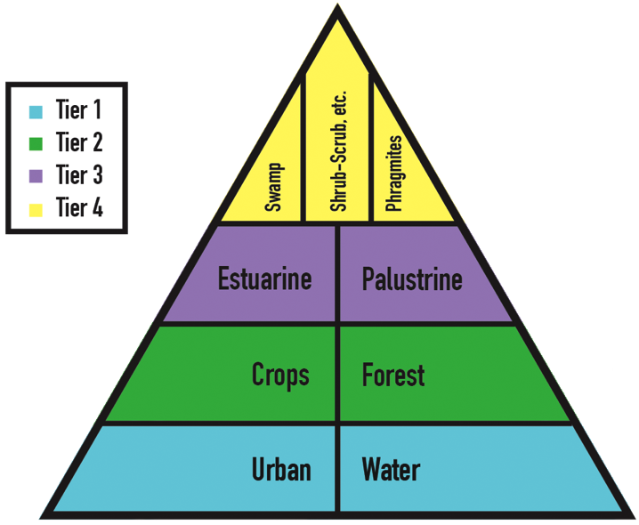
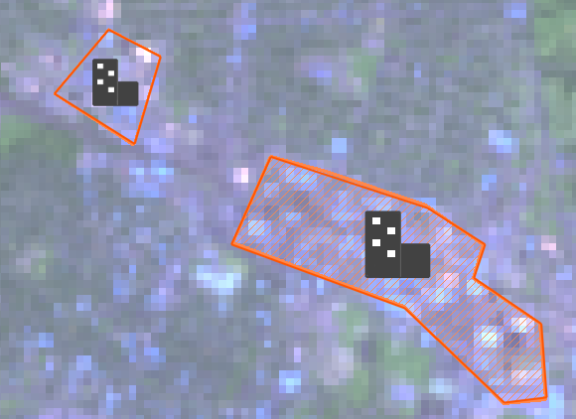



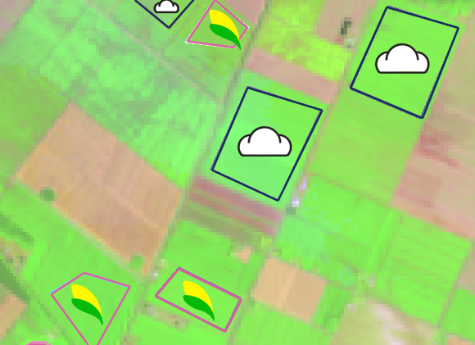

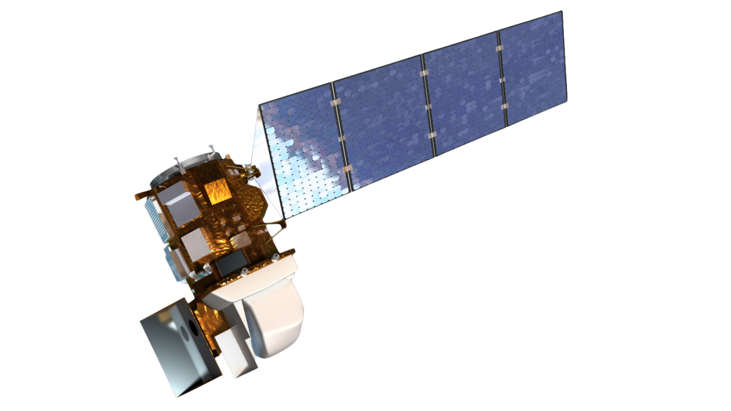
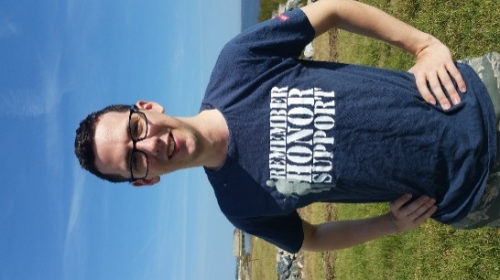

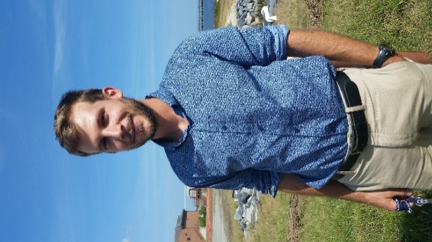
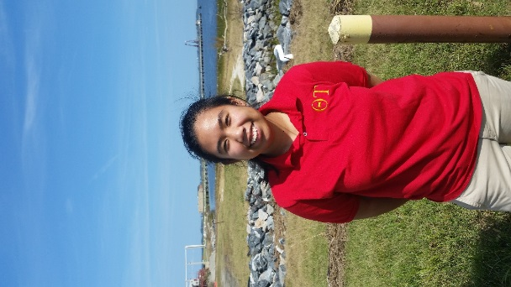
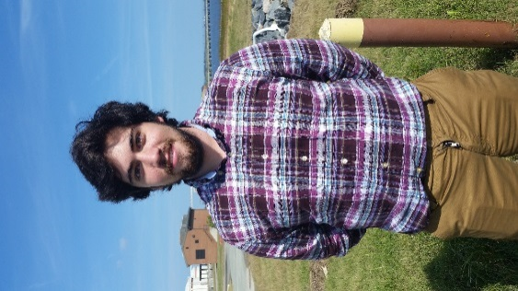

North Carolina Ecological Forecasting
reassessment of NOAA C-CAP wetland delineation and further disaggregation of land use classes using remote sensing
Ben Roberts-Pierel (Project Lead), Brett Buzzanga, Michelle Pasco, Jake Patrick, Benjamin Charlem, Taylor Sage
NASA DEVELOP National Program at NASA Langley Research Center
Abstract
Objectives
Keep this blank for now.
Body text point size should be at least 24.
Caption text point size should be at least 16.
Feel free to rename, move, and resize sections as needed.
Aims to provide an updated classification that is tailored to the Albemarle-Pamlico Estuary with important land classes such as invasive species, Phragmites australis
Create a replicable method so it would be possible for APNEP to update these classifications on a more regular basis than what C-CAP offers
Study Area
Methodology
Study Period: September 2015 to November 2015
Each color on the map indicates a different river basins in the area of focus
Analyzed Landsat, Soil, NHD, and DEM imagery
Mapped out polygons using the methodology pyramid built upon Tier 1
Conducted and supervised land classification in ERDAS Imagine
Earth Observations
Results
Landsat 8 OLI/TIRS
N/A
Use images.
Make sure that it has some sort of flow, that it makes sense. Show your results in a logical order.
No bullets.
Conclusions
N/A
Use bullets.
Use complete sentences with periods.
Team Members
Project Partner
Acknowledgements
Emily Adams, Langley Center Lead
Rebekke Muench, Langley Assistant Center Lead
Dr. Kenton Ross, NASA DEVELOP Science Director
Zand Bakhtiari, Previous Contributor
Stephen Zimmerman, Previous Contributor
Kayla Patel, Previous Contributor
Brad Gregory, Previous Contributor
Pictured (from left to right): Taylor Sage, Brett Buzzanga, Ben Roberts-Pierel (Project Lead), Michelle Pasco, Jake Patrick
Not Pictured: Benjamin Charlem
NASA Langley Research Center

