Slide 1
Colorado Water Resources II
Utilizing NASA Earth Observations to Identify Locations for Sedimentation Mitigation in the Ralston Creek Watershed Following the September 2013 Colorado Floods
Tyler Rhodes (Project Lead)
Romina Gotzmann
Amy Phillips
Jared Ryks
Rebekke Muench
Notes:
Amy: Good morning. My name is Amy Phillips and I am a rising senior at Clark University.
Romina: I’m Romina Gotzmann and I am a graduate of the University of South Florida.
Tyler: My name is Tyler Rhodes and I am in graduate school at Old Dominion University.
Rebekke: My name is Rebekke Muench and I am a recent graduate of Christopher Newport University.
Amy: We are the Colorado Water Resources team, continuing the work done with our partner Denver Water in Spring, 2015. We used NASA Earth Earth Observations to map erosion risk in the Ralston Creek Watershed to identify locations for sedimentation mitigation.

Slide 2
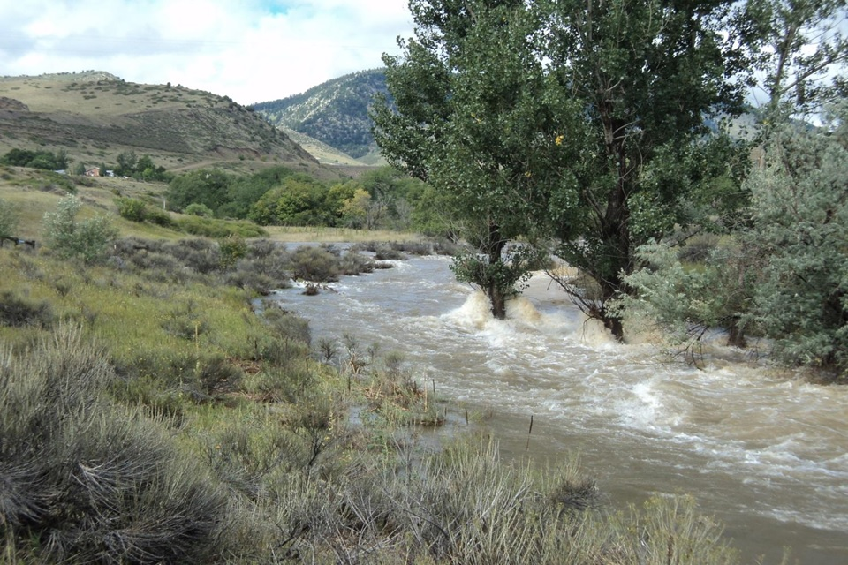
Background
Denver, CO received record breaking rains in September 2013
Increased precipitation and uncharacteristic weather continued into 2015
Credit: NASA
Notes:
In September, 2013, Colorado received record breaking rainfall, which resulted in flooding and damage from Colorado Springs to Fort Collins. Heavy and uncharacteristic precipitation continued into the Spring and Summer of 2015.

Slide 3
Community Concerns
Increased rainfall leads to…
Sedimentation, nutrients, & heavy metals in water bodies
Water quality & ecosystem health
Credit: Denver Water
Notes:
Heavy rainfall can result in increased sedimentation, nutrients, and heavy metals in water bodies, which decreases water quality and ecosystem health. For these reasons, it is important that we limit erosion by taking preventative measures to ensure that the waterbodies we rely on are kept clean.

Slide 4
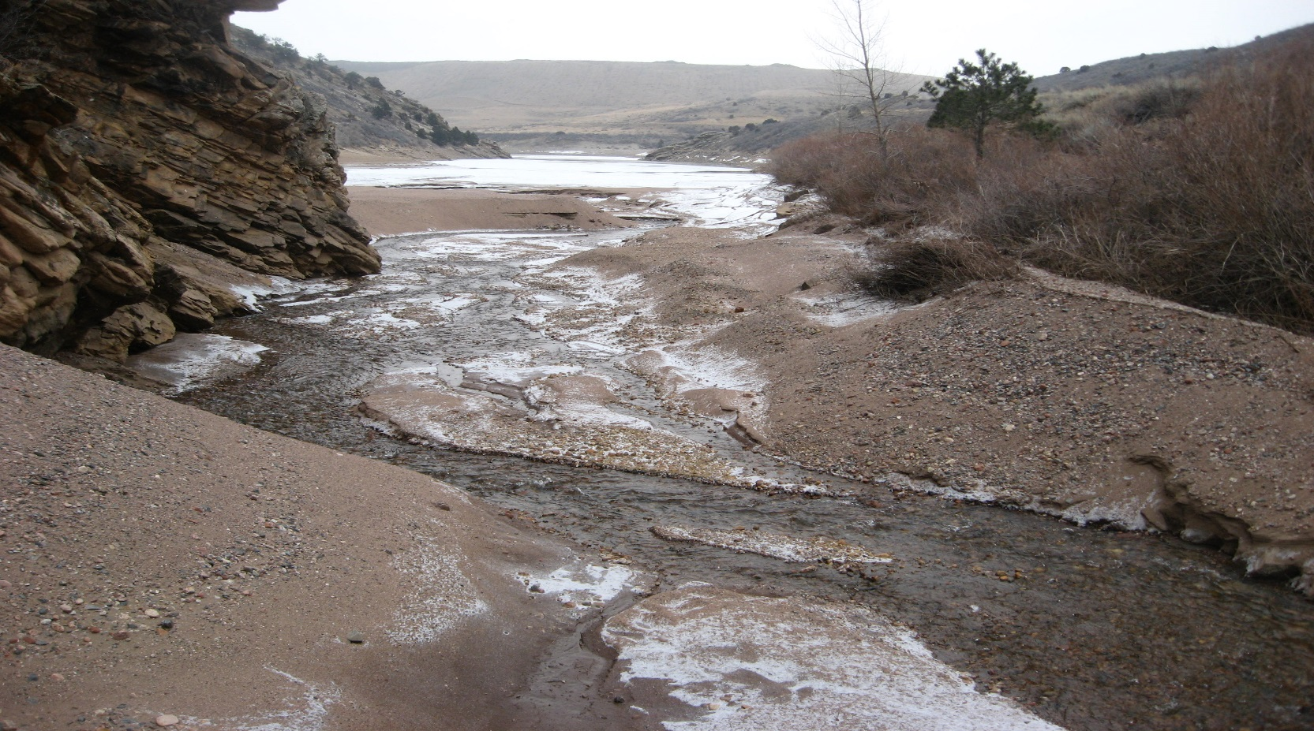
Objectives
Develop soil erosion risk assessment maps for 2002, 2010, & 2014
Create a risk change map and forecast future risk
Identify potential erosion mitigation sites within the Ralston Creek Watershed
Create a detailed tutorial outlining GIS methods to analyze erosion risk in any watershed
Credit: Denver Water
Notes:
The objectives of our project were to first create soil erosion risk assessment maps for 2002, 2010, and 2014. We then wanted to map the change in risk between 2002 and 2014 and predictive maps for 2020 and 2030. We could use these maps to identify potential erosion mitigation sites in the watershed. Finally, we wanted to provide Denver Water with a tutorial that would allow them to replicate our methods in any watershed.

Slide 5
Study Area
Study Period
Ralston Creek Watershed
Jefferson County, CO; 30 minutes from Denver, CO
2002, 2010, & 2014
Project to future
Ralston Reservoir
Waterbodies
Ralston Creek Watershed
Notes:
Our study area was the Ralston Creek Watershed which is located 30 minutes northwest of Denver in Jefferson County, Colorado. Our team analyzed erosion risk for 2002, 2010, and 2014 and used these maps to project risk for 2020 and 2030

Slide 6
Methods
Downloaded and preprocessed data
Created transition potential map using Land Change Modeler for 2002 & 2010
Delineated watershed and derived catchments and slope from LiDAR DEM using ArcGIS Hydrology tools
Normalized and inverted all scales. Then multiplied factors in Raster Calculator
Input images into equations to create R and LS factors
Classified Landsat imagery using classification tree analysis for C factor, created K factor classification
Used Land Change Modeler to create change maps for 2002, 2010, & 2014 RUSLE outputs
Notes:
First we downloaded and preprocessed the data. Then we delineated the watershed using a 0.75 m LiDAR DEM. To determine the risk we used the Revised Universal Soil Loss Equation

Slide 7
The Revised Universal Soil Loss Equation (RUSLE)
Predicted soil loss:
R * LS * C * K * P
Notes:
Or the RUSLE Model. This model was developed by the USDA to manage runoff from crops but has since been modified and applied to general soil management practices using remote sensing technology The model incorporated 5 factors that will be explained in the following slides.

Slide 8
Methods
Downloaded and preprocessed data
Created transition potential map using Land Change Modeler for 2002 & 2010
Delineated watershed and derived catchments and slope from LiDAR DEM using ArcGIS Hydrology tools
Normalized and inverted all scales. Then multiplied factors in Raster Calculator
Input images into equations to create R and LS factors
Classified Landsat imagery using classification tree analysis for C factor, created K factor classification
Used Land Change Modeler to create change maps for 2002, 2010, & 2014 RUSLE outputs
Notes:
First, we created the R and LS factors of the RUSLE model. As factors were created they were clipped to the watershed boundary.

Slide 9
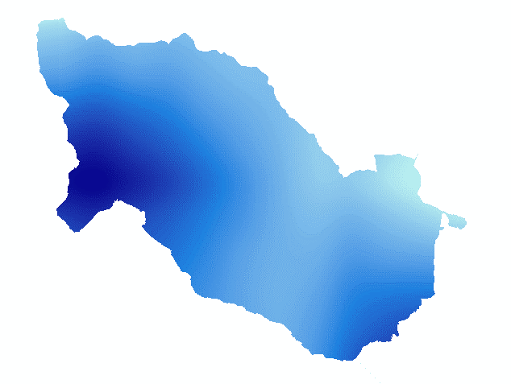
The Revised Universal Soil Loss Equation (RUSLE)
Predicted soil loss: R * LS * C * K * P
R = Rainfall and runoff factor
$$R= \sum_{n=1}^{12}{\left(\frac{p_{n}^{2}}{p}\right)}$$
High
Low
Source: PRISM Precipitation
Notes:
The R factor is the measure of the intensity of rainfall. Because of the watershed’s size, we expected to have small variation in the R factor, so there is not a large difference between the dark and light blue indicated here

Slide 10
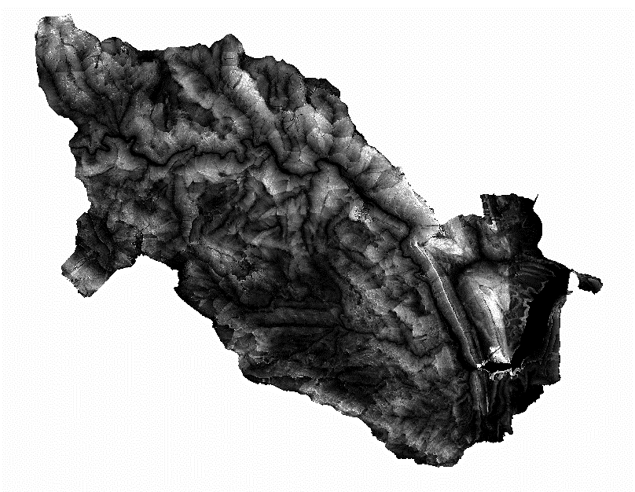
The Revised Universal Soil Loss Equation (RUSLE)
Predicted soil loss: R * LS * C * K * P
LS = Length slope factor
$$LS= {\left(\frac{As}{22.13}\right)}^{m}∗{\left(\frac{\sin{β}}{0.0890}\right)}^{n}$$
As = catchment length
β = slope measure in degrees
High
Low
Source: FEMA LiDAR
Notes:
The LS Factor is the Length Slope factor. The LS equation incorporates the length of catchments and the slope in degrees. In this output map, white indicates a high LS factor and black indicates a low LS factor.

Slide 11
Methods
Downloaded and preprocessed data
Delineated watershed and derived catchments and slope from LiDAR DEM using ArcGIS Hydrology tools
Input images into equations to create R and LS factors
Classified Landsat imagery using classification tree analysis for C factor, created K factor classification
Created transition potential map using Land Change Modeler for 2002 & 2010
Used Land Change Modeler to create change maps for 2002, 2010, & 2014 RUSLE outputs
Normalized and inverted all scales. Then multiplied factors in Raster Calculator
Notes:
Next, we created the C and K factors.

Slide 12
The Revised Universal Soil Loss Equation (RUSLE)
Predicted soil loss: R * LS * C * K * P
C = Crop and land cover management factor
Land Cover Classification | C Factor
Water | 1.0
Forest | 1.1
Developed-Low Intensity | 1.2
Shrub/ Grass | 1.4
Bare Soil | 2.0
Bare Ground
Low vegetation
Low intensity development
Source:
NASA EOS
Landsat 4-5 TM
Landsat 7
Landsat 8
Forest
Water
Notes:
The C factor is the crop and land cover management factor. We used literature to develop a scale that assigns land cover types a measure of erodibility. _ This scale was then applied to our classified landsat maps

Slide 13
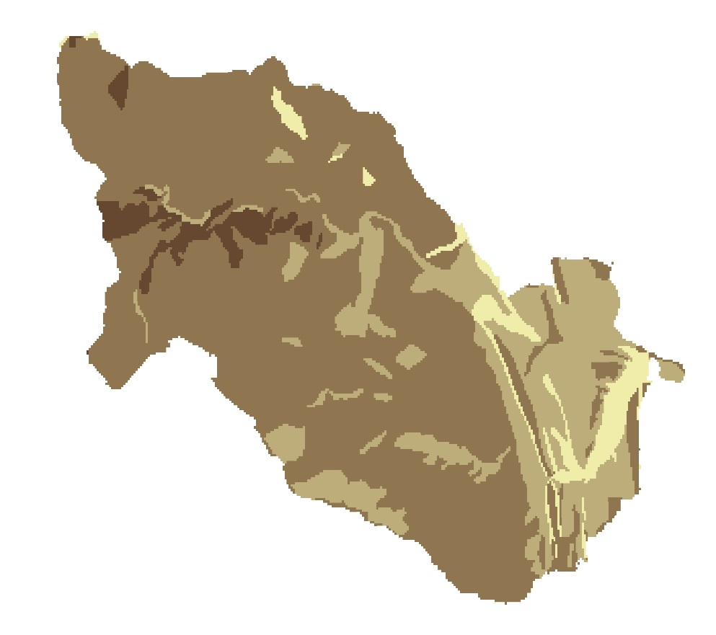
The Revised Universal Soil Loss Equation (RUSLE)
Predicted soil loss: R * LS * C * K * P
K = Soil erodibility factor
Soil Type | K Factor
Water | 1.0
Urban/Bedrock | 1.0
Clay Loam | 1.3
Loam | 1.3
Sandy Loam | 1.7
Loamy Sand | 2.0
Water/ Rock
Loam
Sandy loam
Loamy sand
Source: USDA Web Soil Survey
Notes:
The K factor measured ‘soil erodibility’. Similar to the C factor, we developed an erodibility scale and applied it to our classified soil type map.

Slide 14
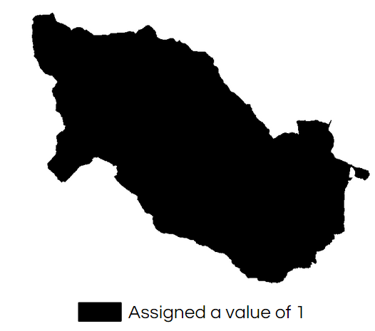
The Revised Universal Soil Loss Equation (RUSLE)
Predicted soil loss: R * LS * C * K * P
P = Conservation practice factor
Notes:
The P factor is the conservation practice factor. It is typically a measure of land management, like stream buffers or grass waterways, which are implemented at such a small scale that they cannot be captured using typical mapping techniques.
That is why we assigned the P factor a value of 1.

Slide 15
Methods
Downloaded and preprocessed data
Created change analysis maps using Land Change Modeler for 2020 & 2030
Delineated watershed and derived catchments and slope from LiDAR DEM using ArcGIS Hydrology tools
Normalized and multiplied factors together
Input images into equations to create R and LS factors
Classified Landsat imagery using classification tree analysis for C factor, created K factor classification
Used TerrSet Land Change Modeler to create change maps for 2002 to 2014 RUSLE outputs
Notes:
After the factors were created, * we normalized them on a scale of 1 to 2 and multiplied them together to create our risk maps. * We then created change maps for 2002 to 2014 using TerrSet’s land change modeler. * Finally, we created a predictive risk map for 2020 and 2030.

Slide 16
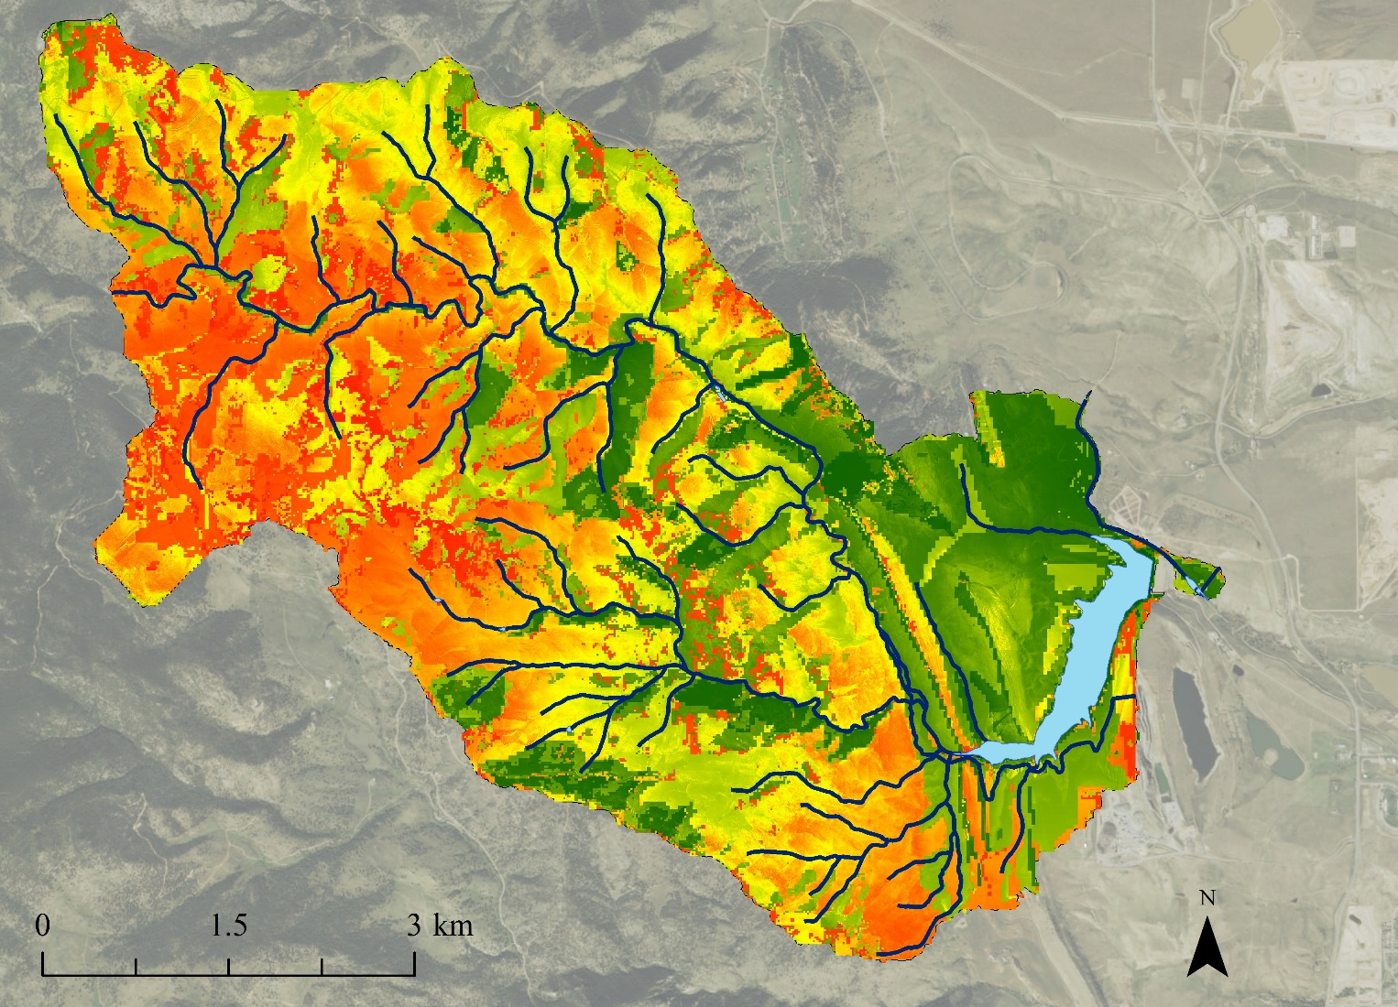
Results: 2014 RUSLE
2 - High
Waterways
Ralston Reservoir
1 - Low
Notes:
This map depicts the RUSLE output for 2014. Red indicates areas at high risk for erosion while green denotes areas at low risk.

Slide 17
Results: 3D Model of 2014 RUSLE
Notes:
We have a short video of our 3- dimensional model of the 2014 RUSLE output.
Red once again indicates high erosion risk while green indicates low erosion risk.
This model shows that high risk areas surround waterways.

Slide 18
Results: 2002 to 2014 Change Map
Ralston Reservoir
2 - High
1 - Low
Increase to High Risk
Increase to Low Risk
Notes:
Here we have the erosion change analysis from 2002 to 2014.
Purple indicates where risk has increased; dark purple is high risk while light purple is low risk.

Slide 19
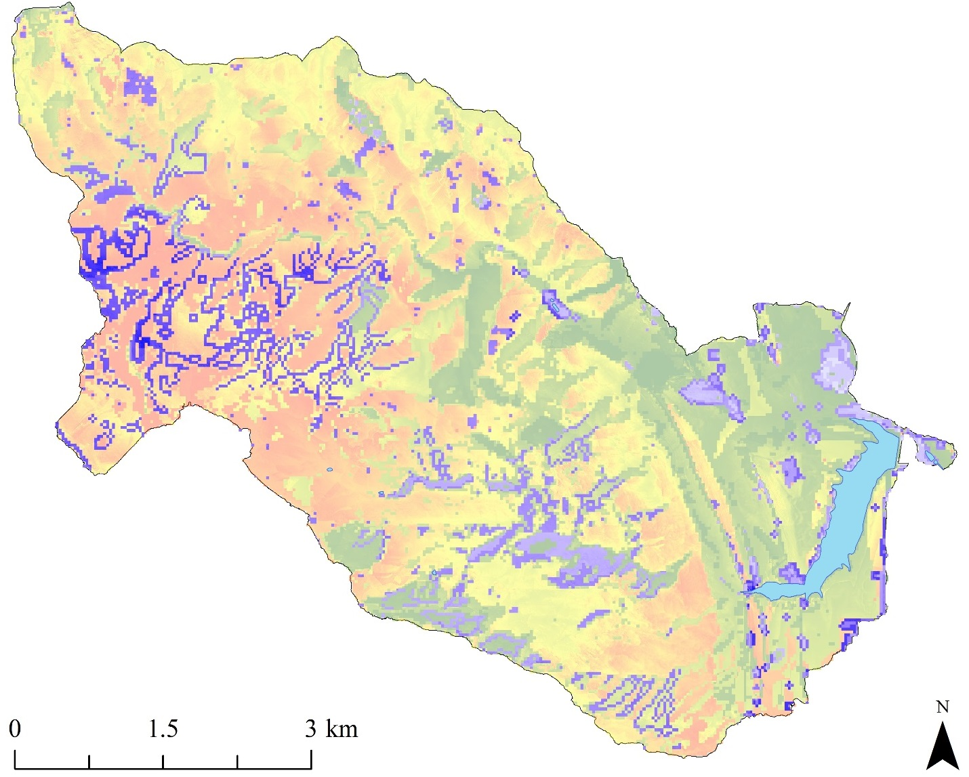
Results: Prediction to 2030
Ralston Reservoir
2 - High
1 - Low
Change to High Risk
Change to Low Risk
Notes:
The map seen here is erosion risk for 2030. Dark purple indicates predicted change to high risk and light purple is predicted change to low risk.

Slide 20
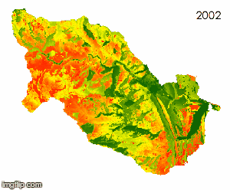
Conclusions
The risk assessment, change analysis, and predicative maps suggest the ideal locations for erosion mitigation is within the circled area on the above map.
If unpredictable weather continues in the Denver area, NASA Earth Observations can help Denver Water locate sites of high erosion risk in order to guide mitigation efforts
Notes:
Throughout the years, we noticed there was a consistent region of the watershed that had high erosion risk, which is circled in black. Mitigation efforts should be focused here.
If unpredictable weather continues in the Denver area, NASA Earth Observations can help Denver Water locate sites of erosion risk within this, and other watersheds.

Slide 21
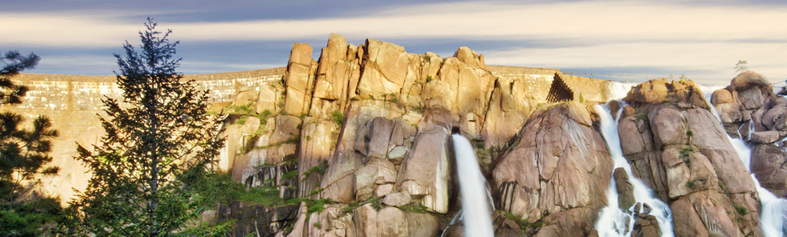
Limitations
Subjective error
Other factors that affect soil erosion
Future Work
North American Land Data Assimilation Systems (NLDAS) or the Soil Moisture Active Passive (SMAP) satellite
Temperature and sediment in the Ralston Reservoir
Credit: Denver Water
Notes:
The RUSLE model relies on subjective quantification of both the C and K factors, which may introduce bias. Additionally, erosion-influencing factors, such as like soil moisture content, are not included in the model. Future work should include soil moisture data from the North American Land Data Assimilation System, or NL-DAS, or the Soil Moisture Active Passive satellite, SMAP.
Remote sensing could also be used to assess water quality by measuring temperature and sediment in water bodies, but it is difficult to measure due to temporal and spatial limitation of open source imagery.

Slide 22
Advisors
Dr. Kenton Ross, NASA DEVELOP National Program (Science Advisor)
Partners
Denver Water, end-user:
POC: Linda Rosales (Water Quality Specialist)
POC: Diego Portillo (GIS Specialist)
POC: Sheila Pelczarski ( Remote Sensing Specialist)
Others
Jeff Ely, NASA DEVELOP National Program (Geoinformatics Senior Fellow)
Emily Adams, NASA DEVELOP National Program (Center Lead)
Daniel Wozniak, NASA DEVELOP National Program (Assistant Center Lead)
Notes:
We would like to thank all who provided assistance throughout the term. And a special thank you to our partner, Denver Water.

