Slide 1
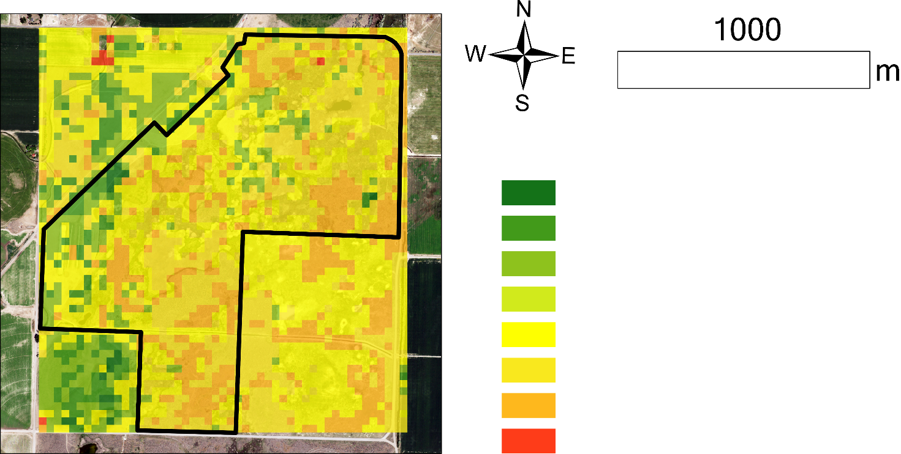
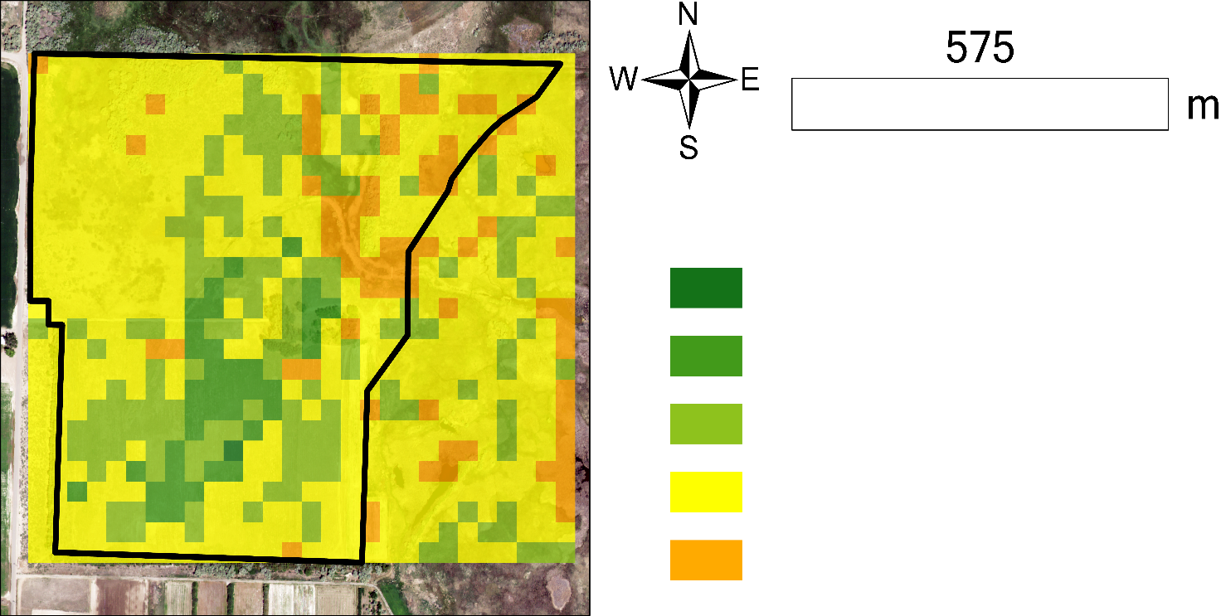
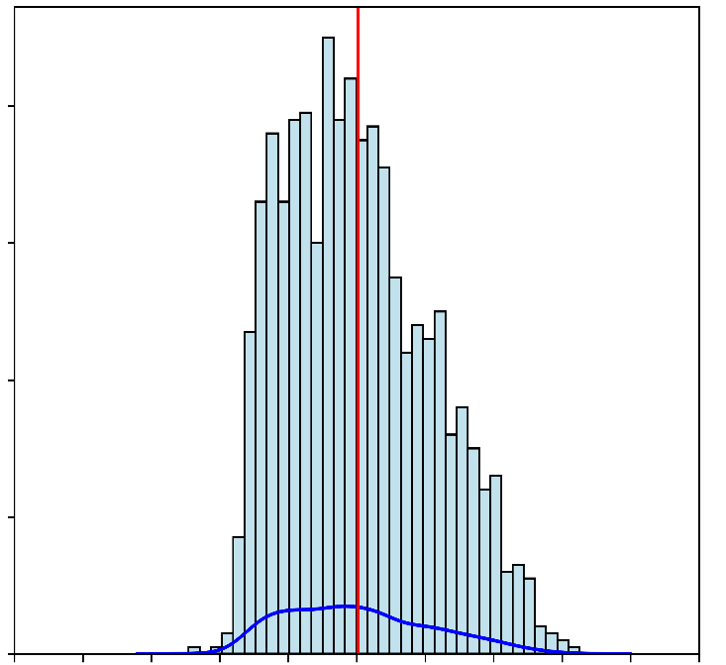
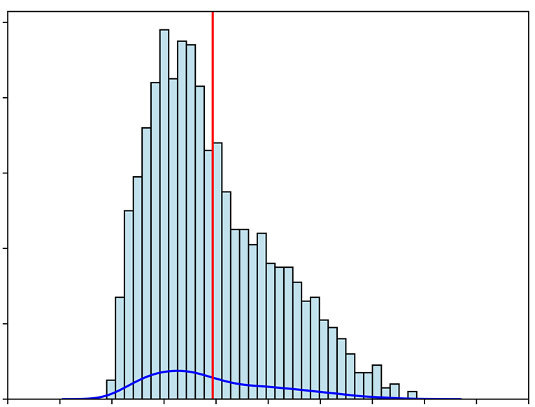
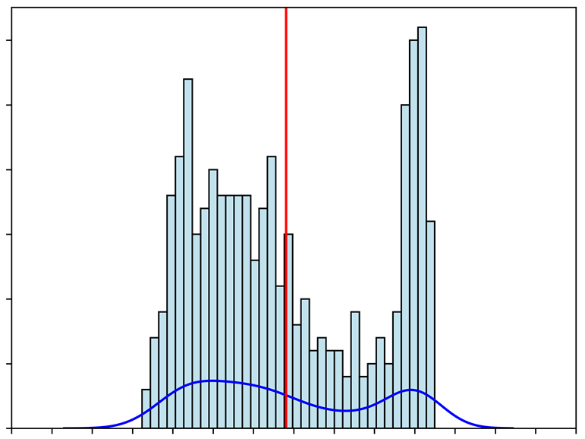
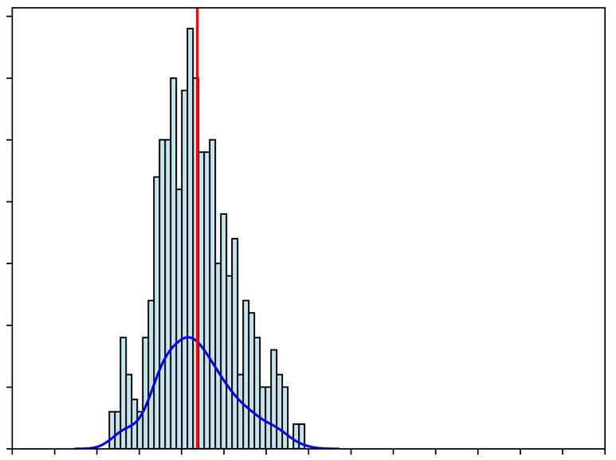
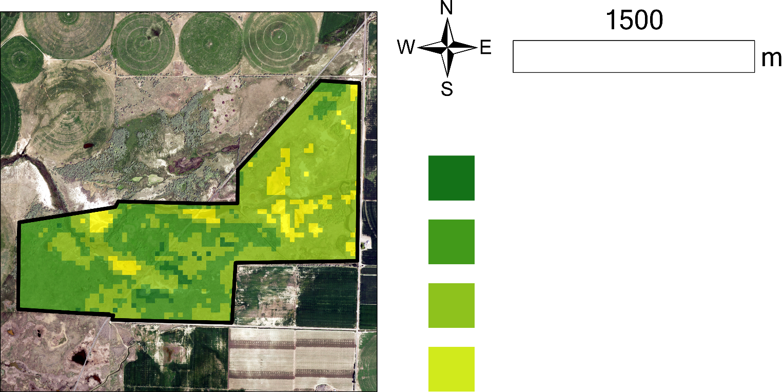
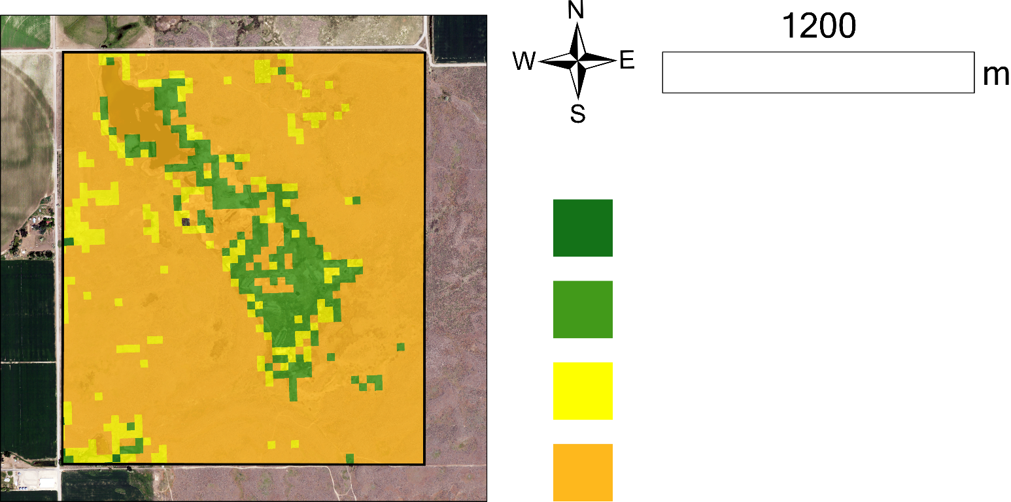
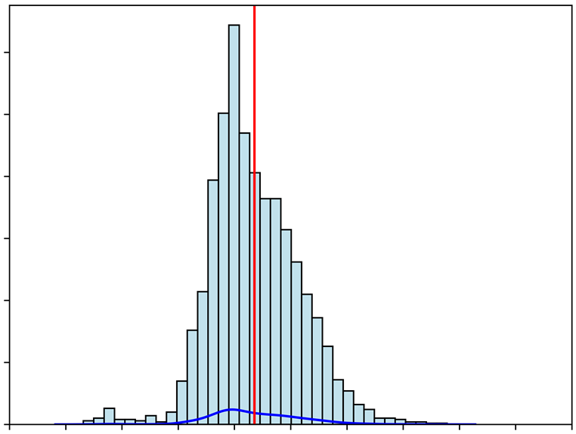
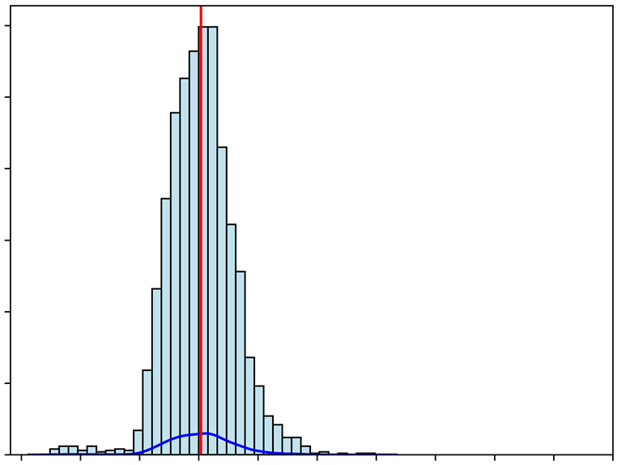
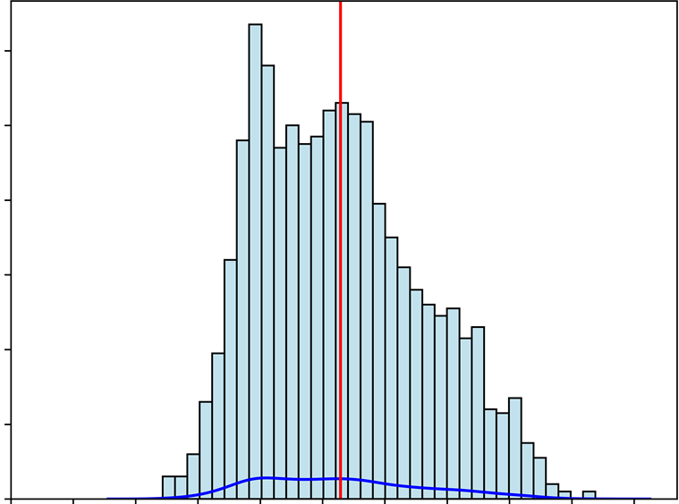
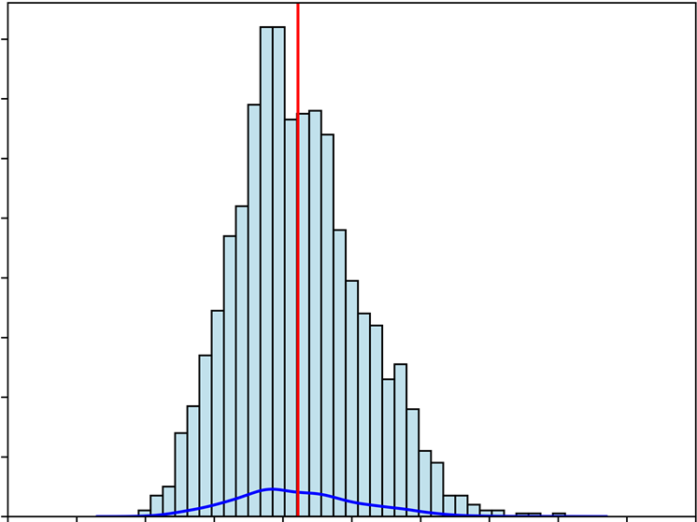
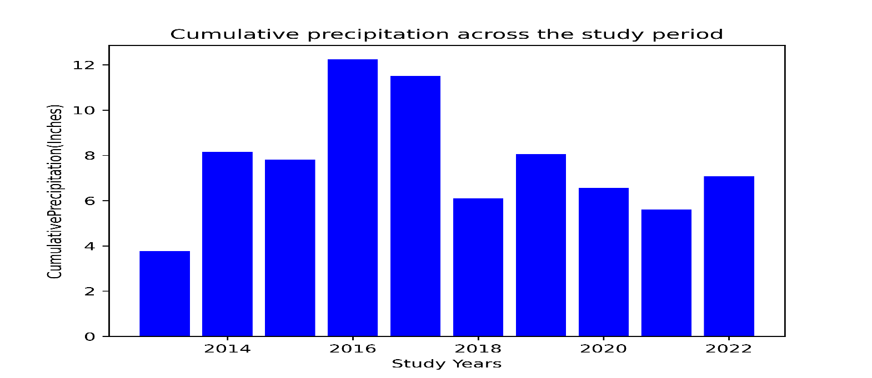
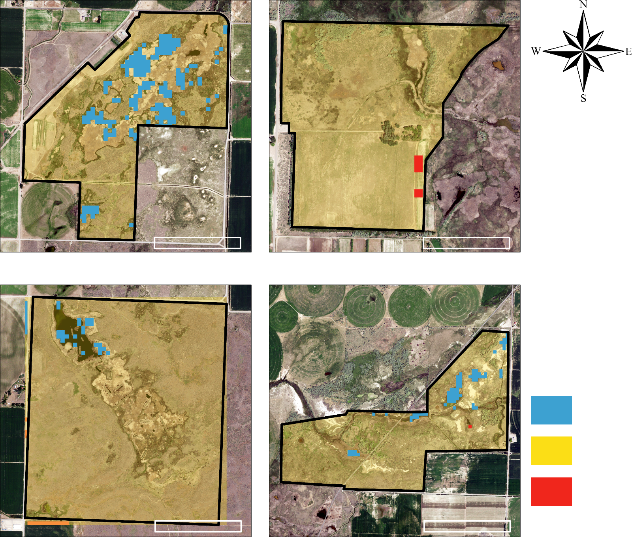
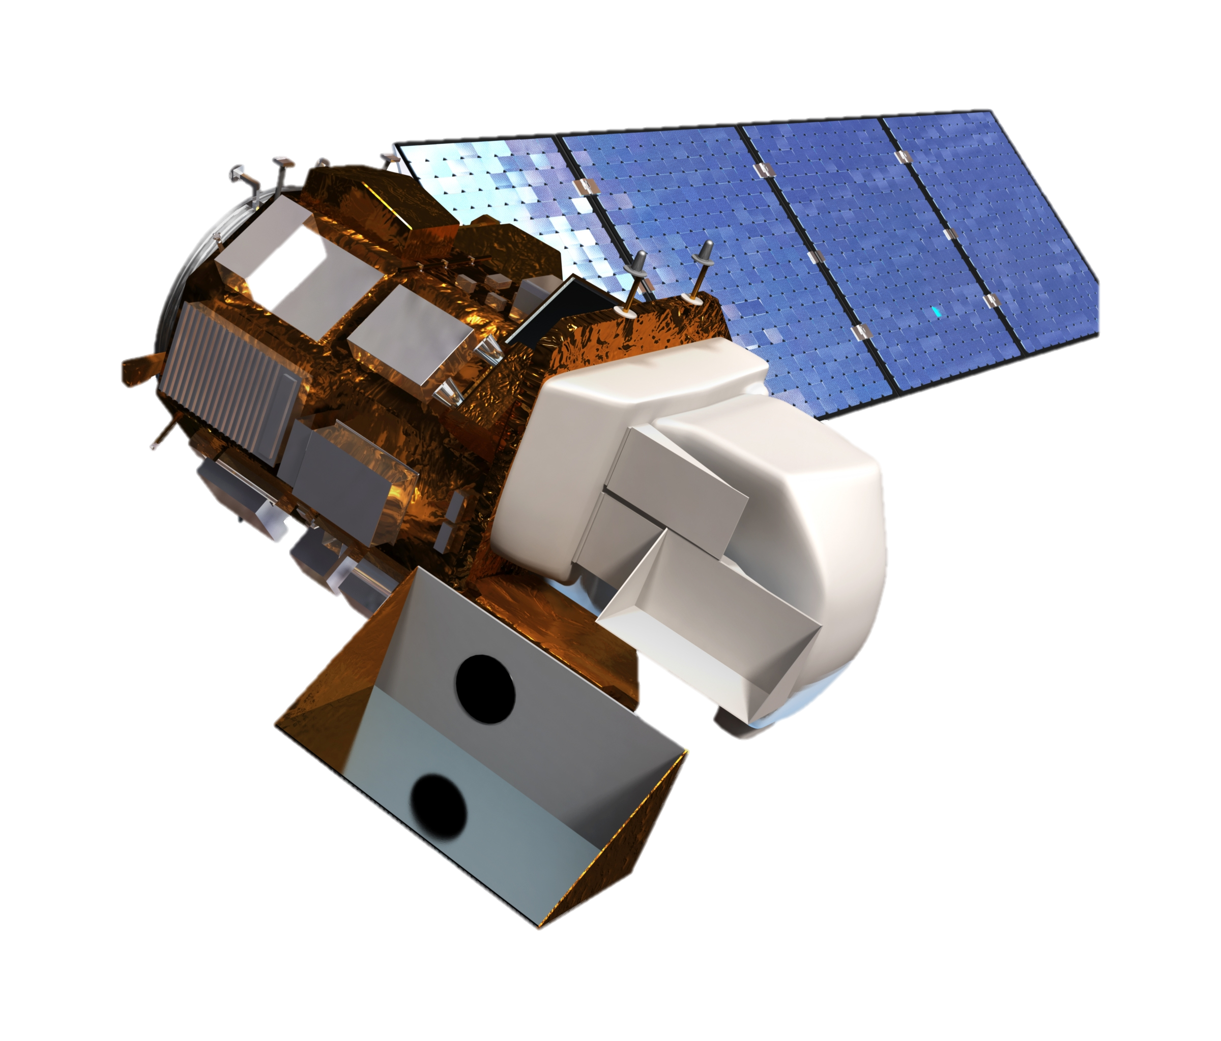
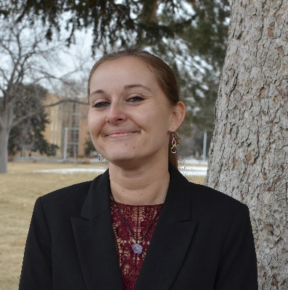
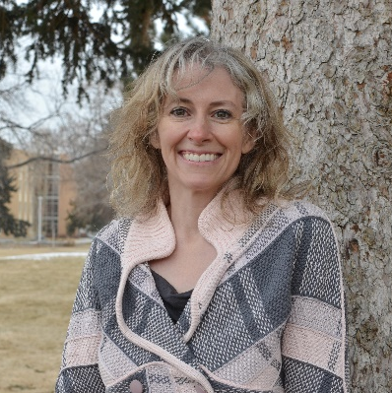
Southeastern Idaho Ecological Conservation
Investigating the Impact of Targeted Grazing to Improve Wetland Habitat in the Sterling Wildlife Management Area
Abstract
Results
Results
Wetland ecosystems are vital for biodiversity conservation and ecosystem services but are often threatened by invasive plant species. Targeted grazing has been proposed as a sustainable alternative to chemical herbicides or burning for controlling invasive plants. The Sterling Wildlife Management Area in Bingham County, Idaho has an issue with decadent and accumulated vegetation growth encroaching on wetland habitat, which presents challenges for wildlife, decreases biodiversity, and limits public access. Land managers introduced targeted cattle grazing in the winter of 2019 to reduce biomass. NASA DEVELOP partnered with the Idaho Department of Fish and Game to determine the impact of the grazing by using NASA Earth observations from Landsat 8 Operational Land Imager in Google Earth Engine. Images were processed with IDRISI TerrSet’s Land Change Modeler and ArcGIS Pro’s Change Detection Wizard to further understand the land changes after grazing. A Normalized Difference Vegetation Index analysis was performed to assess the impacts on vegetation productivity and to compare variances in biomass before and after grazing. A Normalized Difference Water Index was used to measure ground moisture content to determine changes post-grazing. Results showed a decrease in the vegetation index and an increase in the water index post-grazing. The DEVELOP team’s analysis suggests that the grazing helped break down the thick, senesced vegetation and increased the ground moisture. Providing a workflow model allows partners to continue monitoring in this area and other management areas around the state. ​
2022 Vegetation Difference Between Estimated Non-Grazed NDVI and Actual NDVI
1000
m
575
m
> 0.3 Increased Vegetation
> 0.3 Increased Vegetation
> 0.2 Increased Vegetation
> 0.2 Increased Vegetation
> 0.1 Increased Vegetation
> 0 Increased Vegetation
> 0.1 Increased Vegetation
= 0 No Change
= 0 No Change
> 0 Decreased Vegetation
> 0.2 Decreased Vegetation
> 0 Decreased Vegetation
100
> 0.3 Decreased Vegetation
35
80
Mean: 0.3
Median: 0.3
Std.Dev: 0.05
80
Mean: 0.25
Median: 0.23
Std.Dev: 0.06
30
Mean: 0.39
Median: 0.37
Std.Dev: 0.11
30
Mean: 0.27
Median: 0.23
Std.Dev: 0.06
60
25
25
60
20
20
40
40
15
15
Objectives
20
20
10
10
Generate quantitative results that show the effects of grazing​
Quantify change in vegetation productivity and surface water cover​
Compare vegetation productivity and surface water cover before and after cattle grazing treatment​
Develop step-by-step tutorial to provide the Idaho Department of Fish and Game with tools for future monitoring and analysis​
0
0
5
5
0
0
0.05
0.15
0.25
0.35
0.45
0.55
0.05
0.15
0.25
0.35
0.45
0.55
0.05
0.15
0.25
0.35
0.45
0.50
0.65
0.75
0.05
0.15
0.25
0.35
0.45
0.55
0.65
0.75
American Game Unit
Thompson Unit
1500
m
1200
m
Study Area
Study Period
> 0.4 Increased Vegetation
> 0.2 Increased Vegetation
2013–2022
> 0.3 Increased Vegetation
> 0.1 Increased Vegetation
Sterling Wildlife Management Area
> 0.2 Increased Vegetation
= 0 No Change
300
> 0.1 Increased Vegetation
> 0.1 Decreased Vegetation
American Game Unit
01/27/21 – 03/04/21
400 AUMs
01/14/22 – 03/01/22
400 AUMs
12/31/22 – 02/24/23
400 AUMs
300
Mean: 0.31
Median: 0.31
Std.Dev: 0.01
Mean: 0.26
Median: 0.26
Std.Dev: 0.05
120
Mean: 0.27
Median: 0.26
Std.Dev: 0.04
160
Mean: 0.2
Median: 0.2
Std.Dev: 0.03
250
250
100
140
200
200
80
120
150
100
150
60
80
100
100
40
60
Thompson Unit
01/14/22 – 03/01/22
400 AUMs
50
50
20
40
0
0
20
0.05
0.15
0.25
0.35
0.45
0.55
0.05
0.15
0.25
0.35
0.45
0.55
0
0
Control: Orth & Johnson Units
0.05
0.15
0.25
0.35
0.45
0.55
0.05
0.15
0.25
0.35
0.45
Wetlands
Control: Orth Unit
Control: Johnson Unit
Water Area Changes Before and After Grazing (2020 – 2022)
Cumulative Precipitation Across the Study Period
12
*Location: Aberdeen, ID, Source: Agrimet, Bureau of Reclamation
Methodology
10
Suitability Analysis
Preprocessing
Ecological Forecasting
8
600
m
600
m
Land Change
Modeler
(IDRISI TerrSet)
Cumulative precipitation (inches)
American Game Unit
Thompson Unit
Water Area
Landsat 8 OLI
(Google
Earth Engine)
Surface Reflectance
6
Vegetation Area
Grazing Area
Boundary
Clip Raster
Prediction Image (NDVI 2022)
4
Increase
2
No Change
NAIP
(Reference)
Georeference Check
Change Detection
(ArcGIS Pro)
0
2014
2016
2018
2020
2022
600
m
600
m
Decrease
Change Detection
(ArcGIS Pro)
Study Years
Control: Johnson Unit
Control: Orth Unit
Normalized Difference
Water Index (NDWI)
Rectified Images
Conclusions & Discussion
Normalized Difference
Vegetation Index (NDVI)
Calculate
Year-Max NDVI
Prediction – Observed
NDVI
Vegetation & Water cover change
Grazed units (American and Thompson) show lower vegetation cover​ than non-grazed units (Orth and Johnson) when compared with NDVI changes
Precipitation increased by 20% between 2020 – 2022, as water area also increased in all study units; more water area is observed in American Unit (Grazed area) from NDWI monitoring
Future consideration
Time-series analysis with more sample years and units is needed to make a full determination of the grazing impact
Vegetation index from PlanetScope, 3m high-resolution image could be considered for future monitoring; needs to be reevaluated due to low correlation with Landsat
Comparison of PlanetScope (30m resample) and Landsat 8
Sample date: July 2022
Quantifying the Effect of Grazing on Ecosystem
*The image acquisition period was chosen using Pheno-Calc – software designed at Idaho State University to determine the most comparable dates between years based on phenological changes in the vegetation
Quantifying
Vegetation Changes
Team Members
EXAMPLE
Preethi Balaji (Lead)
Talissa Cota
Kangsan Lee
Melissa McNally
Acknowledgements
Partners: Idaho Department of Fish and Game; Advisor: Keith Weber (ISU GIS Training and Research Center); Fellow: Ryan Healey Special thanks: Maria Pacioretty (Habitat Biologist, IDFG) & Jeff May (IT Software Engineer, IDFG), Chase & Dallin Carter (Ranchers, Pingree, ID), Kindra Blair (IT Service, GIS TReC, Idaho State University)
Idaho – Pocatello

