Slide 1
Colorado Eastern Plains
Agriculture
Rangeland Monitoring to Inform Grazing Management in Eastern Colorado
Sarah Hettema
Jillian Joubert
Deni Ranguelova
Fort Collins – Colorado | Fall 2022

Slide 2
Presentation Outline
Background
Study Area | Community Concerns | Objectives | Partner Organizations
Methodology
Data Acquisition | Data Processing | Data Analysis
Results
Monthly Biomass Maps | Max Biomass Maps | Product Comparison
Conclusions
Key Findings |Caveats| Future Work

Slide 3
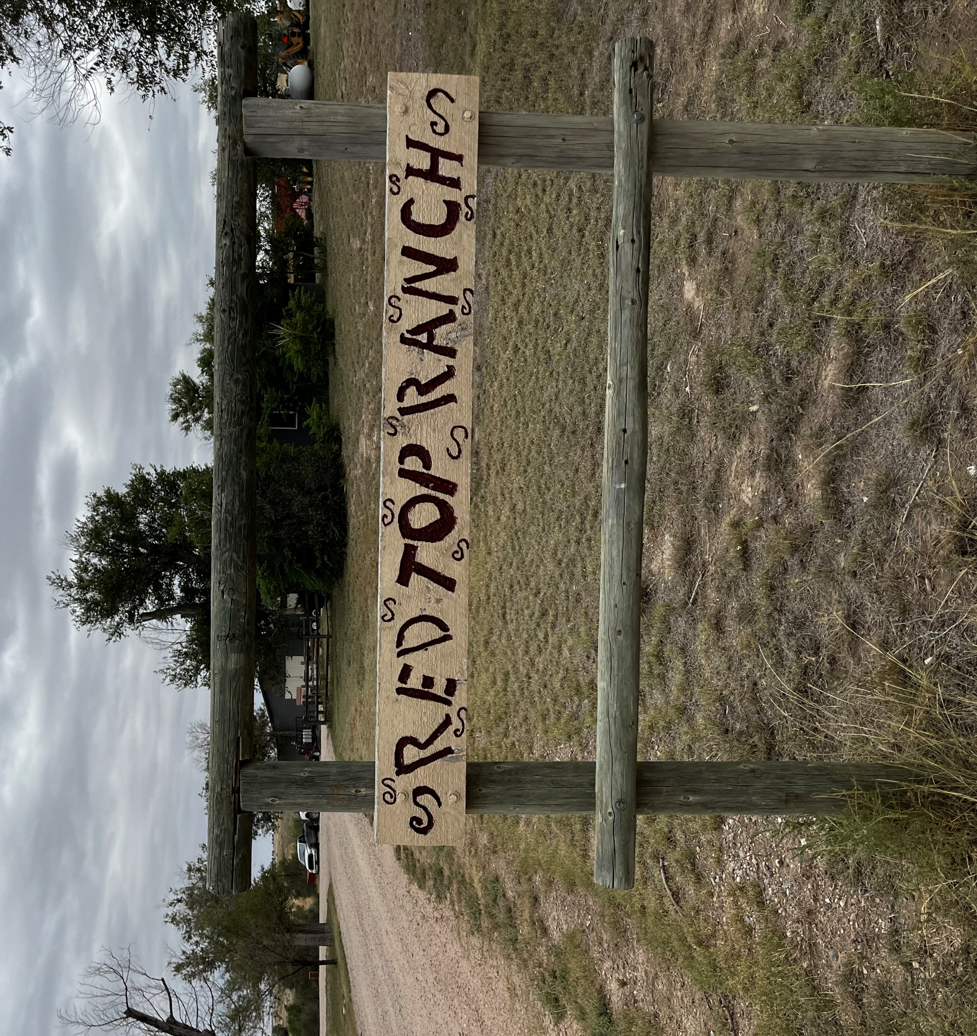
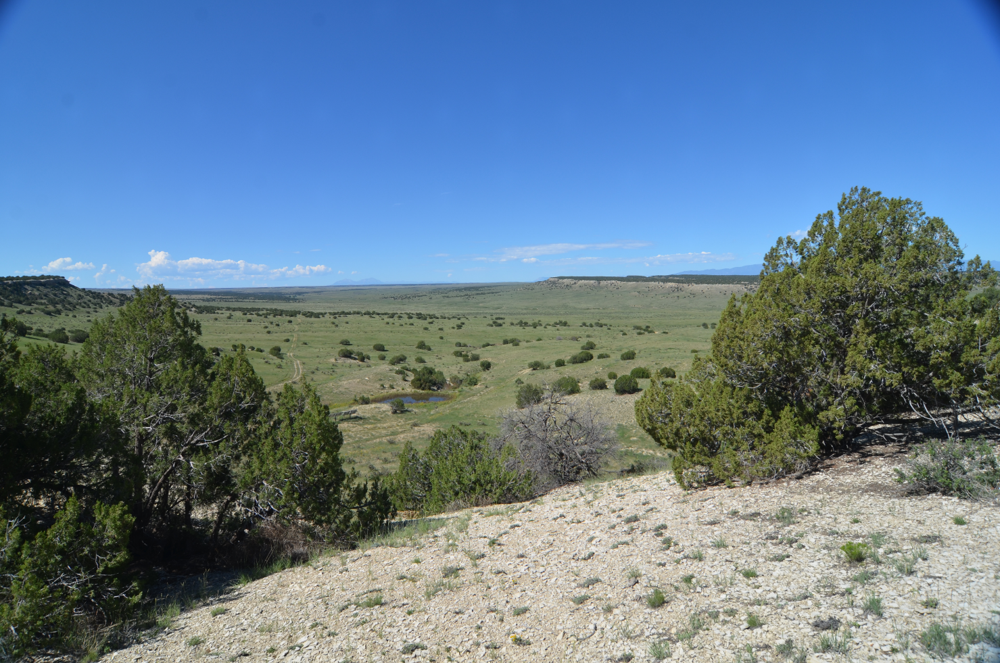
Western Cattle Ranching
Privately owned rangelands provide:
Ecologically diverse landscapes
Economically impactful local goods
Unique cultural identity
Background
Methods
Results
Conclusions
Notes:
Ranchers are a keystone species
They keep natural landscapes intact
Provide food and economic value from the land
Maintain biodiversity if properly managed
Protected, managed rangelands prevent the land from becoming developed
Ranchers are a cultural identity and many ranchers have passed the profession down through generations
Images taken by DEVELOP CO Eastern Plains team

Slide 4
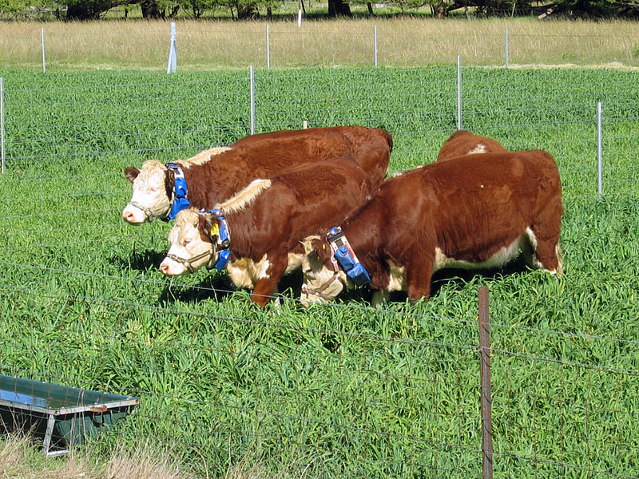
Virtual Fencing in Adaptive Management
Emerging technology for rangeland environments
Potentially improves management efficiency
Quickly being adopted across ranches in the Western US
Image Credit: CSIRO
Background
Methods
Results
Conclusions
Notes:
Trackable collars are placed on cattle and linked to a virtual map where ranchers can edit the boundaries of the fence.
Cattle are given a stimuli when they approach the fence, followed by a shock if they pass the boundary.
This type of management allows ranchers to herd cattle remotely, improving management efficiency.
This approach has the potential for several different applications, such as the improvement of biodiversity, creation of fuel breaks for wildfire prevention management and riparian buffer protection.
------------------------------Image Information Below ------------------------------
Image Credit: CSIRO
Image Source: https://commons.wikimedia.org/wiki/File:CSIRO_ScienceImage_10833_Cattle_wearing_virtual_fencing_collars.jpg
Creative Commons Attribution 3.0 Unported

Slide 5
Partners & Concerns
Partners:
Red Top Ranch
Working cow ranch
Focused on cattle health and profitable ranch
The Nature Conservancy
Global conservation organization
Focus on the protection of intact landscapes
Concerns:
Forage availability
Virtual Fencing effects on rotation management
Biodiversity and habitat protection
Suitability of virtual fencing in supporting rangeland management and conservation
Background
Methods
Results
Conclusions
Notes:
There are two partners in this study: Red Top Ranch and the Nature Conservancy.
Red Top Ranch is a working cattle ranch in Pueblo County, Colorado.
The Nature Conservancy is a global organization that promotes biodiversity and conservation efforts.
They both are interested in the effects of virtual fencing in rangeland management.
Red Top Ranch also is interested in if it helps inform their rotation management and available forage for their cattle.
The Nature Conservancy is interested in how virtual fencing can be applied to other study areas and if it can promote conservation efforts.
Icons from Microsoft PowerPoint Suite

Slide 6
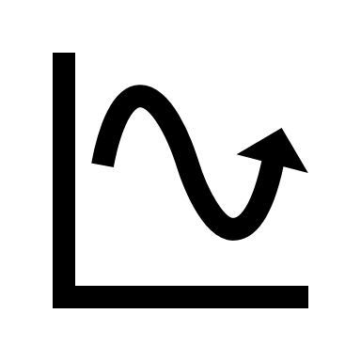
Objectives
1.
2.
3.
Track and quantify range conditions at Red Top Ranch​
Evaluate existing products of standing biomass​
Support larger long-term project that is a collaboration between CSU, TNC, and Red Top Ranch ​
Background
Methods
Results
Conclusions
Notes:
Track and quantify range conditions on Red Top Ranch
Evaluate existing products of standing biomass
Supporting larger long term project that is a collaboration between CSU, TNC, and Red Top Ranch
Icons from Microsoft PowerPoint

Slide 7
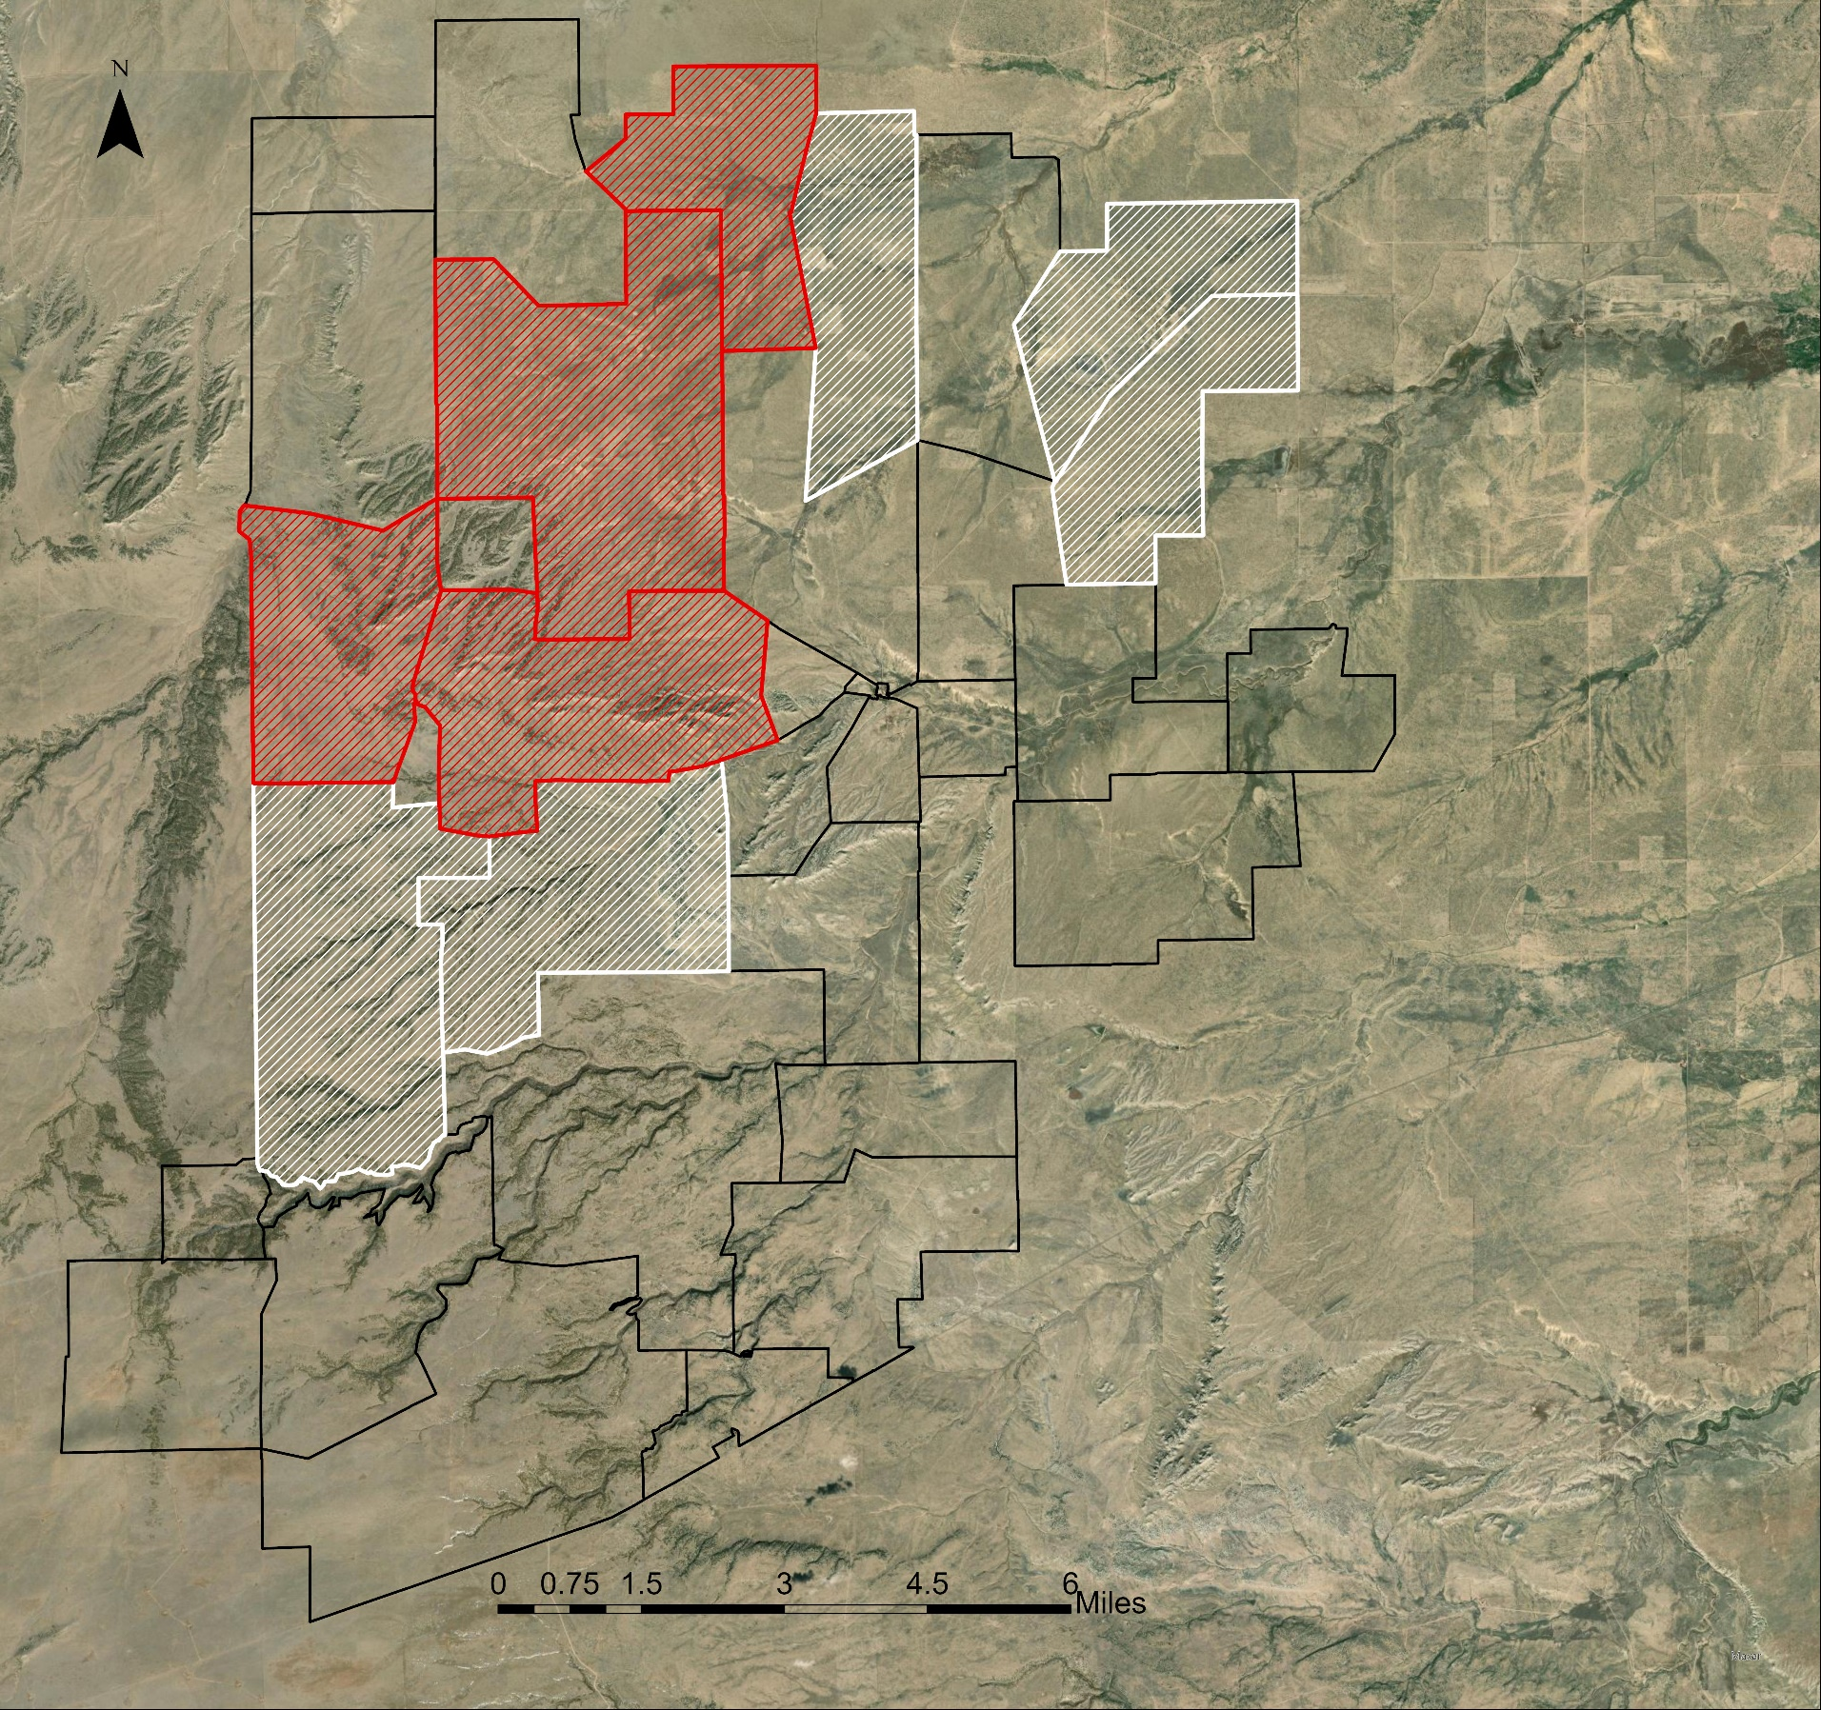
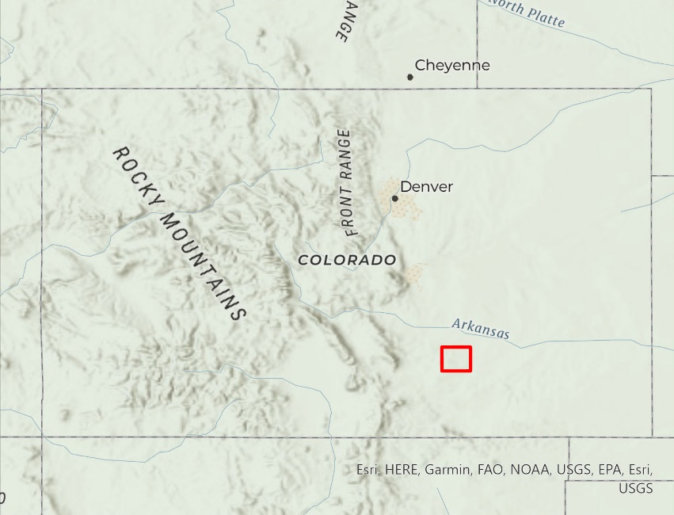
Study Area
Red Top Ranch
~80,000 acres divided into 34 pastures
Working cattle ranch
Shortgrass steppe
Climatic Conditions
Annual Rainfall: 13.02 in.
Annual high temperature: 69ºF
Annual Low: 38ºF
Control Pastures
Experimental Pastures
Pasture Boundary
Background
Methods
Results
Conclusions
Notes:
The study area is Red Top Ranch, in Pueblo County, Colorado.
The ranch spans 80,000 acres and has 34 pastures.
The pastures marked in red are the experimental pastures, where virtual fencing is being trialed as an adaptive management tool.
The white pastures are acting as the control in this experiment. The data we are analyzing are from 2021 and 2022.
Climate Data is for Pueblo, Colorado found here: https://www.usclimatedata.com/climate/pueblo/colorado/united-states/usco0323
Basemap credit: Esri

Slide 8
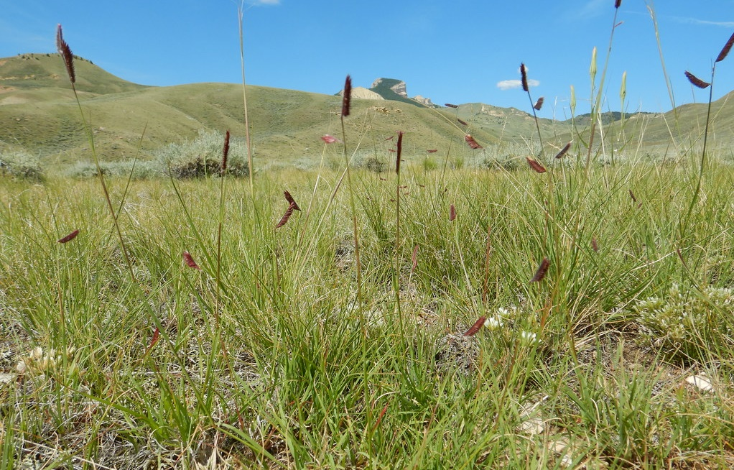
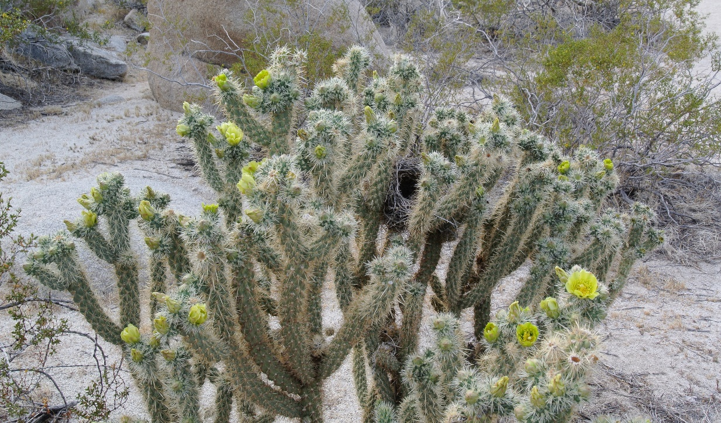
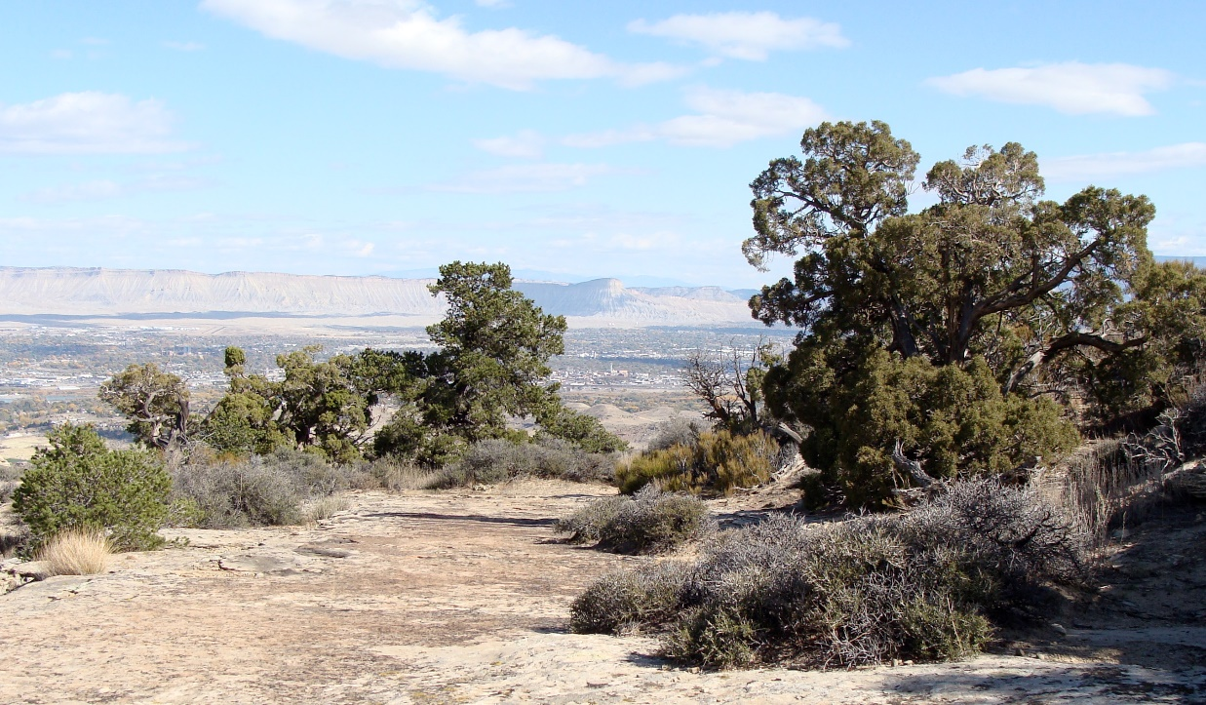
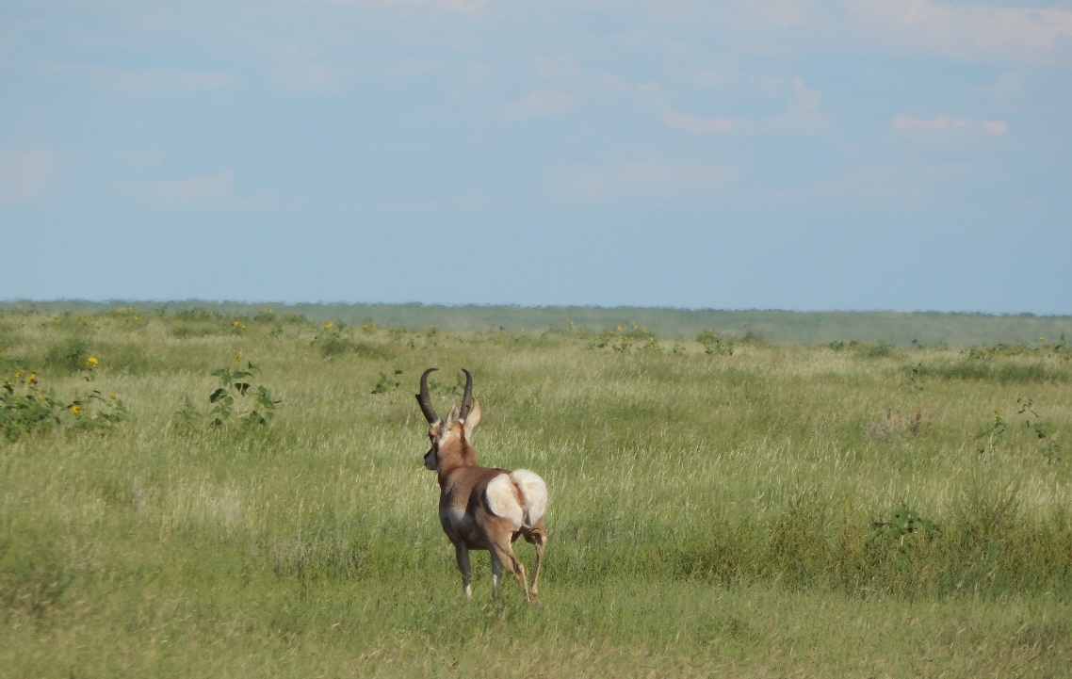
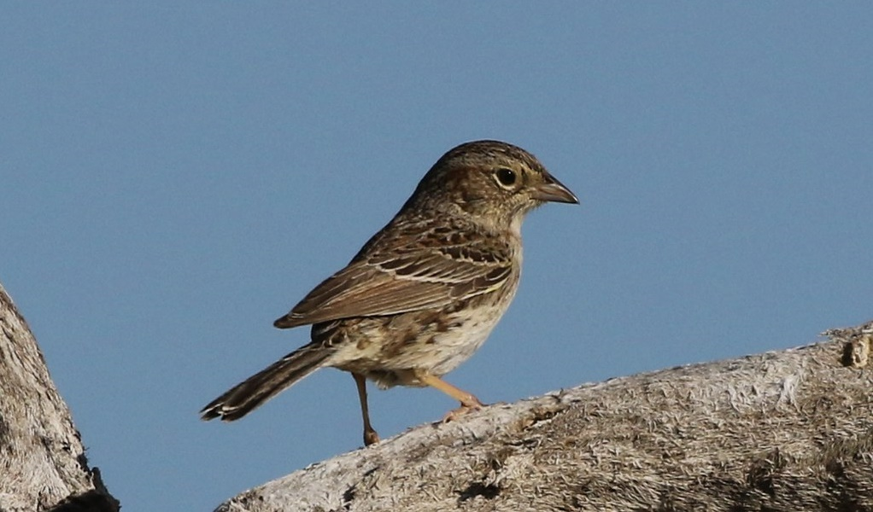
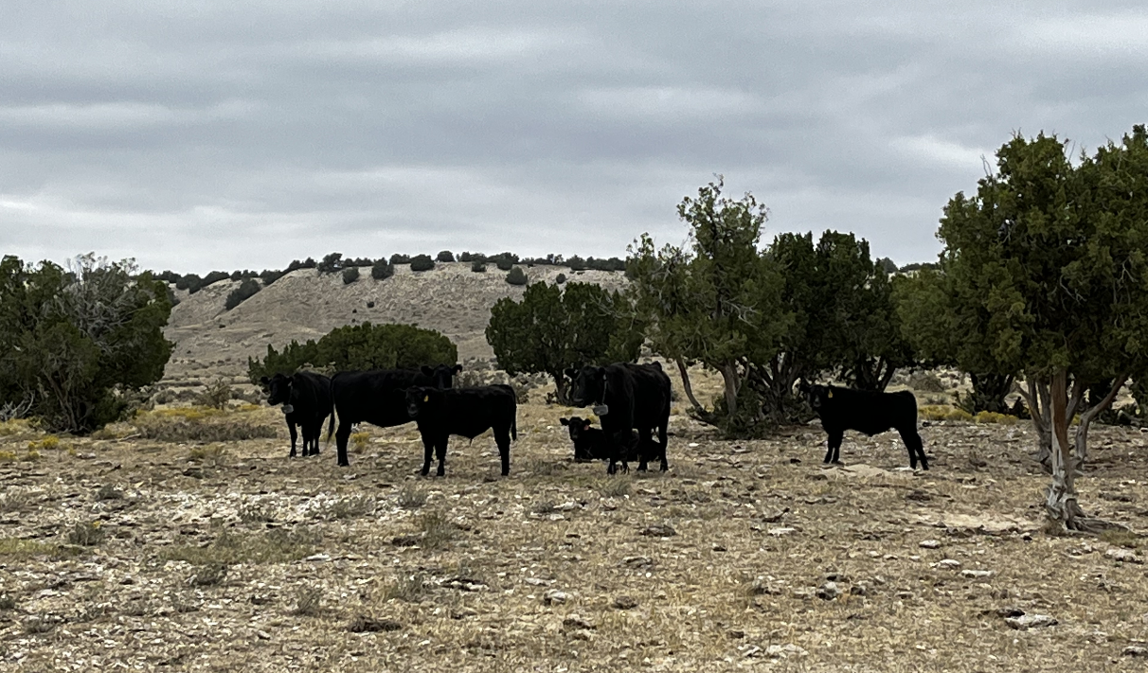
Vegetation and Wildlife
Blue Grama (Grass)
Choya Cactus
Juniper Trees
Image Credit: Matt Lavin
Image Credit: Adba
Image Credit: Jimmy Thomas
Antelope
Cassin's sparrow
Cattle
Image Credit: Tom Benson
Background
Methods
Results
Conclusions
Notes:
Speaker Notes: These are the dominant vegetation and wildlife that is on the ranch lands.
Three types of grass highlighted, Blue gramma, Western Wheat grass, and James Galetta Grass.
Other types of vegetation include Choya Catus, Juniper Trees, and Pickly Pear Cactus.
Antelope, Cassin's sparrow, and cattle are all examples of wildlife that exist and depend on the ranch.
------------------------------Image Information Below ------------------------------
Blue Gramma credit: Matt Lavin
Blue Gamma source: https://www.flickr.com/photos/plant_diversity/48266532477
CC BY-SA 2.0
Choya Cactus credit: Adbar
Choya Cactus source: https://commons.wikimedia.org/wiki/File:Cholla_Anza_Borrego.jpg
CC BY-SA 3.0
Juniper Tree credit: Jimmy Thomas
Juniper Tree source: https://commons.wikimedia.org/wiki/File:Junipers_Serpents_trail_Colorado.jpg
CC BY-SA 2.0
Cassin’s Sparrow credit: Tom Benson
Cassin's Sparrow source: https://www.flickr.com/photos/40928097@N07/46995889254/
CC BY-NC-ND 2.0
Antelope and Cattle image were taken by the DEVELOP CO Eastern Plains Disasters team

Slide 9
Methodology
EXPLORE
EVALUATE & COMPARE
INFORM
Biomass Products and Patterns
Biomass Products and Field Data
Biomass Product Suitability
Background
Methods
Results
Conclusions
Notes:
Track and quantify range conditions on Red Top Ranch
Monthly Biomass paterns and Annual patterns for 2021 and 2022.
Look at ARS and RAP products
Evaluate existing products of standing biomass
Create biomass maps for ARS and RAP tom compare against each other
Compare model-predicted biomass to field collected data
Supporting larger long term project that is a collaboration between CSU, TNC, and Red Top Ranch
Next term's develop project can also build upon our findings
-Satellite, Trees, Scale, Picture, mountain, and cow icon: Office 365 (2021)

Slide 10
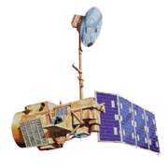
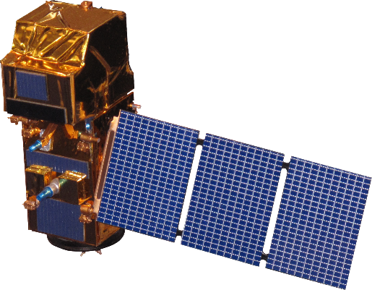
Data Acquisition: NASA Satellites
Landsat 5​
Landsat 7​
Landsat 8​
Sentinel-2
Thematic Mapper ​
(TM)​
Enhanced Thematic Mapper Plus (ETM+)​
Operational Land Imager (OLI)​
Multi-Spectral ​
Instrument​
(MSI)​
Background
Methods
Results
Conclusions
Image Credit: NASA, ESA
Notes:
Landsat Images Credit: National Aeronautics and Space Administration, accessed July 2021. https://eospso.nasa.gov/content/nasas-earth-observing-system-project-science-office (public domain)
Sentinel Image Credit: European Space Agency, accessed July 2021. https://www.esa.int/Applications/Observing_the_Earth/Copernicus/Sentinel-2/Downloads

Slide 11
Data Acquisition
Biomass Rasters
Ancillary Data
Agricultural Research Service (ARS)
2021 & 2022
Calibrated to CPER landscape
Rangeland Analysis Platform (RAP)
30m
Landsat 8 & Sentinel 2 Harmonized
30m
2021
Landsat 5 TM, 7 ETM+, and 8 OLI
Biomass Raster
Biomass Raster
Daily Standing Biomass
Annual and 16-day biomass
Available across Western U.S.
LANDFIRE Existing Vegetation Cover and Type Layers
Updated 2016
Raster product
Visually Observed (VO) and Clipped Biomass Field Data
Collected 2022, Red Top Ranch
Biomass clippings by coordinates
Background
Methods
Results
Conclusions
Notes:
ARS and RAP are both datasets containing biomass rasters. ARS has 365 bands, one for each day of the year. RAP has annual and 16-day periods. NAIP true color image was used in comparison.
We were mainly interested in specific cover types that represent the biomass that will be grazed. Therefore, we utilized LandFire Existing Vegetation Cover and Type layers to pull out only the cover types of interest.
Over the summer of 2022, NREL field staff manually collected biomass clipping plot data at Red Top Ranch that was used to compare against the model predicted biomass values.
Mountain and plant icon: Sourced from Microsoft Powerpoint Icon Suite, 2022.

Slide 12
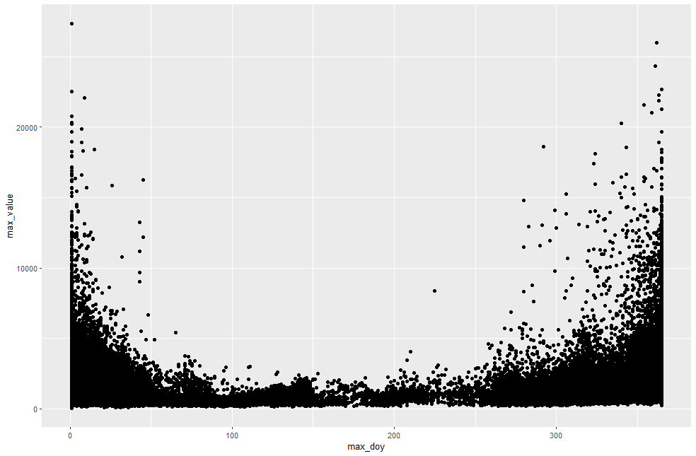
Data Processing
ARS 2021 Biomass Raster
R Studio
Monthly Max Biomass Maps
2022 Monthly Max Biomass Maps
January
February
March
April
May
June
July
August
September
October
10,000
kg/ha
0
Background
Methods
Results
Conclusions
Notes:
We wanted to look at the biomass patterns over one year. 2021 was the most up to date data we had at the beginning of the project, where 2022 was released later. This informed our decision later down the line to limit the range of interest based on month and growing season duration.
Histogram shows high peaks during the beginning (January) and end of year (December). We thought this may be skewing data so we decided to limit the range from April to October.

Slide 13
Data Processing
ARS 2021 Biomass Raster
R Studio
Monthly Max Biomass Maps
2022 Monthly Max Biomass Maps
January
February
March
April
Limit date range to growing season (April-October)
May
June
July
August
April 1,
(Day 91)
October 1, (Day 274)
September
October
10,000
kg/ha
0
Background
Methods
Results
Conclusions
Notes:
We wanted to look at the biomass patterns over one year. 2021 was the most up to date data we had at the beginning of the project, where 2022 was released later. This informed our decision later down the line to limit the range of interest based on month and growing season duration.
Histogram shows high peaks during the beginning (January) and end of year (December). We thought this may be skewing data so we decided to limit the range from April to October.

Slide 14
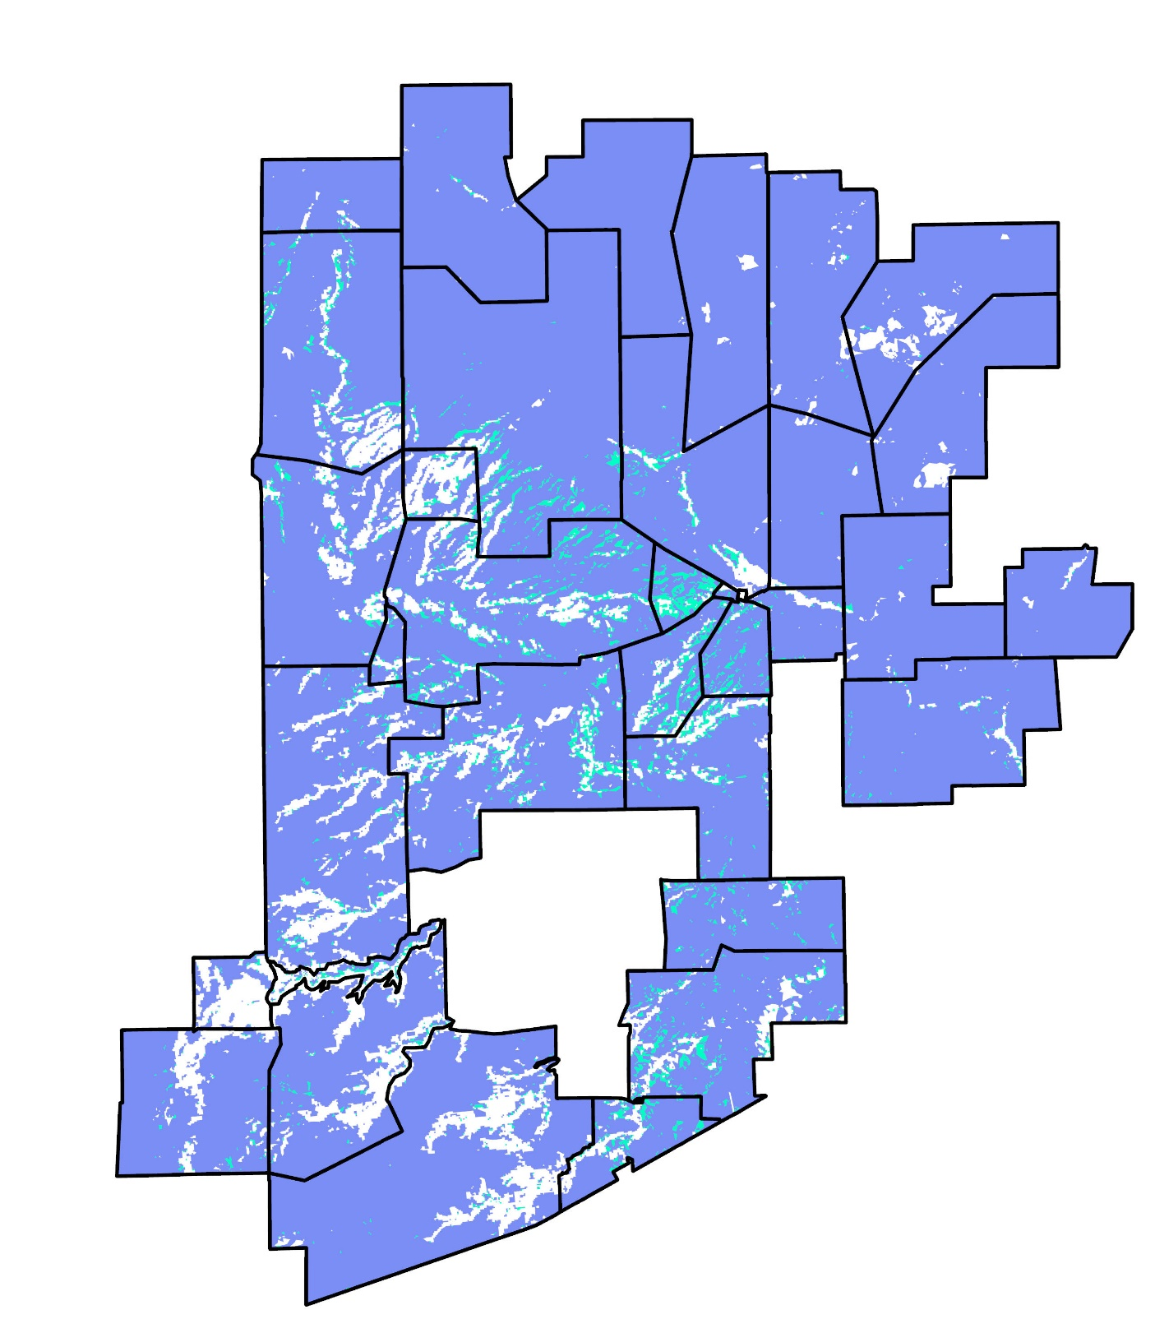
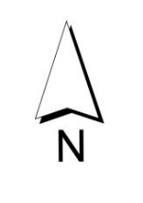
Data Processing: Vegetation Masks
Existing Vegetation Type and Cover layers were analyzed in ArcGIS Pro
LANDFIRE Layers Analysis
Two cover types make up the grasslands of interest
Layers of Interest Selected
Western Great Plains Shortgrass Prairie
Western Great Plains Foothill and Piedmont Grassland
Mask was created and brought into R Studio to be applied to biomass raster data
Vegetation Mask Created
Background
Methods
Results
Conclusions
Notes:
We realized that trees and non-grass vegetation types could be skewing the biomass data values and locations.
We utilized LANDFIRE Cover type layers and chose two that seemed to best represent our biomass of interest.
The white areas on the pasture were mostly tree cover types that we are not interested in for this analysis.

Slide 15
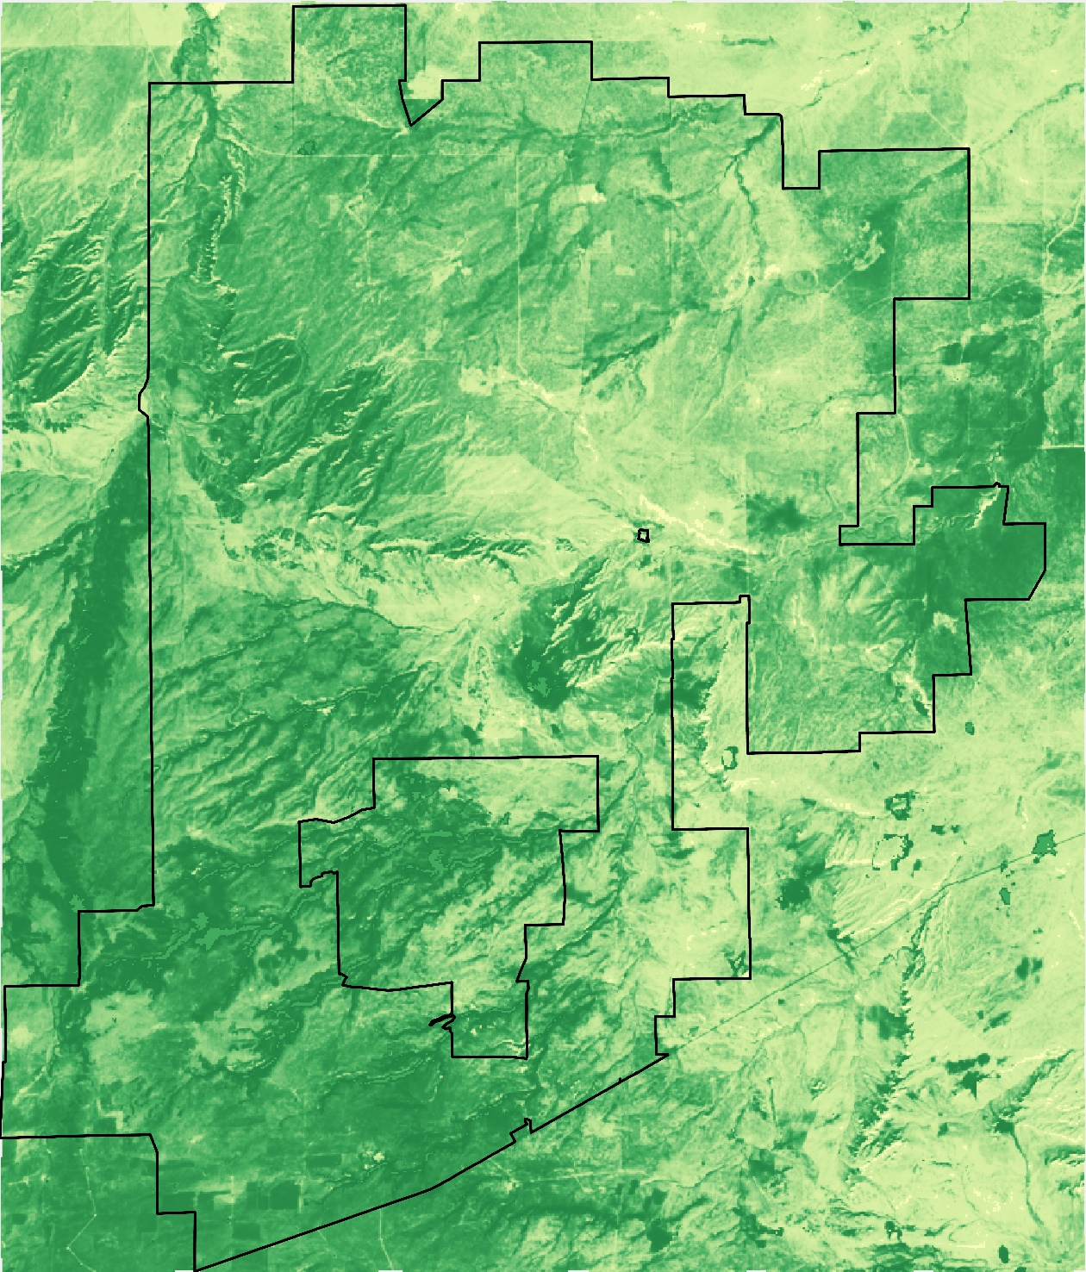
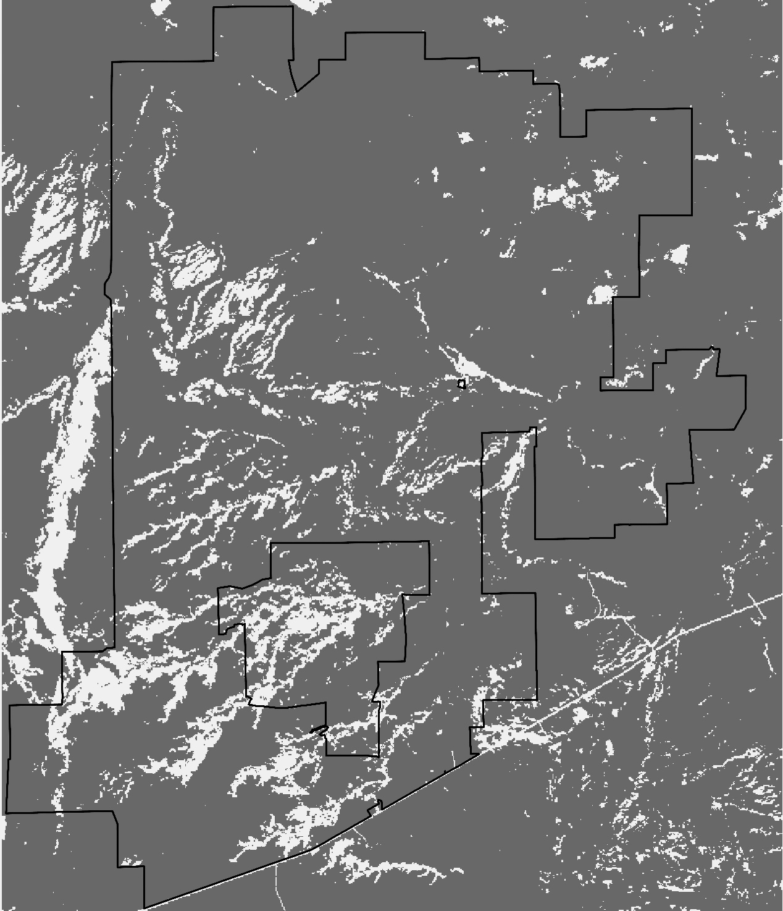
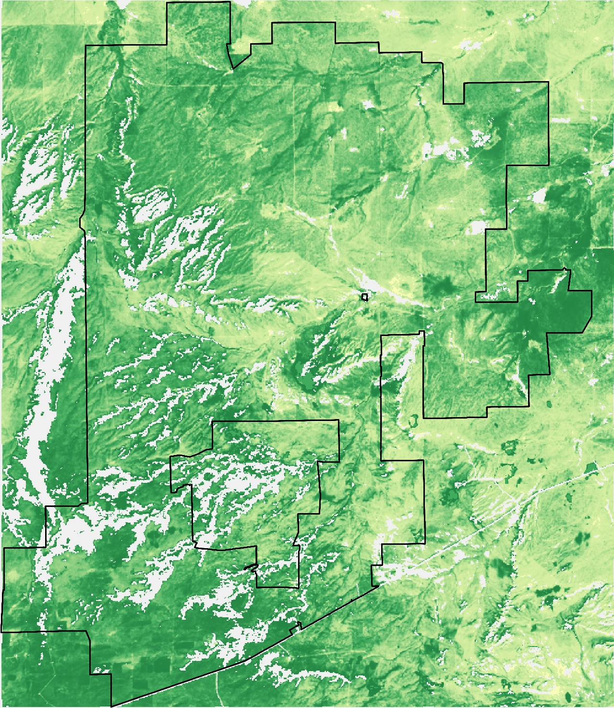
Data Processing: Vegetation Masks
Max Biomass
Land Cover Type Mask
Masked Max Biomass
Background
Methods
Results
Conclusions
Notes:
We created an R script to mask out any land cover types that were not either Western Great Plains Shortgrass Prairie or Western Great Plains Foothill and Piedmont Grassland
We used the data we processed from the EVT layer to further process the ARS imagery
The third image represents the overlay of the two products, allowing us to analyze only the numbers which match the land cover type criteria

Slide 16
April
May
June
July
August
September
October
Red Top Boundary
9000
kg/ha
20
Background
Methods
Results
Conclusions
Notes:
These images show the maximum biomass present across each month of the growing season in 2022
The analysis was completed using R scripts and ArcGIS for visualization
These findings will be used to inform ranch managers where there is high forage availability throughout the growing season

Slide 17
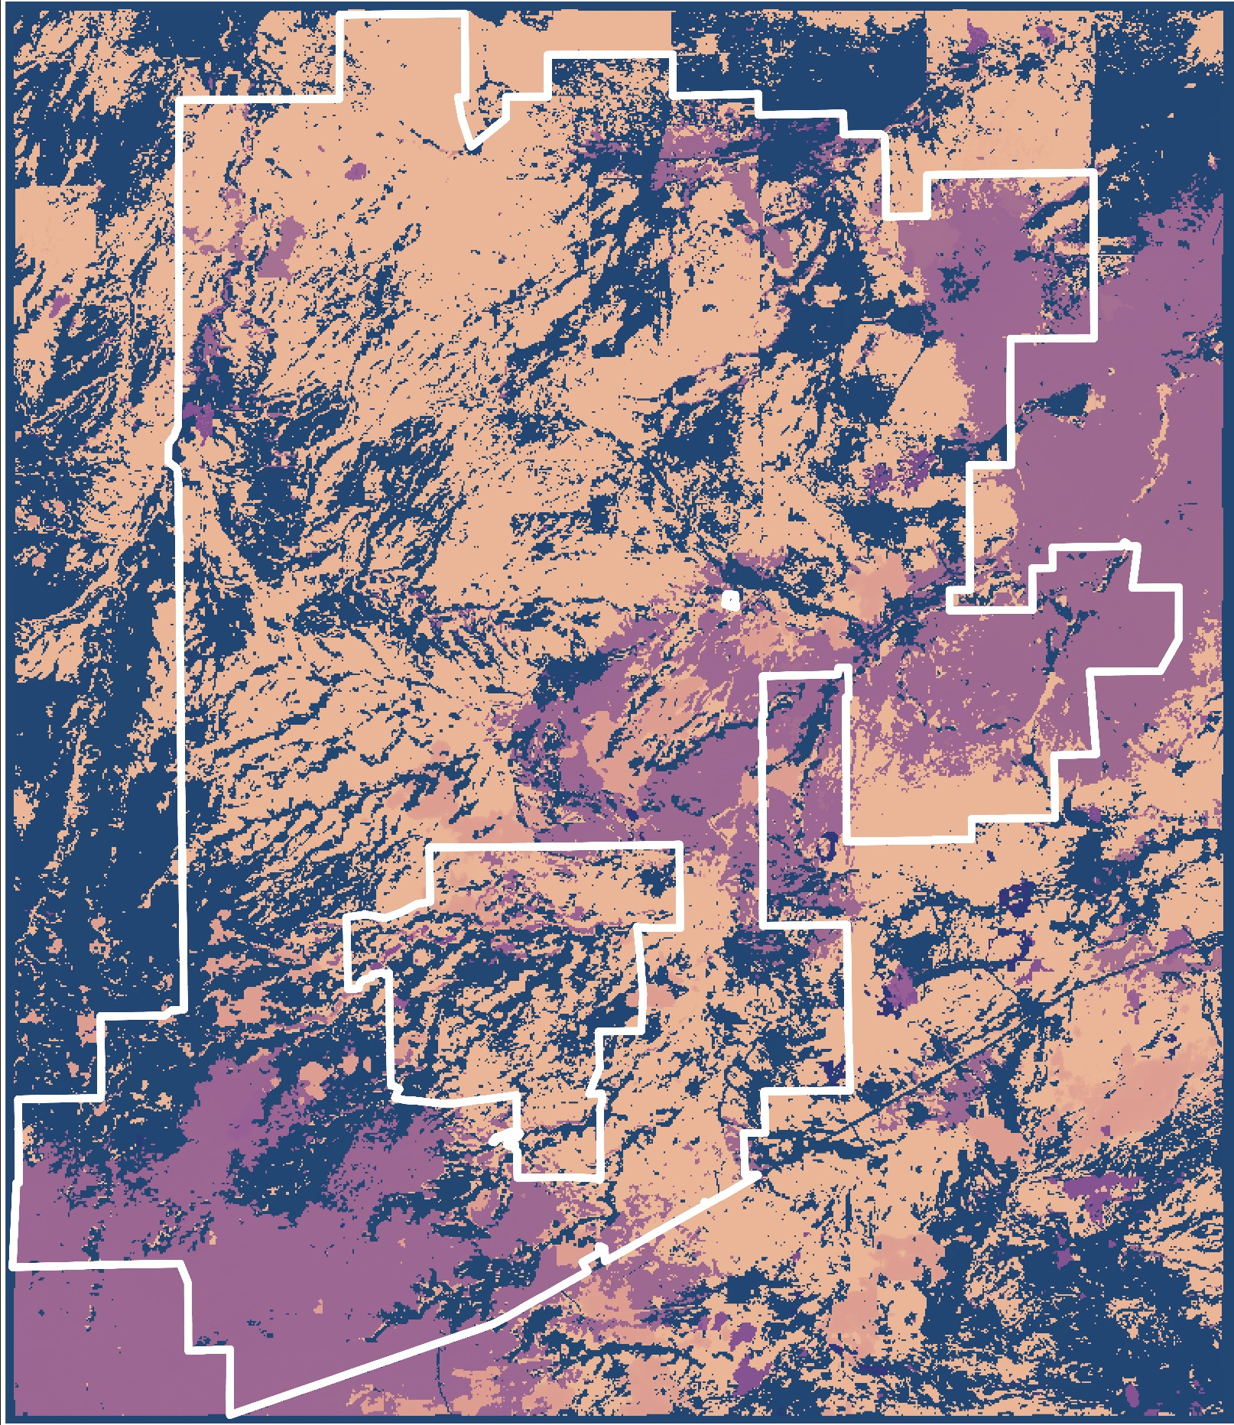
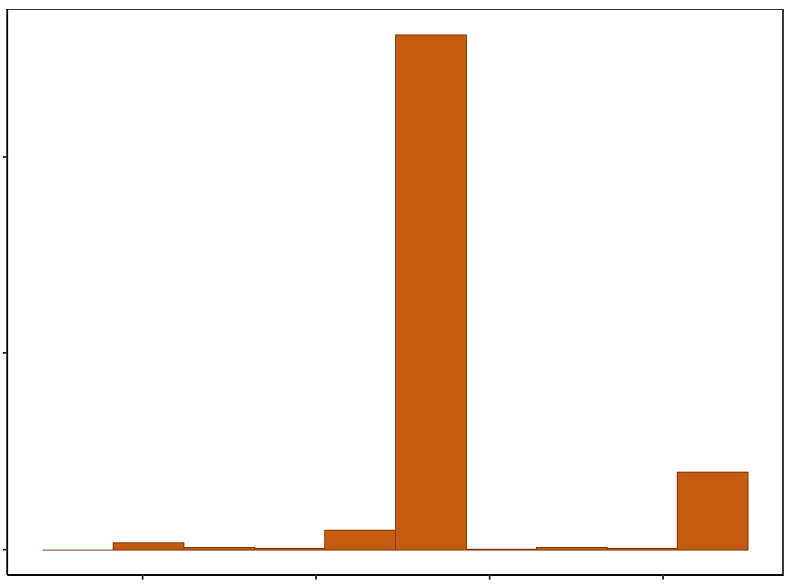
Maximum DOY Analysis
20000
Count
10000
0
275
100
150
200
250
DOY
DOY of Max Biomass
90
Background
Methods
Results
Conclusions
Notes:
Max Annual biomass ARS Map and Date of Max graph
Histogram of the date of the maximum biomass values for 2022 with the grass mass applied
Most values occurring around day 180 or end of June or during peak growing season
Second bump in max date around 260 or middle of September
Corresponds to regrowth of cool season plant

Slide 18
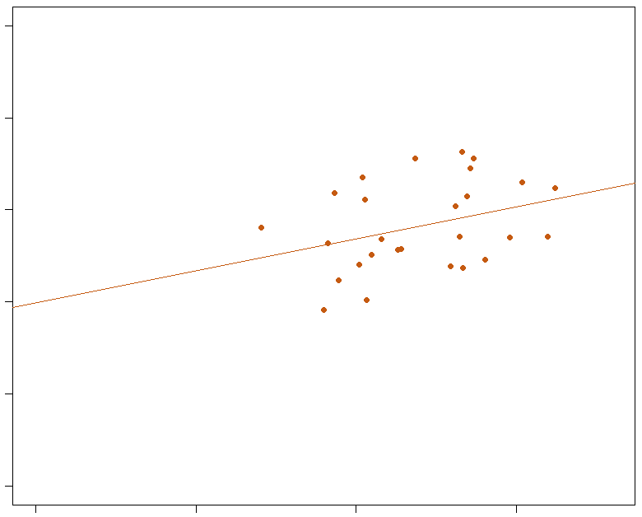
2022 ARS & Field
Data Comparison
1000
800
600
R² | 0.0784
P-Value | 0.0852
y = 0.1384x + 398.9
ARS Daily Biomass (kg/ha)
400
200
0
0
500
1000
1500
VO Biomass (kg/ha)
Background
Methods
Results
Conclusions
Notes:
We compared the visually observed field data collected in 2022 to the daily ARS biomass estimates
Each point was matched based on the day of year in 2022 to the location that the field data was collected
We did not find a significant relationship between the field data and the ARS remotely sensed data
Additional field observations could improve the relationship - There are only 27 field plots represented

Slide 19
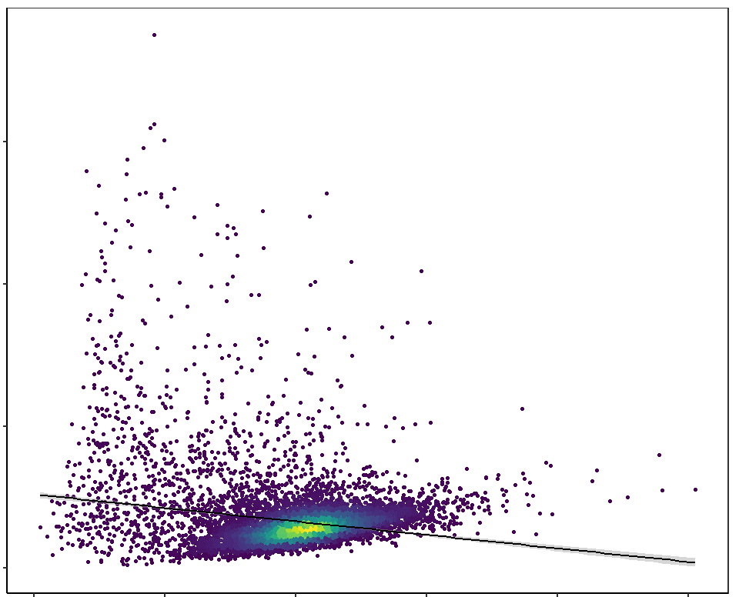
2021 ARS & RAP
Comparison
9000
R² | 0.03512
P-Value | < 0.001
y = -0.56884x + 1560.8
6000
ARS Mean Biomass (kg/ha)
Density of overlapping points
3000
High
0
Low
0
500
1000
1500
2000
2500
RAP Annual Biomass (kg/ha)
Background
Methods
Results
Conclusions
Notes:
Calculated the mean biomass value for every day in 2021 for ARS
Compared to the annual 2021 RAP biomass
Then randomly selected 10,000 pixels from the overlayed raster values
This bright yellow colors in the scatter plot represent high density of overlapping points
We found the two biomass estimates have a statistically significant relationship
Important to note these do not mask out the non-grassland vegetation types so the high biomass values are still represented in this figure

Slide 20
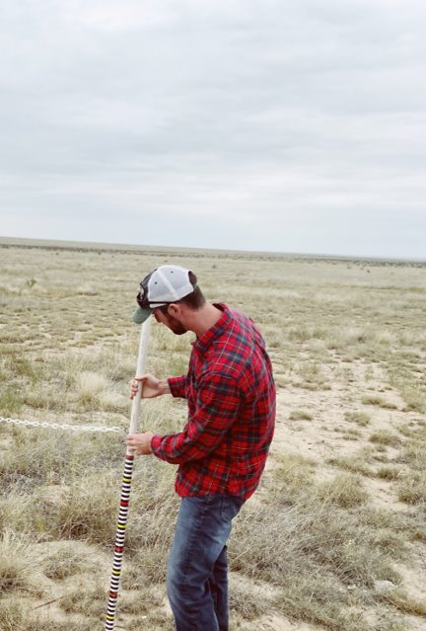
Conclusions – Key Findings
ARS and RAP have a statistically significant relationship to each other
LANDFIRE mask helps in the analysis of specific vegetative cover types
There is not a strong relationship between the 2022 field data and the 2022 ARS biomass values.
Background
Methods
Results
Conclusions
Notes:
ARS and RAP show a relationship between their biomass calculations.
This was apparent when we had a higher sample size of 10,000 vs. The field collected plots
Highlights the potential to use either product for a similar analysis
LANDFIRE cover type layers were useful in targeting specific vegetation types of interest, this project focused on grasslands that would be used for foraging.
There was not a strong relationship between the individual plot field collected data and the ARS biomass model. This could be due to the small sample size.
Photo taken by DEVELOP CO Eastern Plains Disasters team

Slide 21
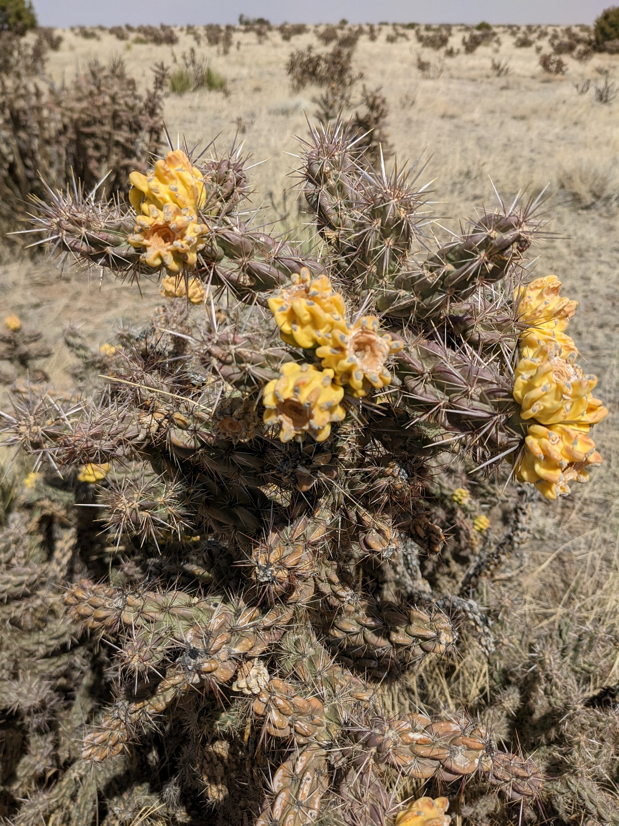
Caveats
LANDFIRE vegetation classes
Based on national datasets
May not include all vegetation types
Custom vegetation masks may be needed
Biomass Models include vegetation that are not used for foraging
Time Period – Growing Season
Deeper analysis on which dates growing season starts and ends
Background
Methods
Results
Conclusions
Notes:
LANDFIRE vegetation classes are made at a national scale. They may not be specific enough to pull out individual vegetation types of interest.
ARS and RAP biomass rasters include all vegetative biomass, and can provide a challenge to isolate specific ones.
Vegetation masks can be refined for higher accuracy
We limited the time range from April to October, may be a more accurate date range to be derived
Photo taken by DEVELOP CO Eastern Plains Disasters team

Slide 22
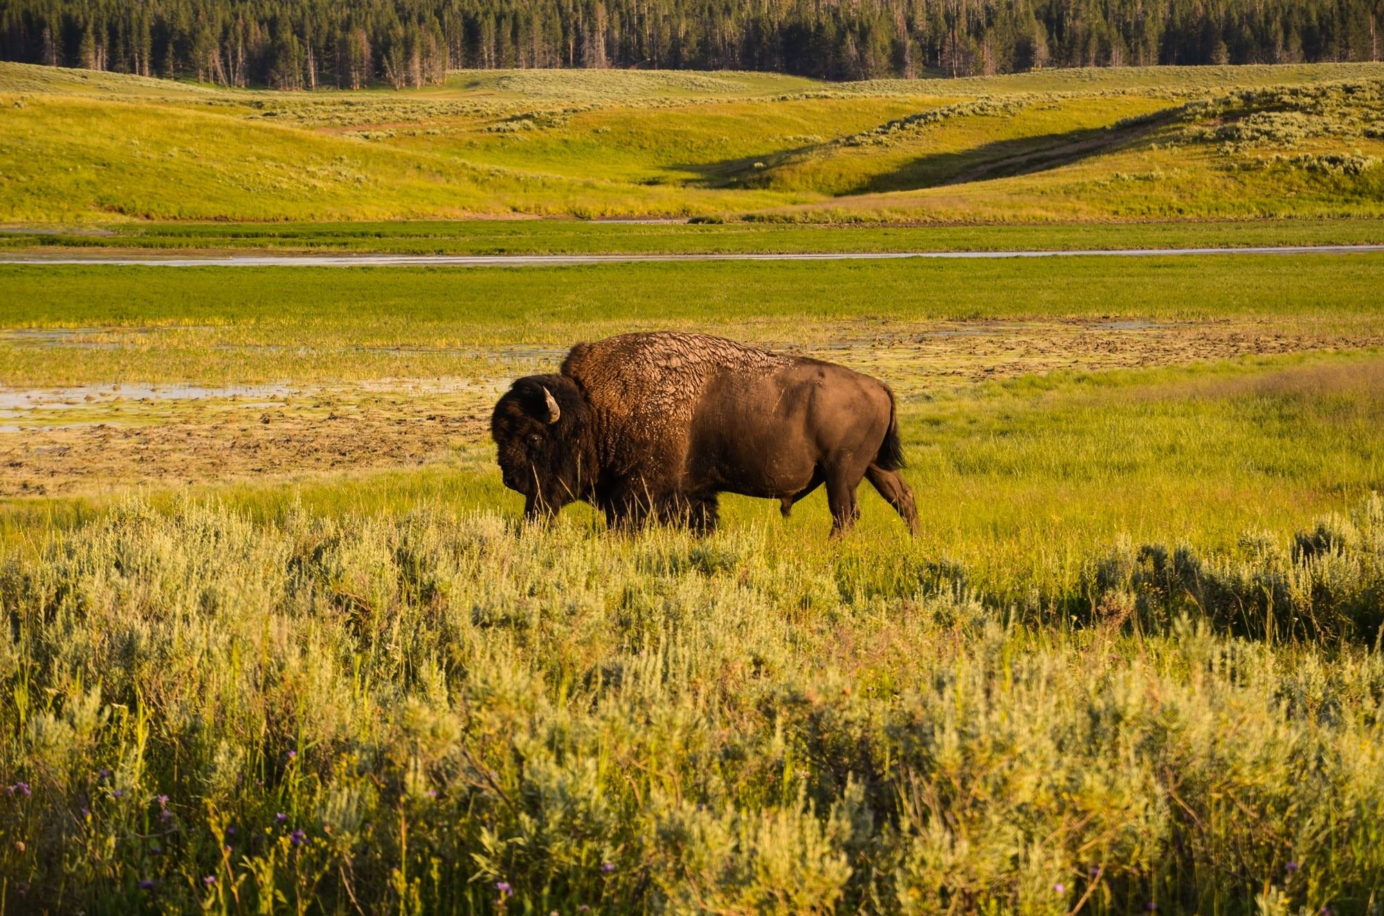
Future Work
Utilization of LANDFIRE to mask out vegetation types based on region
Combining virtual fencing with remote sensing for rangeland management
Application of virtual fencing to more farms, bison management, etc.
Image Credit: Pix4Free
Background
Methods
Results
Conclusions
Notes:
This work lays the foundation for the next DEVELOP project the following term. Our data and methodology can be build upon to further enhance the biomass estimations. Additionally, this methodology can be applied to other test sites, such as bison rangeland monitoring. LANDFIRE layers can be used to filter out vegetation types for specific regions of interest.
Bison picture
Image Credit: Pix4free
Image Source: Free yellowstone national park bison plain forest animal - Image (pix4free.org)
CCO (public domain)

Slide 23
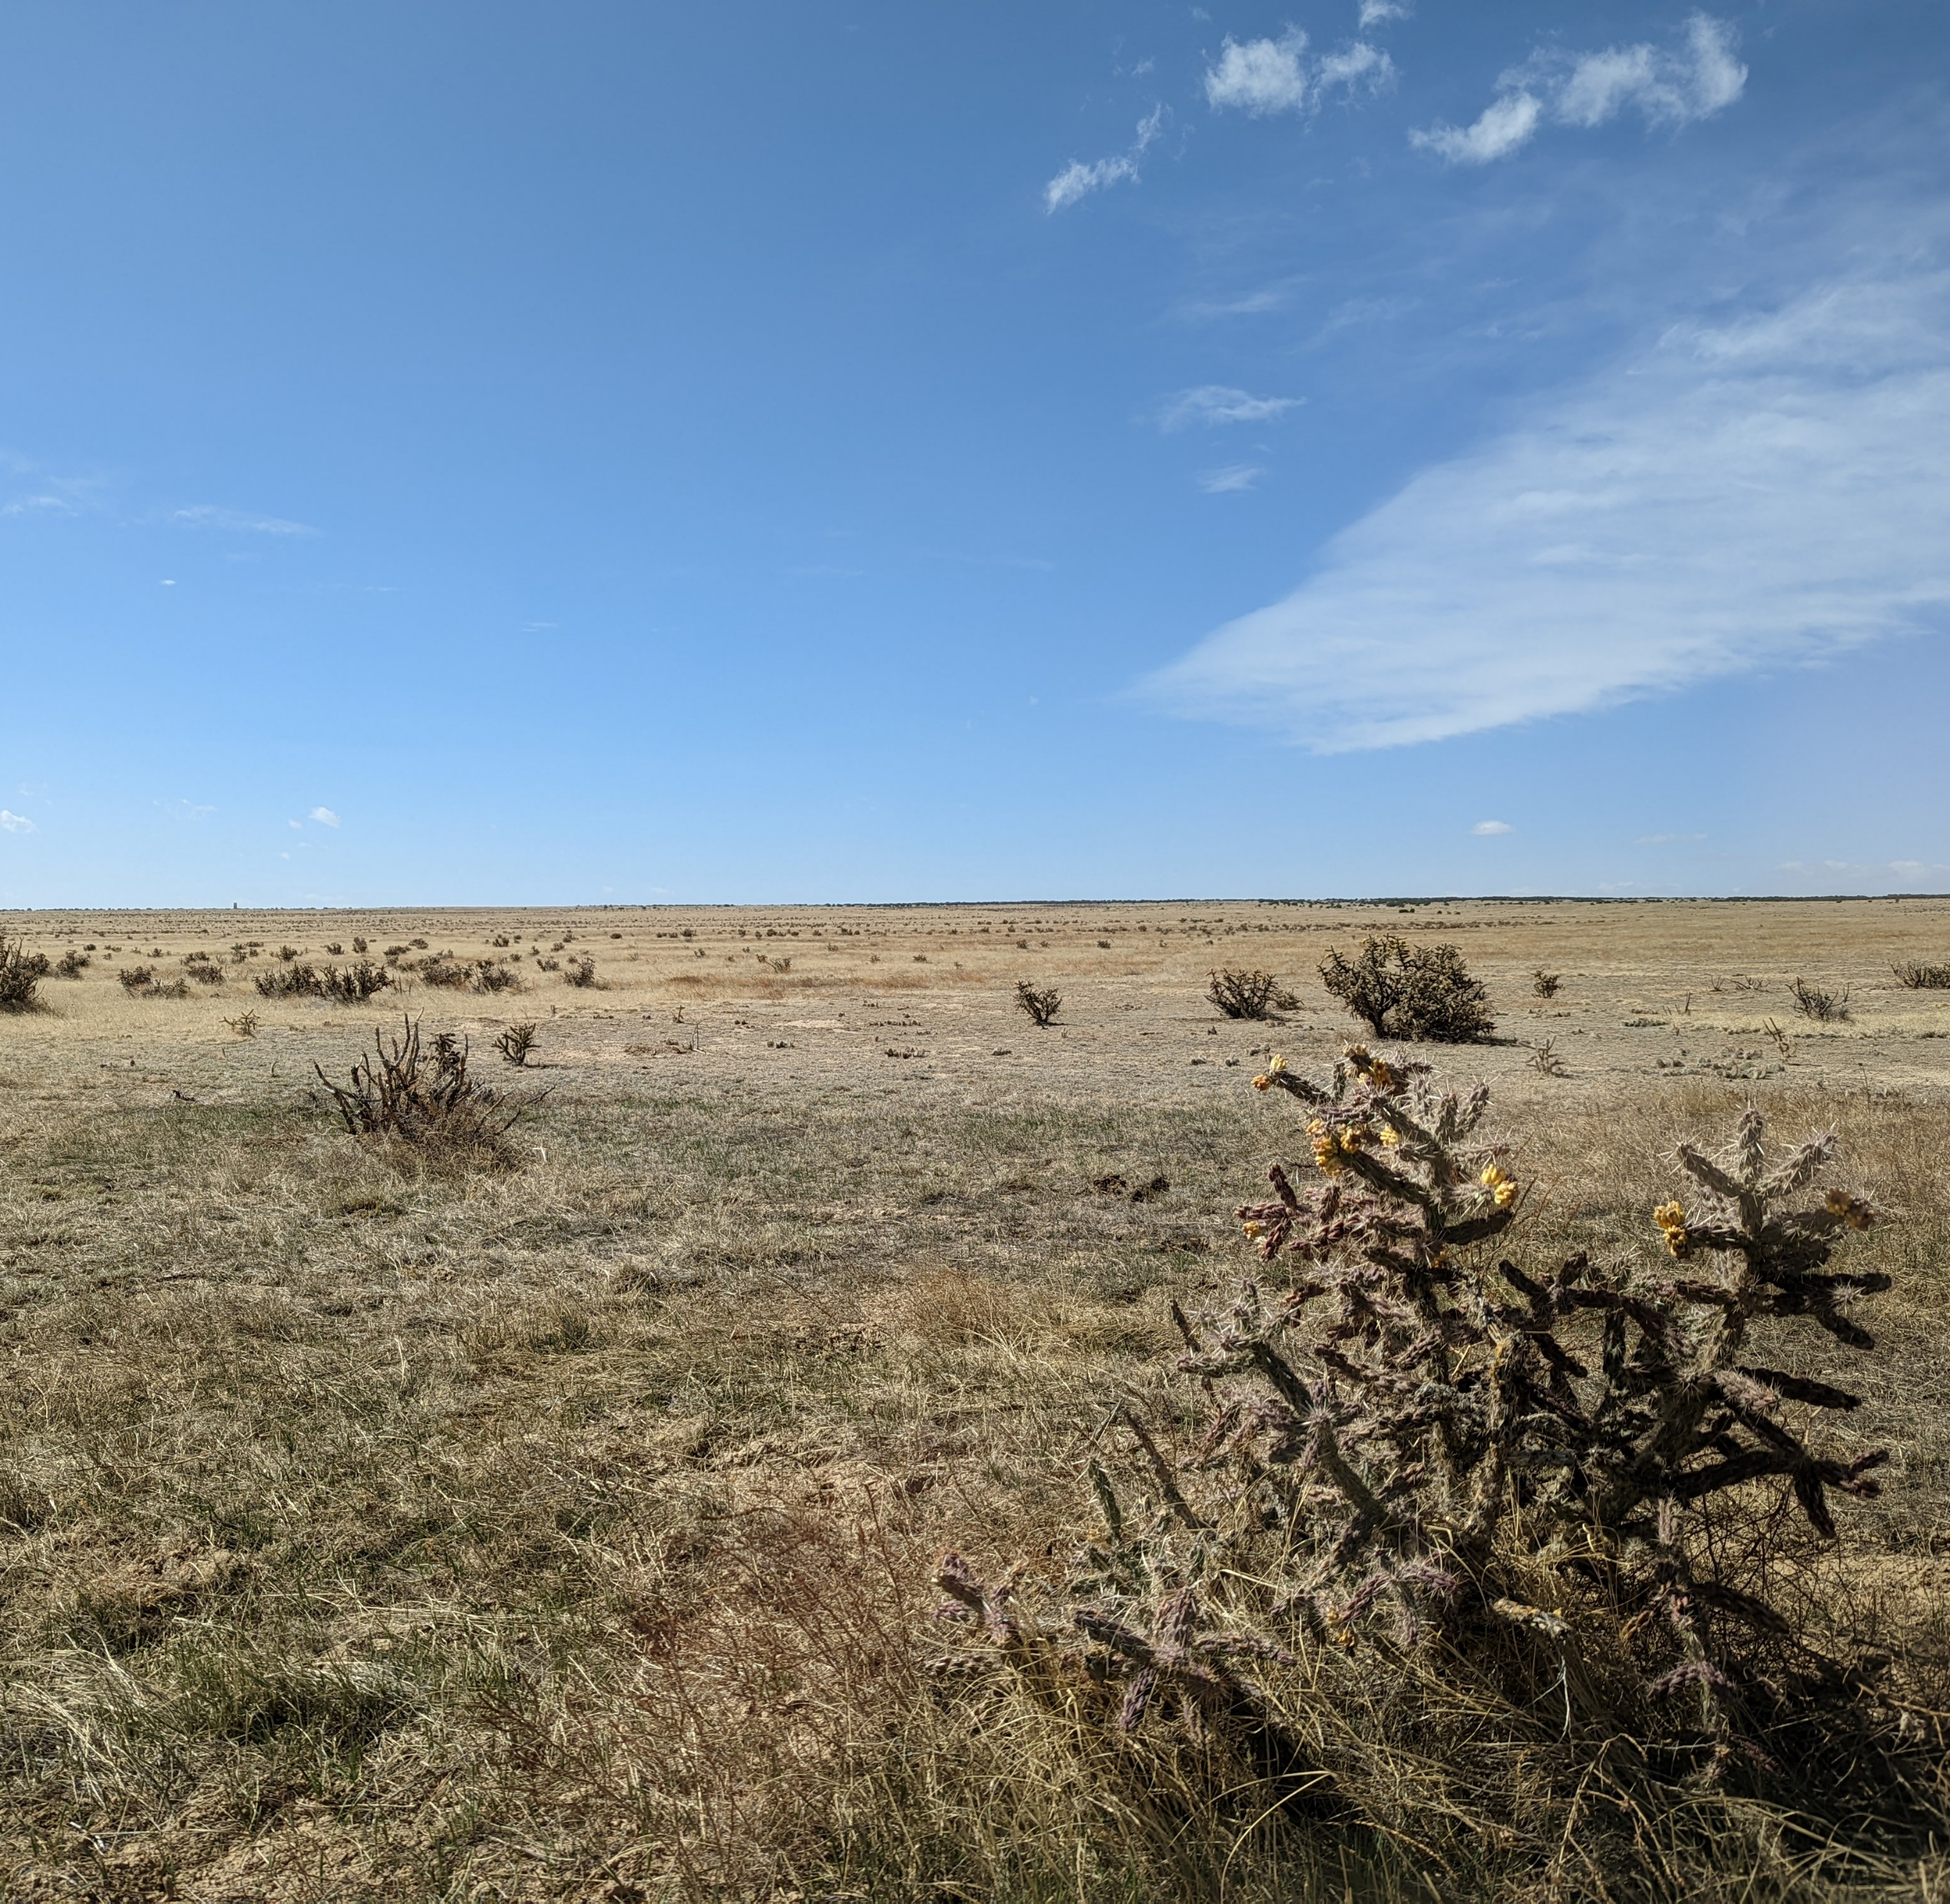
Questions?
Notes:
Photo taken by DEVELOP CO Eastern Plains Disasters team

Slide 24
Science Advisors/Mentors
Tony Vorster (Colorado State University, NREL)
Nick Young (Colorado State University, NREL)
Chris Choi (Colorado State University, NREL)
Peder Engelstad (Colorado State University, NREL)
Paul Evangelista (Colorado State University, NREL)
Catherine Jarnevich (USGS, Fort Collins Science Center)
Field Data Collection
Miles Innes (Colorado State University, NREL)
Grace Coughlin (Colorado State University, NREL)
Makela Riordan (Colorado State University, NREL)
Partners
Davie Brooks (Red Top Ranch)
Bo Boatright (Red Top Ranch)
Rye Austin (Red Top Ranch)
Tegan May (The Nature Conservancy)
JJ Autry (The Nature Conservancy)
William Burnidge (The Nature Conservancy)
ARS Data
Sean Kearney (USDA ARS)
David Augustine (USDA ARS)
Lauren Porensky (USDA ARS)
Additional Support
TR Ingram (NASA DEVELOP National Program)
Max Stewart (NASA DEVELOP National Program)
Notes:
For field data collection : Miles Innes, Grace Coughlin and Makela Riordan
For ARS data and plot design: Sean Kearney, David Augustine, Lauren Porensky
Davie Brooks, Bo Boatright, Rye Austin (note that it is Rye with an “e”), William Burnidge

