Slide 1
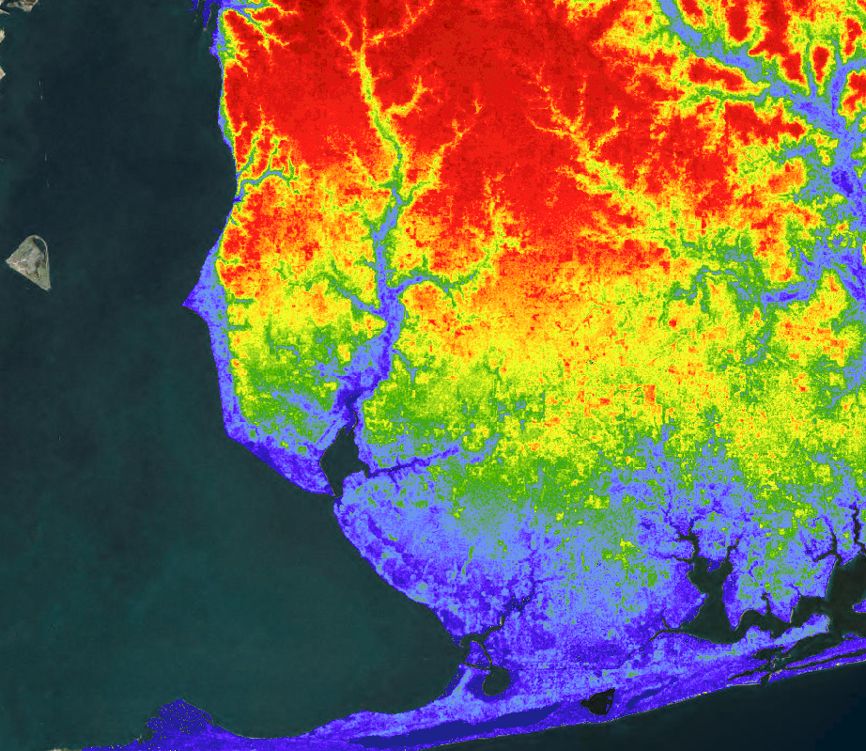
WEEKS BAY WATER RESOURCES
Using NASA Earth Observations to Evaluate Changes in Water Quality in the Weeks Bay Watershed
Vanessa Van Auken (Project Lead)
Dillon Blankenship
Michelle Carver
Ara Metz
Mobile - AL| Spring 2019
Notes:
Weeks Bay Water Resources, Alabama- Mobile node. Center lead: Madison Murphy, Fellow: Kathrene Garcia, Project lead: Vanessa Van Auken, Team members: Dillon Blankenship, Michelle Carver, Ara Metz
Photo- needs to be updated to one of ours!

Slide 2
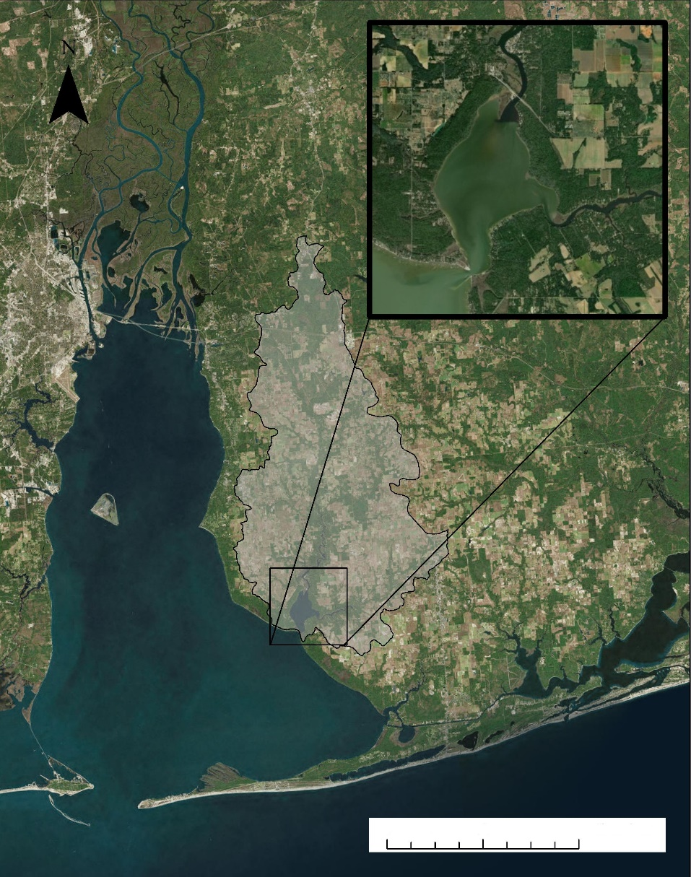
Study Area & Period
Weeks Bay
Weeks Bay Watershed
The Weeks Bay Watershed is located on the easter side of Mobile Bay off the Gulf of Mexico in southern Alabama.
Area: 498.425 km²
Time period : 2014-2018
Population increase has been trending in this area since 2010.
Weeks Bay Estuary
Weeks Bay Watershed
0
5
10
20
km
Notes:
For our study area and time period, we looked at the Weeks Bay Watershed located in Baldwin County, Alabama (point to watershed on map). The Weeks Bay watershed encompasses approximately 498.425 square kilometers and covers roughly 9.5% of Baldwin County. For our study period we analyzed data from 2014-2018, this analysis allowed us to look at the most recent data provided.
Map: Vanessa
Source: ESRI, Digital globe, GeoEYE, Earthstar, Geographics, CNES/ airbus DS, USDA, USGS, AeroGRID, and the GIS User

Slide 3
Community Concerns
Water Quality Degradation
Rapid Urban Development
Land Cover Conversion
This Photo by Unknown Author is licensed under CC BY-SA-NC
This Photo by Unknown Author is licensed under CC BY-SA
This Photo by Unknown Author is licensed under CC BY
Notes:
During our partner meeting we discussed what the major implications for the Weeks Bay watershed, the 3 areas of main concern were water quality degradation, rapid urban development, and land cover conversion. These community concerns have played a large role on the surrounding ecosystems.
Image 1- https://fromthepews.blog/2010/07/14/marriage-is-not-for-wimps/ (Found through online photo option in PowerPoint)
Image 2- https://en.wikipedia.org/wiki/List_of_tallest_buildings_in_Mobile,_Alabama (Found through online photo option in PowerPoint)
Image 3- https://www.eea.europa.eu/themes/landuse (Found through online photo option in PowerPoint)

Slide 4
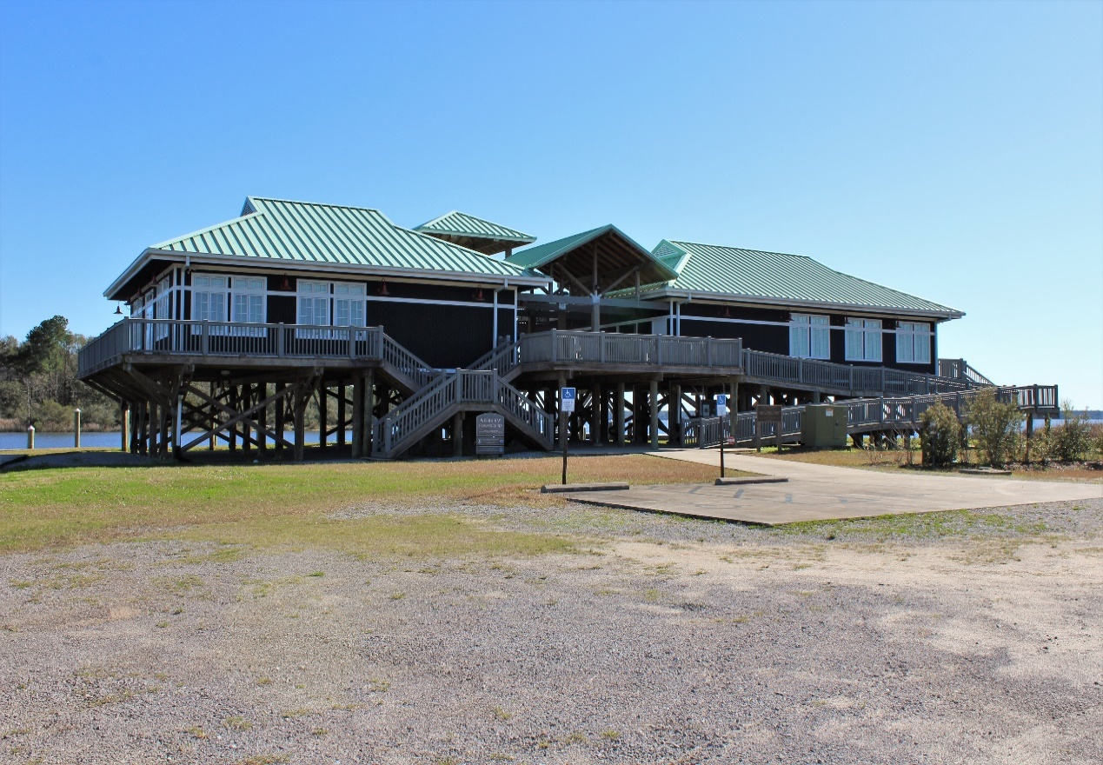
Project Partners
End User
Alabama Department of Conversation and Natural Resources, Weeks Bay National Estuarine Research Reserve (NERR)
Notes:
For this project we partnered with the Alabama department of Conservation and Natural Resources, Weeks Bay National Estuarine Research Reserve. The Weeks Bay National Estuarine Research Reserve promotes stewardship and conservation efforts for the Weeks Bay estuary through community outreach.
Photos: Ara

Slide 5
Objectives
Demonstrate how to collect data from NASA Earth observations to contribute to the knowledge base of the Weeks Bay NERR
Conduct a comparative analysis of a pervious SWAT model derived from in-situ data to a SWAT model informed primarily by NASA Earth observations
Identify sub-watersheds of special concern for prioritizing conservation efforts aimed at improving water quality in Weeks Bay
Notes:
To provide Weeks Bay with valuable information we determined 3 objectives. The first objective was to do a comparative analysis of the Weeks bay watershed. This analysis compared a pervious SWAT model to one derived from NASA Earth observations. The second objective was to demonstrate how this data was collected from NASA EO and how this information could be added to the knowledge base for the Weeks Bay research team. Lastly, we identified the sub-watershed basins that are of major concern and should be prioritized for conservation efforts.

Slide 6
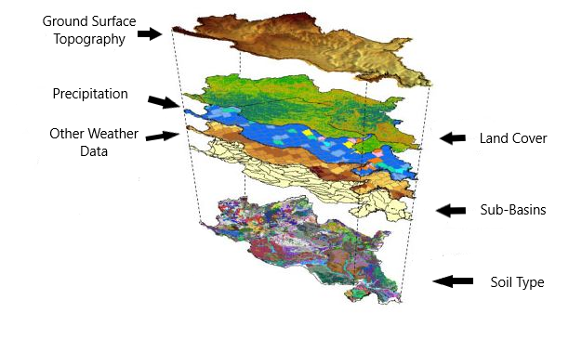
SWAT Model
SWAT Model is a soil and water assessment tool which is used to simulate water quality and quantity.
ArcMap extension
Image: University of Chicago Swift Case Studies on Hydrology
Notes:
The SWAT model (Soil and Water assessment tool) is used to model the water quality and quantity of a hydrological area. The inputs for the SWAT model are ground surface topography, land cover, soil type, Sub-Bains, precipitation, and other climatic data. To do a comparative analysis, in situ data was put into SWAT and compared to NASA Earth observation derived data.
Image from: http://swift-lang.org/case_studies/Hydrology.php

Slide 7
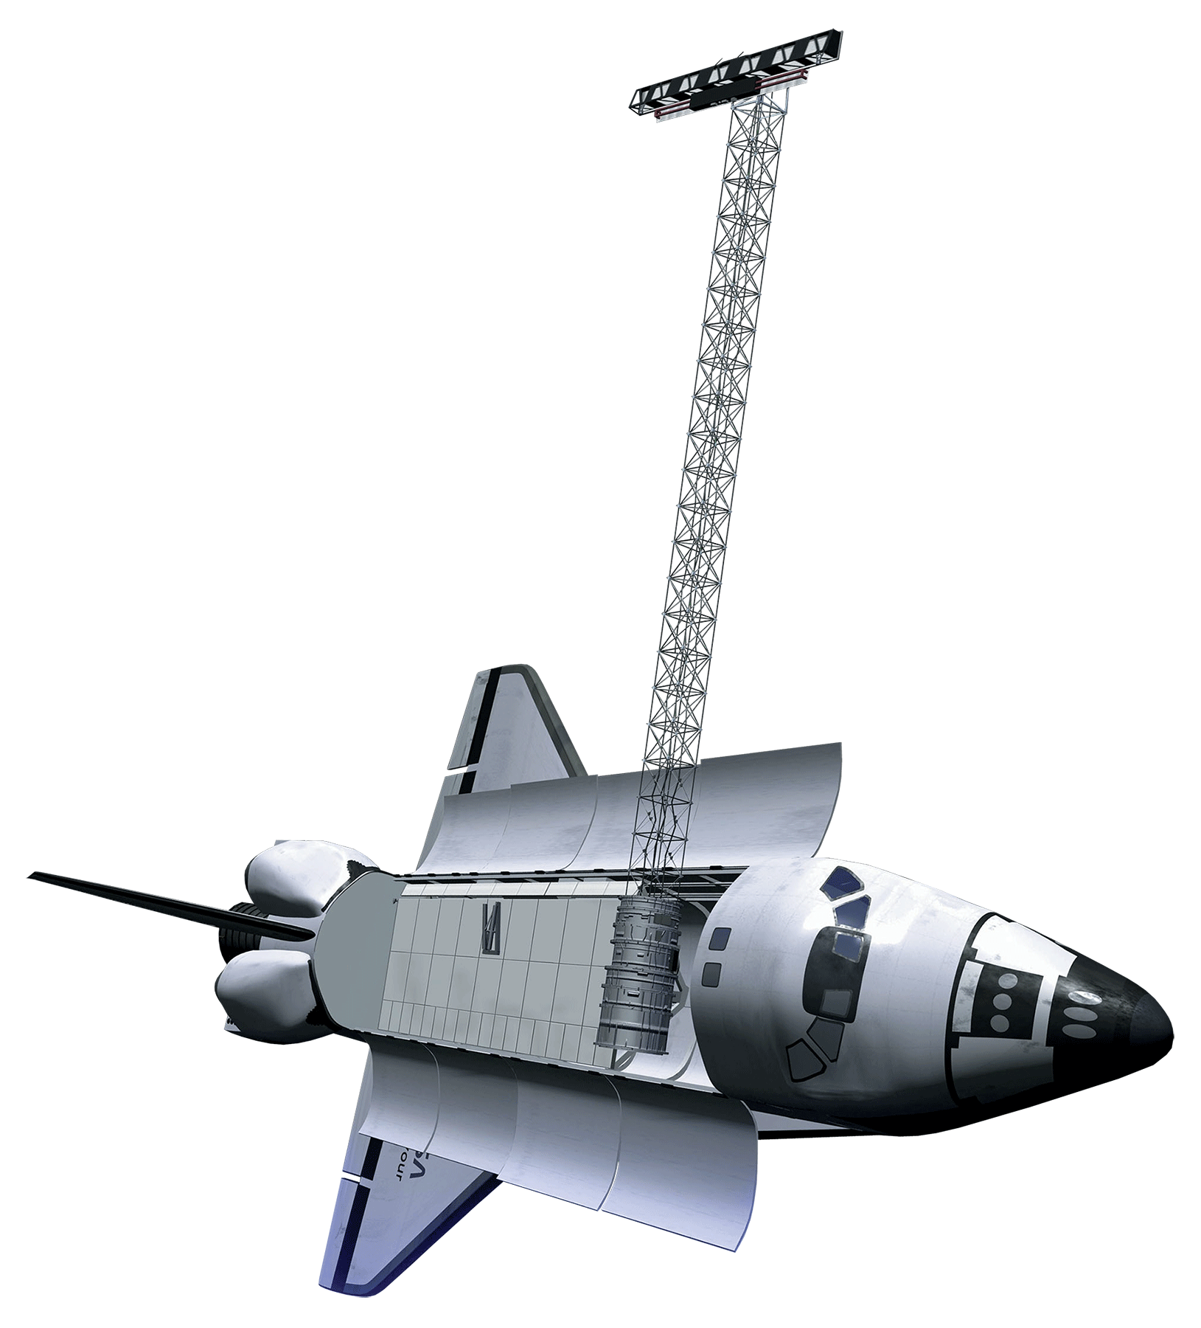
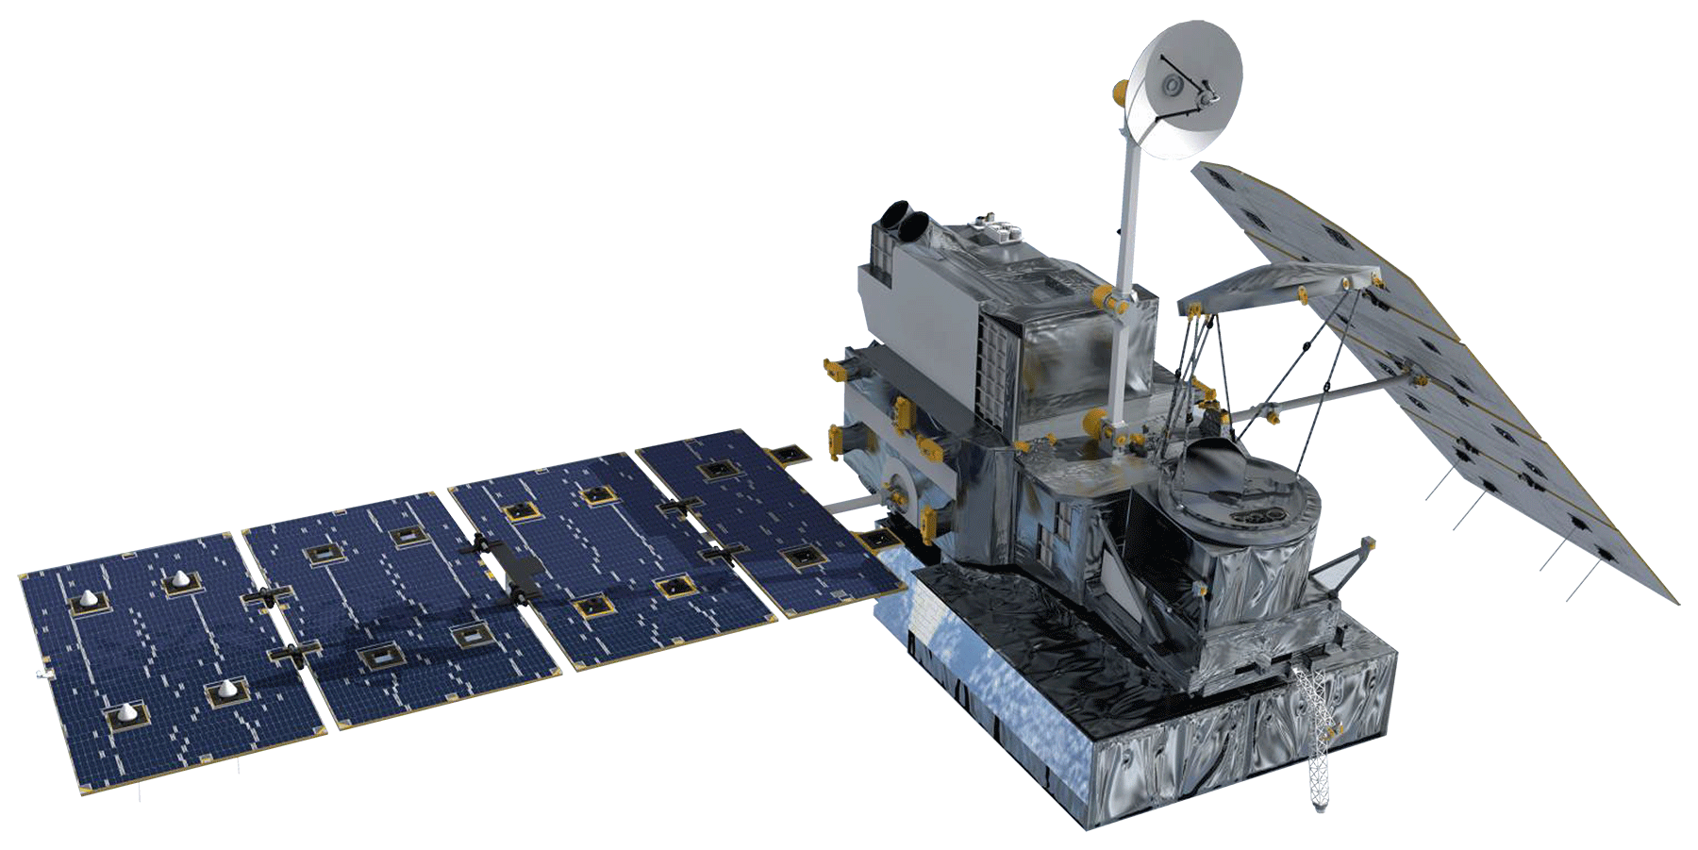
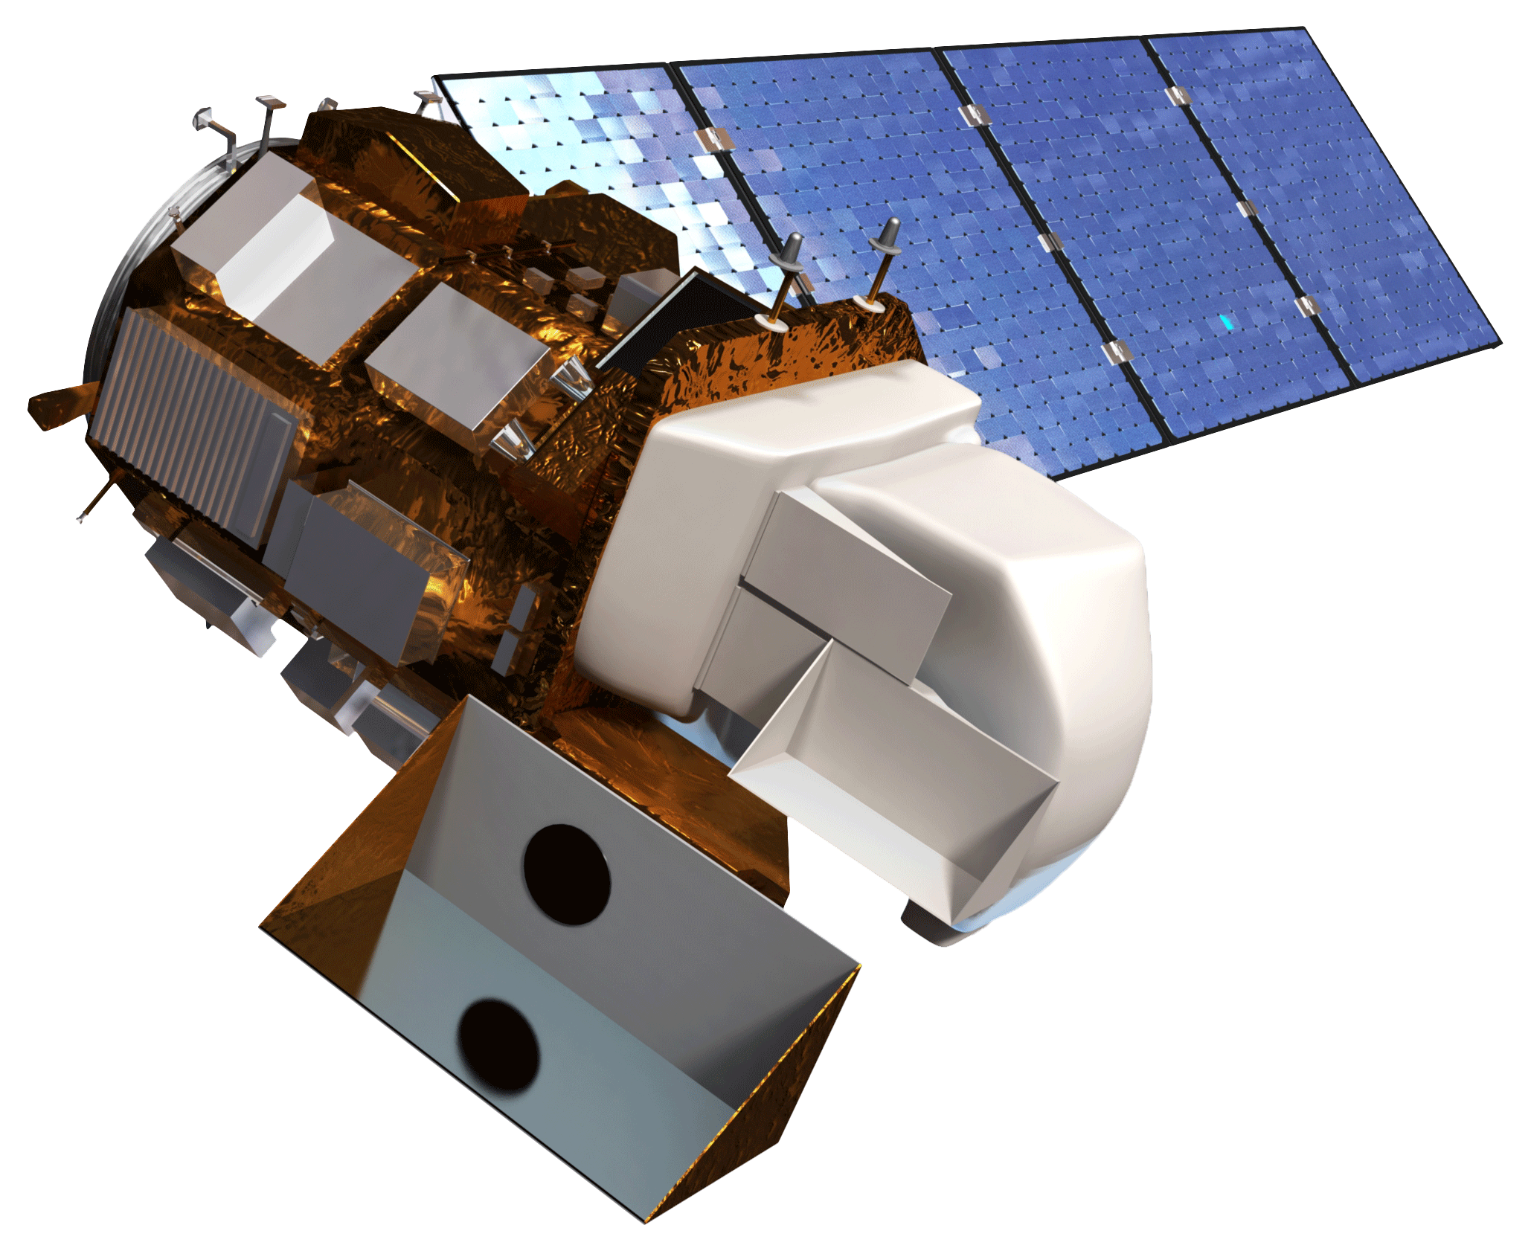
Sensors Used
GMP IMERG
Landsat 8 OLI
SRTM
Precipitation
Surface Reflectance
 Digital Elevation Model
Images from NASA
Notes:
In order to do a comparative analysis, we utilized 3 NASA derived sensors. The utilization of these sensors gave us the parameters needed to run the SWAT model. We obtained precipitation data from GMP IMERG, surface reflectance data from Landsat 8 OLI, and Digital Elevation data from SRTM.
GPM: http://www.devpedia.developexchange.com/dp/images/1/14/08_GPM.png
Landsat: Landsat 8 OLI: http://www.devpedia.developexchange.com/dp/images/c/c2/03_Landsat8.png
SRTM: SRTM: http://www.devpedia.developexchange.com/dp/images/a/ab/12_SRTM.png

Slide 8
Ancillary Datasets
Data used for Validation & Calibration
Land Cover: National Land Cover Database
In Situ Water Quality Measurements: National Estuarine Research Reserve (NERR), Centralized Data Management Office (CDMO), Alabama Water Watch
Water Quantity: USGS National Water Information System
Data Used for SWAT Input
Soil Data: United States Department of Agriculture &Natural Resources Conservation Service (USDA- NRCS)
Weather Data: Texas A&M SWAT Database
Data Used for Comparison
Inputs for previous SWAT Model: Thompson Engineering Firm
Notes:
Other datasets that were used for calibration and verification of the SWAT model derived from NASA Earth observations. In addition, the original input data for the comparative analysis was provided to us by Thompsons Engineering.

Slide 9
Methodology
DATA
ANALYSIS
MODEL
NLCD
Land Cover
Sub-watershed Endangerment Zone
Map
Hydrological Response Units (HRU)
USDA-NRCS
Soil Type

NOAA C-Cap
Land Cover
Seasonal Variation
Graphs
SRTM
Digital Elevation Model
Delineate Watershed
GPM IMERG
Precipitation
SWAT Model Projection with 2040 Land Cover Map
Streamflow & Discharge
Texas A&M SWAT Database
Weather Data
Comparative Analysis Report of NASA EO-Derived SWAT to non- NASA
NERRS, CDMO, Alabama Water Watch
In Situ Data
Calibration & Validation
Notes:
In order to the run the SWAT model, these datasets were used as inputs. To determine the hydrologic response units (HRU), land cover data and soil type were chosen as main inputs. Using the digital elevation model acquired from SRTM, the watershed was delineated. The delineation was done in ArcSWAT based on the digital elevation model provided. Inputs like precipitation data derived from GPM IMERG and weather station data were used to create a streamflow and discharge model. Lastly, in situ data derived from NERR, CDMO, and Alabama Water Watch were used to calibrate and validate the NASA EO derived SWAT model.
These models were than used for analysis of sub-watershed endangerment zones, seasonal variation graphs, SWAT projection land cover map, and comparative analysis report of NASA EO SWAT to non-NASA SWAT.

Slide 10
End Products
Sub-watershed Endangerment Zone
Map
Seasonal Variation
Graphs
SWAT Model Projection with 2040 Land Cover Map
Comparative Analysis Report of NASA EO-Derived SWAT to non- NASA
Notes:
For our end products we have created seasonal variation graphs of water quality and quantity. In addition to variation graphs, we created a sub-watershed endangerment zone map to highlight areas of major concern around Weeks Bay estuary. For statistical analysis we created a comparative analysis report, to show to the difference in SWAT models derived from NASA Earth observations to a model derived from in situ collection methods. Lastly, using the SWAT model projection we created a 2040 land cover map.

Slide 11
Statistical Variation Graph
Work in progress
Notes:
Graphs of statistical variation
SECTION IN PROGRESS

Slide 12
Sub-watershed Endangerment Zone Map
Work in progress
Notes:
Map of endangered areas created from sub-watershed information.
SECTION IN PROGRESS

Slide 13
SWAT Model Projection with 2040 Land Cover Map
Work in progress
Notes:
A 2040 land cover map derived from the SWAT model projection
SECTION IN PROGRESS

Slide 14
Limitations
Some of the NASA data used was spatially coarse (e.g., GPM IMERG) and may not be optimal for the size of the watershed that was studied.
Work in progress
Notes:
One of the limitations determined in this project was the size of the study area. It was hard finding EO with enough resolution to accurately analyze the watershed.
SECTION IN PROGRESS

Slide 15
Conclusion & Discussion
Work in progress
Notes:
SECTION IN PROGRESS

Slide 16
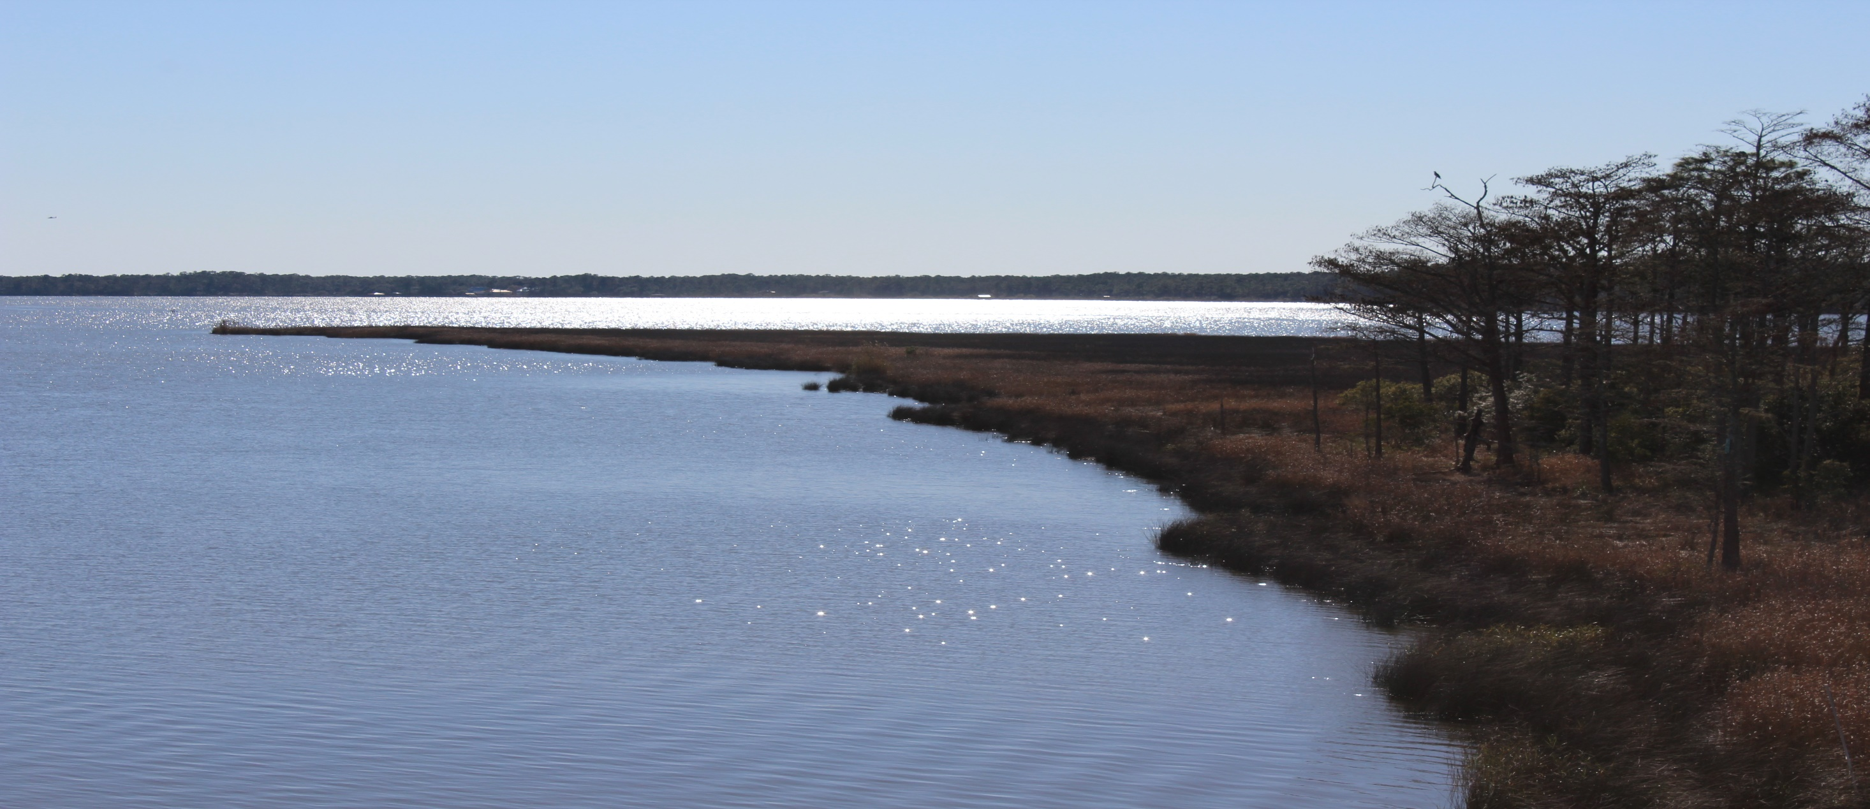
Questions?
Notes:
At this moment we will take time for questions if anyone has some.
Photo: Ara

Slide 17
Dr. Scott Phipps, Weeks Bay National Estuarine Research Reserve
Sarah Johnston, Weeks Bay National Estuarine Research Reserve
Angela Underwood, Weeks Bay National Estuarine Research Reserve
Eric Brunden, Weeks Bay National Estuarine Research Reserve
Joe Spruce, Science Systems Applications Incorporated
Dr. Ibrahim N. Mohammed, Science Applications International Corporation
Dr. Brenard Eichold, Mobile County Health Department
Notes:
We would like to thank all of these individuals for their contribution to this project.

