Slide 1
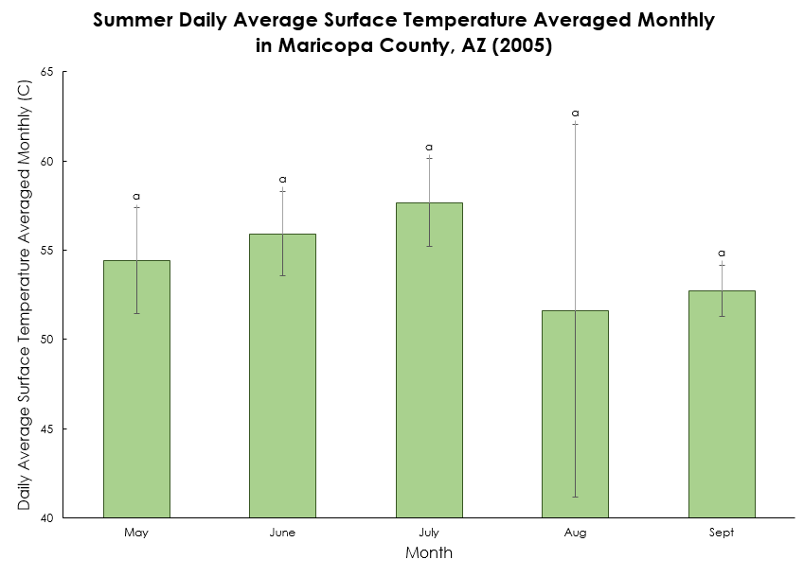
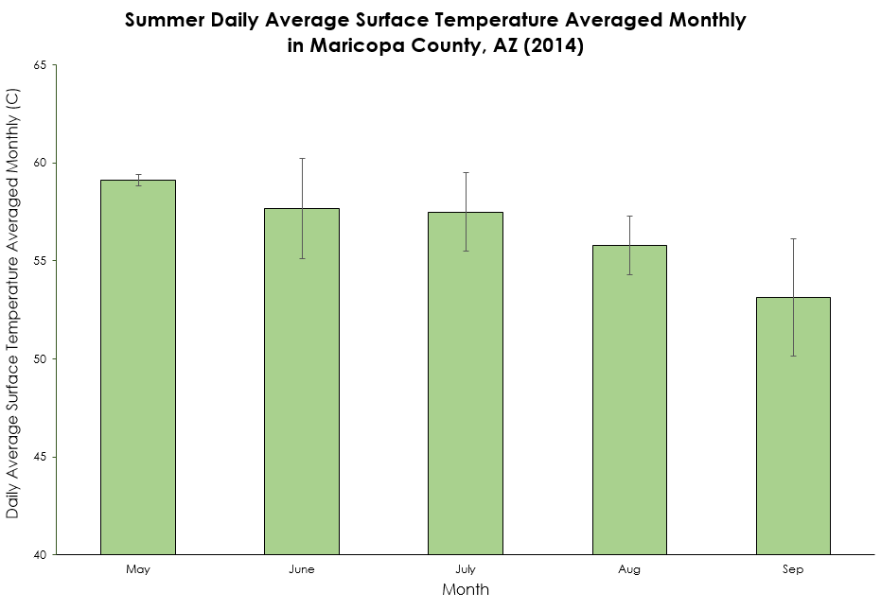
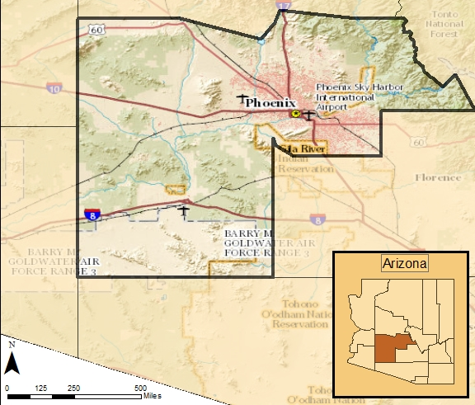
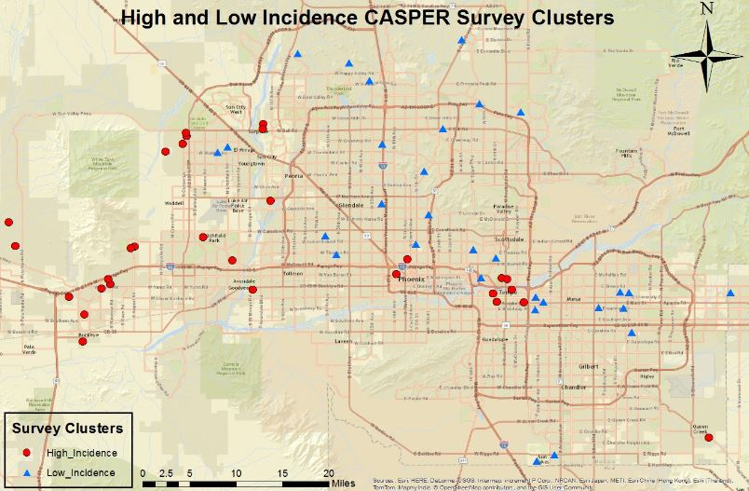
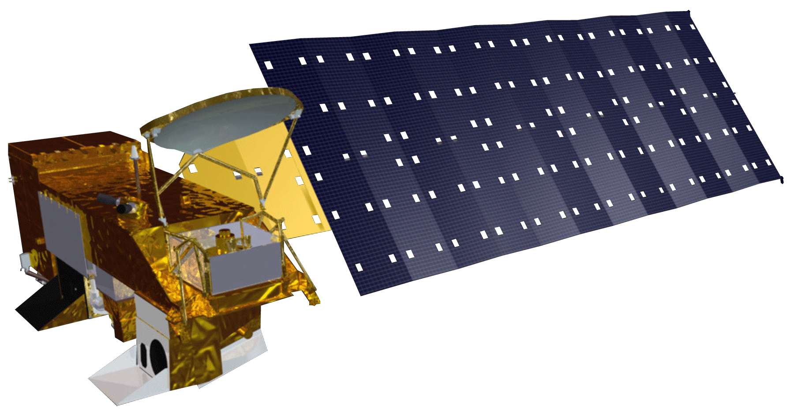
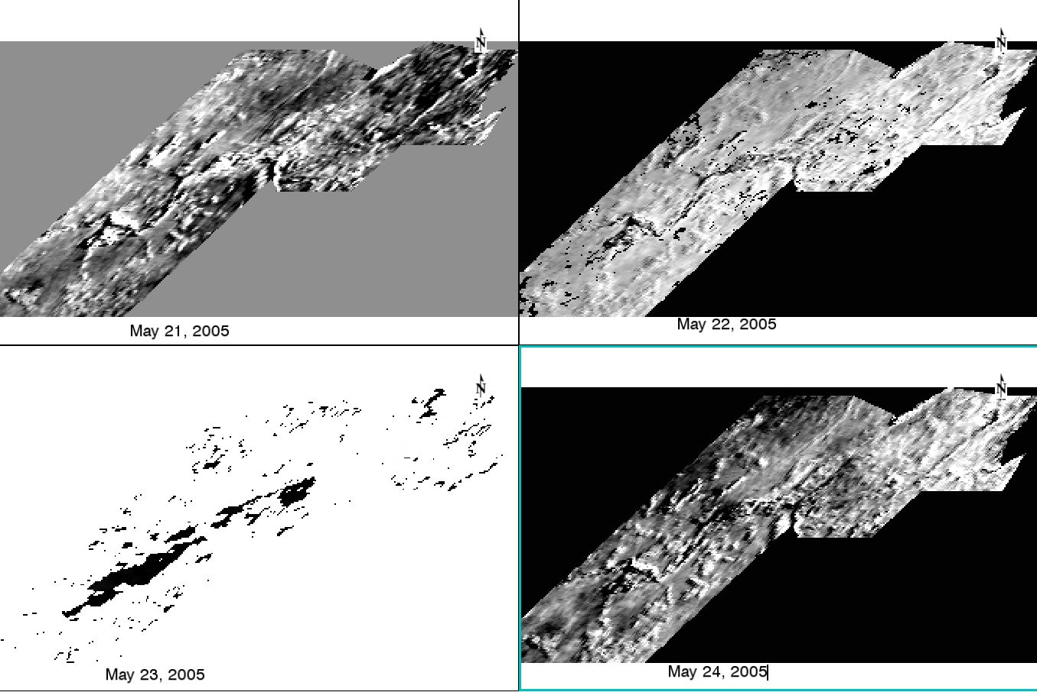
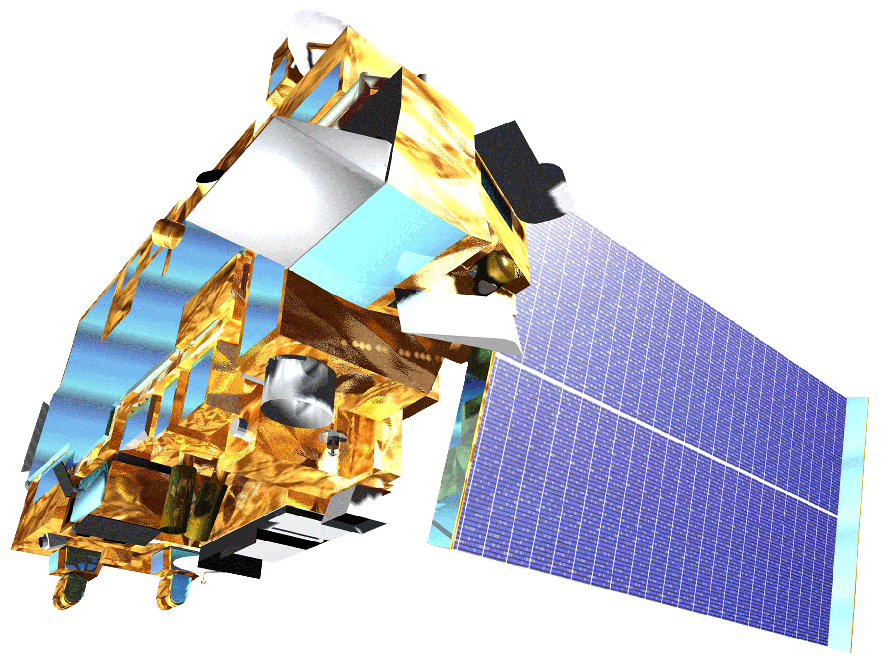
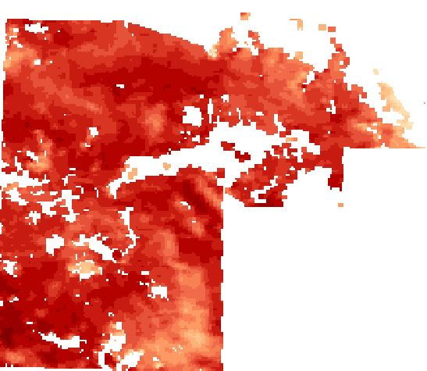
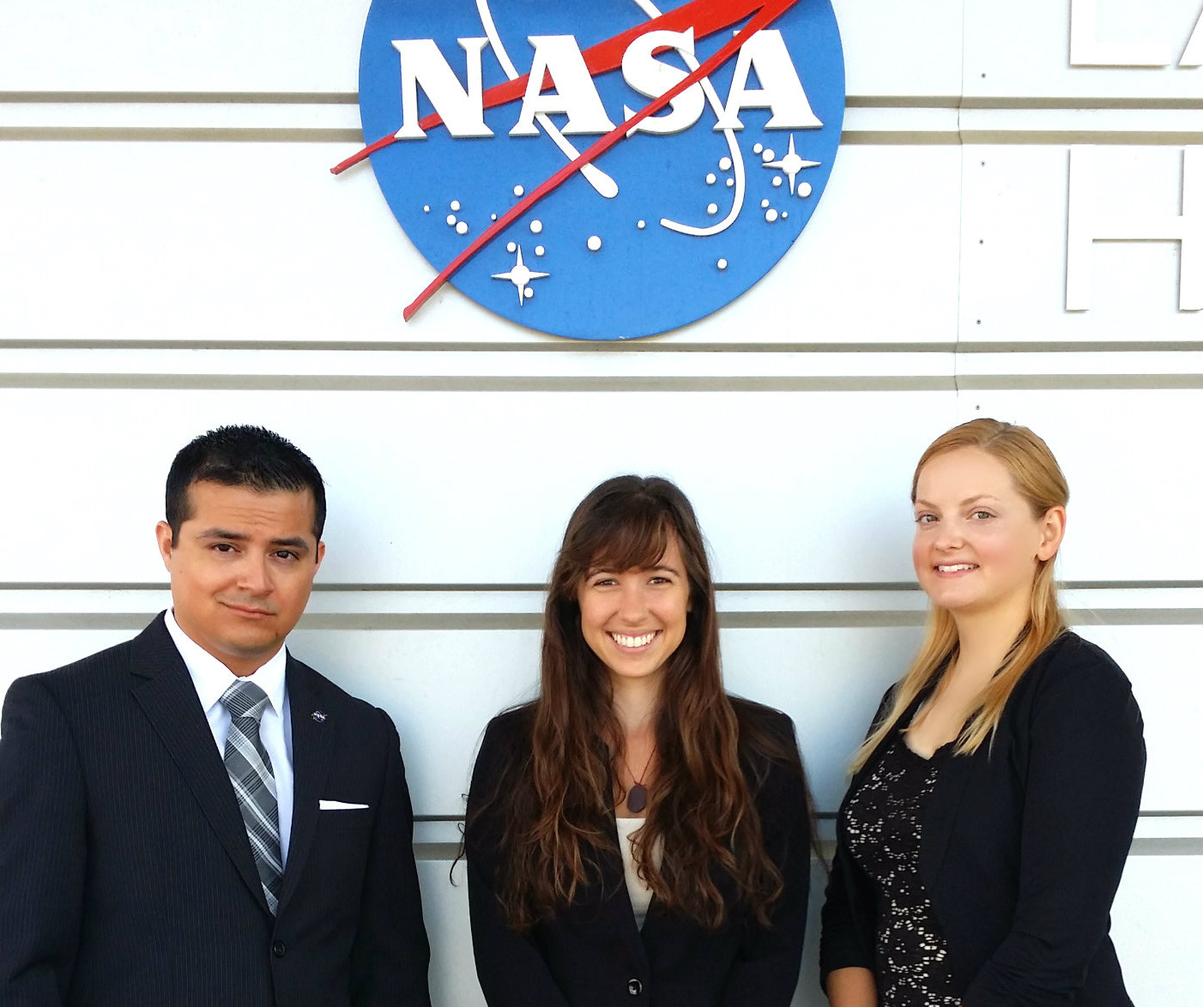
Arizona Health & Air Quality
Enhancing Extreme Heat Intervention and Preparedness Activities in Maricopa County, AZ
Amy Stuyvesant (Project Lead), Geordi Alm, Rocky Garcia, Emma Baghel, April Rascon, Bernardo Gracia
NASA DEVELOP National Program
Objectives
Results
Abstract
Keep this blank for now. Body text point size should be at least 24. Caption text point size should be at least 16. Feel free to rename, move, and resize sections as needed. Keep this blank for now. Body text point size should be at least 24. Caption text point size should be at least 16. Feel free to rename, move, and resize sections as needed. Keep this blank for now. Body text point size should be at least 24. Caption text point size should be at least 16. Feel free to rename, move, and resize sections as needed. Keep this blank for now. Body text point size should be at least 24. Caption text point size should be at least 16. Feel free to rename, move, and resize sections as needed. Keep this blank for now. Body text point size should be at least 24. Caption text point size should be at least 16. Feel free to rename, move, and resize sections as needed. Keep this blank for now. Body text point size should be at least 24. Caption text point size should be at least 16. Feel free to rename, move, and resize sections as needed. Keep this blank for now. Body text point size should be at least 24. Caption text point size should be at least 16. Feel free to rename, move, and resize sections as needed. Keep this blank for now. Body text point size should be at least 24. Caption text point size should be at least 16. Feel free to rename, move, and resize sections as needed. Keep this blank for now. Body text point size should be at least 24. Caption text point size should be at least 16. Feel free to rename, move, and resize sections as needed. Keep this blank for now. Body text point size should be at least 24. Caption text point size should be at least 16. Feel free to rename, move, and resize sections as needed. Keep this blank for now. Body text point size should be at least 24.
Create a climatology map of Maricopa County, Arizona to detect extreme heat anomalies on various scales (i.e. daily, monthly, seasonal) and the consistency among such events (where, how, and why variations between extreme heat events occur).
Determine current use and frequent users of relief resources in order to establish how this correlates with current socioeconomic vulnerability assumptions.
Analyze these anomalies and survey results to determine where, when, and how relief efforts should intervene.
Month | 2005 | 2006 | 2007 | 2008 | 2009 | 2010 | 2011 | 2012 | 2013 | 2014
May | 5 | 7 | 2 | 3 | 4 | 0 | 0 | 6 | 0 | 6
June | 12 | 27 | 20 | 19 | 8 | 19 | 15 | 22 | 29 | 25
July | 28 | 22 | 21 | 25 | 26 | 27 | 24 | 22 | 22 | 25
August | 13 | 13 | 20 | 20 | 24 | 21 | 27 | 20 | 21 | 15
September | 8 | 2 | 12 | 5 | 10 | 18 | 14 | 7 | 11 | 10
Total # of Days | 66 | 71 | 75 | 72 | 72 | 85 | 80 | 77 | 83 | 81
2005
2014
Within a single season, average surface temperature significantly differ between summer months.
Study Area
Summer Daily Average Surface Temperature in 2005
Summer Daily Average Surface Temperature in 2014
Maricopa County, Arizona
Study Period:
May - October
2005-2014
Limitations
Methodology
Earth Observations
1
Processing
Preparing Surface Temperature Data
Aqua MODIS
Surface Temperature Averages
Python, ENVI, Matlab
Used to gather daily surface temperature (1:30 AM/PM passover) data per census tract for statistical comparisons
2
Data Analysis
In addition to door-to-door surveys, provide an environment of randomized surveys to lower bias.
RStudio
One-Way ANOVA for monthly averages 1) within a season and 2) months between years
Cluster Analysis by K function in RStudio over all days of interest
Landsat 8
Cloudy Days
Cluster Analysis
Average Comparisons
Used for refining the spatial resolution of temperature averages over census blocks
Terra MODIS
Nuances within Urban Heat Index
Simply used to compare surface temperature values with Aqua MODIS for accuracy.
3
Survey Analysis
What makes user more or less likely to use relief network
Conclusions
Surface Temperature August 12, 2007
(MODIS/Aqua - MODIS/Terra)
/
(MODIS/Aqua + MODIS/Terra)
Community Health & Emergency Response Survey
Ordered Logistic Regression
There is significant clustering that shifts throughout the season.
Relief efforts should shift correspondingly.
Average values within a month in a season and between a single month throughout the years does significantly vary.
Relief efforts should intensify for a consistently hot July and be prepared for large variability in the early season.
Raw CASPER Results & Ave. Surface Temp.
Our focus was the “what”, “when” & “where” questions of variations in the effects of UHI. Future studies could focus on “why” the heat waves shifts to determine patterns by employing landuse classifications.
Explore long-term solutions (i.e. suitability analysis of strategic solar panel locations).
Dates chosen from MesoWest weather data
Temperature Threshold: 104°F
Binary Logistic Regression
Who uses AC or relief networks
Team Members
Project Partners
Acknowledgements
Arizona Department of Health Services
(ADHS)
Environmental Remote Sensing and Informatics Lab
(ASU ERSL)
Center for Policy Informatics
(ASU CPI)
ADHS coordinates the statewide heat safety task force, for which the Maricopa County Department of Public Health and ASU are active participants, and leads the state’s participation in CDC’s Building Resilience against Climate Effects initiative. Decision support tools and project findings will be shared through statewide heat safety meetings.
Special thanks to our science advisors: Dr. David Hondula (ASU)for his heavy involvement and guidance on this project and to Dr. Kenton Ross (NASA LaRC), providing practical direction and support.
Additional thanks go out to Emily Adams (LaRC Center Lead) and Dan Wozniak (LaRC Assistant Center Lead) for helping our project progress efficiently, as well as to Jeff Ely (SSAI Geoinformation Scientist), whose expertise of the dnppy module made our data processing of large data sets possible.
We would also like to thank a fellow DEVELOP participant Grant Mercer (LaRC), whose python expertise has been invaluable to our team.
Geordi Alm
April Rascon
Rocky Garcia, Amy Stuyvesant, Emma Baghel
Bernardo
Gracia
Langley Research Center

