Slide 1
Gulf of Mexico Water Resources
Utilizing NASA Earth Observations to Detect Factors Contributing to Hypoxic Events in the Southern Gulf of Mexico
Rebecca Chapman (Project Lead)
Alannah Johansen
Irma Caraballo Álvarez
Mackenzie Taggart
Åse Mitchell
Bridget Smith
Notes:
Hi my name is Rebecca Chapman, and I am the team Lead on this project. I recently graduated from Clark University with a BA in Geography and Economics.
Hi, my name is Alannah Johansen, and I graduated from University of California - Davis with a BS in Ecology
Hi, my name is Ase Mitchell, and I graduated from University of California –Berkeley with a BA in Geography.
Hi, my name is Irma Caraballo Alvarez, and I am a Ph.D student at the University of Puerto Rico, studying Environmental Science.
Hi, my name is Mackenzie Taggart, and I am a undergraduate at California Polytechnic State University, studying Earth Science.
Hi my name is Bridget Smith, and I am a recent graduate from University of California –Berkeley with a BS in Environmental Science.
Our project uses NASA Earth observations to study occurrences and drivers of hypoxic events, dead zones, and harmful algal blooms in the southern Gulf of Mexico.

Slide 2
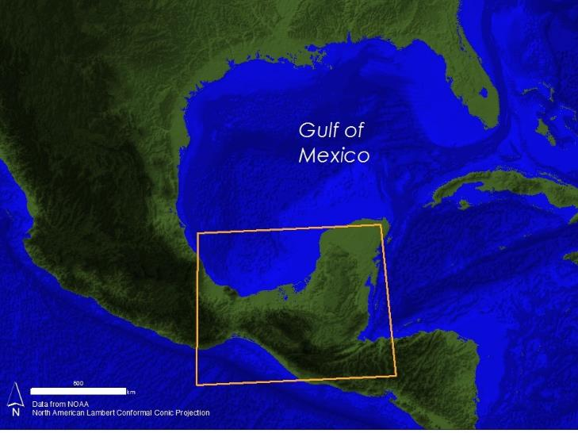
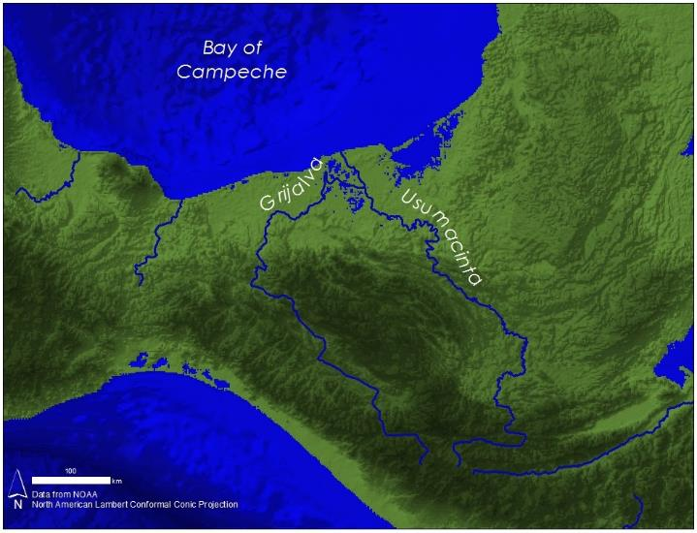
Study Areas
Notes:
We are particularly concerned with the Bay of Campeche and the Grijalva-Usumacinta River Basin.
This watershed is the second largest freshwater contributor to the Gulf of Mexico. The majority of the basin falls within the political boundaries of Mexico, with drainage from the states of Tabasco, Chiapas, and Campeche. The region is characterized by a tropical monsoon climate with a June to October wet season.

Slide 3
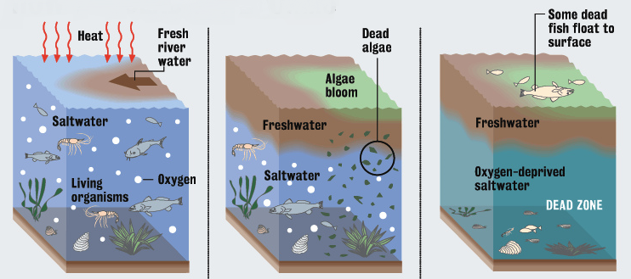
Community Concerns
Image credit: Dan Swenson
Human Illness
Economic Loss
Hypoxia
Notes:
Harmful algal blooms, dead zones, and hypoxia occur frequently in the southern Gulf of Mexico and are known to be influenced by sediment and nutrient influx. Algal blooms grow in response to excess nutrients in the water. After the algae die, oxygen levels can decrease to the point of hypoxia, which means that there is no longer enough oxygen in the water column to support aquatic life. These events result in human illness, fish kills, as well as economic loss for fisheries and tourism industries.
Image Credit: Dan Swenson, Staff Research. Distributed under a Creative Commons Attribution 2.0 license.
https://www.flickr.com/photos/48722974@N07/4911433052/in/photolist-8u1nWd-cMxCUG-8ZSEfa-8ZSE7M-8ZSE4c-8ZSDVn-8ZSDSF-8ZSDRa-8ZVJMb-8ZSDFK-8ZSDDt-8ZVJCY-8ZVJt9-8tVND6-8pMBY2-8p9Sse-9CiyXj-9CfE4P-81CcmS-7WP73Y-4gwBkG-7RGoB1-8EP7uT-7ZkiF3-8ELJPv-8ELJLB-7XrEnM-7Gjz91-7WPHHA-7WLefV-8ESikC-7V1Dye-8GpLiR-7Xte2o-8EP8Z6-8UaqWY-7PnNTm-7PnNRE-7PnNFC-9Ehp1W-9EhoW9-7TLshE-7WM6ns-7WNFLG-9AdVbL-9AghcJ-7U1p5f-9AhDtL-9AeFV6-9AeFPH

Slide 4
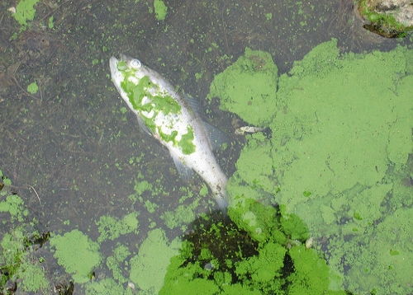
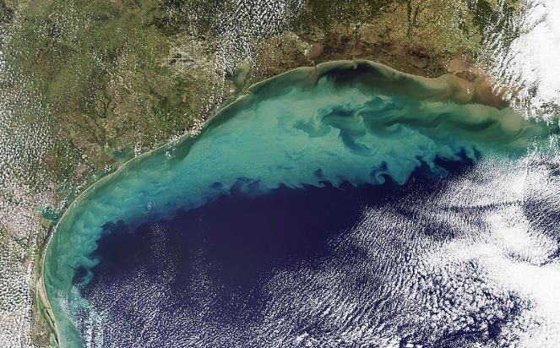
Objectives
Photo Credit: Dr. Jennifer L. Graham
Identify indicators of hypoxic events and harmful algal blooms in the southern Gulf of Mexico
Understand the impact of nutrient and sediment loading from the Grijalva-Usumacinta River Basin
Photo credit: NASA
Notes:
Our main objectives were to identify the indicators of hypoxic events and harmful algal blooms in the southern Gulf of Mexico and to understand the impact of nutrient and sediment loading from the Grijalva-Usumacinta River Basin.
We partnered with a variety of state and academic organizations. Our insights and models serve as decision support tools and aide their efforts of improving water quality.
Photo Sources: Distributed under a Creative Commons Attribution 2.0 license.
https://www.flickr.com/photos/48722974@N07/4558031458/in/photolist-7WM6Xh-7RC7eF-7WHSvB-7VMhxE-7WxfeH-7RWfqk-7RGiTW-81CcmS-7V3qMG-9Ciz1h-83c1Dx-82TKDq-bN5GKR-7RFmAE-9CfE8X-9CfE8v-7RYuKj-7RWaer-7Scnqj-7RC7ee-7Wxaf6-7WM6FC-8u1nWd-7VHZKp-54wxhr-9kSMVi-9n97dh-9kSQGe

Slide 5
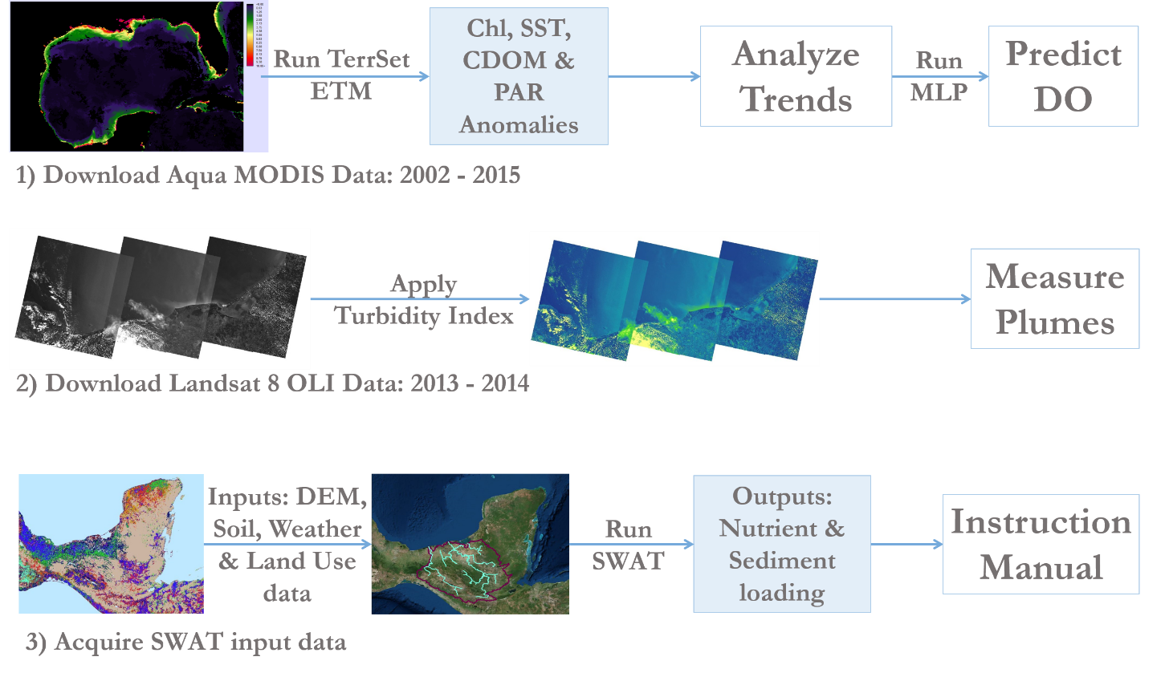
Overview
Notes:
To achieve these objectives, we performed three separate analyses.
First, we used Clark Labs TerrSet software to analyze trends in the potential indicators of hypoxic events, and then predicted dissolved oxygen values based on these indicators.
Second, we applied a turbidity index to Landsat 8 imagery and used the resulting images to measure plume sizes.
Third, we adapted the Soil and Water Assessment Tool (SWAT) to the Grijalva-Usumacinta River Basin.

Slide 6
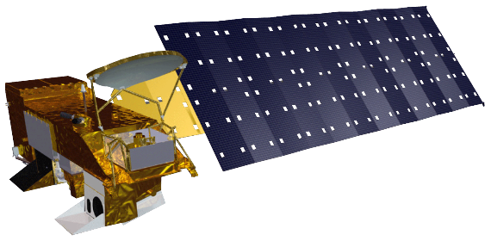
Potential Indicators of Hypoxia
Aqua MODIS L3 SMI Products (2003-2014)
Chlorophyll a (Chl)
Colored Dissolved Organic Matter (CDOM) Index
Photosynthetically Available Radiation (PAR)
Sea Surface Temperature (SST)
Earth Trends Modeler (ETM)
Multi-Layer Perceptron (MLP) Regression Analysis
Notes:
Although we cannot remotely sense dissolved oxygen, we can observe several known indicators of hypoxic events.
These include chlorophyll-a (Chl), an index of colored dissolved organic matter (CDOM), photosynthetically-available radiation (PAR), and sea surface temperature (SST).
First we used the Earth Trends Modeler (ETM) to display the historical trends of these indicators.
Then, used Multi-Layer Perceptron Regression Analysis (MLP) to determine the strength of these drivers.

Slide 7
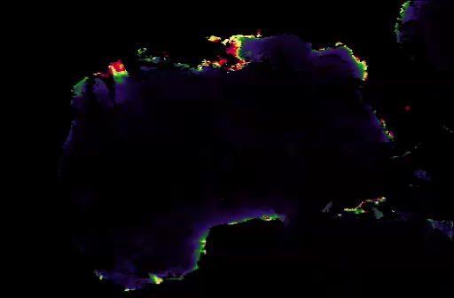
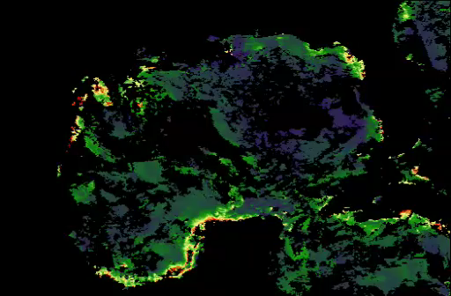
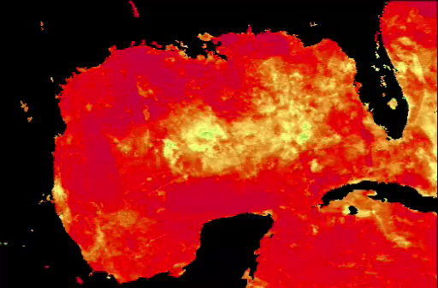
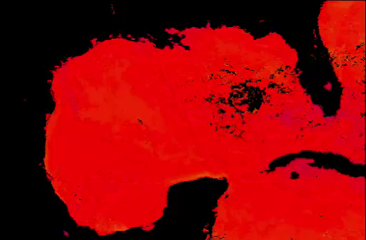
Earth Trends Modeler
Chl
CDOM Index
PAR
SST
Notes:
Here we present a visualization of our time series. The data spans from 2003-2015 and includes nearly 600 images for each variable.

Slide 8
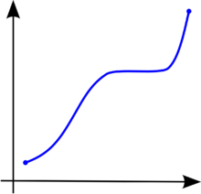
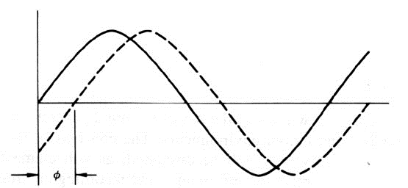
Inter-Annual Trends
Seasonal
Trends
Outputs:
Linear Correlation (r)
Monotonic Trend
(Mann-Kendall Test)
Outputs:
Amplitude and phase color composite maps
Fitted Seasonal Curves
Notes:
We examined the entire time series in search of long term trends and seasonal characteristics.
We looked for linear correlation between the values of each pixel over time and a perfectly linear series. We also explored monotonic trends using a non-linear trend indicator that measures the degree to which a trend is consistently increasing or decreasing.
To look at seasonal trends, each year of data was submitted to a harmonic regression to generate a series of shape parameters, known as amplitudes and phases, which characterize annual and semi-annual cycles.

Slide 9
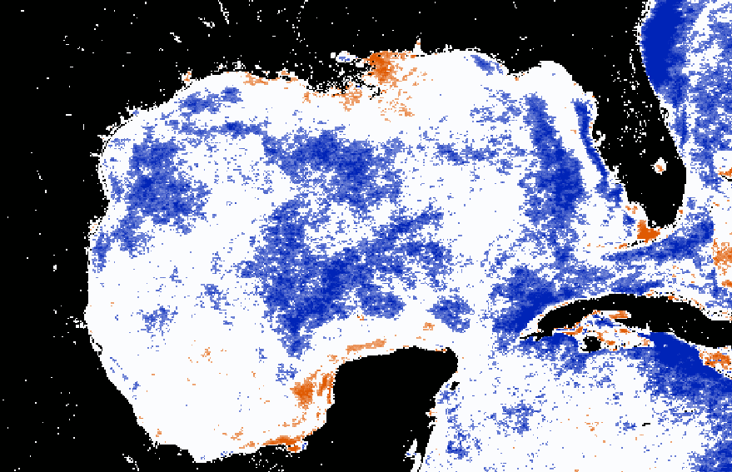
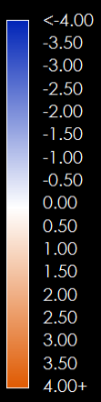
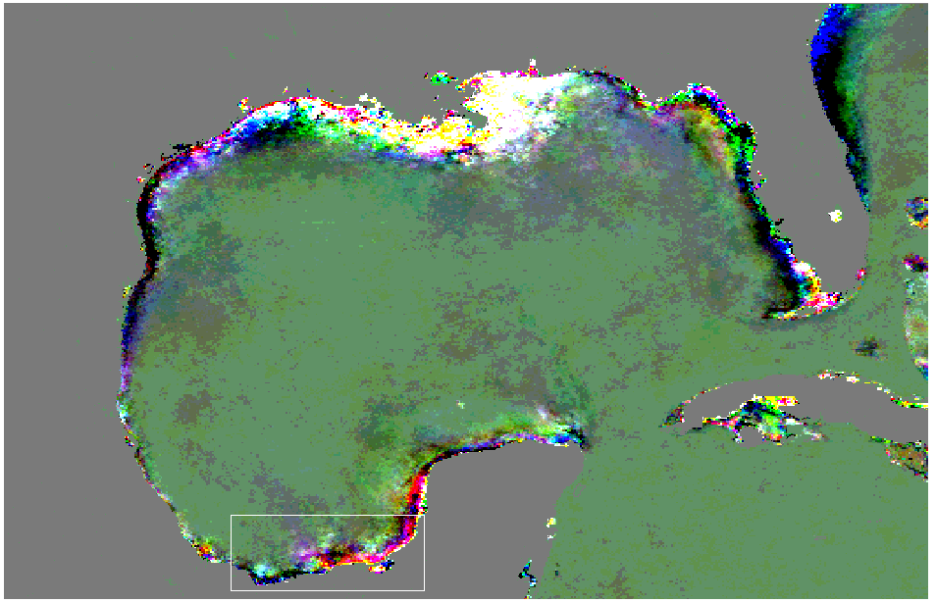
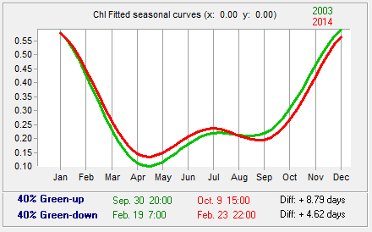
Chl
Z Values
Top: Monotonic trends (orange = significantly increasing, blue = significantly decreasing, α=0.05).
Bottom: Amplitude color composite map (left). Fitted seasonal curves (right).
Notes:
Here are representations of the inter-annual and seasonal trends for chlorophyll a in the Gulf of Mexico.
At the top, we see a map of monotonic trends, masked at a significance level of .05. Seen in orange, chlorophyll a concentrations are significantly increasing in the coastal zones surrounding the both the Mississippi and Grijalva-Usumacinta River Deltas.
On the bottom, we see an amplitude color composite map that compiles the mean annual cycles, annual cycles, and semi-annual cycles for chlorophyll. Each color represents a specific seasonal pattern, so regions of similar colors are experiencing similar seasonal trends.
The graph to the right shows a fitted seasonal curve for the southern coastal region. The green curve represents the first six years of the study period, and the red curve represents the last six. The curves follow a bimodal distribution with peak chlorophyll a concentrations occurring from November to February. A smaller peak can be seen in July.

Slide 10
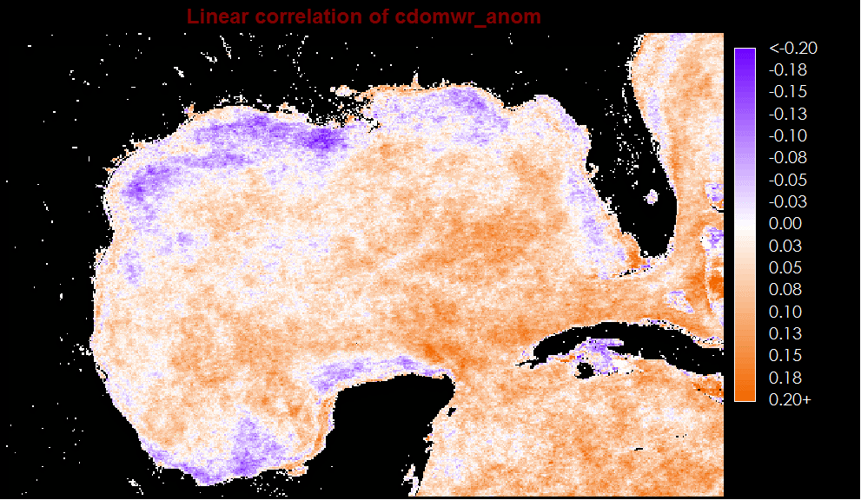
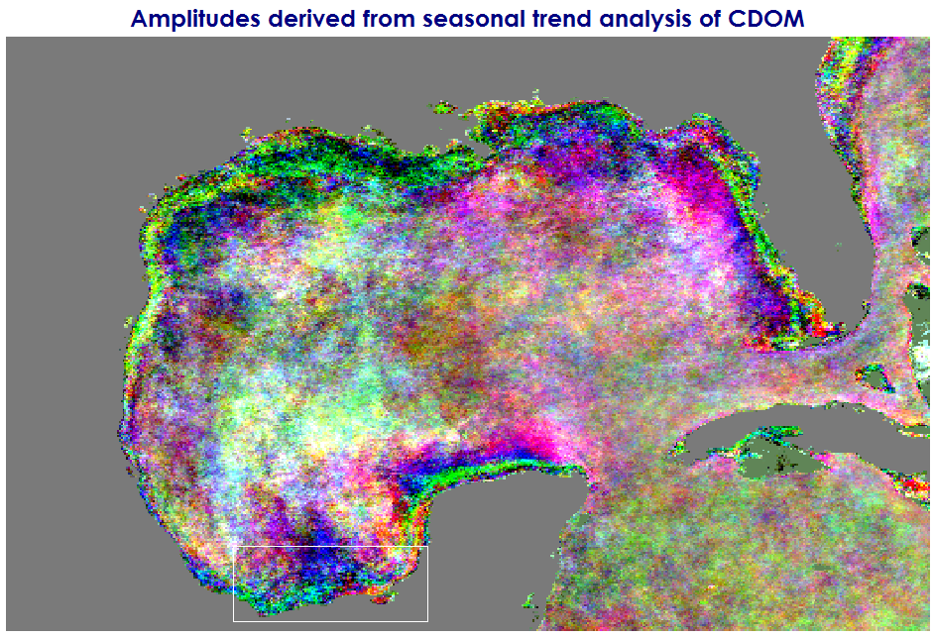
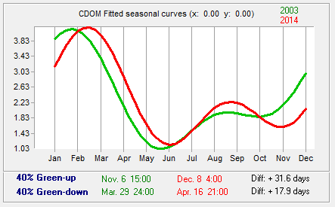
CDOM Index
r Values
Top: Linear correlation (orange = positive, purple = negative).
Bottom: Amplitude color composite map (left). Fitted seasonal curves (right).
Notes:
Here are the trends for CDOM Index. At the top we see a linear correlation map. Purple regions, such as the northern and southern coastal zones, show a slightly negative linear correlation. These regions correspond to the areas that are known to experience algal blooms and hypoxia. Here, the negative correlation is expected since low index values can either mean low CDOM concentrations or high chlorophyll concentrations.
On the bottom, the fitted seasonal curves follow a bimodal distribution that is similar to chlorophyll a, but lagged approximately 2 months, with peak index values occurring in February and Mid-August. This time lag was expected since CDOM is produced when algae decompose.

Slide 11
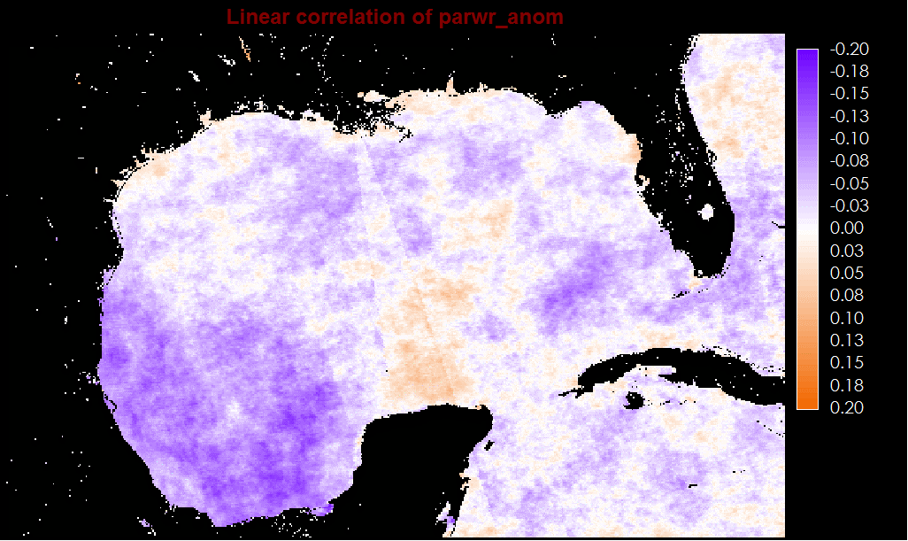
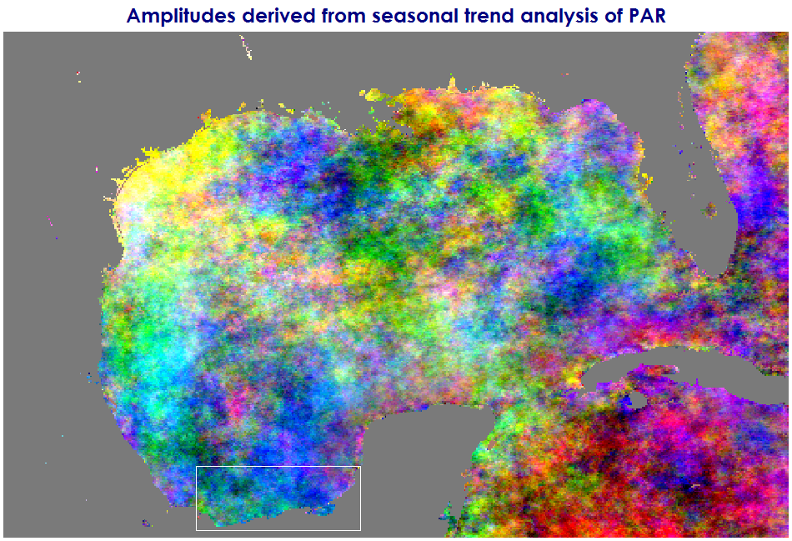
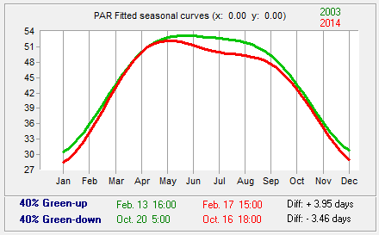
PAR
r Values
Top: Linear correlation (orange = positive, purple = negative).
Bottom: Amplitude color composite map (left). Fitted seasonal curves (right).
Notes:
Here are the trends for PAR. We can see a negative linear correlation in the Bay of Campeche, which would indicate that PAR was decreasing in that region.
On the bottom, the fitted seasonal curves show peak values occurring in the spring and summer months.

Slide 12
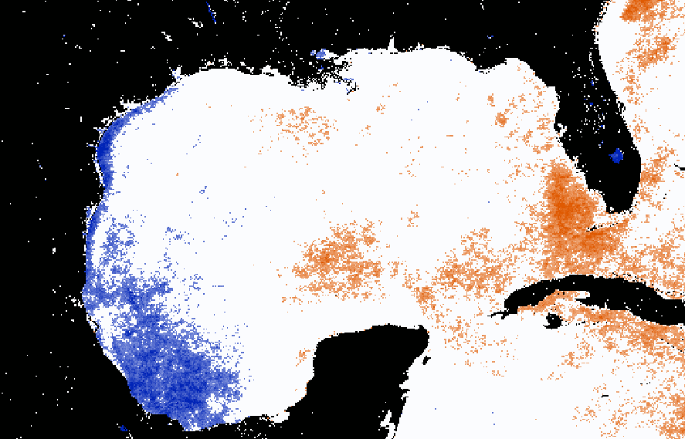
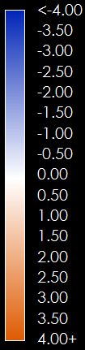
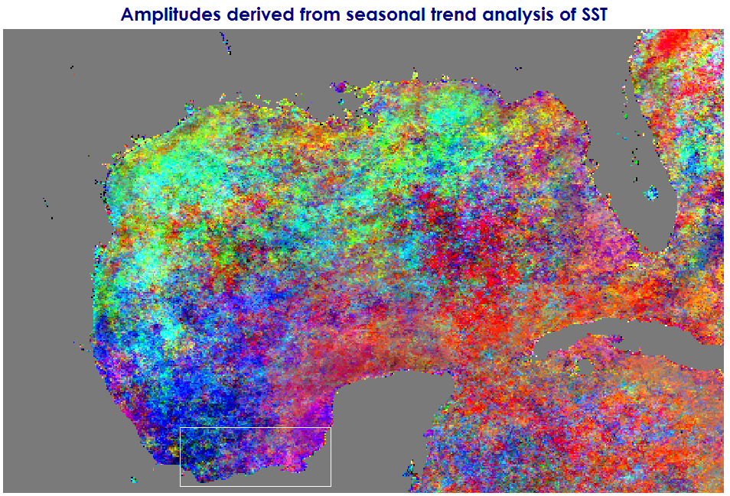
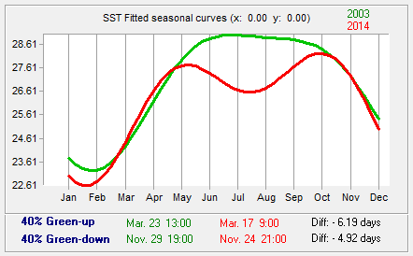
SST
Z Values
Top: Monotonic trends (orange = significantly increasing, blue = significantly decreasing, α=0.05).
Bottom: Amplitude color composite map (left). Fitted seasonal curves (right).
Notes:
For SST, we see significantly decreasing monotonic trends along the eastern coast of the GoM and in the Bay of Campeche. The decrease in PAR and SST seen in these regions could possibly be due to hurricanes or dust storms that occurred during our study period.
The fitted seasonal curves show a similar distribution to PAR, with peak values occurring in the spring and summer months.

Slide 13
Multi-Layer Perceptron (MLP)
Uses an artificial neural network to classify images
Dependent variable:
Dissolved oxygen (DO)
Independent Variables:
Chl, CDOM Index, PAR, SST, Bathymetry
Outputs: Predicted DO maps
Input Layer
Output Layer
Hidden Layer
Notes:
A neural network is a modeling tool that processes information through a nervous system structure. It works like our brain in acquiring knowledge through learning, and storing strengths in the neuron connectors. The most common neural network model is the multi-layer perceptron (MLP).
We used the MLP for regression analysis using MODIS products and bathymetry as independent variables. For our dependent variable, we had in-situ bottom dissolved oxygen from the northern Gulf of Mexico.
The MLP will create a model that correctly maps the input to the output using known data, so that the model can be used to produce outputs when they are unknown. This is how we were able to take limited in-situ coverage and predict for the entire Gulf of Mexico.

Slide 14
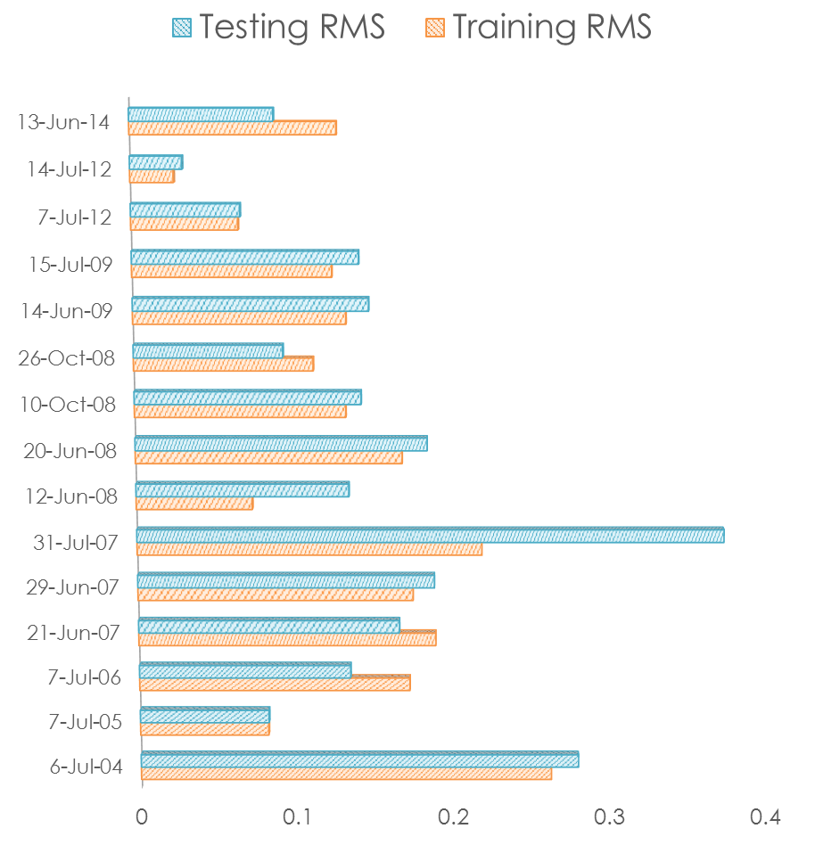
Notes:
Pixels with dissolved oxygen values are randomly divided between training and testing. The purpose of training is to get the proper weights for the neuron connections between the input and hidden layers, and between the hidden and output layers for the classification of unknown pixels.
Here you can see the root mean square errors from training and testing.
We also saw R-squared as high as 0.7814 for our MLP Models, with Chl being the most influential variable on the model.

Slide 15
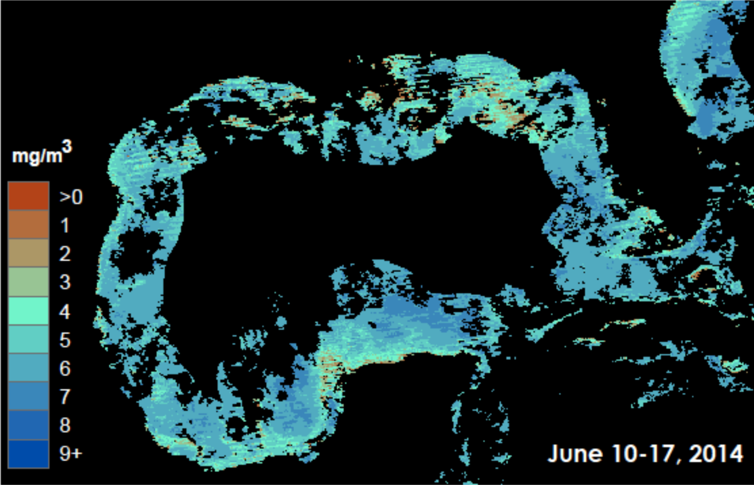
Predicted Dissolved Oxygen
Notes:
The study area is defined as areas with valid observations for all independent variables. We also choose to mask out regions further than 200km from shore.
Areas with low predicted dissolved oxygen concentrations are found in red.
Our results allow users to see historical and current proximities and extent of hypoxia. With these maps we can better understand the distribution and timing of hypoxic events for mitigation efforts.

Slide 16

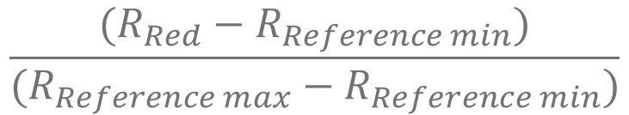
Turbidity Index
Related TI to in-situ data
Measured plume sizes
Produced Turbidity Assessment Report
$$\frac{(R_{Red}−R_{Reference min})}{(R_{Reference max}−R_{Reference min})}$$
Landsat 8
2013 - 2014
Notes:
Using Landsat 8, we transform reflectance into a Turbidity Index. The approach separates turbidity from all other spectral signatures using the formula here.
The reference min and max were chosen by hand. This was done by selecting and averaging multiple satellite image target pixel values of where the brightest and darkest land pixels were within a 3 x 3 grid.
After the Index was applied we performed an accuracy assessment test using tiles and buoy data from the Northern Gulf.
We then examined the spatial extent of these plumes.

Slide 17
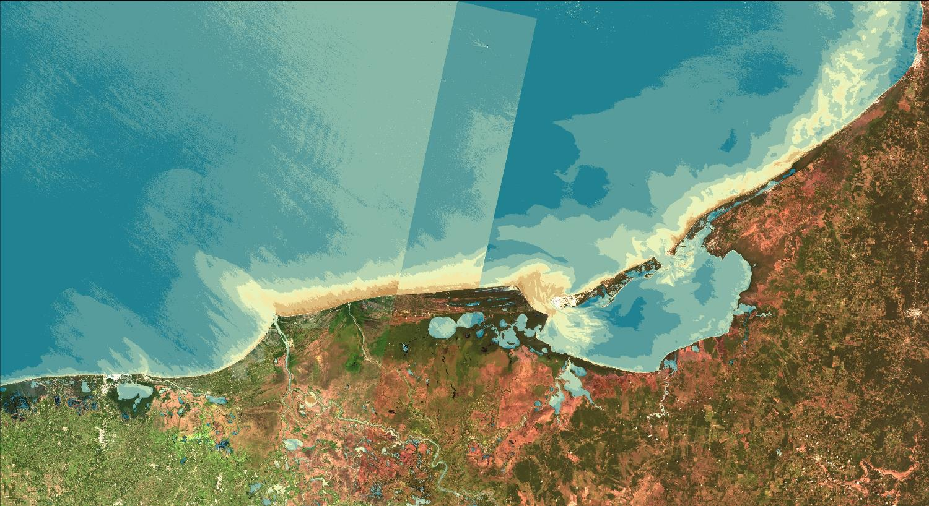
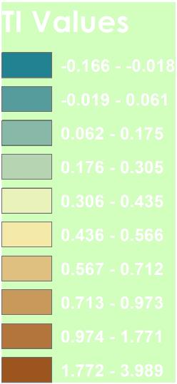
Turbidity Index
Results Placeholder
Notes:
Here you can see our map product. Low index values are displayed in Blue, and High values are displayed in Brown.
These values help to show where turbid waters are located, which is important for further watershed mitigation and management efforts.

Slide 18
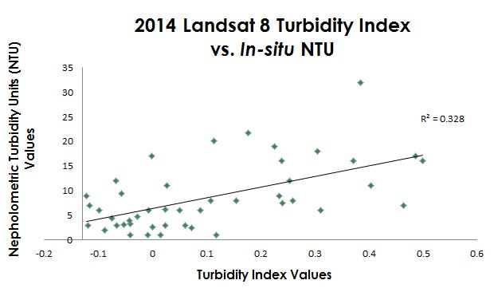
Results Placeholder
Linear regression between in-situ turbidity and Turbidity Index (R²=0.328)
Notes:
Landsat 8 tiles were acquired from the Northern Gulf as a way to understand how well index values correlated with in-situ results.
This resulted in an r-squared value of 0.328. After having verified a moderate correlation between satellite imagery and in-situ turbidity data, the index was determined to be an appropriate tool to study turbid waters within the Gulf of Mexico.

Slide 19
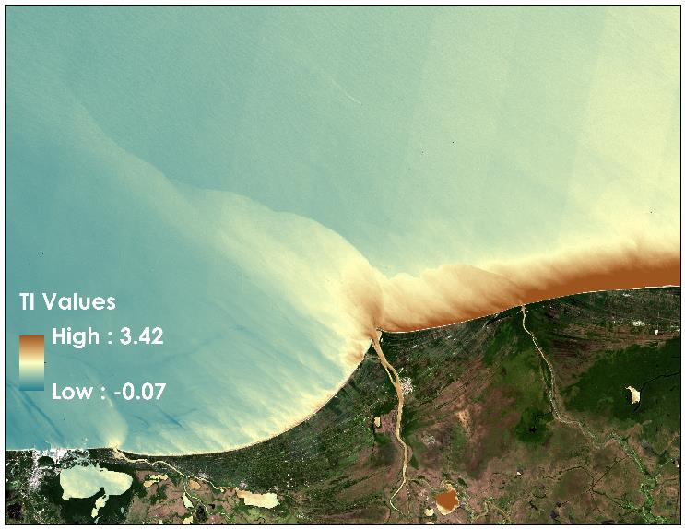
Plume Analysis
Plume shape and size influenced by seasons, ocean and wind currents
Largest plume: 87 km in July 2013
No plumes East of the river delta
Turbidity Index from 07/27/2013
Notes:
After map production, we measured plume size and trends.
All of the plumes flow towards the NE, following both ocean and wind currents, but the plumes vary in size by season.
Typically we noticed that the larger plumes formed during the wetter spring and summer seasons with July 27th, 2013 being the largest plume extent we observed.
On this particular day we calculated the extent to measure approximately 87 KM flowing NE offshore from the Grijalva-Usumacinta river mouth.
There are no plumes to the east of the delta.

Slide 20
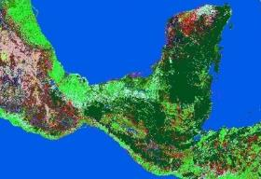
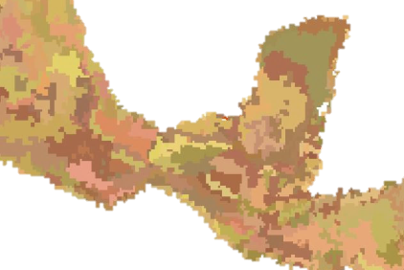
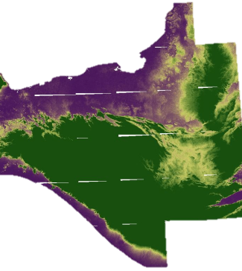
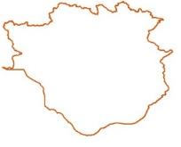
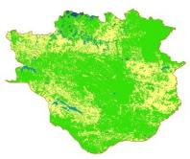
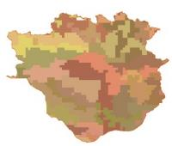
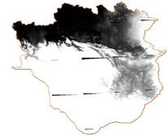
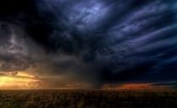
SWAT Inputs
Watershed Delineation
Landuse
Soil
DEM
Reclassification
Run SWAT
Watershed
Photo Credit: Zooey
Landuse
Soil
DEM
Weather
Notes:
To run the Soil and Water Assessment Tool, four basic inputs are needed: a landuse map, a soil map, a digital elevation model, and weather data. The landuse, soils, and DEM inputs are used for delineating the watershed. For this step, it is also possible to add a shapefile of rivers and streams to aid in the stream definition of the watershed. After the delineation is completed, subbasins, a new stream network, and outlets are generated. The next step in the process is to reclassify these first three inputs according to adaptations that were previously made for the specific study area. For our area, a new tropical rainforest classification was added for land use. Soils were also added and edited into a SWAT ready format. Furthermore, the DEM slopes were reclassified into 5 categories according to the raster quantiles.
The last input in the model is the weather data. This data contains information on temperature, precipitation, solar radiation, wind speed, and relative humidity. After these files were imported we ran the model.

Slide 21
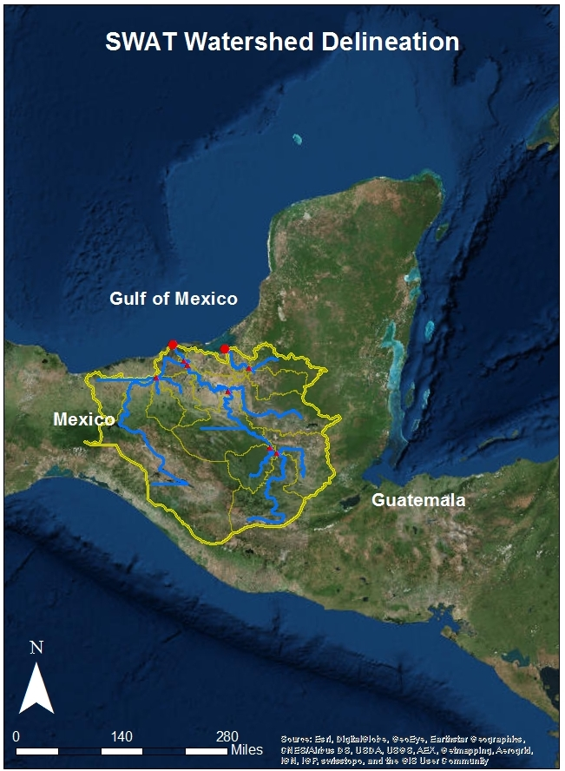
SWAT Outputs
Notes:
The final SWAT outputs can be generated daily, monthly, and/or on a yearly basis. To the left we have an example of output loadings over time.
To the right we have the completed watershed delineation. However there are certain limitations. In this map, we can see how the delineation does not reach the coast in certain areas. Also, gaps in the DEM resulted in several horizontal “rivers”. SWAT data outputs and products will depend on the quality and availability of inputs.
The final product is a manual for our project partners that specifies how to gather the necessary datasets, how to condition these datasets, how to run the model, and a troubleshooting section.

Slide 22
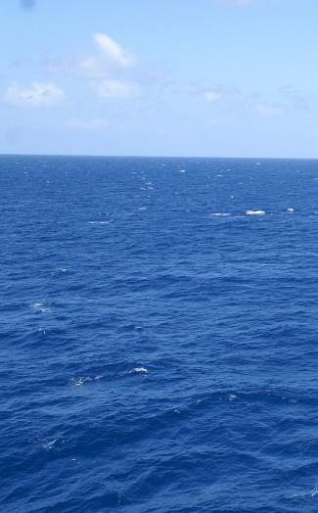
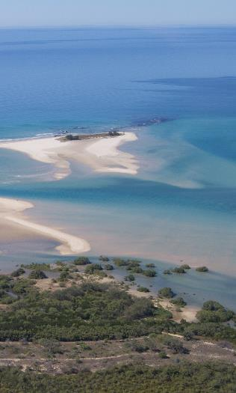
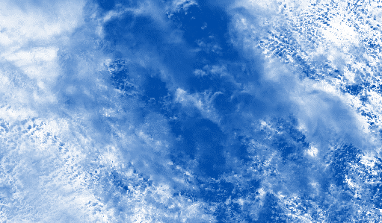
Limitations
In-situ data
Spatial resolution
Case 1 vs. Case 2 Waters
Cloud cover
SWAT developed for USA
Photo credit:
Michael McCarthy
Photo credit: srv007
Photo credit:
Notes:
To improve our SWAT model and MLP regression, in-situ data is needed to calibrate and validate our results.
While there are many benefits to using earth observations, we are limited by the resolution of Landsat bands and MODIS mapped products.
The algorithm used to derive level III SMI MODIS products was designed for Class 1 open waters, creating additional uncertainty within the Class 2 waters influenced by the river basin.
Cloud cover also limits the amount of LandSat and MODIS images suitable for analysis.
Lastly, SWAT was developed for the USA, hence land use and soil classifications for other regions need to be input manually and formatted.
Image Links: Distributed under a Creative Commons Attribution 2.0 license. https://www.flickr.com/photos/savidgefamily/10005164946/in/photostream/
https://www.flickr.com/photos/msmccarthyphotography/3562116870/in/photolist-6qLMf7-61Rh6J-r1jNe-pVcTr-9Y6bQz-9g6n62-apacf-5vY8Z2-8XQBf5-6dgA9T-nEMDen-9ZYzTU-8Up8Xt-sgGHyE-iEWcze-8d9XG6-mP3qe8-ajTQb5-fjoyRK-8AySM2-4Zbu5j-4HdEQB-4r7URx-ndkwSm-nuMXSa-fjoMpK-iZKhi-naJsrc-6dLdCx-du4F1q-8UNShL-6PyqNk-ptRJ75-5qBEZj-4RvUxc-6sWsSt-a3JPMR-wUW2R-7wu1PP-9iZEVg-9RCJV7-yWcyJ-5iJu84-5EcMZS-7yYuyN-fcimAF-7tE6ET-6dgyQP-6dgBqn-v3HezN

Slide 23
Conclusions
ETM and MLP analyses can be used to forecast the timing of hypoxic events and HABs.
The Turbidity Index can be performed as a method of remote water quality monitoring.
The SWAT model can be used to revise regulatory water quality standards.
Earth observations can be used for environmental monitoring when in-situ data are scarce.
Notes:
In conclusion we found that our ETM and MLP results can be used to forecast the timing of hypoxic events
Earth observations can be used to remotely monitor water quality. We showed this in our turbidity assessment.
We also believe that SWAT can be improved to further serve as a decision support tool to influence water quality regulations.
Throughout our project we found ways to use earth observations in lieu of in-situ data.

Slide 24
Products Produced for End Users
Hypoxia Assessment Report for the Bay of Campeche
Turbidity Assessment Report for the Grijalva-Usumacinta River Delta
SWAT Instruction Manual for the Grijalva-Usumacinta Watershed
Notes:
We will hand off quite a few products to our end-users.
A hypoxia report presenting our MLP work. A Turbidity report using Landsat data.
As well as a SWAT instruction manual that will compliment our handoff of SWAT files and data.

Slide 25
Project Partners
Consorcio de Instituciones de Investigación Marina del Golfo de México y del Caribe (CiiMar-GoMC)
Centro del Cambio Global y la Sustentabilidad en el Sureste (CCGSS)
Comisión Nacional para el Conocimiento y Uso de la Biodiversidad (CONABIO)
Centro Nacional de Datos Oceanográficos (CENDO)
Universidad Autónoma de Baja California (UABC)
Universidad Juárez Autónoma De Tabasco (UJAT)
Secretaría de Marina (SEMAR)
The Federal Ministry of Health
Notes:
We would like to thank our project partners for bringing this issue to our attention.

Slide 26
Science Advisors
Dr. Juan L. Torres-Pérez, Bay Area Environmental Research Institute, DEVELOP National Program
Dr. Sherry L. Palacios, Bay Area Environmental Research Institute
Chase Mueller, Bay Area Environmental Research Institute
Other Contributors
Andrew Nguyen, DEVELOP National Program
Chippie Kislik, DEVELOP National Program
Notes:
We would also like to thank our science advisors for their invaluable guidance,
As well as everyone in the DEVELOP offices who have helped us troubleshoot problems and refine our deliverables.

