Slide 1
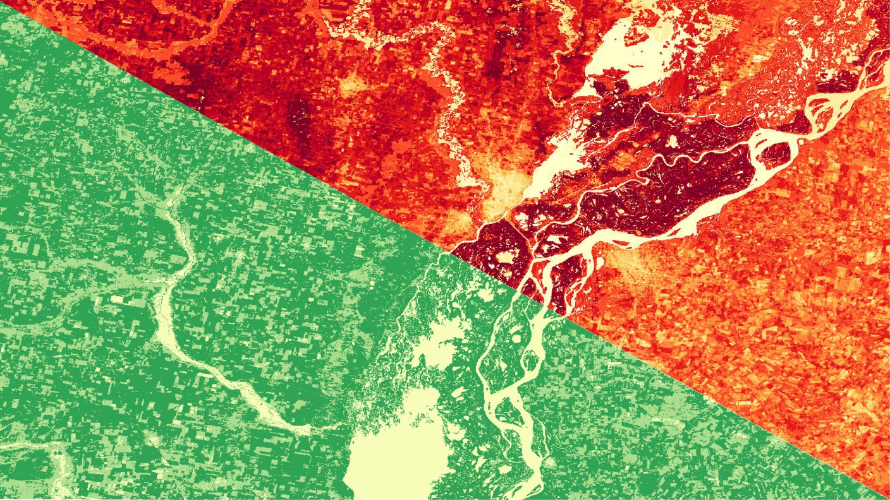
ARGENTINA WATER RESOURCES
Evaluating Evapotranspiration in Humid Subtropical and Semi-Arid Climates with NASA Earth Observations to Understand Water Balance in Paraná and the Patagonian Steppe of Argentina
Carl Jurkowski
Ahmed Baqai
Jose I. Ochoa
A. R. Williams
Idaho – Pocatello | Spring 2019
Notes:
*Project lead reads title and node name
*Everyone introduces themselves

Slide 2
Outline
Introduction
Background
Community concerns
Study Area
Objectives
Evapotranspiration(ET)
Methodology
Results
Conclusion
Discussion
Acknowledgements
Image Credit: Milton Blumhagen
Notes:
Image Credit: Provided by partner (have permission to use)

Slide 3
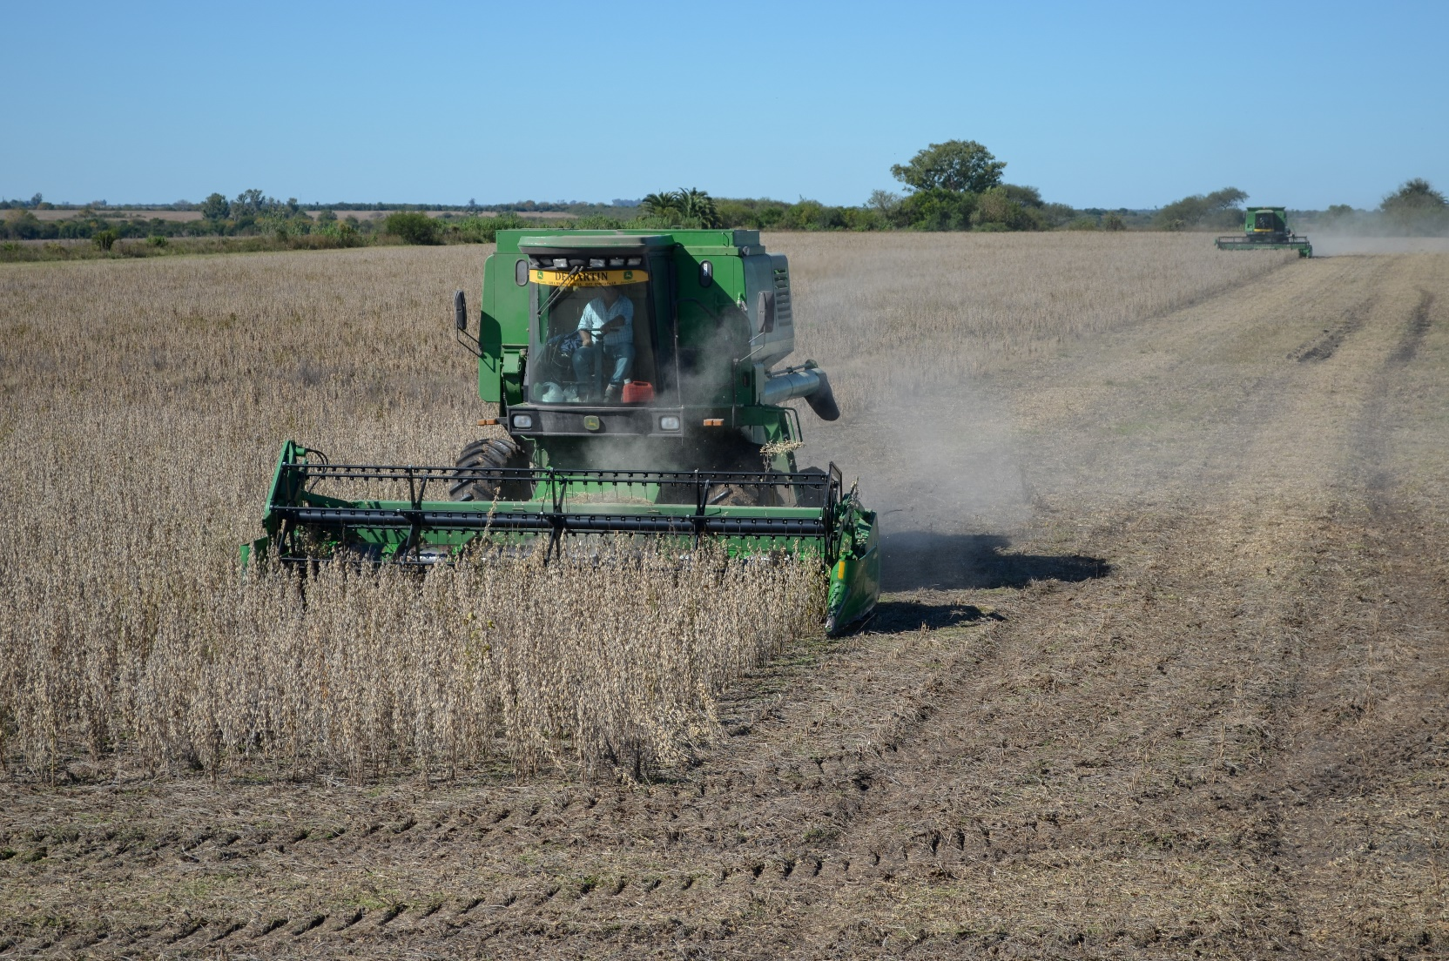
Community Concerns
ET models
Heterogeneous environments
Untested semi-arid
Penman and Bartholic-Namken-Wiegand
Decision making
Empirical data
Land management
Water conservation
Image Credit: Milton Blumhagen
Notes:
In Argentina ET models are largely untested in semi-arid environments. Models that currently exist like the Penman and Bartholic-Namken Wiegand models over estimate ET in heterogeneous environments. As for decision making there is a lack of empirical data used to make land management decisions. Land managers need tested ET models estimates to aid in decision-making processes to help with water scarcity, drought indicators, and to aid in general water conservation.
Image Credit: Provided by partner (have permission to use)

Slide 4
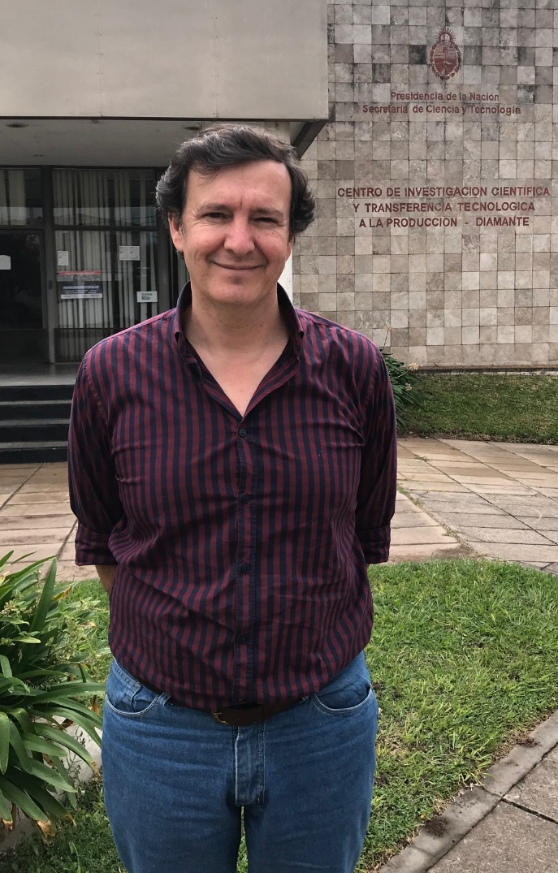
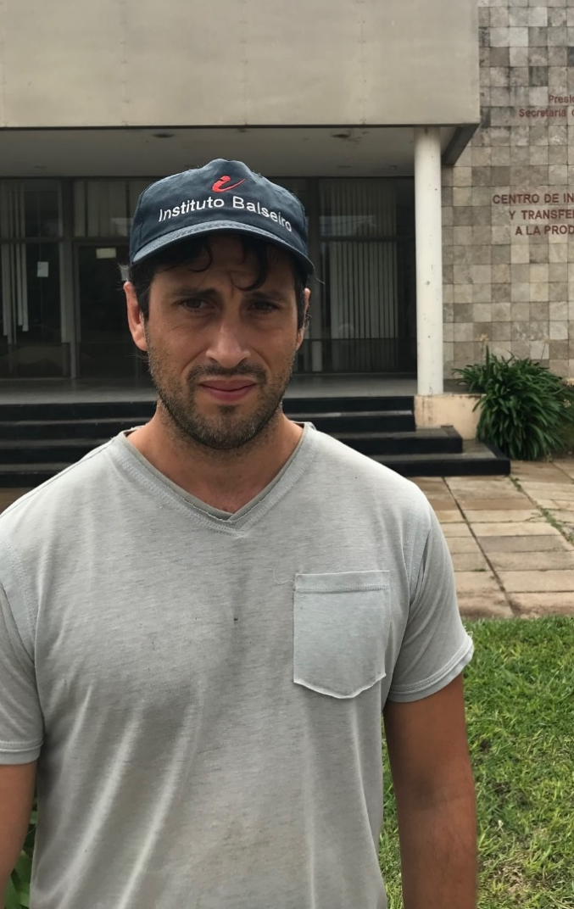
Partners
National Scientific and Technical Research Council (Argentina)
“Consejo Nacional de Investigaciones Científicas y Técnicas (CONICET)”
Dr. Pablo G. Aceñolaza (left)
Sebastián Gavilán (right)
Image Credits: CONICET
Notes:
For this project we had one partner agency, Argentina the Consejo Nacional de Investigaciones Científicas y Técnicas (CONICET) translated as National Scientific and Technical Research Council. At CONICET we worked with Dr. Aceñolaza, Doctor of Biological Science and Sebastián Gavilán an Agronomist Engineer and PhD student.
Image Credit: Provided by partner (have permission to use)

Slide 5
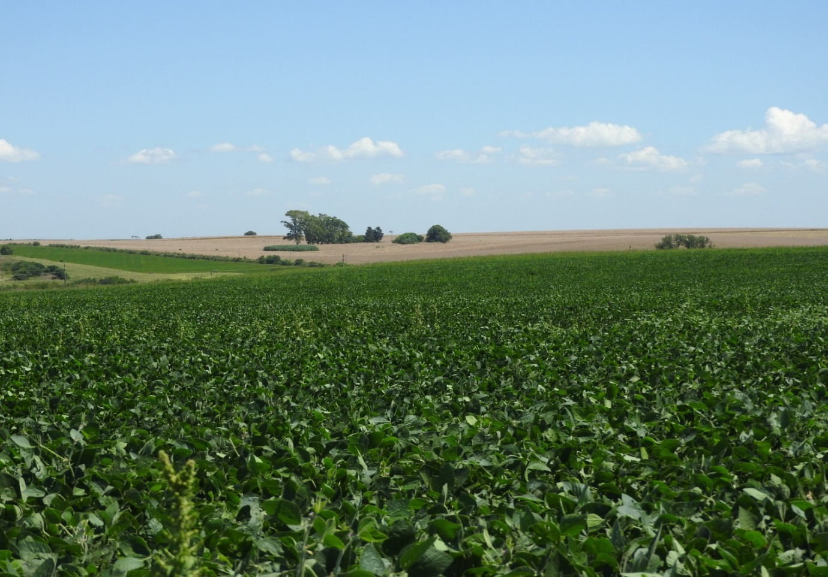
Paraná, Argentina
Humid sub-tropical region
Agriculture
Evapotranspiration
Image Credit: Sebastián Gavilán
Notes:
In Argentina we had two study areas; The first was Paraná, a humid sub-tropical region.
Image Credit: Provided by partner (have permission to use)

Slide 6
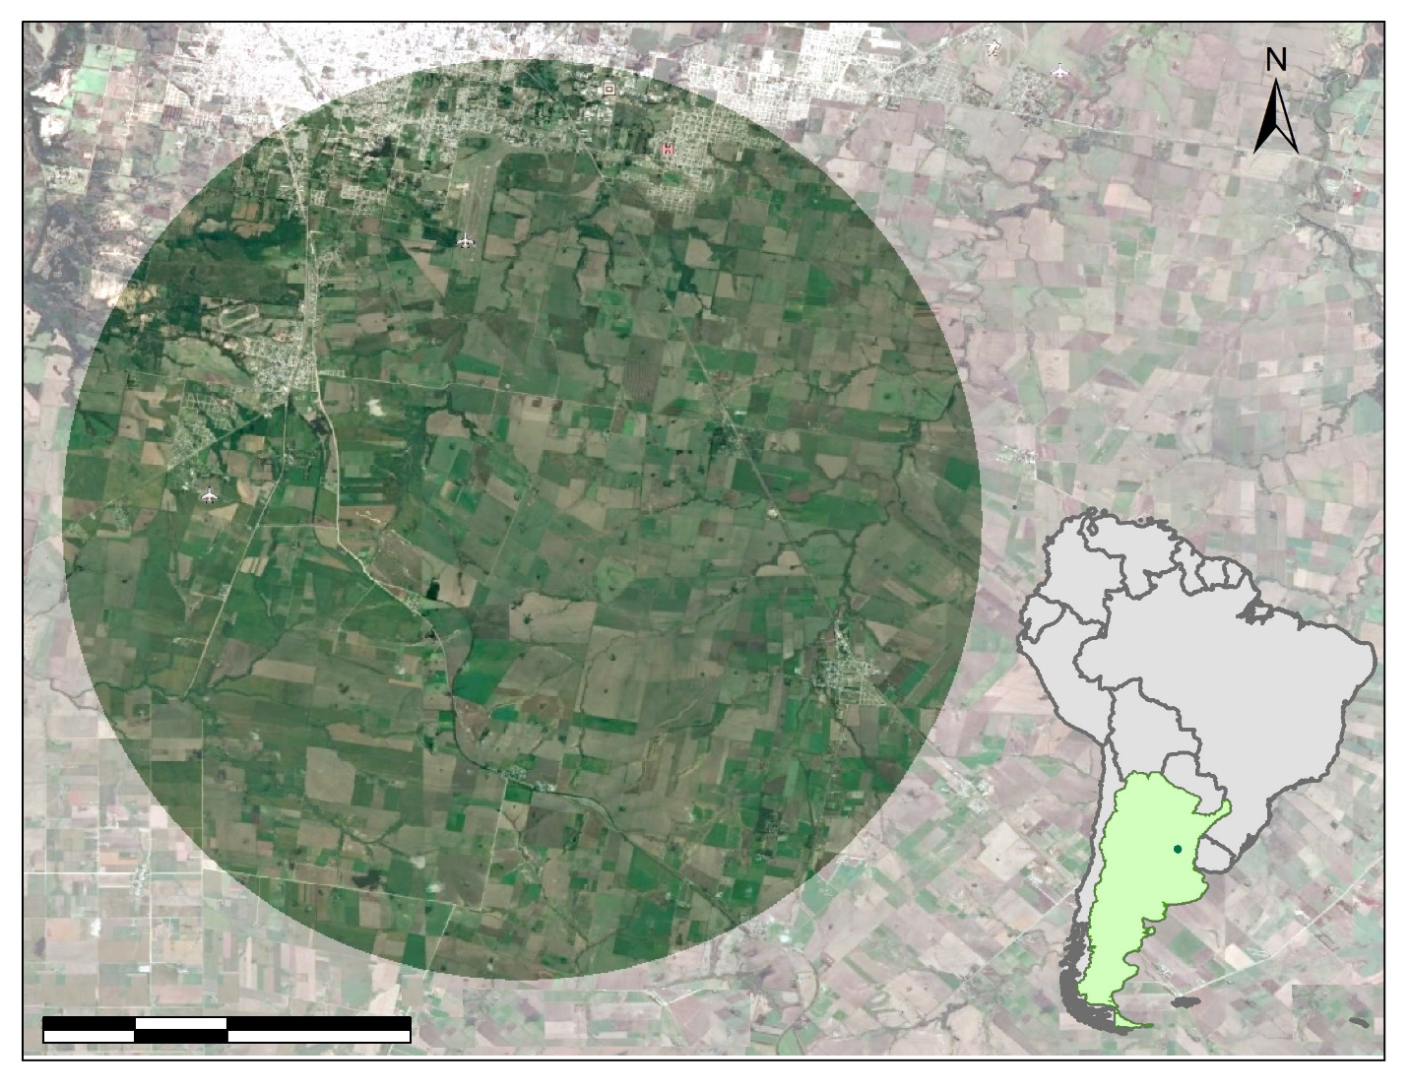
Paraná
0
2
4
8
km
Image Credit: Argentina Water Resources Team
Notes:
Here we can see our study area in Northeastern Argentina. It is composed of primarily agriculture land, natural vegetation and crops.

Slide 7
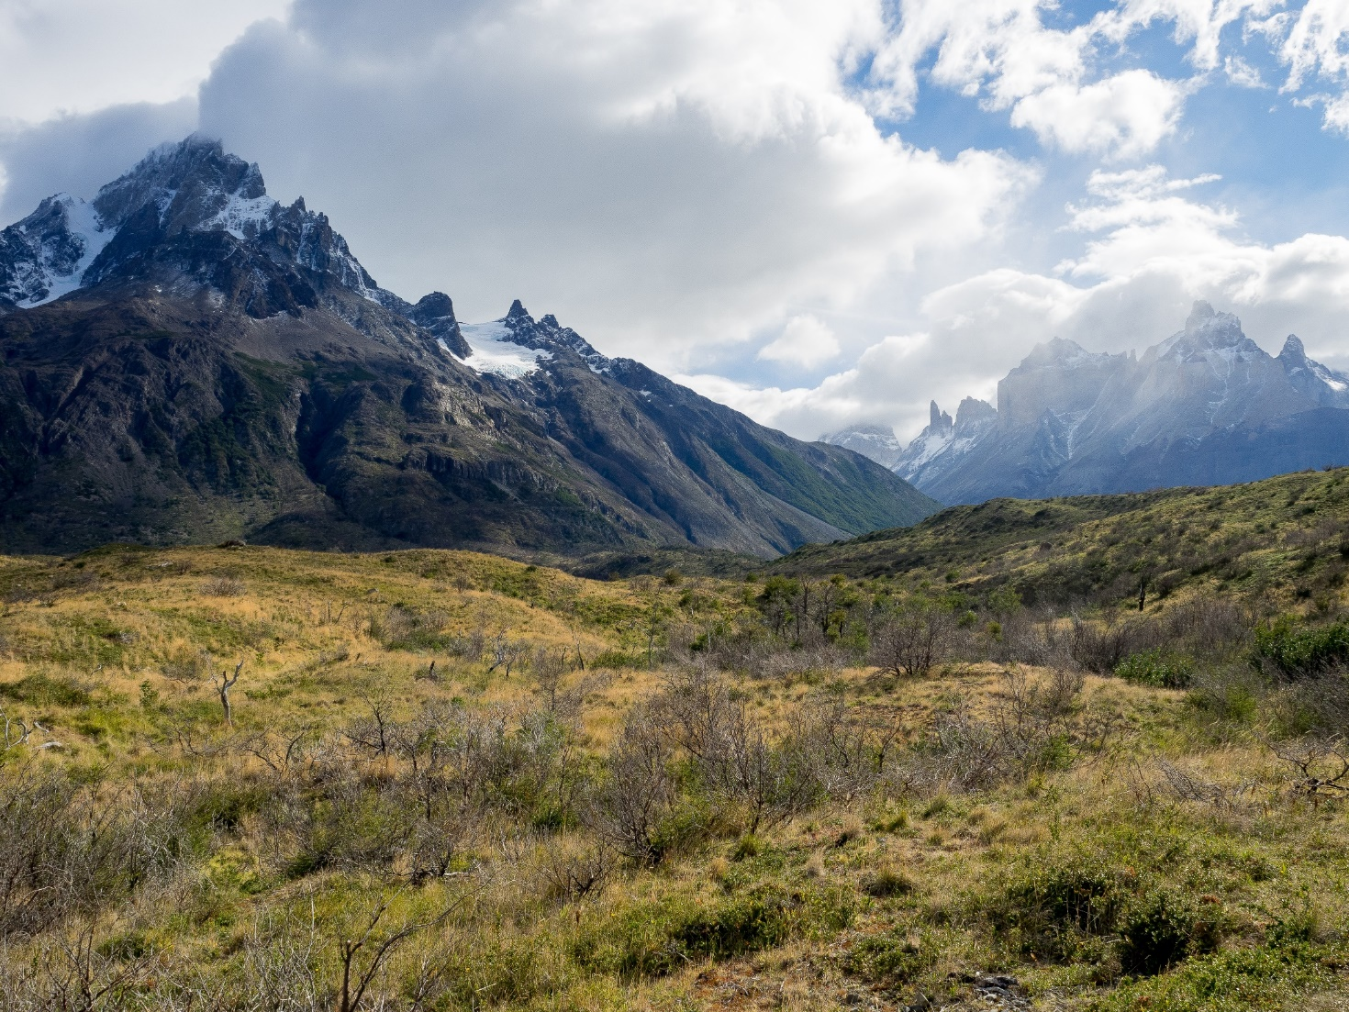
Patagonian Steppe, Argentina
Semi-arid region
15% of Argentina, semi-arid ecosystems
Evapotranspiration
Image Credit: Ajay Suresh
Notes:
Our second study area in Argentina was the Patagonia Steppe , a semi-arid region. 15% of Argentina consists of semi-arid ecosystems . Evapotranspiration is not well studied in this climatic zone.
Image credit: https://commons.wikimedia.org/w/index.php?title=Special:Search&limit=20&offset=140&ns0=1&ns6=1&ns14=1&search=patagonia&advancedSearch-current={%22namespaces%22:[0,6,14]}#/media/File:Patagonia-34_(26233631911).jpg (Creative Commons License, Attribution 2.0 Generic license)

Slide 8
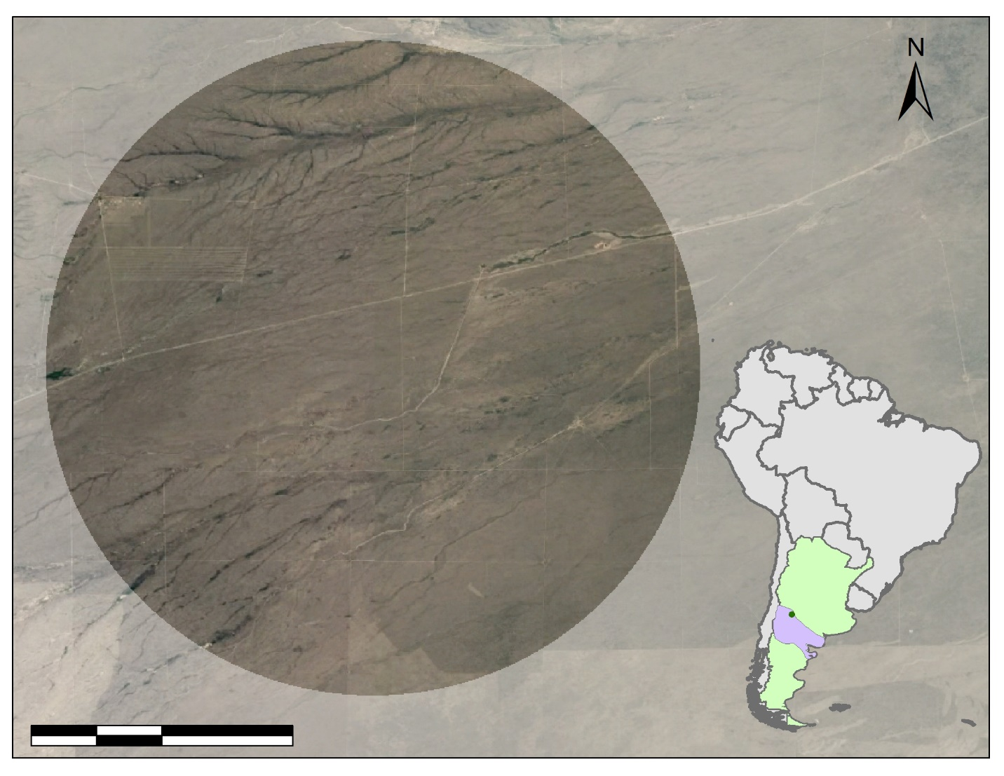
Patagonian
Steppe
0
2
4
8
km
Image Credit: Argentina Water Resources Team
Notes:
Here we can see our study area over the Patagonia Steppe of Argentina. Focused on the semi-arid steppe region. This location was selected using climatological analysis of precipitation data and predefined semi-arid climate zones based on Köppen-Geiger climate classification map of Argentina.

Slide 9
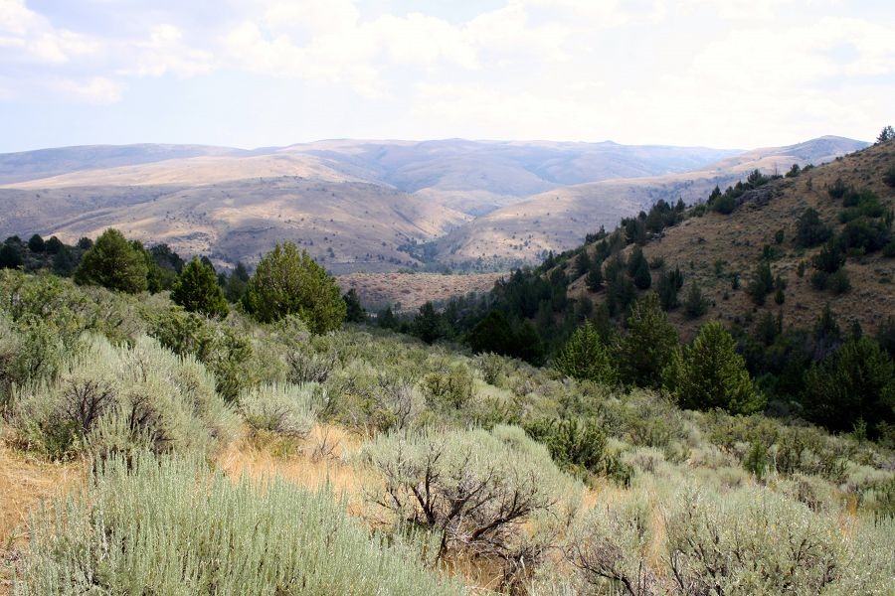
Reynolds Creek Experimental Watershed (RCEW)
RCEW
Semi-arid Idaho
Two models
MODIS global ET Project (MOD16)
Operational Simplified Surface Energy Balance (SSEBOP)
Validation site
Image Credit: Critical Zone Observatories
Notes:
RCEW is used as a validation site in this study. RCEW is located in the semi-arid sagebrush steppe ecosystem and is biophysically similar to the Patagonia steppe of Argentina. The Idaho Water Resources II NASA DEVELOP team validated four ET models with in situ data. Two of these models were applied to both study areas in Argentina; MOD16 MODIS global ET project and the Operational Simplified Surface Energy Balance or SSEBOP model.
Image URL :https://criticalzone.org/reynolds/infrastructure/field-area/johnston-draw/#settingResearch (Public Domain → Critical Zone Observatories are part of the US NSF National Program)

Slide 10
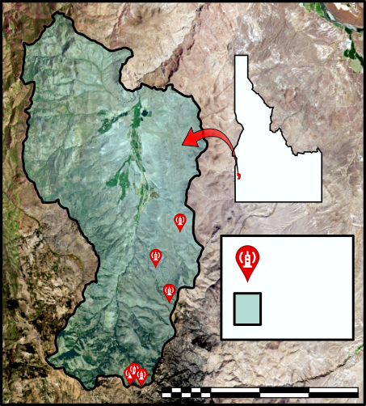
RCEW
N
Idaho
Eddy Covariance Flux Towers
Study Area Outline
0
kilometers
20
Image Credit: Idaho Water Resources II Team
Notes:
Here we can see the validation site from the Idaho Water Resources II project. The previous term validated two of the four models used in our project, based upon the RCEW study area in Idaho. RCEW is a semi-arid landscape in the Northwestern US. We can compare these models to our Patagonia Steppe location in Argentina because both are semi-arid regions.

Slide 11
Objectives
Evaluate multiple ET models in Paraná & Patagonia Steppe
Compare models’ ET outputs and run statistical analysis
Validate which model works best for humid subtropical and semi-arid environments
End Goal: Identify calibrated model for decision making and effective ET modeling
Notes:
Our study period was from 2015-2017.
Our objectives were to evaluate three ET models and test them against each model for the study areas. This was done to identify which model provides the best estimated ET. We compared the models’ ET outputs by running a statistical analysis. We also investigated which models work best in each region. Models will be discussed further in the methodology section. Our goal for this project was to find an effective ET modeling to aid in decision making processes.

Slide 12
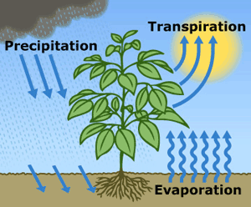
Evapotranspiration (ET)
Movement of water
Precipitation
Water from atmosphere to ground and canopy
Evaporation
Water from ground to atmosphere
Transpiration
Water from plants to atmosphere
Image Credit: USGS
Notes:
Evapotranspiration or ET is a movement of water. Here in the image we can see the process of ET. First precipitation falls providing water. Then as the surface warms there are the components of ET, evaporation, the movement of water from the surface or soil to the atmosphere, and transpiration, the movement of water from plants to the atmosphere.
Image credit: https://water.usgs.gov/edu/watercycleevapotranspiration.html (Public Domain)

Slide 13
Satellites and Sensors
Aqua MODIS
Terra MODIS
Landsat 8
OLI & TIRS
Image Credit: NASA
Notes:
In this project we utilized:
National Aeronautics and Space Administration(NASA): Aqua MODIS(Moderate Resolution Imaging Spectroradiometer), Terra MODIS
United States Geological Survey(USGS): Landsat 8 OLI(Operational Land Imager) and TIRS(Thermal Infared Sensor)
Image URL’s: http://www.devpedia.developexchange.com/dp/index.php?title=List_of_Satellite_Pictures (Public Domain)

Slide 14
Methodology
ET Models
MOD 16
SSEBop
GLDAS(Global Land Data Assimilation System)
In Situ Data
Paraná
RCEW
DATA
Comparison
ET outputs to in situ data
Statistics
Time series, regression, Kruskal Wallis, Student’s t post hoc
ArcGIS Pro
Clip study areas
Analysis
Final Products
ET maps, statistics, and graphs
Output
Notes:
We used three ET models in this project: MOD16, SSEBOP model, and Global Land Data Assimilation System(GLDAS)-2-Noah. To clip our study area for Paraná, Patagonia Steppe, and RCEW we used ArcGIS Pro. To evaluate ET between models we ran statistical analysis including regression and linear regression in Excel, and a Kruskal Wallis and Student’s t post hoc test in JMP. We also created time series graphs of the data as indicators to create map outputs. By completing these analysis we were able to produce ET maps for each location and provide results based on the statistical analysis to meet our main objective.

Slide 15
Results: GLDAS-2-Noah RCEW Validation
Notes:
This is a correlation of GLDAS ET values on the y-axis to RCEW ET values on the x-axis. Firstly, it is important to note that GLDAS has a resolution of 0.25 degrees and RCEW fell completely within one pixel of GLDAS. We wanted to see how GLDAS preformed in our validation site. For us to see what the relationship was like between in situ data and GLDAS we look at R² values. A perfect relationship would be 1 to 1 so if the R² values are closer to 1 the relationship is better. On this graph for 2016 you can see that GLDAS preformed decently at predicting the ET values over RCEW with R² values ranging from 0.26-0.78.

Slide 16
Results: GLDAS-2-Noah RCEW Validation
Notes:
For 2017 GLDAS preformed even better with R² values ranging from 0.42-0.84. This means that overall GLDAS preform decently in a semi-arid region.

Slide 17
Results: GLDAS-2-Noah
Notes:
In the next few slides we will be looking at the ET variation in water years based on each model. For our study a water year in the southern hemisphere is defined as July through June. Both graphs are for ET values from GLDAS. In the first graph we can see that 2016 has lower ET values than 2017 for Paraná, with January having the largest variation between the two years. In the second graph we can see that Patagonia Steppe contains lower ET values in 2017 than those of 2016.

Slide 18
Results: SSEBop
Notes:
SSEBop has a resolution of 1km pixels. In the first graph it shows that ET values follow a similar trend for each year with some minor variation. In the second graph for Patagonia there is more variation than the first graph. 2016 looks to have higher ET values throughout the water year compared to 2017.

Slide 19
Results: MOD 16
Notes:
MOD16 has a resolution of 500m pixels. ET values for Paraná, the first graph, follows a similar pattern over both years with minor variation in the month of January. The Patagonia Steppe shows that 2016 contained higher values than 2017 meaning that 2016 most likely received more precipitation than 2017 did especially for the months of January and February.

Slide 20
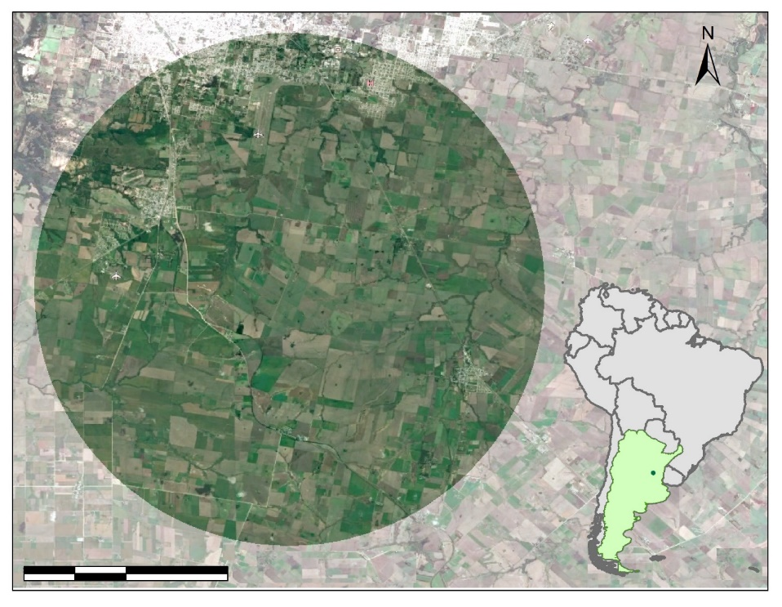
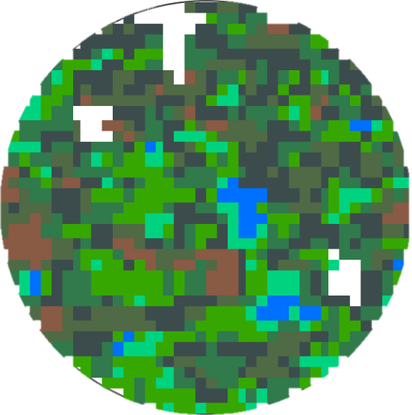
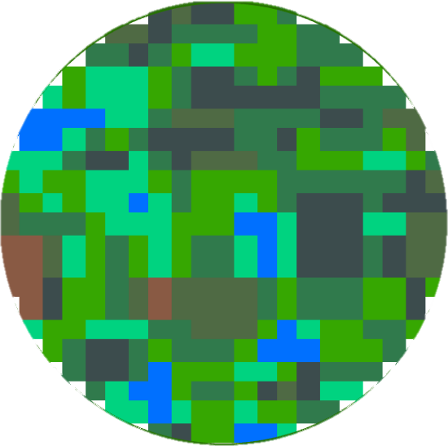
Results: Paraná
MOD16
SSEBop
GLDAS-2-Noah
0
2
4
8
km
0
2
4
8
km
0
2
4
8
km
Low
High
ET (mm)
Notes:
Here we can see a visual representation of the model outputs for Parana with a relative cumulative ET bar bellow the maps.

Slide 21
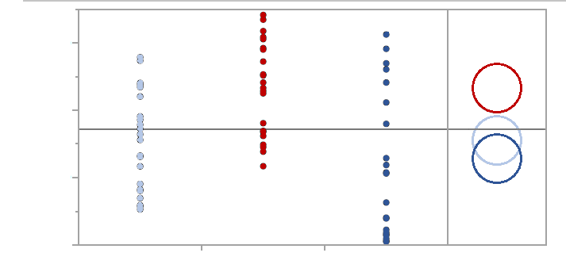
Results: Paraná Statistics
150
Group A
100
Monthly ET (mm)
Group B
50
MOD16
SSEBop
0
GLDAS-2-Noah
GLDAS-2-Noah
MOD16
SSEBop
Each Pair Student’s t
Notes:
We ran statistics using a Kruskal Wallis test which has a null hypothesis. The null hypothesis assumes that the models will have the same ET values based on a given location. The graph is a plot of all the points for ET for 2017. In the circle graphic from the Student’s t post hoc test we can see that it places MOD16 in Group A, SSEBop in Group B, and GLDAS in both Group A and Group B. This means that MOD16 was more different from the other two models. While SSEBop and GLDAS are more similar.

Slide 22
Results: Paraná Statistics
Water Years | Kruskal Wallis | Student’s t
 | All Models | MOD16 vs. SSEBop | MOD16 vs. GLDAS-2-Noah | GLDAS-2-Noah vs. SSEBop
Two Water Years | 0.0009** | 0.0001** | 0.0035** | 0.2927
2016 | 0.0144* | 0.0032** | 0.0181* | 0.4939
2017 | 0.0523 | 0.0169* | 0.0920 | 0.4400
* Significant Level at 95%
** Significant Level at 99%
Notes:
In the Kruskal Wallis test the p-value for 2 years was significant level of 99%, meaning the models were different enough for a significant rejection of the null hypothesis at 0.0009. However, after conducting a Student’s t post hoc test it was identified that SSEBop and GLADS accepted the null hypothesis, MOD16 and GLDAS and SSEBop and MOD16 were significantly different having a 99% significant level. If we look at the individual years we can see that MOD16 and SSEBop were the most different with a 99% significant level in 2016 and a 95% significant level in 2017.

Slide 23
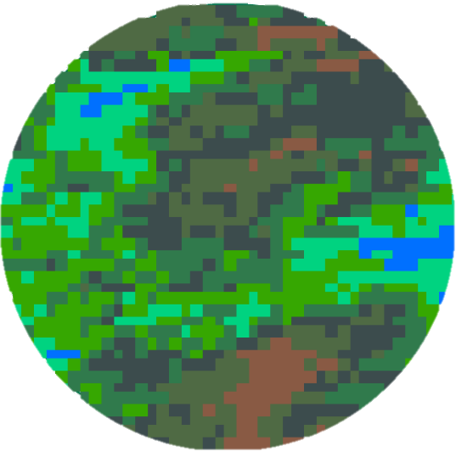
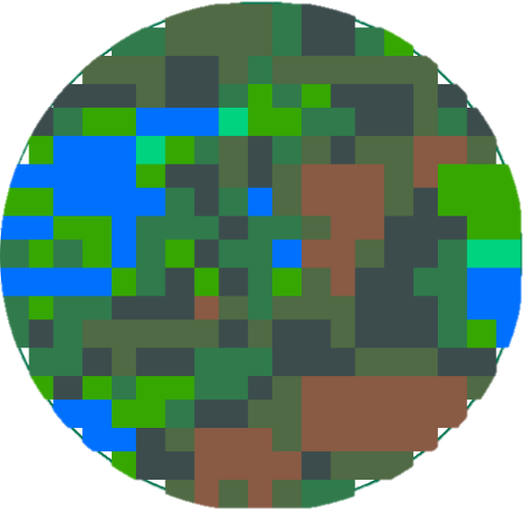
Results: Patagonia Steppe
MOD16
SSEBop
GLDAS-2-Noah
0
2
4
8
km
0
2
4
8
km
0
2
4
8
km
Low
High
ET (mm)
Notes:
Here we can see a visual representation of the model outputs for the Patagonia Steppe with a relative cumulative ET bar bellow the maps.

Slide 24
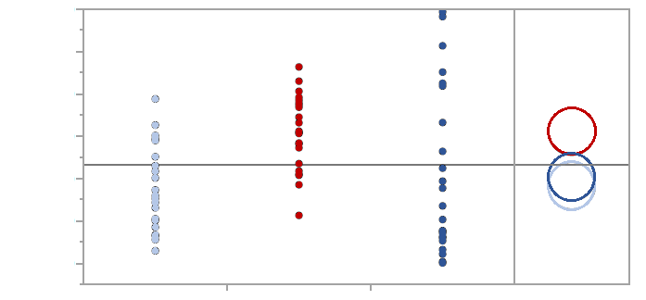
Results: Patagonia Steppe Statistics
120
100
80
Group A
Monthly ET (mm)
60
40
Group B
20
MOD16
0
SSEBop
GLDAS-2-Noah
GLDAS-2-Noah
MOD16
SSEBop
Each Pair Student’s t
Notes:
Here we can see the data points for 2016 and 2017. The Student’s t post hoc, the circle graphic, indicates that MOD16 (group A) was different form both SSEBop and GLDAS (group B) and that SSEBop and GLDAS are very similar because of their overlap.

Slide 25
Results: Patagonia Steppe Statistics
Water Years | Kruskal Wallis | Student’s t
 | All Models | MOD16 vs. GLDAS-2-Noah | MOD16 vs. SSEBop | SSEBop vs. GLDAS-2-Noah
Two Water Years | 0.0011** | 0.0018** | 0.0079** | 0.6163
2016 | 0.0418* | 0.0229* | 0.0615 | 0.6553
2017 | 0.0139* | 0.0301* | 0.0540 | 0.7906
* Significant Level at 95%
** Significant Level at 99%
Notes:
Using the Kruskal Wallis test for 2 years we found that there was a significant difference among the three models with a p-value of 0.0011 at a 99% significant level. This means that at least one of the models was different from the others. To identify which models were different we ran a Student’s t post hoc test, and found that there was an acceptance of the null hypothesis for SSEBop and GLDAS, significant rejection of the null hypothesis between MOD16 and SSEBop, and MOD16 and GLDAS at a 99% significant level. If we look at the individual years we can see the greatest difference is between MOD16 and GLDAS for the Patagonian Steppe.

Slide 26
Results: Summary
MODEL | PROS | CONS | Spatial Resolution | Temporal Resolution
GLDAS-2-Noah | Good correlations High temporal resolution | Low spatial resolution Correlation may depend on availability of meteorological data | ~28 km | 3 hour
SSEBop | Easy to access/ download data | Varying outputs | 1 km | 10 day
MOD16 | Fairly high spatial resolution Available through GEE | Overestimates ET relative to other models in study | 500 m | 8 day
Notes:
To describe the models relative to each other we put together this table. The table displays pros, cons, spatial resolution, and temporal resolution of each model. SSEBop is easy to access and download data however outputs varied between the two years of our study. The spatial resolution was the second best of the study at 1 km and the temporal resolution is 10 days. GLDAS-2-Noah had good correlations during the validation correlation coefficient test (to RCEW) and it had the highest temporal resolution at 3 hr. However, it had the poorest spatial resolution at ~28 km. Outputs from GLDAS-2-Noah are calculated using meterorological data from weather data station, therefore high correlations might be a product of the utilization of weather station data making its usefulness in remote locations unknown. MOD16 is freely available on GEE and can be accessed using a small amount of coding. However, MOD16 utilizes a Penman-Monteith equation which has been known to overestimate ET in semi-arid region in some cases. Its spatial resolution is 500 m and it has an 8 day temporal resolution.
Figure modified from Idaho Water Resources II team

Slide 27
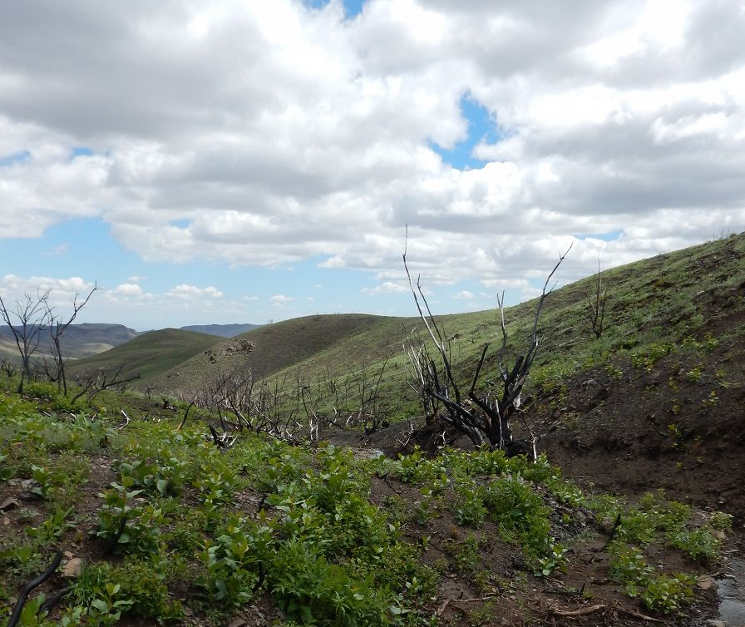
Discussion
Statistics
Paraná vs. Patagonia Steppe
Semi-arid regions
Patagonia Steppe and RCEW
Limitations
Data acquisition feasibility
Image Credit: Critical Zone Observatories
Notes:
We found an interesting result between models and the two study areas while running our statistical analysis. In Paraná MOD16 and GLDAS were the most different, but in the Patagonia Steppe MOD16 and SSEBop were more different. This could be due to how GLDAS works. GLDAS uses meteorological station data as part of its ET calculation so where there are no meteorological stations the values may very more.
Models that preformed well in RCEW should also preform well in the Patagonia Steppe of Argentina as both are semi-arid regions. This means that GLDAS and SSEBop will preform better than MOD16 in these areas.
We had one major limitation in this research, data acquisition feasibility. Due to this limitation we were unable to work with certain models.
Image URL: https://criticalzone.org/reynolds/infrastructure/field-area/murphy-creek/ (Public Domain → Critical Zone Observatories are part of the US NSF National Program)

Slide 28
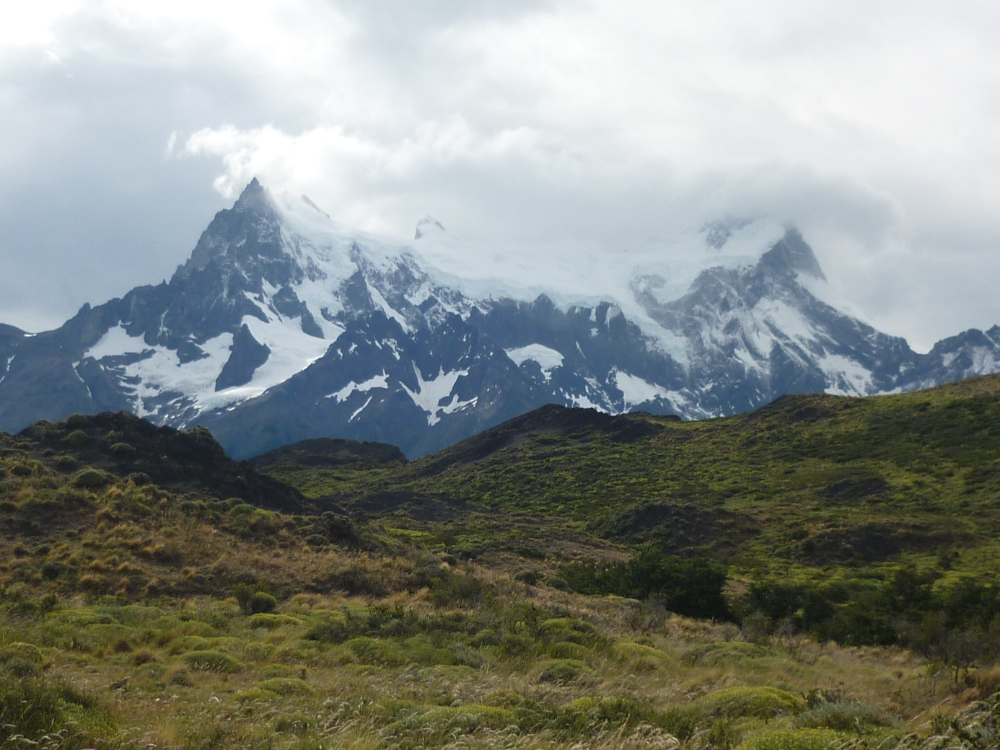
Conclusion
MOD16
GLDAS-2-Noah & SSEBop
Statistics
Semi-arid region
New Model
Hybrid of GLDAS-2-Noah & SSEBop
Image Credit: Chaparroandrea
Notes:
We used the models that were validated in RCEW to identify which ones may work well in the Patagonia Steppe of Argentina. After running the statistical analysis we were able to identify that SSEBop and GLDAS are not significantly different because they provide similar ET values over both Paraná and the Patagonia Steppe, and that MOD16 estimates are significantly statistically different.
GLDAS and SSEBop have potential to be applied in semi-arid regions similar to the Patagonia Steppe.
A hybrid model using both the high temporal resolution data from GLDAS and the high spatial resolution data from SSEBop models can be an effective way to measure ET more accurately.
Image credit: https://commons.wikimedia.org/wiki/File:Patagonia..JPG (Creative Commons License, Attribution-Share Alike 3.0 Unported license)

Slide 29
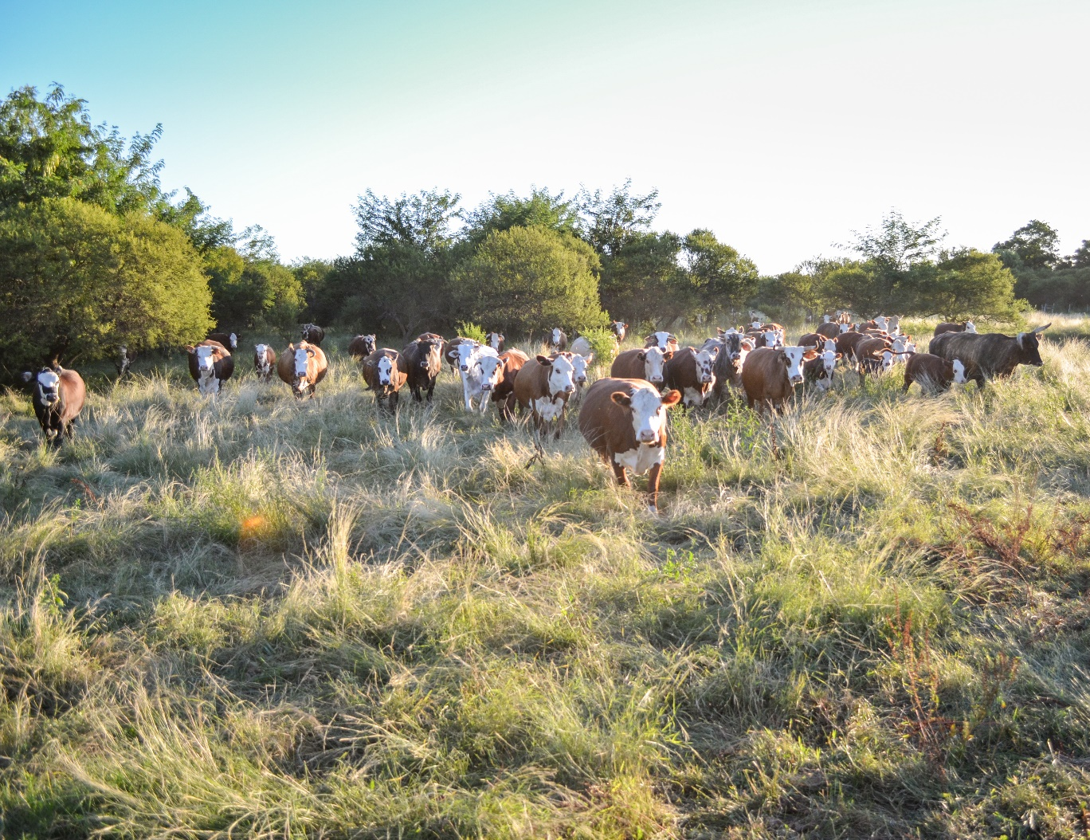
Next Steps
Validation with in situ data
Test ECOSTRESS
Developing automated image download
Analysis of Shifting Climates
Climatological analysis in shifts of temperature and precipitation in Argentina
Image Credit: Milton Blumhagen
Notes:
In the future it would be beneficial to use in situ data for Paraná and the Patagonia Steppe to validate the models in each area.
Research on this project could continue by expanding the number of models used for validation such as ECOSTRESS.
Also if a code were developed to automated the process of image download to run the partner model it would reduce time constraints.
Another aspect would be to look at how the Earth’s climate is changing and how that could cause a change in temperature and precipitation regimes in Argentina.
Image Credit: Provided by partner (have permission to use)

Slide 30
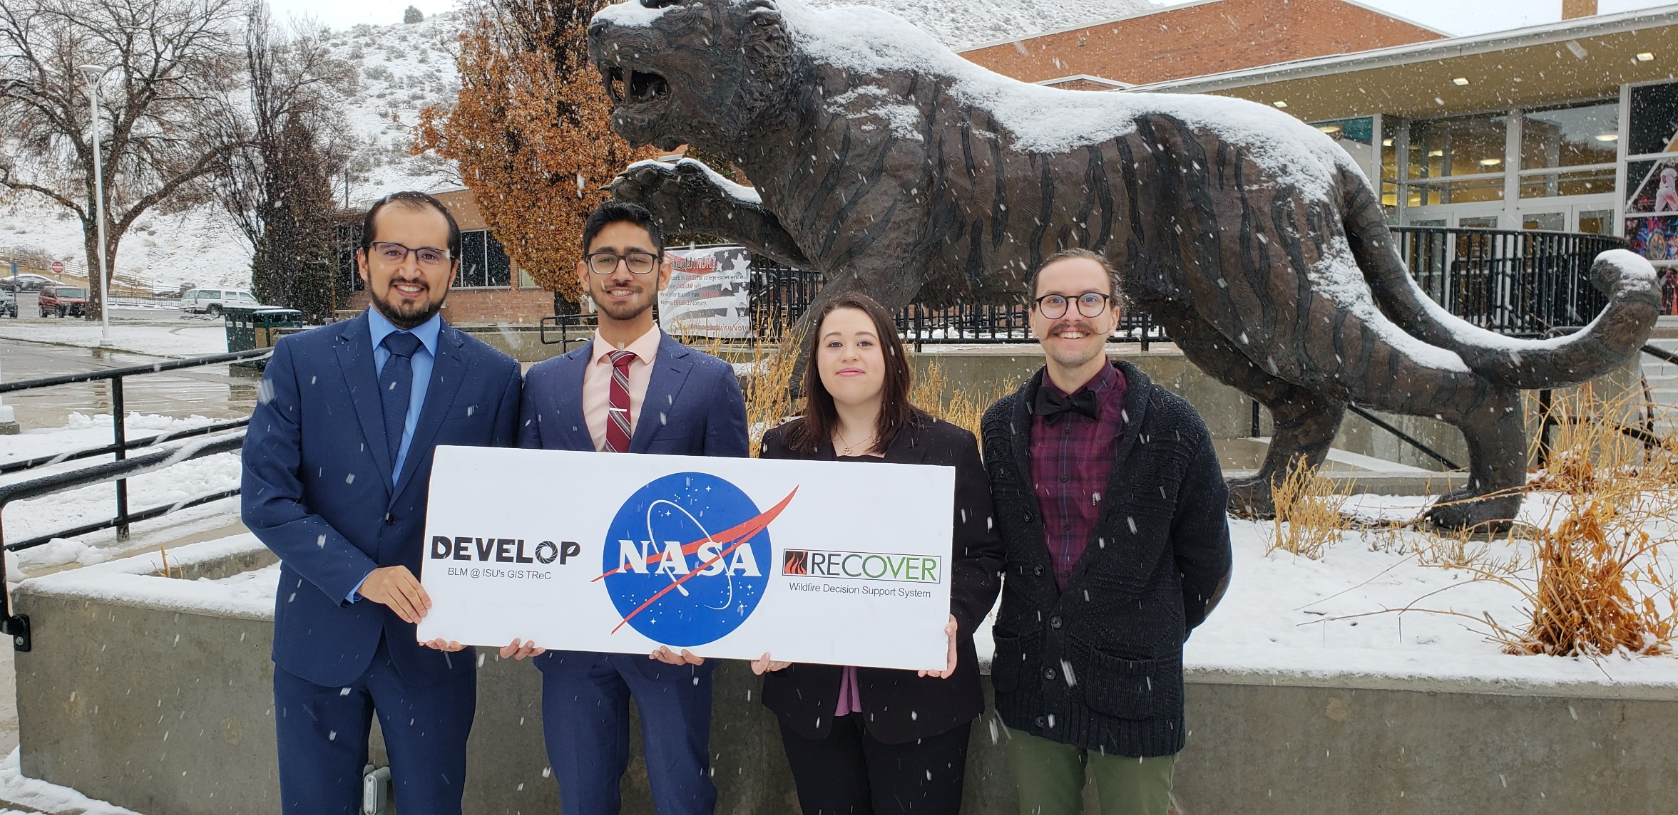
QUESTIONS

Slide 31
Advisor, Keith T. Weber (Idaho State University, GIS TReC)
Partners, Dr. Pablo G. Aceñolaza, Researcher; Sebastián Anibal Gavilán, Researcher
Center Lead, Kristen Dennis
Geoinformatics Fellow, Dane Coats
Notes:
We would like to thank our science advisor Keith Weber at Idaho State University, our partners at CONICET Dr. Pablo Aceñolaza and Sebastián Gavilán, our center lead Kristen Dennis, and geoinformatics fellow Dane Coats for their guidance and support during this project.

Slide 32
Idaho Water Resources II
ET Model Validations

Slide 33
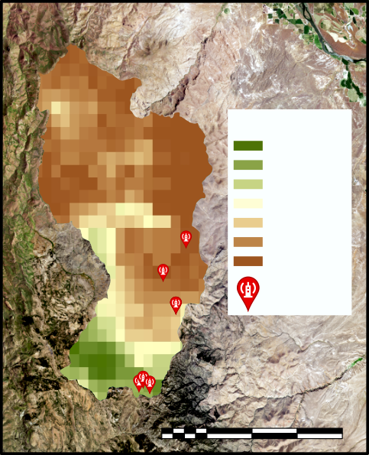
Results: SSEBop
E.C. Flux Towers
SSEBop
Low Sage
Mtn. Sage 1
Mtn. Sage 2
WY Sage
Evapotranspiration
110
ET (mm/month)
(mm/
month)
0
E.C. Flux Towers
0 5 10 20 km
Notes:
MOD16 has a resolution of 500m pixels. ET values for Paraná, the first graph, follows a similar pattern over both years with minor variation in the month of January. The Patagonia Steppe shows that 2016 contained higher values than 2017 meaning that 2016 most likely received more precipitation than 2017 did especially for the months of January and February.

Slide 34
Results: SSEBop
E.C. Flux Towers
Low Sage
Mtn. Sage 1
Mtn. Sage 2
WY Sage
ET (mm/month)
Notes:
MOD16 has a resolution of 500m pixels. ET values for Paraná, the first graph, follows a similar pattern over both years with minor variation in the month of January. The Patagonia Steppe shows that 2016 contained higher values than 2017 meaning that 2016 most likely received more precipitation than 2017 did especially for the months of January and February.

Slide 35
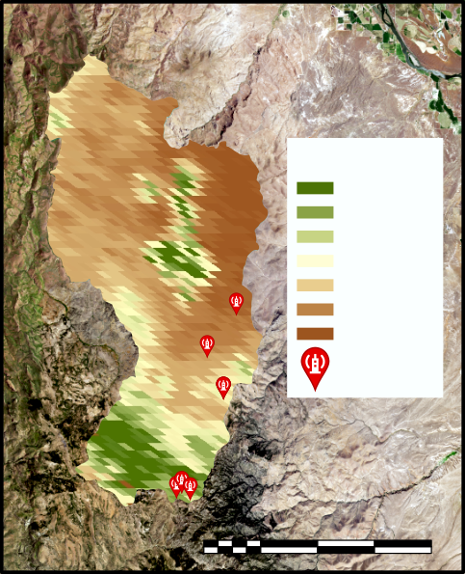
Results: MOD16
E.C. Flux Towers
MOD16
Low Sage
Mtn. Sage 1
Mtn. Sage 2
WY Sage
Evapotranspiration
ET (mm/month)
45
(mm/
8 days)
0
E.C. Flux Towers
0 5 10 20 km
Notes:
MOD16 has a resolution of 500m pixels. ET values for Paraná, the first graph, follows a similar pattern over both years with minor variation in the month of January. The Patagonia Steppe shows that 2016 contained higher values than 2017 meaning that 2016 most likely received more precipitation than 2017 did especially for the months of January and February.

Slide 36
Results: MOD16
MOD16 vs. RCEW 2015-2017, Monthly
E.C. Flux Towers
Low Sage
Mtn. Sage 1
Mtn. Sage 2
WY Sage
ET (mm/month)
Notes:
MOD16 has a resolution of 500m pixels. ET values for Paraná, the first graph, follows a similar pattern over both years with minor variation in the month of January. The Patagonia Steppe shows that 2016 contained higher values than 2017 meaning that 2016 most likely received more precipitation than 2017 did especially for the months of January and February.

Slide 37
Results: Modeled ET vs. RCEW Correlations
Notes:
MOD16 has a resolution of 500m pixels. ET values for Paraná, the first graph, follows a similar pattern over both years with minor variation in the month of January. The Patagonia Steppe shows that 2016 contained higher values than 2017 meaning that 2016 most likely received more precipitation than 2017 did especially for the months of January and February.

