Slide 1
ALASKA DISASTERS
Development of a Snowmelt Monitoring Tool Using NASA MODIS and NOAA Climate Data Records to Aid Wildfire Managers in Alaska
Caroline Jahn (Team Lead)
Laurel Mahoney
Daniel Lucas
Jeshua Pott
Notes:
Script: Hello everyone thank you for being here today. My name is Caroline, my name is Laurel, my name is Daniel, my name is Jeshua, and we are the Alaska Disasters team from NCEI.
Our project focuses on the development of a snowmelt monitoring tool using NASA MODIS and NOAA Climate Data Records to aid Wildfire Managers in Alaska.

Slide 2
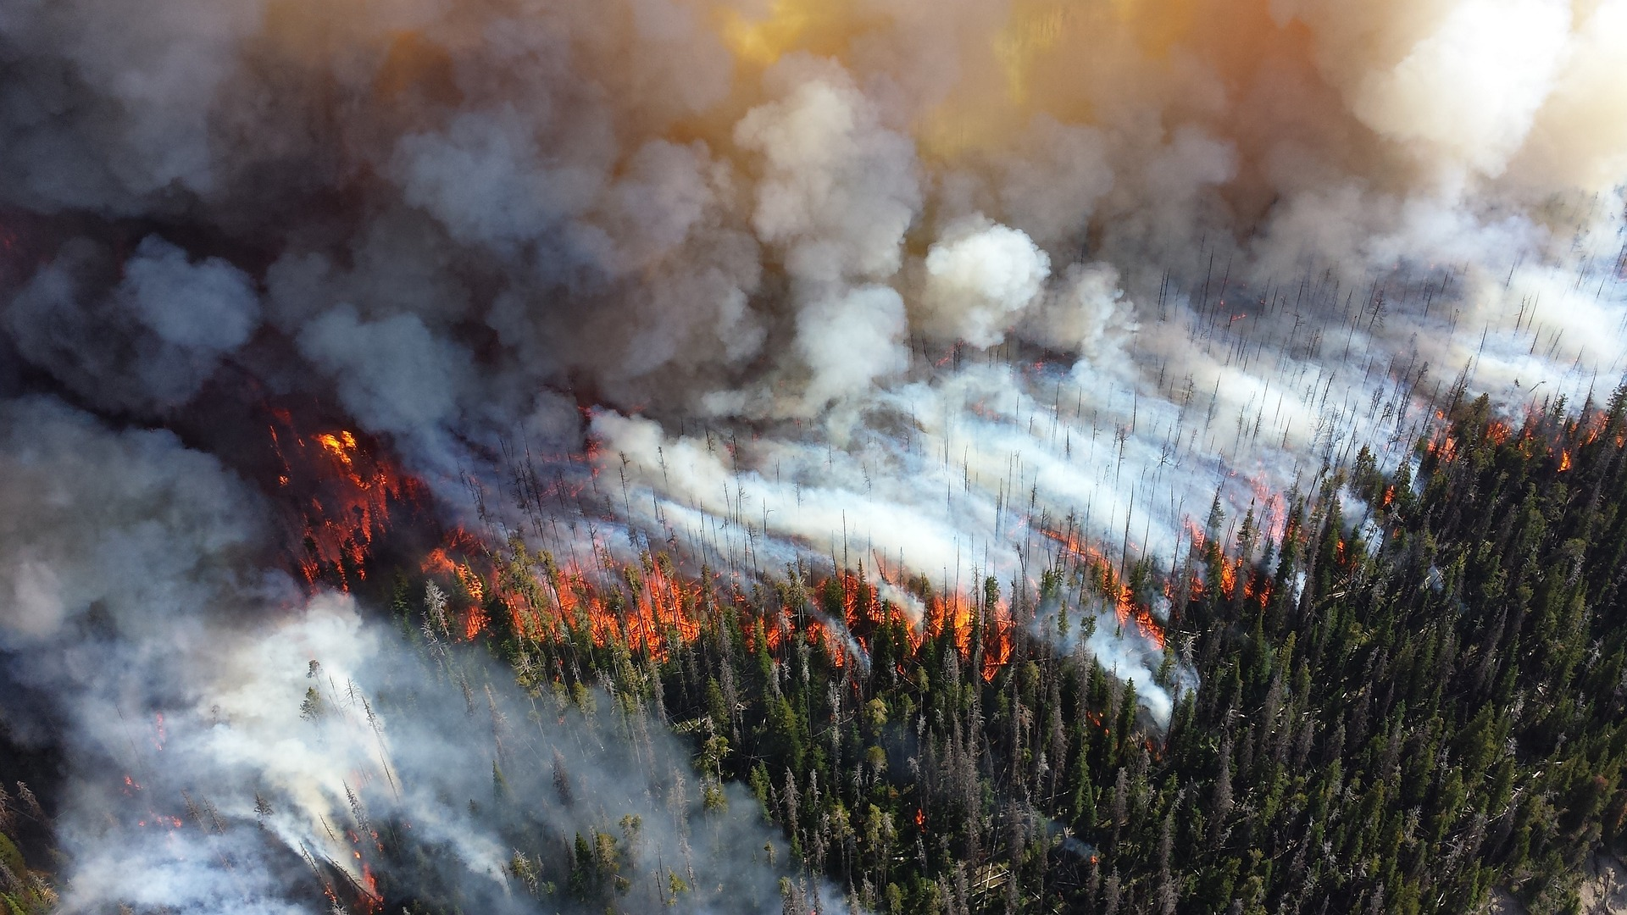
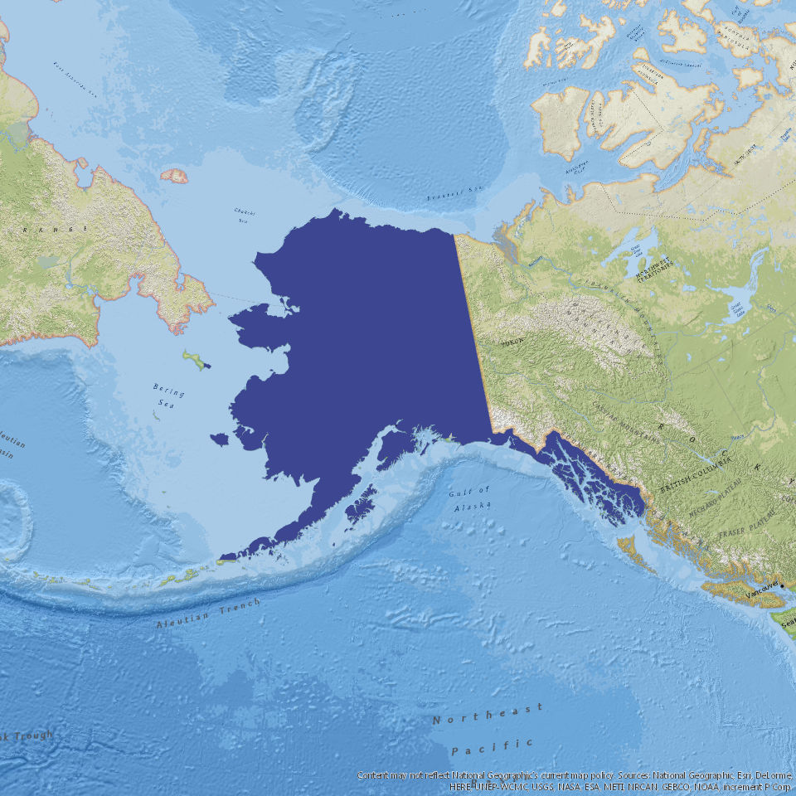
Study Area & Period
Study Period:
SnoCoM Tool
January 2016 to July 2016
January 2017 to July 2017
Historical Trend Analysis
1967 - 2017
Image Credit: Pixabay
Notes:
Laurel - Script: Our study area is the state of Alaska. The study period for this project is from 1967 to 2017. We used this time frame for the historical trend analysis and for the tool we looked from January to July of 2016 and January to July of 2017. The reasoning for the first study period is to correlate with our project partner’s official wildfire season, which is from January to May.
Image Source: skeeze https://pixabay.com/en/forest-fire-blaze-smoke-trees-1161868/

Slide 3
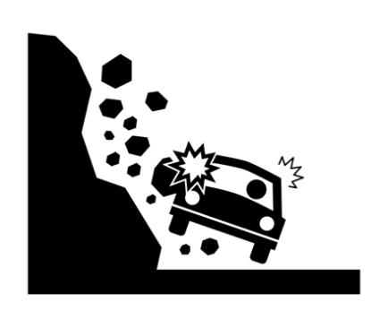
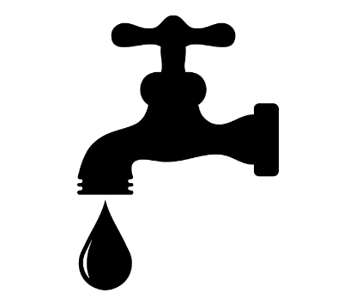
Community Concerns
Limited data available to inform the AICC of when snow cover melt occurs
Limited Data
An increase in fires could cause:
Erosion
Soil Composition Fluctuation
Flooding
Wildlife Habitat
Timber Production
Water Production & Accessibility
Notes:
Jeshua - Script: There are two main community concerns associated with this project: Limited Data and an Increase in Fire. There are limited data available to inform the AICC of when snow cover melts throughout the state, leaving unmonitored areas at risk to wildfire before mitigation planning and efforts can be provided. Alaska is warming twice as fast as the rest of the nation due to changes in the climate, causing shorter winters, thawing permafrost, and rapidly receding glaciers. All of these weather changes are lengthening wildfire seasons and increasing the number of wildfires experienced by the state. An increase in wildfires could cause an increase in flooding, erosion, and biogeochemical changes with carbon storage, plus fluctuation in soil composition; as well as a decrease in wildlife habitat, timber production, and in water production and accessibility.
These changes are detrimental to the Alaska economy, which is heavily based on the extraction and use of natural resources (Fishing, Tourism, Forestry, and Oil)
Image Source:
Computer: Created by Gregor Cresnar from Noun Project
Plant: Created by Ben Davis from Noun Project
Waves: Created by Nathan Diesel from Noun Project
Water Spout: Created by Ben Didier from Noun Project
Timber: Created by Gan Khoon Lay from Noun Project
Land Slide: Created by Gan Khoon Lay from Noun Project

Slide 4
Project Partners
Alaska Interagency Coordination Center, Heidi Strader, Meteorologist
National Weather Service, Alaska Region, Rick Thoman, Climate Science and Services Manager
Notes:
Caroline - Script: To carry out this project, we partnered with the Alaska Interagency Coordination Center, the National Weather Service, and the National Oceanic and Atmospheric Administration.
(James Partain, NOAA Regional Climate Services Director, Alaska Region (Partner) was a part of the creation of this project)
Image Source: NOAA Logo http://www.noaa.gov/ https://commons.wikimedia.org/wiki/File:NOAA_logo.svg
Image Source: NWS Logo https://www.weather.gov/ https://commons.wikimedia.org/wiki/File:US-NationalWeatherService-Logo.svg
Image Source: AICC Logo https://fire.ak.blm.gov/ http://www.wildfireincidents.com/wildfire-links/geographic-area-coordination-centers

Slide 5
Project Objectives
Utilize both NASA Earth observations and NOAA climate data to fill the gaps in current data
Create a snow cover monitoring tool to calculate the changes using MODIS NDSI
Distribute gridded snowmelt data to partners for use within existing mapping services
Revise tool to use near real-time VIIRS Land Cover data
Study climatological trends in seasonal snow cover melt to provide insight on historic changes in snowmelt
Image Credit: Pixabay
Pixabay
Notes:
Danny - Script: The objectives for this project were to utilize both NASA Earth observations and NOAA climate data to fill the gaps in current data used by project partners. Create a snow cover monitoring tool to calculate the changes in near real-time using the MODIS Normalized Difference Snow Index data. Distribute raw gridded snowmelt data to project partners for use within existing mapping services. Revise tool to produce using VIIRS near real-time Snow Cover data outputs for project partners. Study and document climatological trends in seasonal snow cover melt to provide insight on historic and expected changes in snowmelt
Image Source: dsurver https://pixabay.com/en/icebergs-glacier-alaska-2707576/

Slide 6
Data Acquisition
NASA’s Moderate Resolution Imaging Spectroradiometer (MODIS) Normalized Difference Snow Index (NDSI)
NASA’s Suomi National Polar-orbiting Partnership (NPP) Visible Infrared Imaging Radiometer Suite (VIIRS)
Natural Resources Conservation Service SNOw TELemetry (SNOTEL)
NOAA’s Snow Cover Extent - Climate Data Record (SCE-CDR)
Notes:
Danny - Script: The data acquired to complete this project and tool were:
MODIS: daily snow cover data via NDSI values. from January 2016 to July 2016 and January 2017 to July 2017 in order to establish the tool.
We then used the VIIRS satellite near-real-time snow cover data to update our already built tool. We could not get access to historical VIIRS data, which is why MODIS data was used for building the tool.
SNOTEL: snow cover data measured on sight. It will be used for verifying our tool by comparing output results and actual on sight measurements.
SCE-CDR to conduct a historical trend analysis. This is weekly data that were converted to monthly averages.
Image Source: http://www.devpedia.developexchange.com/dp/index.php?title=List_of_Satellite_Pictures
Image Source: Daniel Fisher - USDA Natural Resources Conservation Service https://toolkit.climate.gov/image/570
Image Source: https://data.nodc.noaa.gov/cgi-bin/iso?id=gov.noaa.ncdc:C00756

Slide 7
Data Processing – Building SnoCoM
Change Detection Analysis of grid cells
1 → 0 → 0 → 0 snowmelt
Record & Store Day of Thaw
Historical Day of Thaw File
Output: Gridded data & Map
Map: Gradient based on days since thaw
Raw Gridded Snowmelt: Start Fire Indices
Download MODIS NDSI data
4 consecutive days during snowmelt season
Project & Clip to Alaska
Alaska Albers Equal Area Conic
Reclassify NDSI Values to Binary
Non-burnable areas excluded
NDSI | Binary
0-15 | 0
16-100 | 1
101-255 | Null
Notes:
Caroline & Danny - Script: Caroline & Danny - Script: In order to build the Snow Cover Monitoring (SnoCoM) Tool we scripted code with python. Our first step was to input 4 consecutive days of MODIS NDSI data into the tool. We chose to analyze four days because our partner, the AICC, uses the Fire Weather Index System to monitor wildfire risk and through this system an area necessitates fire risk assessment and is officially considered snow-free after three consecutive days without snow. The next step in this process was to project the data to the Alaska Albers Equal Area Conic projection and clip it to a polygon of Alaska using arcpy. Then we reclassified the NDSI values to a binary no-snow/snow. We chose a 15% snow cover threshold for no-snow based on literature review.
Then we preformed a change detection analysis, using the gdal package, that looped through each grid cell of each of the four days to detect a 1,0,0,0 snowmelt pattern. It also determines snow-free and snow-covered areas. Then we recorded and stored the day of thaw in separate csv file which allowed us to establish how long cells have been snow-free. We used this data to create a final map output for the AICC that not only shows which areas are snow-covered vs. snow-free but also displays the amount of days snow-free on a gradient. Our second output was raw gridded data that simply indicates whether or not fire indicis should be run that day (if it is 1,0,0,0) for use within the Alaska Fire and Fuels existing interactive map.

Slide 8
Data Processing
Day 1
Day 3
Day 4
Day 2
for i in range(rows):
for j in range(cols):
if day_1[i,j] == 1 and day_2[i,j] == 0 and day_3[i,j] == 0 and day_4[i,j] == 0:
outarray[i,j] = 20
#20 = Recent snowmelt
Day 1
Day 3
Day 4
Day 2
Day 1
Day 3
Day 4
Day 2
Day 1
Day 3
Day 4
Day 2
Notes:
Caroline – Script: This is an example of the binary snow-covered data for four days, with white being snow, green being no-snow and black being non-burnable areas (as determined by our partners). Beneath is snippet of code that runs through the arrays that we created from our four rasters and outputs a distinct snowmelt value into a new array of our change detection analysis.

Slide 9
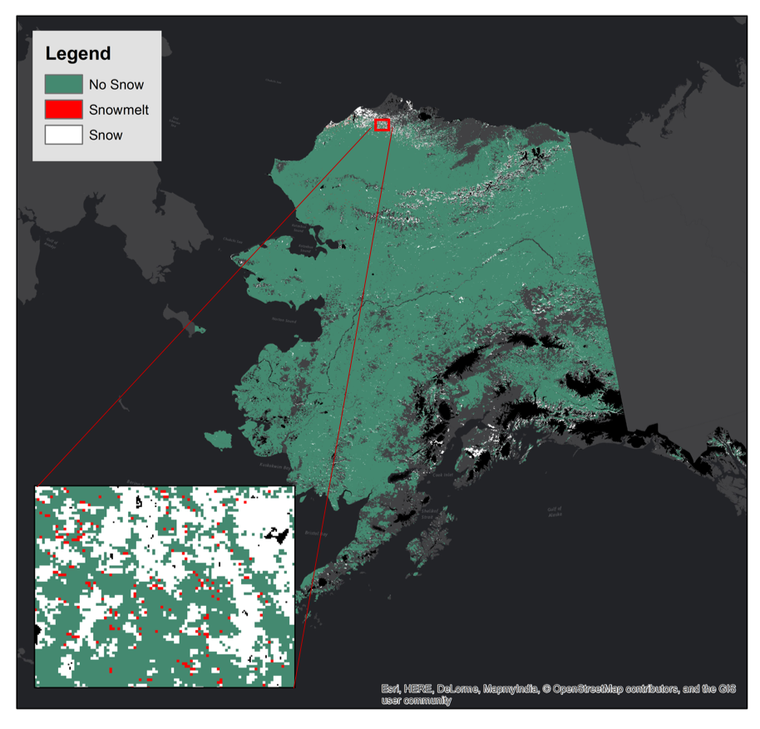
Results
Notes:
Caroline - Script: Tested the tool using MODIS data as a proof of concept – the outputted maps are from test. These maps and data are what was used to verify with SNOTEL data. The actual tool will use VIIRS data that the project partner requested.

Slide 10
Data Processing – Adding VIIRS
Fetch VIIRS Land Cover data
Parse data to Retrieve TIFF file
Use Current Day + 3 Days Prior
Convert Land Cover to NDSI
Input Code to First Part for VIIRS
Extracted from Alaska GINA – SANDY site
Fetched JSON file
Data from UAFGINA
Julian Days (Maximum Day)
Need 4 days for snowmelt check
Max Julian Day + 3 Days Prior
Applied Equation: NDSI =
(Band1 – Band3)
------------------------
(Band1 + Band3)
Added Code to First Part to replace MODIS
Notes:
Laurel & Danny - Script: Our project partners requested that the final product of the SnoCoM tool utilize VIIRS data. After creating a proof of concept using the historical data from MODIS, the DEVELOP team coded a new first step for the tool to switch the inputting data source. Using Python, the Land Cover data was coded to extract from the Alaska GINA site, SANDY, and fetched the JSON file. The files were then coded to only grab the needed files by parsing the url to only grab TIFF files, data from the UAFGINA (University of Alaska, Fairbanks) location, and use Julian days to grab the current day and 3 most recent days previous. After the all the correct files were extracted and downloaded, the Land Cover data was converted to NDSI data. This was done by using bands from the Land Cover data and completing this equation that was taken from the VIIRS Snow Products User Guide. Once the data was outputted as an NDSI value, it was able to be added to the previous coding that was done with MODIS and create the necessary data and maps.

Slide 11
SnoCoM
Fetch near real-time Land Cover VIIRS data
Output: Gridded Data and Map
Convert Land Cover to NDSI
Record & Store Day of Thaw
Project & Clip to Alaska
Change Detection Analysis of each grid cell
Notes:
Caroline - Script: This graphic depicts the actual process that the tool will take every time it is run by our project partners.

Slide 12
Historical Trend Analysis
A Monthly Trend per Decade Analysis using NOAA’s Snow Cover Extent - Climate Data Record (SCE-CDR) from 1967 - 2017
Methodology:
Coded in IDL using previous work from Science Advisor - Jake Crouch
Fetched snow cover data from January - July
Each month is compared per decade
Outputs monthly snow trends depicting the rate of change in snow cover days per decade
Notes:
Laurel - Represent a Monthly Trend per Decade for each map. A historical analysis of snowmelt using NOAA Snow Cover Extent - Climate Data Records (SCE - CDR) was also conducted on the state of Alaska. One thing to keep in mind with the results is that because the SCE-CDR is one of the longest climate data records going back to 1967, in order to retain continuity with the results, we have to keep the same methodology that has been used for prior data. Due to this, the maps appear at a lower resolution, however, we can still gain a lot from both the maps and the data itself.
Rate of change per decade – Time rate of change is occurring over
Image Source: https://data.nodc.noaa.gov/cgi-bin/iso?id=gov.noaa.ncdc:C00756

Slide 13
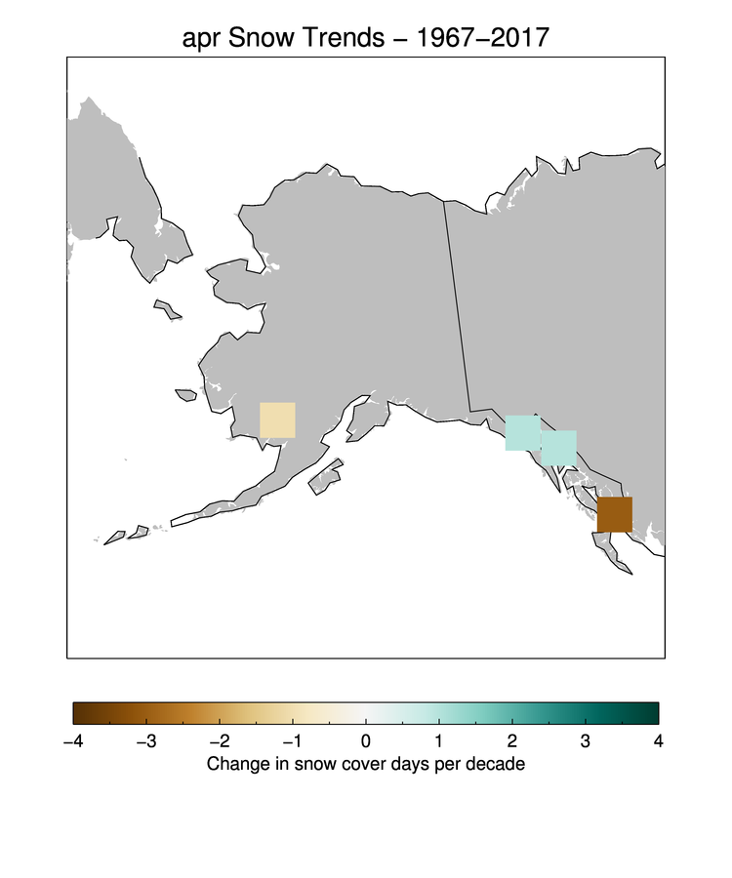
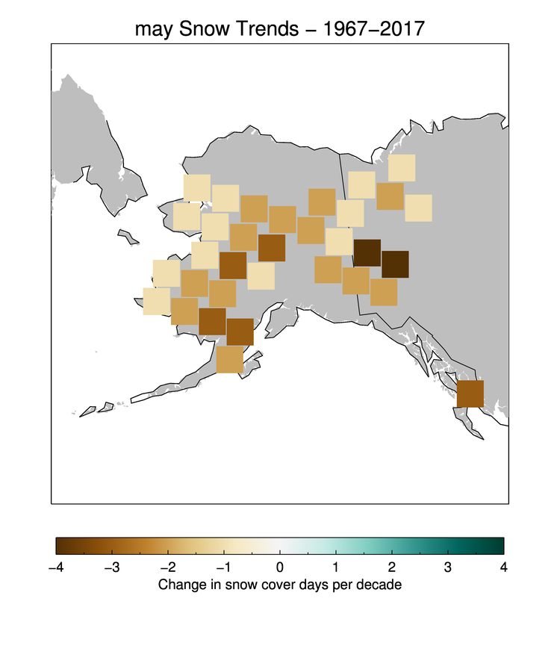
April Snow Trend 1967 – 2017
May Snow Trend 1967 – 2017
Notes:
Laurel - The results of this monthly trend per decade analysis show these main conclusions:
Greater amount of change occurring in the transition seasons
Winter and summer trends still established, however warming trend expanding
Compared results to Alaska temperature trends using NCEI tool that shows the average temperature of each month from 1925-2017. Interesting find was that even though April shows little change on the Historical Trend Analysis, the rate of temperature change in Alaska is greater during April compared to May and June, which led us to hypothesize that we haven’t seen change, because it has yet to occur, due to temperature impact still occurring.

Slide 14
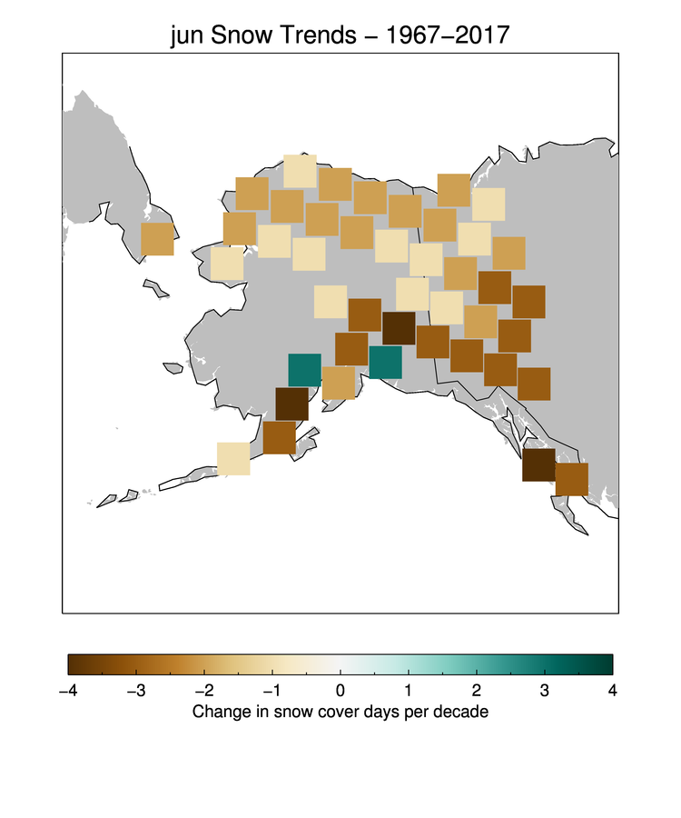
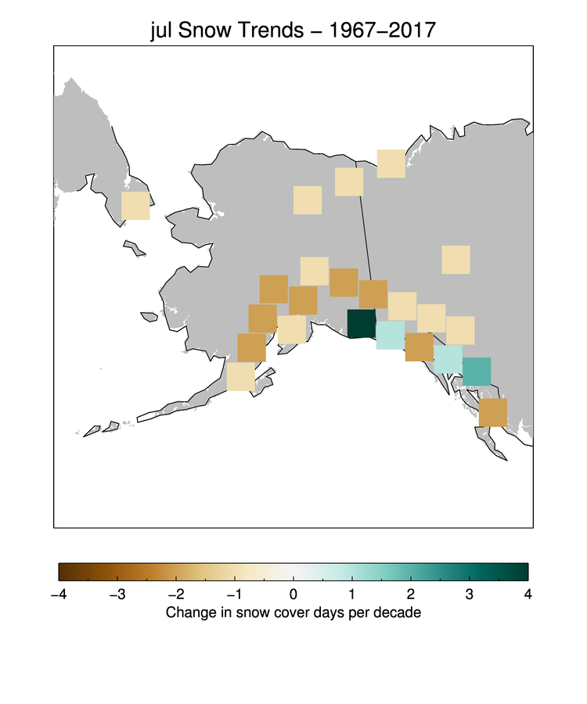
June Snow Trend 1967 – 2017
July Snow Trend 1967 – 2017
Notes:
Laurel - Main Conclusions:
Greater amount of change occurring in the transition seasons
Winter and summer trends still established, however warming trend expanding
One potential reason for the blue/green towards the South Coast of Alaska is the topography and geographic set up of the state, which creates a rain shadow effect. There is a mountain range towards the lower part of the state called the Alaska Range (Home to Denali National Park) that divides a dry northern region and a wet southern region. This divide only exacerbates an already rain/precipitation prone area by keeping the weather in the southern coastal zone.

Slide 15
Conclusions
Using this tool, the AICC and wildfire managers can better determine when to run wildfire indices to minimize disaster risk
Revising the SnoCoM tool to run on VIIRS data will allow our partners to visualize data at a higher resolution
Our Historical Trend Analysis suggests that a greater amount of change in snow cover days is occurring during transition seasons
Image Credit: Pixabay
Notes:
Danny, Caroline, Laurel - Script: The main conclusions for this project were that: Using this tool, the AICC and wildfire managers can better determine when to run wildfire indices to minimize disaster risk. Revising the SnoCoM tool to run on VIIRS data will allow our partners to visualize data at a higher resolution. Our Historical Trend Analysis suggests that a greater amount of change in snow cover days is occurring during transition seasons
Image Source: 12019 https://pixabay.com/en/mount-st-elias-icy-bay-wrangell-1730071/

Slide 16
Implementation of SnoCoM
AKFF Data
Outputs a distinct day to start fire indices rather than estimate from historical data
Operational:
Will be the first step for Fire Management to determine flight paths and monitoring zones
Cost savings measure that pin points locations that require fire management
Image Credit: Pixabay
Notes:
Jeshua – Script: The SnoCoM tool will be implemented into our project partners current system (AKFF Data) and will output a distinct day to start fire indices rather than an estimate from historical data. This tool will also be utilized by Fire Managers in Alaska: Will be the first step for Fire Management to determine flight paths and monitoring zones. Cost savings measure that pin points locations that require fire management.
Image Source: girlart39 https://pixabay.com/en/mountains-ice-bergs-antarctica-berg-482689/

Slide 17
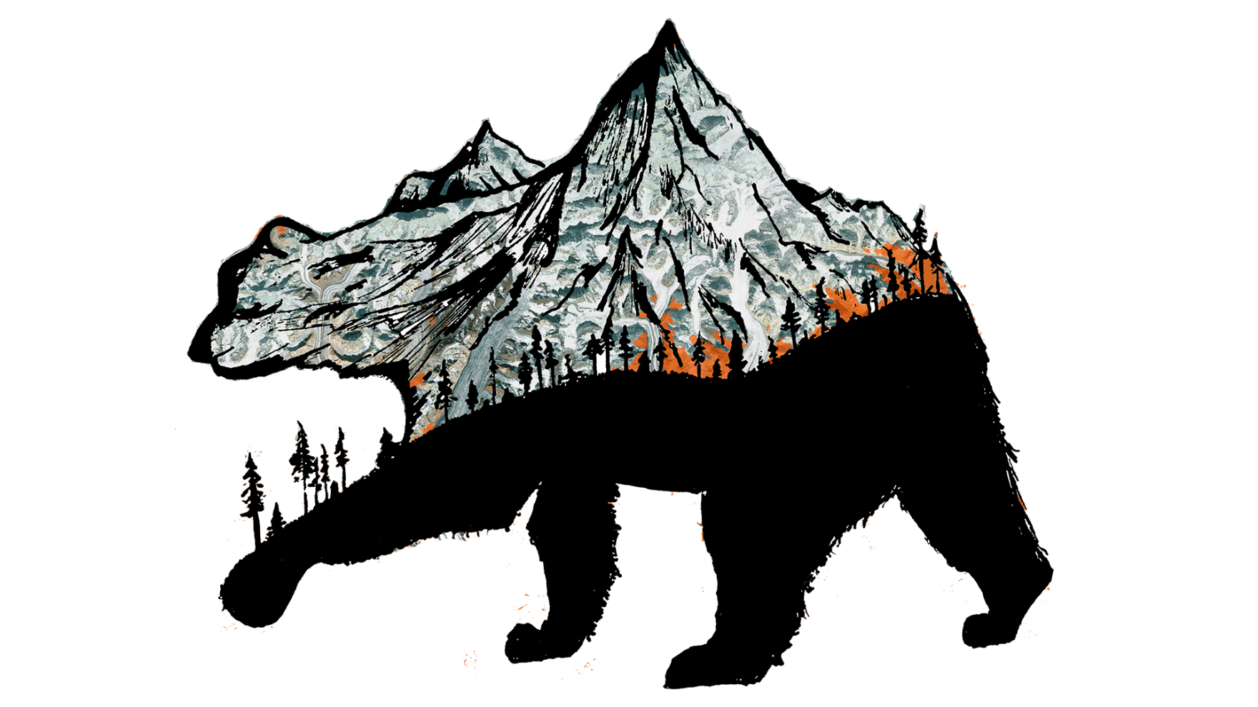
Acknowledgements
Jake Crouch, NOAA National Centers for Environmental Information, Physical Scientist (Science Advisor)
Heidi Strader, Alaska Interagency Coordination Center, Meteorologist (End User)
Rick Thoman, National Weather Service, Alaska Region, Climate Science and Services Manager (Partner)
James Partain, NOAA Regional Climate Services Director, Alaska Region (Partner)
Aaron Mackey, Center Lead
Jonathan O’Brien, Assistant Center Lead and Communications Fellow
James Adams, NOAA National Centers for Environmental Information
Rocky Bilotta, NOAA National Centers for Environmental Information
Notes:
Caroline - The Alaska Disasters team would like to thank our science advisor, Jake Crouch, as well as our Center Lead, Aaron Mackey, and Assistant Center Lead, Jonathan O’Brien. We would also like to acknowledge all of the NCEI employees, our partners, and fellows who dedicated their time and assistance to this project.

Slide 18
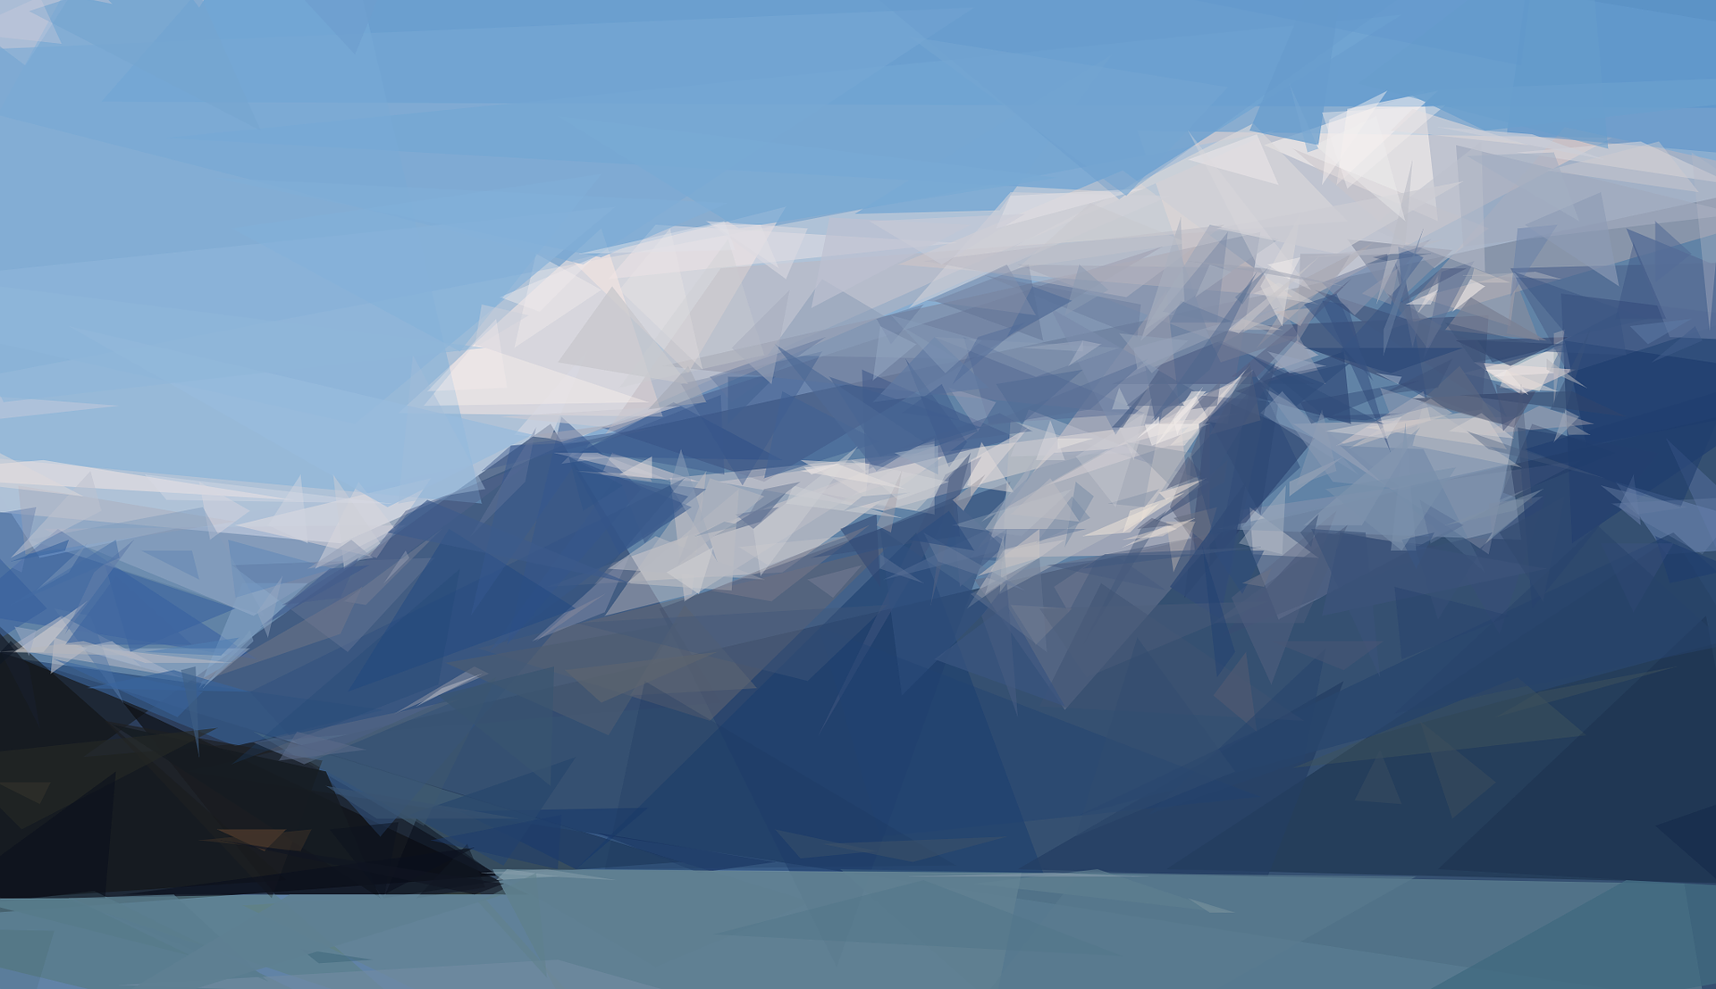
Thank You!
Image Credit: Pixabay
Notes:
Script: Thank you for your time and we hope you all enjoyed the presentation!
Image Source: Fotocitizen https://pixabay.com/en/alaska-water-lake-glacier-wildlife-1988844/

Slide 19
Data Verification
Ground Verification of data used for the tool with Natural Resources Conservation Service SNOw TELemetry (SNOTEL)
This dataset was used to check the results of the tool running on MODIS and verify the Day of Thaw with a threshold of a week
Notes:
Script: Still in the process of completing.
Image Source: https://www.nrcs.usda.gov/wps/portal/nrcs/detail/ak/snow/?cid=nrcs142p2_036017
https://www.wcc.nrcs.usda.gov/snow/

