Slide 1
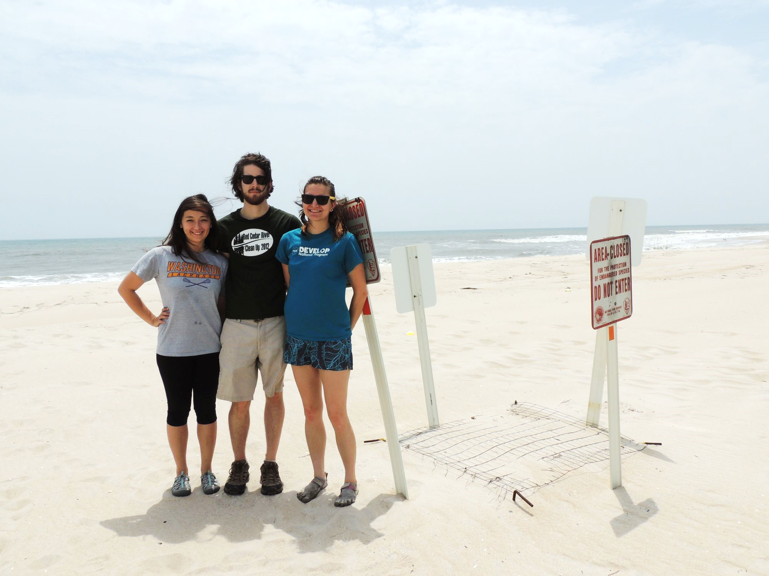
Maryland Ecological Forecasting
Utilizing NASA Earth Observations to Monitor and Strengthen the Survivorship of Maryland’s Sea Turtles
Notes:
Hello, I’m Erica and this Chris and this summer we also worked with Kiersten on the Maryland Ecological Forecasting project. We focused on using NASA Earth observations to monitor and strengthen the survivorship of Maryland’s sea turtles, particularly the loggerhead turtle. For this study, we focused on Maryland’s coastline which touches the Atlantic Ocean and Chesapeake Bay.

Slide 2
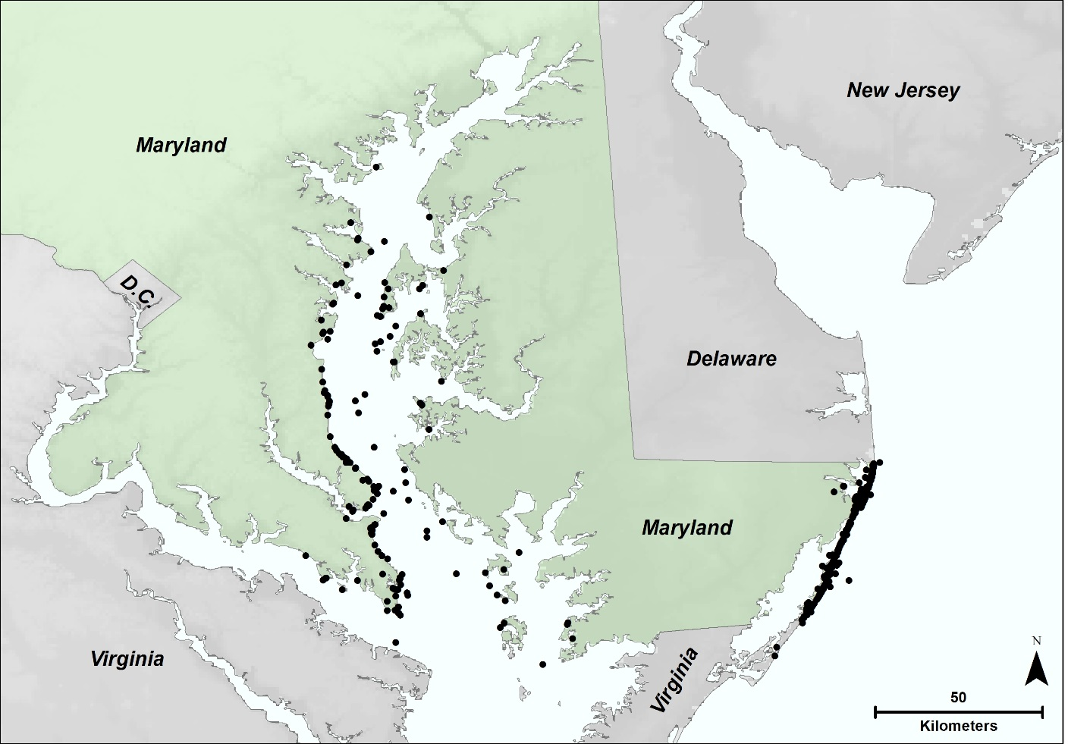
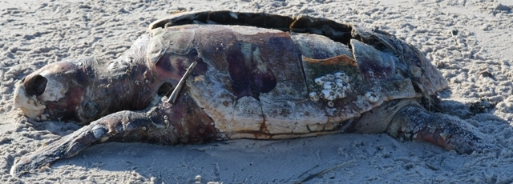
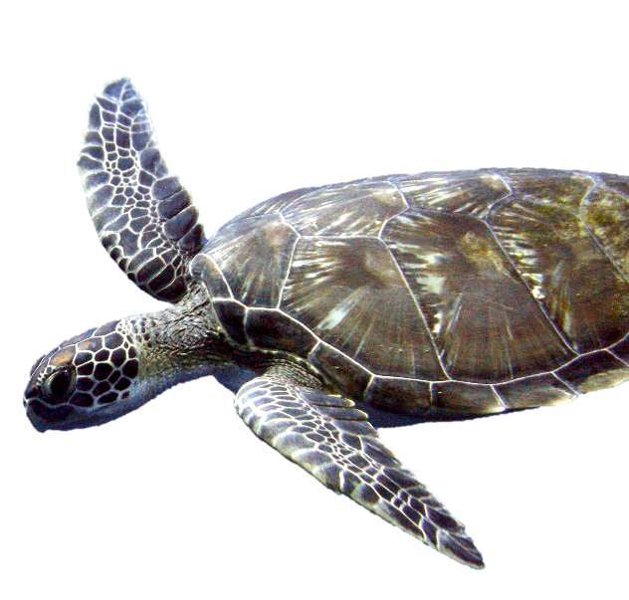
Study Region & Species
460 loggerhead strandings since 1991
Maryland Department of Natural Resources
Strandings
Matt Kleffer
Notes:
Loggerhead sea turtles are the most prevalent in this region and are listed as Threatened on the Endangered Species List. Since 1991, there have been 460 loggerhead sea turtle strandings. The cause of the strandings are sometimes easy to determine such as a boat strike, but other times are unknown and could be due to temperature or algae activity.
Our end users, the Maryland Department of Natural Resources, seeks to improve the survivability of loggerhead turtles by analyzing stranding and nesting.

Slide 3
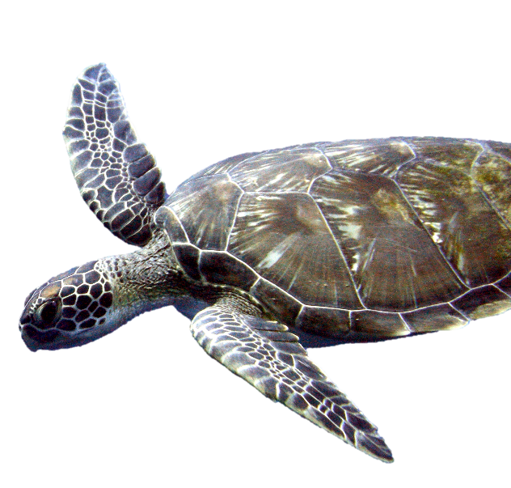
Objectives
Analyze correlations between loggerhead strandings, chlorophyll a and sea surface temperature.
Stranding
Climate Change
Predict changes in nest site use and availability
Nesting
Identify optimal nesting locations along Atlantic Coast
Matt Kleffer
Notes:
Our research is split into three major objectives.
The first is to analyze the stranding data to see if there are any correlations with loggerhead death and sea surface temperature and chlorophyll-a, which is a proxy of algal bloom activity.
Then, although nesting events are rare in Maryland, we wanted to investigate how climate change will drive loggerheads northward. As their nesting population increases in Maryland, we wanted to identify the optimal nesting site locations along the coast.

Slide 4
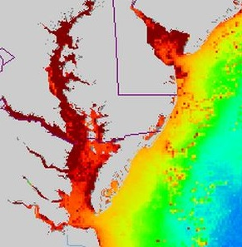
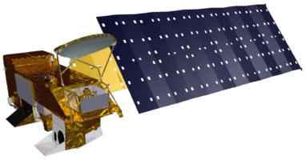
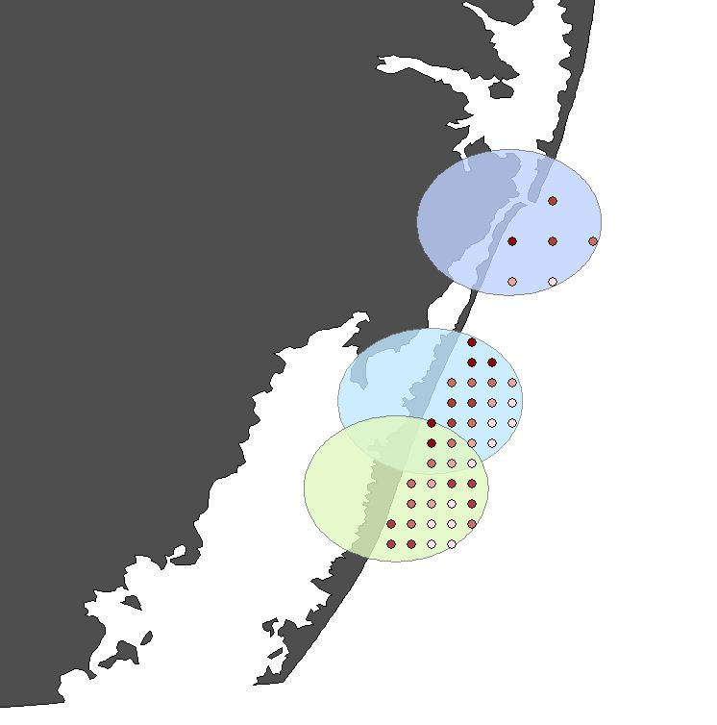
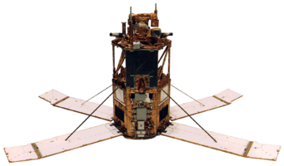
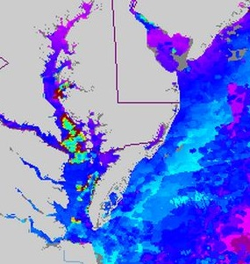

Stranding: Methodology
1. Examine SST and Chl-a within 5km of stranding
Aqua
2. Average 8-day composites from 1-4 days prior to the stranding date
Chlorophyll-a
OrbView-2
3. Calculate Pearson’s Correlation
Terra
Sea Surface Temperature
Matt Kleffer
Source: NOAA CoastWatch Program and NASA’s Goddard Space Flight Center, Ocean Color Web
Notes:
To further understand loggerhead strandings, chlorophyll-a and sea surface temperature were obtained as 8-day composites from Earth observation satellites 1 to 4 days prior to the stranding date, depending on the level of decomposition.
Once the datasets were obtained, values were averaged within a 5-km buffer zones representing the greatest likelihood of the point of death. Finally, the Pearson’s correlation coefficients were calculated to determine the relationship between stranding and the oceanic variables.

Slide 5
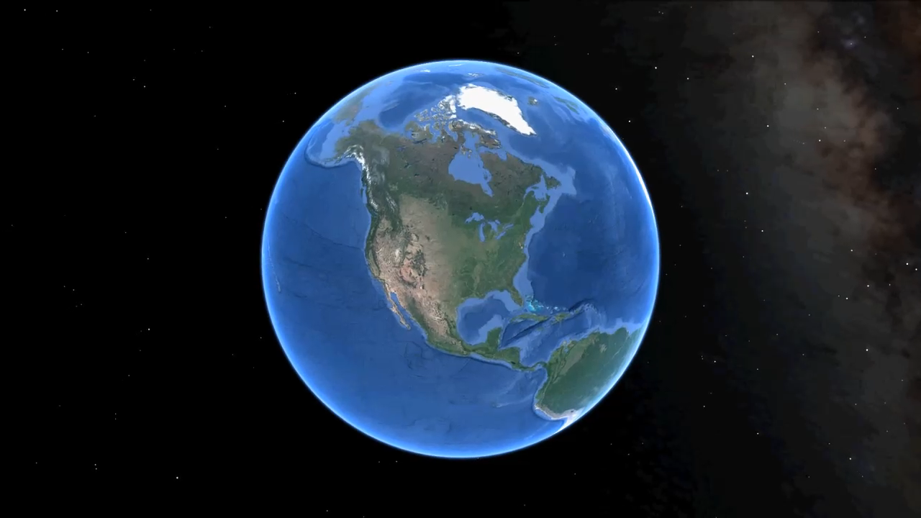
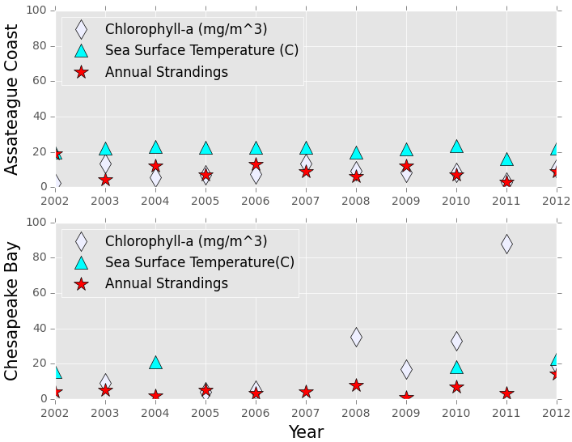
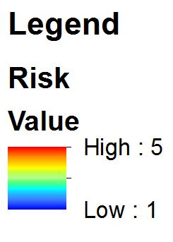
Stranding: Results
Parameter | Pearson’s r Correlation | P | CORR
Chl-a | -0.00397 | 0.991 | - None
SST | 0.551 | 0.098 | + Strong
Parameter | Pearson’s r Correlation | P | CORR
Chl-a | -0.308 | 0.419 | - Mod
SST | 0.525 | 0.648 | + Strong
Matt Kleffer
Notes:
The graph illustrates a comparison between the annually averaged chlorophyll-a concentrations, sea surface temperatures, and stranding counts for two distinct regions. The Pearson’s r correlation coefficient indicate a strong, positive correlation between sea surface temperature and annual stranding events.
Finally, a risk map was created revealing the spatial distribution of potential areas of concern for sea turtle strandings in 2015, which may be helpful for future risk management and mitigation efforts.

Slide 6
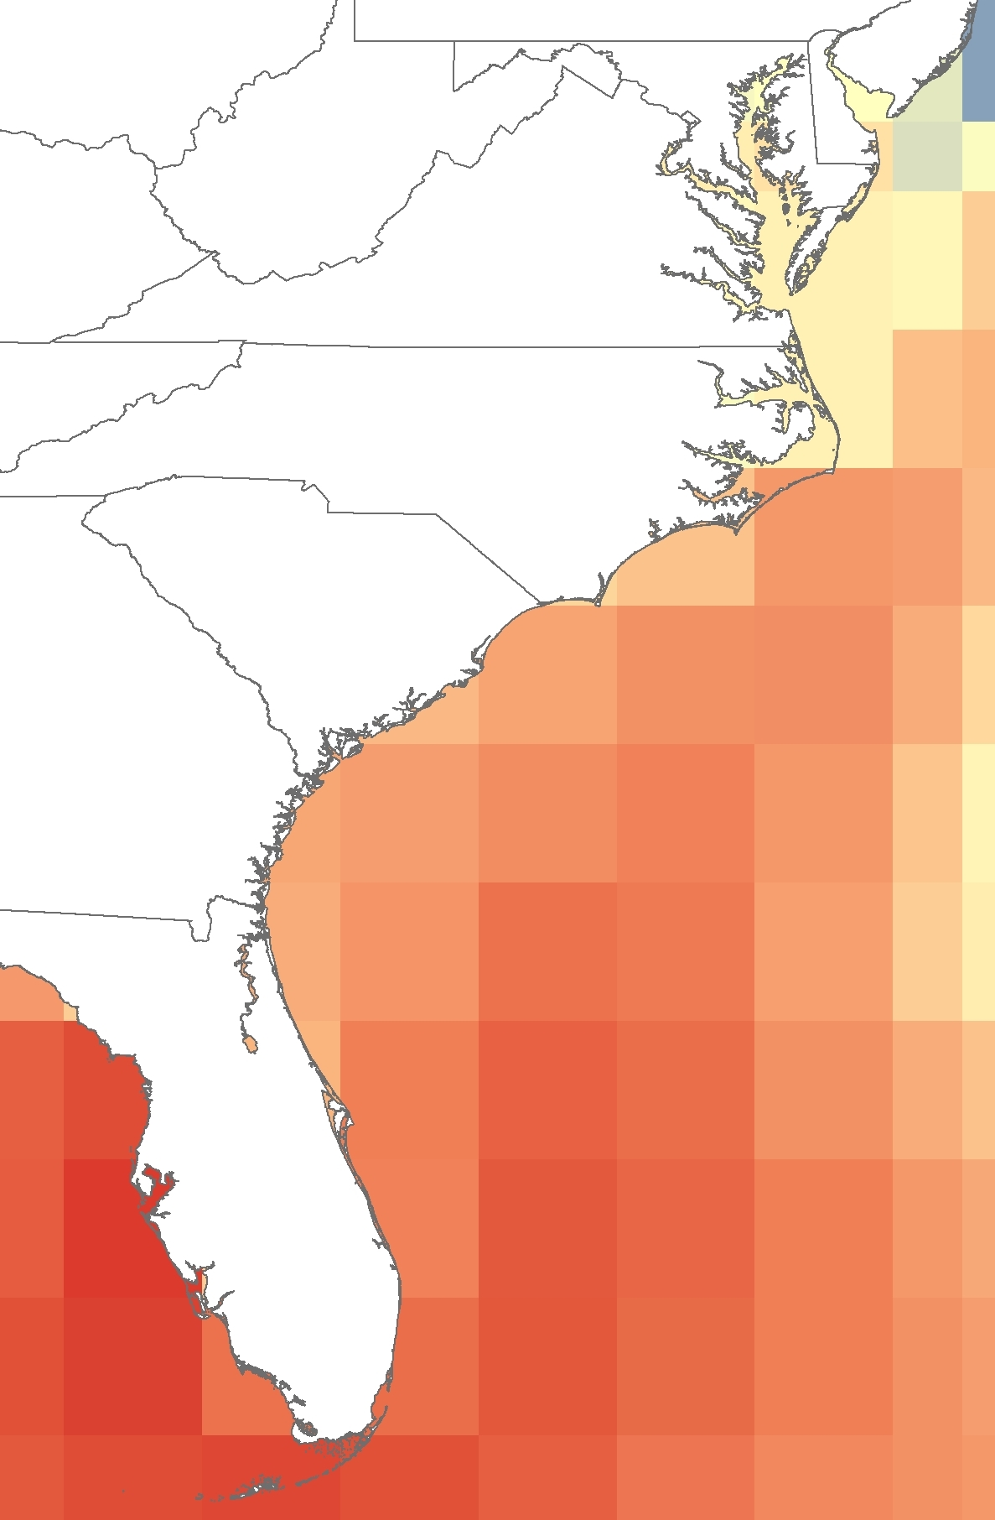
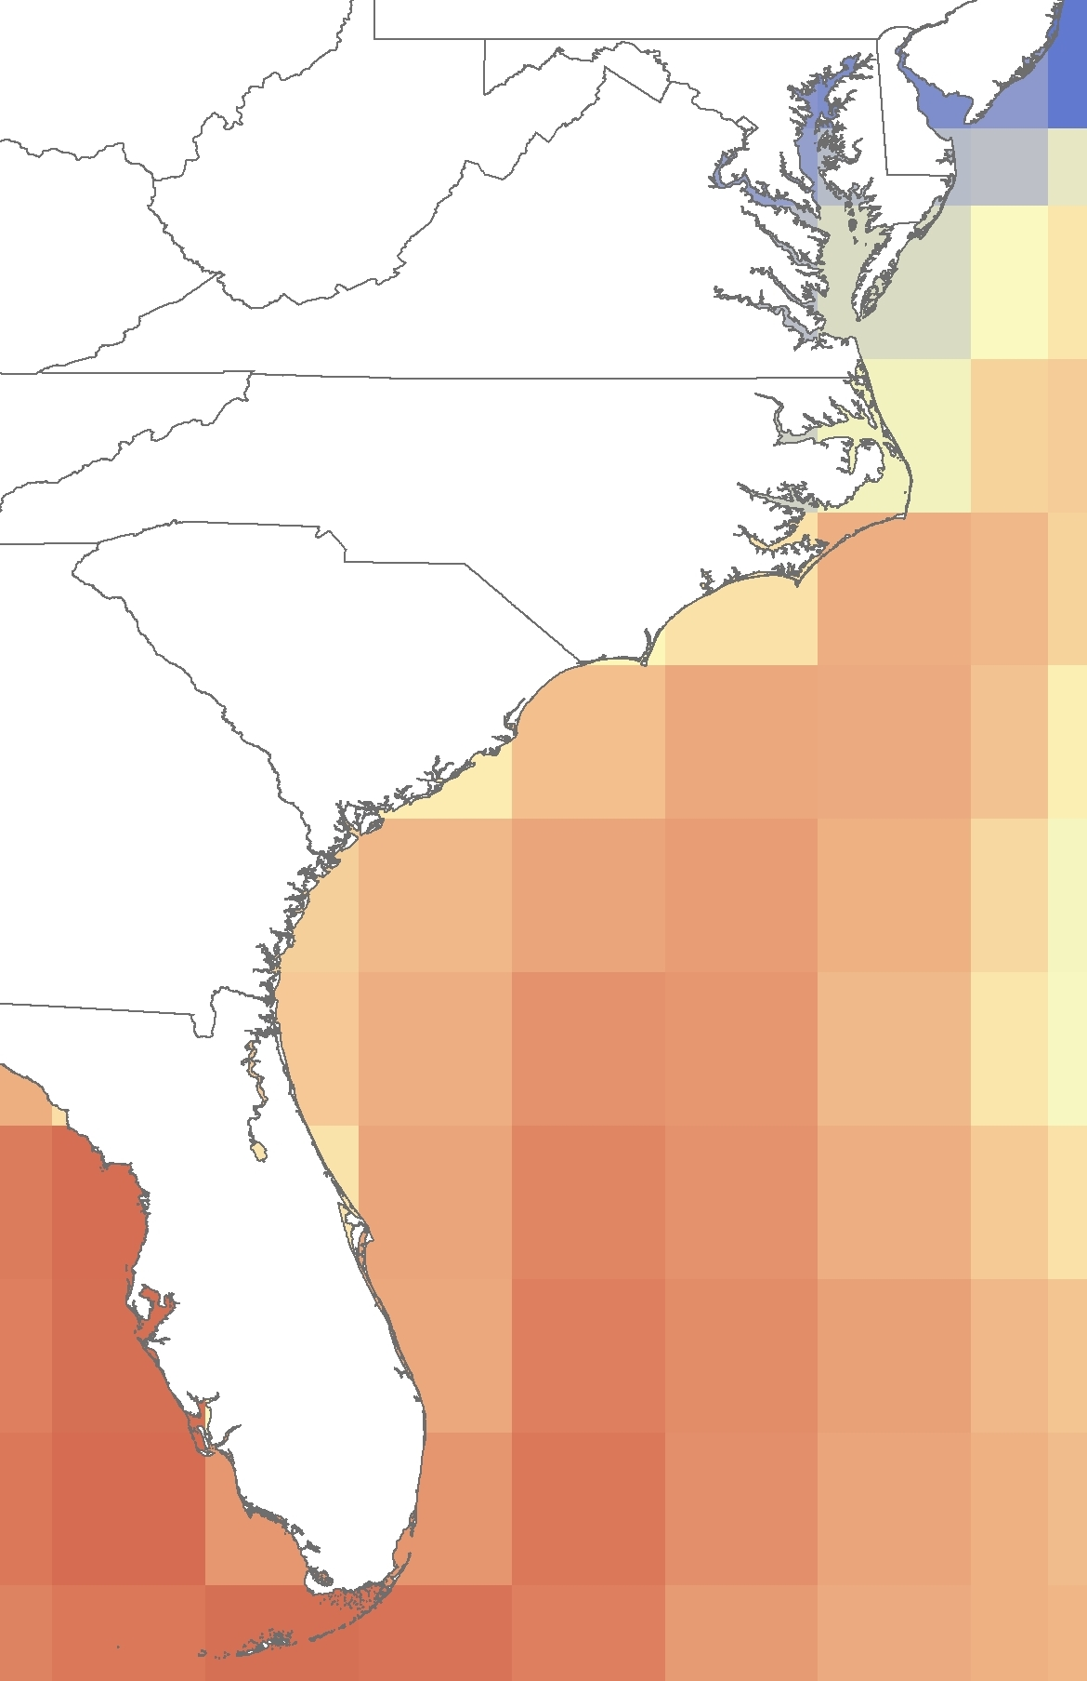
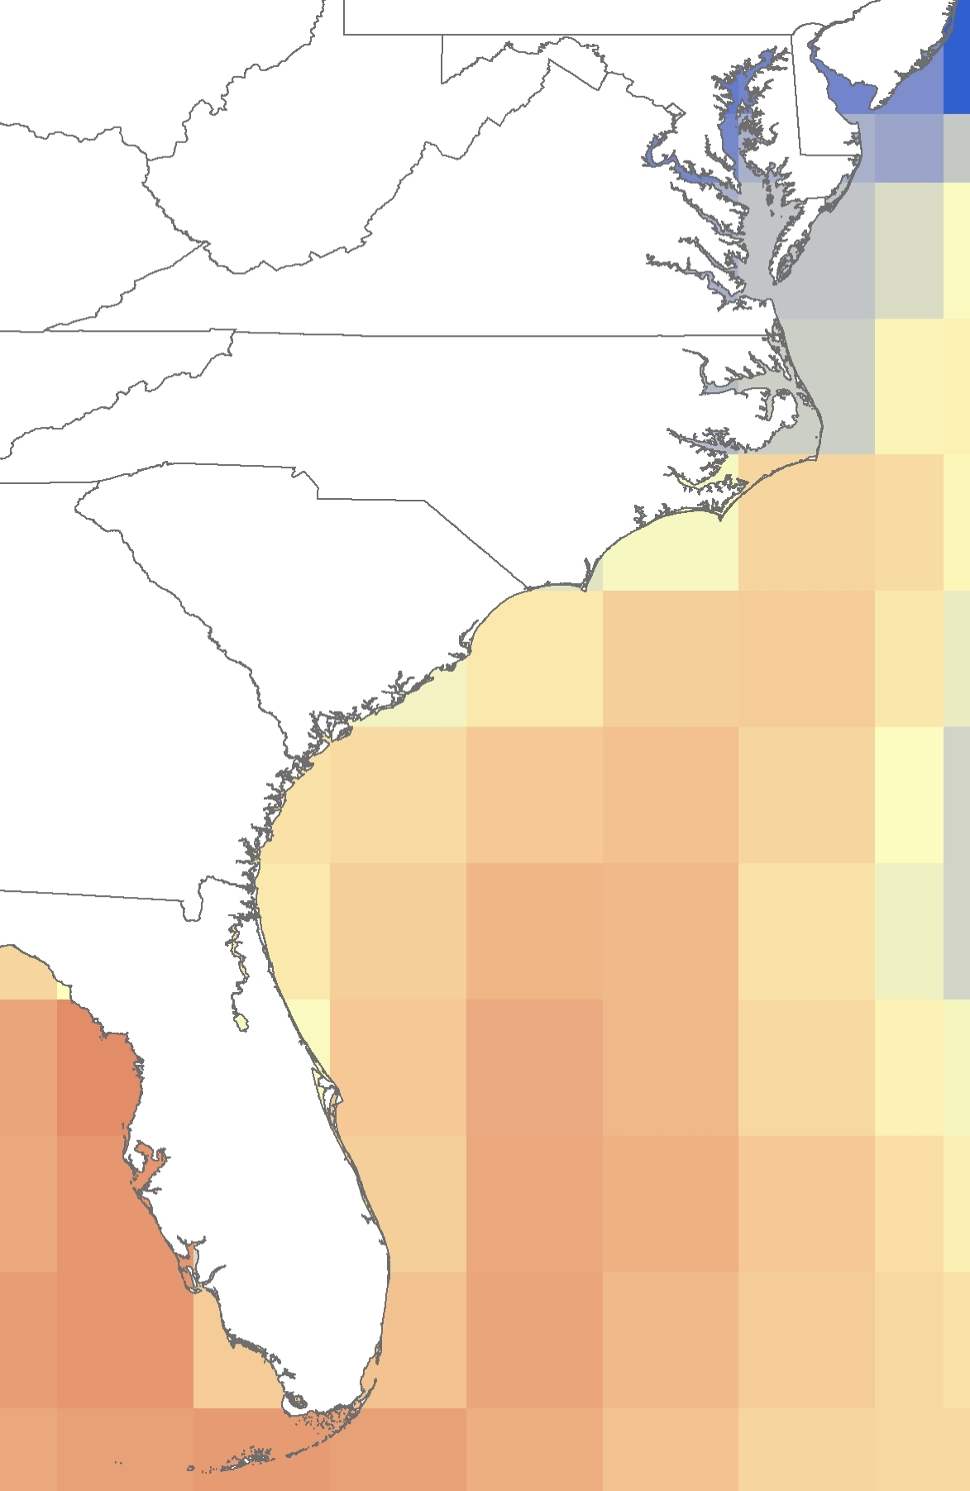
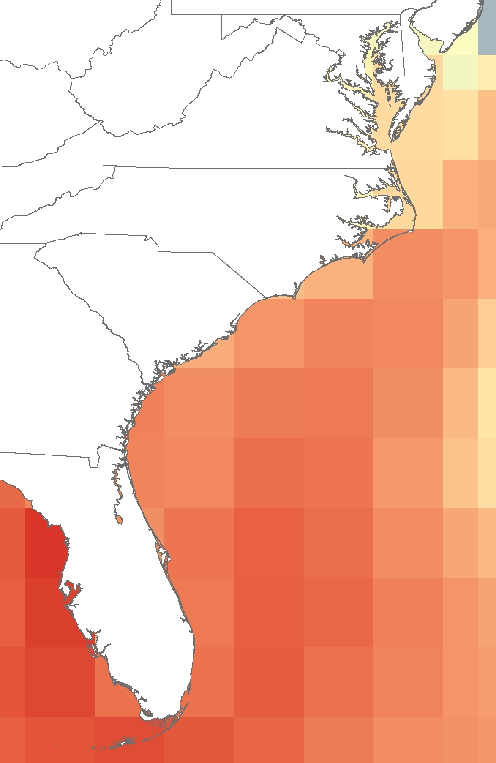
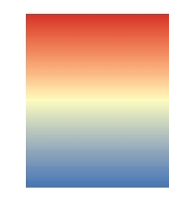
Climate Change
Methods
National Center for Atmospheric Research (NCAR)
Community Climate System Model 3
International Panel on Climate Change (IPCC)
Breeding range
29.75°C
23.11°C
Commit
High A2
Low B1
Med A1B
Notes:
Currently the breeding range of loggerheads spans from Florida to North Carolina, so we investigated how future climate change will affect nest site distribution in Maryland. We used NCAR’s Community Climate System Model 3 which are derived from the 4th IPCC
We analyzed four different surface temperature scenarios, shown here for July in the year 2050.
The Commit scenario assumes constant emissions since 2000.
The others assume low, medium, and high emissions.
As you can see, the future climate in Maryland changes drastically depending on the scenario.

Slide 7
Climate Change: Results
May
July
Current nesting temp from FL - NC
Surface temperature (°C)
June
August
Notes:
We identified the range of temperatures during their current breeding season, which runs from May to August
We then compared the offshore temperature in Maryland over the four scenarios until 2099.
In May, only the highest emission scenario lead to significant nesting in Maryland by 2080.
The trend is similar in June, but nesting increases by 2070.
In July, loggerheads most active nesting period, the medium and highest scenario reaches breeding temperatures around 2040. For August, breeding temperatures are reached by 2030 across most scenarios.

Slide 8

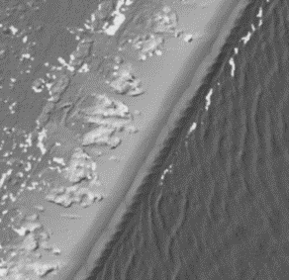
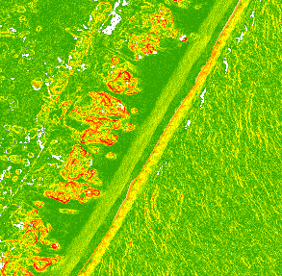
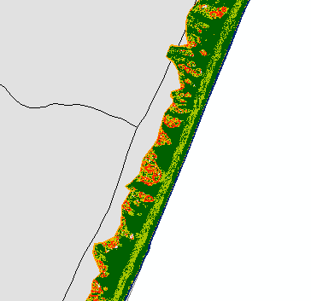
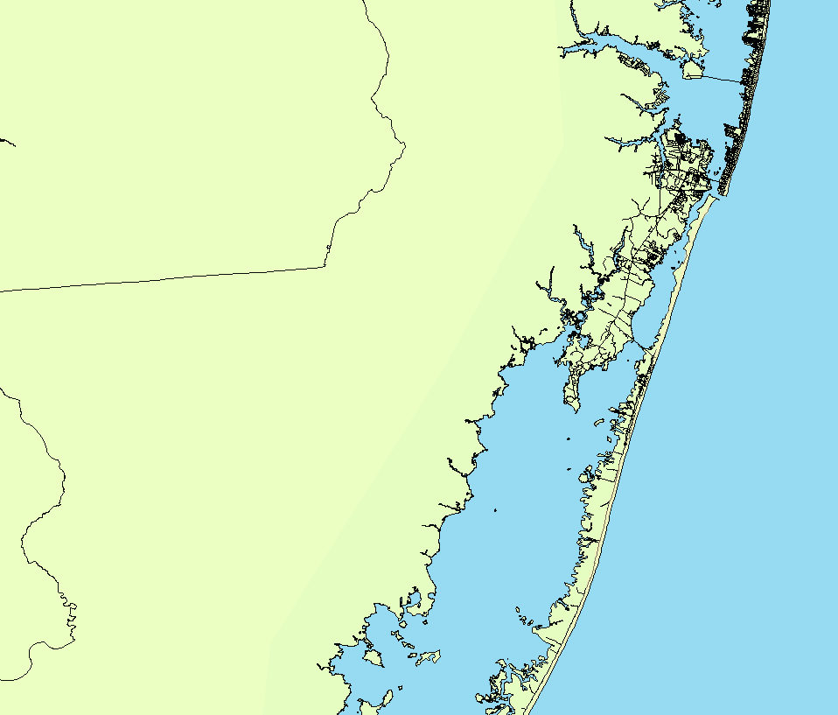
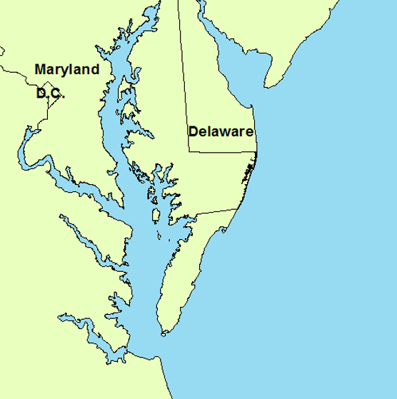
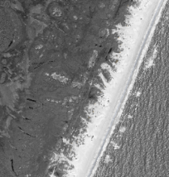
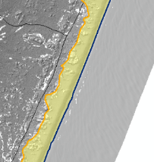
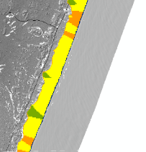
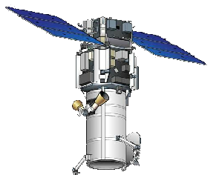
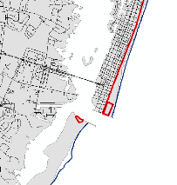
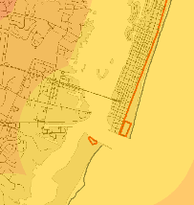
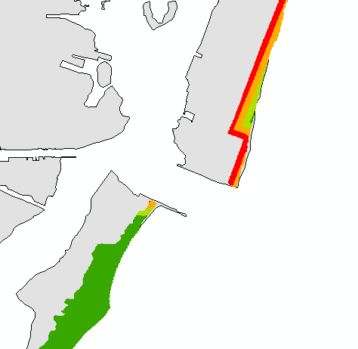

Nesting: Methodology
Data Acquisition
DEM
Slope
Suitability
NOAA LiDAR Survey
Slope
Ocean City
Beach Zone, Width
Width
Suitability
Imagery
Slope
Aspect
WV2 Satellite
Assateague Island
MD Atlantic Coastline
Roads
Distance
to Dev.
Dist. to Dev.
Suitability
TIGER Layers
Matt Kleffer
Notes:
We investigated potential nesting grounds for Loggerheads in our study region, focusing on the Atlantic coast of Maryland. This area is approximately 31 miles long covering Ocean City and Assateague Island. For this region, we obtained data from a NOAA LiDAR survey, imagery from WV2, and vectors from the TIGER database. LiDAR data provided a DEM and slope layer, WV2 imagery (as well as topography layers) provided beach zone and width layers, and the TIGER roads file provided a distance to development layer. These were used to create suitability layers for slope, beach width, and development proximity.

Slide 9
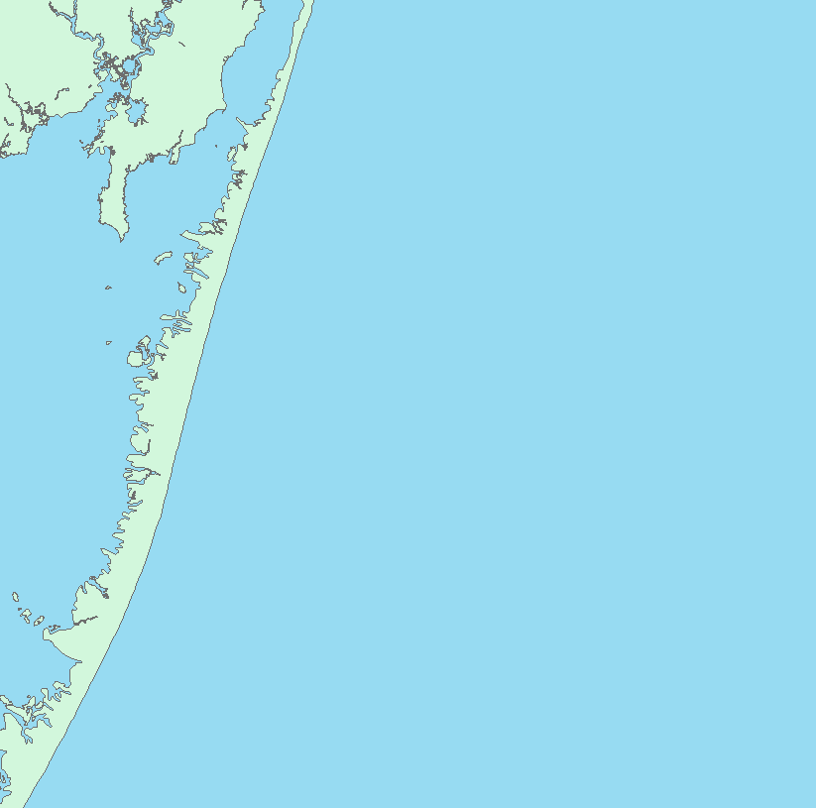

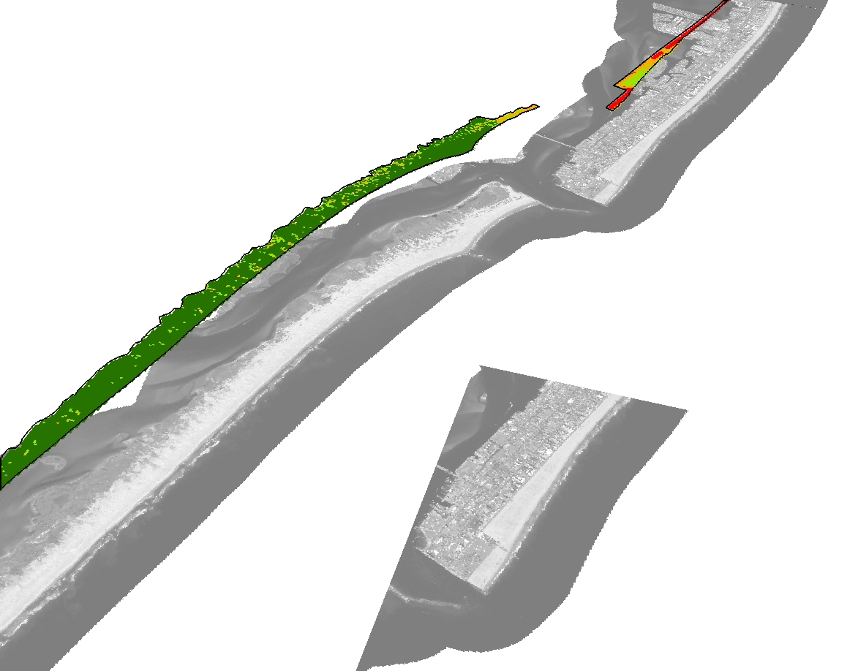
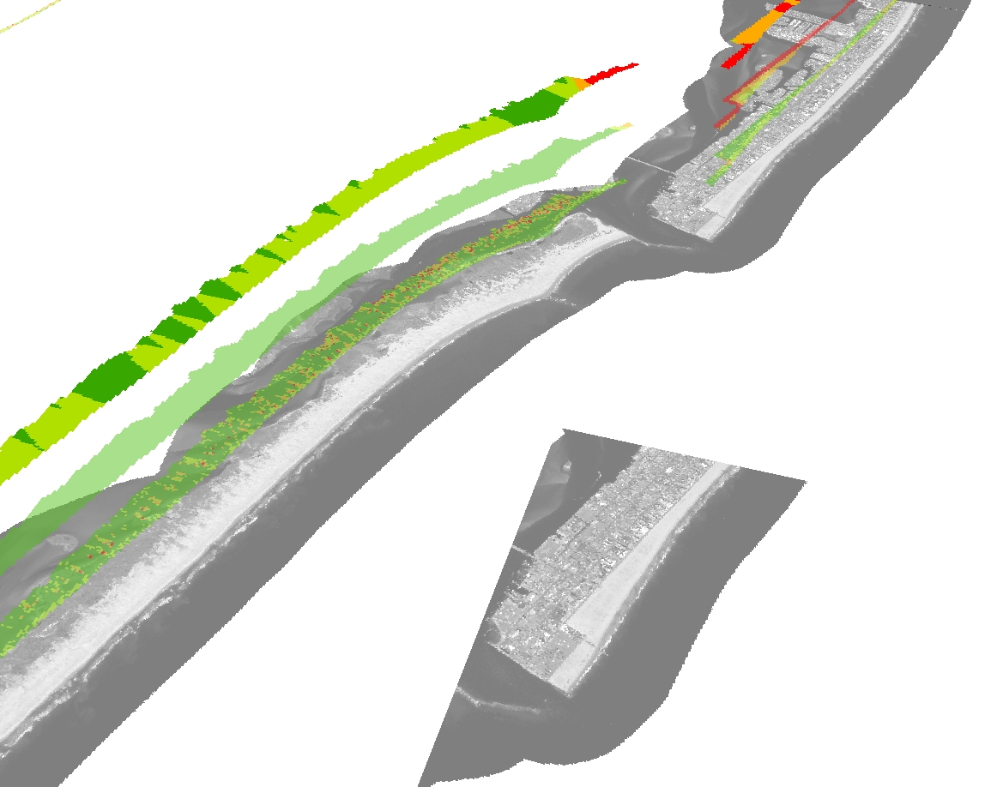
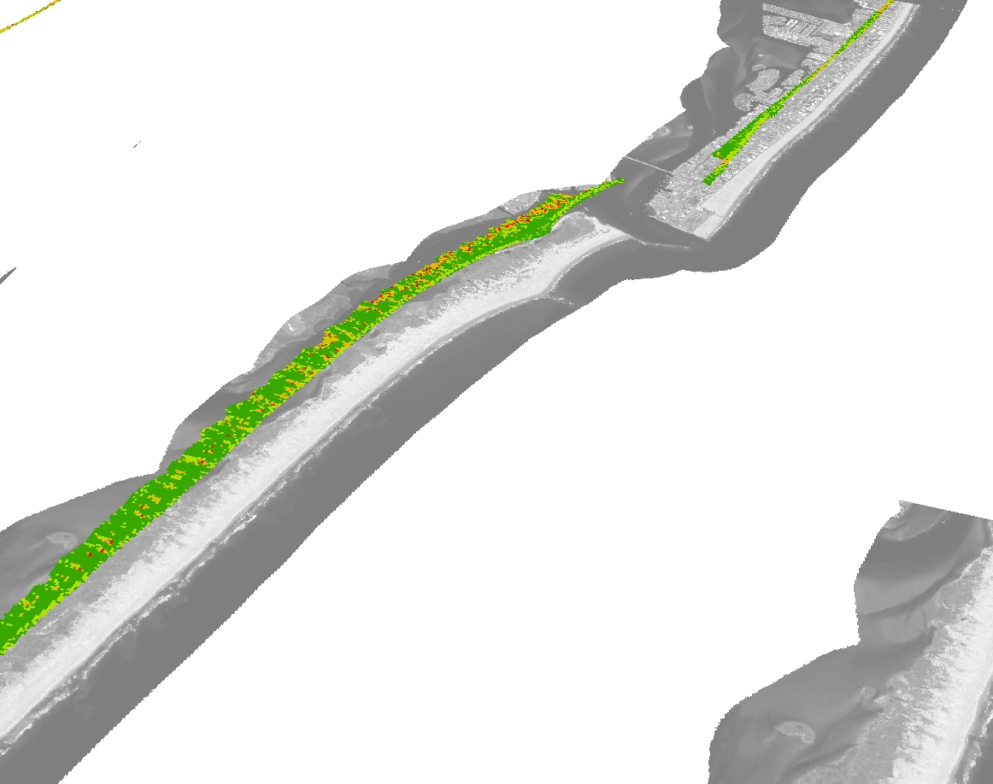
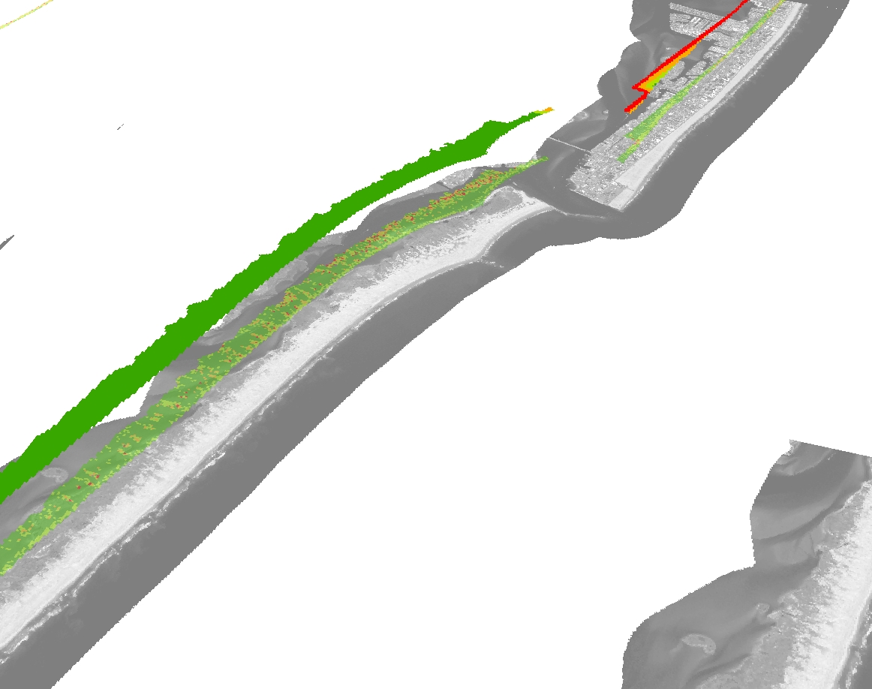
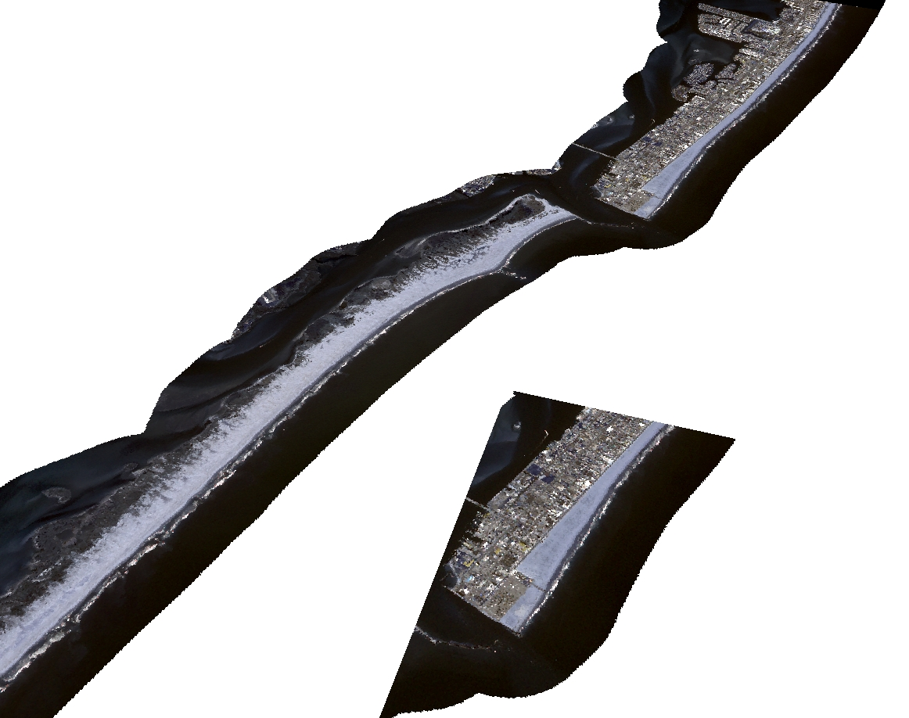
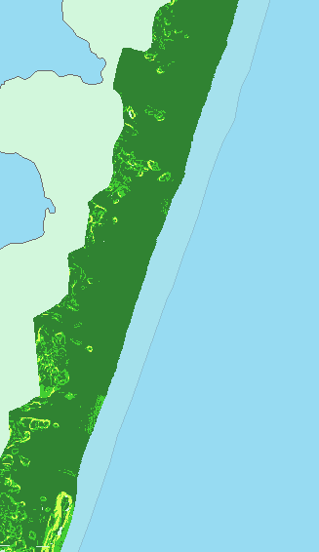
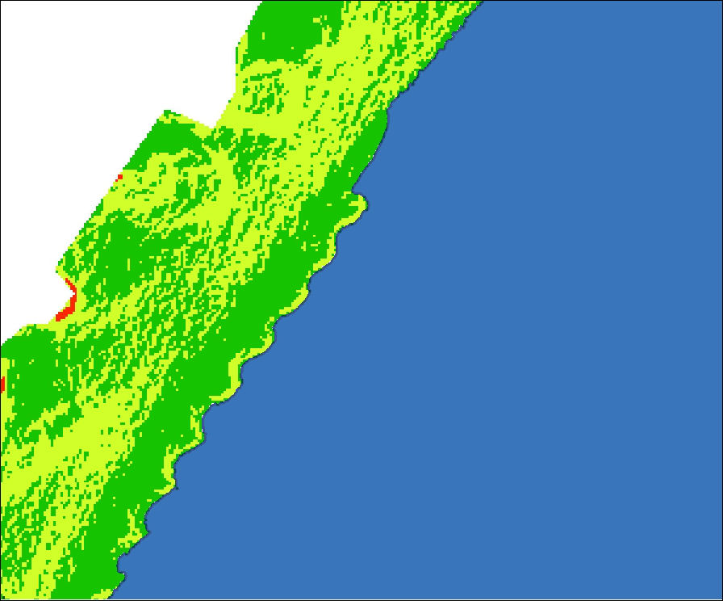
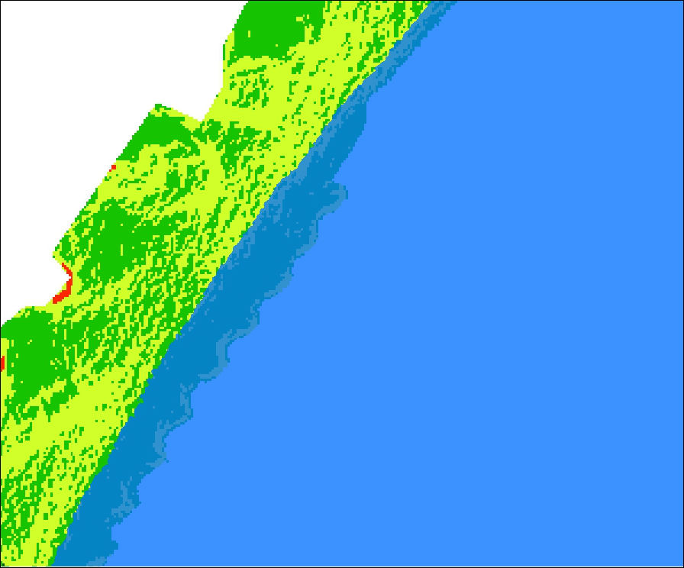
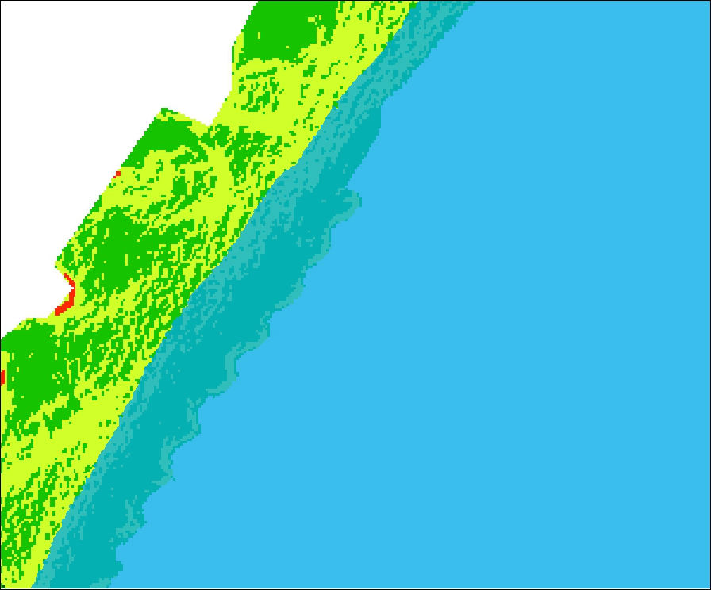
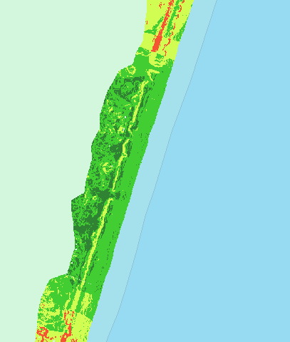
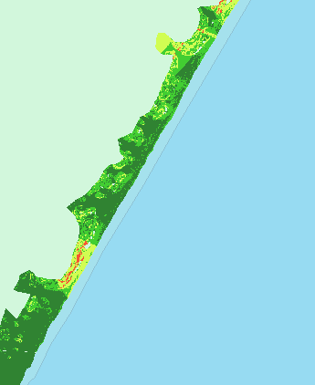
Nesting: Results
+2m
+0m (current)
+1m
Overall Nesting Suitability
Width
Distance to Development
Slope
Matt Kleffer
Notes:
We overlaid these three layers to create suitability layer for nesting habitat in our study area. We found approximately 6 square kilometers of highly suitable habitat, mostly along Assateague Island. These areas are vulnerable to estimates of future sea level rise, with a 1 and 2 meter rise resulting in approximately 6 and 11 percent losses respectively. We identified several regions of suitable habitat that may be resistant to climate change impacts. Areas like these could serve as a basis for future turtle conservation in Maryland.

Slide 10
Conclusions
Increased temperatures correlated to increased strandings, potentially due to more bacteria
Climate change is expected to increase
nesting in Maryland, particularly in July
and August
Suitable nesting sites are plentiful outside of Ocean City, with some regions more resilient to sea level rise than others
July
Matt Kleffer
Thank you!
Notes:
We found strong correlations between increased temperatures and strandings, which were used to create a risk map of future stranding patterns.
We also found that climate change will increase temperatures in July and August by 2040 to levels similar to current nesting grounds This may result in loggerheads frequenting the Maryland coast.
We identified regions of highly suitable nesting habitat for loggerheads that should be of greatest conservation concern since these areas may be the least affected by future sea level rise.
With that, we would like to thank all of our collaborators and you for joining us today.

