Slide 1
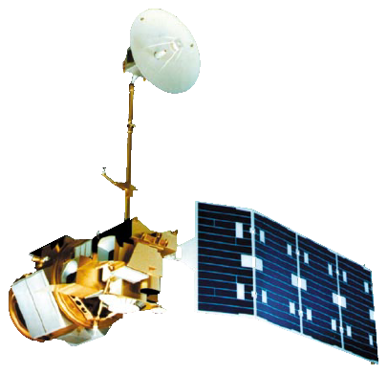
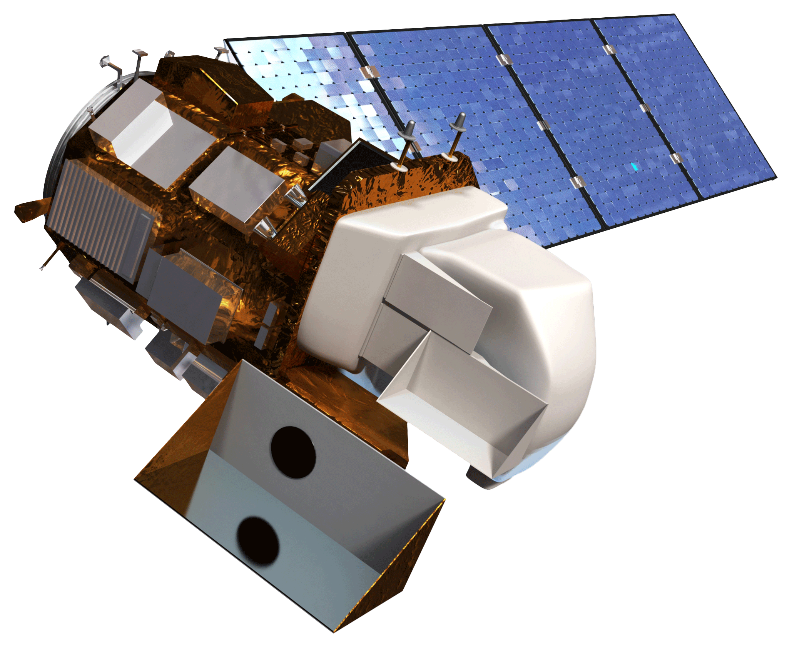
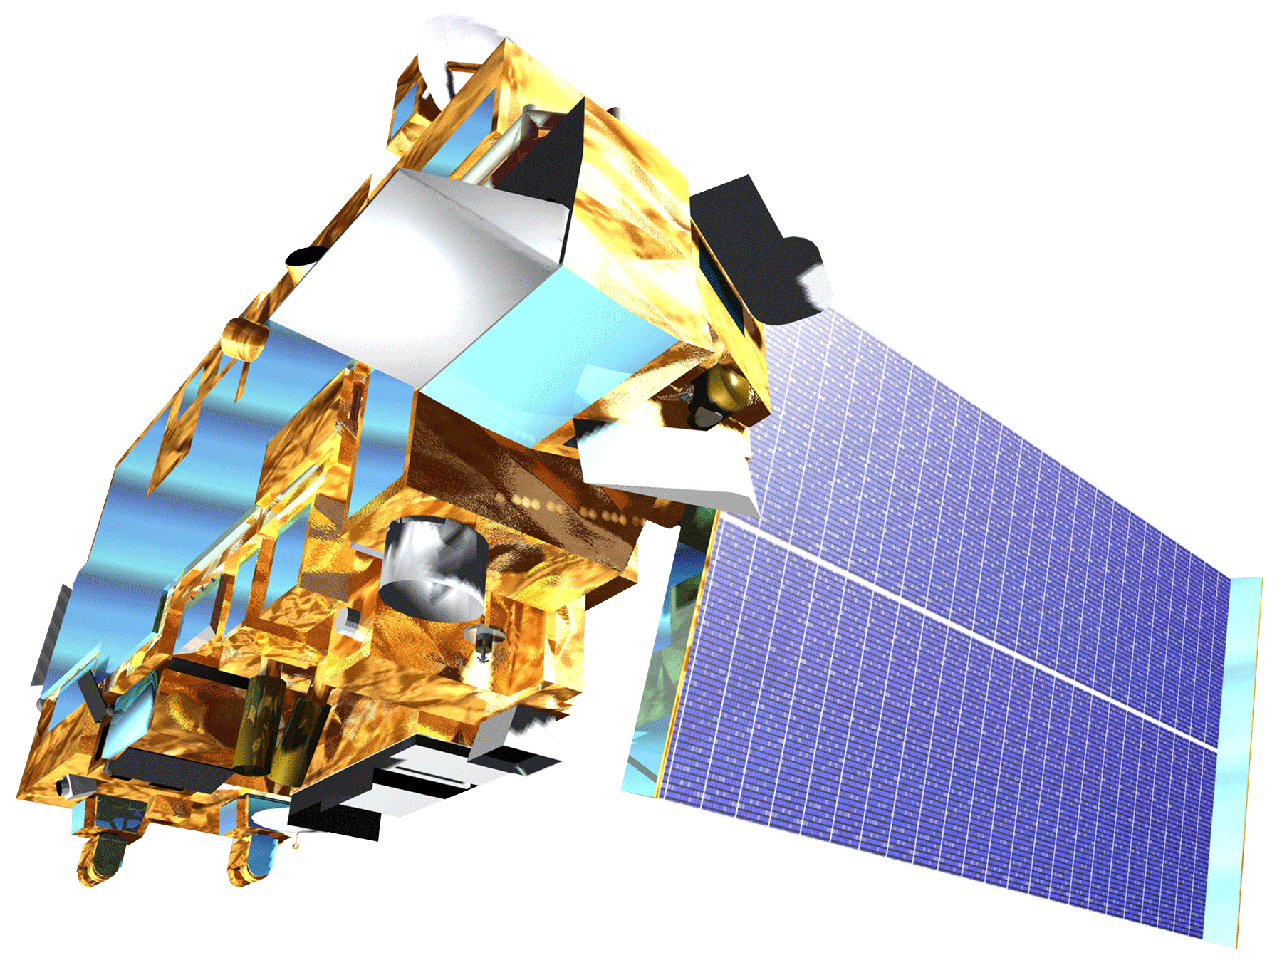
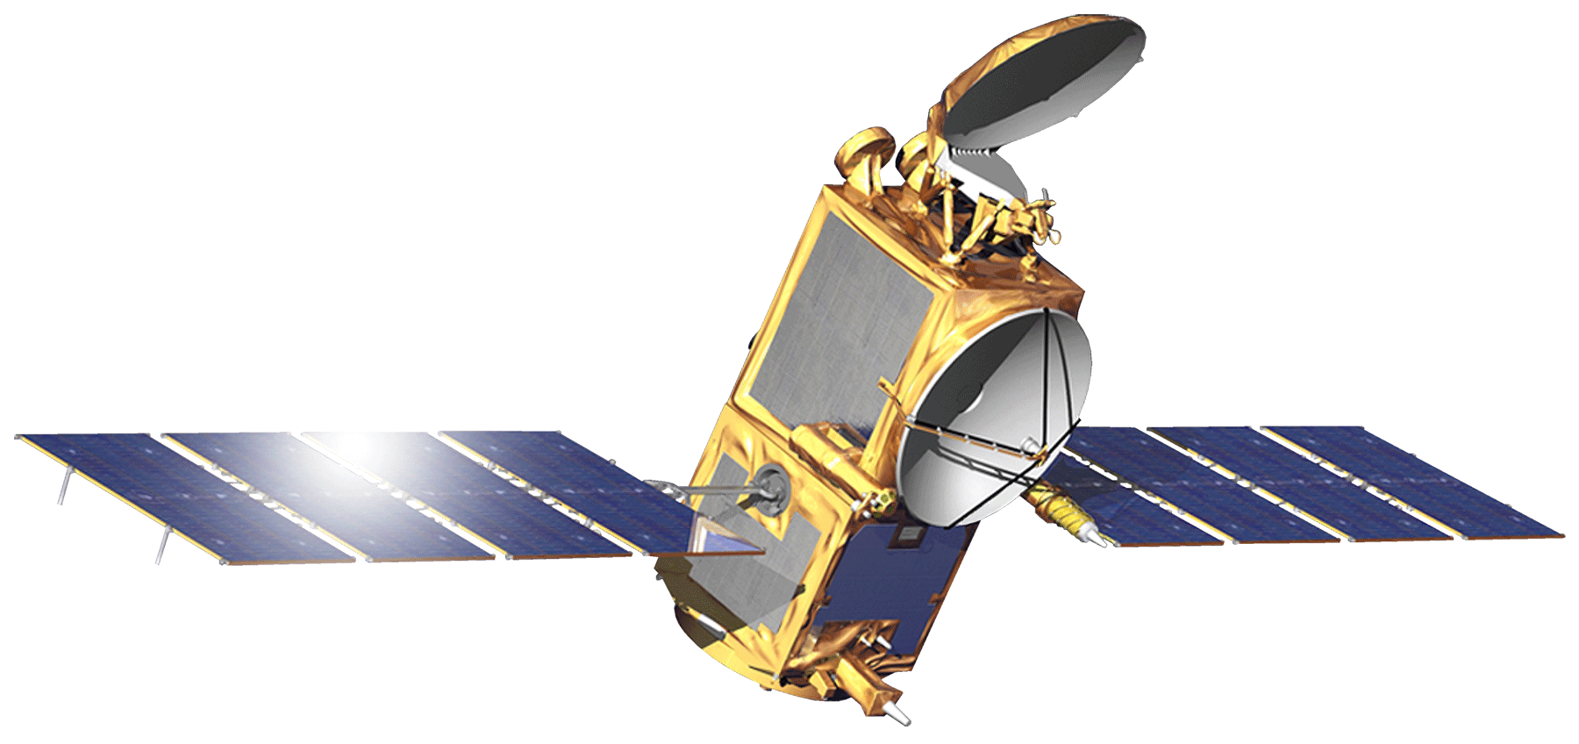
Great Lakes climate ii
Monitoring the Impacts of Climate Change and Decreasing Water Levels on Wetlands in the Great Lakes Region of North America
Emily Adams (Project Lead), Idamis Del Valle Martínez, Miriam Harris, Rodney Meyer, Stephen Zimmerman,
NASA Langley Research Center
Create historic and current land cover classification maps for Georgian Bay, ON and the southern portion of Lake Ontario including Rochester, NY
Produce wetlands extent change maps
Generate time series of wetland extent
Data Acquisition
Data Processing
Data Analysis
Landsat 5
TERRA
Land Cover for Georgian Bay
Landsat 5 (July 1987)
Landsat 8 (June 2013)
Top of Atmosphere Corrected
Training Site selection
Incorporation of thermal bands and ASTER DEM
Landsat 8
OSTM/Jason-2
Land Cover for Southern Lake Ontario
Landsat 5 (June 1987)
Landsat 8 (June 2014)
Mosaicked Georgian Bay Landsat Scenes
Random Forest Land Cover Classification Script (R)
Water Levels
TOPEX/Jason-1
OSTM/Jason-2
In situ water level gauges
Study area defined by 10 km buffer around shoreline
Validation and Accuracy Assessment
Great Lakes and St. Lawrence Cities Initiative
David Ullrich
Executive Director
Georgian Bay Forever
David Sweetnam
Executive Director
Ontario Ministry of Natural Resources
Mike Robertson
Imagery Project Manager
Dr. Kenton Ross
NASA DEVELOP National Program
James Favors
NASA DEVELOP National Program
Jeff Ely
NASA DEVELOP
Fall 2014 Great Lakes Climate I

