Slide 1
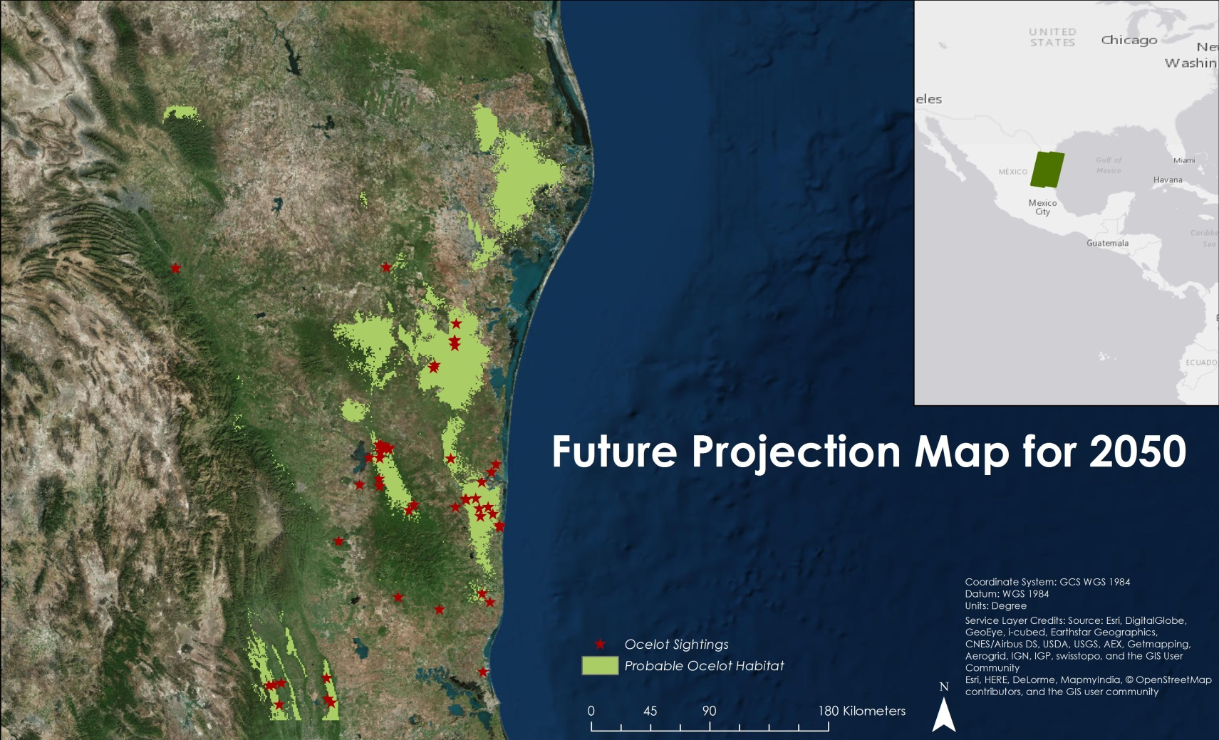
North Mexico
Ecological Forecasting
Using NASA Earth Observations to Monitor and Manage Ocelot Habitat Loss in North Mexico
Authors: Ryan Schick (Project Lead), Maggi Klug, Leigh Sinclair, and Padraic Conner
Future Projections Map for 2050 using MaxEnt Model
Community Concerns
The ocelot (Leopardus pardalis) are a medium sized wild cat found from Argentina to the extreme southern United States, where they are listed as endangered. Ocelots require seven square miles of dense vegetation to hunt for prey, but urban development, agricultural land use, road development, and border fences have led to habitat fragmentation. Inbreeding, caused by this habitat fragmentation, has further reduced the survivability of the species. Due to increased agriculture and urbanization, over 95% of Tamaulipan brushland habitat in northeastern Mexico has been eliminated.
DEVELOP Location
NASA Marshall Space Flight Center
Earth Observations
Landsat 5, Landsat 8, Suomi NPP, SRTM-v2
Partners
Caesar Kleberg Wildlife Institute at Texas A&M University-Kingsville, The Denver Zoo, South Texas Refuge Complex, Texas Department of Transportation, East Wildlife Foundation, Pittsburgh Zoo & PPG Aquarium, SEMARNAT
Advisors
Dr. Jeffrey Luvall [NASA at The National Space Science and Technology Center],
Dr. Robert Griffin [University of Alabama in Huntsville]
Decision Support
This project created Habitat Percent Graphs to assess the current extent of ocelot habitat in northeastern Mexico, Habitat Probability Maps to show areas most likely to be inhabited by breeding populations, Future Habitat Probability Maps to estimate habitat growth or loss, and a Road Risk Map to identify areas of road that intersect probable ocelot habitat. These end products will help project partners with conservation efforts.

