Slide 1
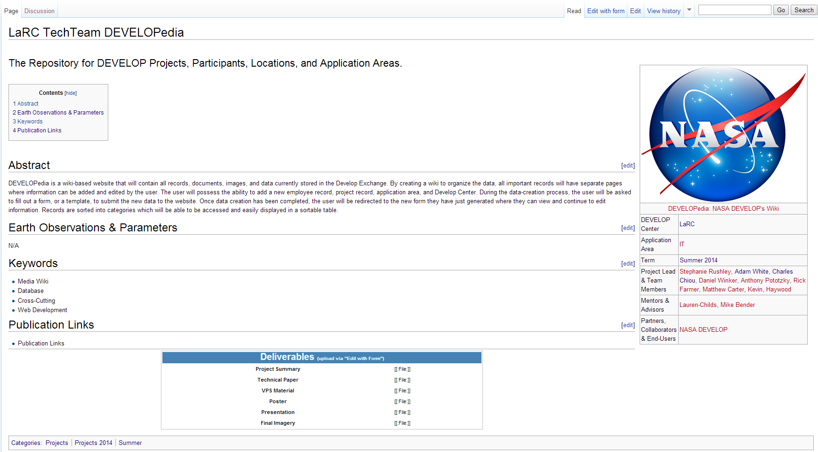
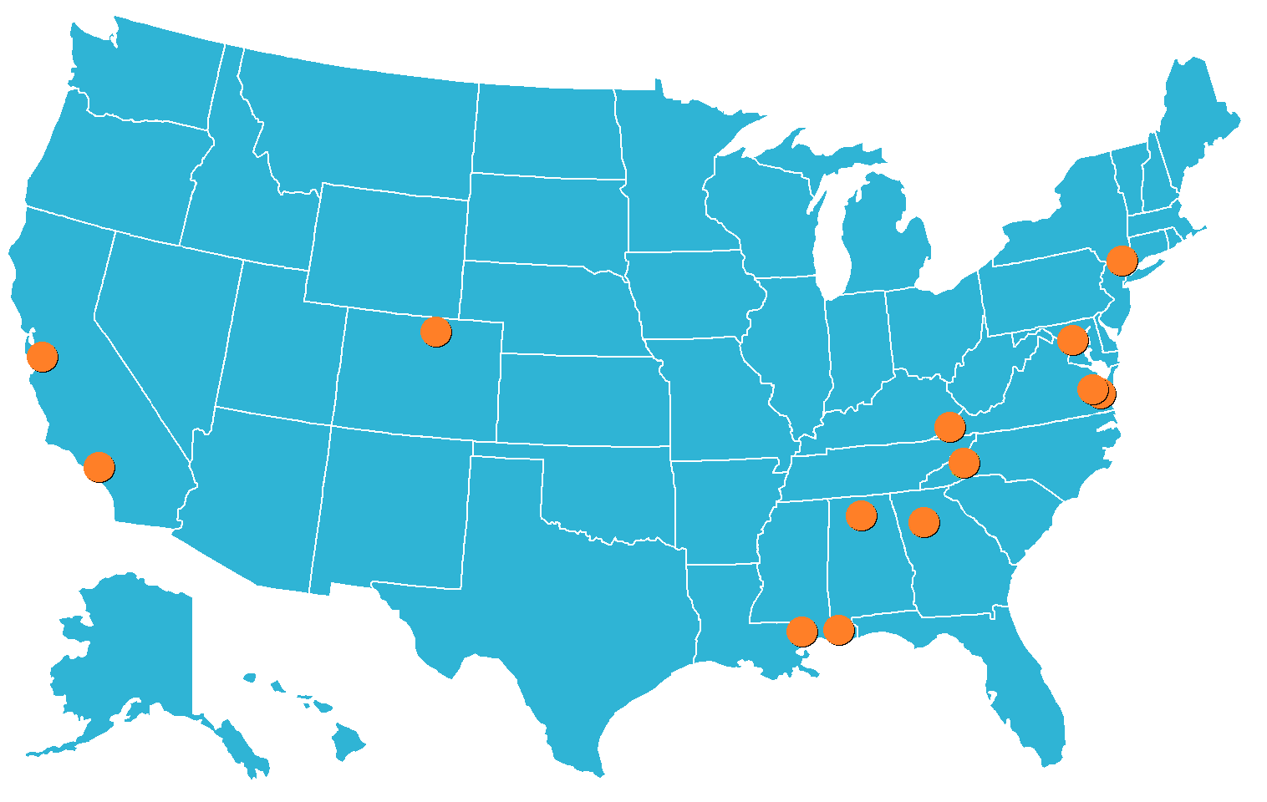
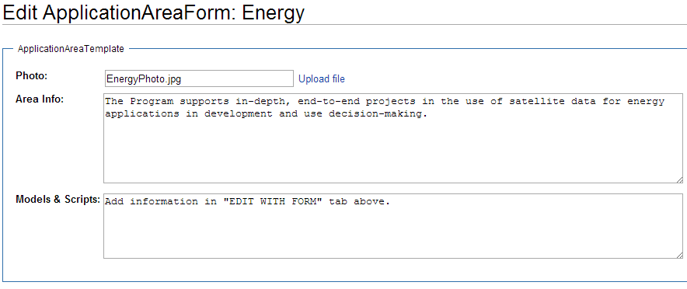
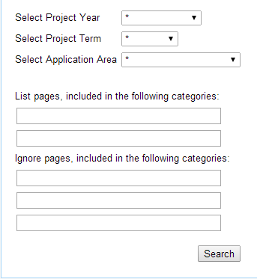
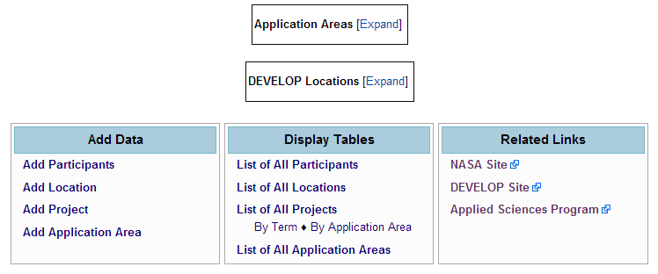
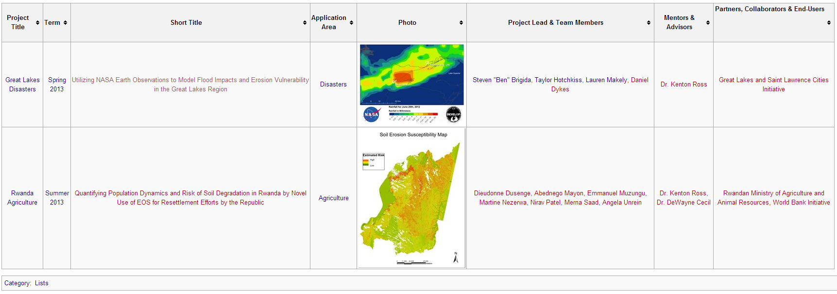
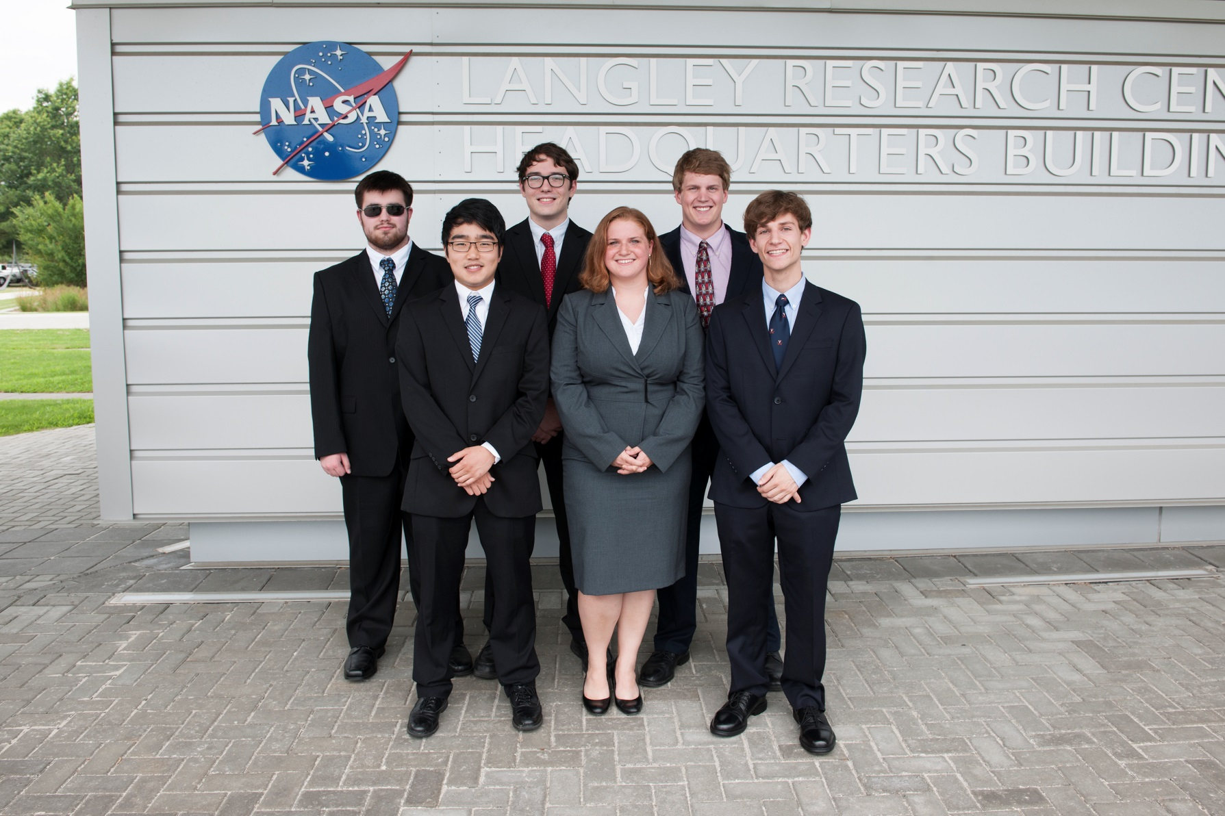
DEVELOPedia
DEVELOPedia: NASA DEVELOP’s Wiki
Stephanie Rushley (North Carolina State University), Matthew Carter (United States Air Force), Charles Chiou (Old Dominion University), Rick Farmer (Mathews High School), Kevin Haywood (United States Air Force), Anthony Pototzky (Old Dominion University), Adam White (Christopher Newport University), and Daniel Winker (University of Virginia)
NASA Langley Research Center
NASA DEVELOP tackles multiple projects every year. Projects are stored on the DEVELOP Exchange; however, the Exchange has not been known to be user friendly. With the objective of creating a useful database, DEVELOPedia was designed to service the mass amounts of information and data related to DEVELOP. The initial framework was already in place, but the wiki was not complete. Extensions were used to grant users the ability to upload multiple files at once and display category trees for search assistance. Forms and templates were updated to display correctly and properly so DEVELOP participants can browse with ease. Sections to add data and search data were appropriately placed to greet users when they enter the front page. DEVELOPedia has even allowed users to view, upload, and edit data on DEVELOP application areas, locations, participants, and projects. Projects are added every year as updates are maintained each term for continued improvement.
Create a user friendly database for DEVELOP users
Organize and display past and current DEVELOP projects and information
Expand multiple upload abilities and image formatting
NASA DEVELOP Center Locations
MS Upload – Multiple Upload
Category Tree – Table of Contents
Multi-Category Search – Custom Search
Main Directory
Edit with Form Ability
Custom Search
List Display
Lauren Childs-Gleason DEVELOP Operations Lead
Mike Bender DEVELOP National Technical Lead
Jim Farmer SSAI
Jonathan Hicks SSAI

