Slide 1
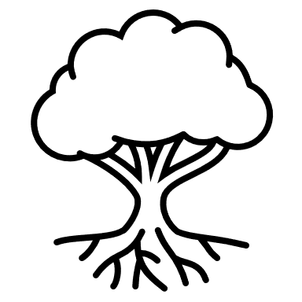
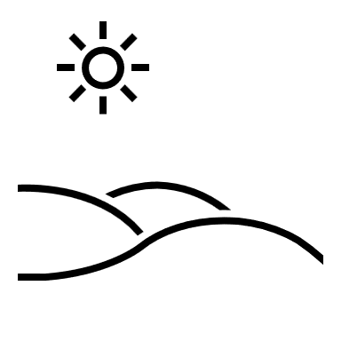
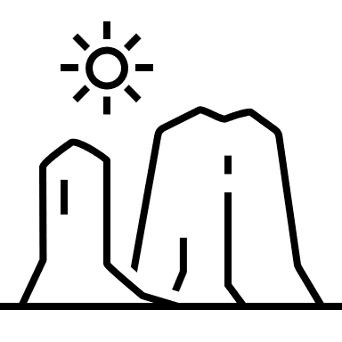
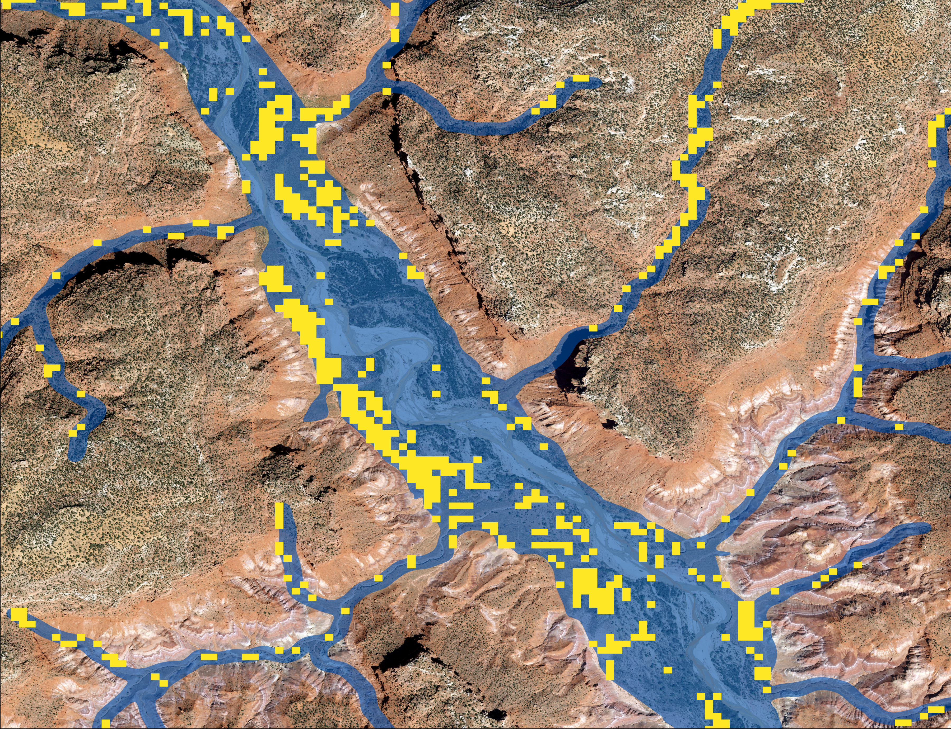
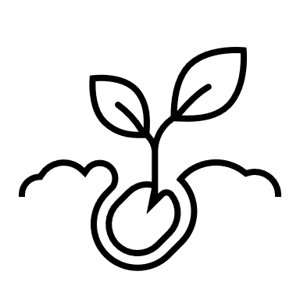
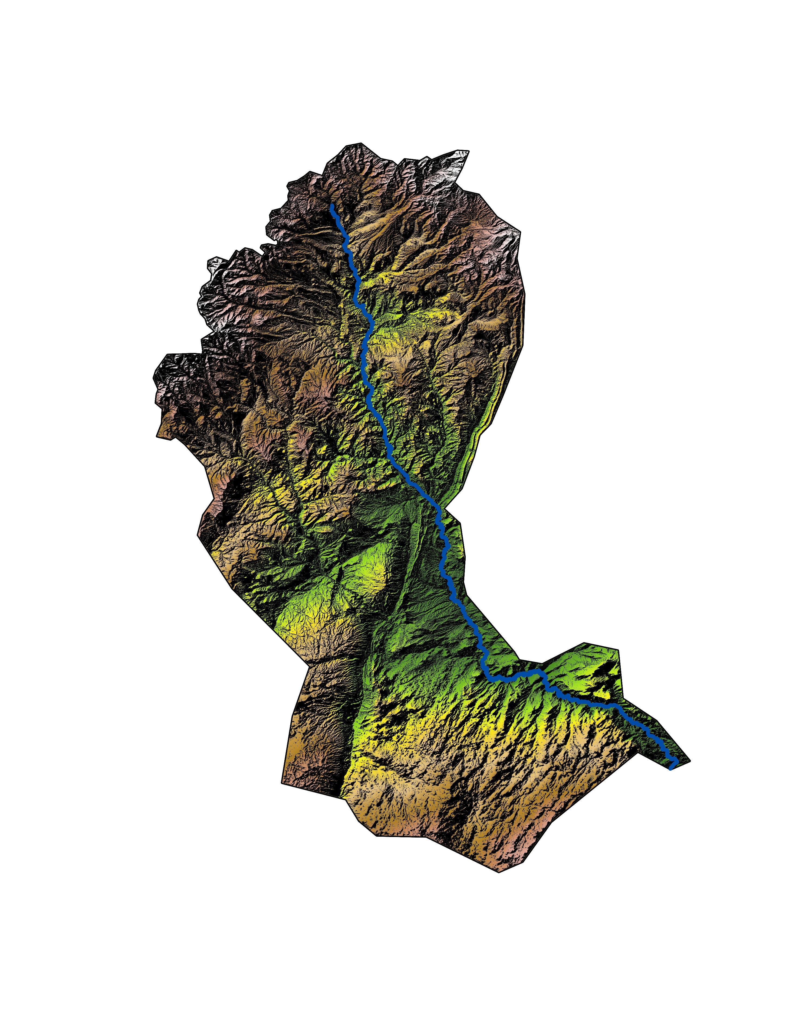
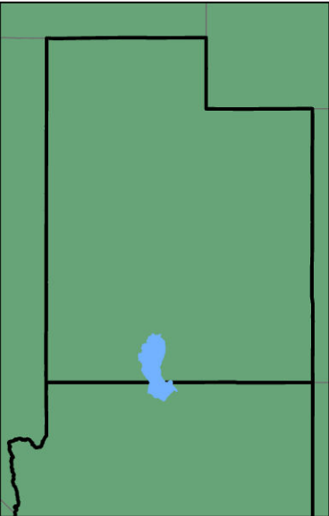
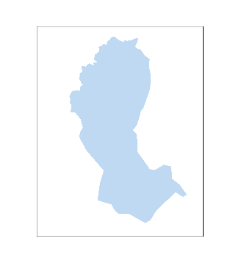
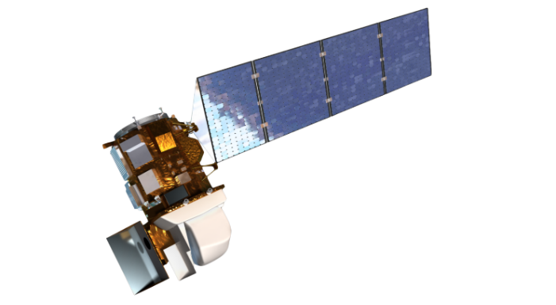
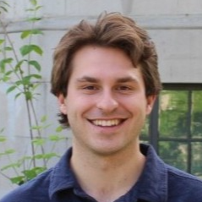
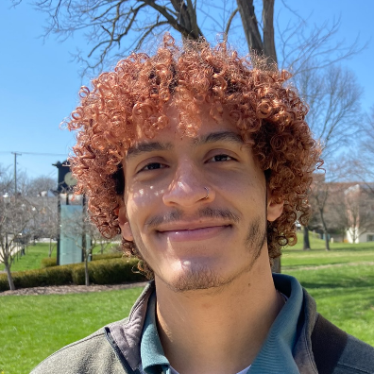
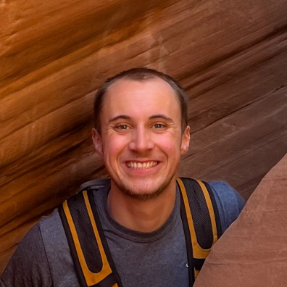
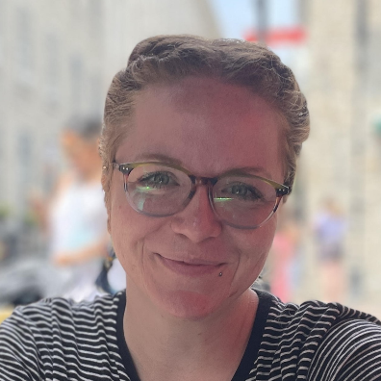
Paria River Ecological Conservation
Mapping Russian Olive and Tamarisk to Inform Invasive Species Management Along the Paria River, Utah
Russian olive (Eleagnus angustifolia):
Brought to the U.S. for erosion and wind management
Widely planted in 1940’s
Fourth most common woody riparian species in the Western U.S.
Due to its adaptability, easily crowds out native riparian species through formation of dense stands
Tamarisk (Tamarix ramosissima):
Brought to the U.S. for erosion control
Widely planted in early 1900’s
Second most common woody riparian species in the Western U.S.
Secretes salt through depositions, increasing soil salinity
High evapotranspiration rate
Study Area – Paria River
Model Input Predictor Variables
Major tributary of the Colorado River along the UT/AZ border
LiDAR Canopy Height
Topography
Passes directly through the Grand Staircase-Escalante National Monument (GSENM) (est. 1996)
Spectral Indices
Classification Modeling Confusion Matrix
 | False | True | Class Error
False | 181 | 22 | 0.11
True | 51 | 28 | 0.65
940+ unique species of vegetation within GSENM
Main source of sediment for the Grand Canyon
Utah
Tamarisk Presence
Riparian Corridor
0
0.34
0.67
1
km
NASA Earth observations used to map invasive species, can help stakeholders like the Grand Staircase-Escalante partners identify and prioritize treatment areas
Arizona
0
180
360
Satellites/Sensors
km
0
14
28
Team Members
km
Landsat 8 OLI
Landsat 9 OLI-2
Shuttle Radar Topography Mission
Acknowledgements
Max VanArnam
Project Lead
Wesley Rancher
Truman Anarella
Annie Kowalski
The team would like to thank everyone who made this project possible:
Partners: Kevin Berend, Grand Staircase Escalante Partners
Advisors: Dr. Paul Evangelista (Colorado State University, Natural Resource Ecology Laboratory), Dr. Catherine Jarnevich (USGS, Fort Collins Science Center), Dr. Anthony Vorster (Colorado State University, Natural Resource Ecology Laboratory), Peder Engelstad (Colorado State University, Natural Resource Ecology Laboratory), Christopher Tsz Hin Choi (Colorado State University, Natural Resource Ecology Laboratory)
Fellow: Sarah Hettema (DEVELOP CO)
Colorado – Fort Collins

