Slide 1
GRAND VALLEY
Ecological Forecasting
Assessing Trends in Pinyon-Juniper Habitat Relative to Drought, Beetle Infestation, Wildland Fires, and Treatment to Plan Future Management Strategies.
Garrett Powers
Kolawole Arowoogun
Elizabeth Stone
Mitchell Tree
Idaho – Pocatello
Notes:
Hi, we are the Grand Valley Ecological Forecasting team, and our project focused on assessing trends in pinyon-juniper and sagebrush habitat relative to drought, beetle infestation, wildland fires, and treatment to plan future management strategies. My name is [PLACEHOLDER], and my teammates are [PLACEHOLDER].
​
------------------------------Image Information Below ------------------------------​
•Image Credit: Claude Monet​
•Image Source: http://commons.wikimedia.org/wiki/File:Claude_Monet_-_The_Magpie_-_Google_Art_Project.jpg

Slide 2
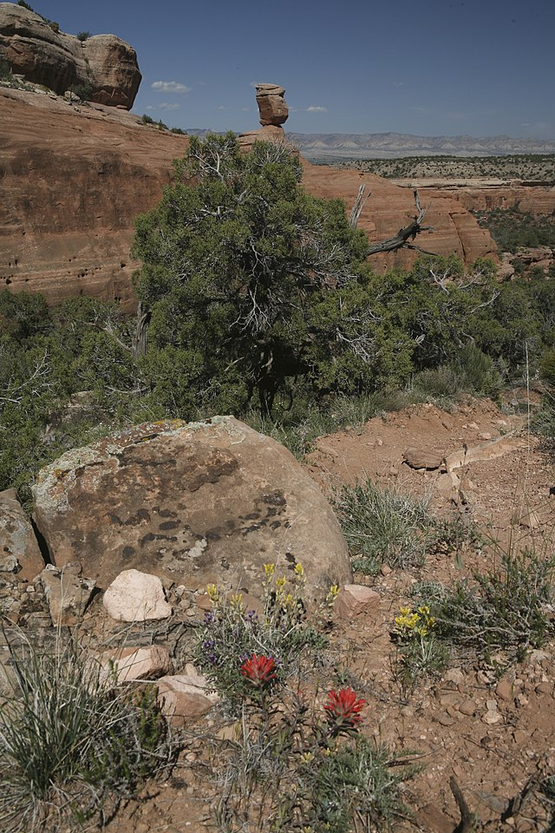
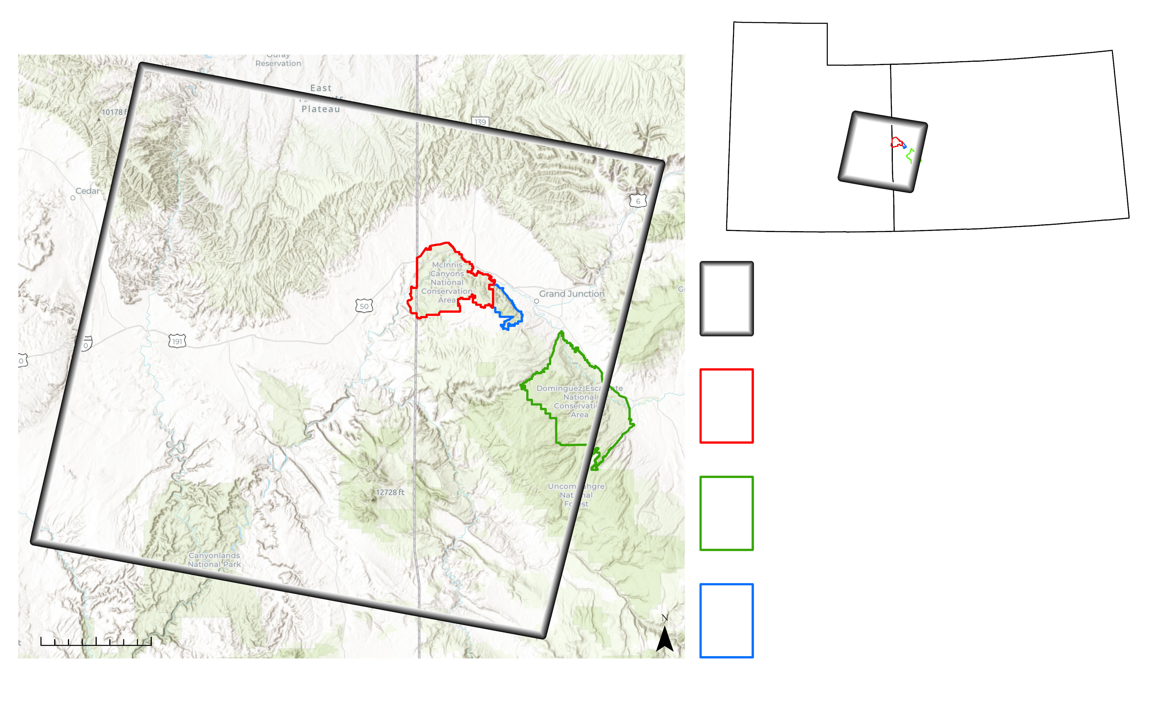
STUDY AREA AND PERIOD
Grand Valley, CO
Study Period: 1986 – 2021
UT
CO
Study Extent
McInnis Canyons NCA
Dominguez-Escalante NCA
0 50 km
Colorado National Monument
Image Credit: Bob Wick, BLM
Notes:
The Grand Valley spans the Colorado and Utah border along the Colorado River. Situated within the Colorado Plateau, the arid landscape of the Grand Valley is predominantly covered by pinyon-juniper woodlands and sagebrush habitat. Beetle infestation and wildfire are two types of disturbance that impact the vegetation communities within our study area. The increasing frequency and size of wildfire disturbance and expanding beetle infestations are indicators of a changing disturbance regime.
------------------------------Image Information Below ------------------------------​
•Image Credit: Bob Wick, BLM California, Wikimedia Commons
•Image Source: https://commons.wikimedia.org/wiki/File:McInnis_Canyons_National_Conservation_Area_(9320789173).jpg (CC BY 2.0)
•Basemap Credit: Esri

Slide 3
PROJECT OBJECTIVES
Monitor
Monitor Pinyon – Juniper woodland and sagebrush extent over time
Measure Disturbance
Quantify impacts of wildfire and Ips beetle infestation on the landscape
Assess Treatments
Quantify vegetation response to pre-fire treatments to guide future management
Notes:
With that background in mind, we sought to accomplish three objectives for our project:
First, we monitored changes in the extent of pinyon-juniper woodland and sagebrush habitat over the last few decades, since 1986
Second, we measured the impacts of disturbances caused by wildfire and beetle infestations, focusing specifically on their effects on vegetation health and fractional vegetation cover up to 20 years later
Third, we assessed the effects of vegetation treatments on the landscape to help managers assess which treatments have the highest chance of success
------------------------------Image Information Below ------------------------------​
•Image Credit: Icons provided by Microsoft PowerPoint
•Image Source: Icons provided by Microsoft PowerPoint

Slide 4
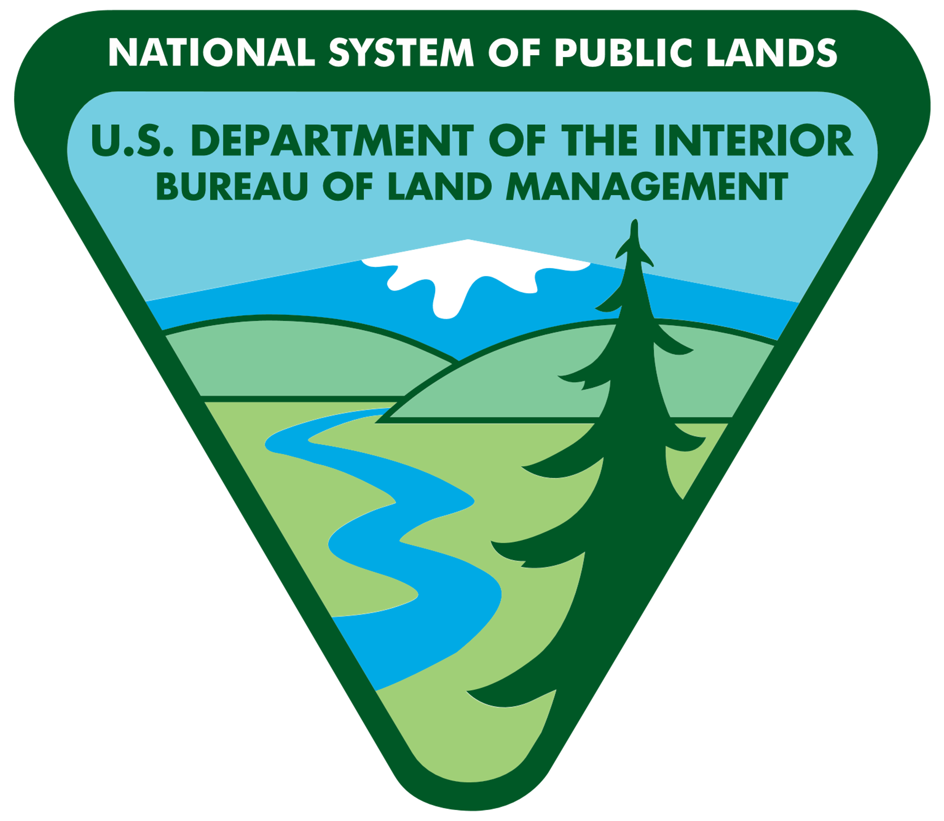
PARTNER ORGANIZATIONS
National Park Service
Colorado National Monument
20,000+ acres
Management Focus:
Recreation
Wildlife preservation
Bureau of Land Management
McInnis Canyons and Dominguez-Escalante NCA
342,000+ acres
Management Focus:
Recreation
Grazing
Wildlife preservation
"Multiple use, sustainable yield"
Image credit: NPS; BLM
Notes:
Our partners in this project are the National Park Service and the Bureau of Land Management. Combined, these partners manage over 350,000 acres of public land within the Grand Valley and are tasked with maintaining their land in a way that preserves their respective land uses for future generations.
------------------------------Image Information Below ------------------------------​
•Image Credit: NPS, BLM
•Image Source: https://nps.gov/, https://www.blm.gov/, (provided by partner)

Slide 5
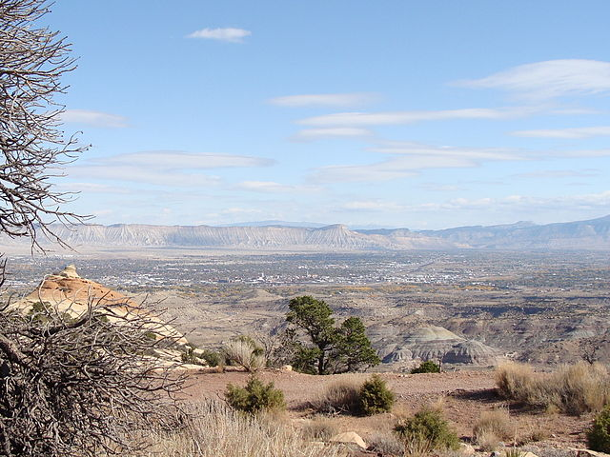
COMMUNITY CONCERNS
Pinyon – Juniper woodlands and sagebrush provide wildlife habitat, grazing, and recreation
More frequent and severe disturbances are impacting these habitats and threatening current land uses
Management practices are limited by budgets and personnel
Image Credit: Jimmy Thomas
Notes:
The vegetation communities of the Grand Valley provide wildlife habitat, grazing, and recreation, among many other services. The changing disturbance regimes in recent decades impact the recovery of these habitats and threaten current land uses. Our partners work within a limited budget and must decide where treatment practices are used after major disturbance. Land mangers need to know where treatment is most needed and where it is most likely to succeed.
Examples of changing disturbances:
Ips beetle infestations increase fire severity
Invasive vegetation
Woody encroachment into sagebrush habitat
Fire threats at the wildland – urban interface
------------------------------Image Information Below ------------------------------
•Image Credit: Jimmy Thomas, Wikimedia Commons
•Image Source: https://commons.wikimedia.org/wiki/File:Grand_Valley,_Colorado.jpg, (CC BY 2.0)

Slide 6
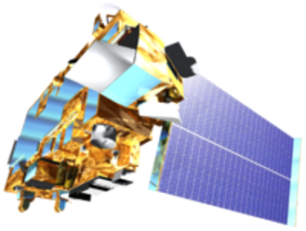
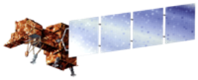
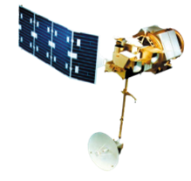
NASA Earth Observations
​​ ​​ Satellite /​ Sensor Name​ | ​​ ​ ​Landsat 5, 7, & 8 – Thematic Mapper, Thematic Mapper Plus, and Operational Land Imager | ​ Terra and Aqua – Moderate Resolution ​ Imaging Spectroradiometer (MODIS)​
​​ ​​ ​Data​ Products ​​ | Land Cover – Normalized Difference Vegetation Index (NDVI) | Vegetation Greenness – Normalized Difference Vegetation Index (NDVI)
Image Credit: NASA
Notes:
We used two different earth observations in our analysis, Landsat and Terra/Aqua MODIS.
1. We used Landsat TM, ETM+, and OLI (thematic mapper and operation land imager) imagery from missions 5, 7, and 8. Specifically we created Normalized Difference Vegetation Index composites from Landsat images and downloaded Landscape Change Monitoring System data derived from Landsat imagery to understand land cover change.
2. We also used Moderate Resolution Imaging Spectroradiometer, or MODIS sensor from the Terra and Aqua satellites. Specifically, we downloaded MODIS NDVI images to analyze vegetation health over time.
------------------------------Image Information Below ------------------------------
MODIS Mission Credit: NASA
Image Source: https://www.devpedia.developexchange.com/dp/images/9/91/05_Terra.png
Landsat 4/5 Mission Credit: NASA
Image Source: https://www.devpedia.developexchange.com/dp/images/6/69/01_Landsat5.png
Landsat 7 Mission Credit: NASA
Image Source: https://www.devpedia.developexchange.com/dp/images/3/39/02_Landsat7.png
Landsat 8 Mission Credit: NASA
Image Source: https://www.devpedia.developexchange.com/dp/images/c/c2/03_Landsat8.png

Slide 7
Ancillary Datasets
​​ ​​ Source | ​ Landscape Change Monitoring System (LCMS) | Rangeland Analysis Platform (RAP) | Monitoring Trends in Burn Severity (MTBS) | Partner Data
​​ ​​ ​Data Products​ ​​ | Vegetation Cover (Categorical) | Vegetation Cover (Fractional) | Fires – Wildfire locations and burn severity | Fires and Treatment Areas – Wildfire and vegetation treatment locations
Notes:
We used three ancillary datasets, which are all derived from Landsat imagery.
1. We used Land Change Monitoring System (LCMS) to gather categorical data of vegetation types covering our study area.
2. We used the Rangeland Analysis Platform (RAP) to understand what percentage of each type of vegetation cover (of 6 different categories) comprise our study area.
3. We used Monitoring Trends in Burn Severity (MTBS) to finalize wildfire boundaries and to understand burn severity of each fire through categorical raster layers and dNBR data.
------------------------------Image Information Below ------------------------------
•Image Credit: LCMS, PowerPoint, MTBS,
•Image Source: https://apps.fs.usda.gov/lcms-viewer/, https://www.mtbs.gov/

Slide 8
METHODS: IMAGE PROCESSING
L5 SR
L7 SR
L8 SR
Imagery collected by Landsat 5, 7, 8
Tier 1 Surface Reflectance
Harmonized across sensors to improve NDVI comparability
Max value NDVI composites
Intra-annual composites throughout June – September
1986 – 2021
Harmonize
Sensor
Cloud mask
Google Earth Engine
Calculate NDVI
Yearly max composite
NDVI
(1986 – 2021)
Notes:
Our analysis required measurements of vegetation health across the study area over many years
We used satellite imagery collected by Landsat 5, 7, and 8 to calculate vegetation indices that were then compiled into intra-annual composites for each year from 1986 to 2021
Imagery data was provided by the USGS as surface reflectance with atmospheric effects corrected using the LEDAP and LaSRC algorithm
Clouds and cloud shadows were masked out using the pixel quality assessment bands provided with the imagery
NDVI was calculated for each scene individually then compiled into yearly composites of maximum values at each pixel location
Google Earth Engine was used to acquire, process, and compile all imageries

Slide 9
METHODS: LANDCOVER CHANGE
ArcGIS Pro
Land Cover Maps
(1985 – 2020)
Image Preprocessing
Change Analysis
Landcover Change Maps
Notes:
To detect landcover change in the study area I downloaded classified rasters for every year from 1985 – 2020 from the Forest Service Landscape Change Monitoring System (LCMS). The next step I took was to preprocess the classified rasters in ArcGIS Pro for use in Change Detection. To preprocess the imagery, I first clipped all images to the study area and then I projected all the images to NAD 83 UTM Zone 12N. After preprocessing the rasters, I selected 4-time intervals in which to examine for landcover change (1985–1995, 1985–2005, 1985–2015, 1985–2020).
I performed Change detection in ArcGIS Pro using the change detection Wizard to map the landcover change of Tree, Shrub, and Grass & Forb landcover types over these four-time intervals. To detect change I followed a pattern of analyzing change in all landcover types to Tree landcover type (classes 1-7), all landcover types to shrub (Classes 8-9), and all landcover types to grass & forbs (Classes 9-10). The result was landcover change maps that help us to understand the change to these landcover types overtime.

Slide 10
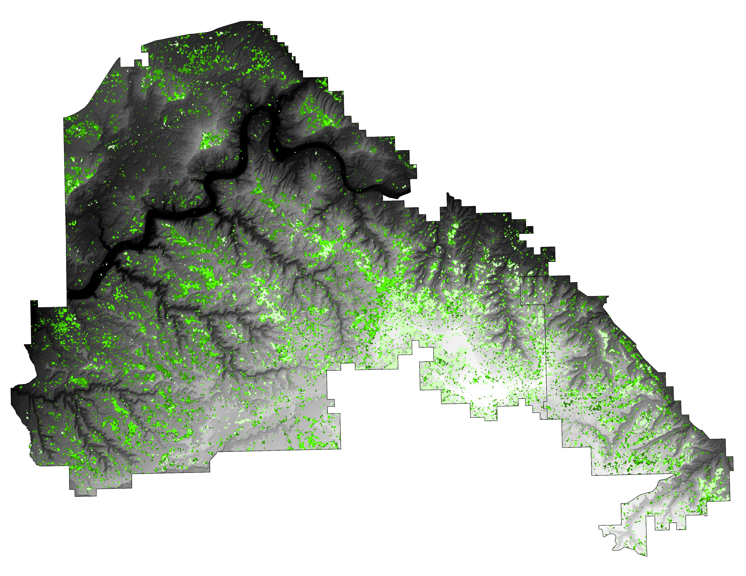
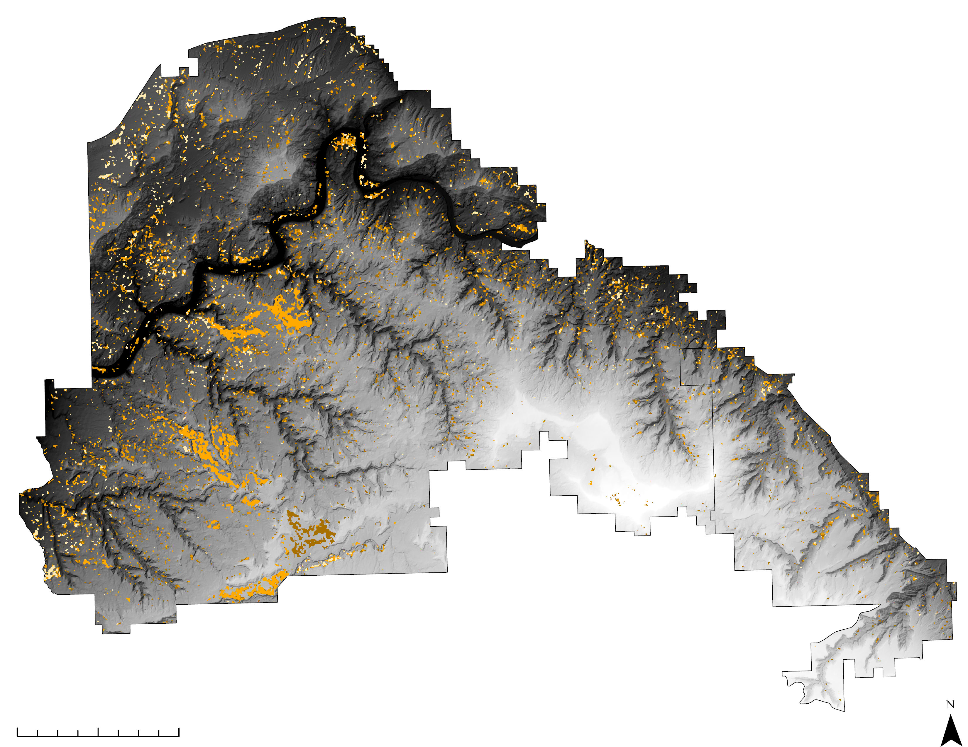
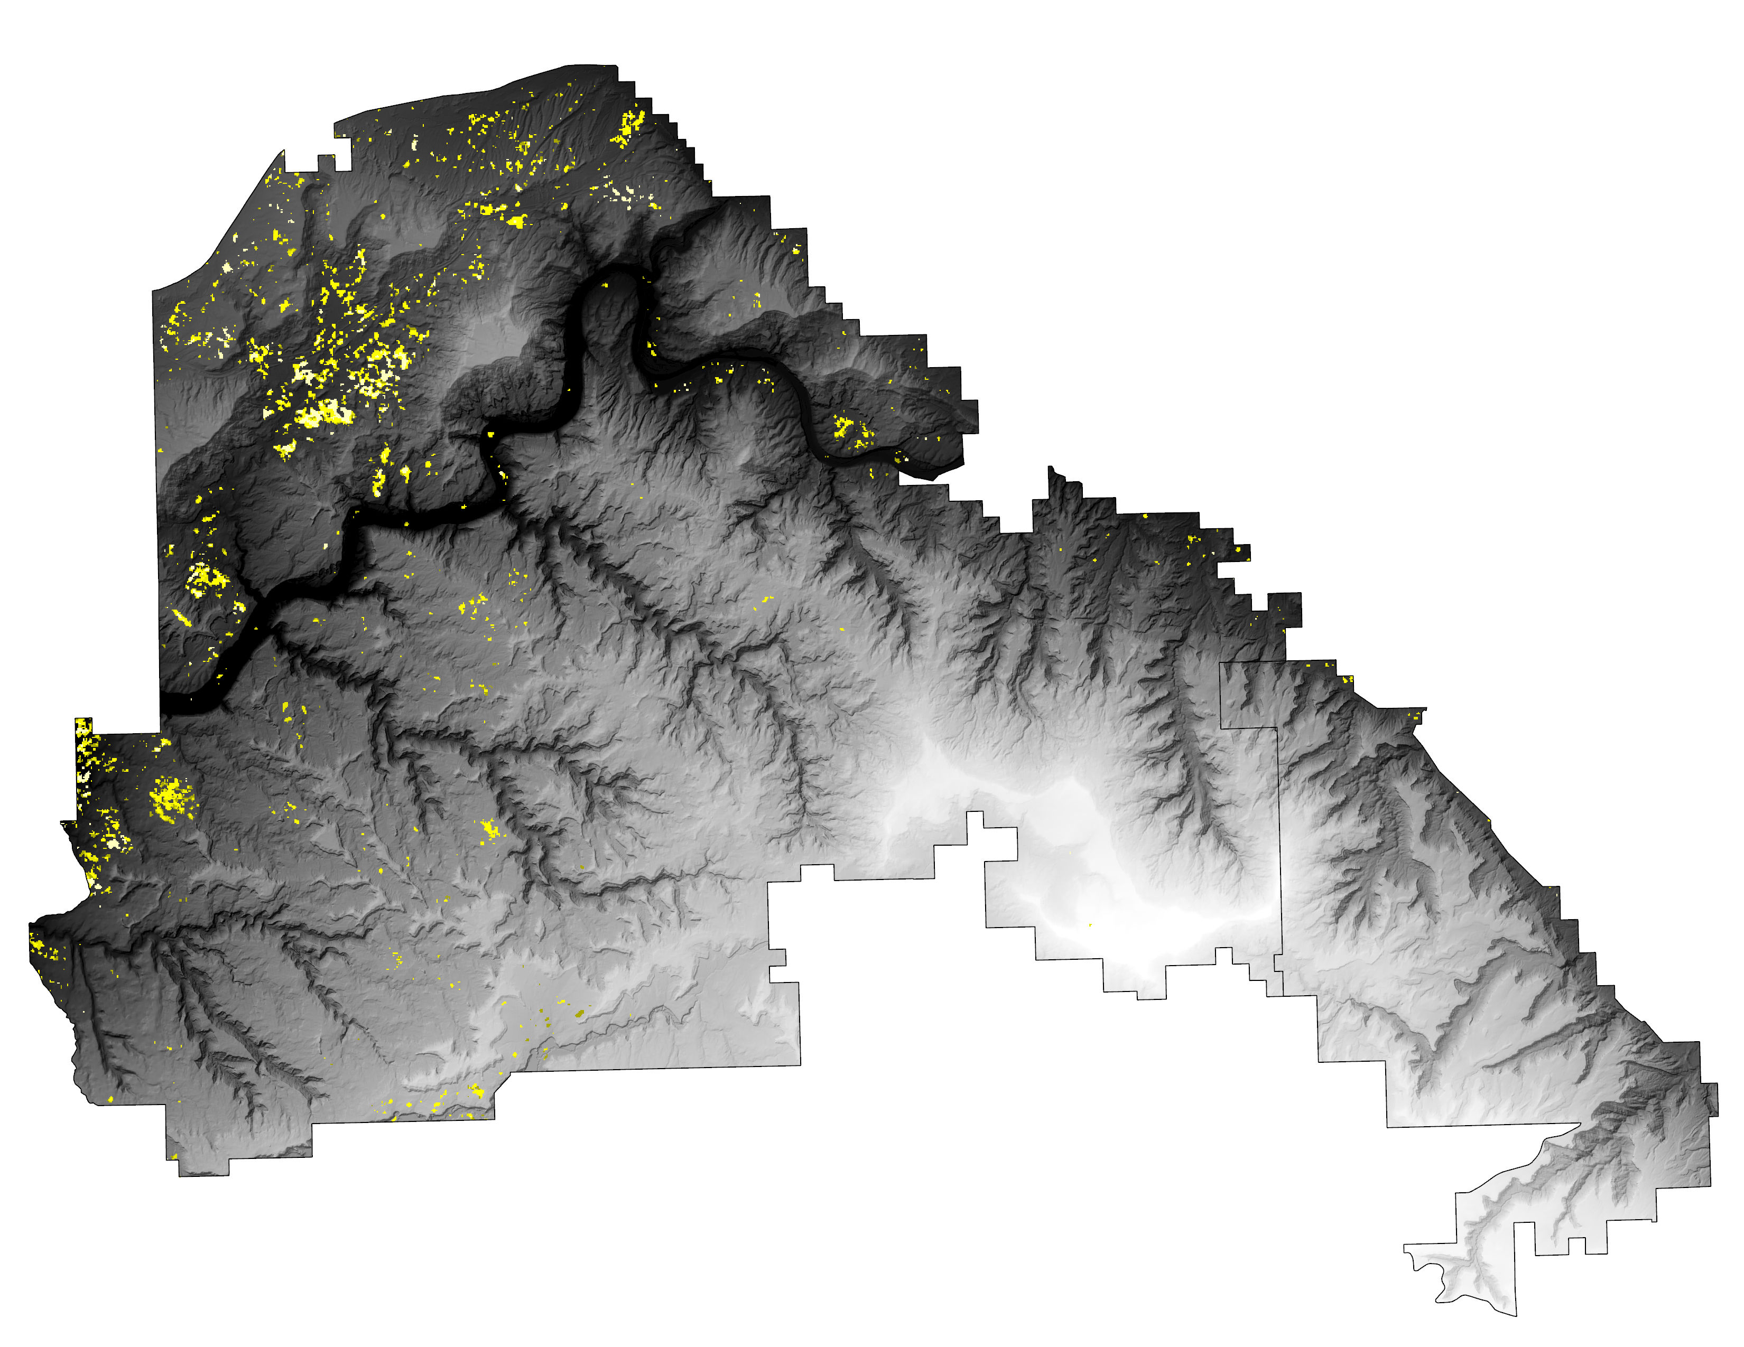
RESULTS: LANDCOVER CHANGE
0 7km
Tree Cover Gain
Shrub Gain
Grass & Forb Gain
1985 – 1995
1985 – 1995
1985 – 1995
1985 – 2005
1985 – 2005
1985 – 2005
1985 – 2015
1985 – 2015
1985 – 2015
1985 – 2020
1985 – 2020
1985 – 2020
Notes:
McInnis Canyons National Conservation Area and Colorado National Monument boundaries broken into three maps showing landcover change over 4-time intervals for Tree, Shrub, and Grass and Forb landcover types. Lighter colors represent early time intervals and dark colors represent later time intervals; this coloring helps to visualize the change of landcover types over the period of 1985–2020. The base map of the maps is a hill shade derived from a 30m digital elevation model that was downloaded from apps.nationalmap.gov. The elevation range in this map ranges from 2175m (White) to 1320m (Black). The landcover data used was downloaded from the Landscape Change Monitoring System (https://apps.fs.usda.gov/lcms-viewer/). Scale is 1:150000
------------------------------Image Information Below ------------------------------​
•Image Credit:
•Image Source: (insert here whether this image is provided by a DEVELOPer/partner, public domain, or the type of creative commons license the image was published under – e.g. CC BY-SA)​

Slide 11
RESULTS: LANDCOVER CHANGE
Gains and Losses Between 1985 and 2020
Other
Grass & Forb
Shrub
Tree
-8000
-6000
-4000
-2000
0
2000
4000
6000
8000
Hectares
Notes:
Graph showing gains and losses in landcover type within the boundaries of McInnis Canyons National Conservation Area and Colorado National Monument from 1985-2020. Landscape Change Monitoring System (LCMS) data was reclassified into these classes for this analysis. We used optical interpretation and the rangeland analysis platform to group classes into representative classes. The Tree class had the most gains and least amount of landcover loss out of the classes which is in agreeance with observations from partners. This Graph was generated using IDRISI TerrSet Land Change Modeler.

Slide 12
METHODS: FIRE EFFECTS
Fire Perimeters
(1986 – 2021)
Partner data
MTBS
Fire Effects
20 Year
10 Year
5 Year
1 Year
Recovery Maps & Graphs
Image Differencing
Analyze impacts and trends
Pre-fire NDVI
&
Cover
Post-fire NDVI
&
Cover
NDVI
&
Cover
Changes
Burn Severity
(dNBR)
Land Cover
Notes:
To detect impacts of fires on the landscape, we first collected fire perimeter data from our partner organization and from the monitoring trends in burn severity (MTBS) dataset.
We then used NDVI composites and percent cover estimates to assess changes in vegetation conditions for time steps up to 20 years after each fire
Pre-fire conditions (landcover, soil unit) and immediate post-fire conditions (burn severity) were also extracted to allow for more detailed analysis of fire responses
These data were then analyzed for trends and differences in response among various groups
We also created maps which showed the location of low-recovery areas to assist managers in prioritizing treatment areas

Slide 13
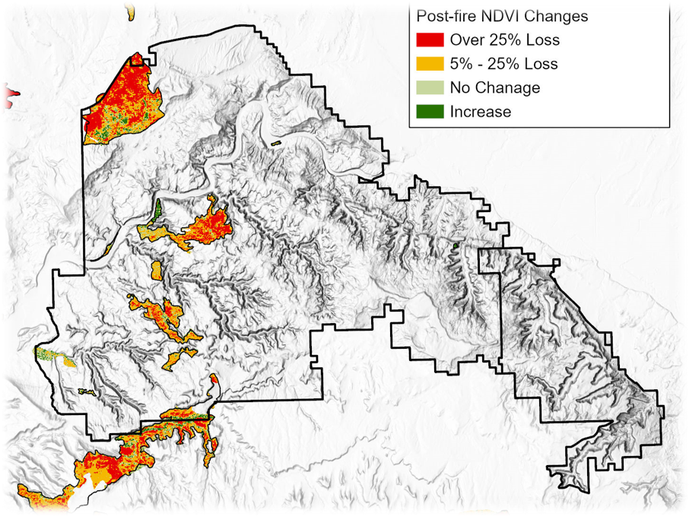
RESULTS: FIRE EFFECTS
Signs of vegetation loss detected after 20 years recovery
Slow recovery evident in both pinyon-juniper and sagebrush habitats
N
Fire Perimeters
Partner Properties
Post-fire NDVI Changes
< -25%
-5% to -24%
No Change
0
5
10
> 0%
Km
Notes:
This map shows the 20-year changes in NDVI values after fires in the western portion of our study area.
We saw long term trends of slow recovery toward pre-fire conditions in burned areas as evident in the low NDVI values at 20 years post fire.
These reduced NDVI values occurred in both pinyon-juniper and sagebrush habitats.
------------------------------Image Information Below ------------------------------​

Slide 14
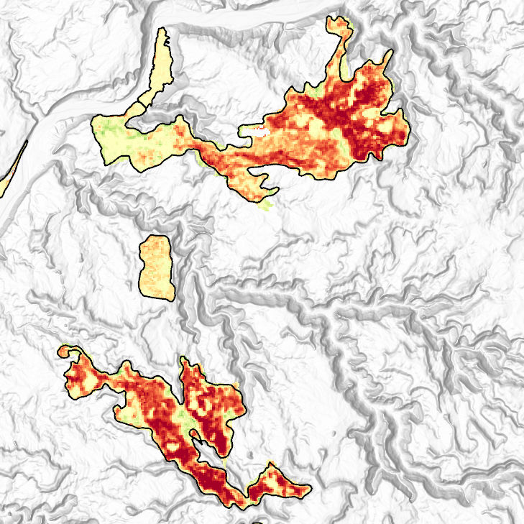
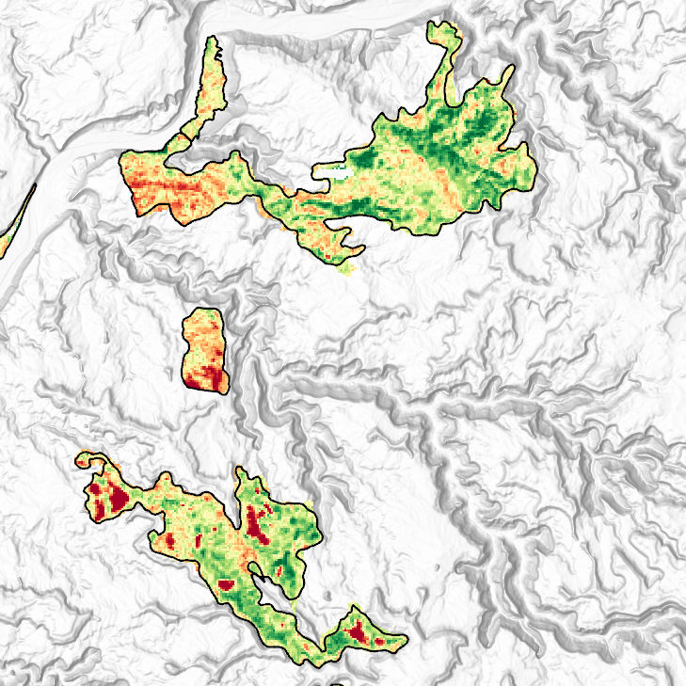
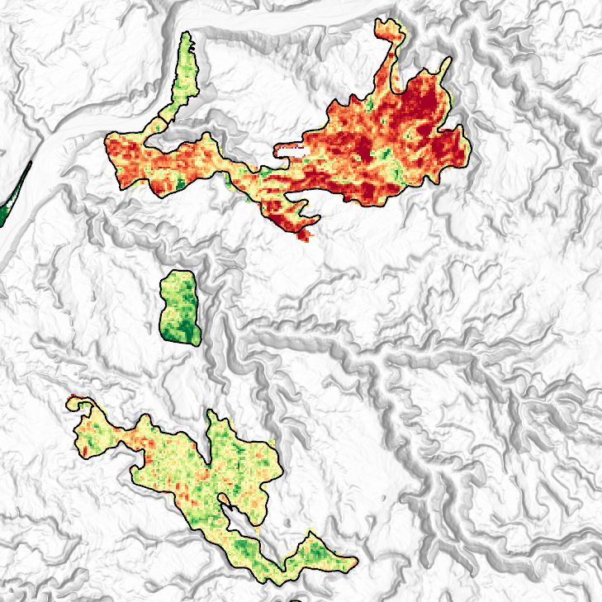
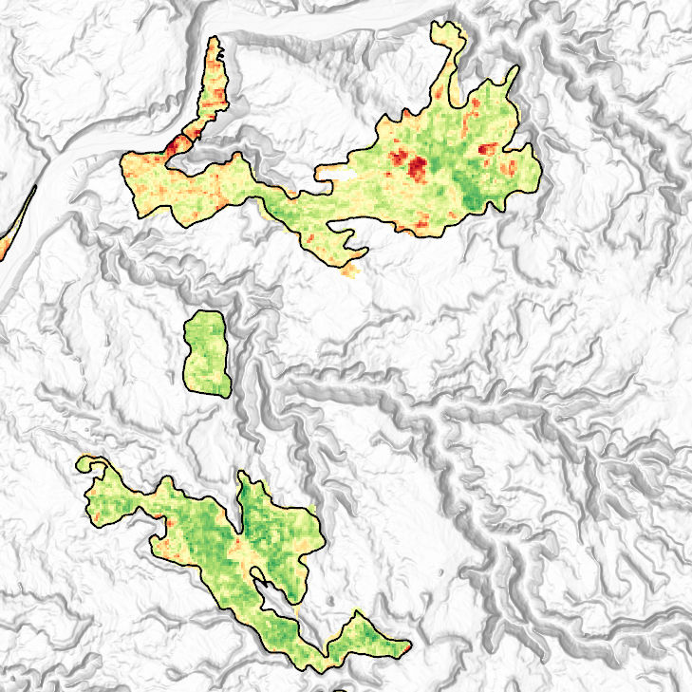
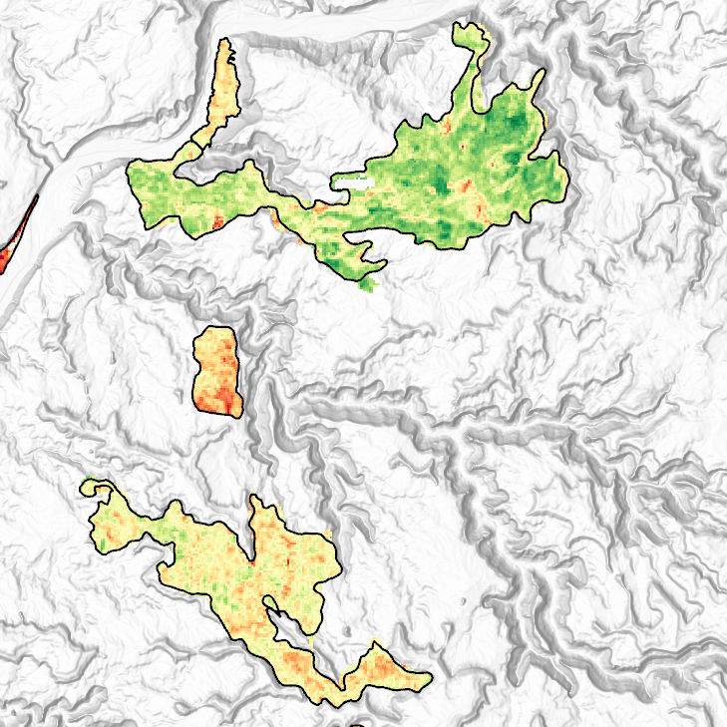
RESULTS: FIRE EFFECTS
Fractional Cover Changes
Fire Perimeters
N
Partner Properties
Trees
Shrubs
Post-fire NDVI Changes
Over 25% Loss
5% - 24% Loss
No Change
Increase
Bare Ground
Grasses & Forbs
+25%
-25%
0
2
0
5
10
Km
Km
Notes:
While NDVI indicates changes in the overall vegetation structure at these sites, fractional cover estimates can provide finer details about how the components of the vegetation community are recovering.
These maps of fractional cover changes after 20 years show a lasting reduction in tree cover and an increase in bare ground cover compared to pre-fire conditions.
Shrub cover had recovered to near and sometimes greater than pre-fire conditions at 20 years except for some sites of highly concentrated shrub loss.
Grasses and forbs appeared to generally recover to pre-fire conditions after 20 years recovery.
------------------------------Image Information Below ------------------------------​

Slide 15
RESULTS: FIRE EFFECTS
Pinyon-Juniper Woodland Fire Recovery
Shrubs
Trees
20%
0%
Burn Severity
-20%
Unburned
Low
Sagebrush Habitat Fire Recovery
Moderate
Percent Cover Changes
Shrubs
Trees
High
30%
0%
-30%
1
5
10
20
1
5
10
20
Years Post-fire
Notes:
We found that post-fire recovery was different between pinyon-juniper and sagebrush habitat.
Burn severity also impacts the magnitude of these changes and the time required for recovery.
Burned pinyon-juniper woodland experienced up to 25% reduction in tree cover and showed minimal signs of recovery even at 20 years post-fire.
Sagebrush habitat saw shrub cover reduced up to 30% after fire disturbance, but high intensity fires seemed to cause more lasting damage than lower severity fires which recovered to near unburned levels after 5 years.

Slide 16
METHODS: BEETLE DISTURBANCE
Max. NDVI Composite
(1986 – 2021)
Image Differencing (1-year step)
Establish
Threshold
Detect Consecutive
Outliers
Consecutive Vegetation decline
Years of Consecutive Vegetation Decline Map
Landcover & Disturbance Masks
Pinyon-Juniper Mask
Vegetation Treatment Mask
Wildfire Mask
Notes:
To map beetle disturbance in the area, we extracted maximum NDVI intra-annual images from the study area between 1986-2021.
We performed image differencing on each pixels using 5-year moving average images and established threshold values for probable vegetation productivity decline.
Probable outliers were detected by finding pixels with values below the established threshold for each image in the composite.
The resulting layers were reclassified and aggregated to show consecutive vegetation productivity decline
Land cover mask using LCMS data and disturbance masks were applied using ancillary dataset provided by the partner to exclude known disturbances in the consecutive vegetation decline layer.
The consecutive vegetation decline productivity layer indicates possible areas affected by beetle infestation throughout the study period.

Slide 17
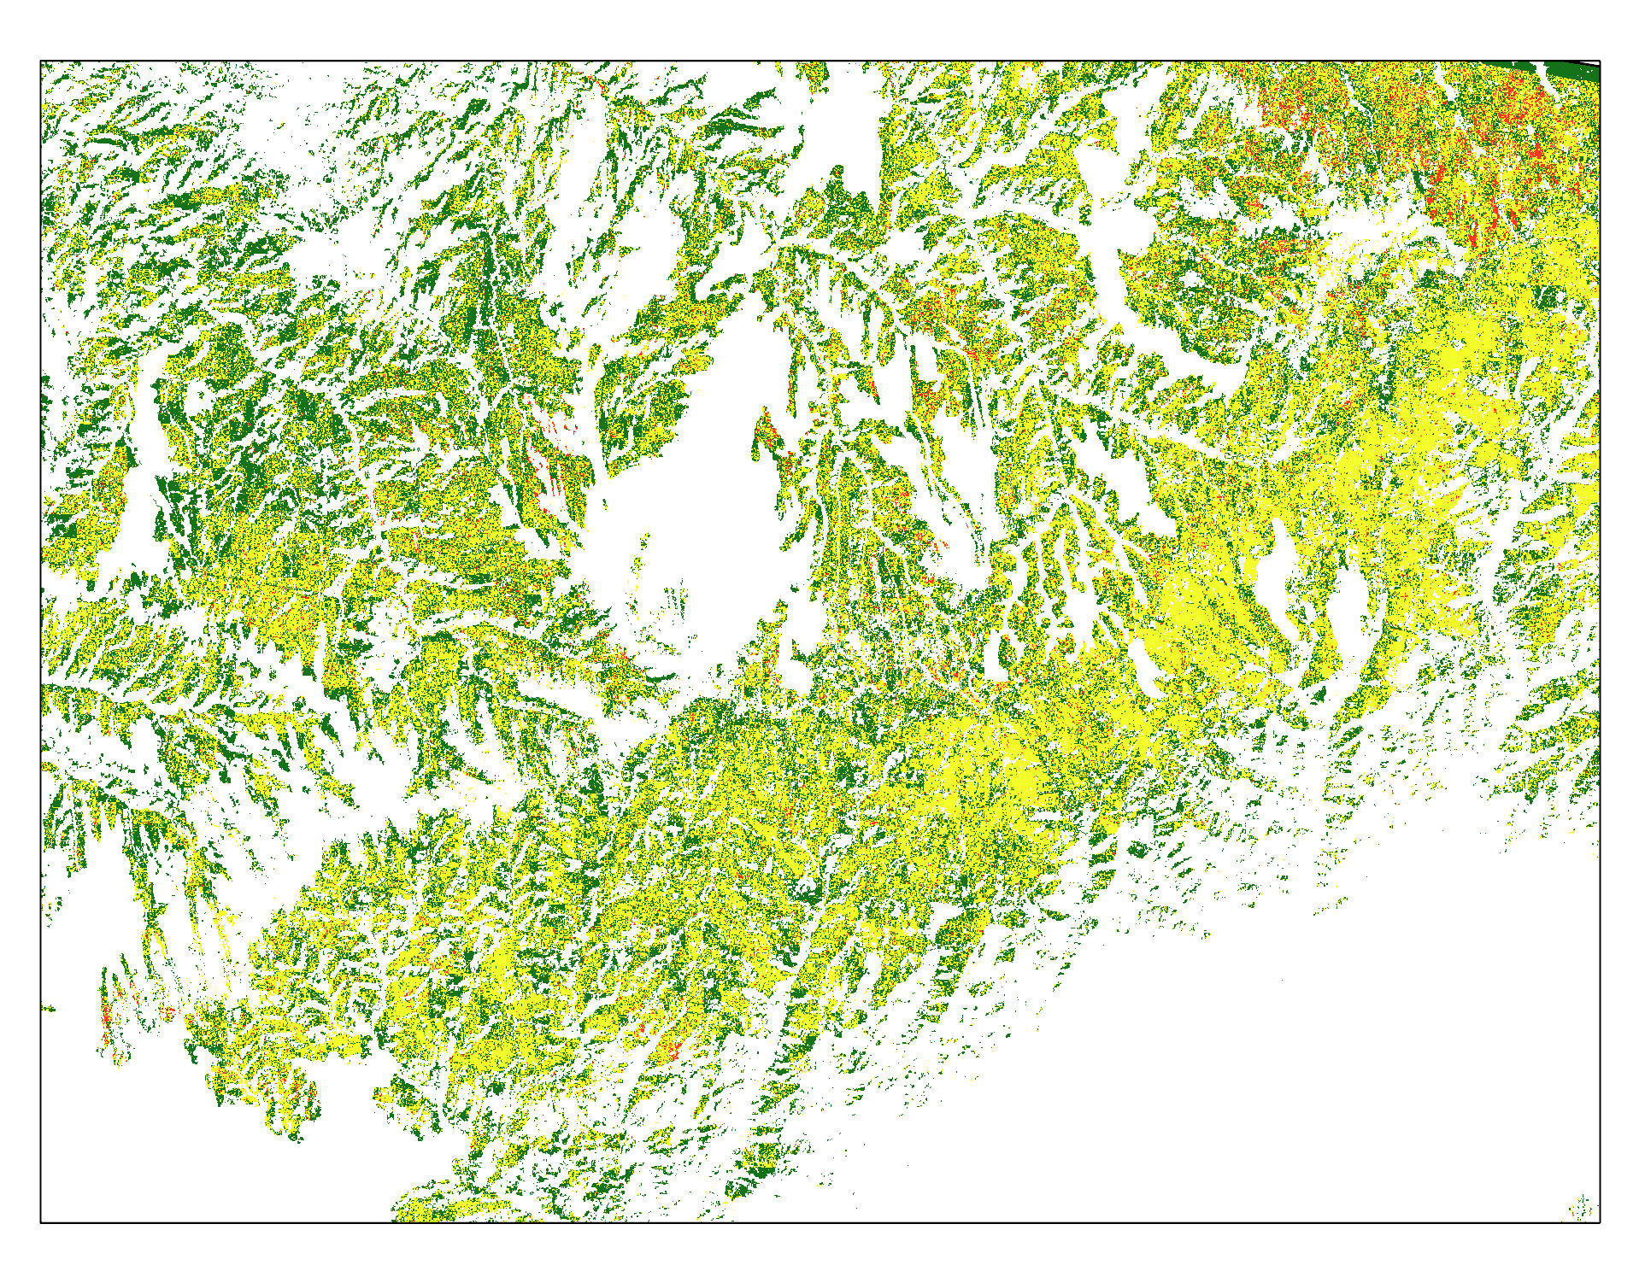
RESULTS: POTENTIAL PINYON IPS DISTURBANCE
N
0
4
0
20
Km
Km
Years of Consecutive Vegetation Productivity Decline
5
0
Study Area
5
Notes:
Consecutive vegetation productivity decline map shows areas with consecutive outliers for five years.
The areas in white were masked out for known disturbances and non-forest areas.
The map serves as a proxy for locating possible Ips beetle disturbance impacted areas within the Pinyon-Juniper trees.
.
------------------------------Image Information Below ------------------------------​
•Image Credit: Kolawole Arowoogun
•Image Source: (insert here whether this image is provided by a DEVELOPer/partner, public domain, or the type of creative commons license the image was published under – e.g. CC BY-SA)​

Slide 18
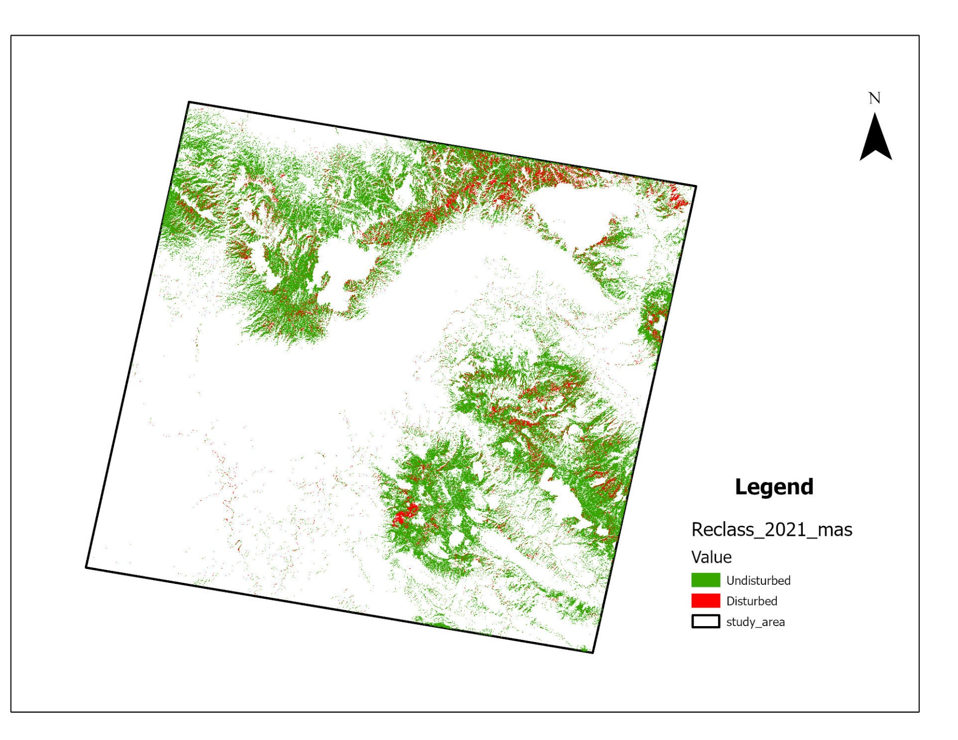
RESULTS: POTENTIAL PINYON IPS DISTURBANCE
Vegetation Disturbance 2021
Undisturbed
Disturbed
Study Area
0
20
Km
Notes:
•This map shows likely beetle infested areas in 2021. The green color represent areas with heathy vegetation while areas represented in red appear to be the disturbed portion.
•We saw the trends of Pinyon-juniper vegetation disturbance. This disturbance is likely caused by beetle infestation in the area.
•The northeastern part (in red) appear to be more disturbed than other areas.
.
------------------------------Image Information Below ------------------------------​
•Image Credit: Kolawole Arowoogun
•Image Source: (insert here whether this image is provided by a DEVELOPer/partner, public domain, or the type of creative commons license the image was published under – e.g. CC BY-SA)​

Slide 19
METHODS: PRE-FIRE TREATMENT EFFECTS
Fire Perimeters
(1986 – 2021)
Partner data
MTBS
Pre-Fire Treatment Polygons
(1999 – 2021)
Partner data
Extract values
Analyze impacts and trends
Treatment Effects
(with attributes)
MODIS NDVI
(2001–2021)
Burn Severity
(1986 – 2021)
Notes:
We looked at pre-fire treatment effects through two different lenses – its impact on vegetation and its impact on burn severity.
Some of the questions we were looking to answer include: What is treatment's impact on vegetation health and on vegetation post-fire? Do different types of treatment have different impacts on vegetation health or fire behavior?
We did this by making multidimensional raster datasets of NDVI images for each year of our time series.
We then used Zonal Statistics to gather mean data and other statistical information for each polygon.
We added this information as fields to the Pre-Fire Treatment polygons' attribute table.
And in those pre-fire treatment polygons that had also seen wildfires, I looked at the burn severity in each polygon.
These data were then analyzed for trends and differences.

Slide 20
METHODS: PRE-FIRE TREATMENT EFFECTS -
CONTROL GROUPS
Control Group Feature Class
Empty polygon shapefile
Pre-Fire Treatment Polygons
(1999 – 2021)
Partner data
Control
Group
Polygons
(with attributes)
Draw Control Groups
Control
Group
Polygons
Extract Values
Analyze impacts and trends
Fire Perimeters
(1986 – 2021)
Partner data
MTBS
% Cover Estimates (1986 – 2021)
MODIS NDVI
(2001 – 2021)
Notes:
We had a similar method when creating our control areas, but a major difference was that we had to draw the control polygons ourselves, which adds an extra step at the beginning.
Using the fire perimeters, treatment areas, and RAP layers as comparison, we placed control polygons on areas not impacted by treatment or fires, but within the same fuel type.
We also created a second control polygon shapefile using this same method, except this time with a focus on control areas within a fire which had not been the site of a previous treatment.
Once the polygons were created, we used Zonal Statistics to extract mean NDVI information for each polygon (same method as previous slide).
Finally, we analyzed this information by creating maps and charts.

Slide 21
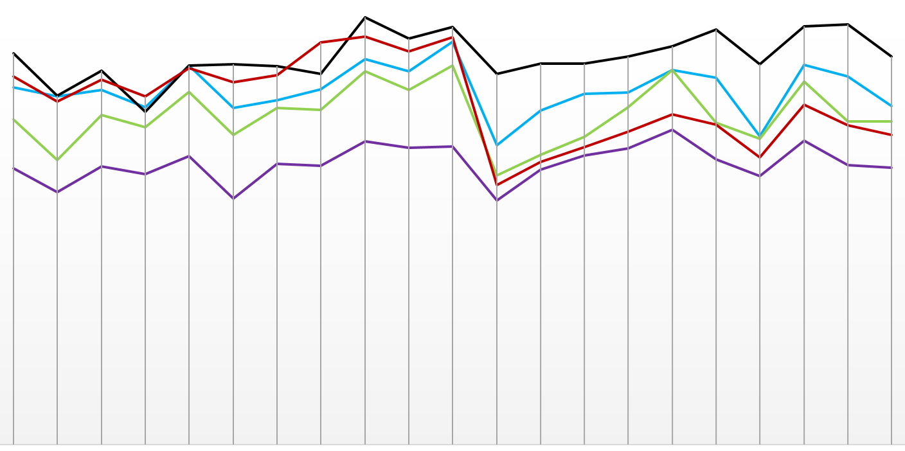
RESULTS: ASSESS TREATMENTS
Mean
NDVI (MODIS)
Pre-Fire Treatment's Response to Disturbances in Comparison to Two Control Areas
Roller Chopper
Treatment 1
0.50
0.45​
Roller Chopper
Treatment 2
0.40
Roller Chopper
Treatment 3
0.35
0.30
No Fire or
Treatment Control
0.25
0.20
No Treatment,
Burned Area
Control
0.15
0.10
Treatment Year
0.05
Fire Year
0.00
2001
2003
2005
2007
2009
2011
2013
2015
2017
2019
2021
Year
Notes:
Here is a line chart of our results that shows the mean NDVI of 5 different polygons from 2001-2021 and their response to disturbance, roller chopper treatment in 2005 and the Cosgrove Fire in 2011.
Three of the lines (blue, green, and purple) represent treatment areas, which were all masticated with a roller chopper in 2005.
These treatment areas were also within the boundaries of the 2011 Cosgrove Fire.
The two other lines (black and red) represent two different control areas.
The black line is vegetation which was impacted neither by treatment nor fire.
The red line is vegetation which was impacted by fire, but is not a treatment area.
These results show that treatment and fire has a noticeable negative effect on NDVI.
These results also show that two of the treatment areas recovered quicker than the No Treatment Control, even though the No Treatment Control started with healthier overall vegetation.
The No Treatment Control has not fully recovered to pre-fire conditions, but all of the treatments more or less did at one point.
There is a noticeable and sharp decline in 2018, and this could possibly be an image error or indication of another disturbance.
------------------------------Image Information Below ------------------------------​
•Image Credit: Elizabeth Stone
•Image Source: MODIS NDVI Imagery, Partner Shapefiles,

Slide 22
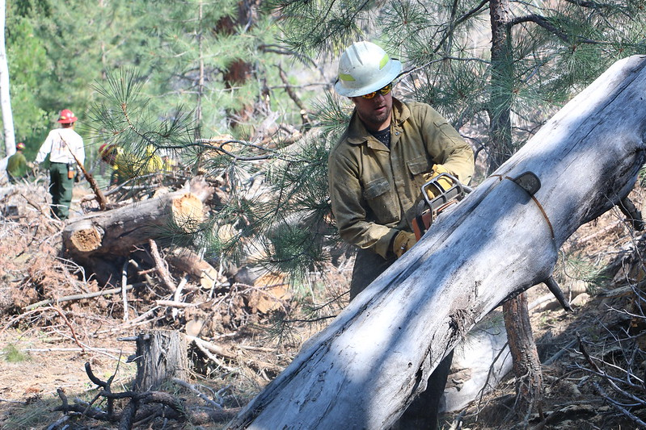
RESULTS: ASSESS TREATMENTS
Treatment's impact on vegetation health post-treatment and post-fire
Negative effect on NDVI in both cases
Treatments and fire boundaries
Effective at stopping or slowing down fires
Comparison to control groups
Control groups show that untreated areas took longer to recover post-fire
Image Credit: BLM
Notes:
We centered our analysis on these three topics and to answer each one in brief:
1. Treatment has a negative effect on vegetation post-treatment and post-fire. Treated area vegetation recovers faster than untreated vegetation after a fire.
2. In many (but not all) instances, treatment areas did indeed stop a wildfire or slow it down enough so that it could be stopped. In these instances, treatment areas intersected wildfire perimeters (as opposed to being entirely inside a fire perimeter).
3. Vegetation health in the status quo control groups (no treatment or fire) helps indicate what is a location-specific disturbance and what may be a greater landcover trend. Vegetation health in the no treatment control groups indicate what recovery is like for non-treated areas post fire. We saw that untreated areas took longer to recover.
------------------------------Image Information Below ------------------------------​
•Image Credit: BLM Flickr
•Image Source: https://www.flickr.com/photos/mypubliclands/albums/72157661484431922
Creative Commons License: https://creativecommons.org/licenses/by/2.0/

Slide 23
CONCLUSIONS
Tree landcover type yielded the biggest percent cover increase out of the three landcover types.
Burn severity can prioritize areas that need post-fire treatment the most.
Possible beetle-induced disturbance Identified
Treatments are effective in slowing down or stopping fires.
Treatments also aid in faster vegetation recovery post-fire.
Notes:
Through our analysis, we found that the woodland landcover type expanded more than other landcover types. We also found that higher severity fires, on average, result in greater impacts to vegetation and fire severity maps could be useful for prioritizing sites for post-fire treatment. We also identified sites of possible beetle-induced disturbance which can be used by land managers to investigate beetle infestations. Finally, our analysis demonstrates that treatments are effective in slowing or stopping fires and treatment also aides in faster vegetation recovery post-fire.
------------------------------Image Information Below ------------------------------
•Image Credit: Icons provided by Microsoft PowerPoint
•Image Source: Icons provided by Microsoft PowerPoint

Slide 24
LIMITATIONS AND UNCERTAINTIES
Discrete landcover classes misrepresent landcover boundaries
Lack of ground-truth data
Fractional cover numbers are estimates
Burn severity datasets were not fine enough and MODIS spatial resolution was too large for some treatment areas.
Notes:
Other limitations include:
Pre-Fire Treatment: The spatial resolution of MODIS is 250 meters. Some treatment areas were excluded for being too small. This also affects the accuracy of NDVI information. Burn severity datasets used were imperfect for analyzing severity relative to treatment – the dNBR data encompassed the whole fire and raster layers were categorical, and thus could not be averaged.
Beetle Disturbance: Damage caused by weather related disturbances such as drought, winds, hail, and ice can be mistaken for beetle disturbance. Lack of in-situ data and poor coverage of ADS data in the area limits accuracy of our method.
Landcover Change: Landcover in the study area is not discrete but is mixed with other landcover types leading to error when assigning landcover classes. With larger spatial resolution of 30m, landcover classification of LCMS data may not be as accurate in detecting landcover boundaries in the study area
------------------------------Image Information Below ------------------------------​
•Image Credit: Icons provided by Microsoft PowerPoint
•Image Source: Icons provided by Microsoft PowerPoint

Slide 25
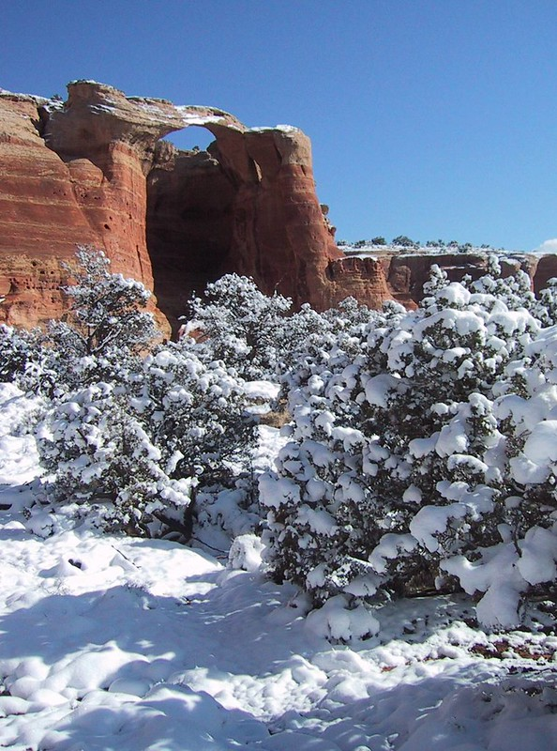
FUTURE WORK
Forecasting
Term II of this project will create forecasting models of these landcover trends.
Analysis
Future researchers can expand upon our data and methods by incorporating new information.
Image Credit: Bob Wick, BLM
Notes:
1. Forecasting
There is a second term planned for this project, where they will be creating forecasting models of these landcover trends.
We will coordinate a handoff of our data to the next term team to use as training data for forecasting models on IDRISI TerrSet.
These forecasting models will project the land cover trends we have uncovered 40-50 years into the future.
These models will help aid our partner's land management decisions.
2. Analysis
Additionally, our initial research and analysis can be expanded by incorporating different datasets and variables, such as drought information, finer burn severity data, and finer imagery, such as using NAIP imagery or Sentinel sensor data.
More ground-truthed data can also add to our previous analysis, especially regarding potential beetle infestation locations.
Our data can also inspire field research in our study area. For instance:
Our partners can use our data to prioritize locations for monitoring, and can then add these monitoring observations to our dataset.
------------------------------Image Information Below ------------------------------​
•Image Credit: Bob Wick - BLM California (BLM Flickr), PowerPoint Icons
•Image Source: https://www.flickr.com/photos/mypubliclands/albums/72157634710824014
Creative Commons License: https://creativecommons.org/licenses/by/2.0/

Slide 26
We would like to thank our science advisors (Prof. Keith Weber and Joseph Spruce), project coordination fellow (Brandy Nisbet-Wilcox), and our project partners (McInnis Canyons National Conservation Area, Dominguez-Escalante National Conservation Area, and Colorado National Monument) for their help on this project, it would not be possible without them.
We would also like to thank Science Systems and Applications, Inc., NASA DEVELOP, and all others who contributed for making this project possible
Maps throughout this work were created using ArcGIS® software by Esri. ArcGIS® and ArcMap™ are the intellectual property of Esri and are used herein under license. Copyright © Esri. All rights reserved. For more information about Esri® software, please visit http://www.esri.com.
Notes:
We would like to thank our science advisors (Prof. Keith Weber and Joseph Spruce), project coordination fellow (Brandy Nisbet-Wilcox), and our project partners (McInnis Canyons National Conservation Area, Dominguez-Escalante National Conservation Area, and Colorado National Monument) for their help on this project, it would not be possible without them. We would also like to thank Science Systems and Applications, Inc., NASA DEVELOP, and all others who contributed for making this project possible. Cartography software and basemaps were provided by ESRI.
------------------------------Image Information Below ------------------------------​
•Image Credit:
•Image Source: (insert here whether this image is provided by a DEVELOPer/partner, public domain, or the type of creative commons license the image was published under – e.g. CC BY-SA)​

