Slide 1
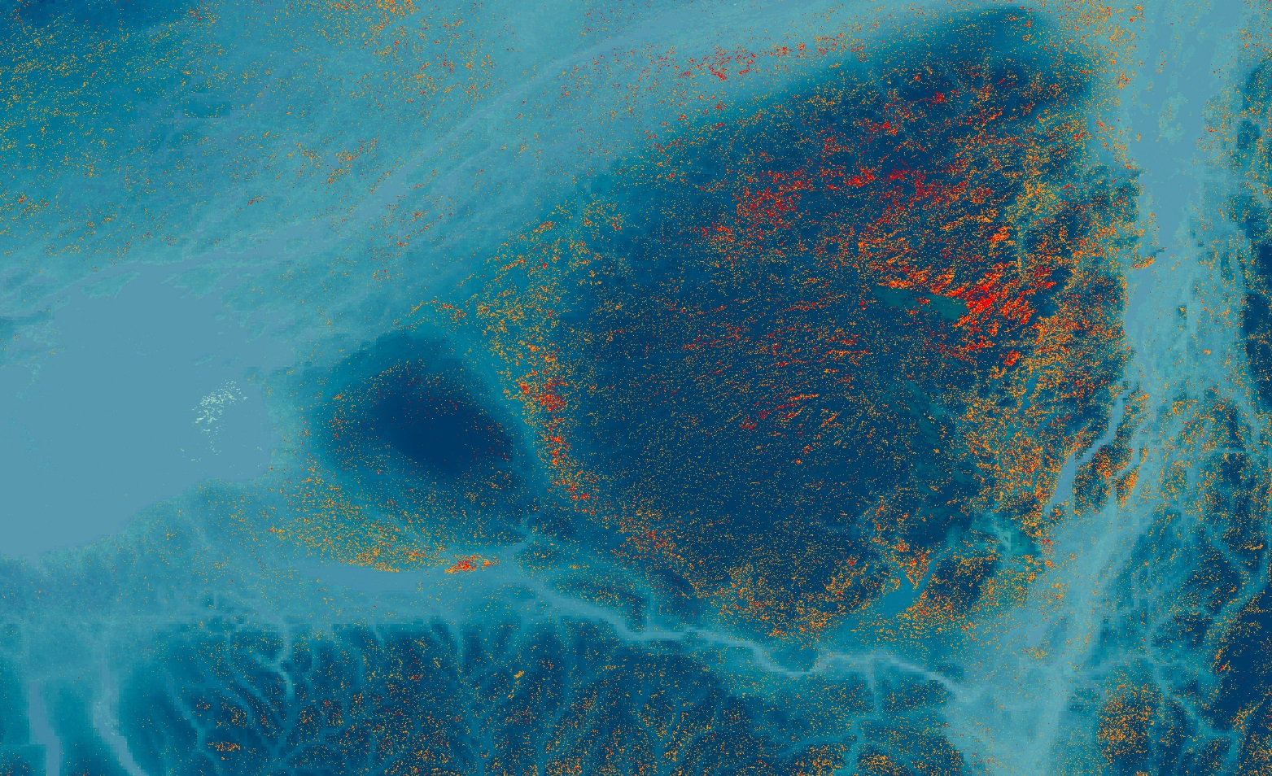
NEW YORK ECOLOGICAL FORECASTING II
Comparing the Efficiency of Space-Based Imagery to AVIRIS Airborne Data for the Identification of Hemlock Forests to Mitigate Invasive Species Expansion
Rya Inman
Abigail Barenblitt
Ryan Hammock
Niharika ‘Chitra’ Kokkirala
Maryland – Goddard | Summer 2019
Notes:
Hello everyone! We are the New York Ecological Forecasting II Team
My name is Rya Inman, I recently graduated from Columbia University with a degree in earth sciences
My name is Abigail Barenblitt, I have a masters in Wildlife and Fisheries Science from Penn State University
My name is Ryan Hammock, I’m a rising senior in environmental science at UT Austin
My name is Chitra Kokkirala, I’m a rising senior in biology and public policy at the College of William & Mary
This is the presentation we expect to give at our Goddard closeout on Wednesday, so if you have any feedback from today’s presentation please let us know. I will now hand it off to Ryan for an overview of the project.
Our project utilizes NASA earth observations to map eastern hemlock for conservation measures against hemlock woolly adelgid in New York state

Slide 2
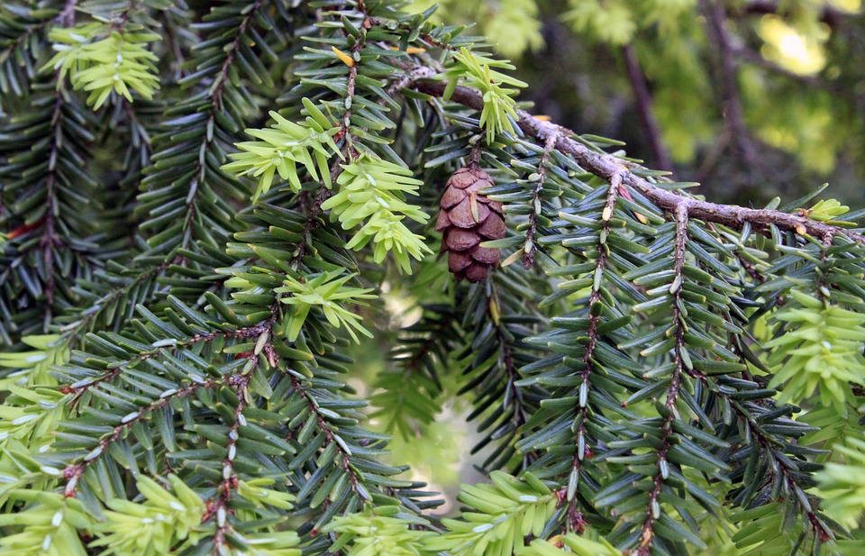
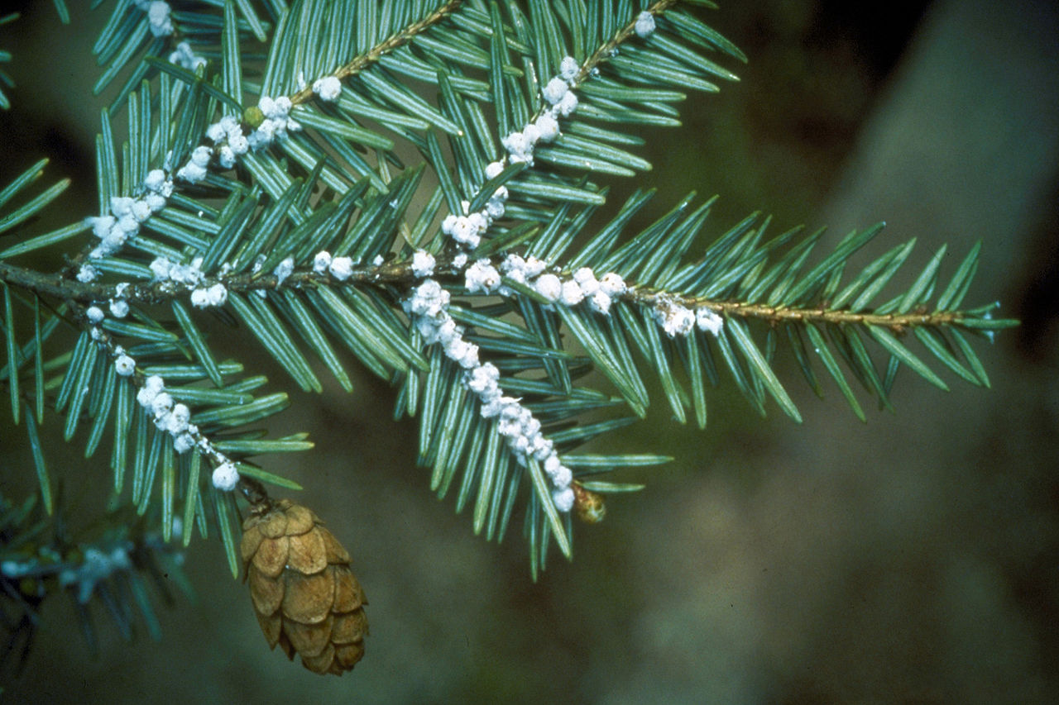
EASTERN HEMLOCK
Keystone species to New York and eastern United States
Declining with rise of the hemlock woolly adelgid (HWA)
Image: Pixabay 905513, Connecticut Agricultural Experiment Station
Notes:
Eastern Hemlock is a keystone species in eastern United States forests. This is an important conifer species that provides a shaded habitat for many animals and plants and prevents soil erosion. Eastern hemlock has a greater capacity to store carbon, regulate stream temperatures, and provide habitat for wildlife compared to cohabitating tree species. However, eastern hemlock grows in small patches dispersed over a large landscape, which can make it difficult for forest managers to locate.
Compounding on this, eastern hemlock is currently impacted by the invasive hemlock woolly adelgid, an aphid species which arrived from eastern Asia. This invasive species is rapidly spreading north due to a lack of native predators and warming winter temperatures.
*Talk about when/where HWA was first found in the US Photos:
Hemlock Tree- Pixabay
https://pixabay.com/photos/hemlock-tree-cones-background-1436186/
License: Free for commercial use, no attribution required
Hemlock Woolly Adelgid- Connecticut Agricultural Experiment Station
https://www.insectimages.org/browse/detail.cfm?imgnum=3225077
License: CC 3.0

Slide 3
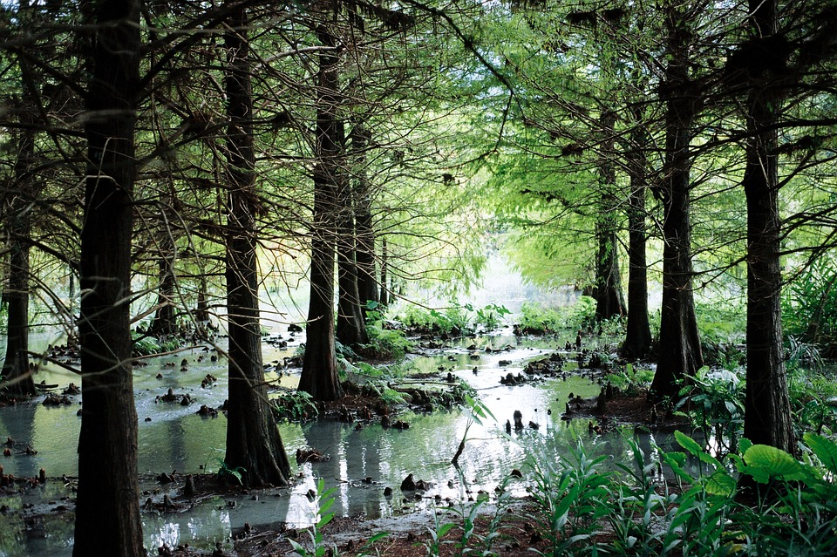
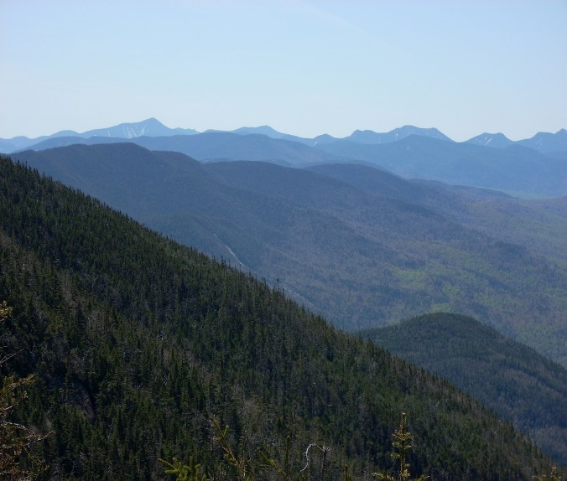
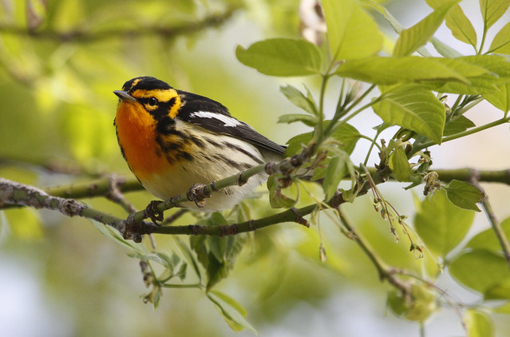
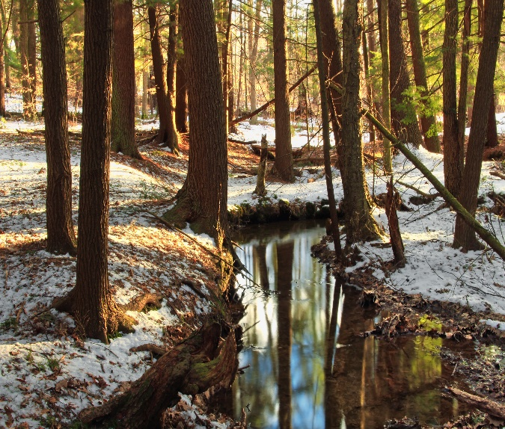
COMMUNITY CONCERNS
Decreasing
Wildlife
Temperature Regulation
Stream
Quality
Carbon Storage
Images: Paul Hurtado, Pixabay nikiY, Nicholas A. Tonelli, R khot
Notes:
The primary motivation for this study is that hemlock is an important forest feature. A number of species of birds and mammals are highly associated with hemlock. The unique structure of these trees provide an important source of food and shelter for these species. Additionally, these conifers help regulate stream quality and temperatures, creating habitat for aquatic species like brook trout. As this species declines from HWA infestation, other forest wildlife and structure could be negatively impacted. (This is the primary motivation for this study)
Photos:
HWA - NPS
https://www.nps.gov/blri/learn/nature/hwa.htm
NPS Photo- Chris Ulrey
Blackburnian Warbler - flickr
https://www.flickr.com/photos/pauljhurtado/8722457774
Licensing Info: CC 2.0
Hemlock Palustrine Forest – Nicholas A. Tonelli, Wikimedia Commons
https://commons.wikimedia.org/wiki/File:Hemlock_Palustrine_Forest_(3)_(8585808725).jpg
Creative Commons License
Stream - Pixabay
https://pixabay.com/photos/forest-stream-woods-green-plants-1727873/
Free for commercial use, no attribution required

Slide 4
APIPP
Study Area & Period
200
NY
APIPP
New York
APIPP
New York
0
100
200
0
100
Km
Km
DEVELOP Spring 2017
Part 1: 2009 to 2016
Forecasted through 2035
DEVELOP Summer 2019
Part 2: 2015 to 2019
Forecasting through 2049
Notes:
Our study primarily focused on Adirondack Park in northern New York. Ground-truthing data from Adirondack Research and APIPP, and New York Natural Heritage Program were collected from within the park and across the state. Later, we created a habitat distribution model that covered the entire state of New York.
During the previous iteration of this project, DEVELOPers used data from 2009-2016 to create a hemlock distribution map using airborne AVIRIS data, hyperspectral imagery collected by commissioned aircraft flights. They also forecasted the habitat suitability of the Adirondacks for Hemlock Woolly Adelgid through 2035. The present study examined the entirety of New York State from January 2016 to January 2019 using scenes collected from Landsat 8 OLI and Sentinel-2 MSI.
Image sources: Esri, team generated

Slide 5
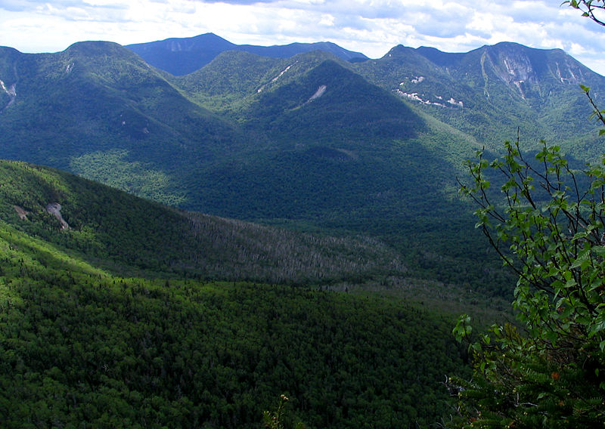
PROJECT PARTNERS
End Users
Adirondack Park Invasive Plant Program (APIPP)
Brendan Quirion and Zack Simek
Saint Lawrence - Eastern Lake Ontario (SLELO)
Rob Williams and Megan Pistolese
Image: Mwanner at Wikimedia Commons
Notes:
Our project partners include Adirondack Park Invasive Plant Program (APIPP). As one of the New York’s eight Partners for Regional Invasive Species Management (PRISMs), they coordinate efforts to prevent the spread of hemlock woolly adelgid
Thank you Brendan and Zack and… [slide change]
APIPP and SLELO are two of eight Partnerships for Regional Invasive Species Management (PRISMs) in New York State (NYS). APIPP and SLELO coordinate efforts through the NYS Hemlock Initiative to mitigate the impending expansion of HWA into unaffected areas of the state. Currently, they are not using NASA Earth observations and remote sensing techniques to inventory hemlock for early HWA detection. Rather, they are using on-the-ground observations to maintain their spatiotemporal database.
Conducting monitoring surveys for eastern hemlock can often be costly and time-consuming if not guided by accurate habitat distribution models. An accurate satellite-based habitat distribution model helps locate hemlock more efficiently than on foot, and will thus give APIPP and SLELO the tools they need to efficiently narrow down hemlock stands to survey for signs of HWA damage.
Photos:
Mwanner at Wikimedia commons (CC)
https://commons.wikimedia.org/wiki/File:Great_Range.jpg

Slide 6
PROJECT PARTNERS
Collaborators
Adirondack Research, LLC
Dr. Ezra Schwartzberg
University of Vermont
Dr. Jennifer Pontius
Cornell University
Dr. Mark Whitmore and Carri Marschner
Image: Mwanner at Wikimedia Commons
Notes:
[new slide]… and Ezra for providing your expert feedback and advice on this project for its two terms.
We have enjoyed working with you.
---------------
Our main collaborator for this project was Dr. Ezra Schwartzberg of Adirondack Research. He and his team surveyed 64 forest plots in the Adirondacks and provided us with this data to use for model training and validation. These field points were a critical component of our model, which could not have been as accurately trained without them.
Photos:
Mwanner at Wikimedia commons (CC)
https://commons.wikimedia.org/wiki/File:Great_Range.jpg

Slide 7
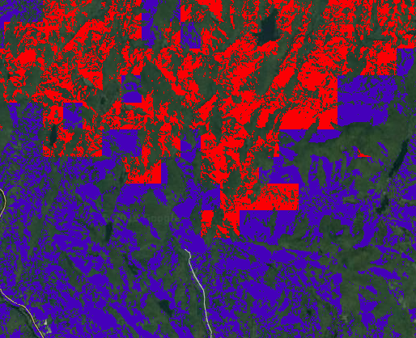
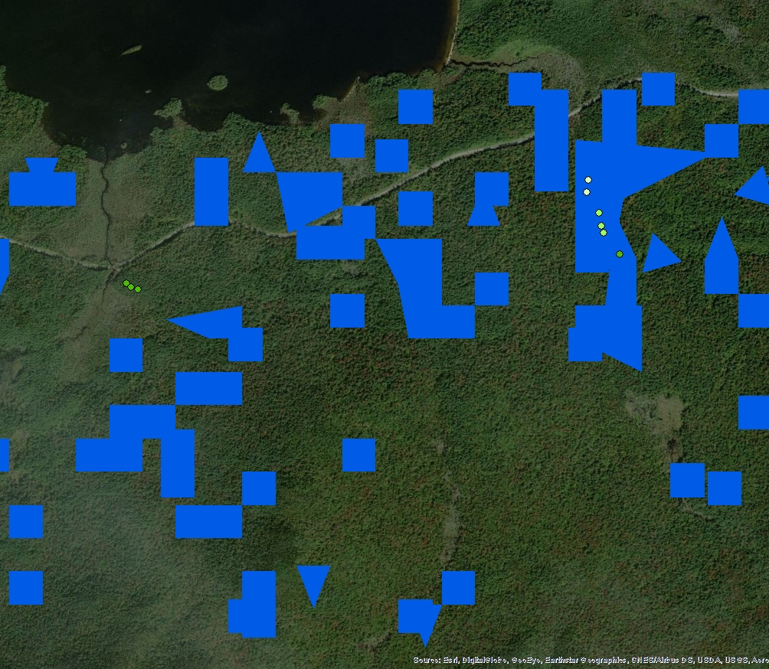
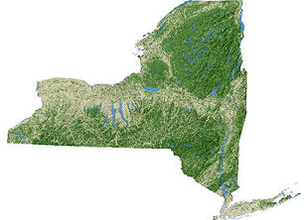
OBJECTIVES
Mapping
Create hemlock stand distribution map
Forecasting
Project hemlock woolly adelgid effects on hemlock to 2049
Model Validation
Determine accuracy of all models
Image: USDA Forest Service
Notes:
Our project had three main objectives. Our first objective was to use current satellite data and habitat parameters to create a new species distribution map predicting the presence of hemlock. Our second objective was to forecast the impact of hemlock woolly adelgid spread on hemlock distribution through 2049. Finally, we wanted asses the accuracy of both our model and the 2017 team’s AVIRIS model. This would allow us to not only determine the efficacy of using airborne AVIRIS data, but also determine if a model created with satellite data improved upon the original model.
NYS Pic: USDA Forest Service
https://www.nrs.fs.fed.us/fia/data-tools/state-reports/NY/default.asp
Free use, USDA generated image

Slide 8
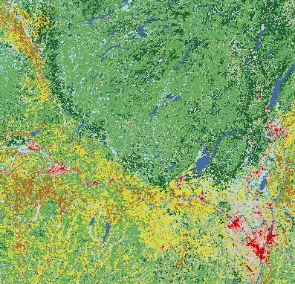
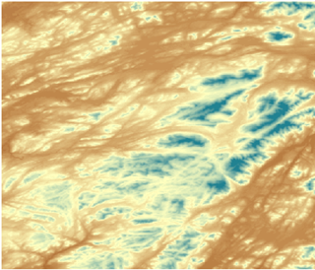
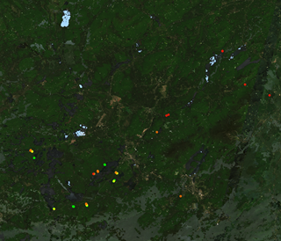
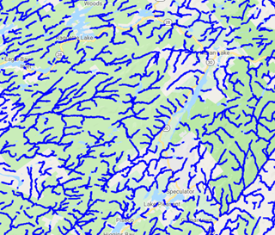
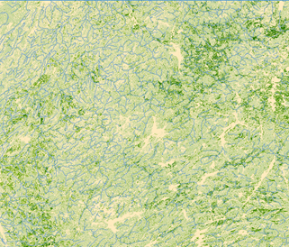
METHODOLOGY
1
1
Soil Acidity
Land Cover
Elevation
& Aspect
Soil Moisture
Distance to Streams
Hemlock Presence
Create hemlock stand distribution map
Trained Random Forest Classification Algorithm
Predicted Hemlock Distribution Map
Image: USDA Forest Service
Notes:
For the first part of our project, we input 80% of the ground-truthed data points, as well as a number of parameters associated with hemlock, into a Random Forest Classification model. We reserved the other 20% for validation. A Random Forest Classification model is a type of supervised machine learning algorithm. Our Random Forest classification was trained using 4 bands from respective satellites, including red, green, blue, and near infrared bands, as well as distance to stream. The Random Forest Algorithm was trained to identify the spectral values within each of these 4 bands that are unique to hemlock. We then calculated NDVI during the leaf-off period to determine areas of evergreen vegetation and applied this to leaf-on imagery to narrow our region of analysis. Finally, we masked out elevation, aspect, soil acidity and moisture, and forest landcover type based on the habitat requirements of hemlock.
Photos:
NYS Pic: USDA Forest Service
https://www.nrs.fs.fed.us/fia/data-tools/state-reports/NY/default.asp
Free use, USDA generated image

Slide 9
METHODOLOGY – FORECASTING MODEL 1
2
2
+
+
HWA Spread Buffer by Decade Using HWA Field Data
Decadal Future Temperature Projections
Present Day Hemlock Distribution Map
Project hemlock woolly adelgid effects on hemlock to 2049
Forecasted Hemlock Distribution by Decade
Image: NASA
Notes:
Next, we forecasted the impact of HWA spread on hemlock distribution through 2049. We used two methods to create this forecasting model. For the first method, we used the observed linear rate of HWA expansion to determine the spread of HWA into New York by 2049. We then used NASA temperature projections as well as our hemlock distribution map created through our model to mask out areas that would not support HWA populations.
Photos:
NASA Climate Projections
https://nex.nasa.gov/nex/projects/1356/
Free use, NASA generated

Slide 10
METHODOLOGY – FORECASTING MODEL 2
Original Model
Parameters
2
2
+
+
Present Day Temperature
HWA Presence
Trained Random Forest Classification Algorithm
Project hemlock woolly adelgid effects on hemlock to 2049
+
Future Temperature
Projection
Original Model Parameters
Predicted Hemlock Woolly
Adelgid Distribution Map
Image: NASA
Notes:
For the second method we ran another Random Forest Model using the original habitat parameters and NASA present day temperature projections. We used HWA presence data from iMAP invasives and USGS BISON to train this algorithm under these present day conditions. This created a model that we used to forecast HWA distribution into 2049 given future climate temperature projections.
Photos:
NASA Climate Projections
https://nex.nasa.gov/nex/projects/1356/
Free use, NASA generated

Slide 11
METHODOLOGY
Individual Model
2018 Ground Validation Data
3
2
3
Spatial
Join
Determine accuracy of spaceborne and airborne models
Accuracy
Assessment
Notes:
Finally, we ran accuracy assessments on the 2017 AVIRIS model, as well as the 2019 Landsat and Sentinel models. We conducted these assessments by overlaying a subset of field data reserved for validation on the model outputs. We then determined whether the models accurately classed whether hemlock was present or absent as well as hemlock dominance in 3 categories.

Slide 12
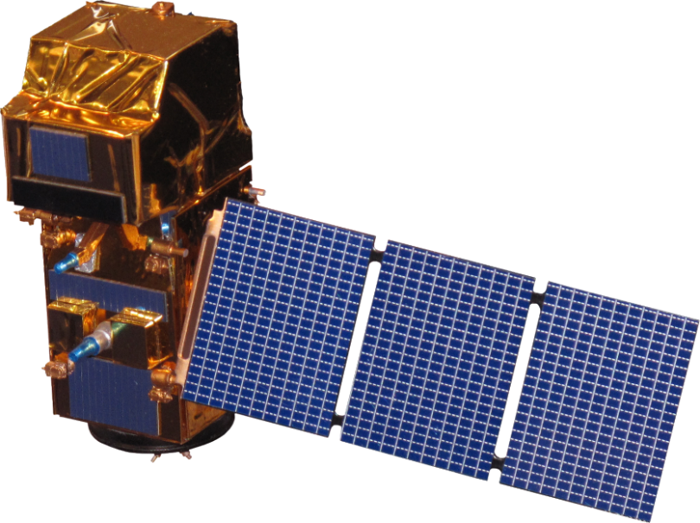
NASA SATELLITES/SENSORS
Landsat 8
Operational Land Imager (OLI)
Sentinel-2
MultiSpectral Instrument (MSI)
Notes:
We initially investigated three satellites to create our habitat distribution model: Landsat 8 OLI, Sentinel-2 MSI, and Terra ASTER. Landsat 8 has a 30m resolution and 16 day interval time and Sentinel-2 has a 10- 20m resolution and 5 day interval time. Each of these satellites were chosen due to their comparable resolution and optical sensing capabilities. Data from these satellites are publicly accessible and contain the bands needed to run these assessments.

Slide 13
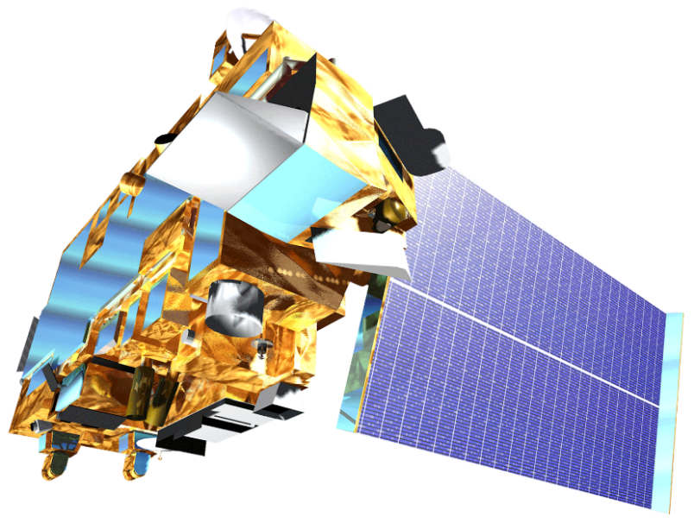
NASA SATELLITES/SENSORS
Terra
Advanced Spaceborne Thermal Emission and Reflection Radiometer (ASTER)
SRTM
Shuttle Radar Topography Mission
Notes:
We excluded ASTER from our final models due to a lack of data across New York State during the leaf-off period. We also used SRTM to quantify elevation and aspect for our models.
*We intended to use ASTER; however, due to the limitations of coverage over New York State during the leaf-off period we did not use ASTER.

Slide 14
RESULTS: HEMLOCK DISTRIBUTION MAPS
Landsat 8 OLI (2017-2019)
Pure Hemlock
Hemlock Dominant
Hemlock Subdominant
Pure Hemlock
Hemlock Dominant
Hemlock Subdominant
0
150
300
0
60
120
Kilometers
Kilometers
New York
APIPP
Notes:
These our the final hemlock distribution maps using Landsat 8, which has a 30 m resolution. Here, pure hemlock stands are displayed in yellow, hemlock dominant stands are displayed in orange, and hemlock subdominant stands are displayed in blue. Pure hemlock was defined as 90-100% hemlock, Hemlock dominant was defined as 50-89% hemlock, and hemlock subdominant was defined as 10-49%. Each pixel represents a 30*30m hemlock stand. Highlight the circle!!!

Slide 15
RESULTS: HEMLOCK DISTRIBUTION MAPS
Sentinel-2 MSI (2016-2019)
Pure Hemlock
Hemlock Dominant
Hemlock Subdominant
Pure Hemlock
Hemlock Dominant
Hemlock Subdominant
0
150
300
0
60
120
Kilometers
Kilometers
New York
APIPP
Notes:
Here you can compare the results of our distribution map using the four Sentinel-2 10m resolution bands. As you can see, within the APIPP boundary, Sentinel-2 displays more hemlock dominant stands.
Highlight the circle area!!!

Slide 16
RESULTS: FORECASTING MODEL
HWA Present
No HWA
APIPP Boundary
0
200
Kilometers
New York, 2049
Notes:
Here are the results of our forecasting models. The results from the two methods were comparable, so the overlay method is displayed here. We established similar results using both methods of analysis. As you can see, according to climate projections, while much of New York will be impacted by HWA into 2049 due to warming temperatures, the Adirondack Mountains may see less of an infestation, due to colder temperatures at higher elevations.

Slide 17
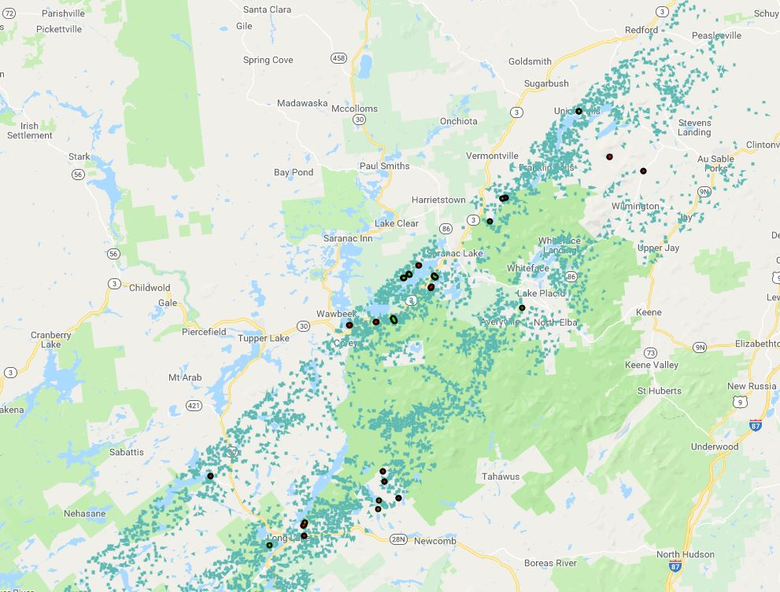
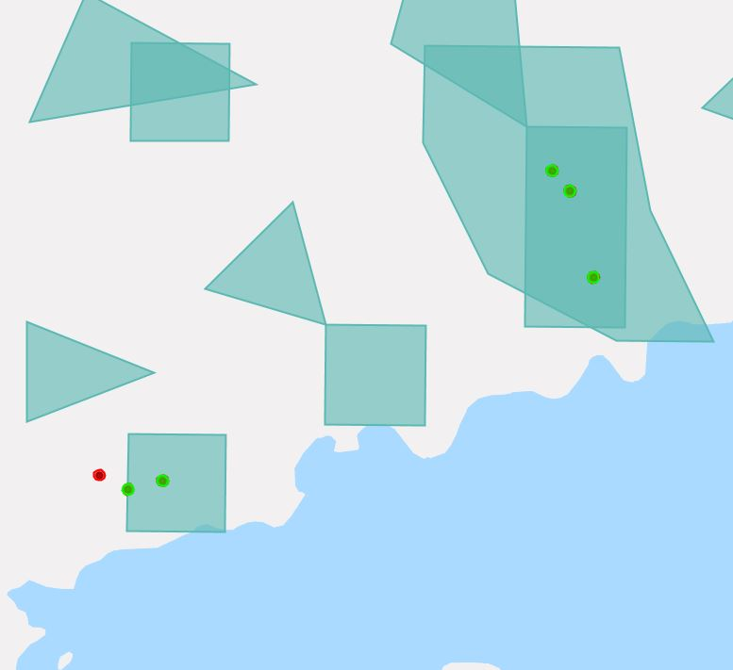
RESULTS: ACCURACY ASSESSMENT
Accuracy Assessment of 2017 AVIRIS Model
Notes:
26 of the 58 data points we used in our accuracy assessment overlapped with the hemlock distribution map created by the previous team. Of the 58 points, 31 points were correctly classed by the predictive model, meaning the model was ~53% accurate. We believe that some of the inaccuracy would be improved by incorporating more habitat parameters, such as slope, elevation, and soils, as well as ground-truthed points into the predictive model.

Slide 18
RESULTS: ACCURACY ASSESSMENT (cont.)
Model | # Matched Points | Accuracy of Hemlock Dominance Predictions | Presence/ Absence Accuracy
Landsat 8 APIPP | 14 | 52% | 67%
Landsat 8 New York State | 36 | 29% | 52%
Sentinel 2 APIPP | 12 | 43% | 57%
Sentinel 2 New York State | 34 | 28% | 50%
AVIRIS | 31 | N/A | 53%
Notes:
Using the same accuracy assessment we determine that the Landsat 8 model for APIPP performed with the best accuracy compared the other models we created. This model was 67% accurate for determining hemlock presence. As you can see, the models we ran for the APIPP regions using Sentinel and Landsat were more accurate than those run for New York State. This is likely due to the concentration of ground-truthed data within APIPP.

Slide 19
FUTURE CONSIDERATIONS
Expanded quantity and range of field data increases model accuracy
More work is necessary to quantify requisite number of training points to achieve 80% accuracy
With 2018 training data and additional ground truthing points, the AVIRIS model holds potential for greater accuracy and should be re-run
Image: Mwanner at Wikimedia Commons
Notes:
During the course of our DEVELOP term, we were only able to validate our model based off a limited number of ground-truthed points. Future field work would not only help us assess the accuracy of the model, but also better train the model in the future.
Additionally, our ground-truthed data came primarily from the Adirondacks. Data collected from other portions of the state could lead to the creation of a better state-wide model.
Within the 10 week project period we were unable to provide an analysis for how many additional ground-truthed points would improve the model to the goal of 80% accuracy. Future iterations of this project should assess the optimal number.
We also believe that the AVIRIS model would be greatly improved by including more recent ground-truthed training data.
Photos:
Mwanner at Wikimedia commons
https://commons.wikimedia.org/wiki/File:Great_Range.jpg

Slide 20
CONCLUSIONS
Satellite-derived models provide a cost-effective, adaptable alternative to airborne data for identifying potential hemlock presence
HWA spread is forecasted to reduce hemlock distribution through 2049 primarily outside of the Adirondack region
Image: Mwanner at Wikimedia Commons
Notes:
Satellite-based models, such as the one we created, can be continuously updated and improved upon. These models use publicly available satellite data, which provides the basis for a cost-effective solution for determining hemlock distribution with a higher temporal resolution and spatial domain.
Our forecasting model shows that HWA effects on hemlock will be less in the Adirondack Mountains due to colder temperatures at higher elevations.
Photos:
Mwanner at Wikimedia commons (CC)
https://commons.wikimedia.org/wiki/File:Great_Range.jpg

Slide 21
Past Contributors
Madeline Ruid
Dr. Sara Lubkin
Sean McCartney
Rachel Soobitsky
Ariel Walcutt
Advisors
Dr. Ezra Schwartzberg
Brendan Quirion
Zachary Simek
Dr. David Lagomasino
Dr. Paul Montesano
Dr. John Bolten
Center Lead
Victor Lenske
Our Friends
The GSFC Ellicott City Disasters DEVELOP Team
This material contains modified Copernicus Sentinel data from 2016-2019, processed by ESA.

