Slide 1
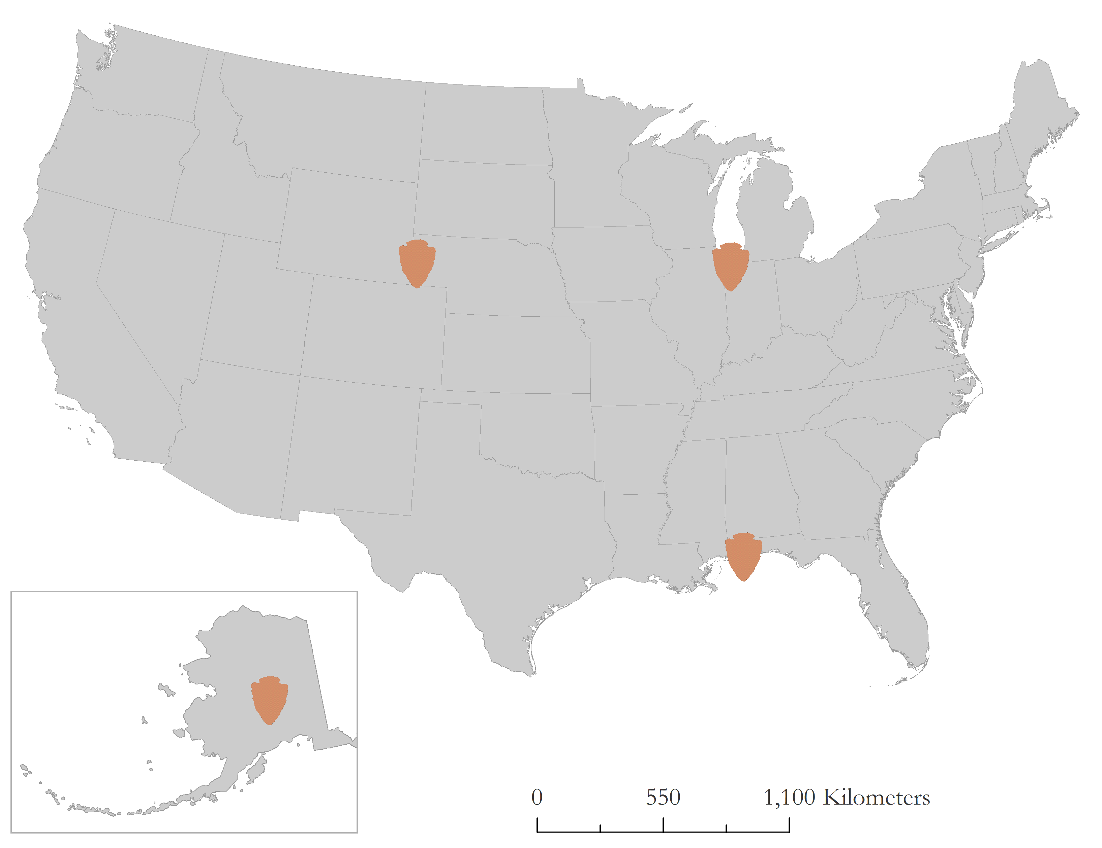
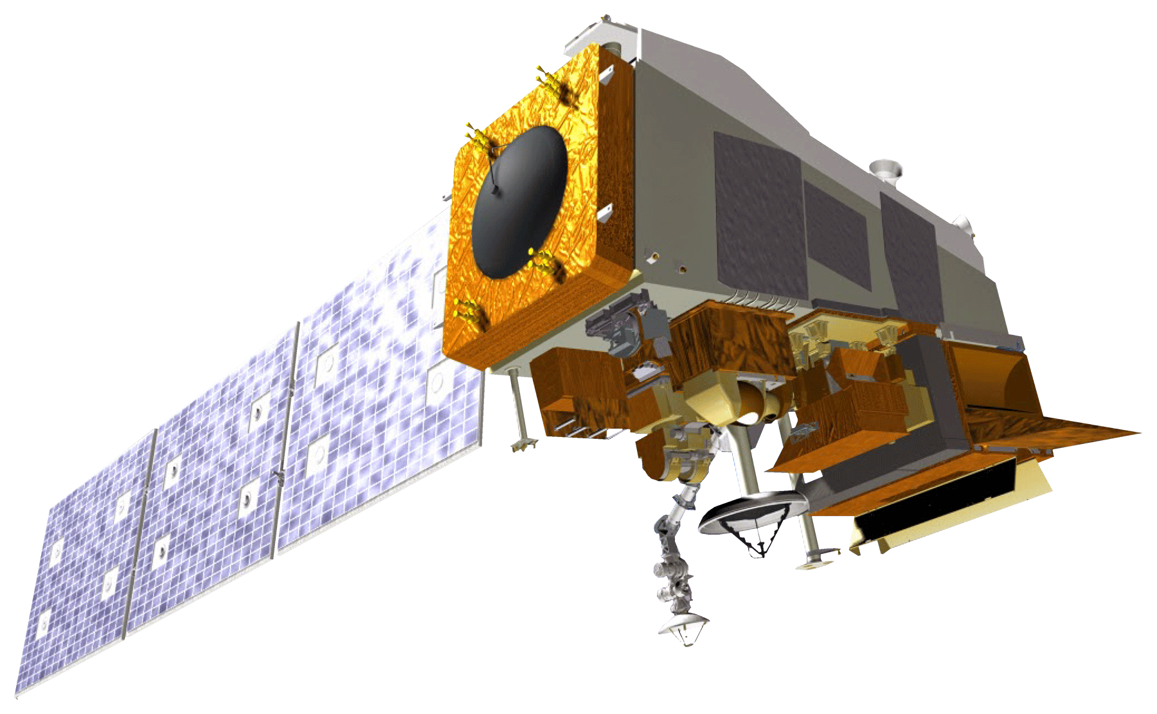
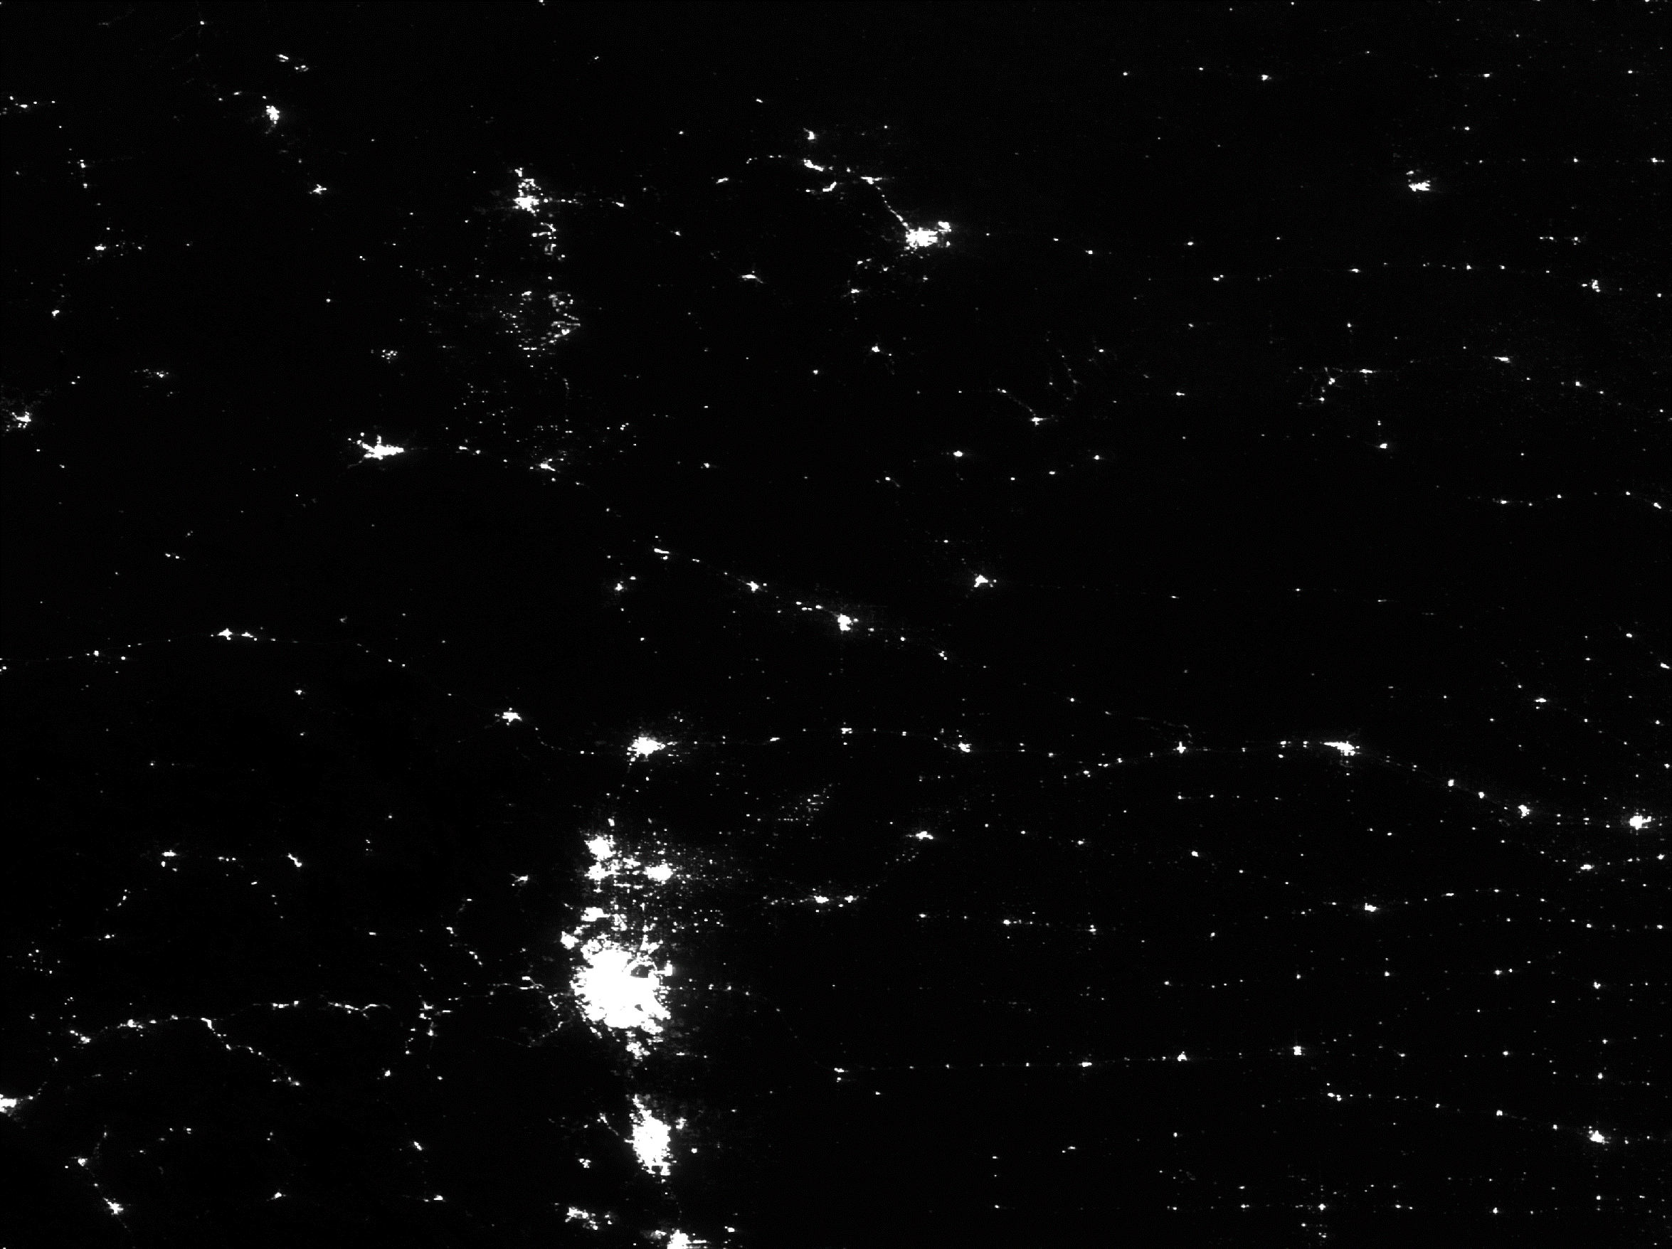

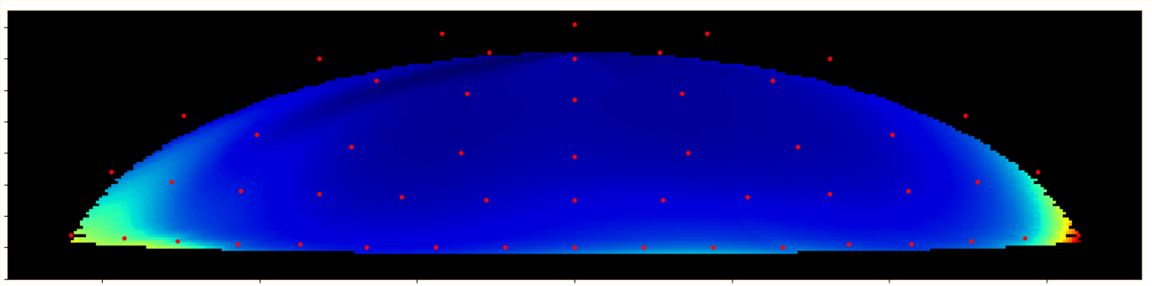
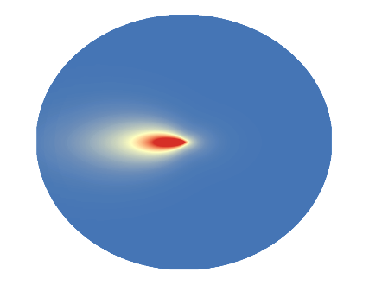
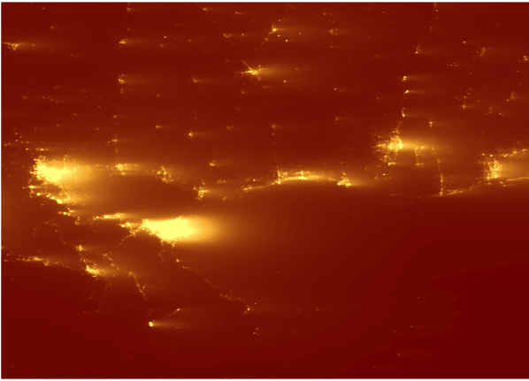
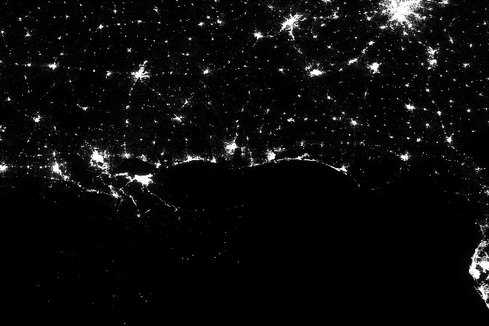
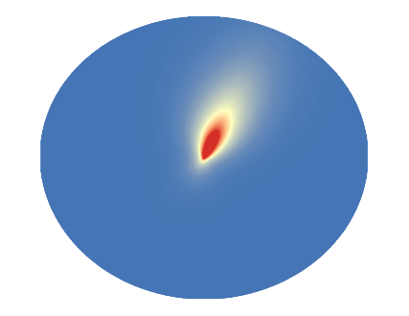
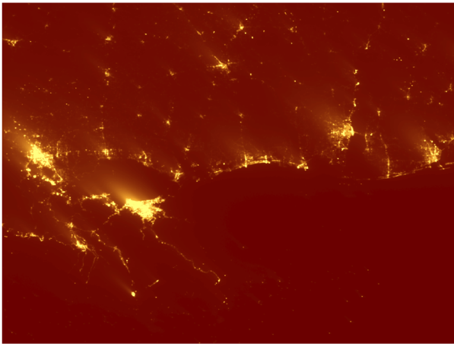
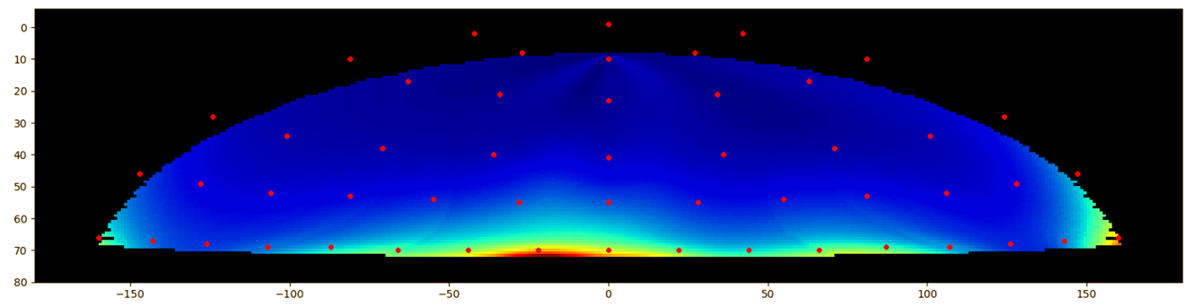
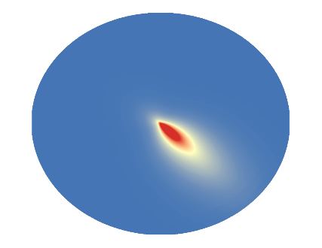
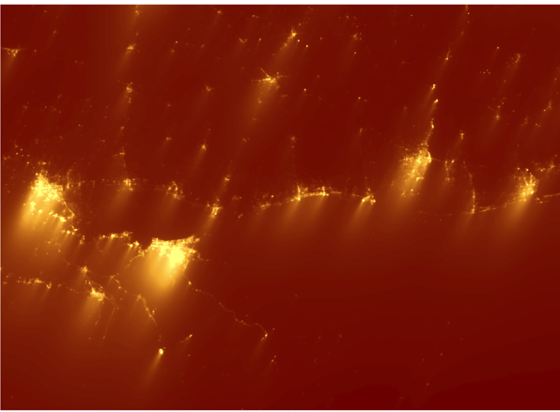
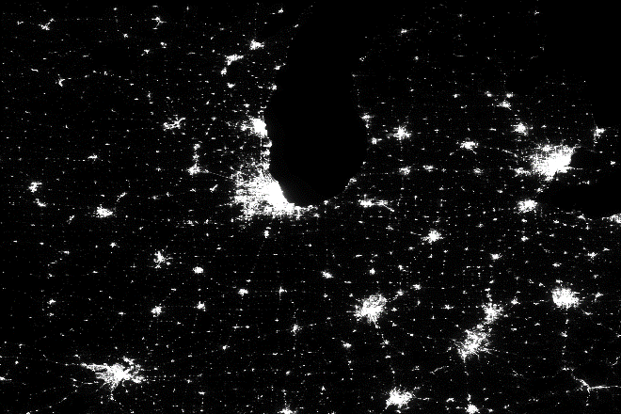
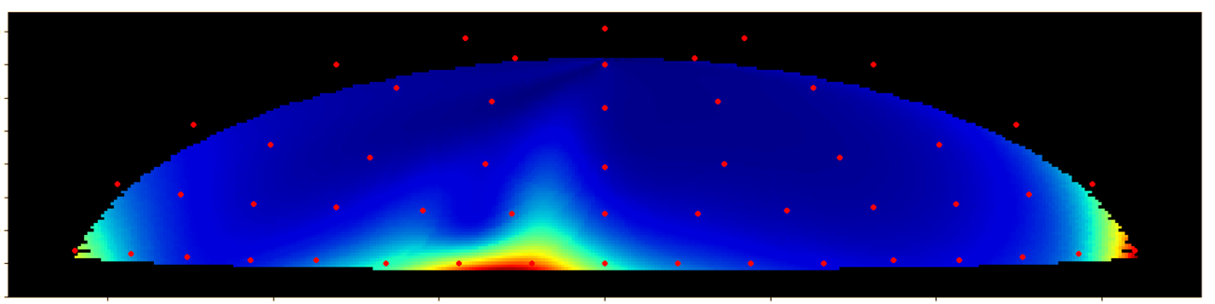
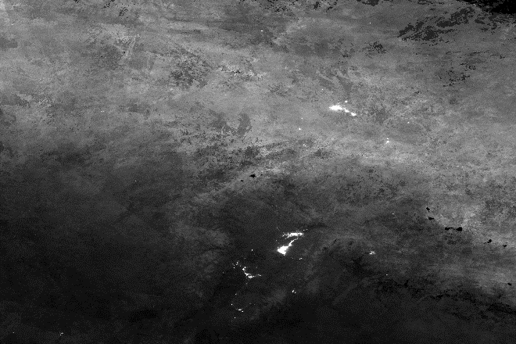

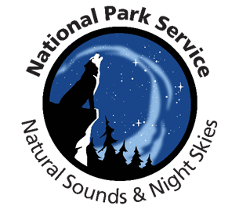





Generating Hemispherical Visualizations of Artificial Sky Brightness Using Updated Sky Glow Estimation Tools on Suomi NPP-VIIRS Data
Abstract
Objectives
The growth of the global population along with rapid industrialization has caused an increase in artificial light pollution, also known as artificial sky glow. Anthropogenic light pollution disturbs the world’s ecosystems by interfering with the interconnected life of flora and fauna, degrading the night sky quality for astronomical and aesthetic viewing, and disrupting human circadian rhythms and melatonin production, which can have lasting negative effects on health. The Skyglow Estimation Toolbox (SET) calculates artificial sky glow by applying a model of light propagation to visible light radiance imagery from the Suomi National Polar-orbiting Partnership (NPP) Visible Infrared Imaging Radiometer Suite (VIIRS) Day/Night Band (DNB). The previous iteration of SET was further expanded by adding a hemispherical visualization feature compiled from individual sky glow maps with different zenith/azimuth angle combinations at one location. The graphical user interface (GUI) of SET was also updated to include all functions of the command line interface and the code repository now works with all versions of Python 2.7 and above. Written unit tests were installed to prevent future code breaks, and several issues were fixed such a logic errors, repository bloat, and lack of documentation. The revised SET was tested on four United States national parks to ensure functionality across different environments. The resulting hemispherical visualizations were provided to the National Park Service (NPS) to compare with in situ measurements. The team explored validation methods, which provided a basis for future action for measuring and managing light pollution around national park units.
Update the Skyglow Estimation Toolbox (SET) to be functional across multiple physiographic and environmental regions
Verify that the tool works in several assigned US national parks
Implement a new feature that displays hemispherical representations of artificial sky glow
Streamline toolbox installation and packaging
Study Area
3
2
Methodology
1
Gulf Islands National Seashore
Florida & Mississippi
1
2
Indiana Dunes National Lakeshore
Obtain VIIRS Raster Data
Suomi NPP VIIRS DNB Data is available on NOAA’s Earth Observation Group’s website.
5
Generate Hemisphere Maps
SET generates a 3D hemispherical visualization by interpolating values between stitched-together artificial brightness maps.
3
Indiana
Scotts Bluff National Monument
4
Nebraska
4
Denali National Park and Preserve
1
4
Run SET
The user specifies input parameters such as latitude, atmospheric clarity, zenith angle, and azimuth angle.
N
Alaska
Create Median Composite
Cell Statistics in ArcMap 10.5 can calculate the median value of inputs on a cell-by-cell basis. This helps in accounting for outliers in the data, such as wildfires.
Earth Observation
2
3
Clip Data to Study Areas
Light from up to 200 kilometers away can affect sky glow at a given observation point.
Suomi National Polar-orbiting Partnership (NPP)
Visible Infrared Imaging Radiometer Suite (VIIRS)
Day/Night Band (DNB)
Results
0
Scotts Bluff National Monument
Lat. 44, Lon. -106
June-Oct. 2014-2017
10
Intermediate Results
20
274.2
30
40
50
60
70
0
80
-150
-100
-50
0
50
100
150
0
Gulf Islands National Seashore
Lat. 32.4, Lon. -89.8
June-Oct. 2014-2017
10
404.8
20
30
40
50
60
0
70
80
-150
-100
-50
0
50
100
150
Intermediate Results
0
Indiana Dunes National Lakeshore
Lat. 43.7, Lon. -89.1
June-Oct. 2014-2017
338.3
10
20
30
40
50
0
60
70
118.3
The limitations of the Suomi NPP VIIRS DNB make it difficult to get accurate results for high latitude regions such as Denali National Park and Preserve in Alaska. Extended daylight hours impact satellite data collection. Snow cover throughout the year contaminates data by over-reflecting nighttime lights.
80
-150
-100
-50
0
50
100
150
0
Conclusions
Project Partners
Limitations of the Day/Night Band prevent accurate radiance measurements at high latitude regions. Data contamination due to snow and daylight produce inaccurate results from SET.
Hemispherical visualizations of artificial sky brightness provide intuitive sky glow estimates at any geographic point within a chosen study area without requiring costly and timely field measurements.
Exploring validation methods will provide a basis for assessing how these hemispherical visualizations compare with on-the-ground measurements performed by NPS.
The US Urban Development team partnered with the National Park Service Natural Sounds and Night Skies Division
Acknowledgements
Team Members
Dr. Kenton Ross
NASA Langley Research Center
Jonathan O’Brien
VA – Langley Center Lead
Sharolyn Anderson, PhD
Physical Scientist, Natural Sounds and Night Skies Division
Li-Wei Hung, PhD
Research Scientist, Natural Sounds and Night Skies Division
Past DEVELOP Contributors:
Veronica Warda (Project Lead), Aubrey Hilte, Benjamin Marcovitz, Christine Stevens, Eric, Ryan Avery, Steven Chao, Stanley Yu, Margaret Mulhern (Project Lead), Manda Au, Ian Brastow
Max Ioffe
Project Lead
Julia Hink
Tyler Jameson
Charlie McClay
US Urban Development
Virginia - Langley| 2018

