Slide 1

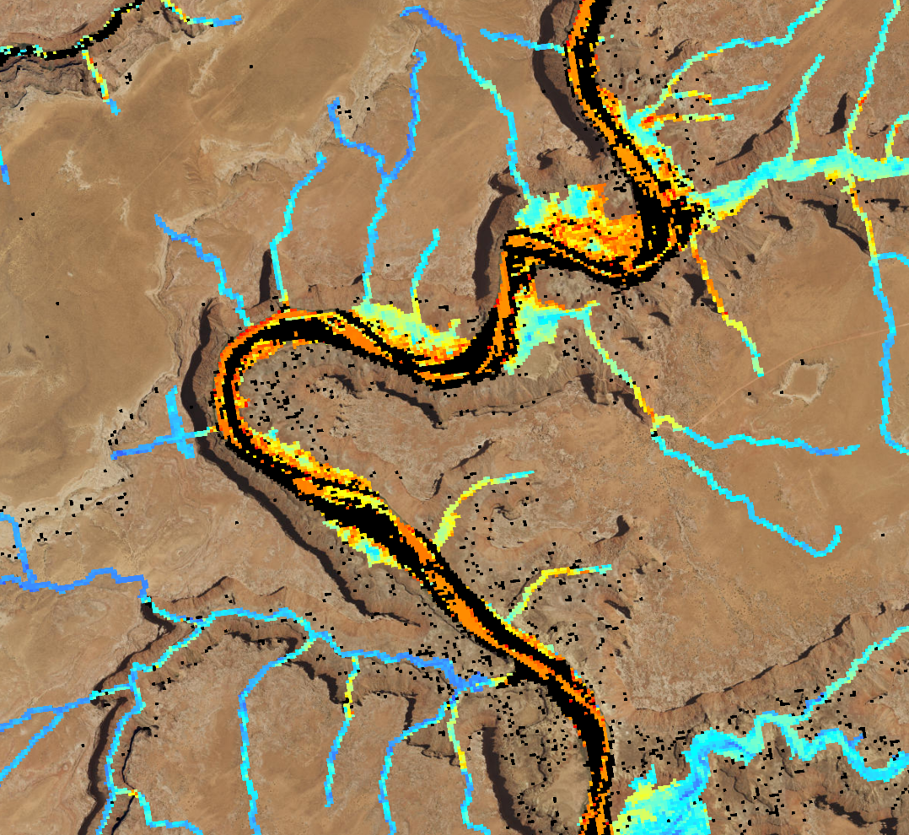

COLORADO RIVER BASIN WATER RESOURCES
Utilizing NASA Earth Observations to Evaluate Invasive Species Cover in Riparian Areas of the Colorado River Basin
Megan Vahsen
Julia Sullivan
Emily Campbell
Chanin Tilakamonkul
Daniel Carver
USGS at Colorado State University
2017 Summer
Notes:
We are the Colorado River Basin Water Resources team and this summer we utilized NASA Earth Observations to evaluate invasive species cover in riparian areas of the Colorado River Basin.

Slide 2
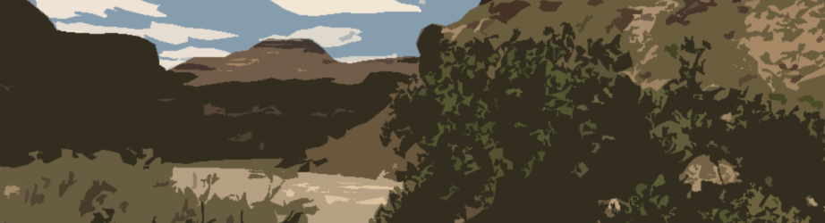
Components
Problem
Objectives
Study area
Study period
Community concerns
NASA satellites/sensors used
Methodology
Results
Conclusions
Errors & Uncertainties
Future work
Acknowledgements
Questions
The slides provided in the template are just a starting point for teams. Feel free to expand upon these topics, alter the headings, and change the order of the slides to fit your needs.
Image Credit: Brian Woodward
Notes:
During this presentation we will first introduce the aims of this project in the context of the needs of our end-user, the Walton Family Foundation. We will then present our general methodology, results, conclusions and make suggestions for future work.
Image Source: Brian Woodward, FC DEVELOP

Slide 3
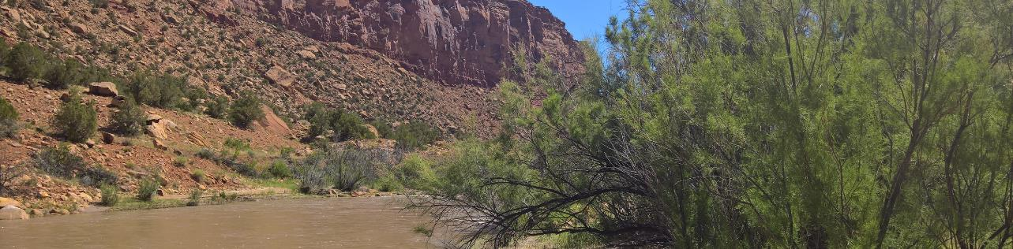
Problem
Invasive species, such as tamarisk (Tamarix spp.), threaten the structure and function of important riparian ecosystems.
Management of tamarisk is expensive to implement and evaluate.
Image Credit: Amanda West
Notes:
In much of the western United States, invasive species threaten invaluable riparian ecosystems. In particular, tamarisk or saltcedar, is of great ecological concern.
Although management efforts for tamarisk have been initiated, they are expensive and evaluations of their efficacy are scarce.

Slide 4
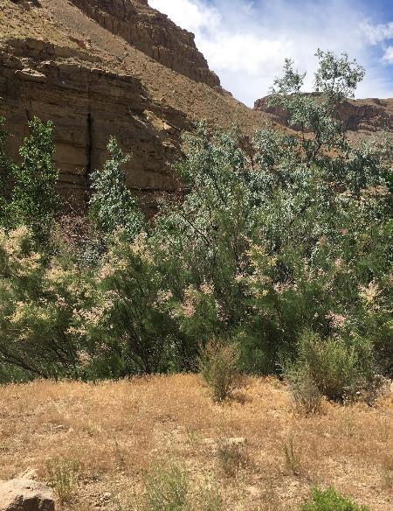
Objectives
Quantify and map area inhabited by tamarisk in the Colorado River Basin
Evaluate change in tamarisk cover between 2006 and 2016
Compare 2016 maps produced using imagery from different satellites
Image Credit: Megan Vahsen
Notes:
Our team, Colorado River Basin Water Resources, sought to quantify and map tamarisk in part of the Colorado River Basin in order to evaluate change in cover between 2006 and 2016.
This time period represents before and after implementation of intensive management of tamarisk in the study area.
We also sought to compare tamarisk cover maps produced using Landsat 8 imagery and recently available Sentinel 2 imagery.

Slide 5
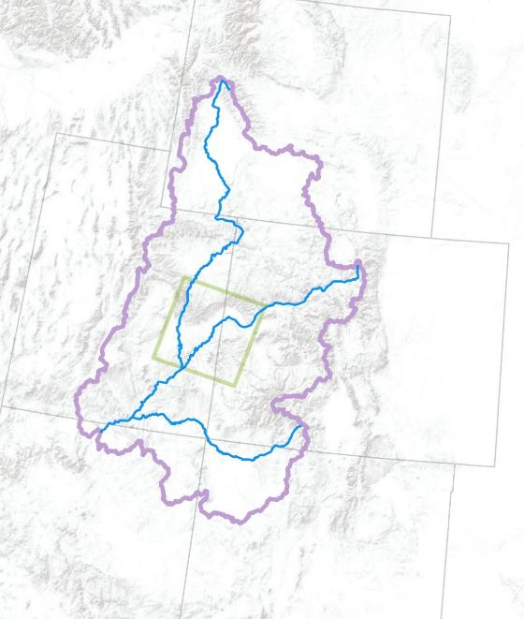
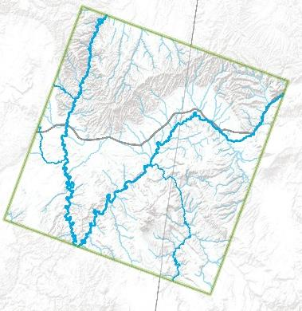


Study Area
Large Area
Map
Study
Area
Wyoming
Upper CRB
Study Area
Map
Landsat P36/R33
Green
River
Green River
Streams
Utah
Colorado
River
I-70
I-70
Colorado
Dolores River
Colorado River
San Juan
River
Arizona
New Mexico
Utah
Colorado
Notes:
Our study area encompasses a portion of the Colorado River Basin as seen in the image on the right where the Upper Colorado River Basin is outlined in purple and our study area is outlined by the green square.
The climate in the Upper Colorado River Basin is semi-arid to arid. The basin ranges in elevation from 4,850 to 13,000 feet and features deep canyons and valleys predominantly composed of limestone, sandstone, and shale.
Major rivers in this area are the Colorado, Dolores, and Green as noted on the left image.
Data from:
USGS National Map: National Hydrography Dataset
USGS National Map: Roadways
Natural Earth Data: State political boundaries
ESRI ArcMap: base map layer

Slide 6
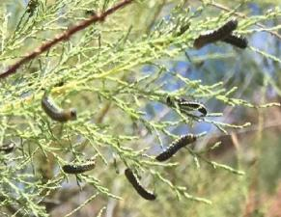
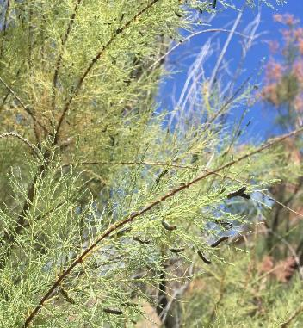
Study Period
2001: Tamarisk leaf beetle (Diorhabda carinulata) introduced as a biological control agent
2006: Salt Cedar and Russian Olive Control Demonstration Act
Pre Treatment
Evaluation Period
10 years
Post Treatment
Field Data Collection
Field Data Collection
2005
2006
07
08
09
10
11
12
13
14
15
2016
2017
Image Credit: Megan Vahsen
Notes:
Our study period was chosen to assess the efficacy of management of tamarisk in the Colorado River Basin. The tamarisk beetle was released as a biological control agent in 2001 to mitigate the spread of tamarisk in riparian zones. Management was further perpetuated by the Salt Cedar and Russian Olive Control Demonstration Act in 2006.
Tamarisk cover has been successfully mapped using remote sensing in the Arkansas River and to a broader extent in the western United States. However, research is still needed to determine the effectiveness of this approach on distinguishing defoliated and dead tamarisk canopies.
Image Source: Megan Vahsen, FC DEVELOP

Slide 7
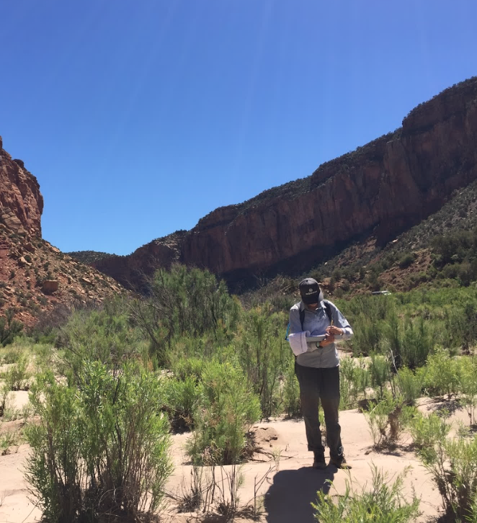
Community Concerns
40 million people rely on water from the Colorado River Basin.
Riparian areas are essential to maintaining the overall health of these waterways.
Invasive species, such as tamarisk, alter ecosystem structure and function.
Image Credit: Julia Sullivan
Notes:
Management of invasive species in the The Colorado River Basin is important, particularly because it is one of the most prominent river systems in the West, spanning 2,300 kilometers across seven states and supplying water to 40 million people.
Riparian corridors of the Colorado River Basin are critical in maintaining water quality and ecosystem structure.
Tamarisk could be considered the most concerning invasive plant in the Colorado River Basin as it covers hundreds of thousands of acres and can form extremely dense monocultures.
Riparian zones dominated by tamarisk have been attributed with reduced water availability and habitat quality for wildlife.
Image Source: Julia Sullivan, FC DEVELOP

Slide 8
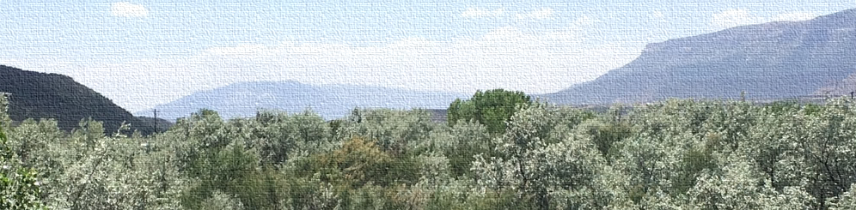
Partners
Image Credit: Brian Woodward
Walton Family Foundation
“Directly improve river flows and riparian habitat in targeted geographies”
United States Geological Survey
“The USGS develops strategies and techniques to understand and facilitate restoration of native species and habitats affected by invasive species.”
Notes:
Our end-user, The Walton Family Foundation, is an organization motivated in improving river flows and riparian habitat particularly in the Colorado River Basin.
The Walton Family Foundation has previously invested in invasive species management in the Colorado River Basin.
Our work will help the Walton Family Foundation assess the effectiveness of previous management efforts and inform future efforts.
Our partners at the US Geological Survey are similarly motivated to effectively manage invasive species and facilitate restoration of invaded areas.
Image Source: Brian Woodward, FC DEVELOP
Quoted material acquired from:
http://www.waltonfamilyfoundation.org/our-impact/environment/colorado-river
https://www2.usgs.gov/ecosystems/invasive_species/west.html

Slide 9


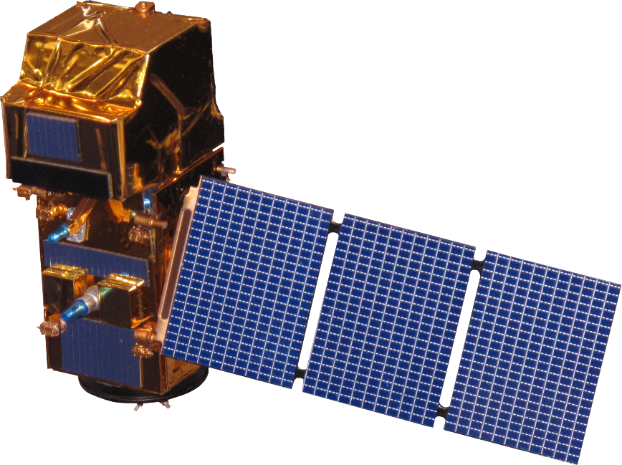
NASA Satellites & Sensors Used
Landsat 5 TM
Landsat 8 OLI & TIRS
Sentinel-2
Notes:
Assessing the change in tamarisk cover between 2006 and 2016 required acquiring imagery from both Landsat 5 Thematic Mapper and Landsat 8 Operational Land Imager and Thermal Infrared Sensor.
We also were interested in comparing 2016 tamarisk cover maps produced using Landsat 8 imagery and maps using the European Space Agency’s Sentinel-2 Earth Observation.
Sentinel-2 was launched in June 2015 and captures bands at higher spatial resolution than does Landsat 8.
Image Source: http://www.devpedia.developexchange.com/dp/index.php?title=List_of_Satellite_Pictures, NASA DEVELOP

Slide 10
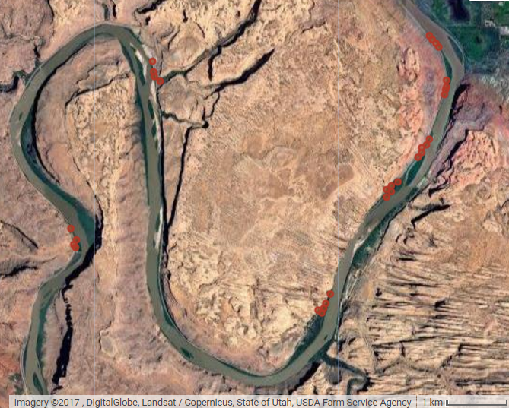
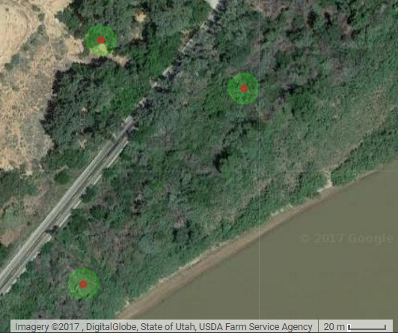

Methodology – Field Sampling
Notes:
To inform 2016 models of tamarisk cover, we conducted field work in parts of the Colorado River Basin during the term in June 2017. We followed an opportunistic field sampling methodology, collecting observations with varying levels of percent tamarisk cover within a 7.32m radius circular plots.
The image on the left shows multiple sampling site locations within the riparian zone of the Colorado River just West of Moab, Utah.
The image on the right shows the circular plots. Species type, height, and percentage cover were recorded for all unique species within a plot. A distinction was made between living and dead tamarisk due to their distinct spectral signature.
Ancillary cover data collected in 2005 and 2006 from the Tamarisk Coalition was used to train 2006 models and absence points were collected from National Agricultural Imagery Program (NAIP) imagery to train both 2006 and 2016 models.
Image Source: https://earthengine.google.com; Points and polygon are data created by Daniel Carver, FC DEVELOP

Slide 11
Methodology – Modeling
Field Data
2016 - 2017
SAHM: Software Assisted Habitat Modelling
RF
NASA Earth Observations
Landsat 5 & Landsat 8
SAHM
MARS
Presence/ Absence
Binary
Maps
GLM: Generalized Linear Model
Field Data
2005 - 2006
GLM
BRT
Riparian Zone
RF: Random Forest
RF
R
Continuous & Binary
Cover
Map
BRT: Boosted
Regression Trees
MARS: Multivariate
Adaptive Regression Splines
NASA Input
Product
Software
Algorithm
Output
1
2
3
4
5
Notes:
For both the 2006 and 2016 cover maps we followed the same methodology.
We first acquired imagery from Landsat 5 and 8 across the growing season of tamarisk (from April to November) and derived several vegetative indices from the raw bands. We were interested in mapping tamarisk in riparian corridors which were outlined using a methodology developed by the Arizona Water Resources I team with hydrologic and topographic data.
We extracted values from bands and indices for our field points. The raster values at these points were then used to train a machine learning algorithm called random forest in R and a suite of models in the US Geological Survey developed software, Software for Assisted Habitat Modeling (SAHM).
We created two types of models and maps for each study year: a regression model which predicted continuous cover values and a classification model.
Our output maps were created using a two-step classification procedure where areas within riparian corridors that were predicted to be absent of tamarisk in the binary model were removed from maps produced by the continuous model. This procedure allowed us to highlight areas where our models agree in tamarisk presence which are most likely the areas of greatest concern for management.

Slide 12
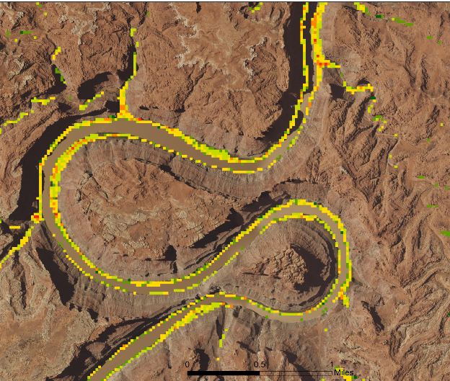
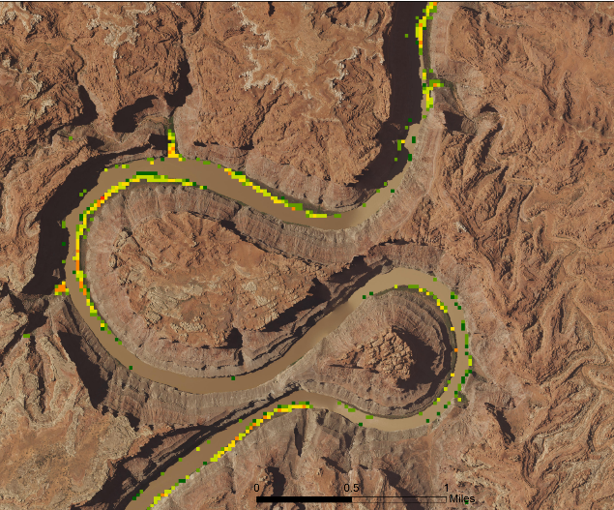
Results
2006 Predicted Tamarisk Cover
2016 Predicted Tamarisk Cover
Predicted
Percent Cover
Predicted
Percent Cover
< 10
10 – 20
20 – 30
30 – 40
40 – 50
> 50
< 10
10 – 20
20 – 30
30 – 40
40 – 50
> 50
Notes:
Here we compare predicted percent cover of tamarisk in 2006 (left) and 2016 (right). Both of these maps used Landsat imagery. Areas that are warmer colors indicate higher predicted tamarisk cover.
We see there is a considerable change in predicted tamarisk cover between 2006 and 2016.

Slide 13
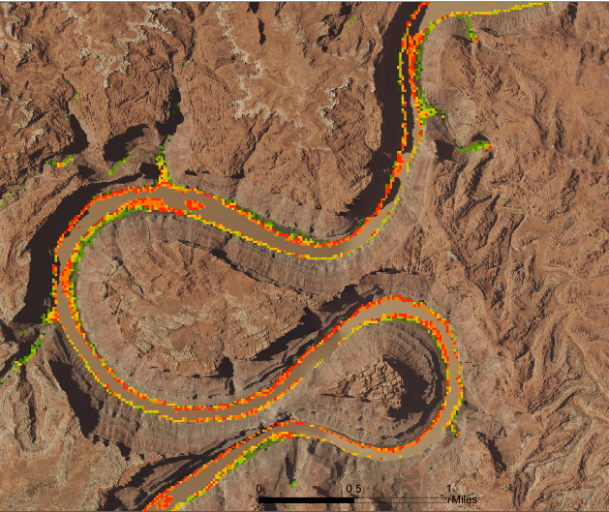
Results
Landsat 8
2016 Predicted Tamarisk Cover
Sentinel-2
2016 Predicted Tamarisk Cover
Predicted
Percent Cover
Predicted
Percent Cover
< 10
10 – 20
20 – 30
30 – 40
40 – 50
> 50
< 10
10 – 20
20 – 30
30 – 40
40 – 50
> 50
Notes:
Here we compare predicted percent cover of tamarisk in 2016 for models utilizing Landsat 8 imagery (left) and Sentinel imagery (right).
Models utilizing Sentinel imagery predict considerably higher tamarisk cover than models using Landsat 8 imagery.

Slide 14
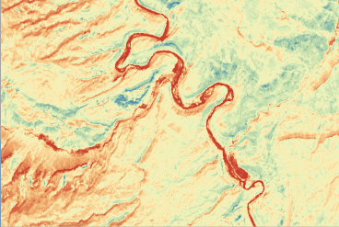
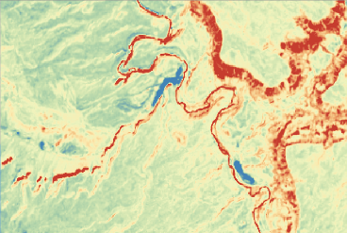
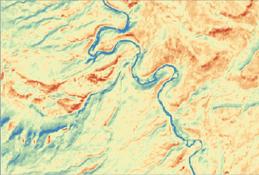
Results – Top Predictors
Landsat 5 TM 2006
August | Tasseled Cap Brightness
April | MNDWI
July/Aug | CTVI
Landsat 8 OLI & TIRS 2016
April | GNDVI
Sept | Blue
July/Aug | NDWI2
Sentinel-2 2016
June | SWIR
Sept | MNDWI
August Tasseled Cap Brightness
April GNDVI
June SWIR
Notes:
From our random forest outputs we assessed the relative importance of bands and indices in predicting tamarisk presence and absence or percent cover.
The bands and indices shown in the table are ones that are important for both binary (presence/absence) and regression (continuous cover) models.
The images below tables show how the indices classify different parts of the landscape. Note: each of the three indices picks out the riparian area very clearly.
Key: MNDWI = Modification of Normalized Difference Water Index; CTVI = Corrected Transformed Vegetation Index; GNDVI = Green Normalized Difference Vegetation Index; NDWI2 = Normalized Difference Water Index 2; SWIR = Short-wave Infrared

Slide 15
Results – Model Evaluation
Landsat 5 TM
2006
Landsat 8 OLI & TIRS
2016
Sentinel-2
2016
Notes:
We can assess how well each model predicts using a variety of metrics.
Here, we show a confusion matrix for the Landsat 5, Landsat 8, and Sentinel 2 binary models.
The green shaded areas show where our model accurately predicted the class of observed data. For example, the upper left quadrant of the first graph represents the number of training points where we observed tamarisk and our model accurately predicted tamarisk presence.
The red shaded areas show where our model fails to accurately predict. For example, the upper right quadrant of the first graph represents the number of training points where we observed absence but the model inaccurately predicted tamarisk presence.
We can see in comparing the upper right quadrants of the graphs between Landsat 5 and Landsat 8 that the model using Landsat 5 imagery predicts more false positives (i.e. observed absence, predicted presence) than the model of Landsat 8.

Slide 16
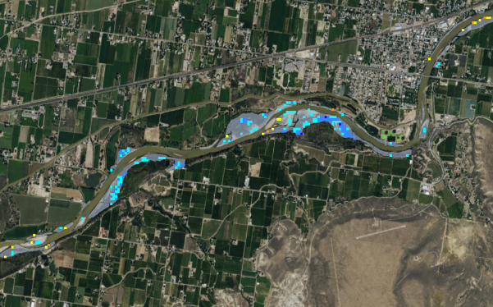
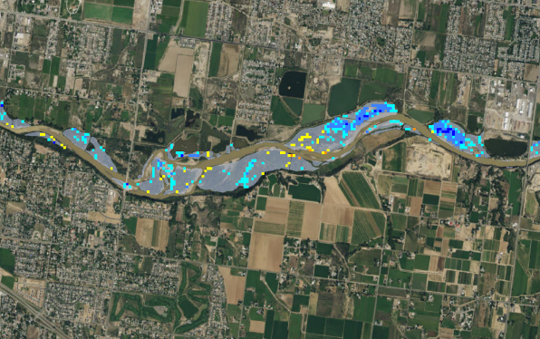
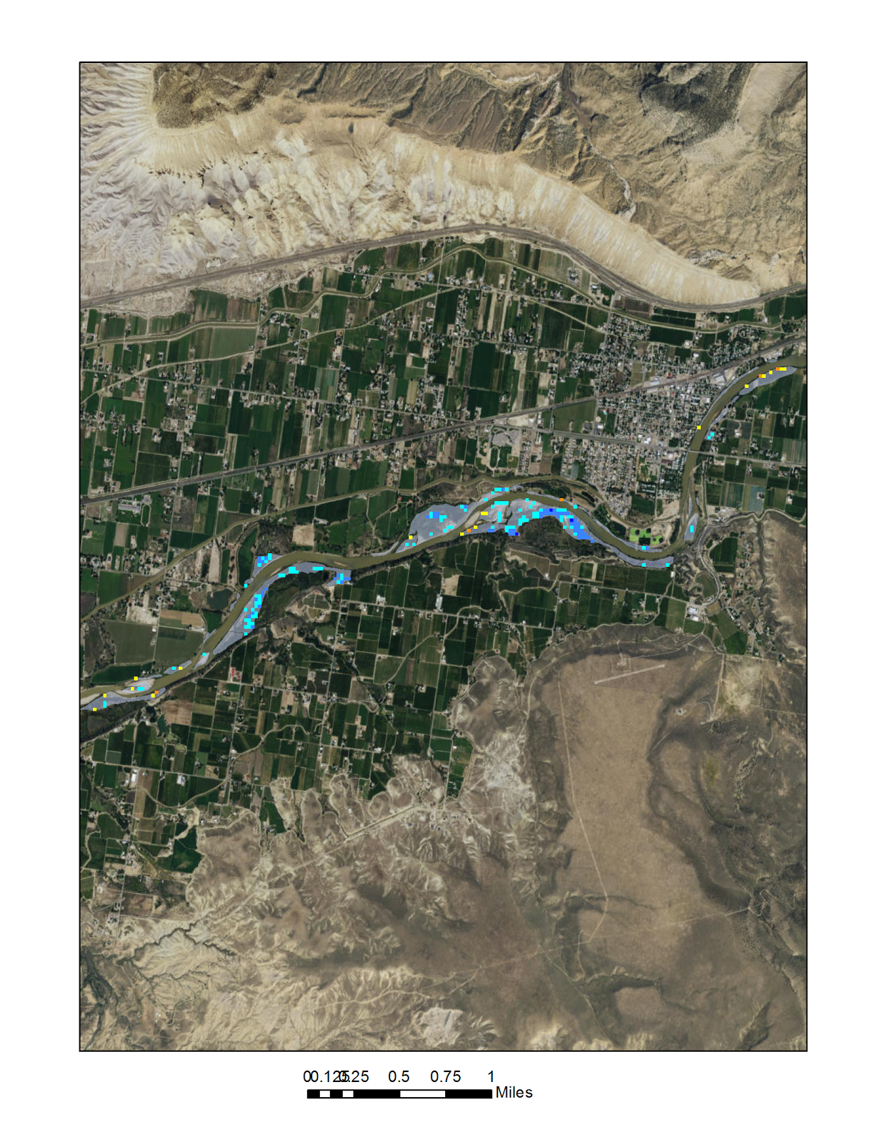
Results – Change in tamarisk cover
Predicted change in tamarisk cover between 2006 and 2016
Colorado River near Grand Junction
Predicted
Change in Percent Cover
Predicted
Change in Percent Cover
>40% ↓
30-40% ↓
20 – 30% ↓
No change
20-30% ↑
30-40% ↑
>40% ↑
Treatment
>40% ↓
30-40% ↓
20 – 30% ↓
No change
20-30% ↑
30-40% ↑
>40% ↑
Treatment
0.125
0.25
0.50
0.75
1.0
0.125
Miles
0.25
0.50
0.75
1.0
Miles
Notes:
We used regression map outputs to visualize changes in predicted tamarisk cover between 2006 and 2016.
Here, we show changes in tamarisk percent cover. Pixels that are colored represent areas where tamarisk has either increased substantially between 2006 and 2016 (>20% increase; warmer colors) or decreased substantially (>20% decrease; cooler colors).
Gray shaded areas represent treatment polygons where there has been known management of tamarisk.
We can see that in these two areas there is a considerable net decrease in predicted tamarisk cover.

Slide 17
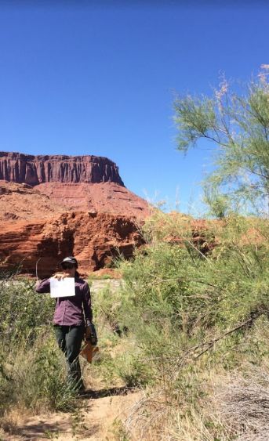
Conclusions, Errors & Uncertainties
Tamarisk cover detected by our models decreased from 2006 and 2016.
Models using Landsat 8 imagery predicted considerably lower tamarisk cover than models that use Sentinel-2 imagery.
More cover data, particularly for areas with high tamarisk cover, could improve model predictability.
Image Credit: Rebecca Girma
Notes:
We detected a decrease in tamarisk cover between 2006 and 2016. This could be an ecologically real effect, but could also be a result of the 2006 model over-predicting tamarisk cover (as was seen in the maps and model evaluation).
We found that models utilizing Landsat 8 imagery mapped lower tamarisk cover compared to models utilizing Sentinel imagery.
Our models for 2006 and 2016 could be improved with more cover training data, particularly for areas with high tamarisk cover. Identifying existing high cover, monoculture stands is important in guiding management, however most of our cover data represented areas of patchy tamarisk cover.

Slide 18
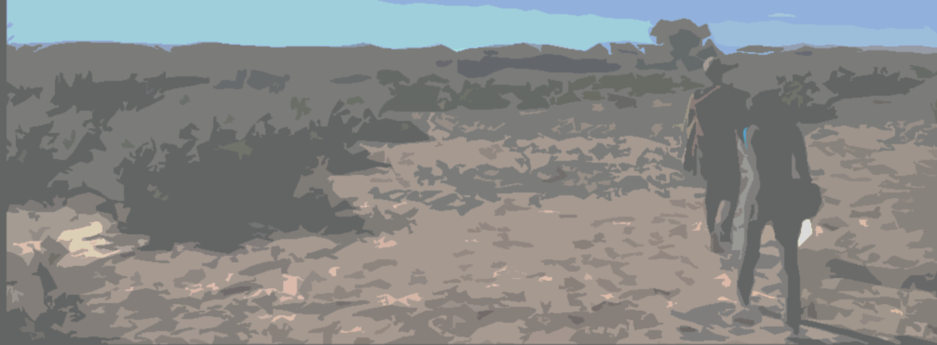
Future Work
Apply predicted tamarisk presence model outputs to estimate water loss to evapotranspiration via tamarisk
Adapt models to distinguish between tamarisk, Russian olive, and other riparian vegetation
Image Credit: Megan Vahsen
Notes:
Future work on this project will aim to understand the consequences of tamarisk in the Colorado River Basin by estimating water loss due to evapotranspiration in tamarisk.
Further, a similar methodology to this project will be applied to other invasive species in the study area, such as Russian olive, to help distinguish between tamarisk, Russian olive, and other riparian vegetation.
Image Source: Megan Vahsen, FC DEVELOP

Slide 19
Acknowledgements
Dr. Paul Evangelista, Colorado State University (Science Advisor)
Dr. Amanda West, Colorado State University (Science Advisor)
Nicholas Young, Colorado State University (Science Mentor)
Anthony Vorster, Colorado State University (Science Mentor)
Previous Contributors:
Brian Woodward(Center Lead)
Sarah Carroll
Leana Schwartz
Amandeep Vashisht
Partners:
US Geological Survey
Walton Family Foundation
Notes:
We would like to thank our science advisors and mentors for their guidance on this project.
We also thank the work of previous contributors from the Arizona Water Resources I team who worked on this project in spring 2017.
We acknowledge our partners from the US Geological Survey and the Walton Family Foundation for motivating this research.

Slide 20
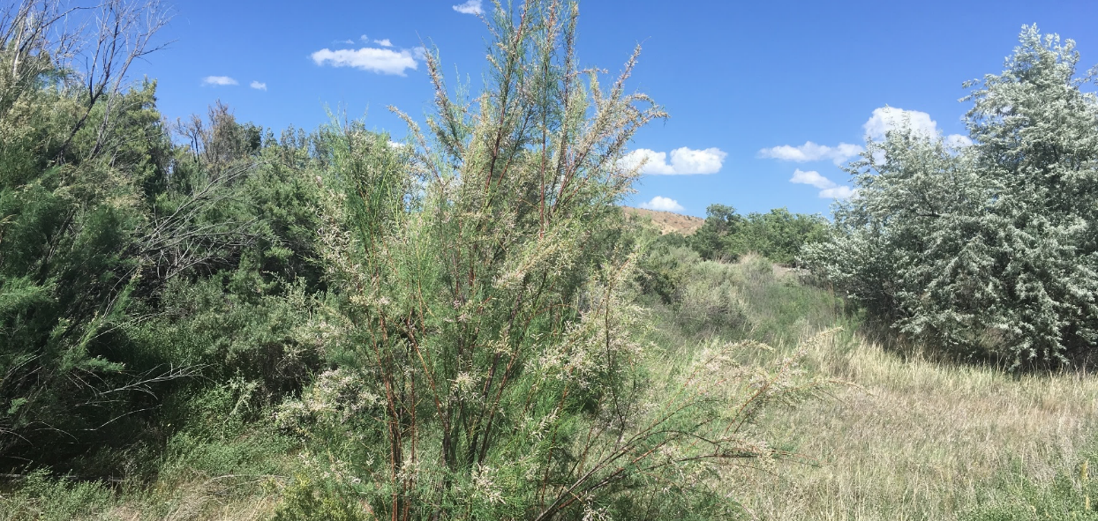
Questions?
Image Credit: Megan Vahsen
Notes:
Image Source: Megan Vahsen, FC DEVELOP

