Slide 1
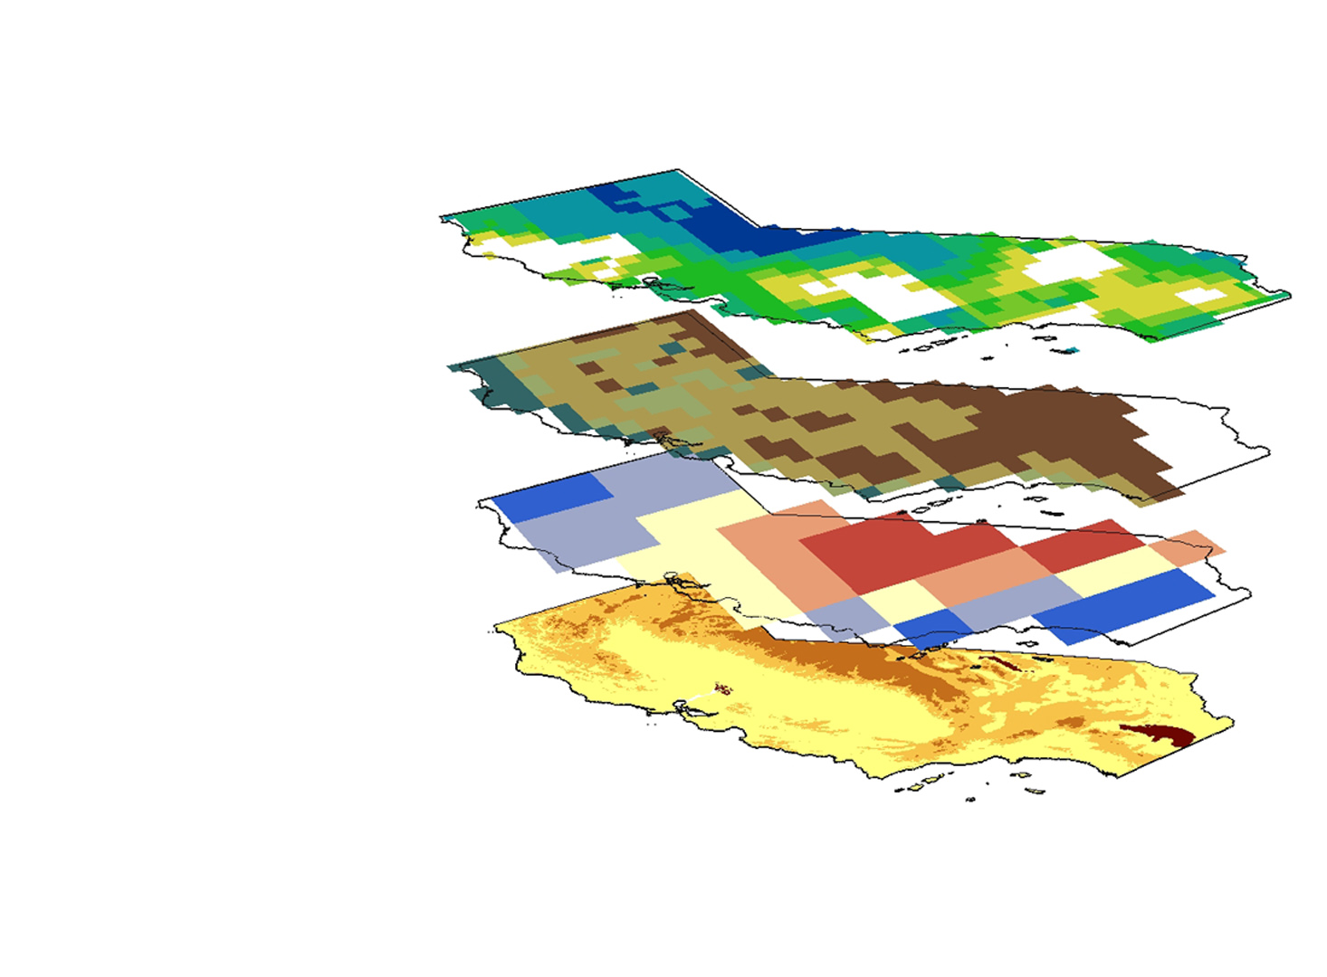

Quantifying the Impacts of the
2015-2016 El Niño Event on
California’s Historic Drought to Improve Water Resource Management
California Water Resources
Justin Lawrence
Lauryn Gutowski
Brittany Zajic
Nick Rousseau

Slide 2
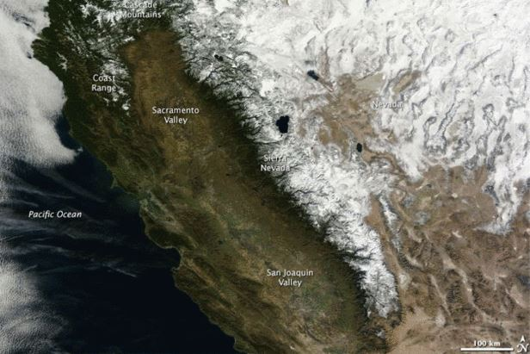
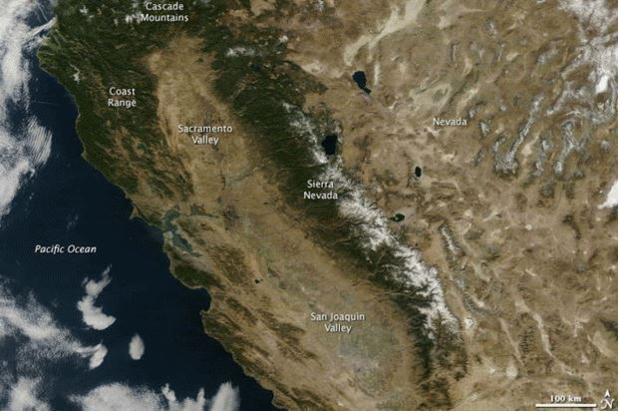
California’s Current Drought
Image Credit : NASA
California is currently in its fifth year of severe drought
Impacts of Drought:
  Water quality degradation
  Surface and groundwater levels decline
  Land subsidence
  Financial stress
2015 was the hottest year on record for the state
California is the most populous state in the US
California supplies nearly half of all produce in the US
Landsat January 2013
Landsat January 2014
Notes:
The state of California has endured record-breaking drought since late 2011 brought on by five years of below-average precipitation. On January 17, 2014 Governor Jerry Brown declared a state of emergency followed by an executive order to increase water conservation regulations on agencies and residents due to low groundwater and reservoir levels statewide.

Slide 3
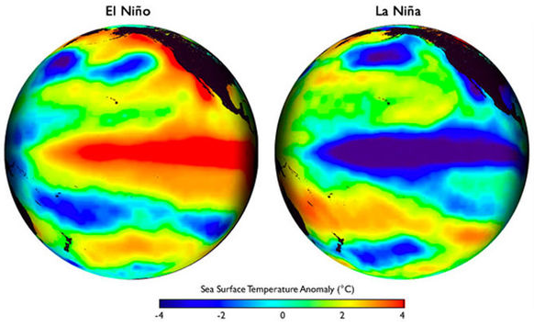
El Niño-Southern Oscillation
El Niño-Southern Oscillation –Cyclical departure from normal conditions in the Pacific
El Niño – warmer than normal central Pacific SST
La Niña – colder than normal central Pacific SST
Image Credit : NOAA
Notes:
The El Niño Southern Oscillation (ENSO) is a cyclical departure from normal atmospheric conditions in the central Pacific, shifting approximately every two to seven years between two conditions commonly called El Niño and La Niña
An El Niño state is typified by weakened, or even reversed, easterly trade winds which allow equatorial surface waters to flow back from the west and pool in the central Pacific while warming in excess of average temperatures.
La Niña, occurs when the easterlies strengthen and blow the cold, deep waters upwelled off the western coast of South America across the Pacific and cause colder than normal surface waters

Slide 4
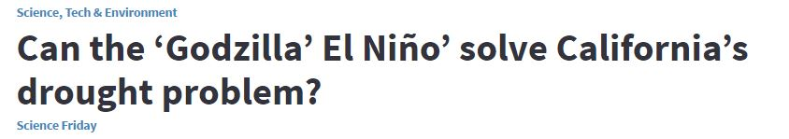
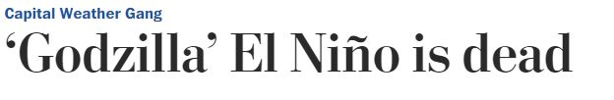
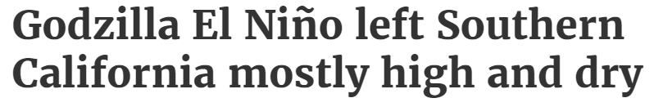

Strongest Recorded El Niño 2015-2016
NOAA’s Climate Prediction Center (CPE) forecasted an El Niño event during the winter of 2015-2016
It had the potential to provide significant precipitation and replenish the state’s water reserves
Image Credit : NASA, The Washington Post, CBS, LA Daily News
Notes:
In the midst of this drought, the National Oceanic and Atmospheric Administration’s (NOAA) Climate Prediction Center (CPE) forecasted an El Niño event during the winter of 2015-2016 that had the potential to provide significant rainfall and replenish the state’s water reserves.
An El Niño event was predicted for the winter of 2015-2016, with the potential to replenish water reserves
The National Oceanic and Atmospheric Administration announced that the El Niño event of 2015-16 has dissipated and has opened the door to its opposite: a La Niña.

Slide 5
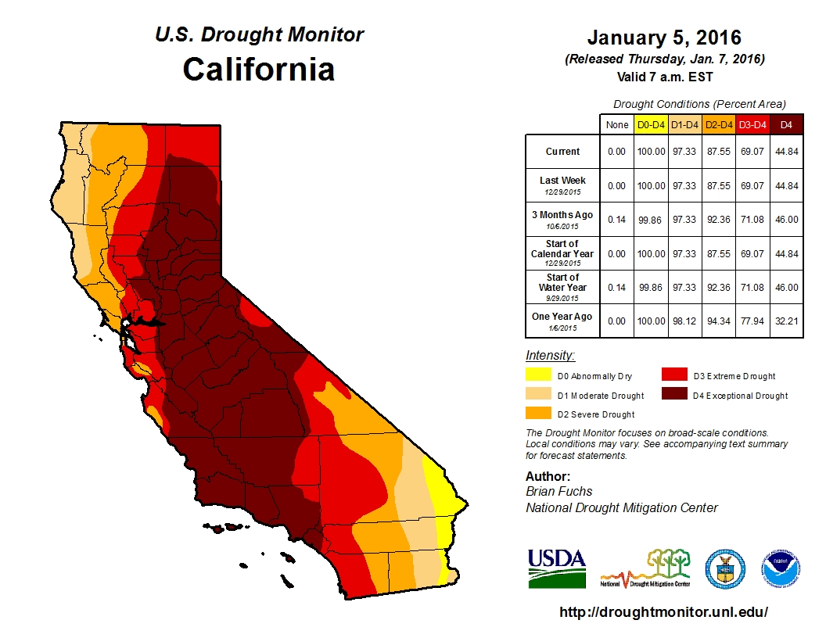
Objectives
Oceanic El Niño Index (ONI)
Determine how much drought recovery occurred throughout California during the 2016 water year
Understand ENSO’s relationship with California’s water balance
Sea Surface Temperature
Image Credit: US Drought Monitor
Notes:
The objective of this research project is to analyze the 2015-2016 El Niño event and determine how much drought recovery occurred throughout the state in the course of the wet season.
In order to gain more insight about current conditions, the project also seeks to further analyze historical climate trends from the past 100 years to compare this El Niño event with past events to better understand the impact ENSO has on California’s climate.

Slide 6
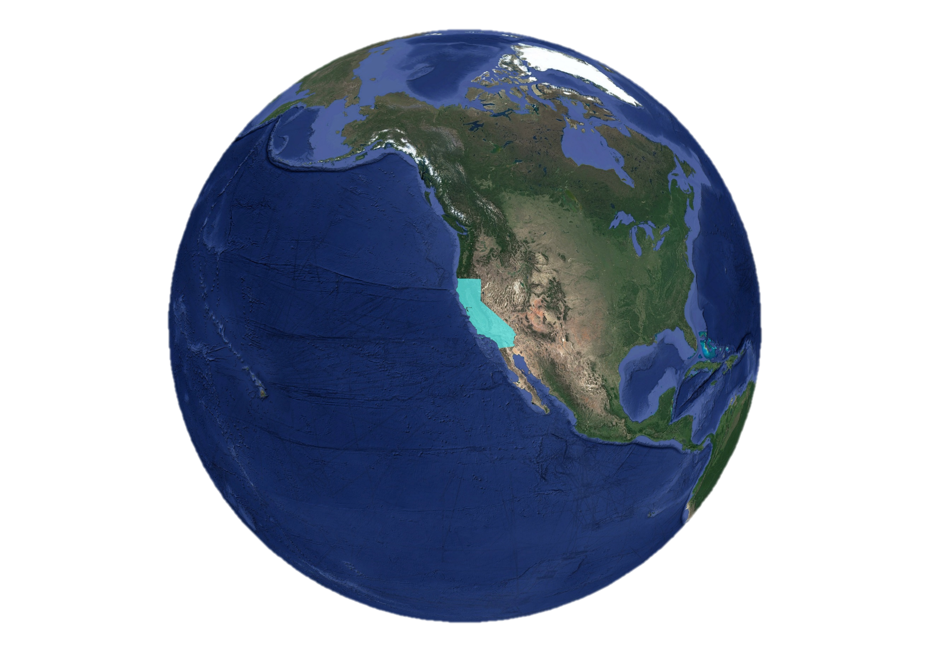
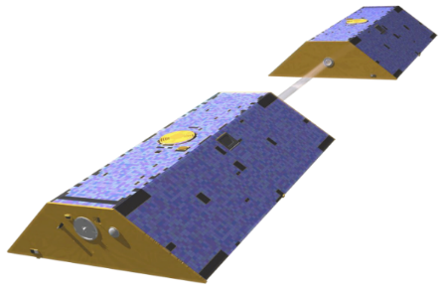
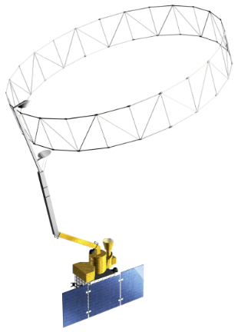
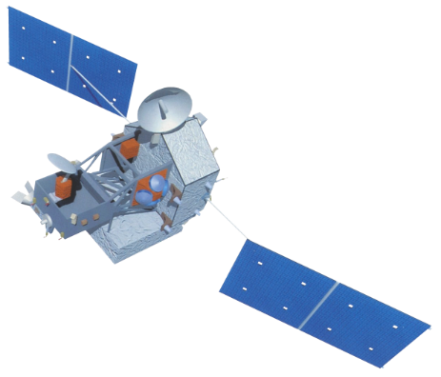
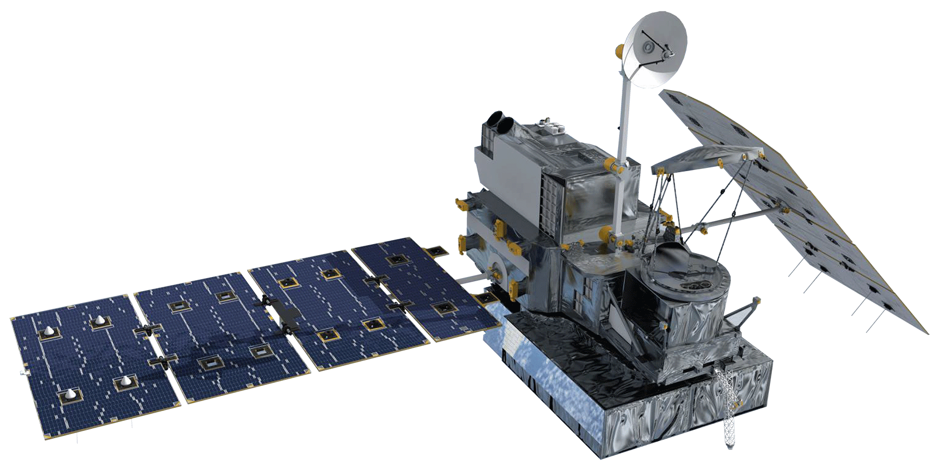
Study Area & NASA Earth Observations
GRACE
Soil Moisture Active Passive
Gravity Recovery and Climate Experiment
SMAP
California
Tropical Rainfall Measuring Mission
Global Precipitation Measurement
April 2002 – March 2016
TRMM
GPM
Image Credit: Google Earth
Notes:
April 2002 to March 2016, although historical NOAA data dates back to 1895, and TRMM back to 1998

Slide 7
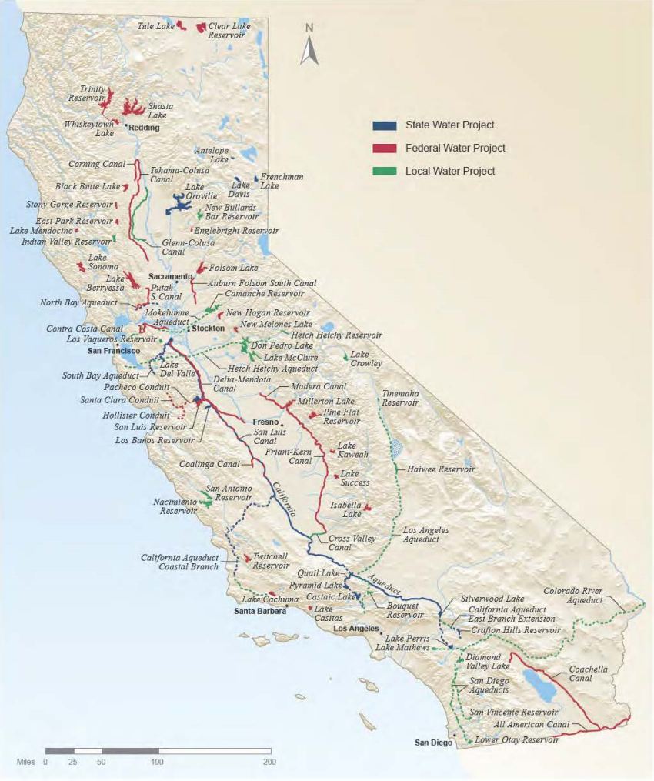
California’s Water Projects
Image Credit : water.ca.gov
Why a Statewide Study?
  Interconnectivity of California water systems
  While northern and southern California are different hydrologically, much of the water is shared statewide
  To match spatial resolution of GRACE
Notes:
Why the entire state? We chose a statewide analysis instead of the NOAA/NCEI Climate Divisions for two main reasons.
To match GRACE’s coarse resolution
To encompass the entire statewide water system
As you can see in this figure there are several CA water projects, from regional/local systems, to state/federal levels. The large transfer of water, North to South, East to West, and import from the Colorado River, create an interconnectivity that is encompassing of our entire study area.

Slide 8
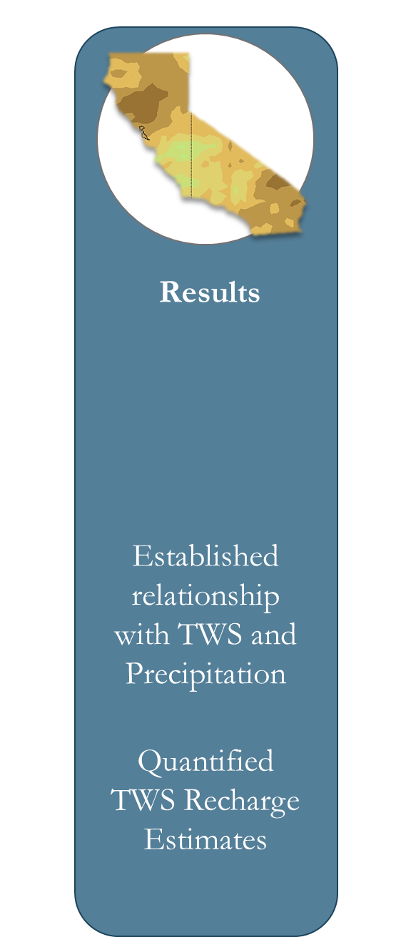
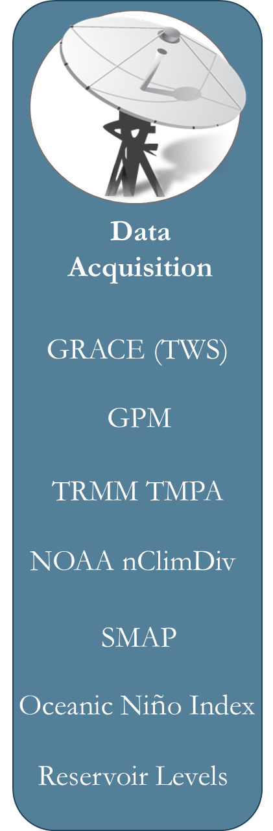
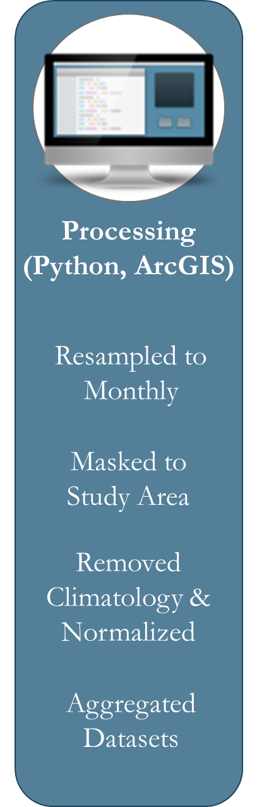


Methodology
Visualization & Assessment Maps
Notes:
As a team, we divided and conquered the satellite data. (GPM/TRMM, GRACE, SMAP, NOAA data). We processed this data using python, in order to manipulate and use the information we wanted. In python, we then created time series graphs, visual maps, and linear regression and correlation coefficients models.

Slide 9
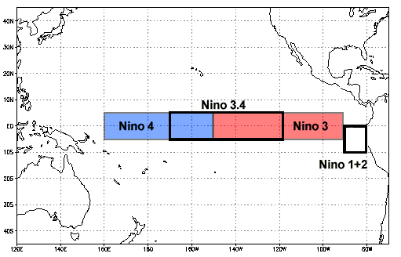
Datasets: Precipitation
1) NOAA NCDC nClimDiv Dataset
  Spatially averaged over the state of CA
  Monthly gridded dataset 1895 – 2016
  Available in climate divisions
4) NOAA Oceanic Niño Index (ONI)
  1950 – 2016
  Calculated by averaging sea surface temperature anomalies in an area of the east-central equatorial Pacific Ocean
2) TRMM Multi-satellite Precipitation Analysis (TMPA)
  Monthly gridded dataset 1998 - 2016
  0.25° x 0.25° spatial resolution
  TMPA/3B43 L3 Rainfall Estimate (HDF4)
3) GPM Precipitation
  Monthly gridded dataset 2014 – 2016
  0.1° x 0.1° spatial resolution
  Global successor to TRMM
  IMERG L3 Rainfall Estimate (HDF5)
Image Credit: NOAA
Notes:
TRMM launched in 1977 to study rainfall, specifically the rainfall and associated heat release that drives global atmospheric circulation. Level 3 (3B43 Multisatellite Precipitation) 0.25° spatial resolution data from May 2002 to March 2014 was accessed via the Goddard Earth Sciences Data and Information Services Center (GES DISC). Consider converting to km.

Slide 10
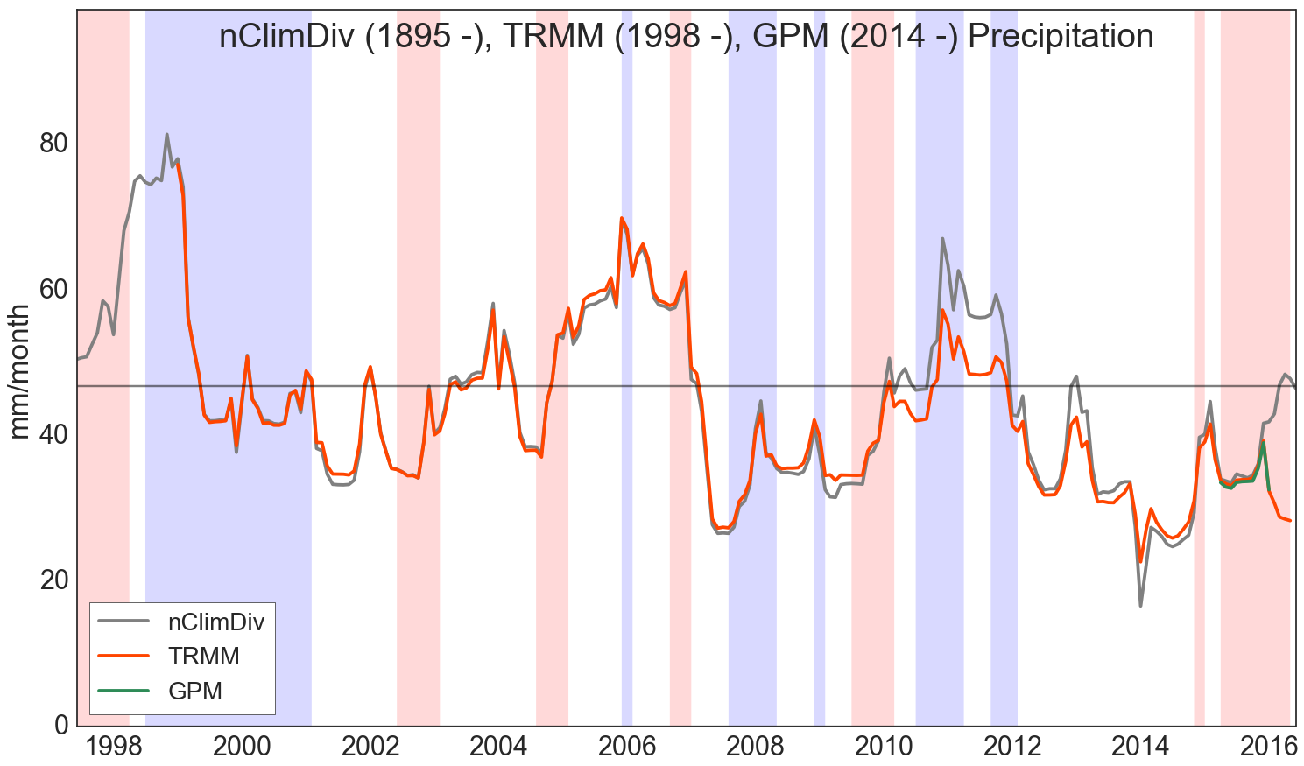
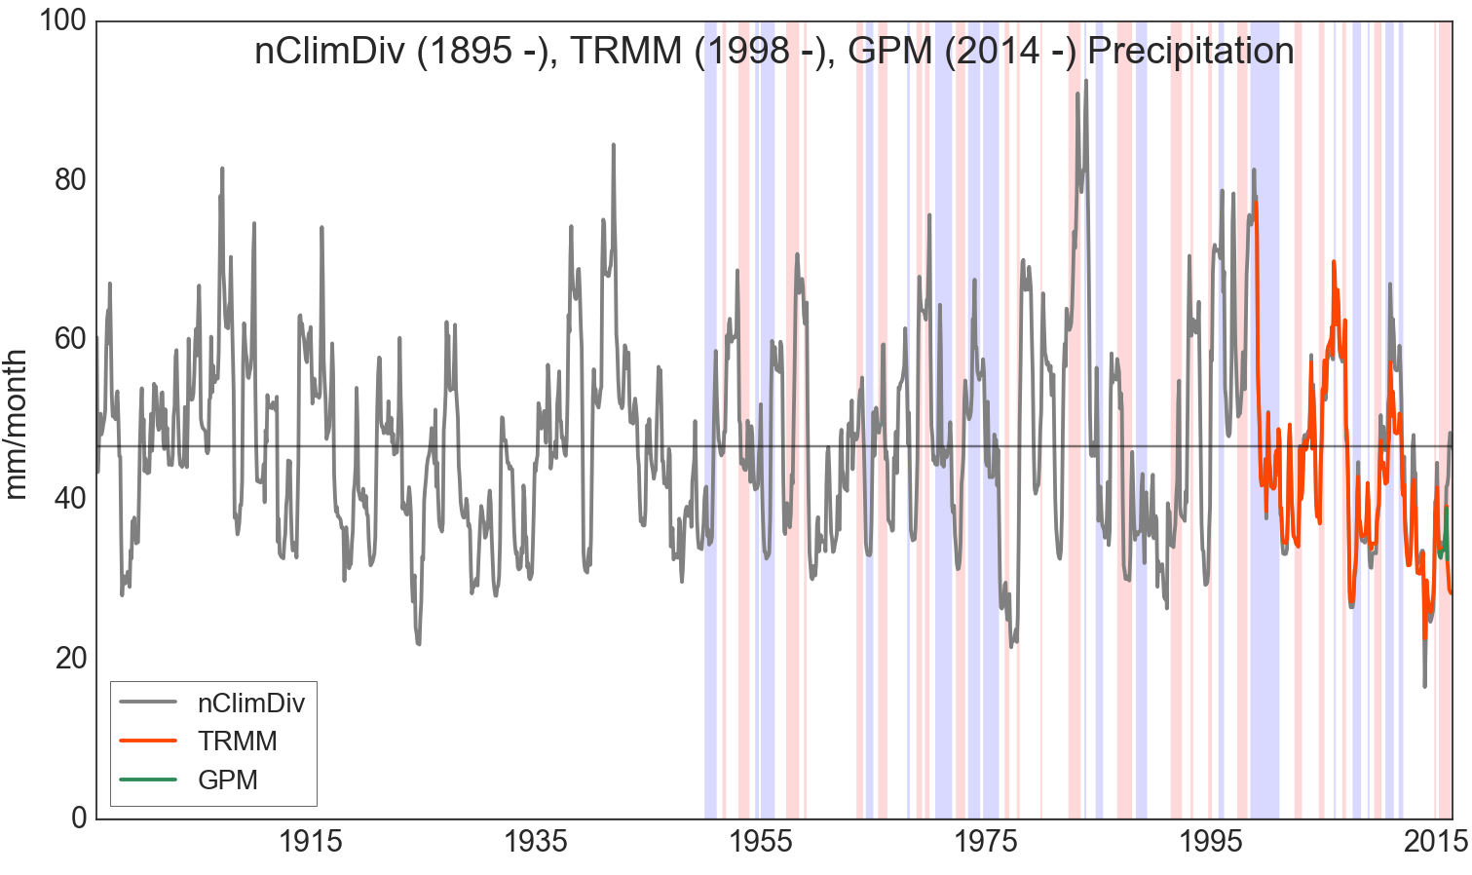
Remotely sensed and in situ precipitation
  Correlation coefficient between TRMM and nClimDiv is 0.97
  Satellite data products can provide broader spatial coverage and match ground based observations
*From 1950 on: blue = La Niña, red = El Niño months
Notes:
13 month rolling average of nCLimDIv, TRMM and GPM
R-value of .94 for TRMM vs. nClimDIv

Slide 11
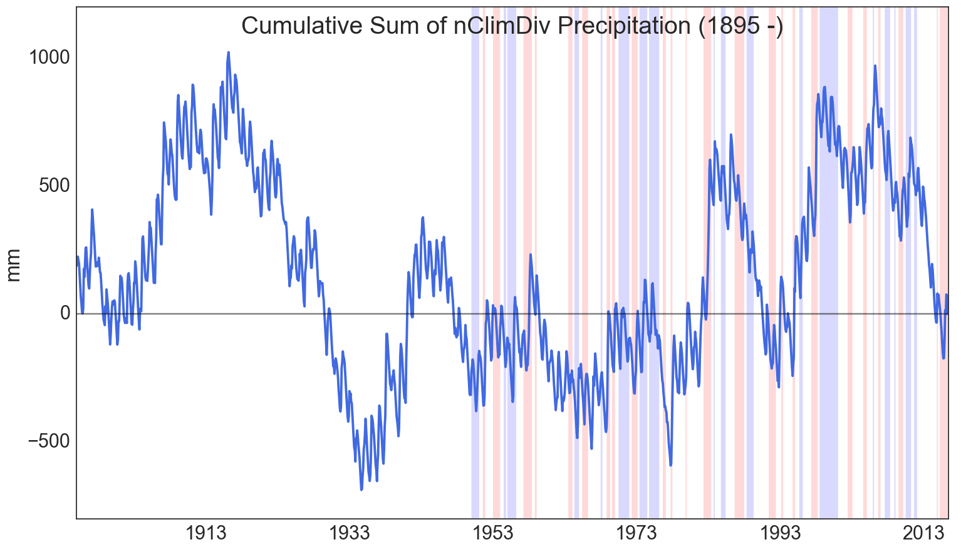
Cyclical precipitation trends in California
Converts precipitation rate to storage to relate to GRACE TWS
This allows us to relate precipitation to TWS
Equation for Cumulative Sum:
CumulativeSum(nClimDiv – mean(nClimDiv))
*From 1950 on: blue = La Niña, red = El Niño months
Notes:
Accumulated Precipitation anomalies show long term wet and dry periods
Why Accumulate?
-To change it from a rate
-- rate → storage

Slide 12
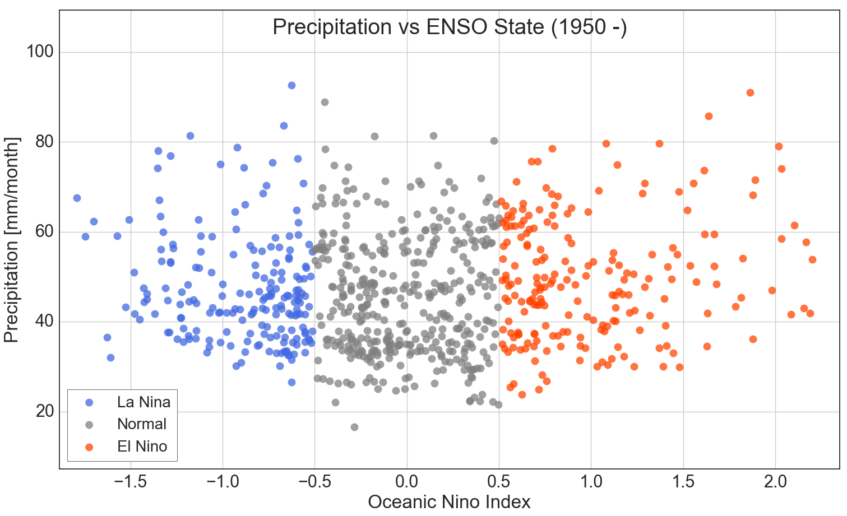
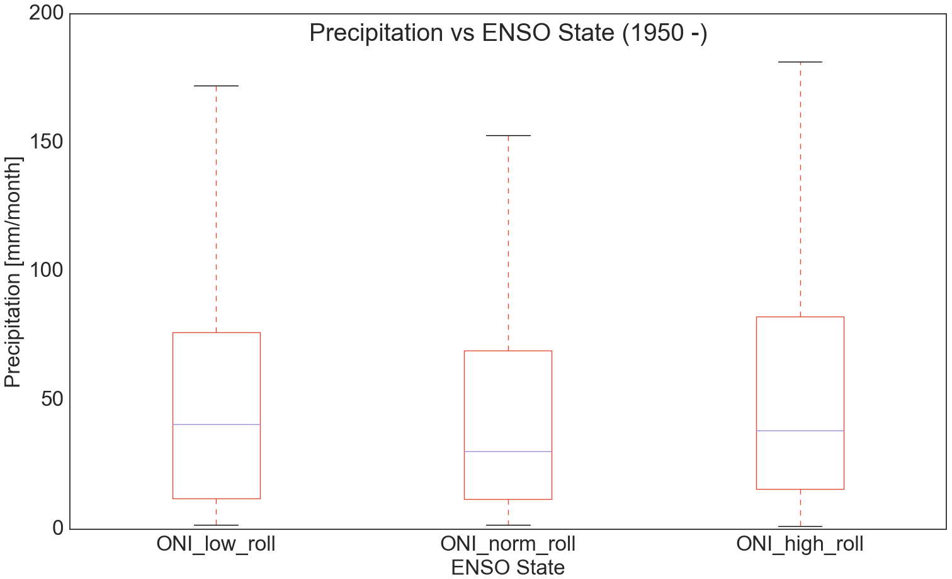
ENSO cannot predict precipitation on a statewide basis
Correlation Coefficient: 0.06
(La Niña)
(El Niño)
(mm) | ONI | nClimDiv Precip | La Niña | Normal | El Niño
mean | 0.03 | 47.03 | 47.3 | 45.59 | 49.64
std | 0.75 | 13.04 | 12.07 | 13.18 | 13.36
min | -1.79 | 16.54 | 26.55 | 16.55 | 23.81
max | 2.2 | 92.57 | 92.57 | 88.86 | 90.51
count | 797 months | 797 months | 194 months | 396 months | 204 months
(Normal)
  13 month moving average
Notes:
* On a statewide basis, according to the ONI 3.4 region.

Slide 13
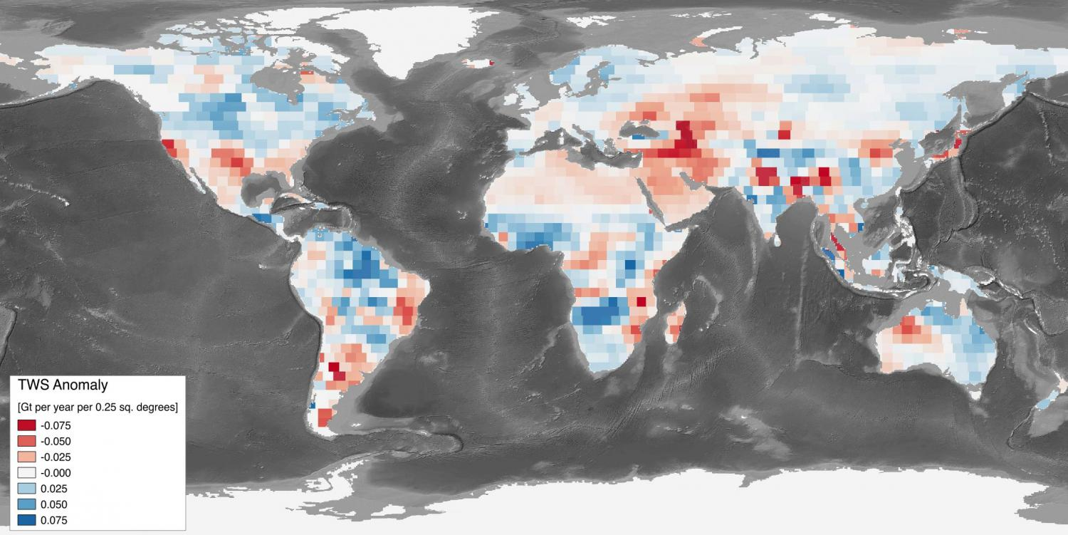
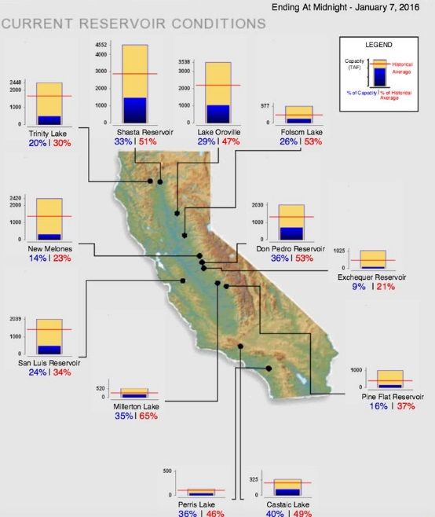
Datasets: Storage
Image Credit: Reager, NASA JPL
1) GRACE Terrestrial Water Storage (TWS)
  Monthly dataset April 2002 – March 2016
  3.0° x 3.0° spatial resolution
  GRACE provides monthly observations of terrestrial water storage anomalies (TWS) that describe spatial and temporal changes in the amount of water stored in soils, groundwater and above the land surface
2) California Reservoir Storage
  Monthly dataset January 2002 – June 2016
  60 largest (> 10,000 Acre Feet) of roughly 700 reservoirs
  Drought reduces snowpack and results in decreased reservoir volume
Image Credit: water.ca.gov
Notes:
Launched in 2002, NASA’s Gravity Recovery and Climate Experiment (GRACE) is made up of a pair of Earth-observing satellites that measure Earth’s gravity field.
GRACE maps Earth’s gravity field by making accurate measurements of the distance between the two satellites and from that we can measure how Earth’s gravity field changes over time. The only thing that moves around at this time scale is water, so GRACE is unique in its ability to measure terrestrial water storage variations, stored at all levels above and within the Earth’s surface.
GRACE provides monthly observations of terrestrial water storage anomalies (TWS) that describe spatial and temporal changes in the amount of water stored in soils, groundwater and above the land surface

Slide 14
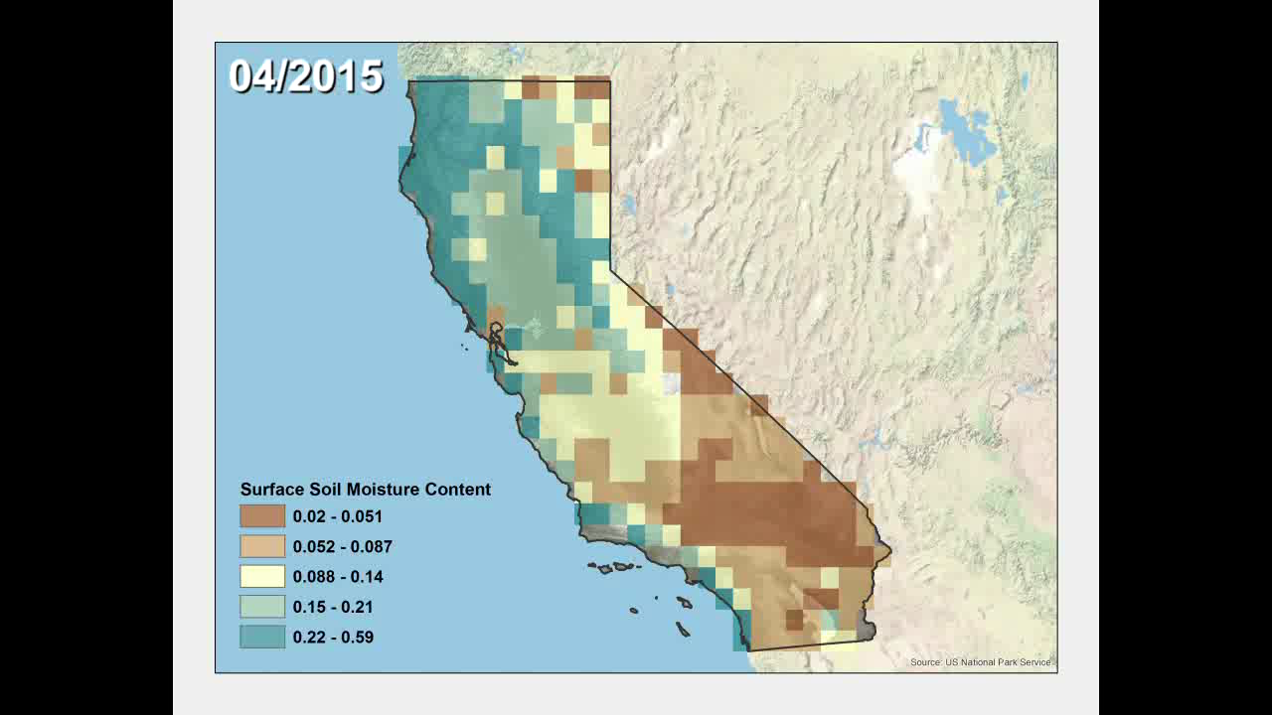
Datasets: Storage
3) SMAP Surface Soil Moisture Content ~ (0 – 5 cm)
  Averaged monthly April 2015 – July 2016
  36 km spatial resolution
  Processed in ArcGIS Model Builder
  Length of dataset too short to incorporate into analysis
Notes:
Dataset too short to incorporate into our analysis, but SMAP offers:
Higher spatial resolution
An important parameter for drought analysis

Slide 15
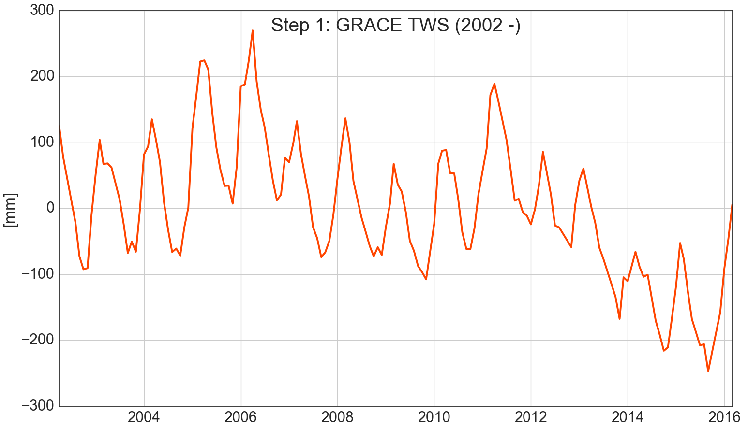
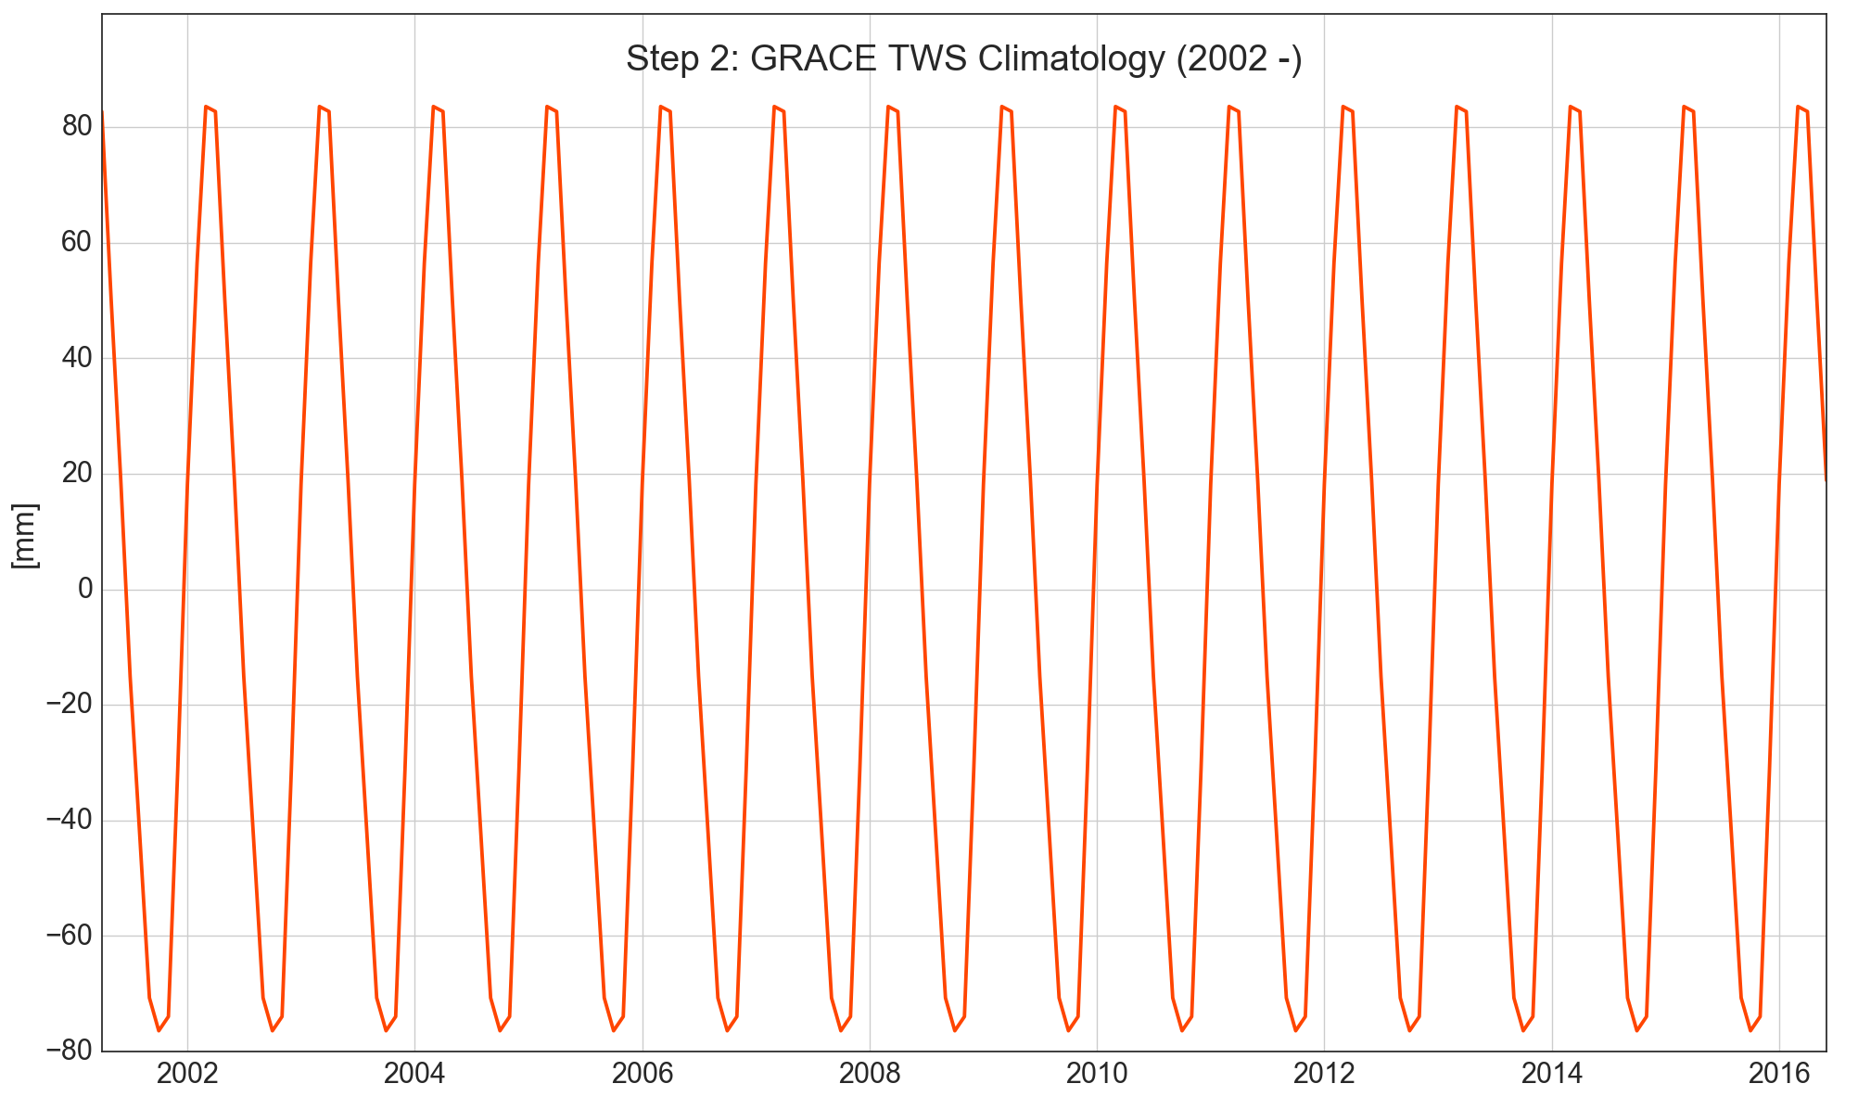
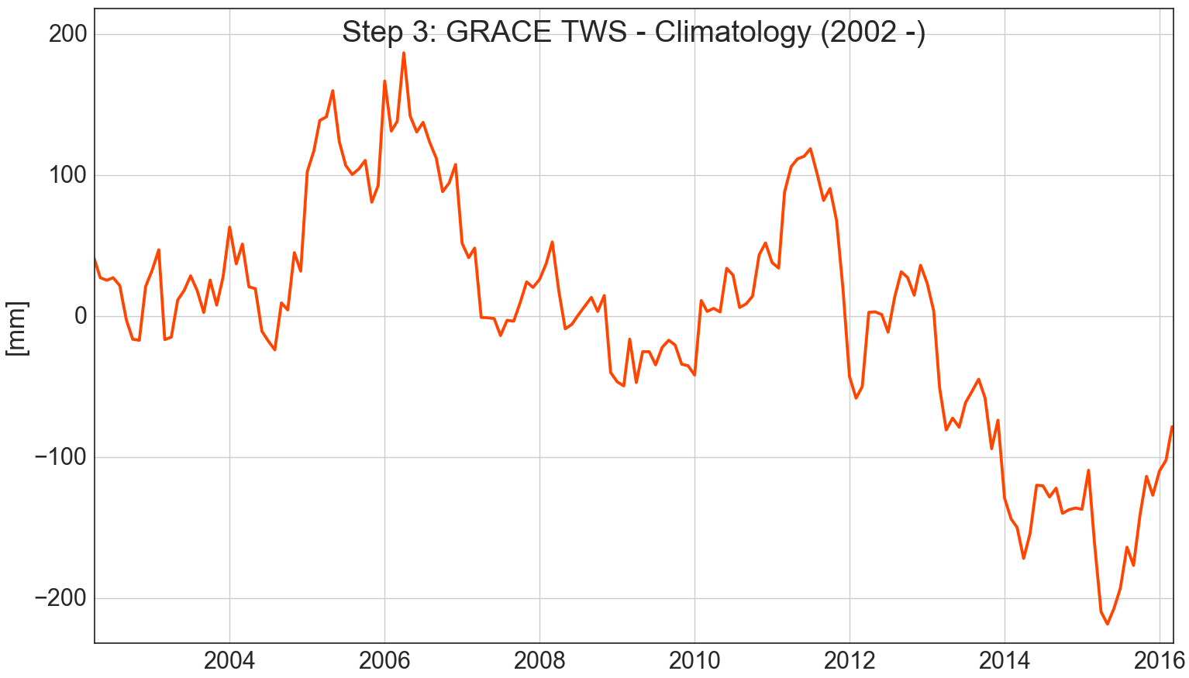
GRACE TWS Processing Steps
Notes:
Figure 1: GRACE TWS
Figure 2: TWS climatology (monthly)
Figure 3: TWS - climatology

Slide 16
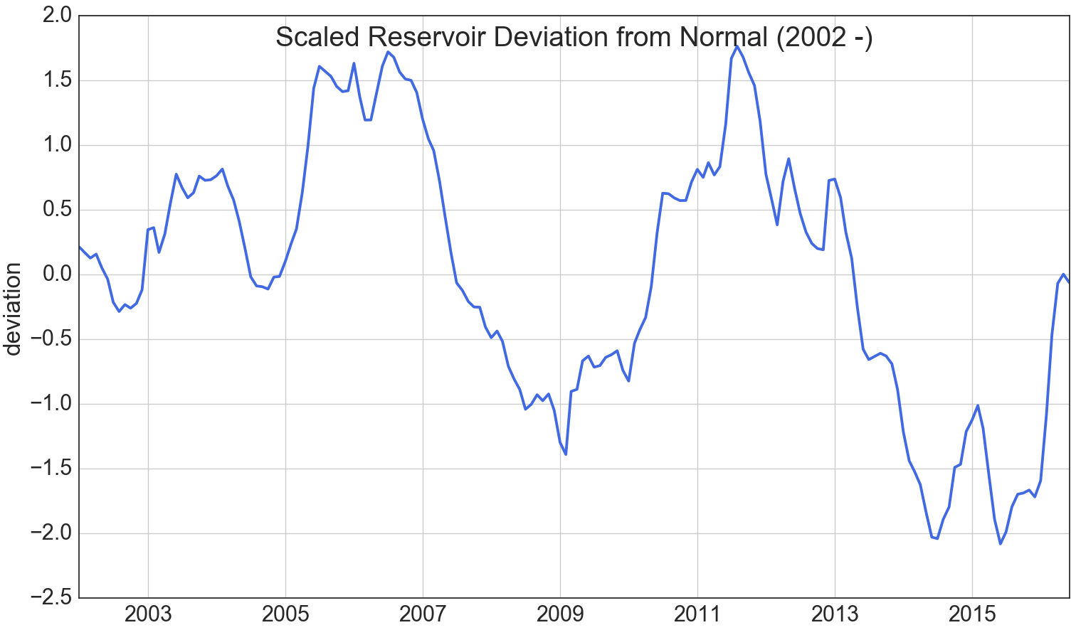
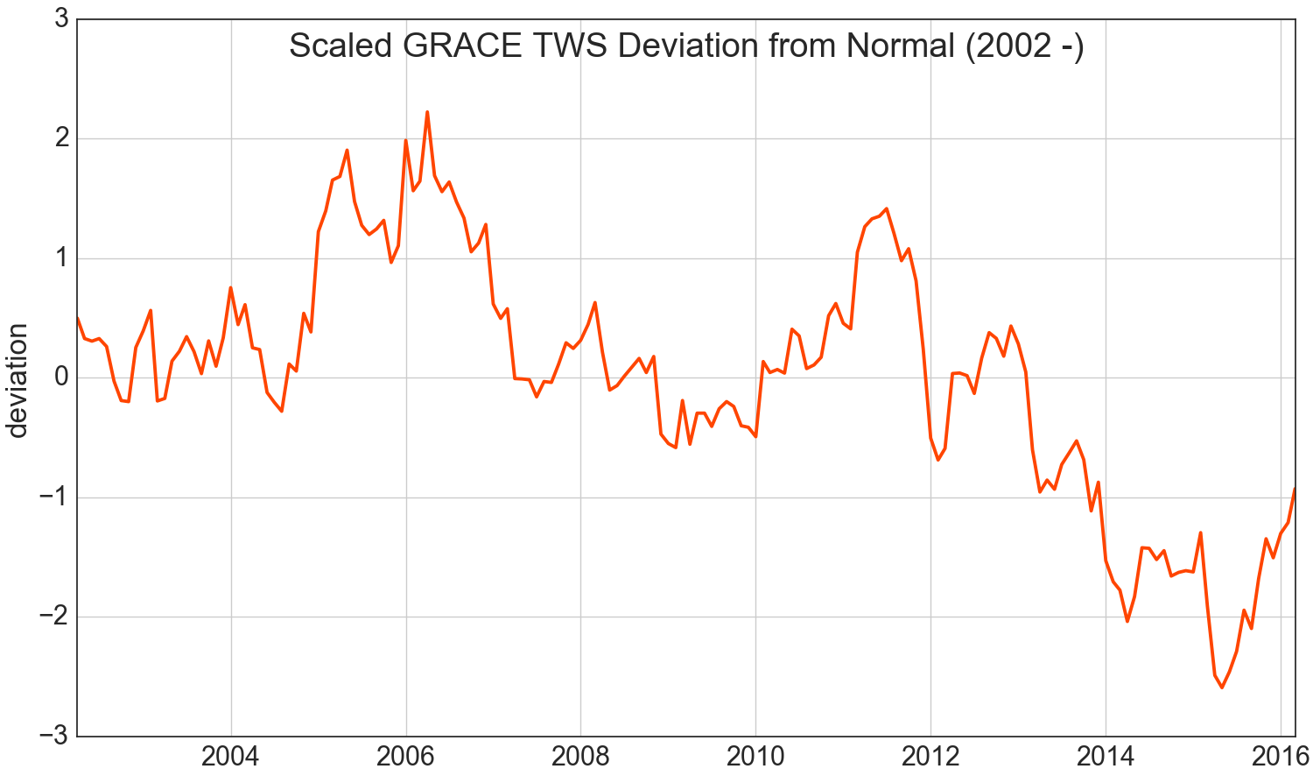
Water storage is more than just skin deep
  A comparison of scaled reservoir and TWS shows that TWS remains below normal while reservoirs appear recovered
Notes:
For the last month, we are still in a drought!
As of March 30, 2016, the California Department of Water Resources (DWR) measured the statewide snowpack to be at 87 percent of normal for this date. However as of June 13, 2016 the statewide snow water equivalent was 6 percent of average for this date.

Slide 17
Relating Precipitation and Storage
1) GRACE Terrestrial Water Storage (TWS)
  To get volumes: TWS * area of CA (423,970 km³)
  2015 peak wetness: -46.26 km³ (below climatology)
  2016 peak wetness: -33.15 km³ (below climatology)
  Recovery during past water year: 13.11 km³
2) nClimDiv Precipitation
  Accumulated precipitation can relate to TWS (both are storage measures)
→ Extrapolate TWS based on Precipitation
Notes:
We’ve introduced a bunch of datasets, here’s the ones were going to create relationships for. Let’s also discuss actual quantifications of water deficit.

Slide 18
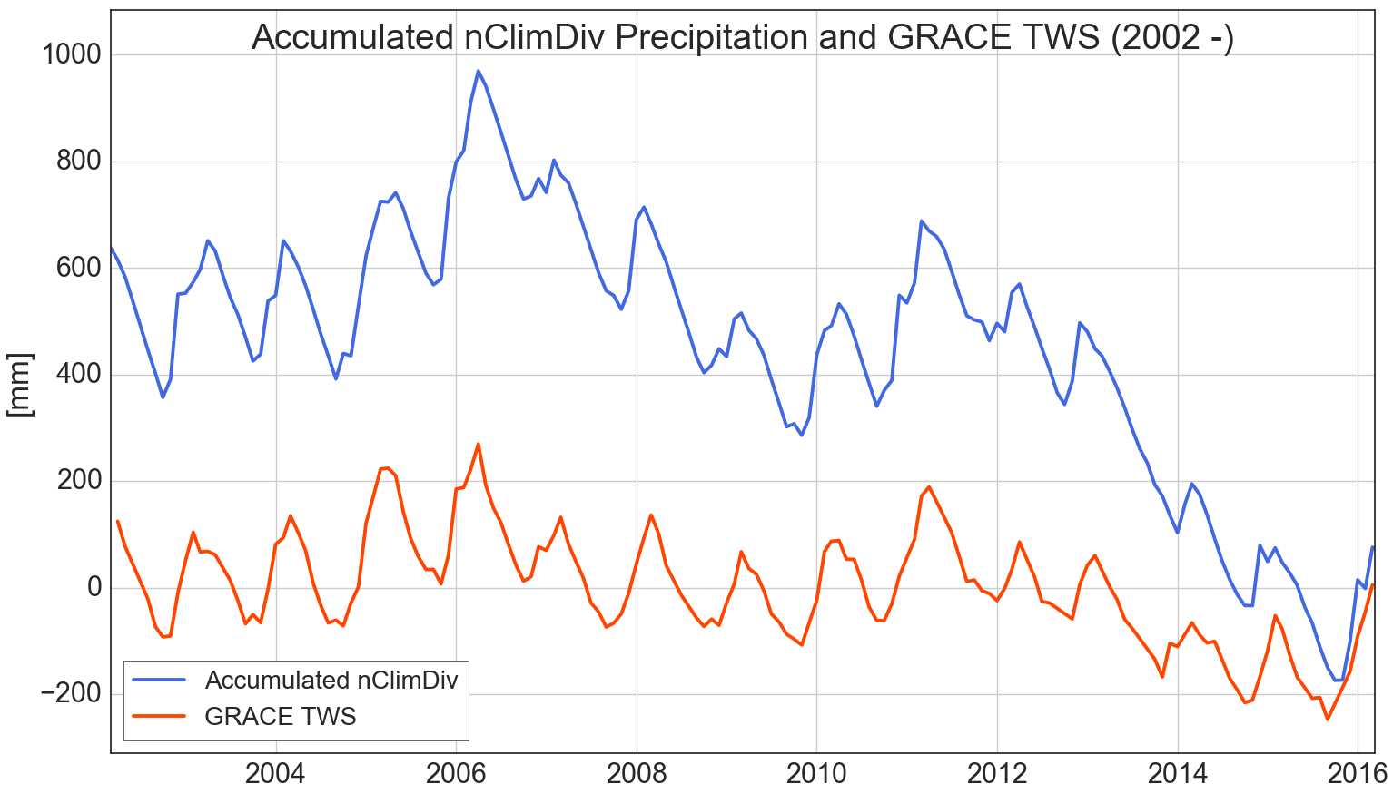
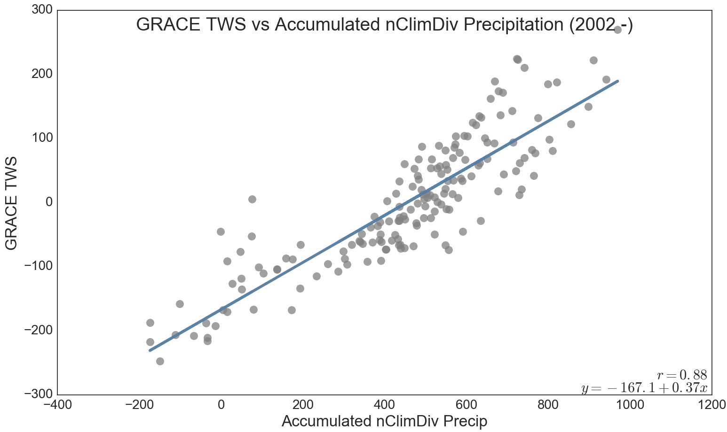
Predicting storage with GRACE and precipitation
  Shows how TWS would respond to precipitation, allowing estimation of storage levels
Notes:
TWS well correlated with Precip- precip explains most but not all changes in storage

Slide 19
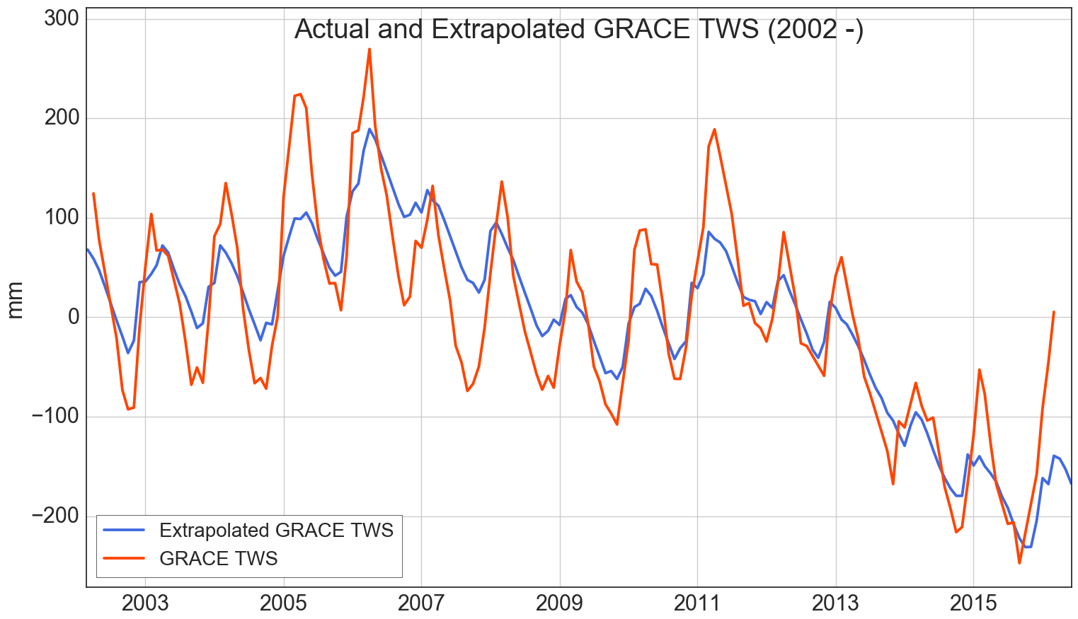
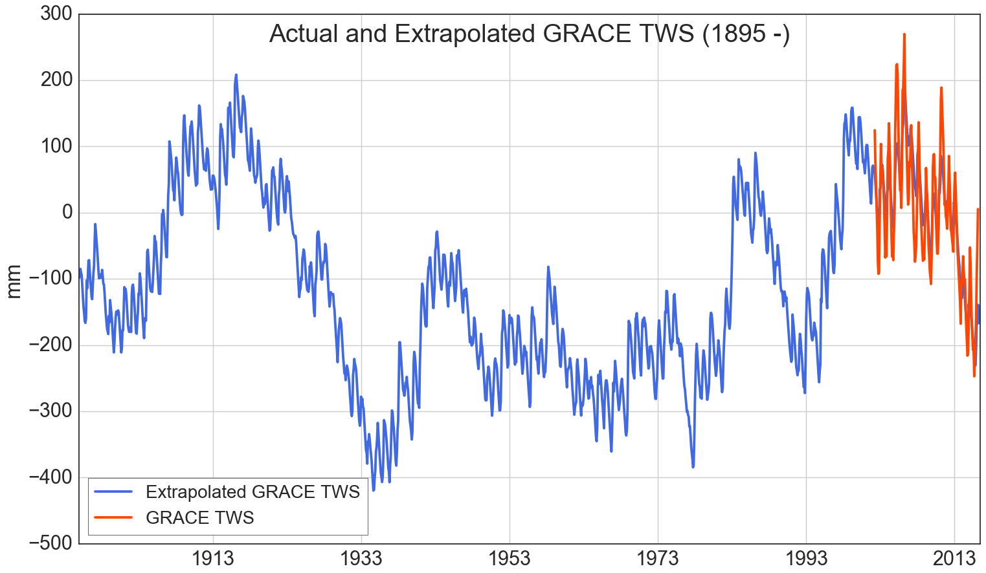
The first satellite launch… was in 1895?
  The relationship between TWS and accumulated precipitation allows for simple extrapolation of TWS
  Above: predicted and real TWS data over the study period.
  Left: Extrapolated historical TWS back to 1895
  Note that past TWS is exaggerated due to lack of temperature in the model
Contemporary 5 year drought
The Dustbowl
Drought
Notes:
Figure Regression with GRACE and precip and how we got this figure, extrapolated TWS (warning: assumes all other parameters to be constant, very simple model)

Slide 20
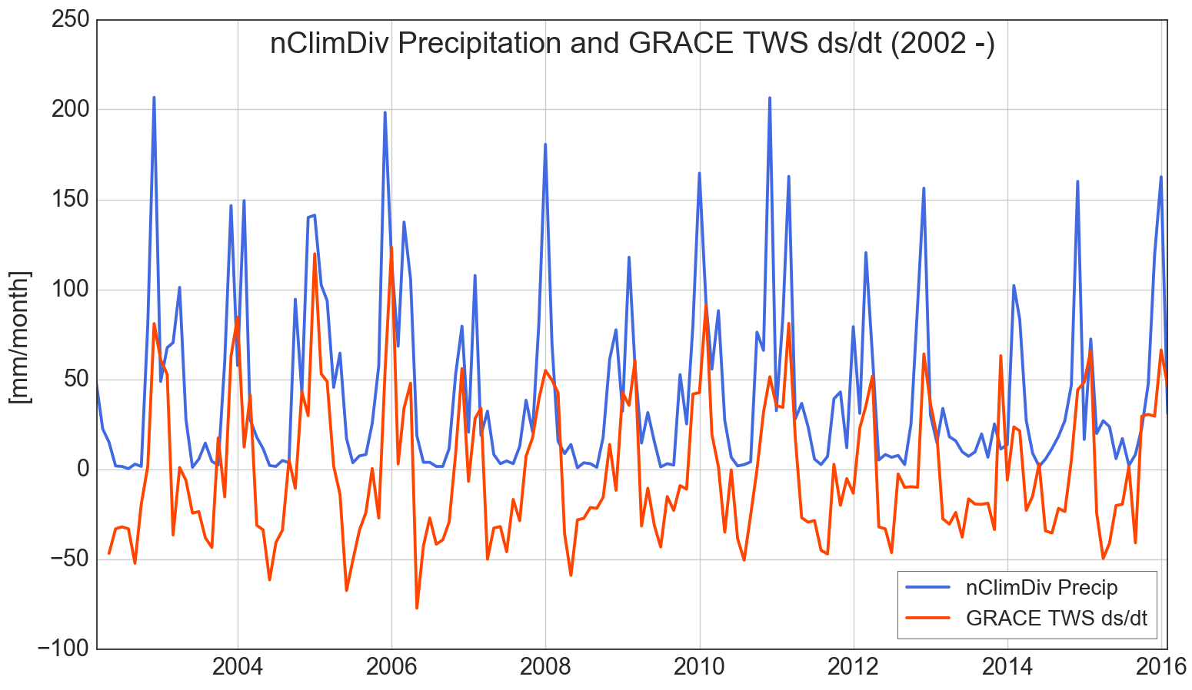
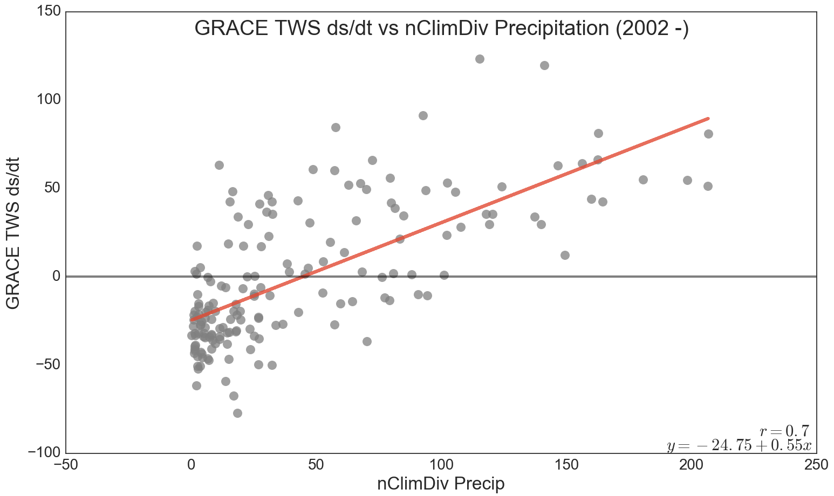
California’s ‘breakeven’ precipitation rate
  If precipitation rates in California fall below an average of ~48 mm per month (54 cm or 22” annually) of precipitation, water reserves are reduced
  Relating the TWS rate of change (ds/dt) with precipitation rates allows the calculation of the ‘breakeven’ precipitation rate – the equilibrium point for statewide water storage
Breakeven Rate = 48 mm/month
Notes:
Ok, now relate rates instead of quantities- TWS ds/dt vs precip. This lets us see that for change in storage to be at equilibrium, CA must get at least 48 mm/month of precip.

Slide 21
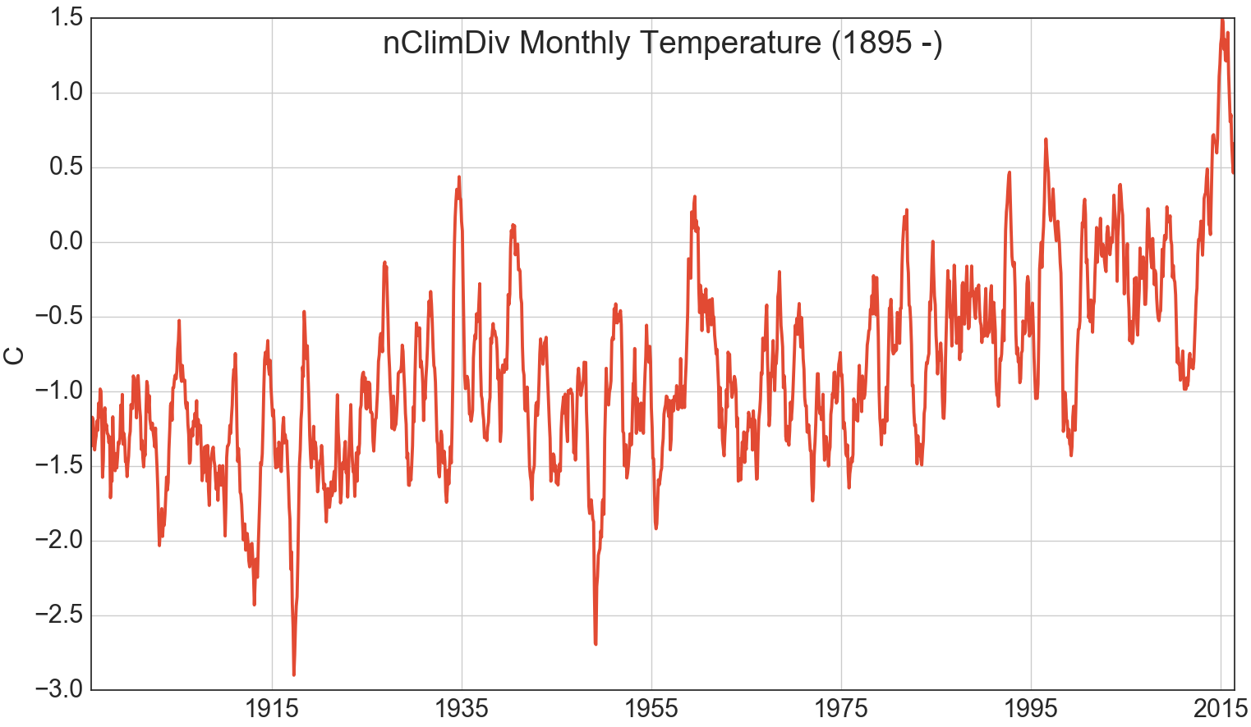
Climate change contributes to increases in drought vulnerability
  Temperatures are projected to continue to rising
  2015 was the warmest year on record for California
  Presents an opportunity for future work to forecast “the new normal”
Notes:
Though not considered in our analysis, we also looked at temperature
CA saw 2015 as the warmest year on record
Climate change
Link for future work

Slide 22
Conclusions
ONI is not a sufficient metric for forecasting precipitation on a statewide basis
GRACE TWS provides a more complete metric than surface storage- even after a ‘monster’ El Niño, water storage remains a full deviation below the climatological mean (or 33.15 km³)
We can also estimate storage levels based on precipitation rates, but we can’t reliably predict precipitation for the whole state!
California’s breakeven precipitation rate for equilibrium water storage is an average of 48 mm/month
With quantitative assessments of statewide water resources becoming increasingly important, NASA GRACE TWS hydrological data presents a uniquely integrated measure to incorporate into water reports for resource managers, decision makers, and stakeholders

Slide 23
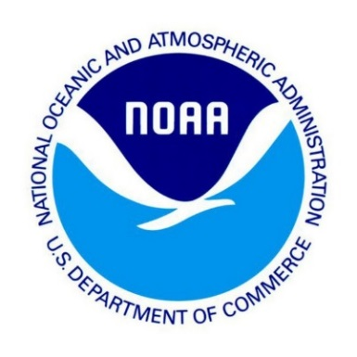
Science Advisor & Co-Author
Dr. John T Reager, NASA Jet Propulsion Laboratory
NOAA/NWS Weather Forecast Office, Los Angeles, Oxnard
Mark Jackson, Meteorologist in Charge
Jayme Laber, Senior Service Hydrologist
John Dumas, Science and Operations Officer
Eric Boldt, Warning Coordination Meteorologist
DEVELOP Mentor
Benjamin Holt, NASA Jet Propulsion Laboratory
We would also like to thank Jinny Lee and Aaron Trefler for their advice and expertise

