Slide 1
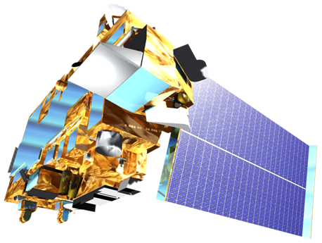
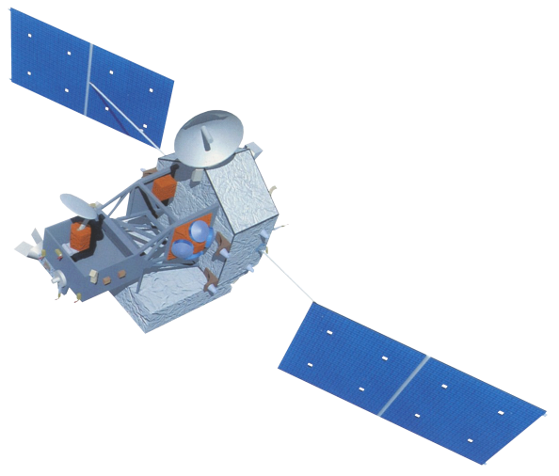
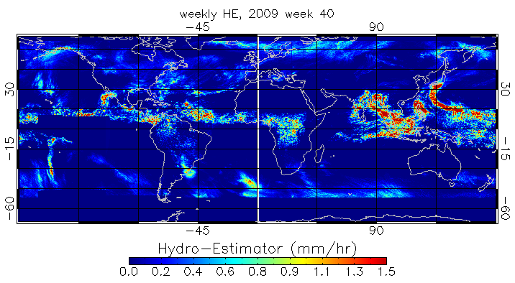
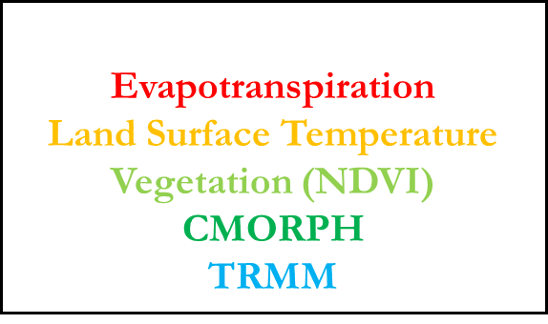
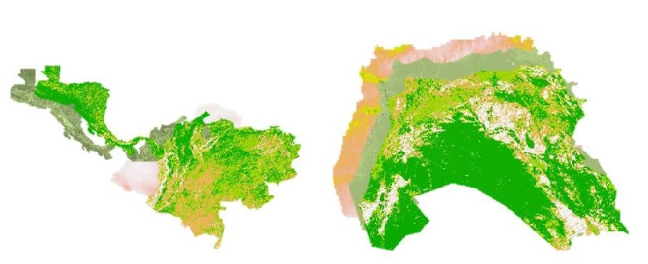
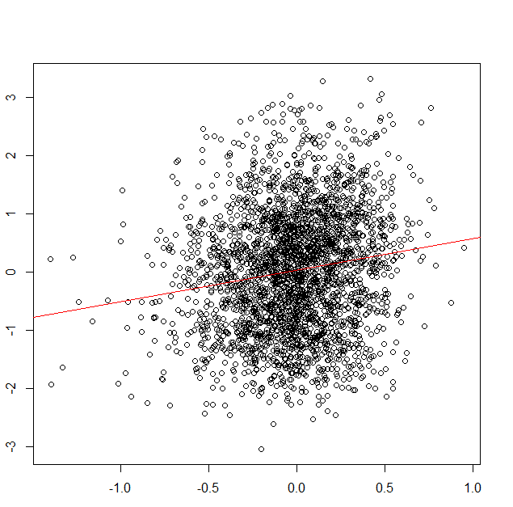
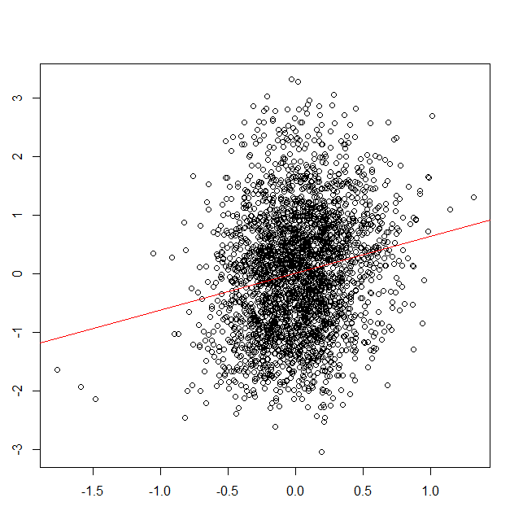
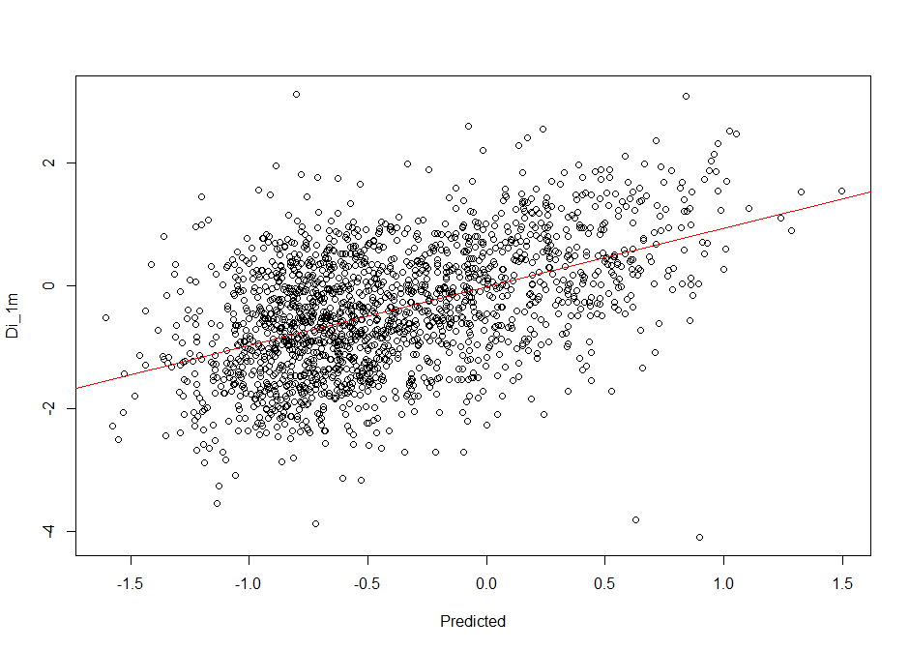
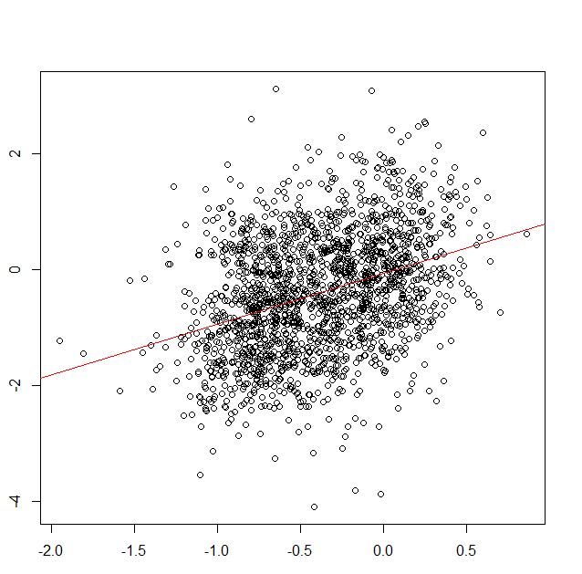
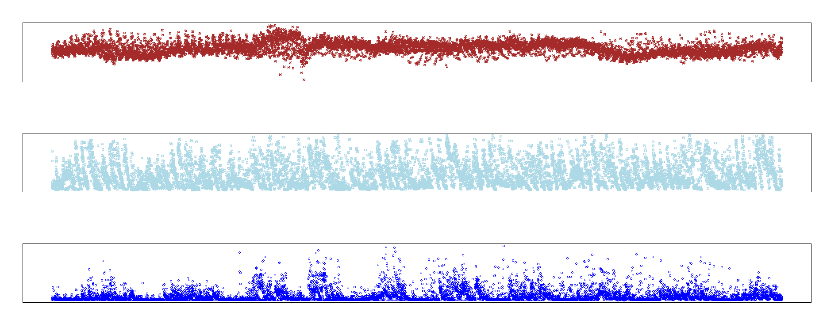
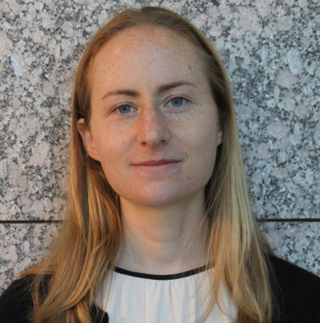
Enhancing Drought Monitoring and Prediction Capabilities of the US Air Force, 14th Weather Squadron in Levant and Central America
Abstract
Study Area
Objectives
Drought is caused by extreme variations in precipitation, which include volume, frequency, and type, and can contribute to water shortages, crop failures, and socio-economic stress. The multiplicity of factors and temporal variability that influence drought proves challenging to model. Current drought models utilize remotely sensed satellite data, in situ ground measurements, or a combination of both, to assess drought severity. In this study, multiple MODIS derived variables, TRMM and CMORPH precipitation data, and the
Enhance the 14th Weather Squadron’s capacity to monitor drought in the study regions
Develop a robust drought model using a machine learning approach
Compare performance of model within and across study regions
Earth Observations
Global Precipitation Climatology Centre (GPCC) in situ drought index product were used to create novel drought models through a machine learning approach. The models were tested on two regions between 2002 and 2014: Central America and the Middle East Levant region. The 14th Weather Squadron will take the models to use in their current operational procedures.
Terra & Aqua – MODIS sensor NASA
Tropical Rainfall Measuring Mission (TRMM) - NASA/JAXA
CPC CMORPH – NOAA
Methodology
Data Acquisition
Processing
Machine learning
Analyzed Results
Independent Variables
Convert to Raster
Random Forest
Clip to Boundary
Dependent Variables
Scale data from 0-1
Random Forest is used because it has been proven to be robust and flexible, as well as avoids overfitting and sensitivity problems according to Park et al (2016)
GPCC Drought Index
Place into machine learning algorithm
Levant & central America Climate II
Results
Di 24m Central America, CMORPH
Di 24m Central America, TRMM
Di 1m Levant, CMORPH
Di 1m Levant, TRMM
Di 9m and Precipitation
Di 24m
Di 24m
Di 1m
(a)
R² = 0.153
RMSE = 1.031
R² = 0.185
RMSE = 1.022
R² = 0.385
RMSE = 0.958
R² = 0.485
RMSE = 0.895
(b)
Predicted
Predicted
Predicted
Predicted
2002
(c)
2014
Figure 1: Scatter plots between predicted drought index based on random forest models for 24 month drought index in Central America and 1 month drought index for the Levant region
Figure 2: 9 month drought index (a), scaled CMORPH (b), and scaled TRMM (c), in the Levant region for the entire study period (2002 to 2014).
Conclusions
Project Partners
In this study, drought was modelled via satellite derived precipitation, vegetation variables, and 1-, 3-, 9-, and 24- month GPCC Drought Indices in Central America and the Levant.
Drought models were more accurate in the Levant region than Central America for both TRMM and CMORPH datasets
In all cases, TRMM outperformed COMPRH.
The tools are fully operational for future use by our project partners.
Raymond Kiess, US Air Force, 14th Weather Squadron
Major Jason Scalzitti, US Air Force, 14th Weather Squadron
Ryan Smith, US Air Force, 14th Weather Squadron
Acknowledgements
We would like to thank our Center Lead Alec Courtright and our science advisor Dr. L. DeWayne Cecil for their experience and guidance throughout this project.
Team Members
We would also like to acknowledge the following for their contribution: Kelly Meehan, Michael Kruk, Michael Brewer, Rob Blevins, James Adams, other NOAA NCEI Employees, and the 14th Weather Squadron
Previous contributors: Christie Stevens and Hayley Hajic
Evan Henry
Team Lead
Patrick Pierce
Lauren Cater
This material is based upon work supported by NASA through contract NNL11AA00B and cooperative agreement NNX14AB60A. Any mention of a commercial product, service, or activity in this material does not constitute NASA endorsement. Any opinions, findings, and conclusions or recommendations expressed in this material are those of the author(s) and do not necessarily reflect the views of the National Aeronautics and Space Administration and partner organizations.
NOAA National Centers for Environmental Information – Fall 2016

