Slide 1
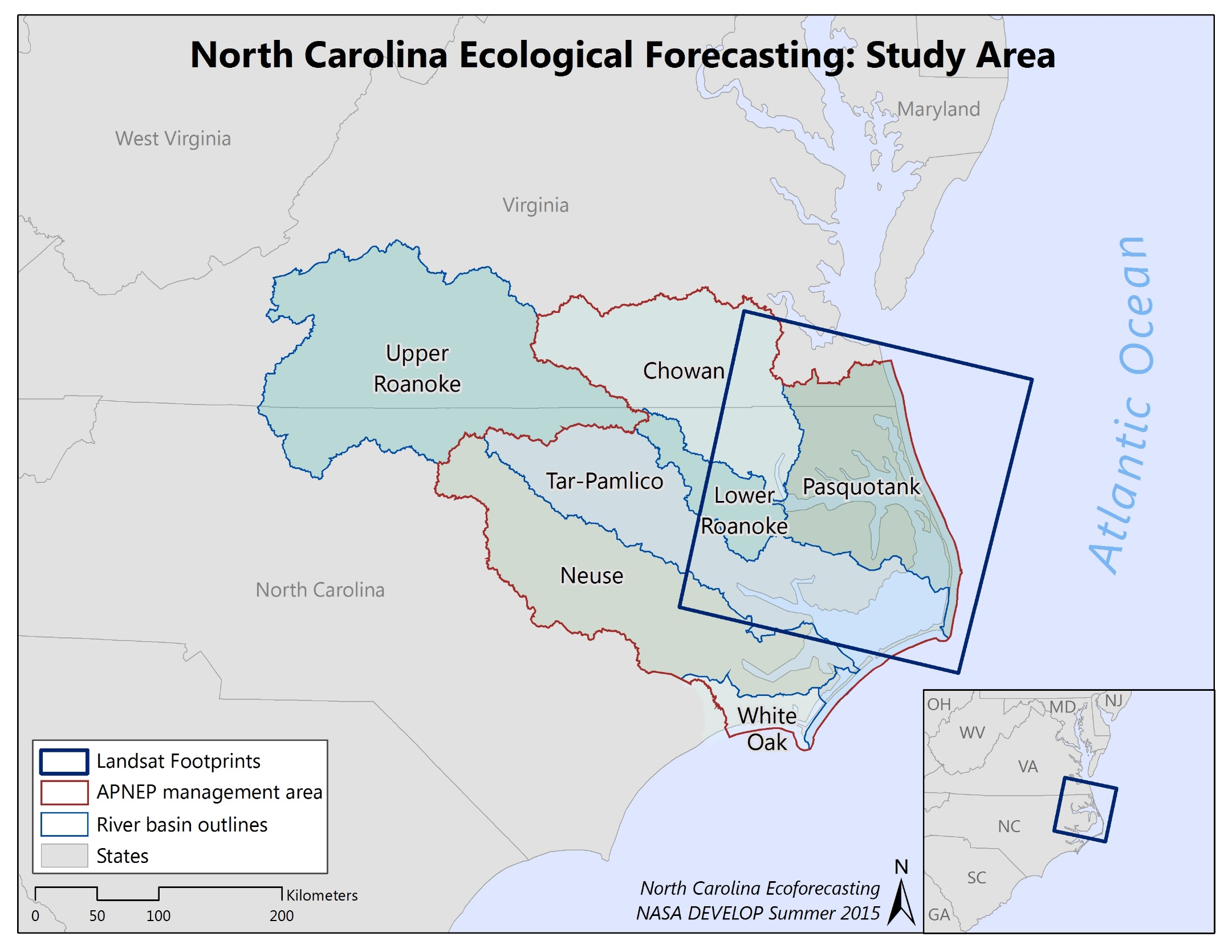
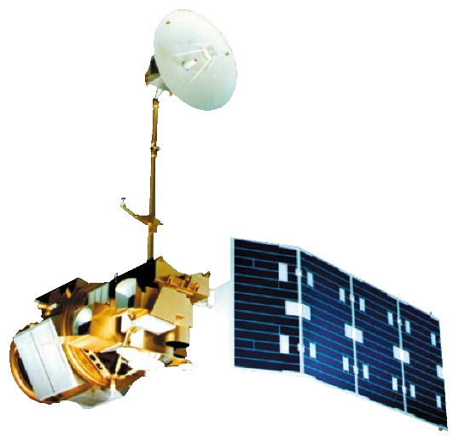
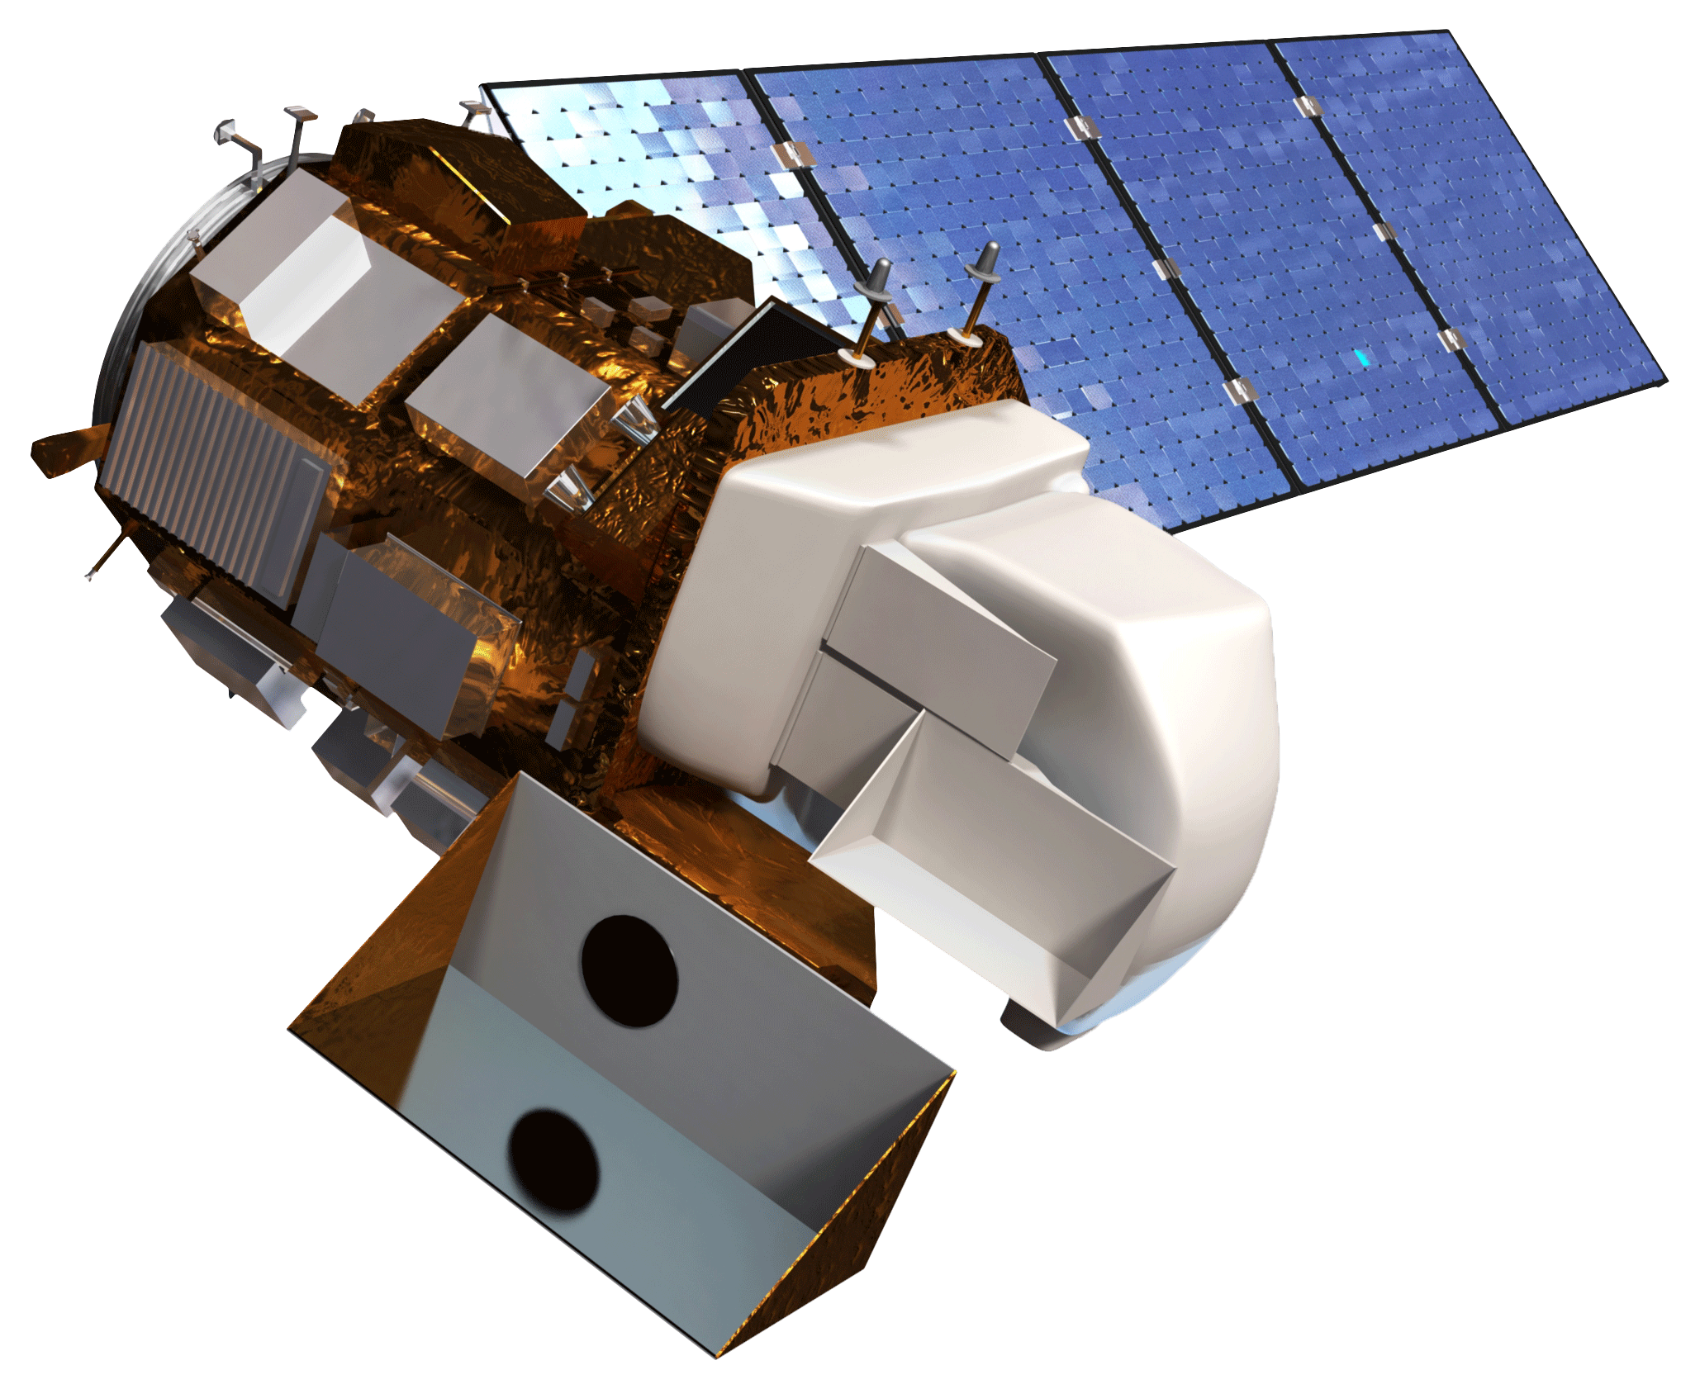
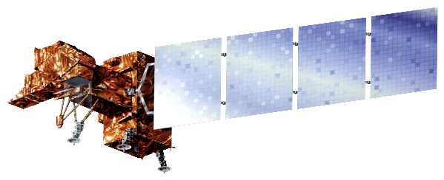
NORTH CAROLINA ECOLOGICAL FORECASTING
Evaluating the Application of NASA Earth Observations to Rapidly Detect
Change in Wetland Types at a regional scale
Zand Bakhtiari (Project Lead), Stephen Zimmerman, Kayla Patel, Brad Gregory
Abstract
Objectives
As a result of their sensitivity to sea level rise, wetlands are considered one of the most vulnerable ecosystems to climate change. In addition, wetland extents have diminished over time due to population increases and associated land change patterns. This project, partnered with the Albemarle-Pamlico National Estuary Partnership (APNEP), sought to delimitate wetland extent within the Albemarle-Pamlico watershed from 2000 to 2015 using NASA’s Landsat 5 Thematic mapper(TM), 7 Enhanced Thematic mapper(ETM+), and 8 Operational Land Imager(OLI). Four images (representing spring, summer, fall, and winter) were collected for each year from 2000 to 2015. Multiple images were used for each year to account for tidal changes and to minimize the noise produced by cloudy imagery. After pre-processing the images, indices that measure water extent and wetland health were calculated for each image. From these indices’ wetland extent and relative health were measured more rapidly than contemporary classification methods. A tutorial was provided to APNEP to support the organization in implementing policies toward wetland monitoring, protection, and restoration.
Determine shoreline extent
Assess relative wetland health by measuring carotenoid/chlorophyll-a ratios
Landsat -5, 7, and 8 scenes(path 14, row, 35)
Four season acquisition
Methodology
Study Area
Green NDVI $=\frac{(Green − NIR)}{(Green + NIR)}$
$$NDPI=\frac{(Red −Blue)}{(Red+Blue)}$$
Wetland Health Index $=\frac{(NIR∗SWIR)}{(NIR+SWIR)}$
56 Landsat (5 TM, 7 ETM+, 8 OLI) scenes were collected form 2000 - 2015
Four scenes per year was acquired in order to account for tidal variations and cloud noise
Python used to calculate indices in an automated process
Earth Observations
Landsat 7 ETM+
Results
Landsat 8 OLI
Use images.
Make sure that it has some sort of flow, that it makes sense. Show your results in a logical order.
No bullets.
Landsat 5 TM
Conclusions
Use bullets.
Use complete sentences with periods.
Team Members
Project Partners
Acknowledgements
Use a professional-looking photo.
Individual headshots are ok, if they aren’t pixelated and are all the same size.
Include a caption that states the team members’ names.
Albemarle-Pamlico National Estuary Partnership (APNEP)
Dr. Kenton Ross
NASA DEVELOP National Program Science Advisor
Jeff Ely
NASA DEVELOP
NASA Langley Research Center

