Slide 1
Southwest US Disasters
Incorporating CDRs and MODIS to Create a Predictive Model of Post-Burnout Vegetation Regrowth in Relation to Flood Risk
Jason Zylberman (Project Lead)
Jennifer Holder
Lance Watkins

Slide 2
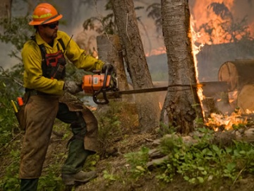
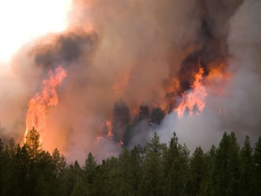
Community Concerns
Wildfires and flooding are two major disasters which cause economic damage and loss of life in the Southwest.
Flood events that occur after periods of wildfires can lead to an increase in soil erosion and larger debris in flood waters
Image Credits: US Forest Services
Notes:
Image Source: http://www.fs.fed.us/managing-land/fire

Slide 3
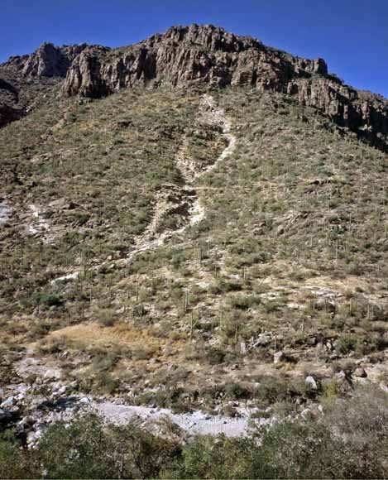
Objectives
Establish a spatio-temporal relationship between vegetation regrowth as a function of NDVI and post-fire runoff hazard, over a 10-year period, for greater Tuscon, Arizona area within the Lower Colorado River Basin
Generate a raster surface indicating vegetation regrowth rate after historical wildfires on a per-pixel basis
Identify precipitation rates associated with increased post-wildfire flooding risk based on historical runoff events
Image Credit: USGS
Notes:
Image Source: http://pubs.usgs.gov/of/2008/1274/images/coverphoto.jpg

Slide 4
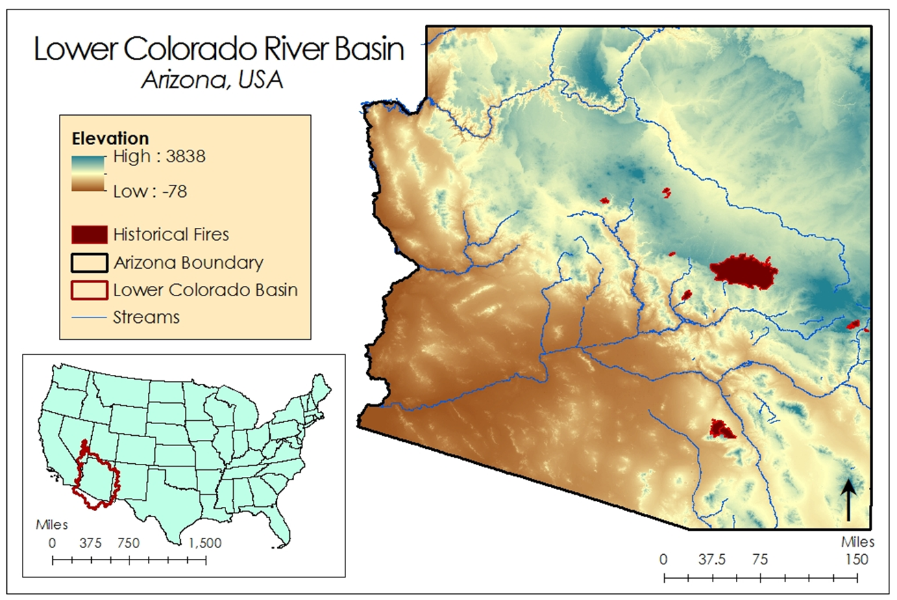
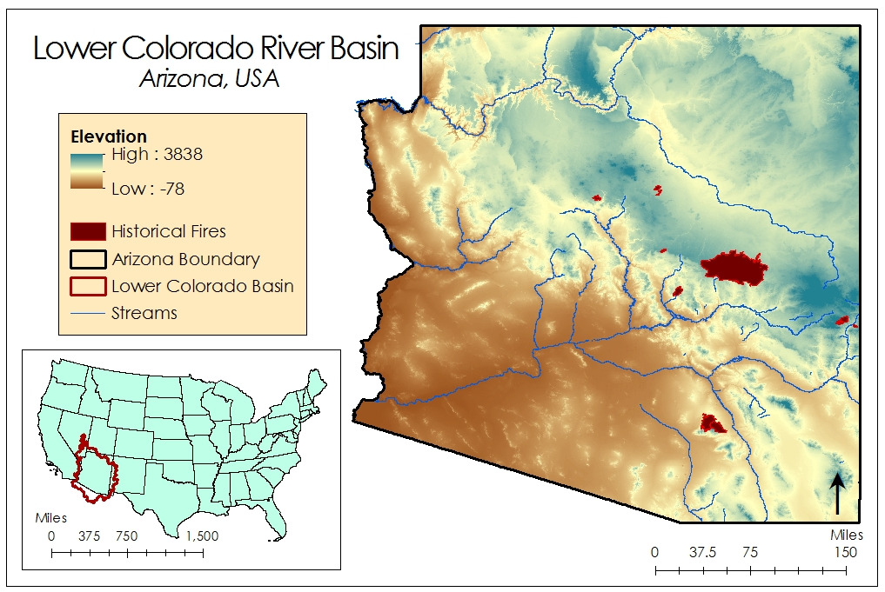
Study Area

Slide 5
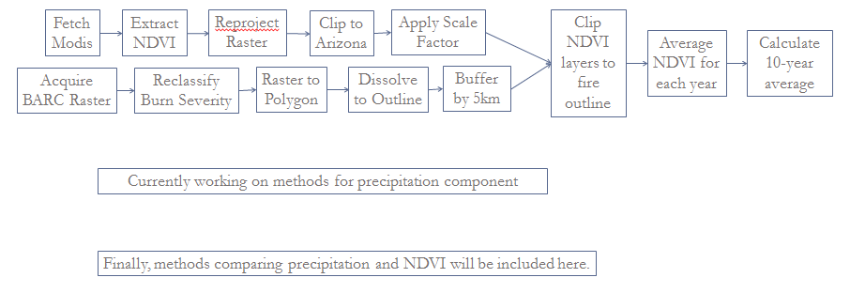
Methodology

Slide 6
NOAA Climate Data Records
Precipitation Estimation From Remote Sensing Information Using Artificial Neural Network (PERSIANN) – Climate Data Records (CDR)
PERSIANN CDR Specifications:
0.25 – deg * 0.25 deg
Daily Product
1983 – present
Updated Quarterly
Inputs to the PERSIANN CDR:
GridSat – B1 CDR (IRWIN)
GPCP 2.5 deg Monthly Data
Notes:
Image Source: Derived from PERSIANN data in ArcMap

Slide 7
Results
Results will be placed here

Slide 8
Conclusions
Conclusions will be placed here

Slide 9
Advisors
Dr. DeWayne Cecil, NOAA National Centers for Environmental Information
Partners
Dr. Gregg Garfin, Climate Assessment for the Southwest
Tim Brown, Western Regional Climate Center
Dennis Staley, USGS Landslides Hazards Team
Jason Kean, USGS Landslides Hazards Team
Others
Michael Schaffner, NWS
Christopher Smith, USGS

Slide 10
General Guidelines I
Things that are typically included in a presentation:
The slides provided in the template are just a starting point for teams. Feel free to expand upon these topics, alter the headings, and change the order of the slides to fit your needs.
Study area
Study period
Objectives
Community concerns
NASA satellites/sensors used
Methodology
Results
Conclusions
Errors & uncertainties
Future work
Acknowledgements
Backup slides
Required Statement

Slide 11
Image Credit: Monet
General Guidelines III
Include speaker notes for each slide (see below).
Include a visual on each slide, if possible.
Arrange content to minimize white space.
Notes:
These notes should be thorough enough for someone not familiar with the project to clearly present the material.
Image Source: http://commons.wikimedia.org/wiki/File:Claude_Monet_-_The_Magpie_-_Google_Art_Project.jpg

Slide 12
Maps & Logos
Maps
Import the legend separately.
Make sure all text is legible and editable.
Cite base layer source in speaker notes.
Logos
US Federal logos only.
No state, NGO, local and or international government logos, or software logos.

Slide 13
Photos & Figures I
You may only use images taken by your team, provided by your partners (as long as you have permission from them), from a Federal Agency, from the new DEVELOP stock imagery collection on DEVELOP’s Flickr page, or Creative Commons images.
Obtain a media release form from all people in photos that your team has taken — no children!
All image sources should be cited using a consistent format and should be visible on the slide.

Slide 14
Photos & Figures II
Please do not include the image URL in the source text box but rather place it in the notes section below.
If you use a border for your images include it on all photographs to keep your presentation consistent.
Keep all images and text boxes editable, including individual elements of flowcharts.
Background images are discouraged. If you use one, make sure that your text remains clear and legible.

