Slide 1
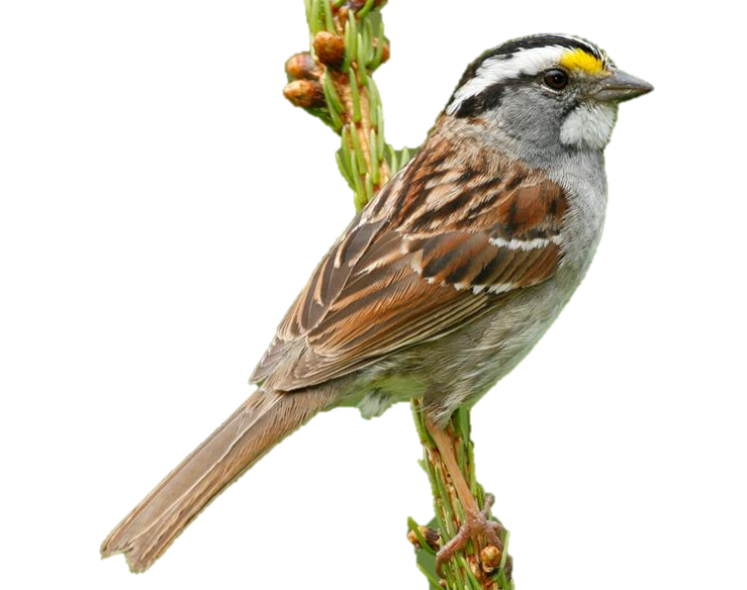
New England Ecological Forecasting Investigating the Effects of Forest Fragmentation on Songbird Populations in New England
NASA DEVELOP (GSFC)
Summer 2014
Alec Nelson (Middlebury College)
Kiersten Newtoff
(UNC Wilmington)
Sam Weber
(Virginia Tech)

Slide 2
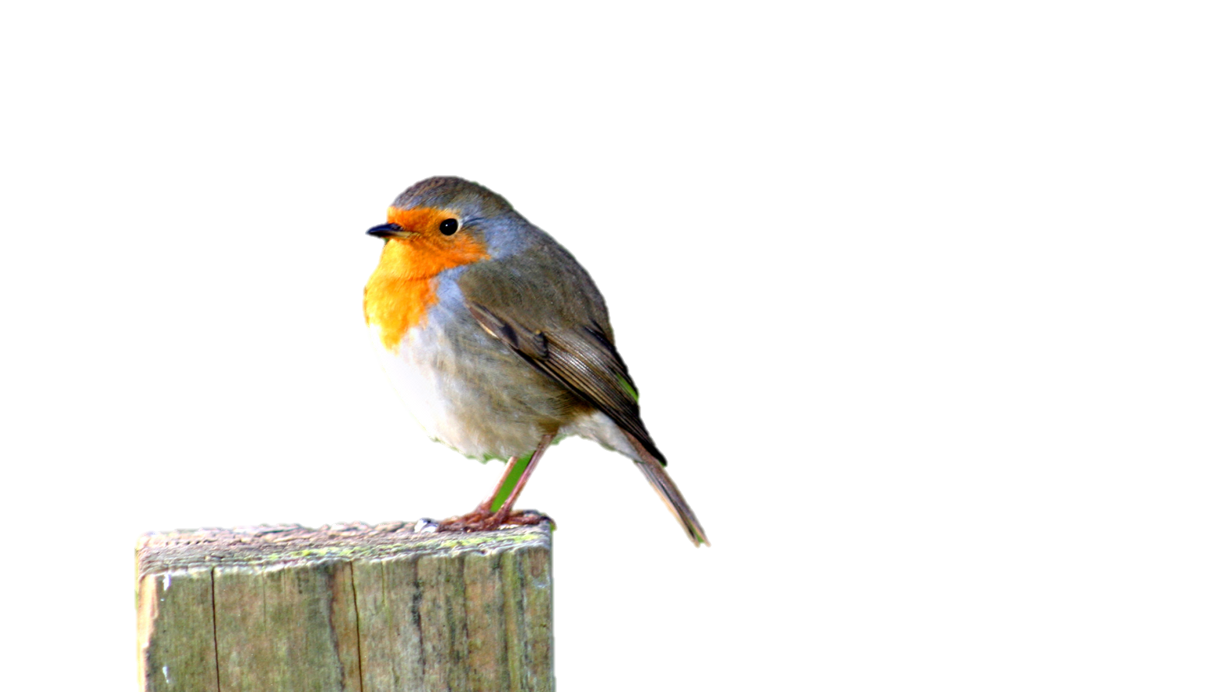
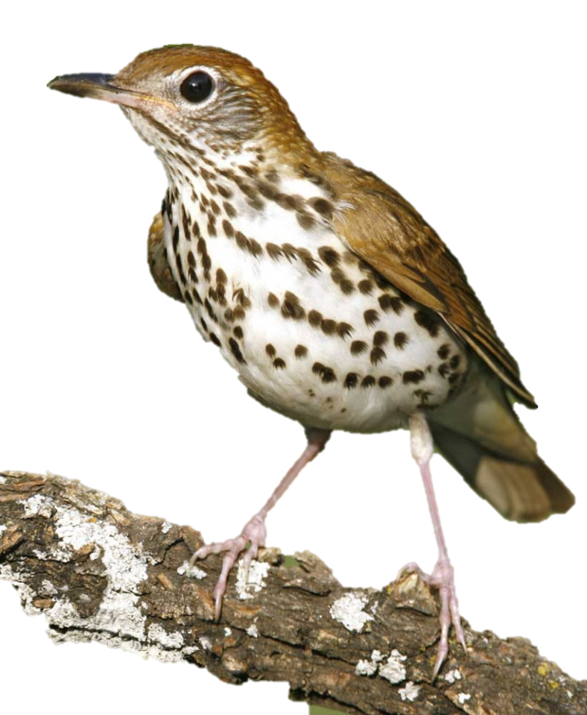
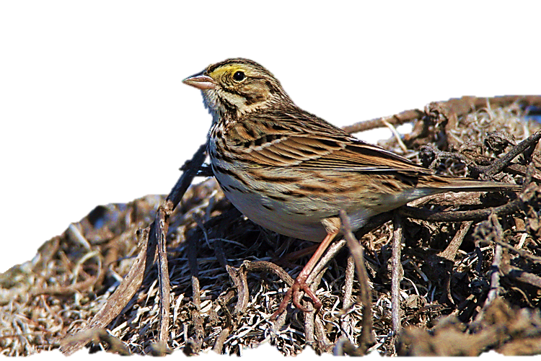
Why Birds?
Important Trophic Link
Sensitive to Changing Habitat
Critical Monitor of the Environment
Notes:
Fragile habitats and diets, indicators of overall ecological health, diversity, and change

Slide 3
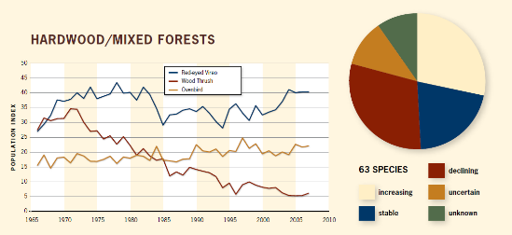
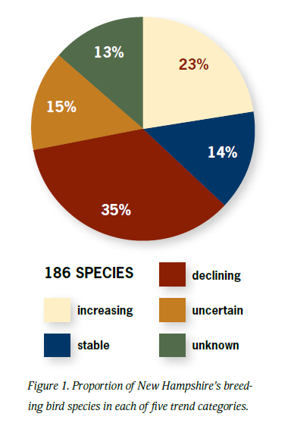
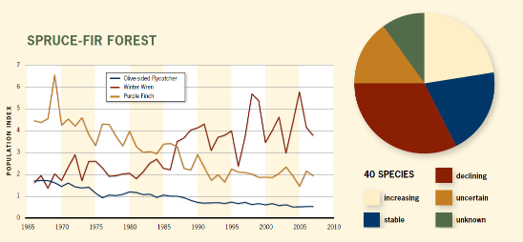
Recent Population Trends
Hunt. P.D., M.D. Watkins, R.W. Suomala. 2011. The State of New Hampshire’s Birds – A Conservation Guide. New Hampshire Audubon, Concord, NH
Notes:
Spruce-Fir forests and Hardwood/Mixed forests are seeing about 33% of their bird species in decline

Slide 4
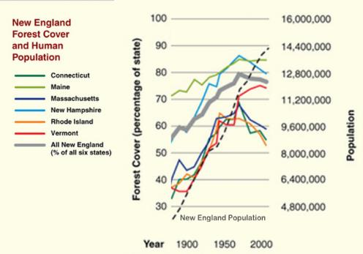
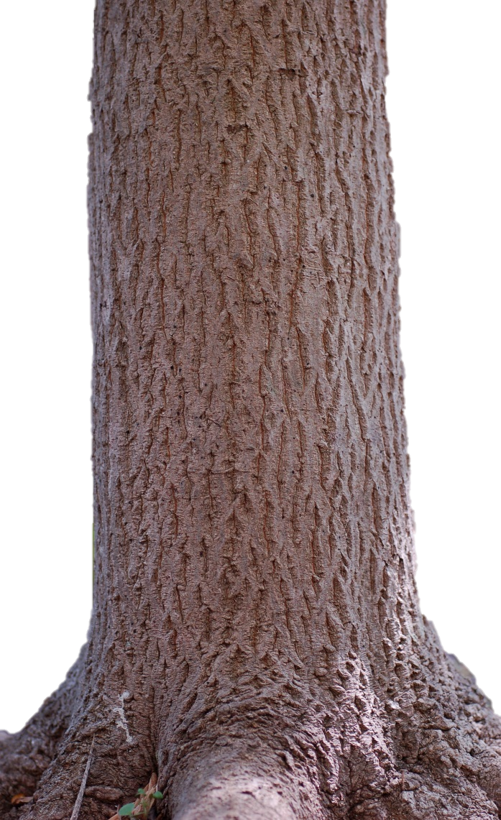
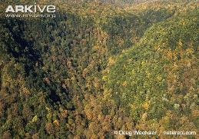
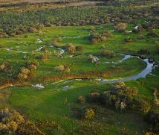
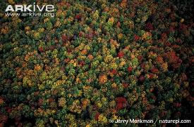
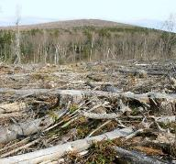
Forest Fragmentation
Hunt. P.D., M.D. Watkins, R.W. Suomala. 2011. The State of New Hampshire’s Birds – A Conservation Guide. New Hampshire Audubon, Concord, NH
Notes:
If vegetation composition, forest structure, or climate changes, so too do songbirds, making them worth caring about and conserving

Slide 5
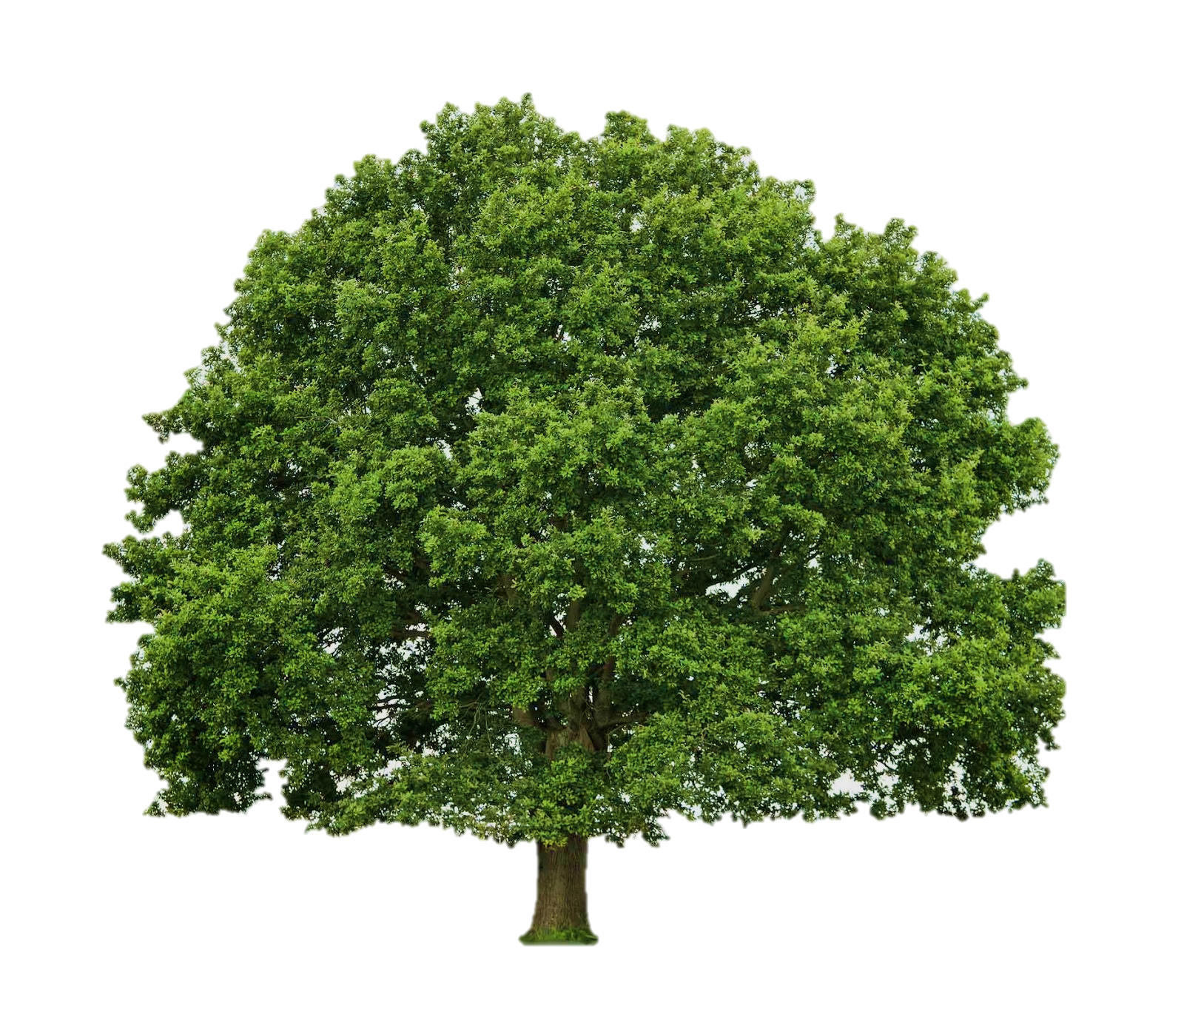
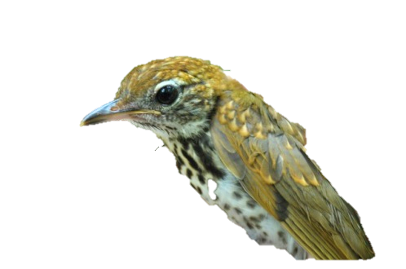
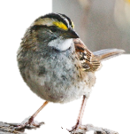
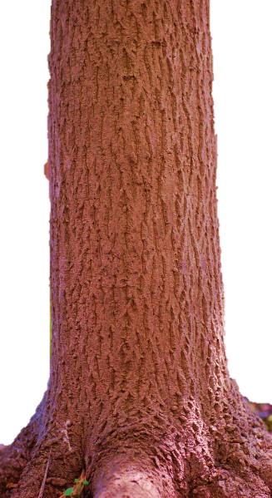
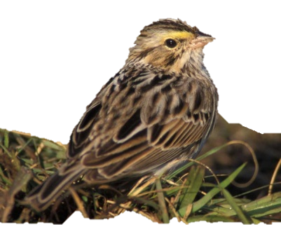
Objectives:
To determine the fragmentation factors affecting the
initial occupancy,
local colonization, and
local extinction
of songbird species with different life histories using an occupancy model.
Notes:
Where and how it applies to the BBS data

Slide 6
Study Area
New England
(Bird Conservation Region 14)
100 Routes in Breeding Season (May – June)
Between 2001 and 2011
Notes:
Average patch size, number of patches, percent forest cover

Slide 7
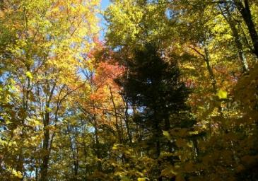
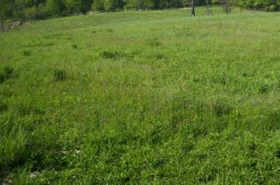
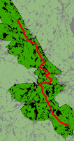
Model Inputs
Fragmentation Factors
Vegetation Quality
NLCD
(Breeding Bird Survey)
2001, 2006, 2011
NDVI
(Normalized Difference Vegetation Index)
Average Patch Area
Number of Patches
Percent Forest Cover
Patch Edge
Bird Presence (Detection)
BBS
(Breeding Bird Survey)
latitude
20°
25°
45°
50°
Notes:
How/why we clumped NLCD data into forest/nonforest and buffered the BBS routes at 400m

Slide 8
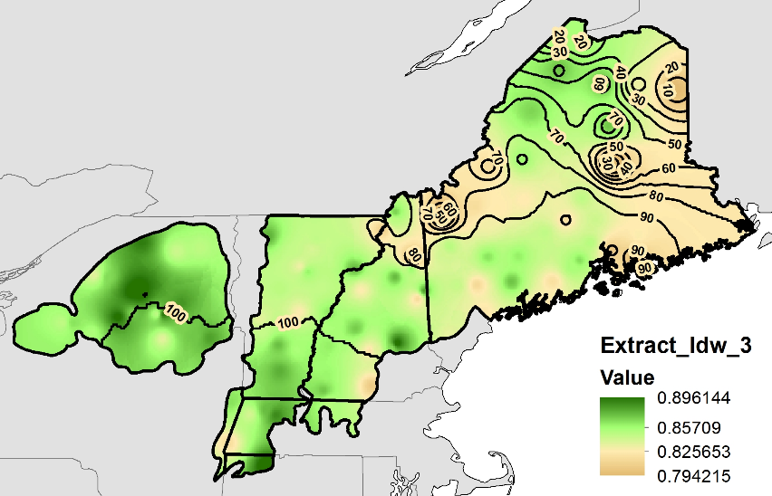
Results – Model Outputs
Percent Likelihood of Initial Occupancy (ψ)
of the Wood Thrush
NDVI
0.896
0.794
Notes:
Summarize results table to show reliance on forests, map and table

Slide 9
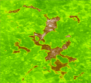
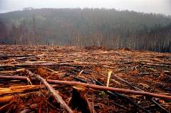
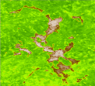
Ecological Forecasting – Wood Thrush
At high latitudes, wood thrush occupancy is highly influenced by NDVI
Aqua
Currently:
0.89 NDVI
56%
1%
0.81
0.89
Deforested for Development:
0.81 NDVI
$$ψ=\frac{1}{1+ e^{−2.12 − \left(0.88−(2.80{∗x}_{Lat}\right)−(2.98∗x_{NDVI}))}}$$
Notes:
http://www.myenvironment.net.au/var/corporate/storage/images/media/images/salvage_logging_151/7236-1-eng-AU/salvage_logging_151.jpg

Slide 10
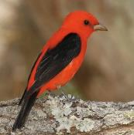
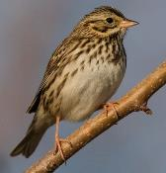
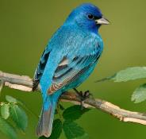
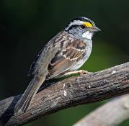
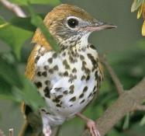
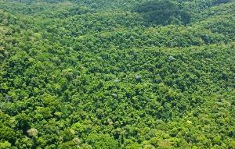
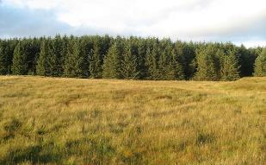
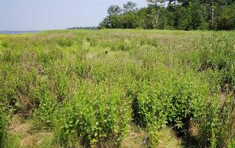
Conclusive Thoughts and the Future
With continued forecasting through NASA EOS, we can better understand the factors critical to our changing ecosystems.
Notes:
Same methodology can be applied to Landsat 8 to deliver the most recent, local information avaliable

