Slide 1
Colorado River Basin
Water Resources
Pairing Phenology Citizen Science Observations with NASA Earth Observations to Monitor Riparian Vegetation
Tyler Pantle, Camille Blose, Brenna Challis, Daniel Dominguez
Colorado – Fort Collins
Notes:
[Introduce the project]
Brenna: Hi everyone, thank you for joining us today. We are excited to share our project with you all! We are the Water Resources Team from the Colorado, Ft Collins node. Team introductions . Our project focused on pairing citizen science observations of phenological processes with NASA Earth Observations. The purpose of this was to determine the feasibility of integrating these different data sources for the purpose of monitoring riparian vegetation.

Slide 2
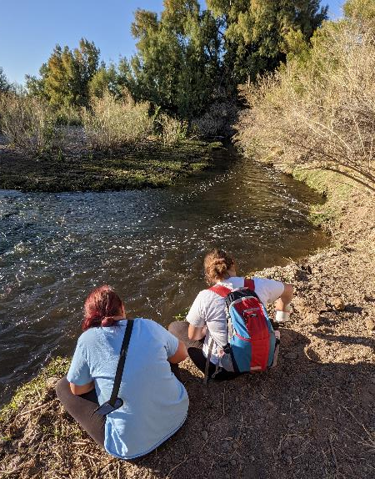
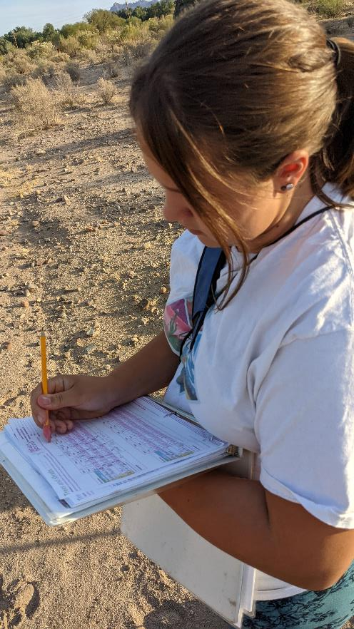
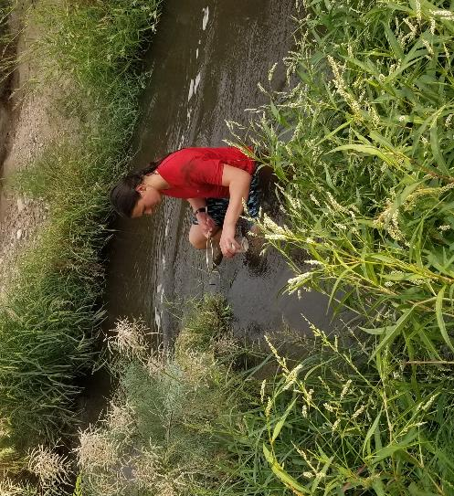
Citizen Science in the Colorado Basin
More than 240,000 square miles that include:
12 ecologically distinct regions
Critical native vegetation threatened by invasive species
Riparian zones provide wildlife habitats, bank stabilization, and water purification
Credit: Kathy Balman
Notes:
Brenna: The CO River Basin is a large watershed, containing valuable water resources and vegetation communities that support the health of the Colorado river. Due to the size of the basin, monitoring its entirety would be challenging for any agency to accomplish by themselves. Therefore, it is necessary for organizations to partner with each other to accomplish this daunting task. Citizen scientists can help provide vital ground observations that help remote sensing scientists build more accurate models to help monitor the basin. Observations of phenology allow us to graph the life cycle of plants year after year, this can be compared to signatures that plants reflect back to the satellites.
------------------------------Image Information Below ------------------------------
Image Credit: Kathy Balman - Educating Children Outdoors (written permission and media release forms)

Slide 3
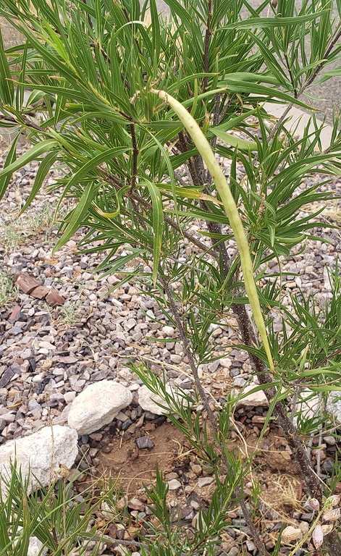
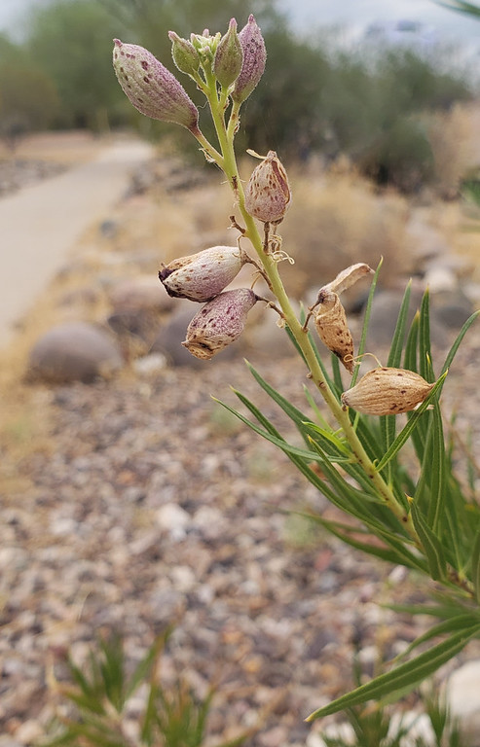
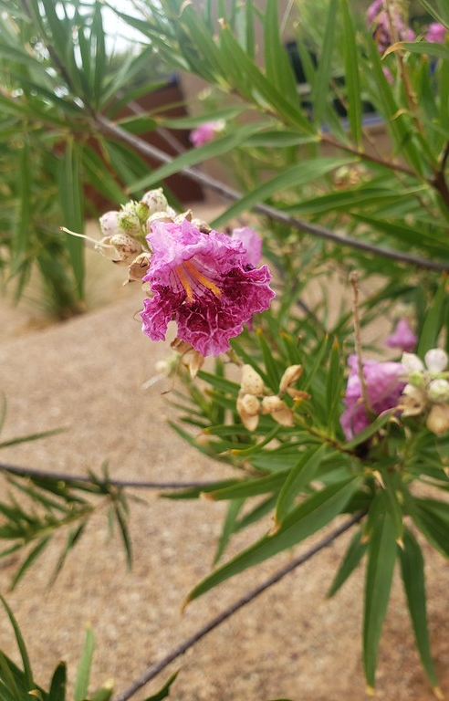
Phenology Background
Phenology is the temporal occurrence of plant development stages, given in phenophases
Satellites can detect the intensity of light reflectance coming from plants
Phenophases correspond to these wavelengths
Desert Willow Phenophases
Credit: Sara Schaffer
Notes:
ALTERNATE 2: In case neither of the previous maps work.
Brenna: Now let’s get into the science of monitoring plants. Phenology is the study of the temporal occurrence of developmental plant stages called phenophases. A phenophase can be classified into different categories, such as leaves, budding flowers, or flowers. Ideally, the measured reflectance of the leaves obtained from satellite imagery will correspond to the phenophase observed on the ground. Measuring phenology throughout the year, over many years, gives us robust data to analyze and contributes to studies analyzing phenological shifts and the drivers that induce changes in the timing of these cycles.
------------------------------Image Information Below ------------------------------
Image Credit: Sara Schaffer via Theresa Crimmins (NPN) – written permission

Slide 4
Objectives
Identify
high-quality NPN & ECO study sites to plot phenological observations
Extract
spectral signatures of phenological changes in riparian vegetation using NASA Earth observations
Assess
feasibility of integrating citizen science with remote sensing
Credit: Icon Finder
Notes:
Camille: Citizen science datasets are incredibly valuable sources of information, but they’re not necessarily setup with the intent of being used with satellite imagery. The overarching goal of our project is to explore whether they could, in fact, be paired with Earth observations so that remote sensing scientists can begin leveraging these datasets. To accomplish this, we established 3 core objectives:
First, we identified both the sites and species we wanted to focus on in our study based on the depth of observations in given years.
Secondly, we used NASA and European Space Agency Earth observations to extract annual spectral signals at our study sites in the form of vegetation indices, showing changes in vegetation reflectance throughout the year.
Third, we brought these two data together and assessed how the citizen science phenology observations aligned with the remotely sensed phenology observations.
Image Citations:
Magnifying Glass. Attribution 3.0 Unported (CC BY 3.0). Chanut is Industries. https://www.iconfinder.com/icons/2921811/analyzing_business_data_analysis_information_research_review_statistics_icon
Computer with bars. Attribution 3.0 Unported (CC BY 3.0). Chanut is Industries. https://www.iconfinder.com/icons/2921803/chart_data_growth_infographic_information_presentation_statistics_icon
Collaboration arrows. Attribution 3.0 Unported (CC BY 3.0). Chanut is Industries. https://www.iconfinder.com/icons/2921805/communication_community_connection_diversity_exchange_networking_relationship_icon

Slide 5
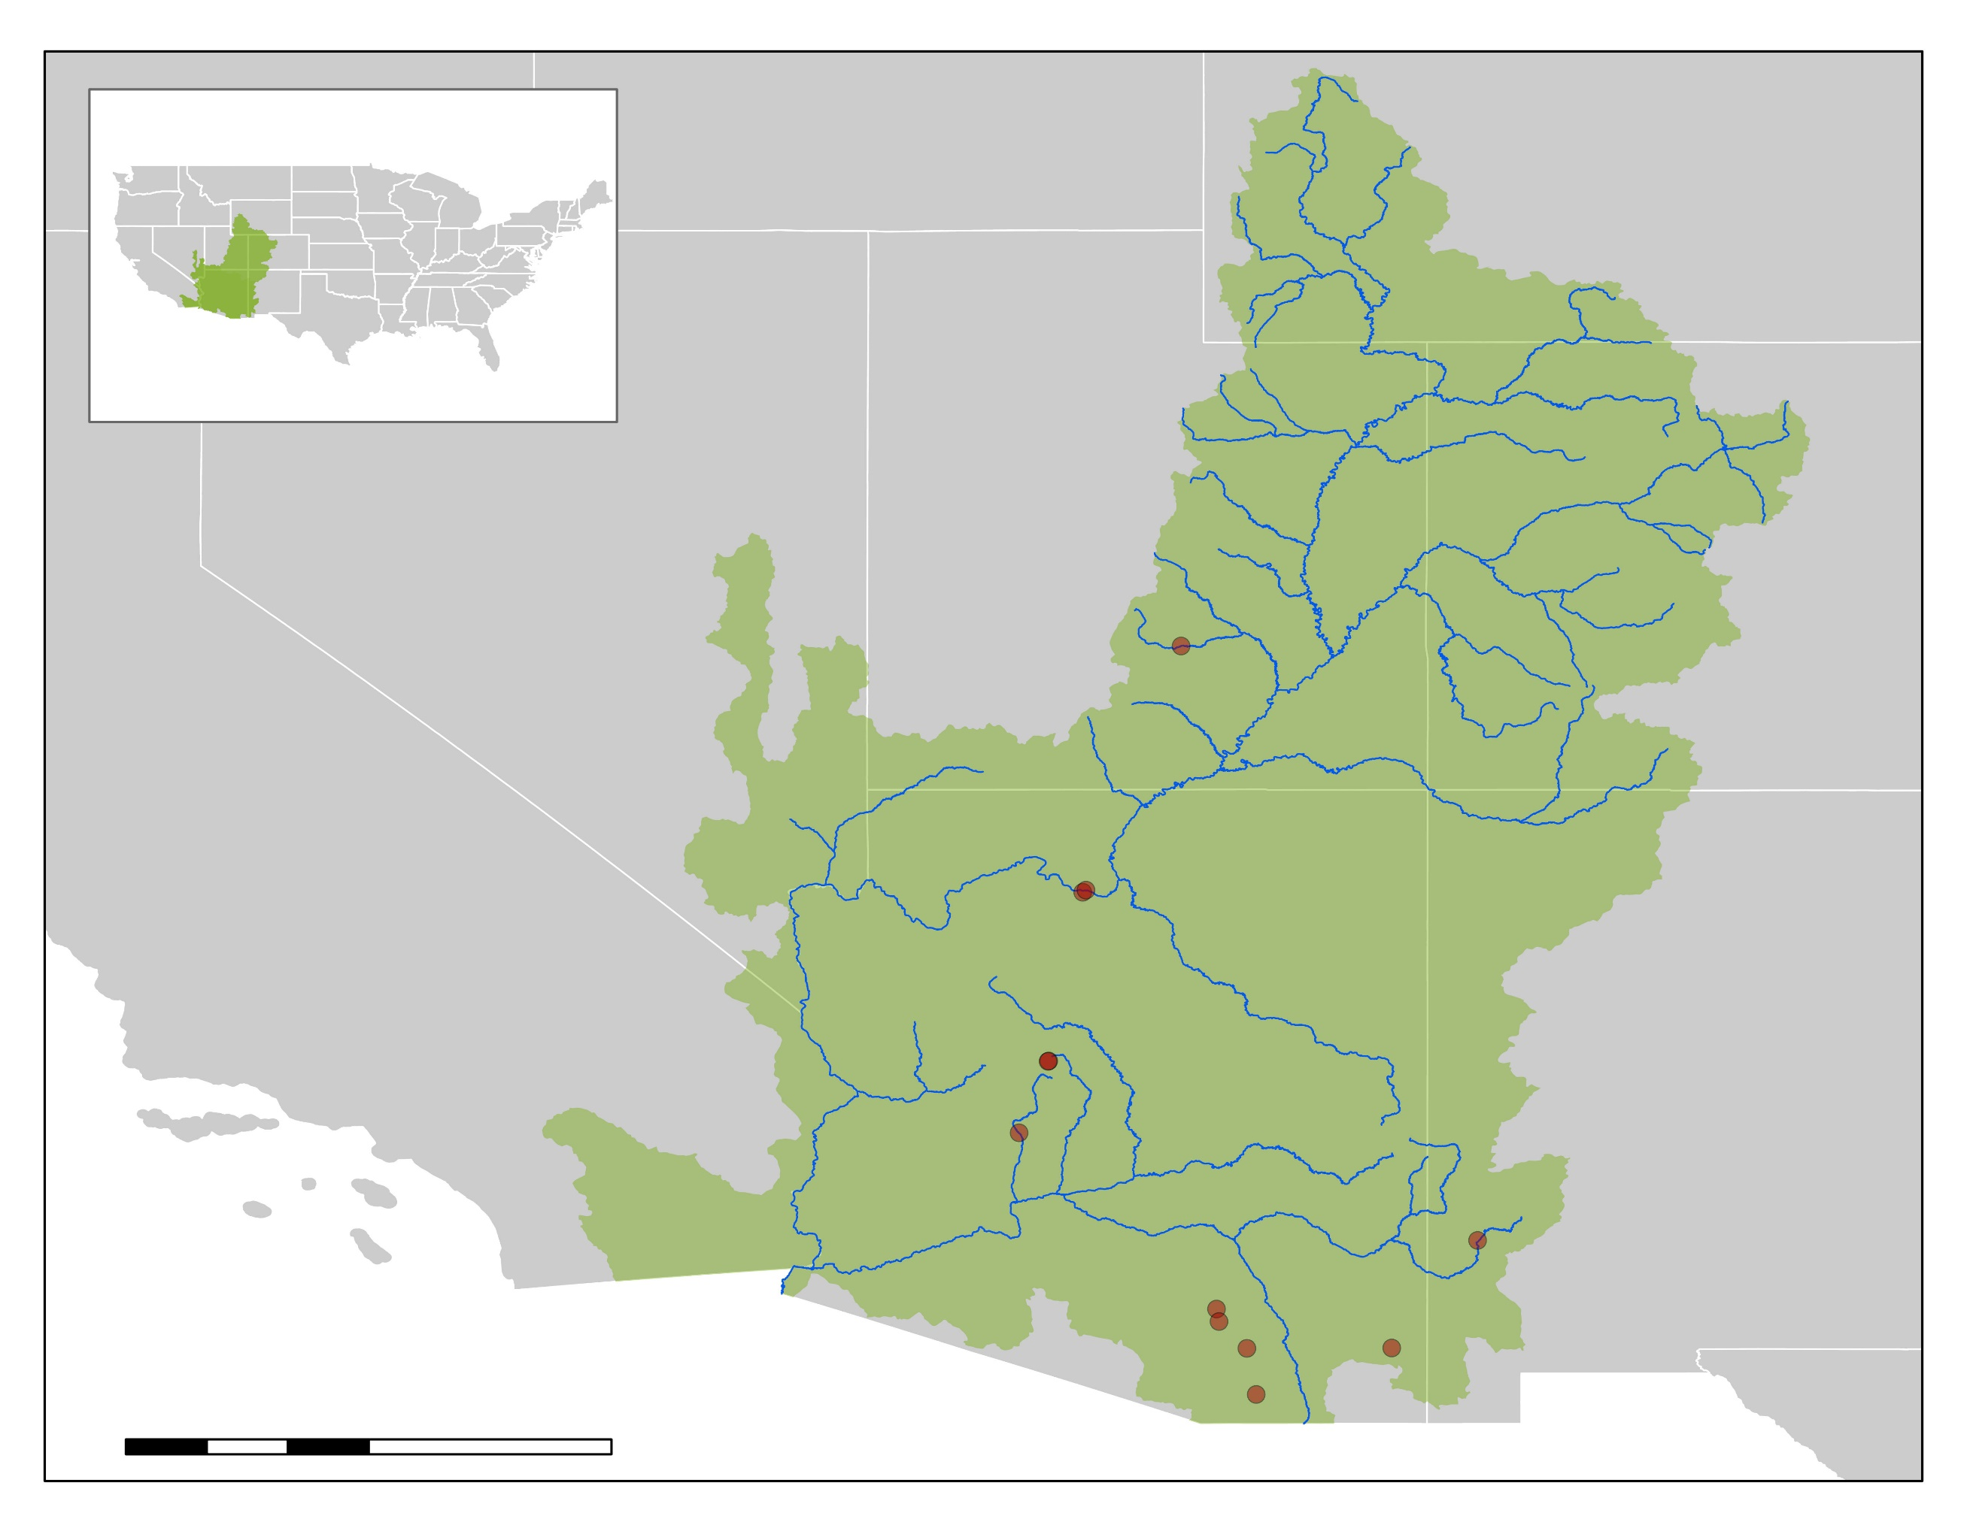
Study Area & Period
In-depth location monitoring at select sites in Arizona, Utah, and New Mexico
Phenology Data from March 2013 – January 2021
One site selected in Nevada for comparative analysis outside the basin
Study Sites
Rivers
Colorado Basin
0
75
150
300
Miles
Notes:
Camille: The team explored the citizen science dataset from our partners, available from 2013 to the present, choosing sites and years that had enough available data to compare to a year’s worth of satellite vegetation measurements. Due to robust observations in Phoenix, AZ, sites closer to this hub have more available data. This pattern was reflected when we explored the available data and selected sites in Arizona, Utah, and New Mexico for in-depth analysis.

Slide 6
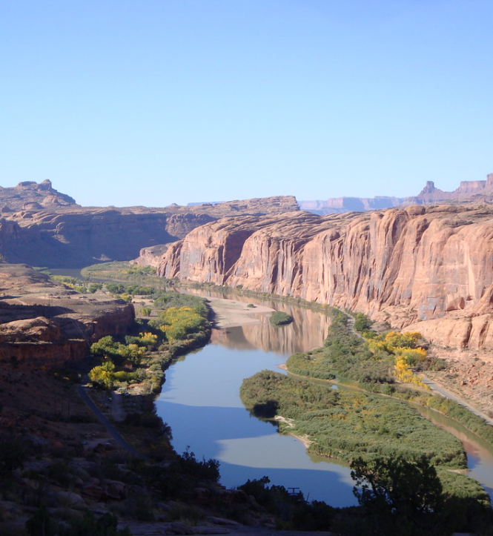
Partners
USGS Fort Collins Science Center
USGS node focused on developing tools and disseminating scientific information
USA National Phenology Network
Nation-wide program, Nature’s Notebook, collecting phenology data on the ground with citizen science
Educating Children Outdoors
Outdoors science education program helping children (5-18 years old) explore nature
U.S. Geological Survey
Notes:
Tyler: Our partners for the project consist of a government agency, in the United States Geological Survey, and two private institutions, the National Phenology Network and Educating Children Outdoors. The USGS Fort Collins Science Center is focused on developing ecological tools and providing information to the public. The National Phenology Network, or ‘NPN’ for short, has been collecting phenology observations with citizen scientists since 2007 and has built an extensive repository of on-the-ground data. Educating Children Outdoors, or ‘ECO’, encourages children from ages five to eighteen to explore the outdoors near their homes, educates them while doing so, and contributes observations to NPN. Importantly, one of the great things about all of our partners is that they’re all involved in engaging their local community and educating their members on scientific matters.
------------------------------Image Information Below ------------------------------
Image Credit: U.S Geological Survey
Image Source: "Colorado River from Moab Rim" by U.S. Geological Survey is marked under CC PDM 1.0. To view the terms, visit https://creativecommons.org/publicdomain/mark/1.0/

Slide 7
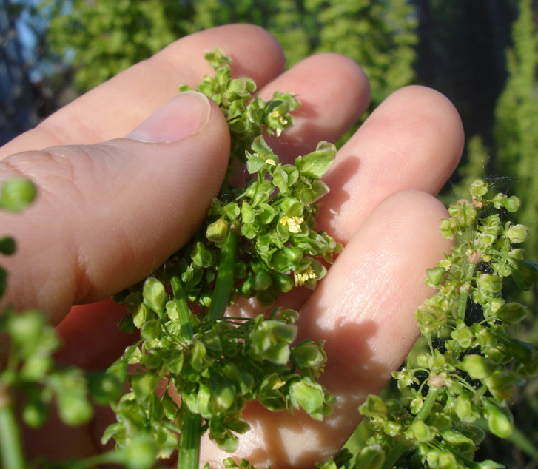
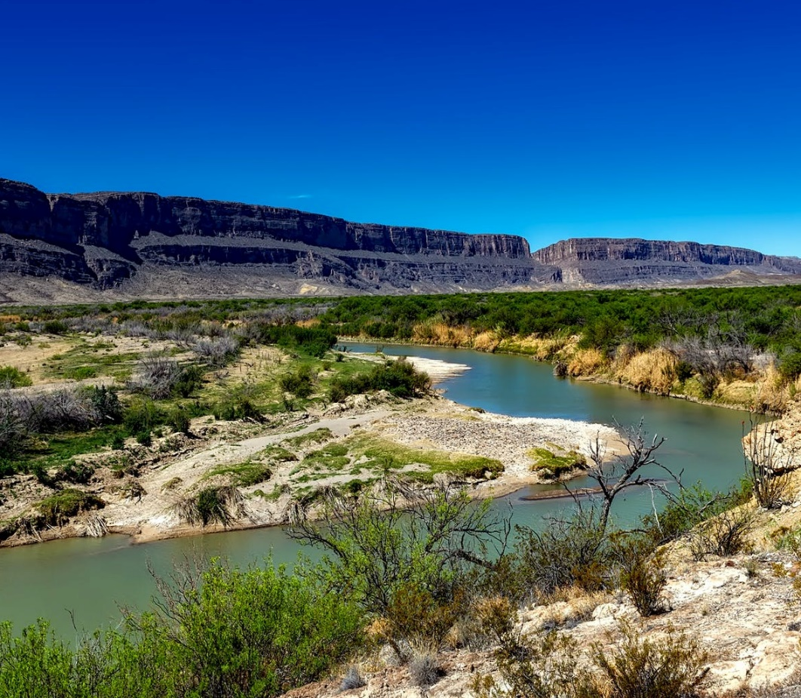
Community Concerns
Credit: Abigail Woods
Credit: Pexels
Credit: Pexels
Monitoring Riparian Species
Citizen Science Applications
Data Collection
Notes:
Tyler: The main concerns from the community revolve around monitoring riparian species to ensure that the native fauna in the basin continue to thrive in the face of threatening invasive plants. Identifying and tracking the growth of native species is a critical part of this concern.
In doing this, we also sought to expand the applications of citizen science. Partners, as well as citizens, want to know the feasibility of integrating their research with satellite data and exploring this novel integration of data sources opens the door for future studies using citizen science.
To that point, it’s important to remember that the feasibility of combining citizen science with satellite imagery is only beginning to be explored and that citizen science data are not collected with the intent of being paired with satellites. Previous studies have been carried out on local and continental scales, but not at the watershed scale so this study will provide us with a new understanding for using data at this level and allow us to make recommendations for future data collection that can be paired with remote sensing.
------------------------------Image Information Below ------------------------------
Image 1 Credit: Pexels – Creative Commons 0 license (CC0) (https://www.pexels.com/photo/body-of-water-between-2-mountains-under-clear-sky-during-daytime-164236/)
Image 2 Credit: "Russian Olive (Elaeagnus angustifolia)" by GlacierNPS is marked under CC PDM 1.0. To view the terms, visit https://creativecommons.org/publicdomain/mark/1.0/
Image 3 Credit: Pexels – Creative Commons 0 license (CC0) (https://www.pexels.com/photo/calculator-and-pen-on-table-209224/)

Slide 8
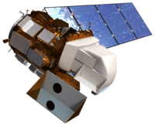
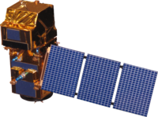
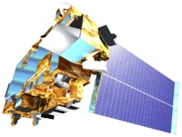
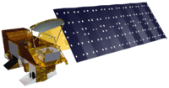
Satellites
Landsat 8 Operational Land Imager (OLI)
NDVI and EVI
Sentinel-2 MultiSpectral Instrument (MSI)
NDVI and EVI
Aqua & Terra Moderate Resolution Image Spectroradiometer (MODIS)
Global Phenology and NDVI products
Spectral Indices
NDVI - Normalized Difference Vegetation Index
EVI - Enhanced Vegetation Index
Credit: NASA
Notes:
Daniel: For this project, we leveraged the capabilities of four satellites: Landsat 8, Aqua, and Terra from NASA and Sentinel-2 from the European Space Agency. We used Landsat and Sentinel as our primary measurements of NDVI and EVI, two vegetation indices that are photosynthetic measurements of a plant’s greenness. These indices were used to track remotely sensed phenology and were compared to on-the-ground citizen science phenology observations. We also used MODIS combined products that were created by combining Aqua and Terra data. The first product was monthly NDVI which provided an additional NDVI metric, and the second product was a global phenology product which provided dates of remotely sensed green-up, maximum greenness, and senescence. The dates of these events were compared to both the other satellite measurements as well as the citizen science observations.
------------------------------Image Information Below ------------------------------
All satellite images: NASA DEVELOP - http://www.devpedia.developexchange.com/dp/index.php?title=List_of_Satellite_Pictures

Slide 9
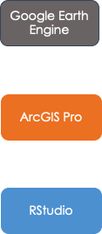
Methodology
Select and filter satellite imagery
Inspect sites for one 30 m pixel of vegetation cover
Plot NDVI and EVI
Trim site list based on available data and species
Finalize list of study sites
Buffer satellite pixel size
Combine end products and analyze for phenology trends
Filter data to "present" observations
Reclassify
phenophase
description
Plot phenophase
event timelines
Data Acquisition
Data Processing
Visualization
Data Analysis
Notes:
Camille: The project workflow took place on three platforms, Google Earth Engine, ArcGIS Pro, and R Studio with four distinct phases: Data Acquisition, Processing, Visualization, and lastly Data Analysis. Data acquisition included filtering the data to only have observations with present phenophases, and trimming the site list based on available data and species at those site. With data processing, we further narrowed down the sites to the Colorado River Basin study area and manually selected sites that would correspond to accurate plant reflectance measurements, excluding sites in heavily urbanized areas. The remaining data was processed manually by observing the In conjunction, both the Nature's Notebook and USA-NPN phenometric datasets were reclassified into qualitative phenophase descriptions to better visualize the data. The final list of sites was then selected through analysis of the temporal spread of the remaining data so that we could capture the variability that occurs across the basin. Using these sites, yearly NDVI and EVI were plotted with the phenophase observations to correlate the citizen science data with remotely sensed imagery. Lastly the visualizations of each platform were overlayed to be able to compare citizen science observations to NASA Earth Observations.
Notes:
We are not cleaning out erroneous data, we just want to view the data and see which points are the strongest.
Put less emphasis on the modelling, because we are focused on the pre-modelling portion of data.

Slide 10
Methodology
Data Acquisition
Processing
Visualization
Analysis
Reclassify phenophase values to categorical descriptions
Combine end products and analyze for phenology trends
Filter NPN data based on presence and frequency of observations
Separately plot NDVI/EVI metrics and phenophase event timeline for final sites
Visually select sites with high proportion of vegetation cover within a 30 m pixel
Notes:
Camille: The project workflow took place on three platforms, Google Earth Engine, ArcGIS Pro, and R Studio with four distinct phases: Data Acquisition, Processing, Visualization, and Analysis. Data acquisition included filtering the data for observations with present phenology descriptions and for sites with a high frequency of observations. With data processing, the phenometric datasets were reclassified into categorical phenophase descriptions for future visualization purposes. In conjunction, we further narrowed down the sites to the Colorado River Basin study area and visually selected sites that lie in areas with a high proportion of vegetation cover, excluding sites in heavily urbanized areas. After this process we end up with a final list of sites that have the most associated observations and that would correspond to pixels with high plant reflectance measurements. Using this final site list, phenophase observations were plotted in order to visualize when changes in phenology occurred throughout the year. Separately, NDVI and EVI were plotted for the same date range, utilizing satellites in Google Earth Engine. Lastly the visualizations of each platform were overlaid to compare citizen science data to NASA Earth Observations.
Notes:
We are not cleaning out erroneous data, we just want to view the data and see which points are the strongest.
Put less emphasis on the modelling, because we are focused on the pre-modelling portion of data.

Slide 11
Methodology
Data Acquisition
Processing
Visualization
Analysis
Reclassify phenophase values to categorical descriptions
Combine end products and analyze for phenology trends
Filter NPN data based on presence and frequency of observations
Separately plot NDVI/EVI metrics and phenophase event timeline for final sites
Visually select sites with high proportion of vegetation cover within a 30 m pixel
Notes:
Camille: The project workflow took place on three platforms, Google Earth Engine, ArcGIS Pro, and R Studio with four distinct phases: Data Acquisition, Processing, Visualization, and Analysis. Data acquisition included filtering the data for observations with present phenology descriptions and for sites with a high frequency of observations. With data processing, the phenometric datasets were reclassified into categorical phenophase descriptions for future visualization purposes. In conjunction, we further narrowed down the sites to the Colorado River Basin study area and visually selected sites that lie in areas with a high proportion of vegetation cover, excluding sites in heavily urbanized areas. After this process we end up with a final list of sites that have the most associated observations and that would correspond to pixels with high plant reflectance measurements. Using this final site list, phenophase observations were plotted in order to visualize when changes in phenology occurred throughout the year. Separately, NDVI and EVI were plotted for the same date range, utilizing satellites in Google Earth Engine. Lastly the visualizations of each platform were overlaid to compare citizen science data to NASA Earth Observations.
Notes:
We are not cleaning out erroneous data, we just want to view the data and see which points are the strongest.
Put less emphasis on the modelling, because we are focused on the pre-modelling portion of data.

Slide 12
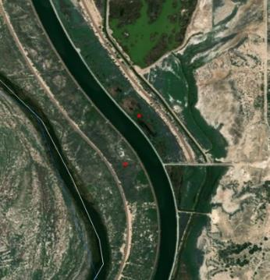
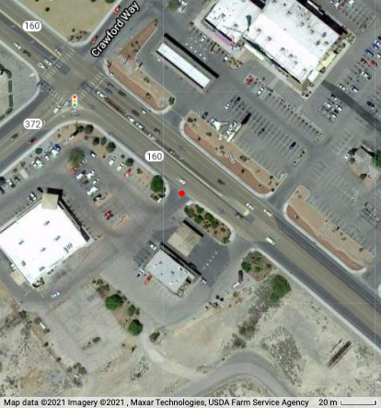
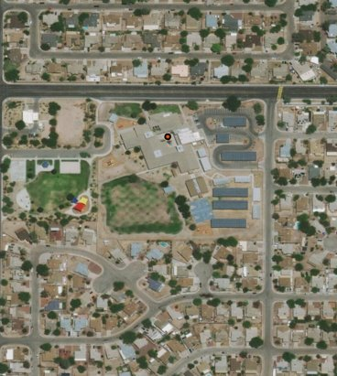
Site Selection
Example of a Usable Site | Example of an Unusable Site
Open space Good vegetation cover Away from large human-made structures Can extract pixel (10-30m) from satellite images | Urban area Mostly consists of human-made structures Vegetation cover too sparse for one pixel (10-30m)
N
N
Basemap: ESRI and Partners
Basemap: ESRI and Partners
Notes:
Brenna: When selecting the final sites, the main priority was to select sites which had the greatest chance of being compatible with satellite imagery. This meant focusing more on sites like the one on the left, showing the Arizona side of the Colorado River, where there is a much more homogenous group of vegetation. The reason for this is that Sentinel and Landsat imagery have a resolution of 10m and 30m, respectively, which means that the signal of everything within those 10-30m pixels will be averaged together into one value for the entire pixel. So while sites, like the one on the right, located west of Las Vegas, Nevada, have great data because of the site's accessibility, they cannot be used for our purposes because they are located in a primarily urban area, the signal of that pixel will more closely resemble the roads and buildings rather than the plants along the sidewalk.

Slide 13
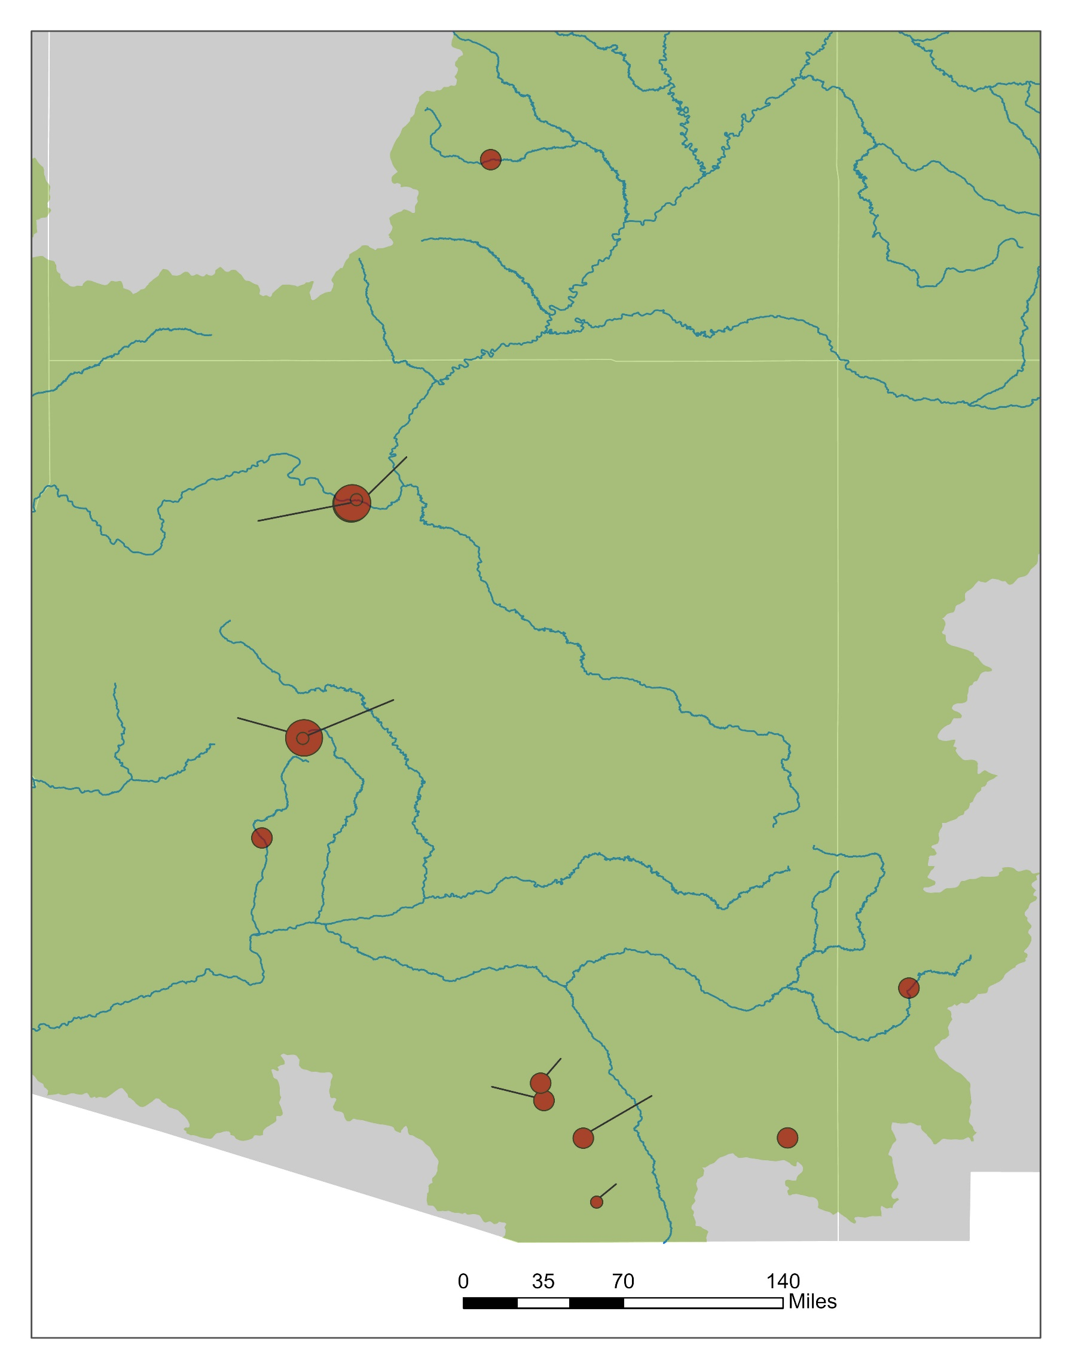
Final Selected Sites
% of total observations used for analysis
23-41%
Chestnut Picnic Area
Sites filtered from the original NPN dataset by:
Analyzing point location with respect to surrounding land cover
Count of observations at each site
Full year of observations
41-62%
62-83%
Indian Garden (Lower & Upper)
Phantom Ranch
Watson Woods N
Watson Woods S
Site Name | Lat. | Long. | Date | Species | Pheno-phase | Intensity Value
Tucson Trail | 32.01 | -110.66 | 2/8/18 | Fremont Cotton | Breaking Leaves | > 95%
Tucson Trail | 32.01 | -110.66 | 8/20/18 | Fremont Cotton | Leaves | > 95%
Tucson Trail | 32.01 | -110.66 | 10/22/18 | Fremont Cotton | Leaves | > 95%
Tucson Trail | 32.01 | -110.66 | 11/19/18 | Fremont Cotton | Colored Leaves | > 95%
Hassayampa River Preserve
Gila Front Yard
Middle Pima Canyon
TBG Phenology Walk
Tucson Phenology Trail
CHIR Office
Robinett/Kennedy
0
35
70
140
Miles
Notes:
Brenna: We narrowed down the total number of sites within the NPN dataset by first looking only at the sites within the Colorado River Basin. We then began looking at the landcover surrounding the sites - we needed sites with plenty of vegetation cover, preferably of the same species. We also needed to ensure that there were consistent and frequent observations being taken at the sites we analyzed in order to record changes in phenophases so they could be compared to remotely sensed imagery. Finally, we needed to have at least one year's worth of data for each site with consistent observations - ideally one a week. With these parameters we ended up with 12 study sites. The map here shows the final sites as well as the percent of the total observations that we used for our analysis. As you can see we were limited in the number of usable observations for our analysis based on the aforementioned parameters. This really goes to show how important it is for frequent and consistent observations to be taken. The table here is a representation of the structure of the Nature’s Notebook data.

Slide 14
Results: Phenology in Remote Sensing Images
Google Earth Engine Time Series
NDVI and EVI time series graphs in multiple formats
Input coordinates of study site
Cloud-masked imagery measured mean NDVI and EVI of pixel containing site
0.25
0.20
Index Value
0.15
0.10
0.05
Apr-2018
Date
Aug-2018
Feb-2018
Jun-2018
Oct-2018
Dec-2018
Satellite
Index
Landsat
EVI
MODIS
NDVI
Sentinel
Notes:
Daniel: As you can see here in the graph, you’ll notice a general trend across all satellites and indices—at this site, vegetation begins to green-up around July/August, peaks in the fall, and then senesces in December. There is variation between both satellites and indices with Landsat and MODIS NDVI having the highest fall peaks at this particular site. We found variation in the satellite signals and indices across sites showing inconsistencies in measurements and a need to further explore the selection of a specific satellite. It’s important to note that each site is different in its physical appearance which leads to variations in these signals from site to site. Data from each site was exported to pair with the phenology data set from citizen scientists. It is important to note the NDVI and EVI indices are not representative of a particular species and that they are both calculated using different formulas and should not be directly compared. Both Fremont and Goodding’s willow are regularly observed at the Tucson Phenology Trail and making a distinction to a single species was not the goal of our project.

Slide 15
Results: Phenology & Remote Sensing
1.00
Site: Watson North
(2017)
MODIS: Green Up
MODIS: Peak Green
MODIS: Senescence Date
0.75
Index Value
0.50
0.25
0.00
Feb-2017
Apr-2017
Jun-2017
Aug-2017
Oct-2017
Dec-2017
Date
Phenophase Intensity
Remote Sensing Source and Index
Phenophase Description
95% or more
Landsat EVI
Breaking leaf buds
Sentinel EVI
Colored leaves
Landsat NDVI
Falling leaves
MODIS NDVI
Increasing leaf size
Sentinel NDVI
Leaves
Notes:
Daniel: One of the ideal sites for pairing remote sensing to citizen science data is Watson Woods North in the 2017 calendar year,
The indices plotted along the year all have a strong signal being observed by vegetation
Each circular point represents a phenophase that was marked present by citizen scientists with the triangular point representing the most prevalent marked as 95% or more in the intensity metrics. The status intensity metrics can further clarify how the phenophase correlates to the NDVI and EVI graphs.
Additionally, the accuracy of the phenology observations can be compared to the global phenology product derived from Aqua and Terra MODIS to gauge when key phenophases (Green-up, Peak-Green, Senescence) are estimated using remote sensing images.
With the main goal to detect visual cues from on the ground vegetation observations knowing the intensity of the most present phenophase can help remote sensing scientist time the acquisition of remote sensing images and correlation to change in phonologic events.

Slide 16
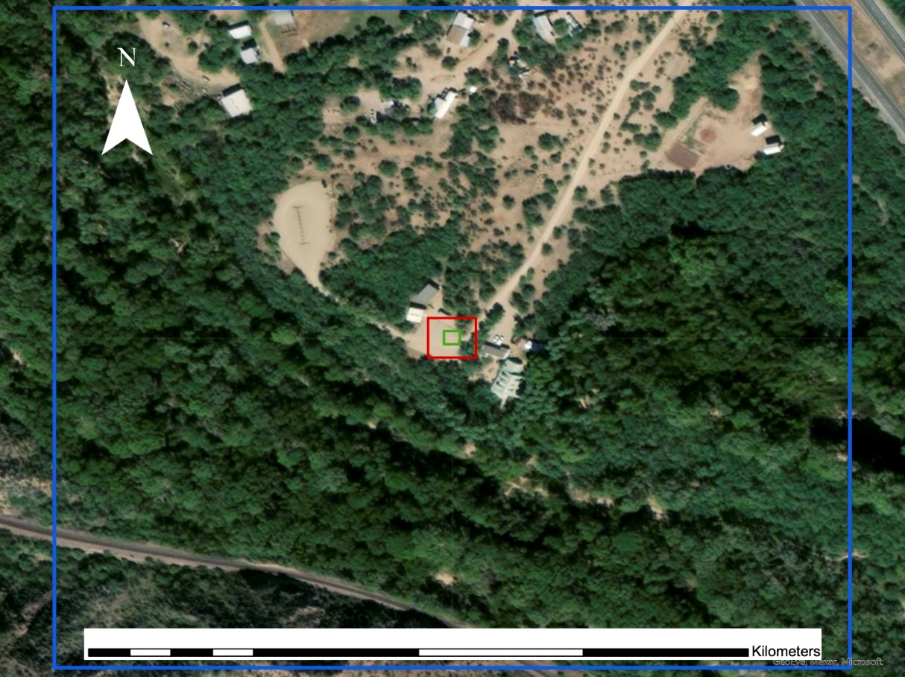
MODIS
Spatial Location Influence
Site: Hassayampa River Preserve
(2019)
1.00
Phenophase Intensity
Remote Sensing Source and Index
Phenophase Description
Sentinel-2
95% or more
Landsat EVI
Breaking leaf buds
Landsat 8
0.75
Sentinel EVI
Colored leaves
Landsat NDVI
Falling leaves
MODIS NDVI
Increasing leaf size
Sentinel NDVI
Leaves
0
0.06
0.13
0.25
0.38
0.5
0.50
Basemap: GeoEye, Maxar, Microsoft
Index Value
0.25
0.00
Feb-2019
Apr-2019
Jun-2019
Aug-2019
Oct-2019
Dec-2019
Date
Notes:
Daniel: Due to the spatial location being located in the parking lot, there is an inconsistency between satellite imagery due to pixel size variation.
The MODIS global phenology product uses a 500-m pixel which captures the majority of the vegetation in the area. However, Sentinel and Landsat images use a 10- and 30-meter pixel size respectively and the spatial point set by citizen scientist is located in the middle of the parking lot where no vegetation cover is located.
Due to the area being surrounded by vegetation it is difficult to know which fauna is being observed without generalizing the vegetation cover in the MODIS pixel.
The MODIS Global Phenology product is also unavailable for the time period being compared to citizen science data with phenophases (Green-Up, Peak-Green, and Senescence) needing to be additionally calculated by remote sensing scientists.
Although we have a consistent observation period at the Hassayampa River Preserve in 2019, The signal being observed with the Landsat and Sentinel pixels is inconsistent as can be observed by the constant oscillations.

Slide 17
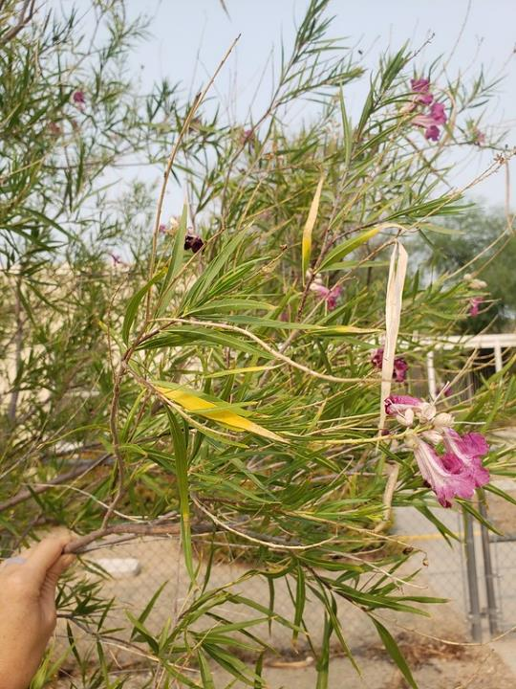
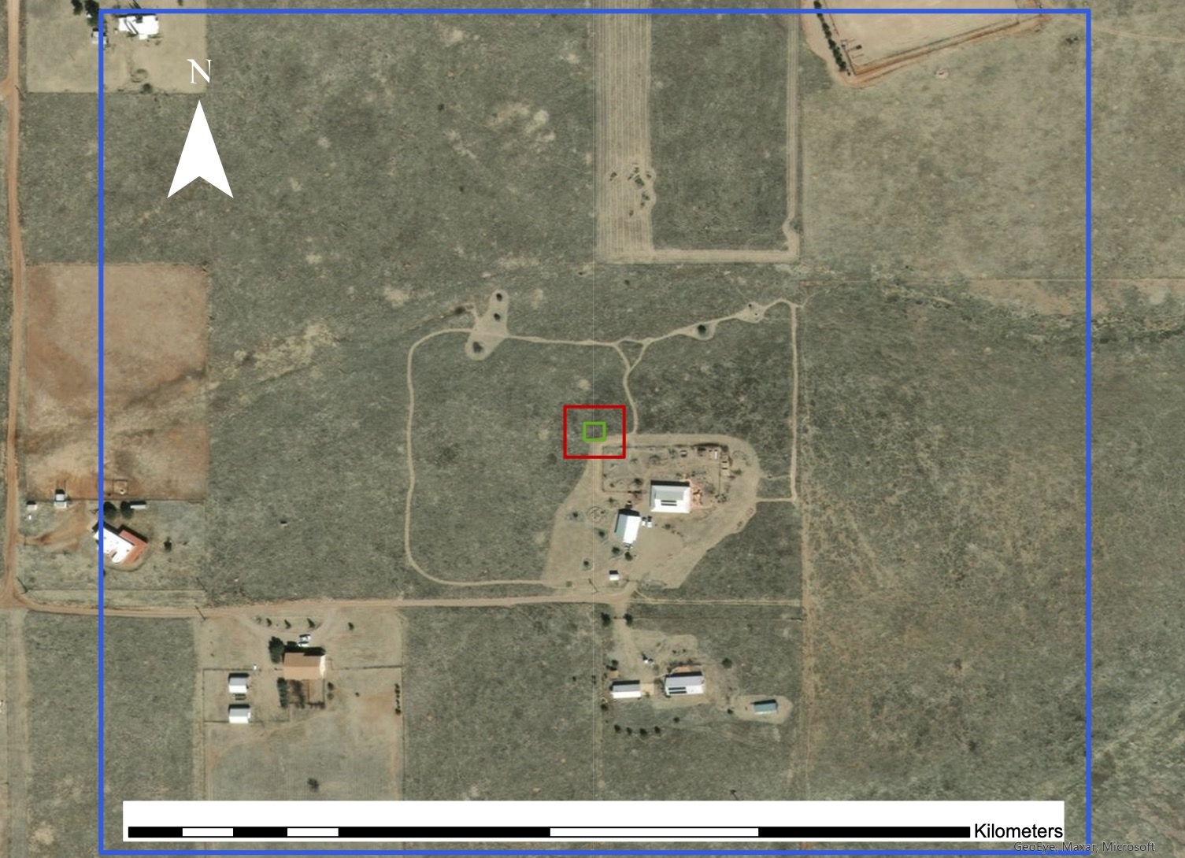
Errors & Inconsistencies
Remote Sensing
Uncertainty in vegetation signals being from species of interest
Limited to the resolution and return time of satellites
MODIS
Credit: Sara Schaffer
Sentinel-2
Citizen Science
Multiple observations of different phenophases on one date
Multiple plants and observations logged to one GPS point
Sites may be assigned multiple spatial points
Landsat 8
0
0.06
0.13
0.25
0.38
0.5
Basemap: GeoEye, Maxar, Microsoft
Notes:
Tyler: We also want to note some inconsistencies and potential sources of error with both the remote sensing and citizen science sides of the project. Daniel mentioned earlier the impact of spatial location and satellite resolution, and we want to reiterate that point and the importance of accurately logging GPS points on the ground in order to increase confidence in the accuracy of satellite signals. Additionally, satellites will vary in the amount of time it takes them to return to the same point on Earth and, when they do pass over a site, there’s always a chance that clouds impede a clear picture of the surface, creating gaps in our timeline of phenology.
On the citizen science side, we found that multiple phenophases can be observed at the same time, like in this photo that shows leaves, colored leaves, and flowers. This further underlies the need to use NPN’s phenophase intensity metric to note which phenophase is the most prominent. We also found that different species were sometimes logged to the same site under a single GPS point, making it difficult to determine which species the signal was coming from. Lastly, on rare occasions, we also found that sites may be assigned to multiple spatial points leading to further uncertainty about the true location of the site and target species.
------------------------------Image Information Below ------------------------------
Image Credit: Sara Schaffer via Thersa Crimmins (NPN) – written permission

Slide 18
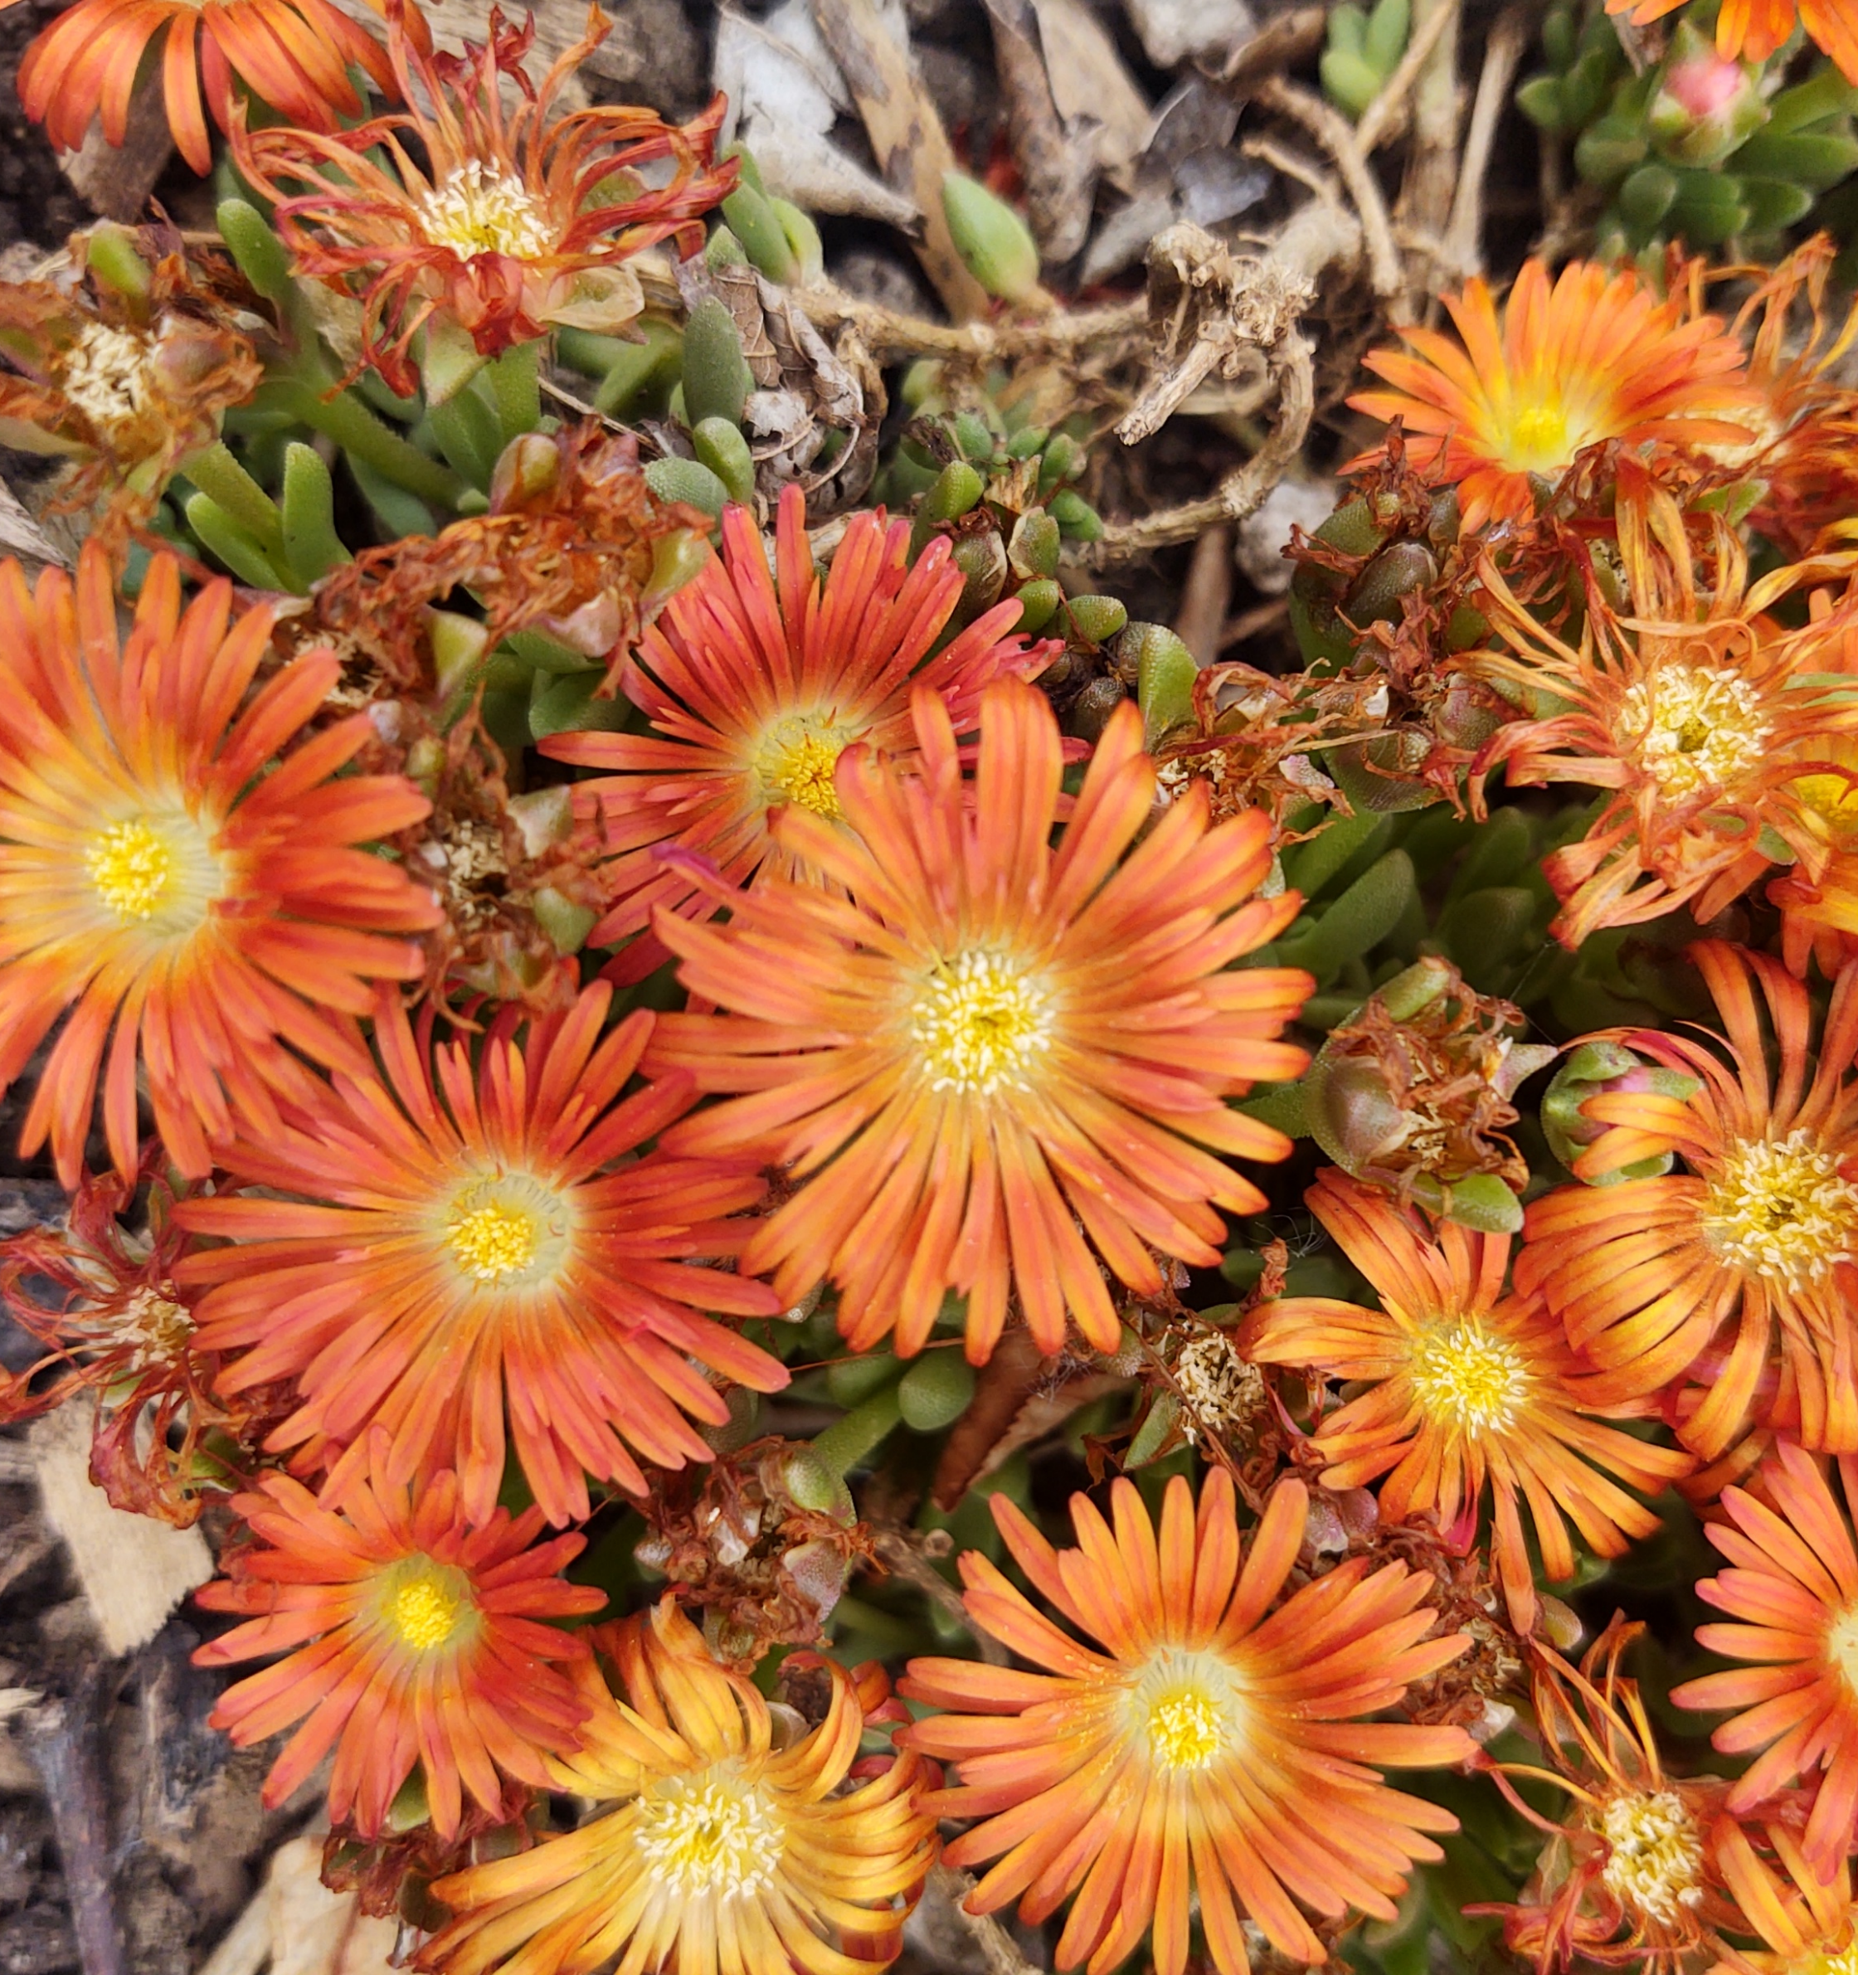
Conclusions
Nature's Notebook and USA-NPN datasets can give key insights into timelines of phenological events
Pairing of citizen science data with remote sensing helps define the changes that are undergoing when we look at NDVI and EVI
Highly influenced by differences in the collection methodologies
Credit: Daniel Dominguez
Notes:
Tyler: So, after all of this, where do we stand? Well, first and foremost, we want to emphasize that the citizen science datasets are incredible and extensive data sources that can provide key insights into the timing of phenological events. Second, with for years of more detailed citizen science data, the observations helped us define the changes we were seeing in the NDVI and EVI plots. For years when these changes weren’t as clear, it reminded us that phenology is not always a cut and dry cycle, but rather a dynamic process that can change every year. Lastly, results can be influenced greatly by different citizen science collection methodologies and the inclusion or absence of optional observation metrics like phenophase intensity, which we’ll explain soon.
------------------------------Image Information Below ------------------------------
Image Credit: Daniel Dominguez

Slide 19
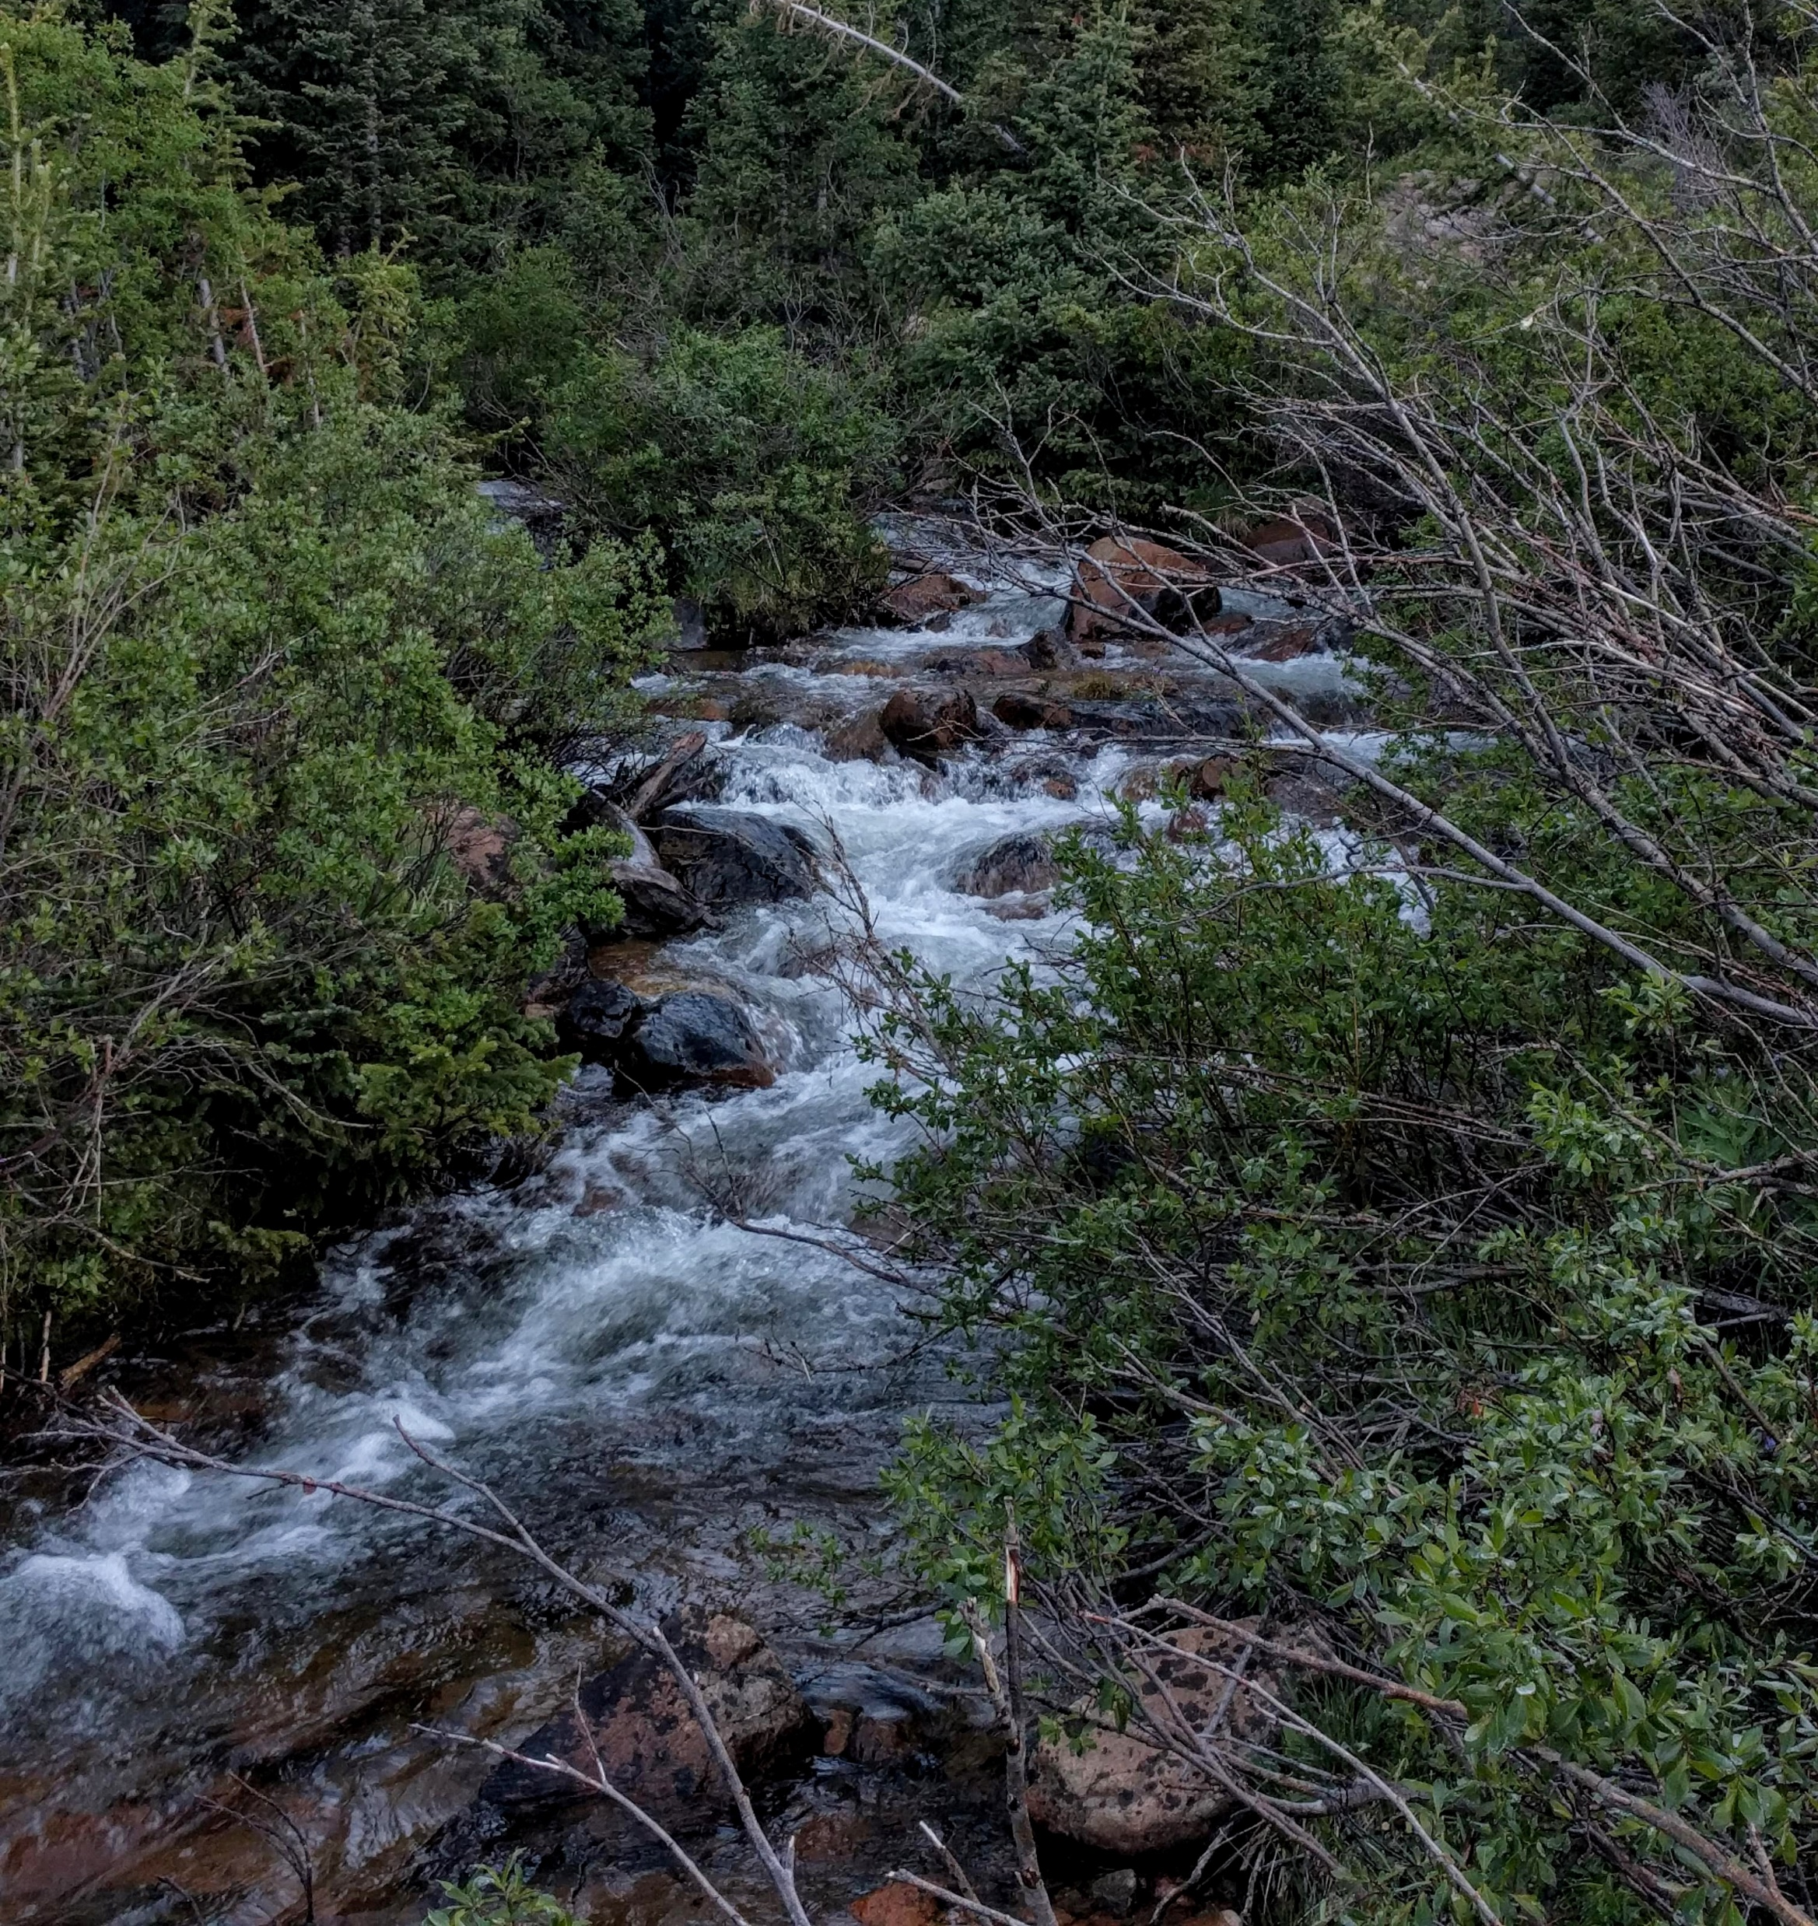
Future Work
Create “data-rich” sites
Log data continuously to fill gaps
Increase accuracy of use with remote sensing
Draw a polygon around dominant target species
Continue collecting data!
Credit: Brenna Challis
Notes:
Camille: Part of the results from this project is providing guidance for future citizen science practices to specifically relate to remote sensing. The creation of data-rich, research-sites would improve the accuracy of pairing spatial data to vegetation, and provide a more continuous collection regimen. Additionally, a transect, or polygon, on the ground that encompasses dominant groups of target species would improve the data-user’s ability to identify the species in satellite imagery. This technique has been demonstrated in previous studies and we believe it could be implemented in the future. Lastly, this study was only made possible by the citizens who use the Nature’s Notebook app and who committed all this time to contribute to science. Fostering a community of scientific contributions is the best way to build these data sets and apply them to important research.
------------------------------Image Information Below ------------------------------
Image Credit: Brenna Challis

Slide 20
Advisors:
Colorado State University, Natural Resource Ecology Lab
Dr. Paul Evangelista
Dr. Tony Vorster
Nicholas Young
Peder Engelstad
Brian Woodward
United States Geological Survey, Fort Collins Science Center
Dr. Catherine Jarnevich
Project Partners:
Dr. Theresa Cummins, USA National Phenology Network
Dr. Janet S. Prevéy, USGS, Fort Collins Science Center
Kathy Balman, Educating Children Outdoors
Fort Collins Node Fellow:
Scott Cunningham
Notes:
We want to extend a very special thank you to all of our science advisors at the Natural Resource Ecology Lab, especially Nick Young and Peder Engelstad, as well as at the USGS Fort Collins Science Center. We also want to thank all of our project partners and especially the teens with ECO whose data helped make this project possible. And lastly, we want to thank our wonderful node fellow who fielded endless question from the team over the past 10 weeks. Thank you everyone and thank you all for tuning in to today’s presentation!

Slide 21
References
Christensen, N. S., Wood, A. W., Voisin, N., Lettenmaier, D. P., & Palmer, R. N. (2004). The Effects of Climate Change on the Hydrology and Water Resources of the Colorado River Basin. Climatic Change, 62(1), 337–363. Retrieved from: https://doi.org/10.1023/B:CLIM.0000013684.13621.1f
Elmore, A. J., Stylinkski, C. D., & Pradhan, K. (2016). Synergistic use of citizen science and remote sensing for continental-scale measurements of forest tree phenology. Remote Sensing, 8(6), 502. Retrieved from: https://doi.org/10.3390/rs8060502.
Kalra, A., Sagarika, S., Pathak, P., & Ahmad, S. (2017). Hydro-climatological changes in the Colorado River Basin over a century. Hydrological Sciences Journal, 62(14), 2280–2296. Retrieved from: https://doi.org/10.1080/02626667.2017.1372855
Richardson, A.D., Keenan, T.F., Migliavacca, M., Ryu, Y., Sonnentag, O., & Toomey, M. (2013). Climate change, phenology, and phenological control of vegetation feedbacks to the climate system. Agriculture and Forest Meteorology, 169, 156-173. Retrieved from: https://doi.org/10.1016/j.agrformet.2012.09.012.
Woodward, B. D., Evangelista, P. H., Young, N. E., Vorster, A. G., West, A. M., Carroll, S. L., ... & Vashisht, A. (2018). CO-RIP: A riparian vegetation and corridor extent dataset for colorado river basin streams and rivers. ISPRS International Journal of Geo-Information, 7(10), 397. Retrieved from: https://doi.org/10.3390/ijgi7100397.
Lieth H. (1973) Phenology in Productivity Studies. In: Reichle D.E. (eds) Analysis of Temperate Forest Ecosystems. Ecological Studies (Analysis and Synthesis), vol 1. Springer, Berlin, Heidelberg. https://doi.org/10.1007/978-3-642-85587-0_4
Younes, N., Joyce, K. E., & Maier, S. W. (2021). All models of satellite-derived phenology are wrong, but some are useful: A case study from northern Australia. International Journal of Applied Earth Observation and Geoinformation, 97, 102285. https://doi.org/10.1016/j.jag.2020.102285

