Slide 1
2018 Summer | Maryland - Goddard
KENAI DISASTERS
Evaluating Grassland Conversion and the Related Likelihood of Fire Disturbance to Enhance Fire Monitoring and Management in the Kenai Peninsula, Alaska
Kate Hess, Project Lead
Cheila Avalon Cullen, PhD
Jeanette Cobian
Victor Lenske
Jake Ramthun
Notes:
Kate

Slide 2
Acknowledgements
Dr. Dawn Magness, U.S. Fish and Wildlife Service, Kenai National Wildlife Refuge
Dr. John D. Bolten, NASA Goddard Space Flight Center
Dr. Adrianna Foster, Universities Space Research Association, NASA Goddard Space Flight Center
Joseph Spruce, Science Systems and Applications, Inc., NASA Stennis Space Center
Kate Hess,
Project Lead
Cheila Avalon Cullen, PhD
Jeanette Cobian
Victor Lenske,
Center Lead
Jake Ramthun
Notes:
Kate

Slide 3
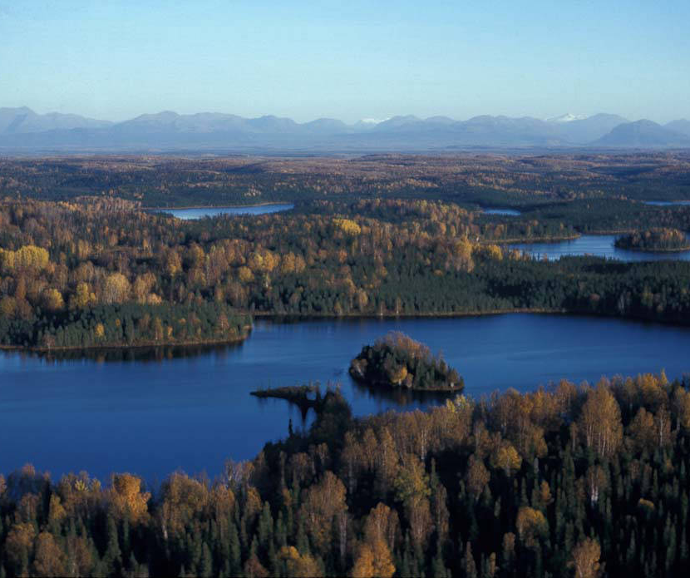
Community Concerns
Spruce beetles (Dendroctonus rufipennis) fuel grassland conversion
Rising temperatures and grass cover help spur fires
Costly/dangerous firefighting conditions
High socioeconomic risk
Beetle Damage, 2013
Source: USFWS
Notes:
Jake
-In the mid-90’s, southern Alaska experienced the largest and most severe outbreak of spruce beetles in North American history, killing about 5 million acres of spruce forest in and around the Kenai Peninsula.
-That’s an area almost the size of New Jersey.
-Forest killed by beetles is often succeeded by grass-dominated ground cover. Dead, desiccated trees and grass cover, combined with warming local temperatures, increases potential for fire.
-Furthermore, the Kenai Peninsula is one of Alaska’s most densely populated areas and is vital to the state’s culture and tourism economy. As such, disturbances in the area have very high socioeconomic risk.
Image Source: https://commons.wikimedia.org/wiki/File:Kenai_Refuge_Lakes_(8426057383).jpg

Slide 4
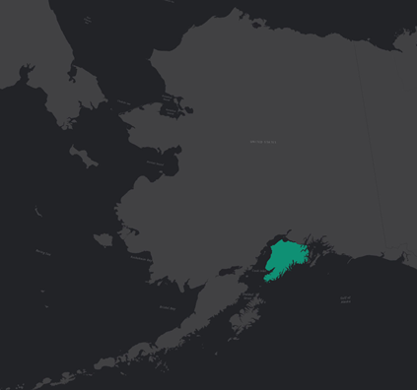
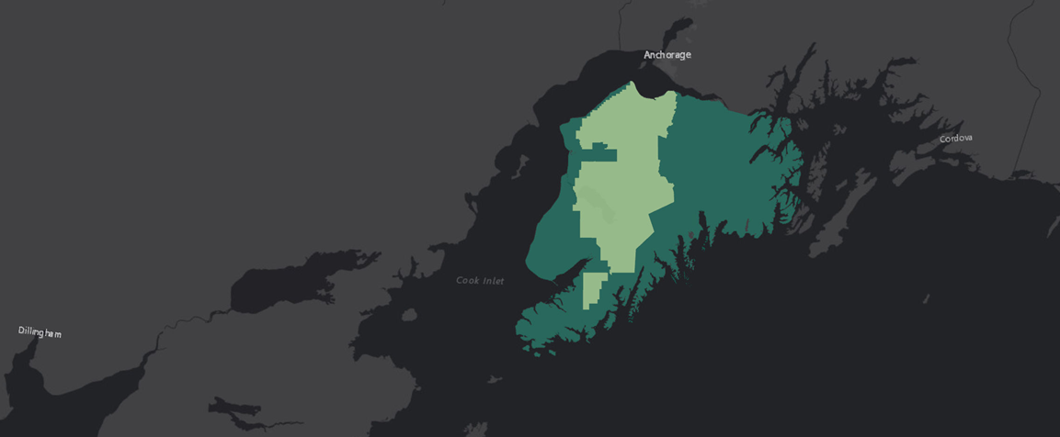
Study Area and Project Partner
Alaska
Kenai Peninsula
0 10 20 40 Miles
Kenai National Wildlife Refuge
Kenai National Wildlife Refuge (US Fish and Wildlife Service)
Notes:
Jake
-For this project, DEVELOP partnered with landscape ecologists at the Kenai National Wildlife Refuge, shown here in light green.
-Governed by the US Fish and Wildlife Service, the Refuge covers nearly 2 million acres of spruce forest on the Kenai Peninsula and borders several communities.

Slide 5
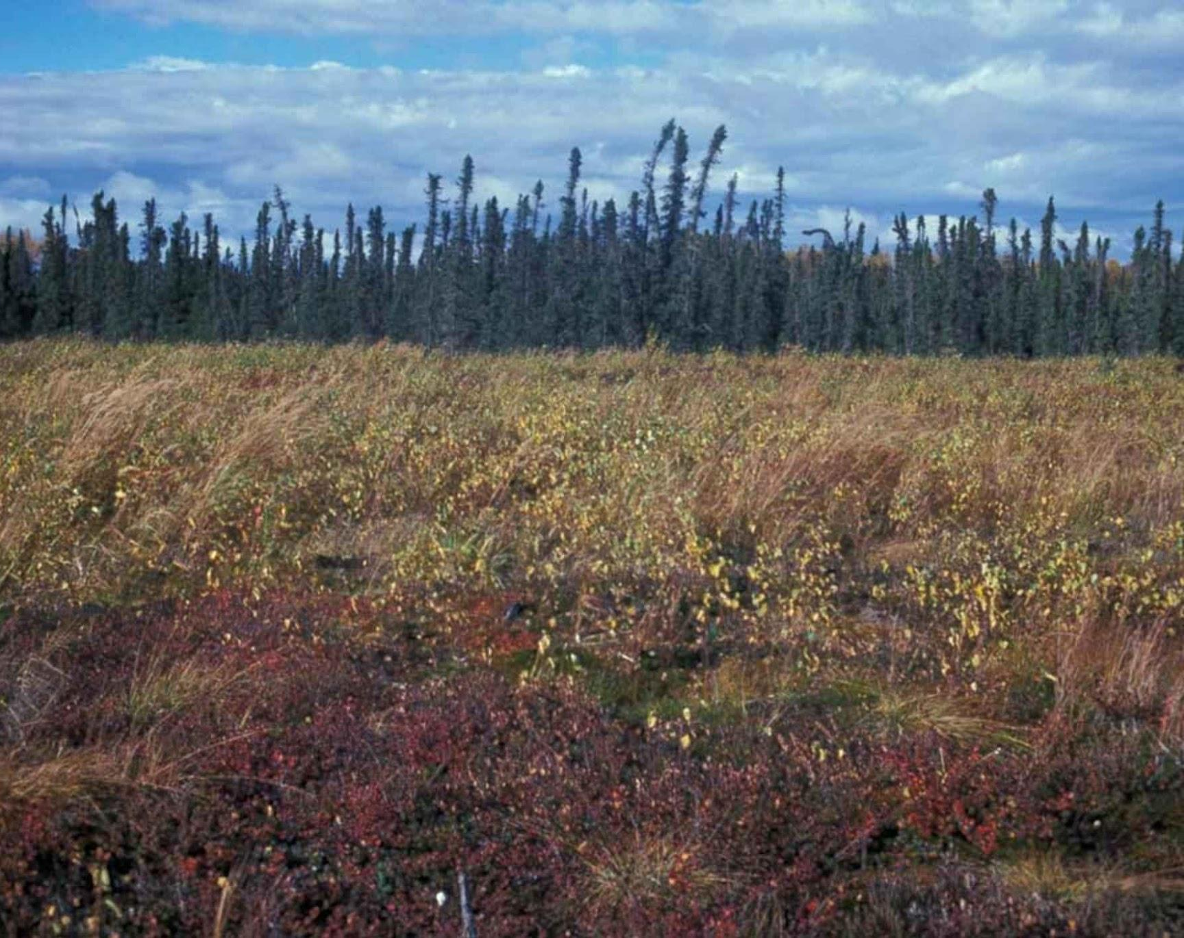
Objectives
From the 1990s to present:
Classify land cover
Detect and quantify grassland conversion
Map and assess emergent fire risk
Kenai National Wildlife Refuge
Source: USFWS
Notes:
Jake
-To help the Kenai National Wildlife Refuge better understand changing ecology and protect local communities from wildfire, we developed three primary objectives;
-First, we had to classify land cover at multiple time intervals since the 90s beetle outbreak: we needed to be able to differentiate between forest cover and grassland in our satellite imagery
-Second, we wanted to overlay those classifications into a change analysis. This made it possible to see when and where grassland was replacing forest, and then to quantify those changes.
-Lastly, we had to evaluate fire risk. We combined our land cover classification with weather and topography data to quantify areas of high concern.
Photo Source: https://commons.wikimedia.org/wiki/File:Kenai_national_wildlife_refuge_landscape.jpg

Slide 6
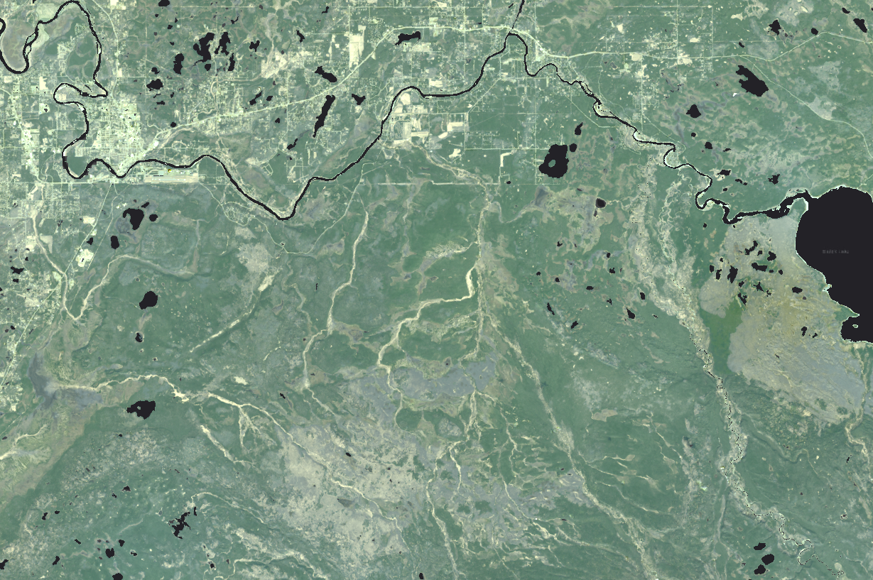
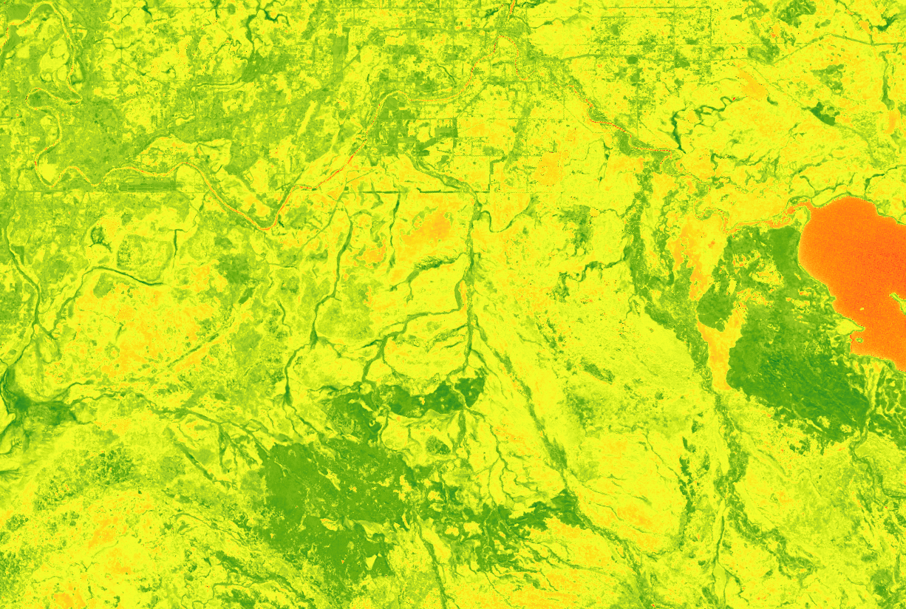
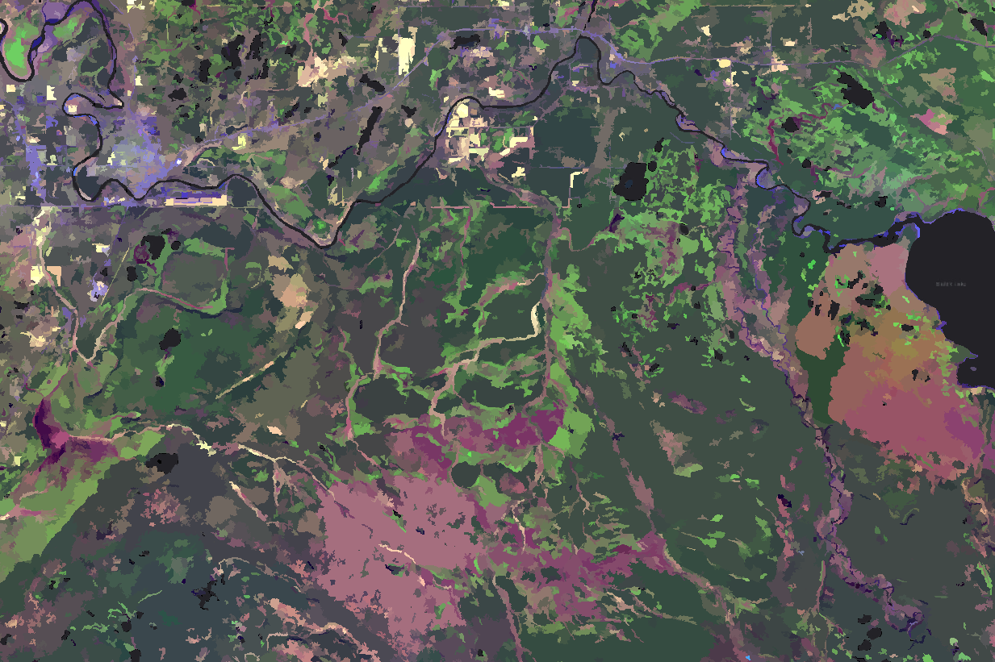
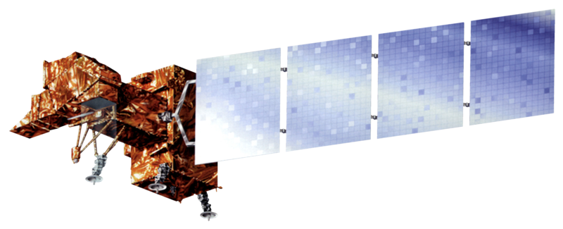
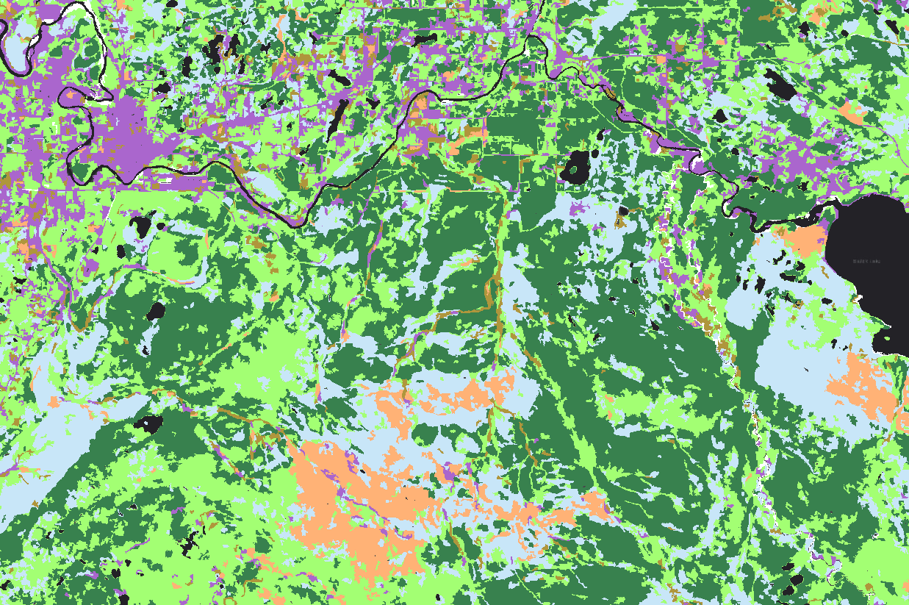
Land Cover Classification
Landsat 4/5
Landsat Reflectance Bands
NDVI
Segmented Image
Classified Image
Landsat 7
Landsat 8
Notes:
Kate
-To classify land cover over the last 30 years, we used imagery from NASA’s Landsat suite of satellites, specifically Landsat 4 through Landsat 8.
-We used the pixel QA band that comes with landsat scenes to mask out water, snow, clouds, and cloud shadows.
-We also chose to crop the Eastern mountains out of our analysis, because they contain a very different ecosystem from the rest of the peninsula, and added significant variation to all of the variables used in the fire risk model.
-After all of this preprocessing, we made an NDVI composite using the red and infrared reflectance bands. This indicates vegetation health and better allowed us to differentiate vegetation types.
-NDVI and the original bands were then put through an unsupervised segmentation classifier to group the image into segments with similar spectral signatures.
-We then created training samples using ground truthed points sent from our project partner and high resolution imagery from the National Geospatial-Intelligence Agency for reference.
-We repeated this process for summer Landsat images at roughly 3 year intervals over our study period, and we were able to use these resulting classified images to identify areas of vegetation type change and as inputs for our fire risk model.

Slide 7
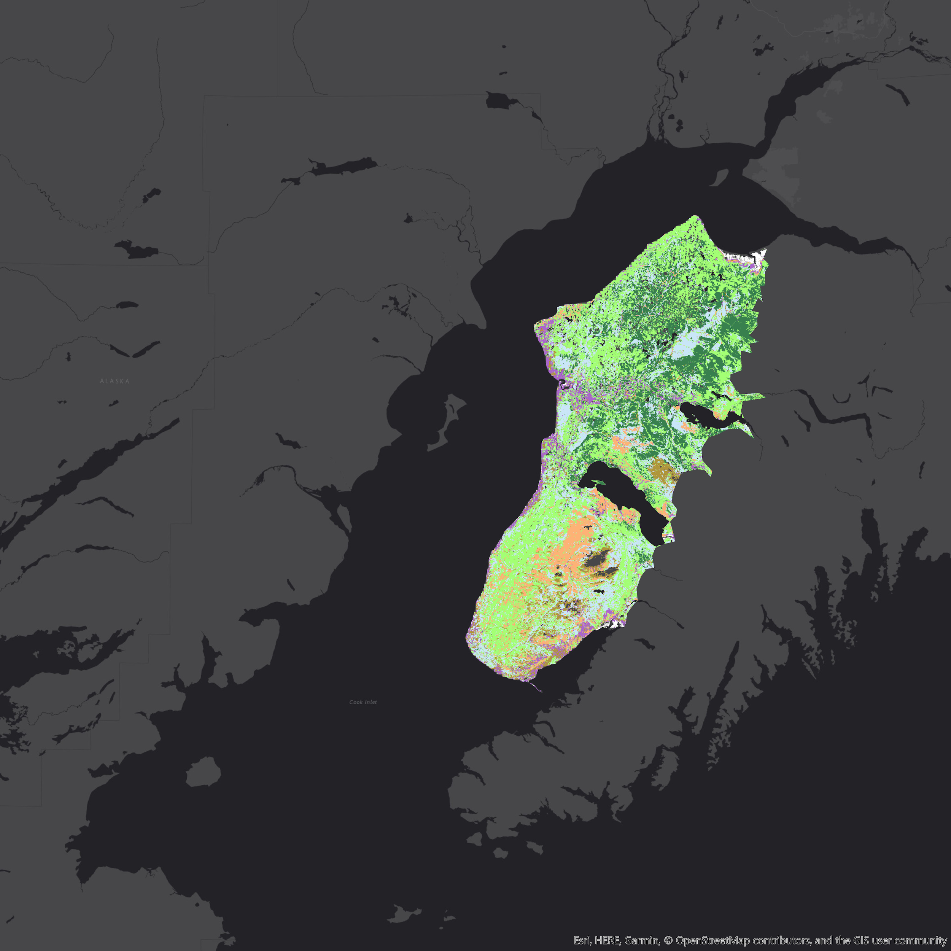
Land Cover Classification
Land Cover Type (2014)
Shrubland
Herbaceous
Black Spruce Forest
Mixed Forest
Developed
Wetlands
Barren
0 5 10 20 Miles
Notes:
Kate
This is the result of our land cover classification for 2014. You can clearly see the area in pink on the southern section of the peninsula where the beetle damage has caused a conversion from forest to herbaceous. You can also see the shrubland in tan, which we found to be at high risk of fire. The black spruce forest is also a land cover type with high fire risk, and you will see that the fire risk map reflects these differing risks based on land cover type.

Slide 8
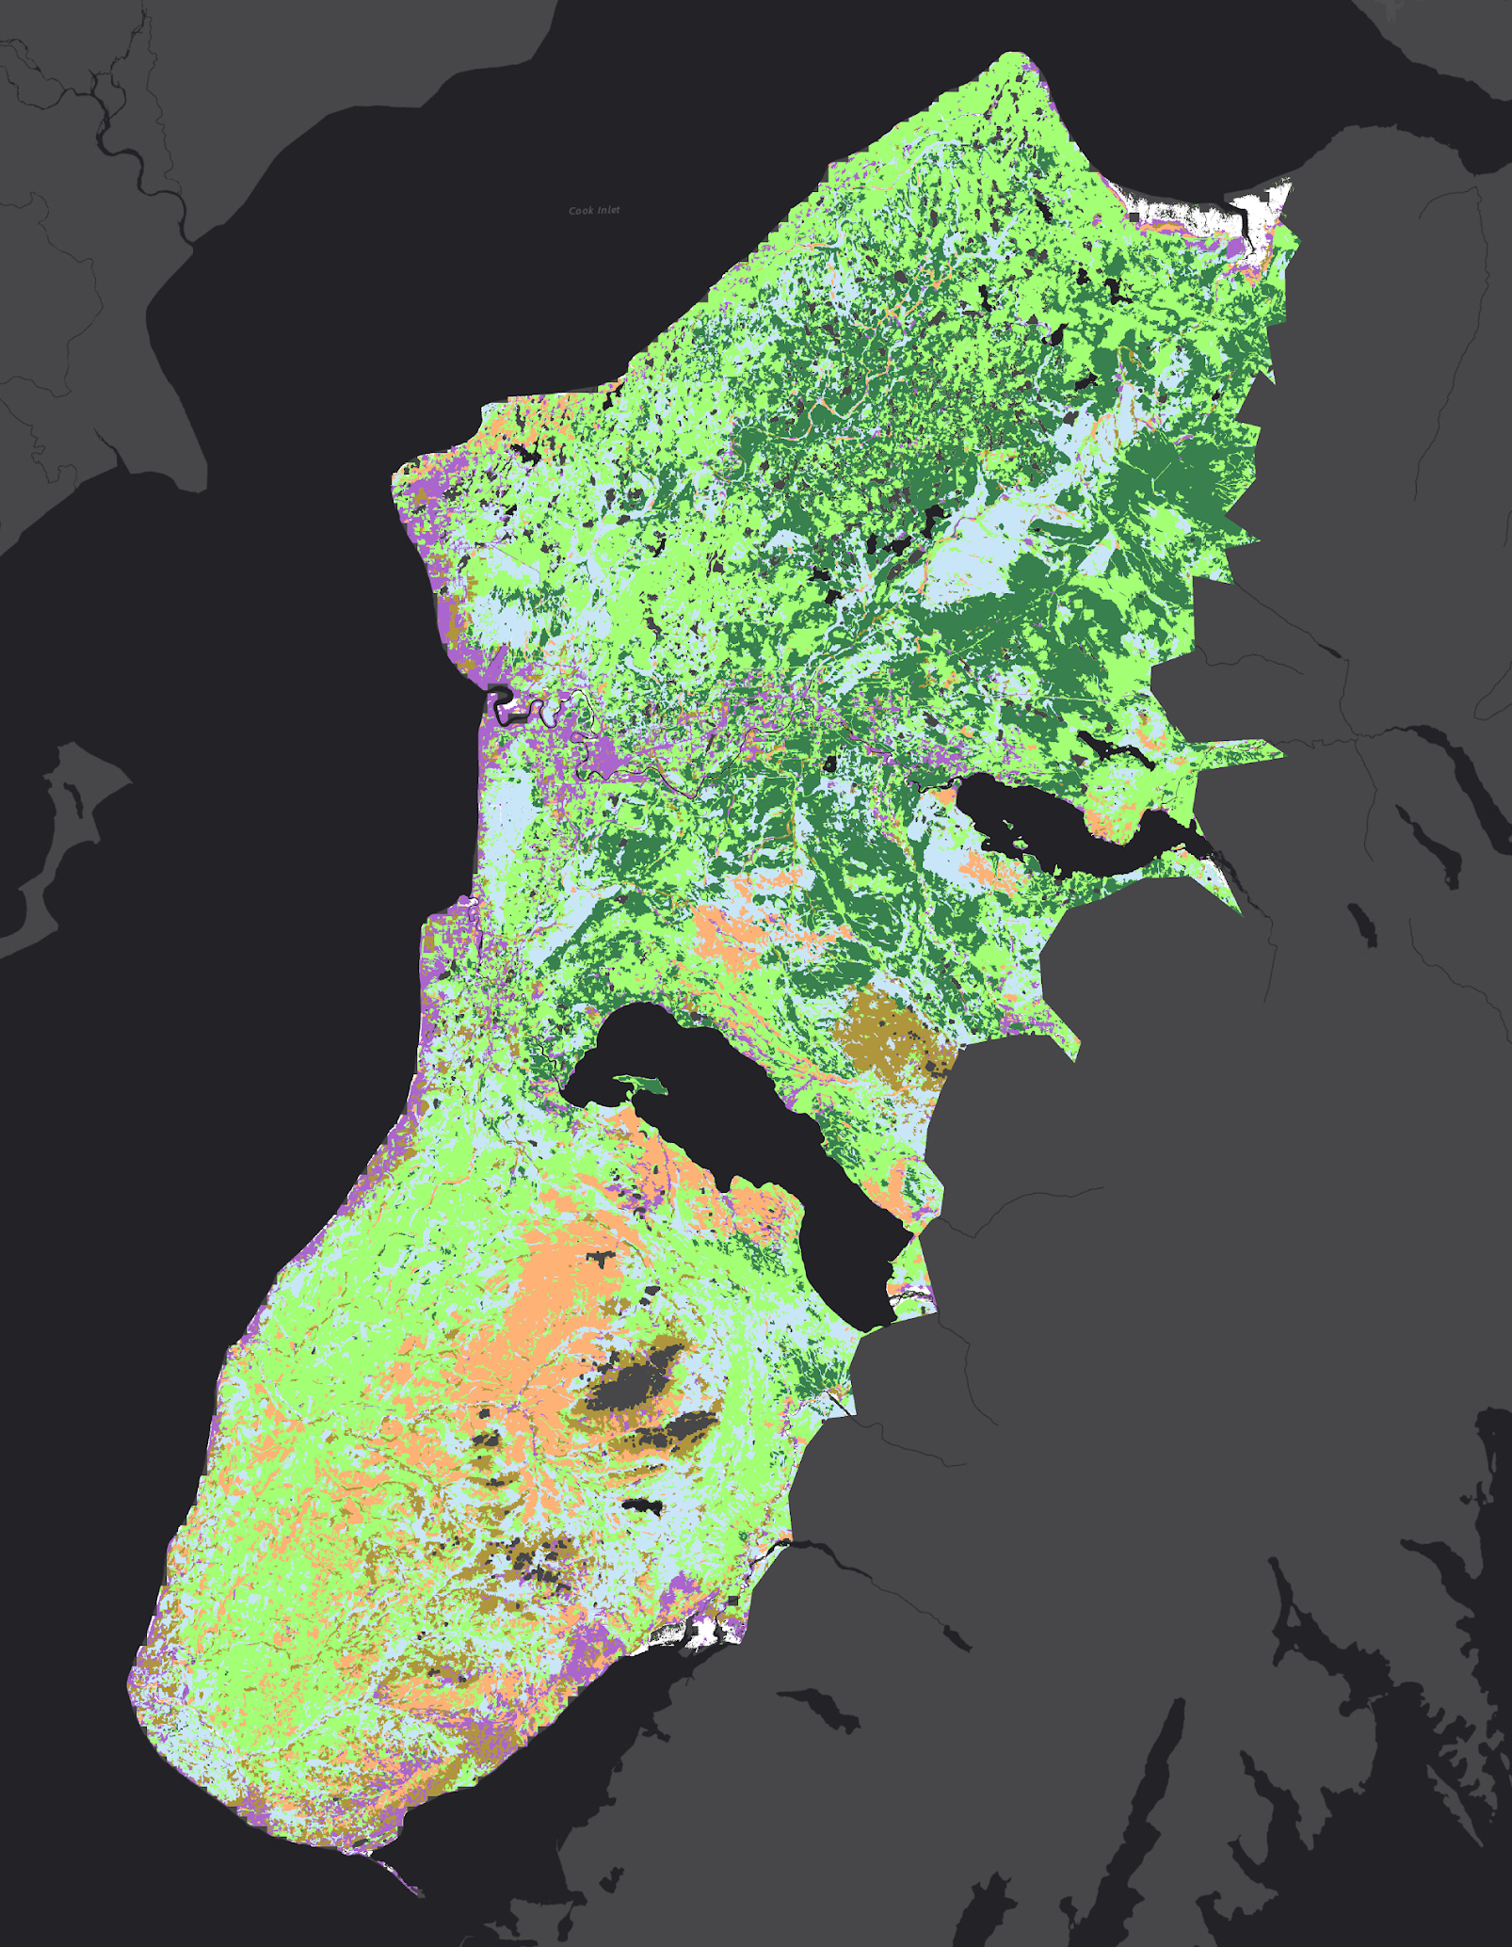
Classification Change Detection
CHANGE
1995
2014
Herbaceous
Shrubland
0 5 10 20 Miles
0 5 10 20 Miles
Notes:
Kate
Here you can see how we used the classified images to pinpoint areas of change.
Each pixel in the classified image has a value between 0-6 based on its land cover type. We used these values in the raster calculator in ArcGIS Pro to subtract the historical classification from the 2014, and then displayed just the values that indicated a change from forest to grassland. More specifically, we kept the pixels that, from 1995 to 2014, had converted from black spruce or mixed forest to shrubland or herbaceous. Now Jeanette will explain how the classification change detection compares with the change detection we performed using the NDVI bands.

Slide 9
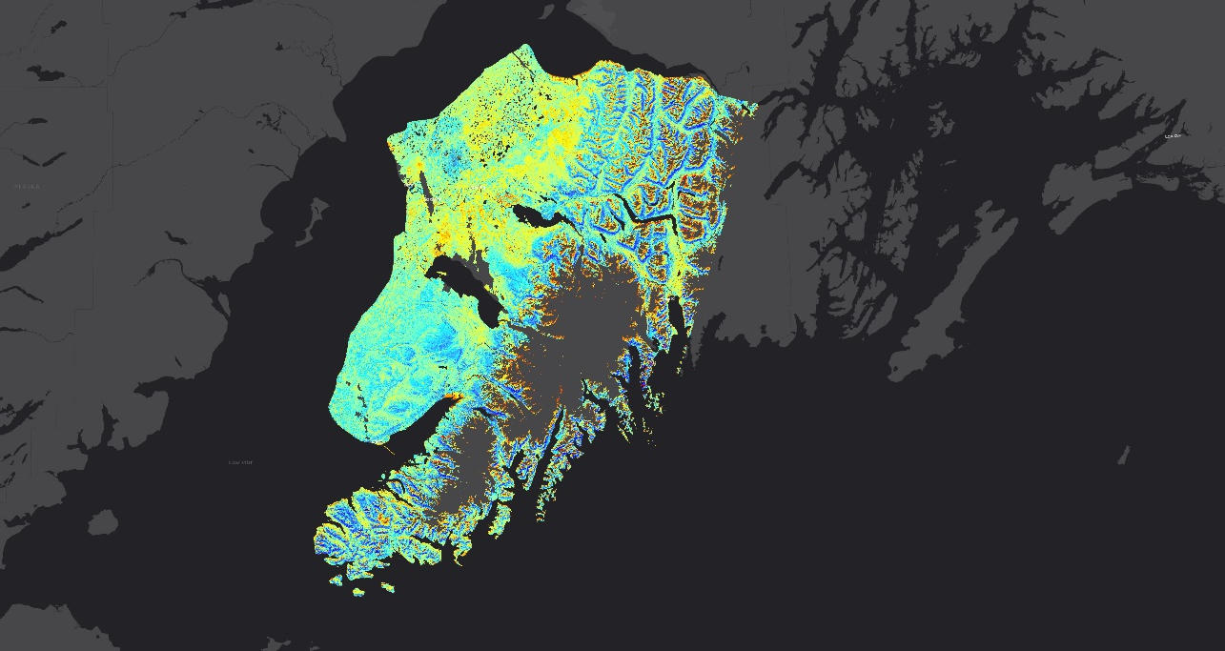
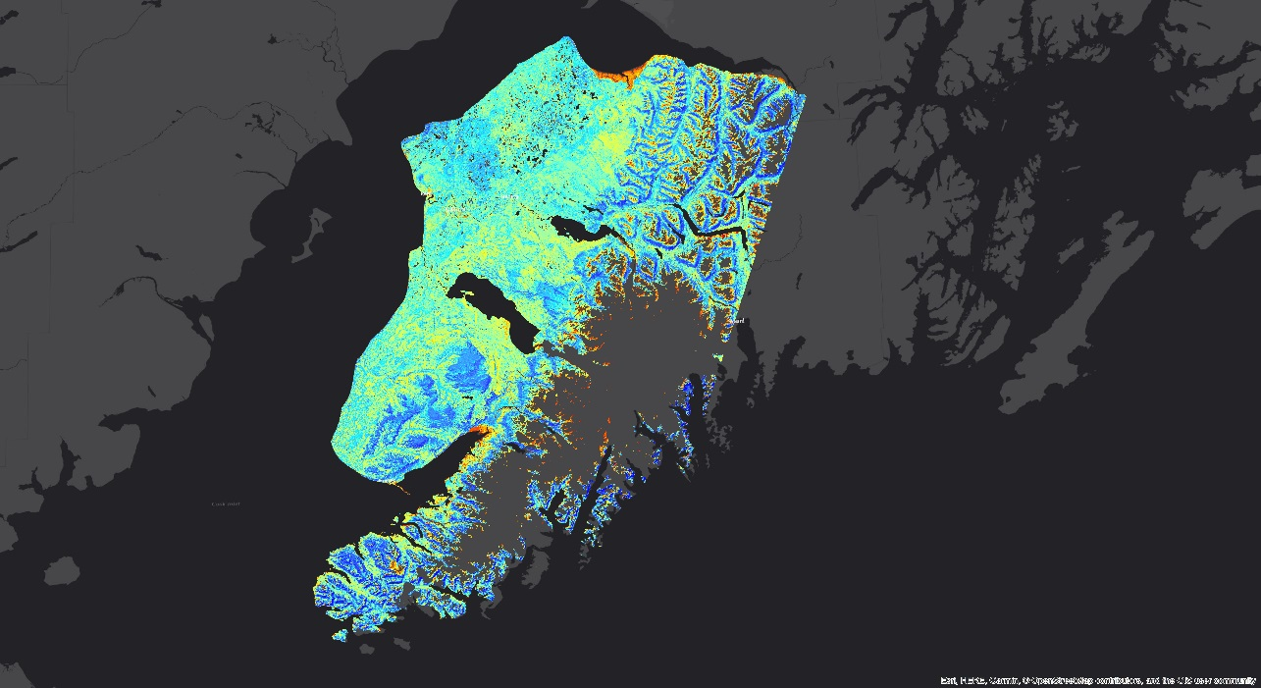
NDVI Change Detection
NDVI ‘Current’
NDVI ‘Current’
NDVI
High: 0.734
2016
Low: -0.367
0 20 40 Miles
NDVI Change
NDVI ‘Historic’
NDVI
High: 0.793
1995
Low: -0.805
0 20 40 Miles
Notes:
Jeanette
Vegetation change was also assessed through calculation of NDVI.
In general, NDVI, or normalized vegetation index, is a ratio of the red and infra-red, or near infra-red bands of sensors such as Landsat . Thus, we obtained data from Landsat 8,7 or 5 depending on data availability for each year.
Here we have NDVI calculated for 1985 and 2016
After calculating NDVI, we estimated the NDVI change by using the formulation here (point to slide). Where for example in the case here, ‘current’ is the most recent dataset or 2016 and historic is the ‘oldest’ dataset, in this case 1995.

Slide 10
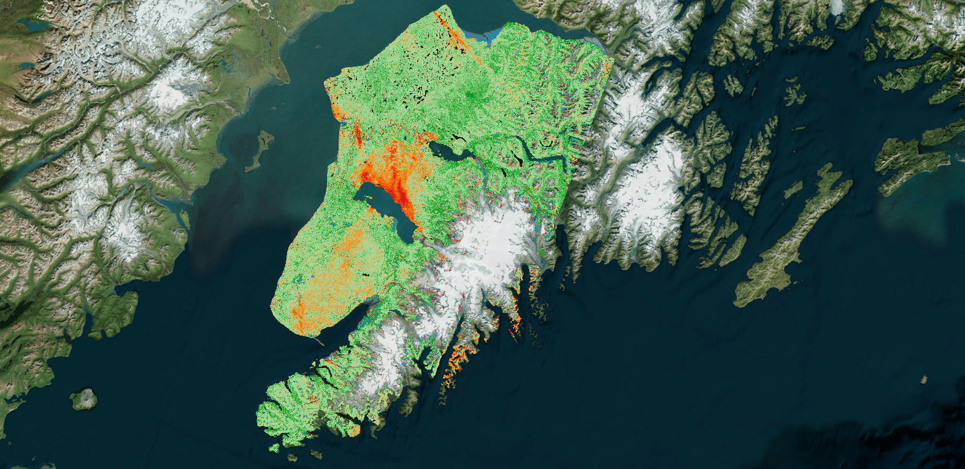
NDVI Change Detection
Change in Vegetation Health*
1995 - 2016
-50%
-20%
0%
20%
50%
0 5 10 20 Miles
*as measured by NDVI
Notes:
Jeanette
Representative results of NDVI change for 1995 and 2016
This time frame is significant for our application because it encompases reported vegetation changes
As can be seen from the image, changes in NDVI were detected in regions where vegetation, or fuels, have converted (point to slide) and as you will see in the next slides, both our calculations for future fire risk and historical fire data indicate increased fire occurrence in these same regions
Details of these increased fire risks are presented in the next slides.

Slide 11
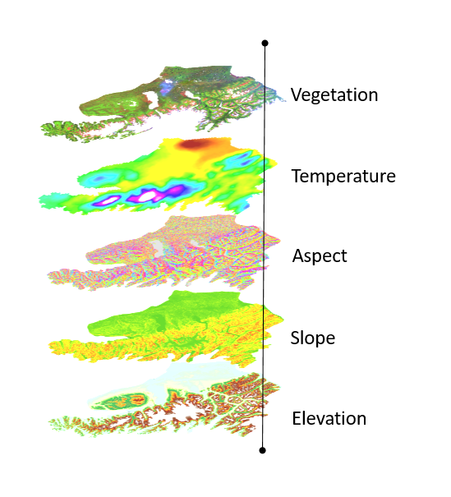
Fire Risk Analysis
Model Training
Inputs
Algorithm
Vegetation
Terra
Temperature
Aspect
Aqua
Slope
FP(Fire Probability)
Historic
Fire
Pixels
(MODIS)
Elevation
Notes:
Cheila
- Fire data was obtained via two sources, 1. the MODIS Thermal Anomalies/Fire data product aboard the Terra and Aqua satellites and 2. a LANDFIRE historical database.
- We used a 10m DEM product from the USGS 3DEP project and derived information related to Slope, aspect and elevation.
- Information related to vegetation comes from our previous vegetation analysis derived from Landsat.
- We took the monthly average surface temperature for the each one of the pixels from the Alaska SNAP program.
Extraction of all the variables including MODIS fire pixels was obtain python and all data was incorporated into a machine learning algorithm in the shape of a logistic regression which basically learns from previous fires and all of the conditions at the time and then predicts the likelihood of fire in similar conditions in the present.

Slide 12
Fire Risk
Probability of Fire (2014)
0 - 20%
20 - 40%
40 - 60%
60 - 80%
80 - 100%
0 5 10 20 Miles
Notes:
Cheila
After the coefficients for each variables were calculated in python, we brought them to ArcGIS pro and using the raster calculator we plotted the logistic regression resulting in our FIRE RISK PROBABILITY MAP.
For each pixel in this map, the algorithm calculated the likelihood of fire in the lighter yellow colors we have the areas less likely to have a fire, and in the orange and red we have areas with more risk. Validation results show that the model predicts cases correctly at a 91 % accuracy, and it is actually very nice to at least visually correlate it to our change detection map

Slide 13
Land Cover & Fire Risk
0 5 10 20 Miles
Vegetation Cover (2014)
Probability of Fire (2014)
Shrubland
Herbaceous
0 - 20%
Black Spruce Forest
20 - 40%
Mixed Forest
40 - 60%
Developed
60 - 80%
Wetlands
Barren
80 - 100%
Notes:
Cheila
Here you can see how the fire risk map compares with the land cover classification. Of course this is just the land cover in 2014, and the model was trained with classifications from 5 different years during the study period, but you can still see how they match up. For example, the wetlands in the Northern central area of the peninsula have a low fire risk. You can also see that the shrublands have the highest fire risk, and herbaceous and black spruce forest areas have high risks as well.

Slide 14
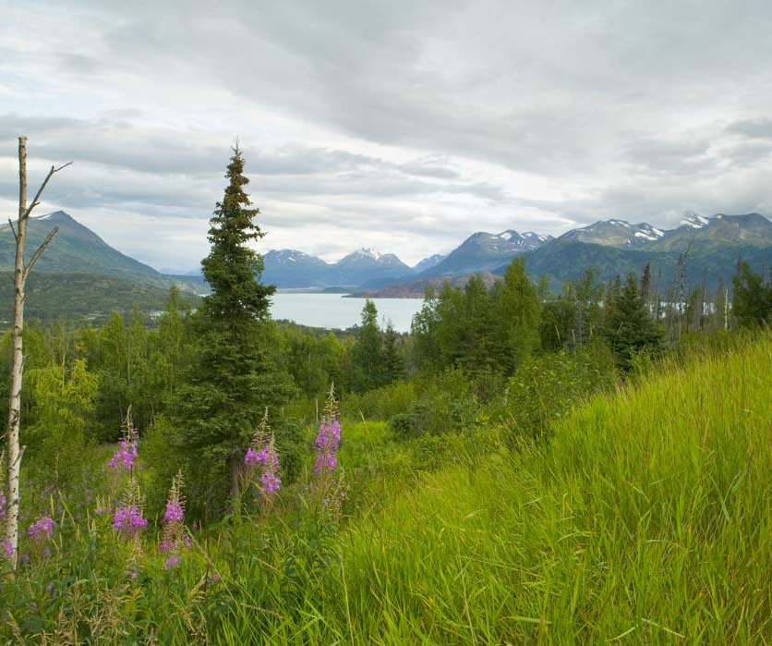
Conclusions & Future Work
Change detection confirms the refuge ecologists’ observations
Fire risk is highest for shrubland, herbaceous, and black spruce forest areas
Future Work:
Extrapolation to other areas
Incorporation of dynamic variables
Update with current data
Kenai NWR
Source: Steve Hillebrand, USFWS
Notes:
Jeanette
To conclude, we wanted to highlight some major observations from our work
First…(here the bullet points will be mentioned)
Change detection analysis on NDVI composites and classifications of Landsat imagery confirmed the refuge ecologists’ observation of transition from forest to grassland following the spruce beetle outbreaks.
Fire risk is highest in areas that are primarily shrubland, herbaceous, or black spruce forest.
Questions?
Image Source: https://commons.wikimedia.org/wiki/File:Hillside_with_Fireweed.jpg

