Slide 1
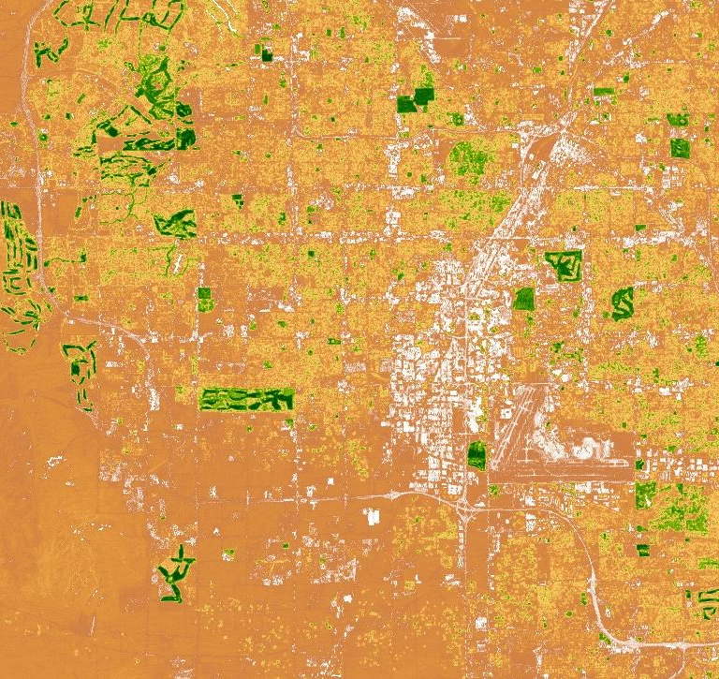
PACIFIC SOUTHWEST CROSS-CUTTING II
Improving Detection of Land Use Changes in Habitat Conservation Plan Areas Using NASA Earth Observations and a Landscape Anomaly Detection Tool
Kimberly Johnson
Justin Herbst
Jarell Perez
Emily Gotschalk
Michaela Britt
Zachery Stout
Virginia – Langley
Fall 2017
Notes:
Speaker Notes:
Hello, I’m Michaela, Jarell, Justin, and Kim. And together we are the Pacific Southwest Cross-Cutting II team.
Image Source:
City of Colton Habitat Conservation Plan, NDVI, 10/12/2004 to 11/12/2004, created in Kim’s Kim_LUADT script

Slide 2
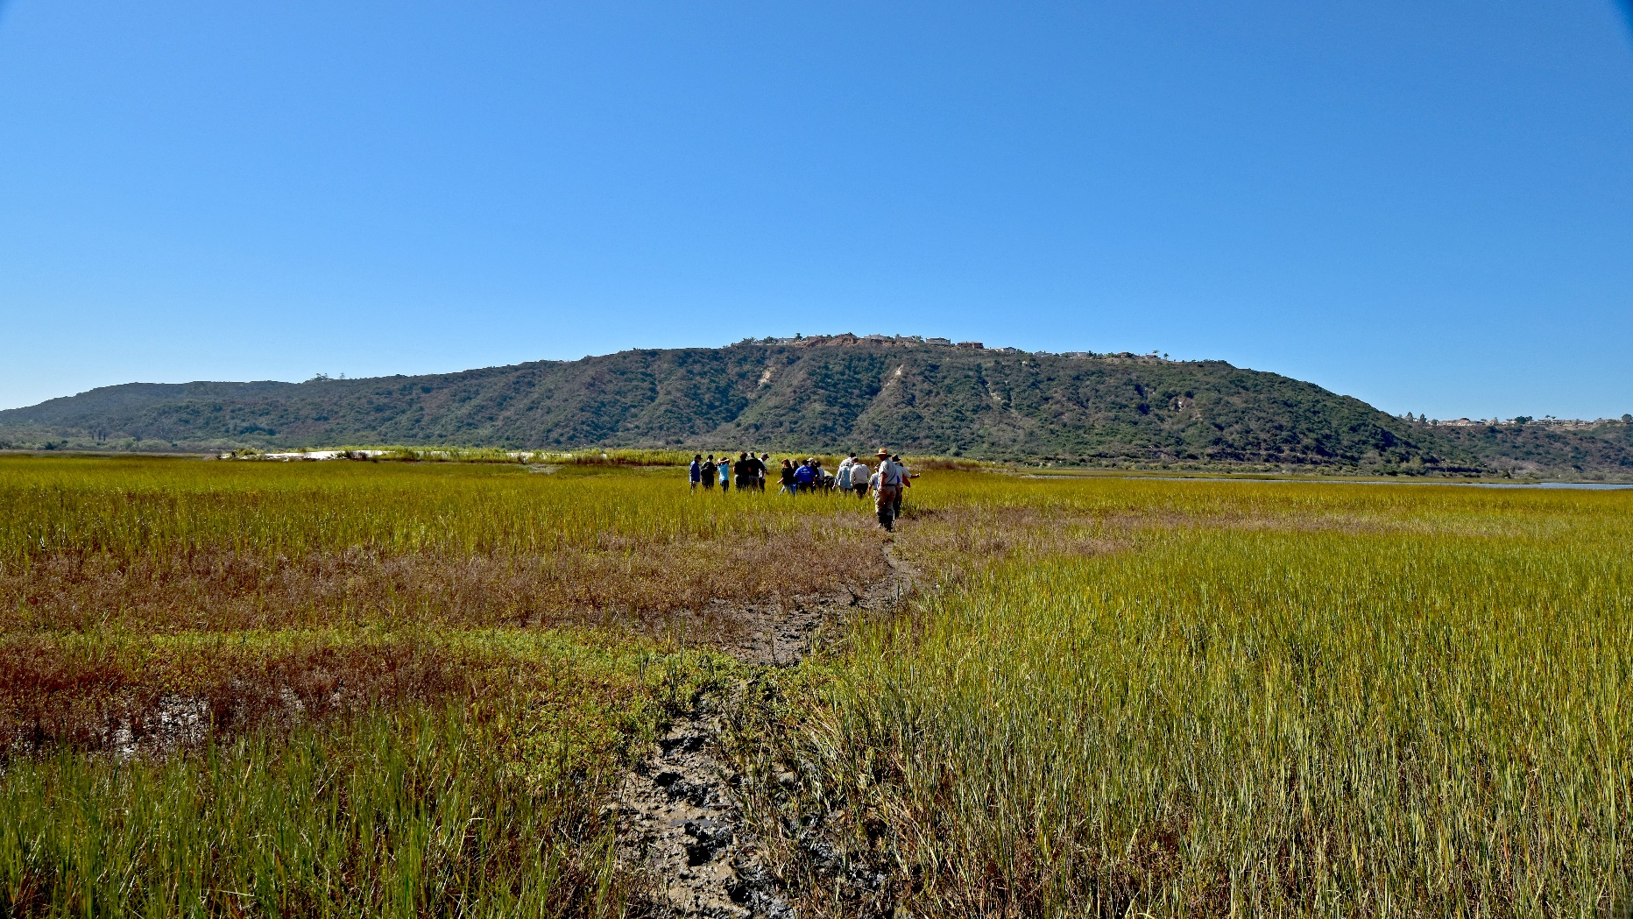
Outline
Partners
Community Concerns
Study Area
Objectives & Satellites
Formulas
Methodology
Results
Errors & Uncertainties
Conclusions
Future Work
Image Credit: USFWS
Notes:
Speaker Notes:
In this presentation we will begin by describing our partners and the community concerns. Next we will explain our study area, objectives, and the satellites we used. Then we will move into the methodology and results. And we will finish with errors, conclusions, and suggestions for future work.
Image Source:
https://www.flickr.com/photos/usfws_pacificsw/37348737472/
Copyright information: Public domain

Slide 3
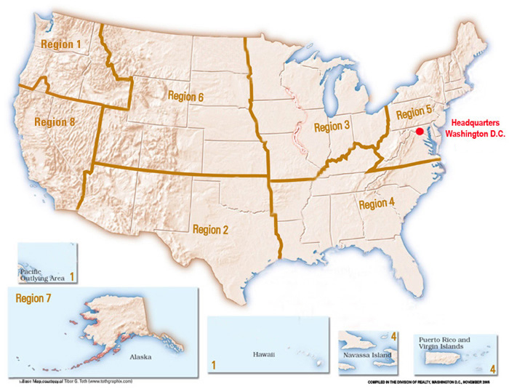
Partners
US Fish and Wildlife Service, Pacific Southwest (Region 8)
US Fish and Wildlife Service, Midwest (Region 3)
Image Credit: USFWS
Notes:
Speaker Notes:
Our team partnered with the US Fish and Wildlife Service. In particular, we worked with three individuals from the Pacific Southwest and Midwest Regions, which are regions 8 and 3 on the map. The US Fish and Wildlife Service is within the Department of the Interior, and its mission is to “work with others to conserve, protect, and enhance fish, wildlife, and plants and their habitats for the continuing benefit of the American people”.
Image Source:
Map: https://www.fws.gov/where/
Quote Source:
https://www.fws.gov/help/about_us.html

Slide 4
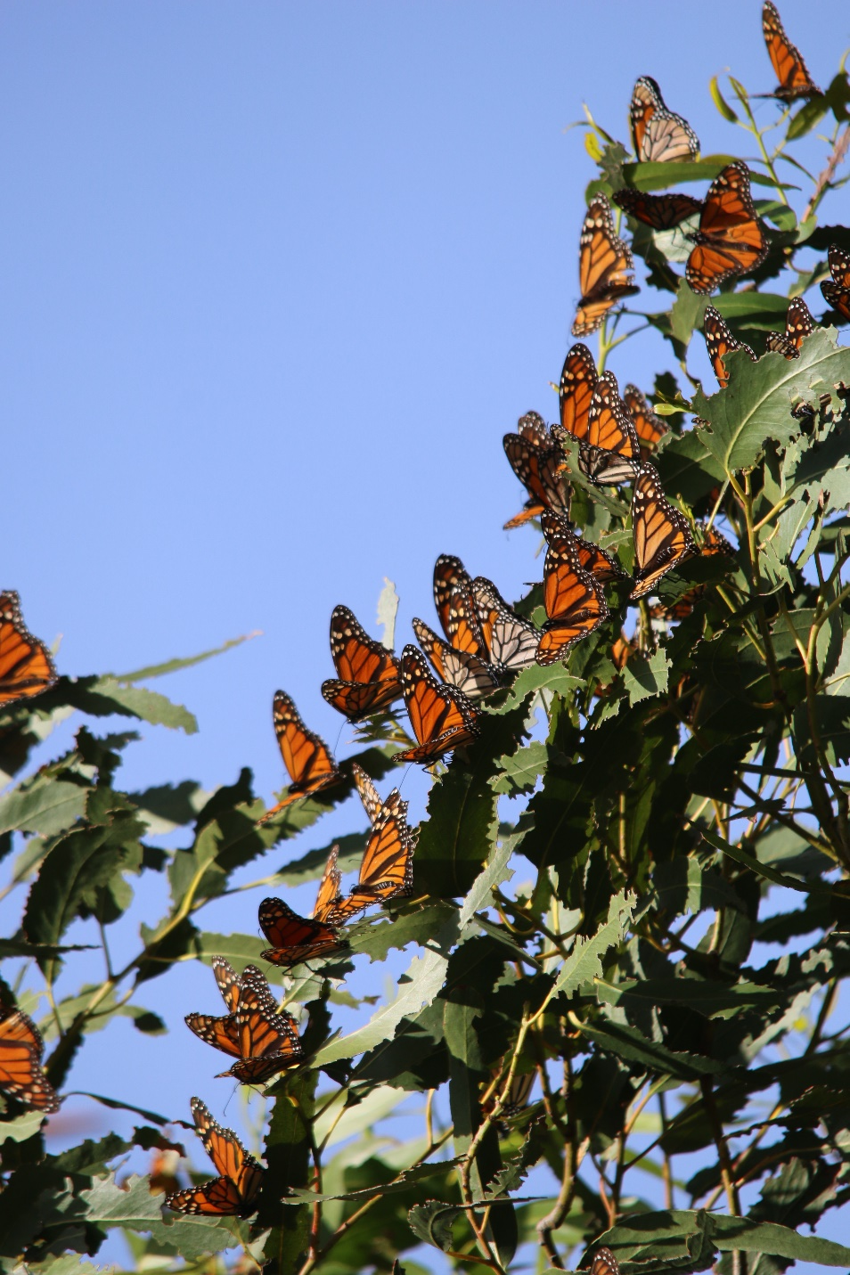
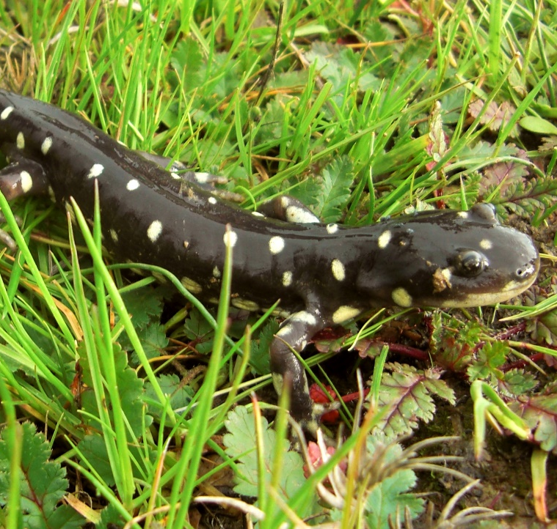
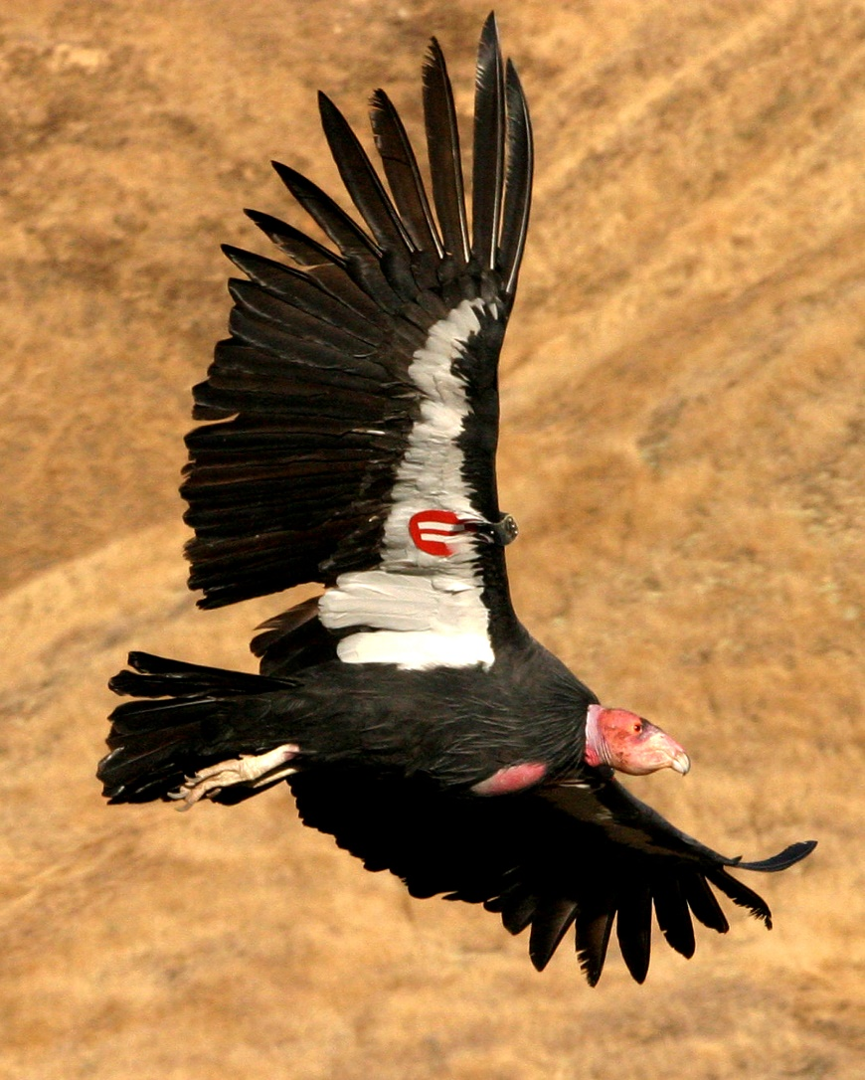
Community Concerns
Image Credit: Hazel Rodriguez/USFWS
Endangered Species Act (1973)
Incidental Take Permits & Habitat Conservation Plans (1982)
Image Credit: John Cleckler/USFWS
Image Credit: USFWS
Notes:
Speaker Notes:
The Endangered Species Act was signed in 1973 to protect endangered and threatened species and preserve their habitats, and is enforced by the US Fish and Wildlife Service. A tension between conservation and development naturally occurs, as people want to develop land for things like housing, schools, and shopping centers. The problem arises when these development activities impact listed species and their habitats. A 1982 amendment to the ESA seeks to resolve this conflict by allowing development in areas that have listed species through Incidental Take Permits, as long as the developer creates a Habitat Conservation Plan or HCP. HCPs are created by the developer and approved by the US Fish and Wildlife Service. HCPs must include how the listed species will be affected by the developer’s activities, a plan to mitigate those impacts, and funding available to implement the mitigation efforts. After the approval of an HCP, the developer must report to the US Fish and Wildlife Service. Biologists help to monitor the implementation of the HCP. However, with over 84 million acres of HCPs in the Pacific Southwest Region, it is very challenging for biologists to effectively monitor land use changes.
Images Sources:
California Tiger Salamander: https://www.flickr.com/photos/usfws_pacificsw/5352834910/in/album-72157687832011533/
California Condor: https://www.flickr.com/photos/usfws_pacificsw/5057206247/in/album-72157628116654501/
Monarch Butterfly: https://www.flickr.com/photos/usfws_pacificsw/32707378946/in/album-72157680033567455/

Slide 5
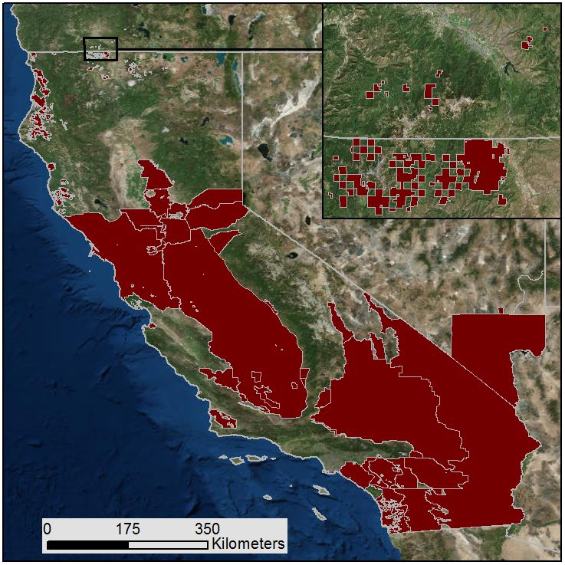
Study Area
Pacific Southwest region
136 Habitat Conservation Plan Areas
84 million acres
346 endangered or threatened species
¯
Habitat Conservation Plans
Notes:
Speaker Notes:
The study area for this research was the Pacific Southwest Region, including California, Nevada, and a small area in southern Oregon. There are 136 HCPs in this area, covering more than 84 million acres. The HCPs outline protection for some of the region’s 346 endangered and threatened species listed.
Image Source:
Map created by Kim Johnson, using ESRI’s World Imagery Basemap and HCP shapefiles downloaded from https://www.sciencebase.gov/catalog/item/521fdafbe4b08e3fb9959e41

Slide 6
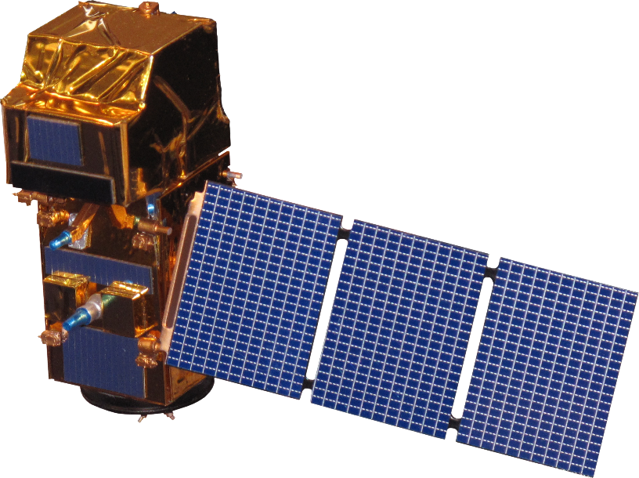
Objectives & Satellites
Identify
Analyze
Explain
Document
Landsat 5 TM
Landsat 7 ETM+
Sentinel-2 MSI
Landsat 8 OLI
Notes:
Speaker Notes:
We were tasked with creating a user-friendly interface in Google Earth Engine that allows biologists to easily and remotely detect land use changes within their HCPs. The US Fish and Wildlife Service wants the tool to allow the user to identify the time and place of interest. Next, the tool needs to be able to analyze earth observations to output a relative greenness image. The next objective that our partners set for us is for the user to be able to overlay other datasets so they can try to explain any land use changes for reasons other than development, such as croplands or likelihood of a fire. The last objective is for the tool to allow the user to document the image they produced by exporting the image to a place they can save it for future use in written reports or presentations, for example.
To address these objectives, we used satellite imagery from Landsat 5, 7, and 8, as well as Sentinel-2. We were able to access this data through the Google Earth Engine API.
Image Source:
http://www.devpedia.developexchange.com/dp/index.php?title=List_of_Satellite_Pictures

Slide 7
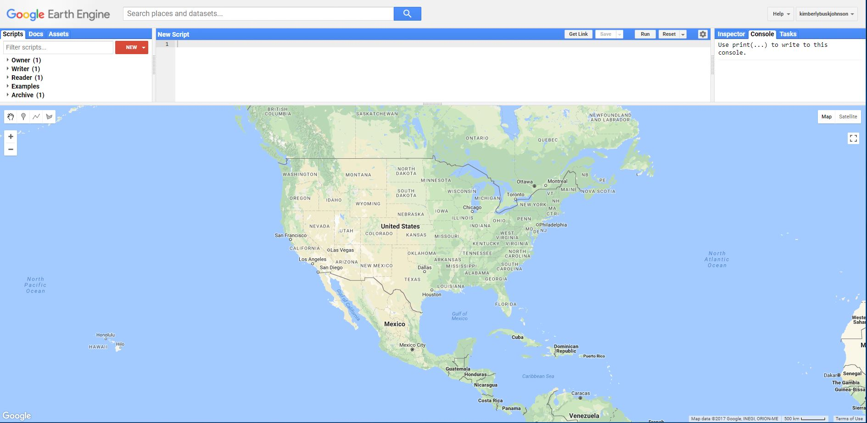
Google Earth Engine
Notes:
Speaker Notes:
To create a tool that would satisfy these objectives, our team used the Google Earth Engine API, which is a cloud computing platform that processes earth observations. This image shows what Google Earth Engine looks like, with the map on the bottom and code editor on the top. You can find data in the search bar, and it is all stored and processed on the cloud, which will be very beneficial for our partners.

Slide 8
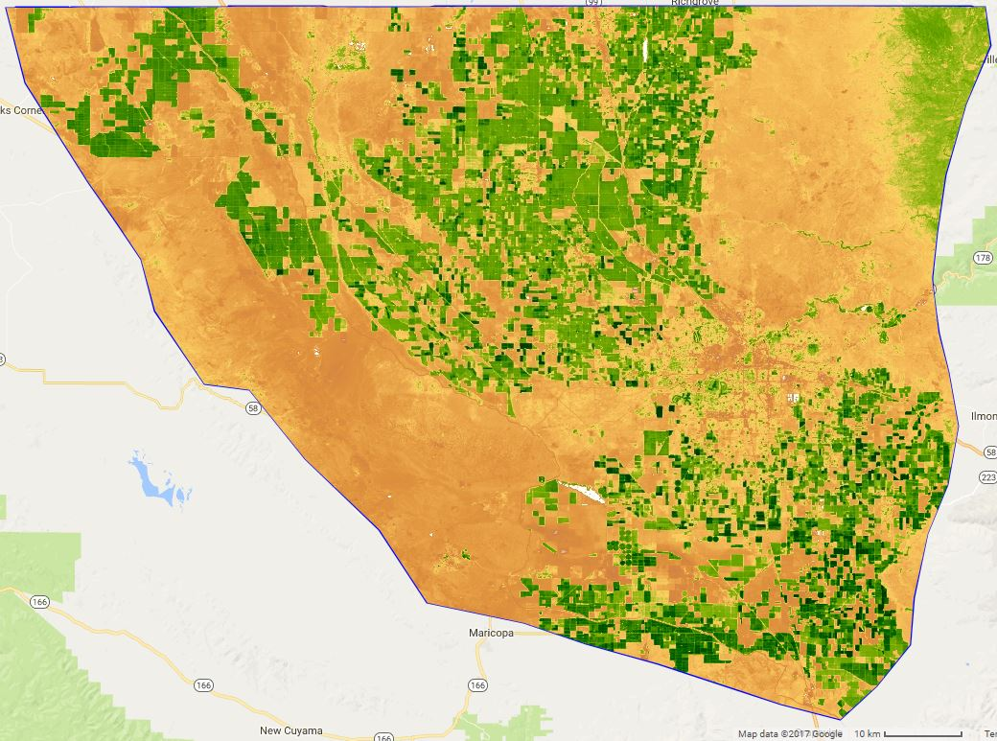
Normalized Difference Vegetation Index
$$\text{NDVI}\text{ = }\frac{\text{NIR}\text{ − }\text{Red}}{\text{NIR}\text{ + }\text{Red}}$$
NIR: Near Infrared Radiation Band
Red: Red Visible Band
NDVI
-1 Minimum vegetation
1 Maximum vegetation
Kern County Valley Floor HCP, California
October 2016
Notes:
Speaker Notes:
This is the first of three formulas we used in Google Earth Engine. The Normalized Difference Vegetation Index formula produces an image with the amount of vegetation in each pixel, with higher values (in green) indicating more vegetation and lower values (in orange) indicating less vegetation. This example is from the Kern County Valley Floor HCP in October 2016. The major challenge with NDVI, though, is that in areas like the Pacific Southwest, where the landscape transitions from sparse to dense vegetation very quickly, it can be difficult to get meaningful NDVI values. It doesn’t make sense to compare NDVI values of a dessert with a forest. To avoid this, our team calculated a relative greenness index.
Image Credit:
Kim’s Kim_LUADT script, Kern County Valley Floor, NDVI, 10/12/2010 to 11/12/2010

Slide 9
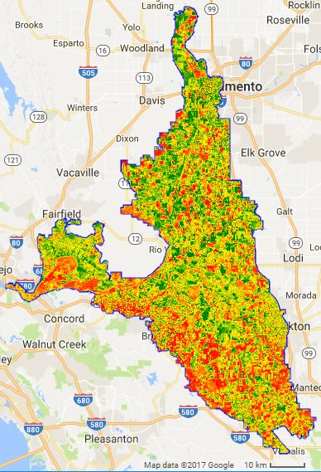
Relative Greenness Index
$${\text{RG}}_{\text{i}\text{,}\text{j}} \text{= }\frac{{\text{NDVI}}_{\text{i}\text{,}\text{j}}\text{ −}{ \text{NDVI}}_{\text{min}\text{,}\text{j}}}{{\text{NDVI}}_{\text{max}\text{,}\text{j}}\text{ −}{ \text{NDVI}}_{\text{min}\text{,}\text{j}}}$$
${NDVI}_{i,j}$ : NDVI value at time of interest
${NDVI}_{max,j}$ : Maximum NDVI value during the baseline period
${NDVI}_{min,j}$ : Minimum NDVI value during the baseline period
Relative Green
-1 (Vegetation Loss)
0 (No Change)
1 (Vegetation Gain)
Bay Delta Conservation Plan HCP, California
October 2016
Notes:
Speaker Notes:
This is the Relative Greenness formula, which also produces an image with the amount of vegetation in each pixel. Higher values (in green) indicate more vegetation. The Relative Green results are more useful and meaningful to the user because it compares each pixel with its history using a baseline of 2000 to 2010, in an attempt to normalize the results and avoid erroneous comparison of different land cover types, such as desert and forests. This example is from the Bay Delta Conservation Plan HCP.
Image Credit:
Summer Term Script, Bay Delta Conservation Plan, RGI, 2014-2017

Slide 10
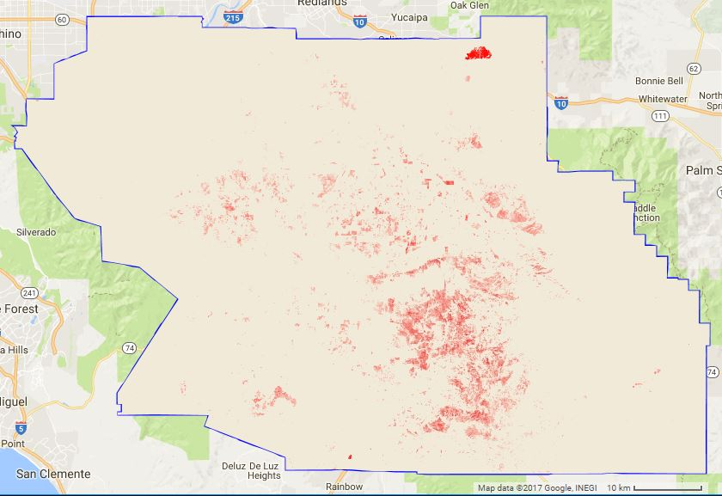
Normalized Burn Ratio
$$\text{NBR}\text{ = }\frac{\text{NIR}\text{ − }\text{SWIR}}{\text{NIR}\text{ + }\text{SWIR}}$$
NIR: Near Infrared Radiation Band
SWIR: Shortwave Infrared Radiation Band
Normalized Burn Ratio
-0.15 (Fire Unlikely)
-0.35 (Fire Likely)
Western Riverside County HCP, California October 2016
Notes:
Speaker Notes:
The Normalized Burn Ratio formula calculates whether or not a fire may have occurred in an area, with more negative values (in red) indicating a higher chance that a fire occurred and less negative values (in beige) indicating a lower chance that a fire occurred. This example is from the Western Riverside County HCP.
Image Credit:
Summer Term Script, Western Riverside County, NBR, 2014-2017

Slide 11
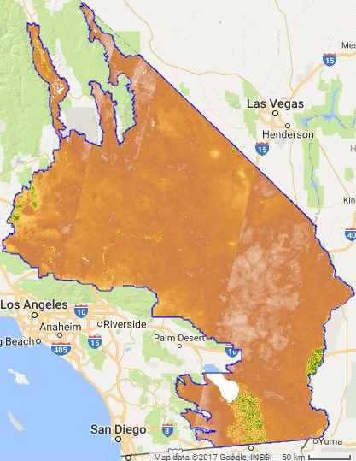
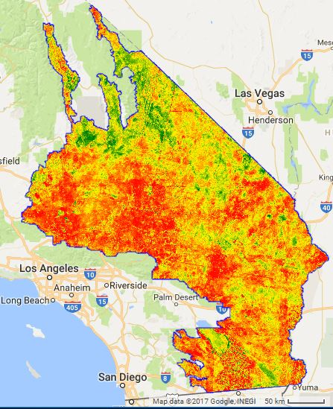
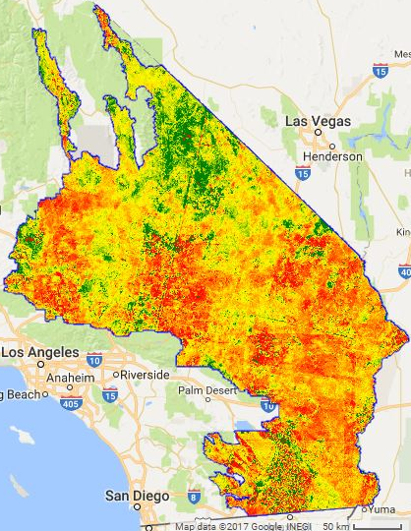
Desert Renewable Energy HCP, October 2016
NDVI
-1 Minimum vegetation
1 Maximum vegetation
Relative Green
-1 (Vegetation Loss)
0 (No Change)
1 (Vegetation Gain)
Percent Change Relative Green
-100% (Vegetation Loss)
0 (No Change)
100% (Vegetation Gain)
Notes:
Speaker Notes:
This slide shows a comparison of NDVI results with Relative Green and percent change in relative green results, which are derived from NDVI. As you can see, the images all look very different, even though they are all the same time and the same area. Focusing in the bottom section of the NDVI image, it looks like there is a large area of vegetated land [POINT TO GREEN AREA ON SCREEN].
If we look at this same area in the relative green and percent change in relative green images, we see a different story. That area is actually losing some vegetation. Additionally, this area [POINT TO SCREEN] in the relative green image that indicates pretty spatially consistent vegetation gain does not show up in the NDVI image.

Slide 12
Methodology
Satellite Imagery
Google Earth Engine API
Land Use Change Identification
Derived Products
Analyze
HCP Polygons
Google Earth Engine API
Land Use Change Identification
Ancillary Datasets
Identify
Document
Explain
Notes:
Speaker Notes:
This slide is a simplified version of our workflow. The data was loaded in Google Earth Engine, where a code calculates the derived products, which include NDVI, relative greenness, and percent change in relative greenness. These products can then be viewed with ancillary datasets in an effort to create a full picture of any land changes that are happening in an HCP.

Slide 13
Methodology
Satellite Imagery
Google Earth Engine API
NDVI
Land Use Change Identification
Relative Green
Percent Change in Relative Green
Month & Year of Interest
Baseline
HCP Polygons
Google Earth Engine API
Normalized Burn Ratio
Land Use Change Identification
National Agriculture Statistics Service
National Agriculture Imagery Program
Notes:
Speaker Notes:
This flowchart shows the steps we’ve taken with our tool. We started with satellite data and HCP polygons, which we viewed in Google Earth Engine. Based on the HCP that the user selected and the month and year they input, the NDVI, relative green, and percent change in relative green is calculated. For the relative green calculations, the baseline period was set to 2000 to 2010. The NDVI of the selected month and year of interest is compared to that same month during the baseline years to calculate relative green. For example, June 2016 would be compared with the minimum and maximum relative greens in all of the Junes from 2000 to 2010. The resulting image is then compared with ancillary datasets, including NBR and cropland data, in an effort to explain any land use changes.

Slide 14
Results
Notes:
Speaker Notes:
Our result is a successful tool that is user-friendly for the US Fish and Wildlife Service biologists that will use it. To use the tool, a user would first select their HCP of interest and type in the month and year of interest. The user can then click to calculate relative greenness and percent change in relative greenness, which use this legend.

Slide 15
Results
Notes:
Speaker Notes:
Next, the user can add ancillary datasets to the map, such as NBR, which is already loaded on this screen. You can also add cropland data for the year you’re analyzing, and then click on an area to learn what crop is grown there. NAIP data can also be added, which is high resolution imagery. The user can export the images to save for future use. Lastly, a chart is automatically created when the relative green button is clicked. The chart shows the trendline of the average NDVI for the HCP during the year of interest.

Slide 16
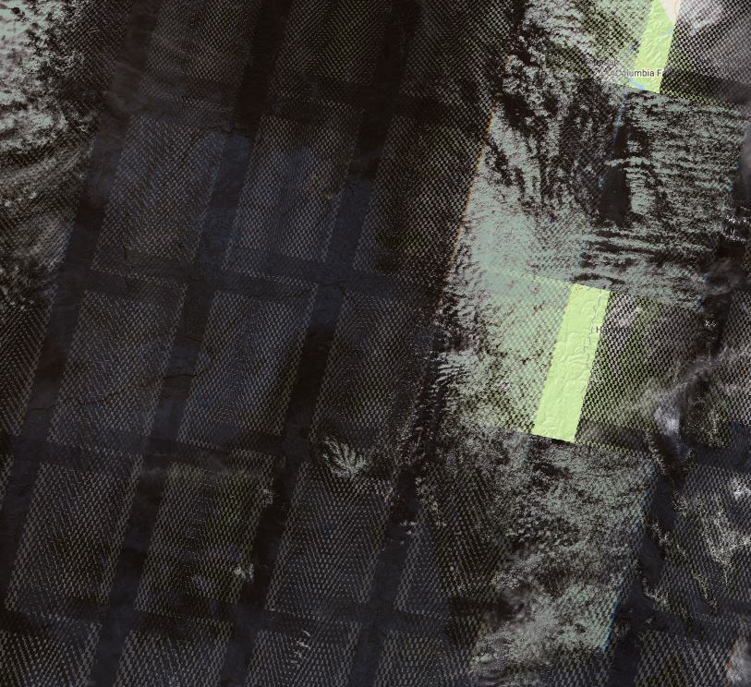
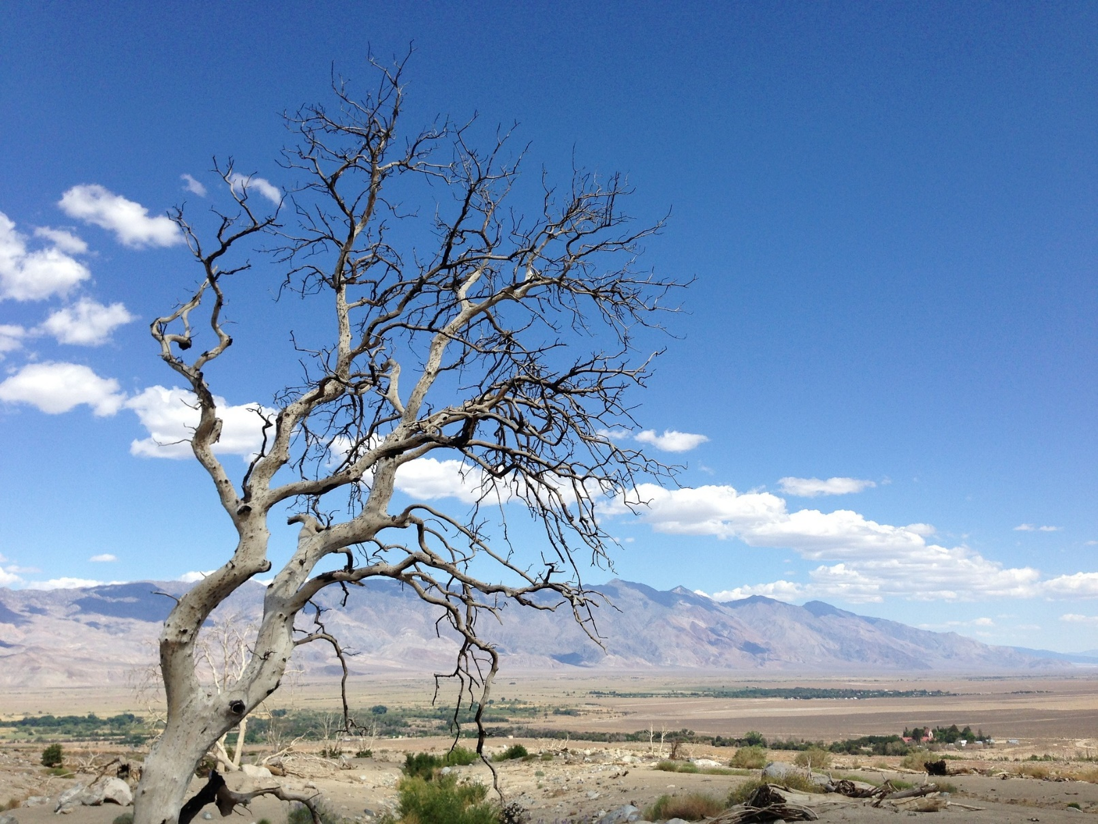
Errors & Uncertainties
Coarse resolution
Sensor error (Landsat 7)
Drought during baseline period
Image Credit: Pixabay
Notes:
Speaker Notes:
There are a few factors impacting the accuracy of our results. Coarse resolution and sensor errors impact the ability of the satellite to accurately read the radiation that is reflected, which impacts the NDVI and relative green calculations. Droughts during the baseline period is another limitation, because droughts cause vegetation extremes which impact the baseline range of maximum and minimum values. Landsat 7’s scan line error may impact our results as well.
Image Source:
Drought: https://pixabay.com/en/california-desert-sky-nature-1059220/
Landsat Errors: Created in Google Earth Engine by Kim’s LandsatErrors script, 10/12/2008 to 10/28/2008 Landsat 7 imagery

Slide 17
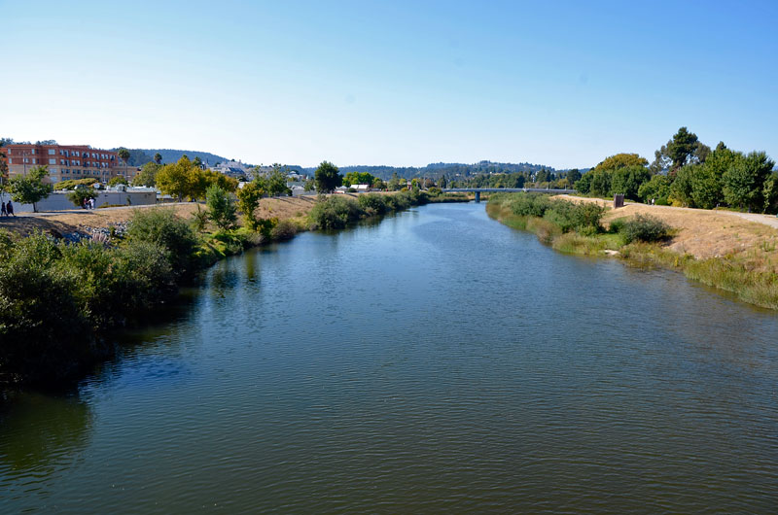
Conclusions
Recent land use changes can be detected with Landsat imagery
The causes of land use changes can be explored using cropland, NBR, and NAIP data, and validated with field visits
This Google Earth Engine tool will enable biologists at the USFWS to more effectively detect land use changes in HCPs
Image Credit: Santa Cruz IMC
Notes:
Speaker Notes:
Our team was successful in creating a tool that allows the user to identify land use changes with Landsat and Sentinel imagery in the tool we made in Google Earth Engine. The use of ancillary datasets enhances the tool to try to explain the land use changes before assuming the changes were caused by developers. Despite our success, there are still ways to improve this tool in the future…
Image Source:
https://www.indybay.org/newsitems/2012/08/14/18719511.php

Slide 18
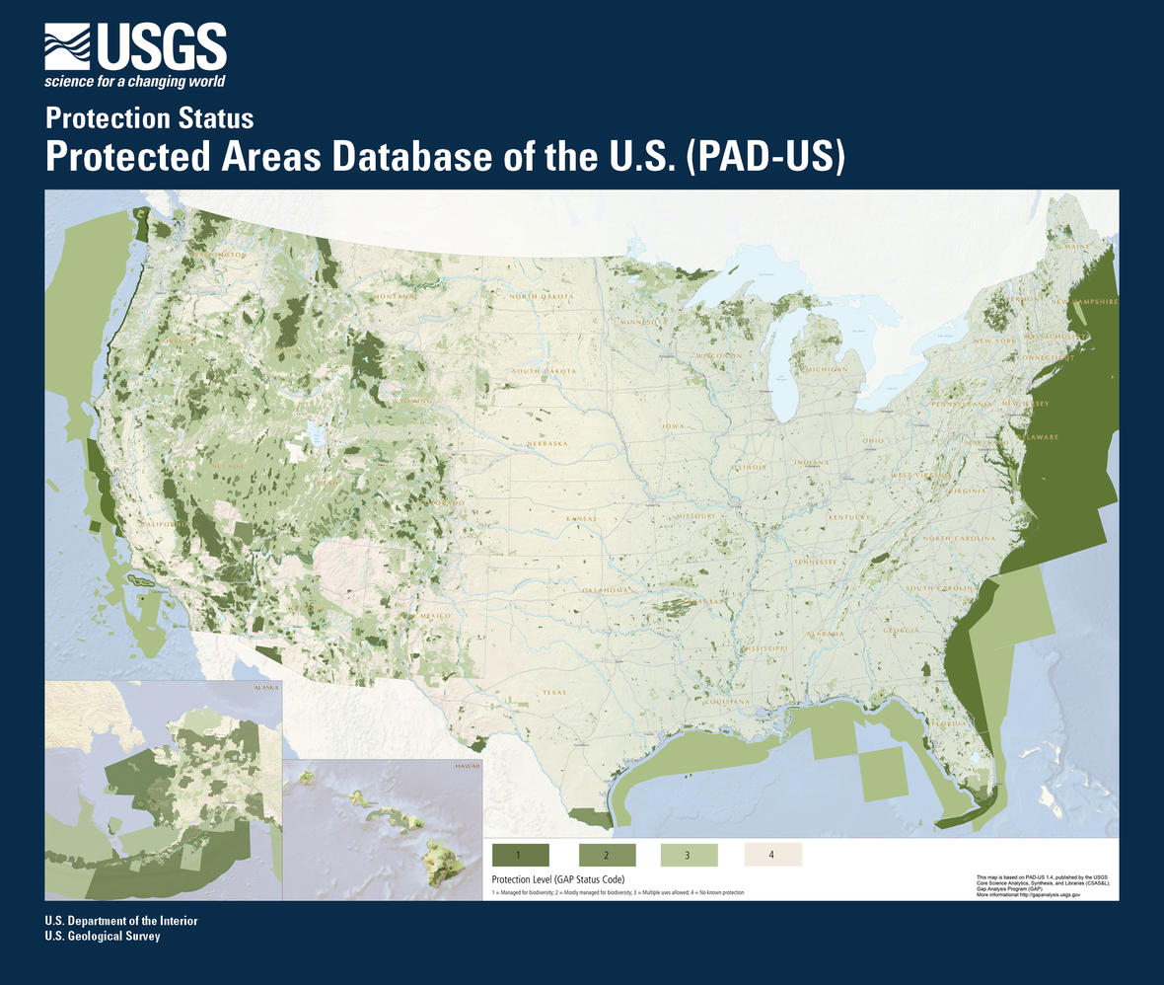
Future Work
Expand the tool’s geography
Other USFWS initiatives
Model for non-land use change tools
Google App Engine
Image Credit: USGS
Notes:
Speaker Notes:
In the future, this tool can be expanded geographically to include other US Fish and Wildlife protected areas. The fusion table was created from a shapefile, so any polygons can be input into the tool, making it useful for the other regions of the US Fish and Wildlife Service. Other organizations that have to monitor large areas, whether for protection or otherwise, could also use this tool to track land use changes. And other USFWS initiatives could use this tool. For example, the tool could be used to determine areas that should be granted protection status. Our workflow can serve as a model for the framework in which a code can be written and structured in Google Earth Engine. Another focus could be to transition the tool to Google App Engine, which would make the tool look more polished and allow for increased customization and flexibility. Using Google App Engine would also allow us to host the tool on our own website, increasing visibility.
Image Sources:
Map: https://www.usgs.gov/media/images/pad-us-flyer2-july-2016jpg

Slide 19
Acknowledgements
DEVELOP Summer Team: Sean Robison, Liz Dyer, Katie Thomas
Dr. Kenton Ross, NASA DEVELOP National Science Advisor
Pat Lineback, Regional GIS Coordinator, USFWS Pacific Southwest Region, Ecological Services Program
Dan Cox, Regional Habitat Conservation Coordinator, USFWS Pacific Southwest Region, Ecological Services Program
Brian Huberty, Regional NWI and Remote Sensing Coordinator, USFWS Midwest Region, National Wetland Inventory
Image Credit: Byrhonda Lyons/USFWS
Notes:
Speaker Notes:
We would like to thank the DEVELOP participants from the summer term who started the work for this project. We would like to thank our science advisor Dr. Ross. And we would like to say a huge thank you to our partners, Pat Lineback, Dan Cox, and Brian Huberty of the US Fish and Wildlife Service.
Image Source:
https://www.flickr.com/photos/usfws_pacificsw/37391837125/

