Slide 1
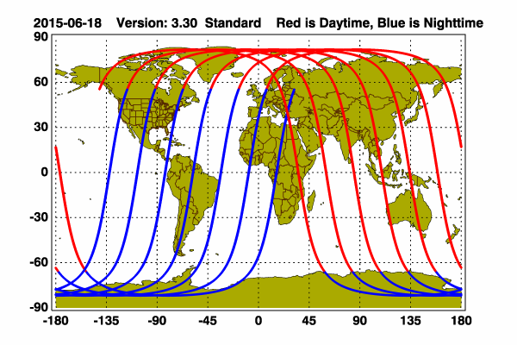
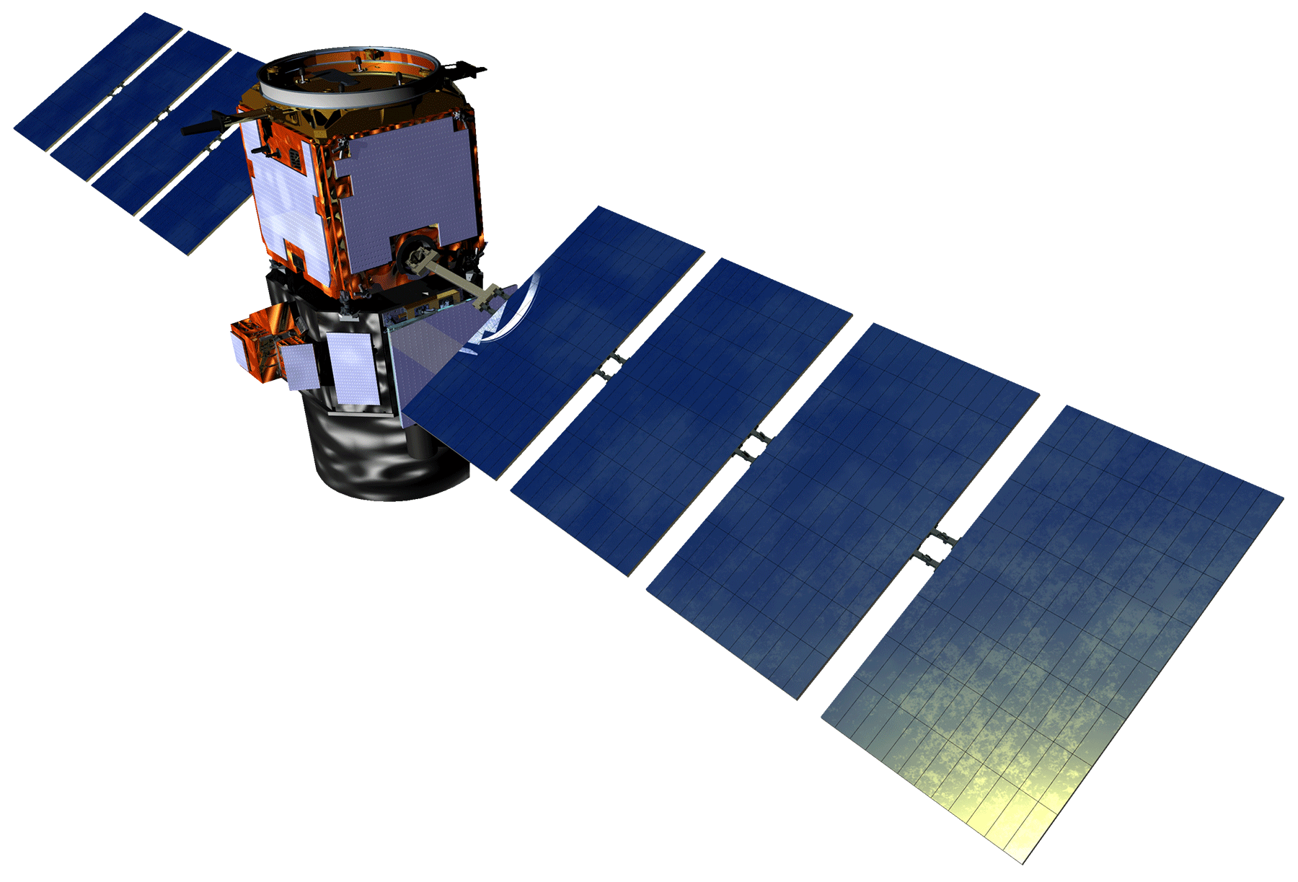
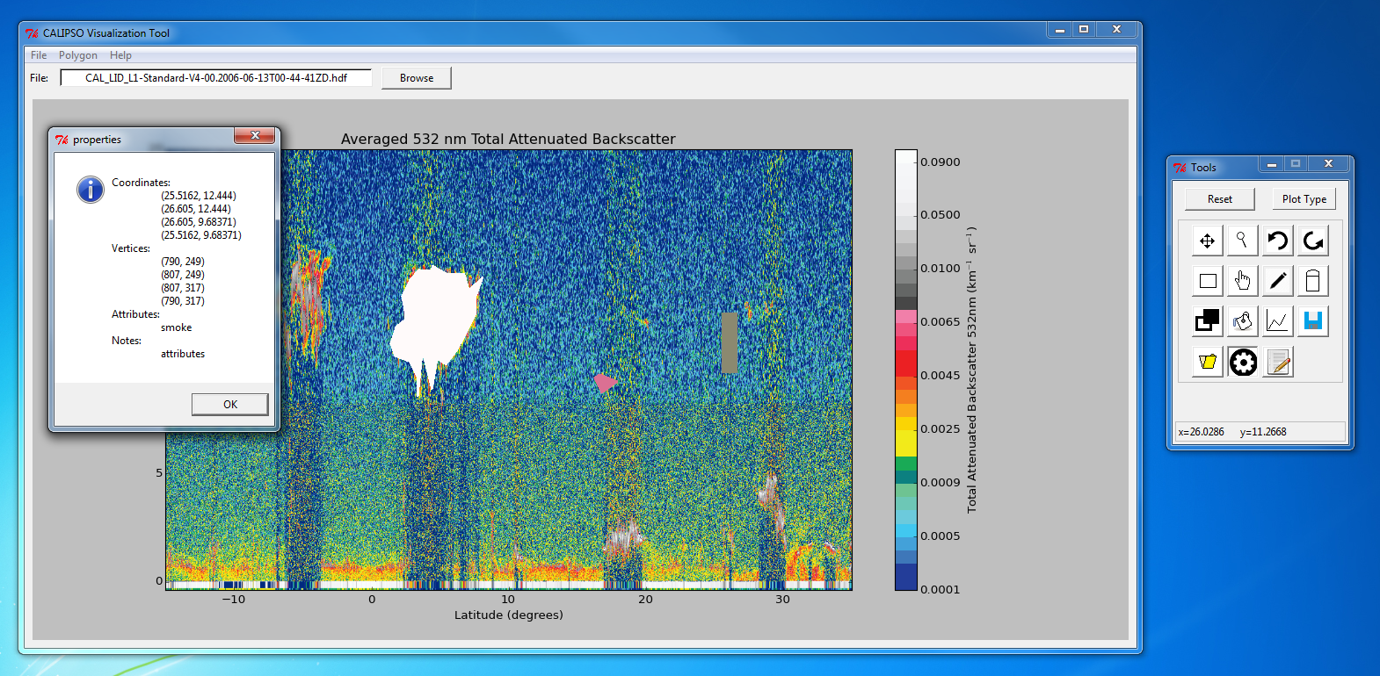
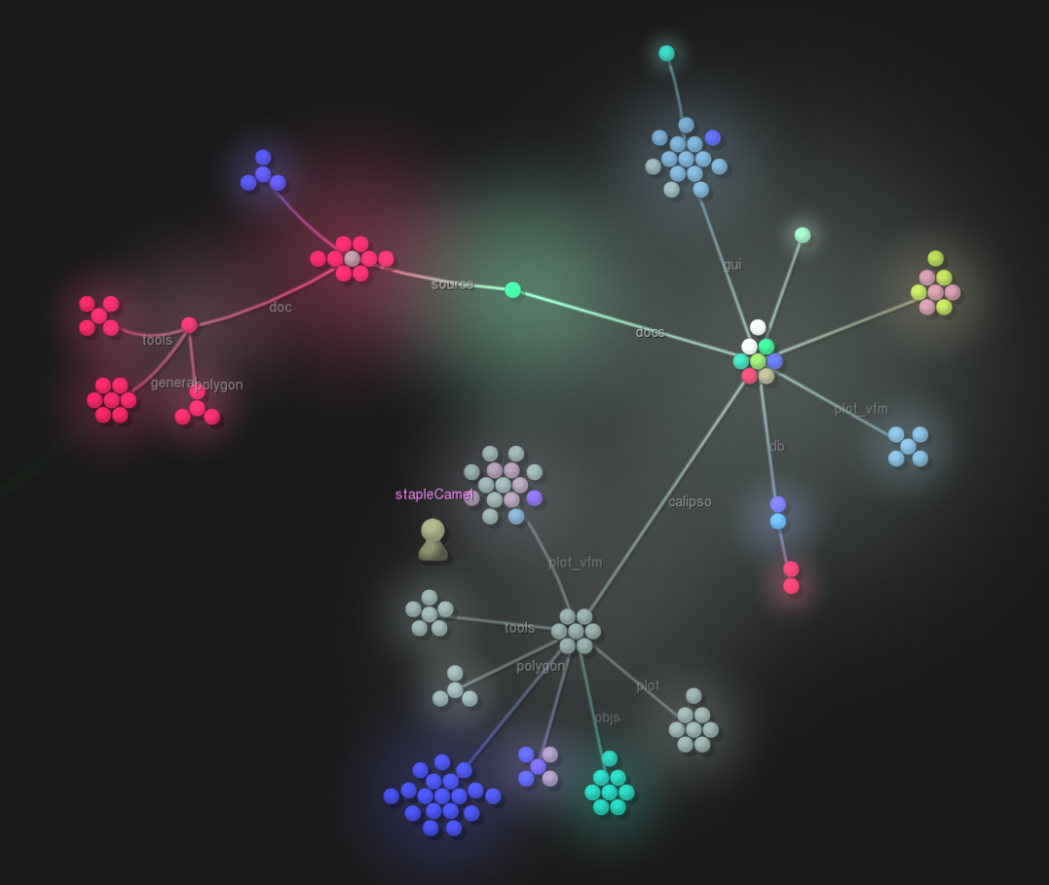
CALIPSO Cross-Cutting
Interfacing CALIPSO data through a graphical user interface
Grant Mercer (Project Lead), Nathan Qian
NASA Langley Research Center
Abstract
Objectives
Keep this blank for now.
Body text point size should be at least 24.
Caption text point size should be at least 16.
Feel free to rename, move, and resize sections as needed.
Adding shape drawing and database features
Allow users to create tags for shapes
Save shapes locally as JavaScript Object Notation (JSON) file types
Open source software release
Study Area
Methodology
Calipso
Displays Interface
PolygonList
Holds list of PolygonDrawers
Handles shape manipulations requests
DatabaseManager
Creates and maintains the database
PolygonDrawer
Draws shape
Store shapes’ internals
PolygonReader
Reads shapes from JSON
Earth Observations
dbPolygon
Converts shape into database entry
Legend
Association
Aggregation
Composition
Cloud-Aerosol Lidar and Infrared Satellite Observation (CALIPSO)
Results
Conclusions
Use bullets.
Use complete sentences with periods.
Team Members
Project Partners
Acknowledgements
Use a professional-looking photo.
Individual headshots are ok, if they aren’t pixelated and are all the same size.
Include a caption that states the team members’ names.
CALIPSO Science Team
Dr. Charles Trepte
Dr. Amber Soja
Include anyone who has helped you with the project.
If this is a continuation project, credit the previous team members and contributors.
If you are including affiliations, use DEVELOP as the affiliation for a DEVELOPer or former DEVELOPer—not their school or former school.

