Slide 1
Peru Disasters II
Identifying and mapping flood prone regions in the La Libertad Region of Peru using NASA’s Earth Observations
William Wilson (Project Lead)
Anthony Donzella
Grant Bloomer
Josh Hammes
Allison Daniel

Slide 2
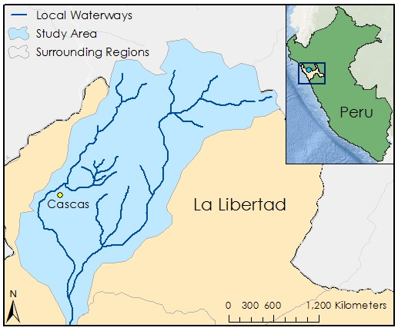
Study Area
Ochape Sub-Basin, Cascas District, La Libertad, Peru
The Cascas District is located within the Gran Chimu Province of La Libertad.
The District of Cascas is home to nearly 14,850 people.
Our study period spanned from 2007 to 2014, focusing on three major flood events in 2008, 2013, and 2014.
Notes:
Service Layer Credits: ESRI, HERE, DeLorme, MapmyIndia, © OpenStreetMap contributors, and the GIS user community.

Slide 3
Project Partners
Water for People is a non-profit organization that works to provide water security for countries around he world.
INDECI is directly responsible for disaster management in Peru.
Partners from Water for People are currently in contact with INDECI and Consejo de Cuenca.
Notes:
Image source: Water for People

Slide 4
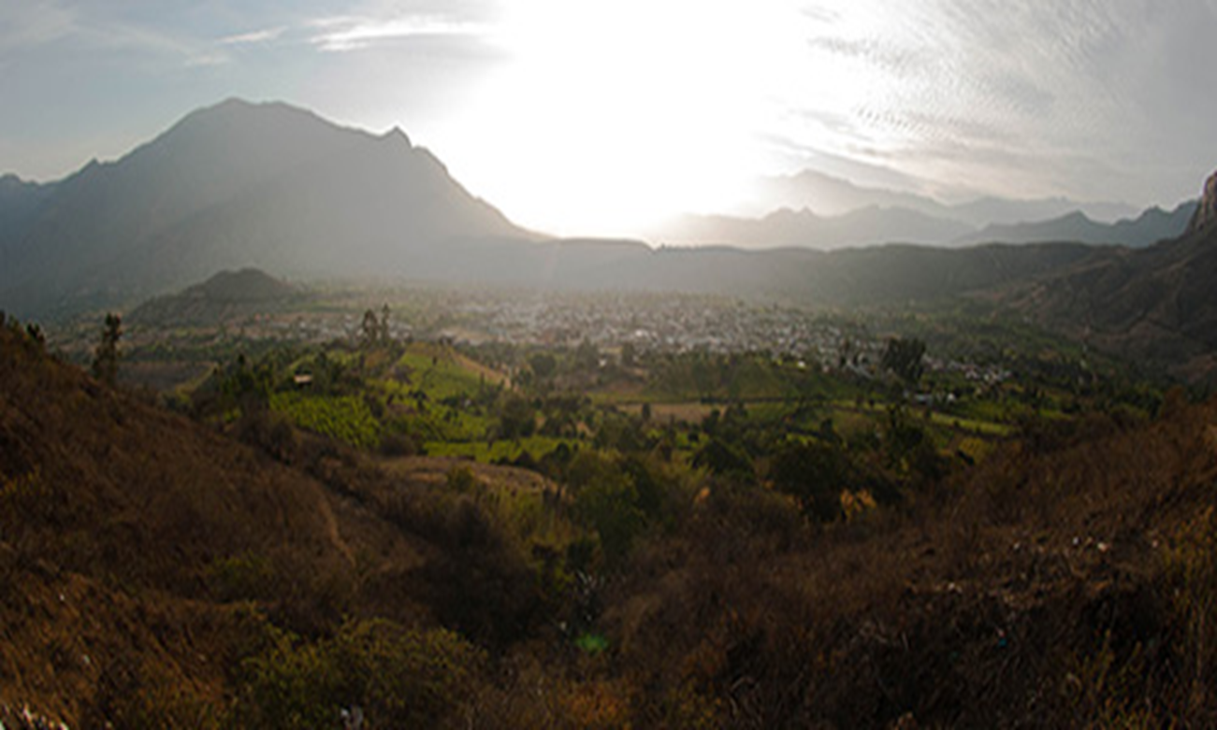
Objectives
This project aimed to produce historic and predictive flood maps utilizing NASA Earth Observations and mathematical models for the La Libertad Region of Peru.
We focused on flood modeling in identified study areas and deriving flood inundation maps.
Notes:
Image source: Water for People

Slide 5
Community Concerns
Current flood disaster management plans are incomplete and there are not enough proactive plans to handle widespread disaster.
Development of an effective flood warning system has not advanced properly due to several factors such as lack of accurate rainfall and geophysical data, as well as the inability to produce and disseminate near real time flood hazard maps.
Notes:
Image source: Water for People

Slide 6
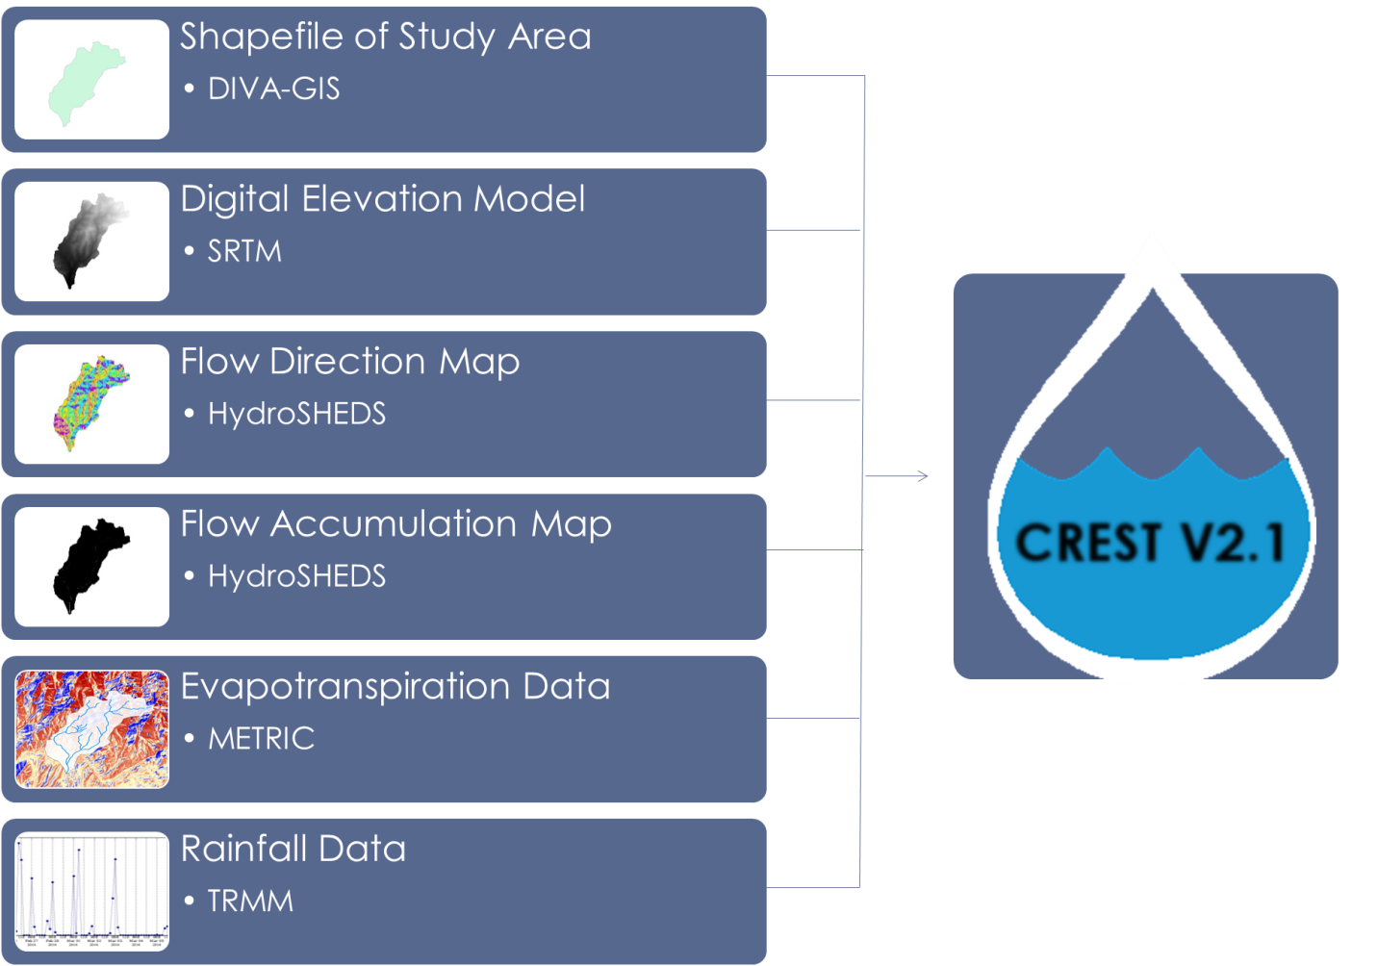
Methodology
Notes:
Methodology still needing to be finished
Analysis of this project was conducted using remotely sensed data from NASA’s Earth Observation Systems (EOS) as input for the hydrological NASA/OU CREST 2.0 model.
The CREST model required datasets for the study area encompassing precipitation data, DEM, FDR, FAC and potential evapotranspiration (PET) data.

Slide 7
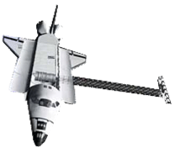
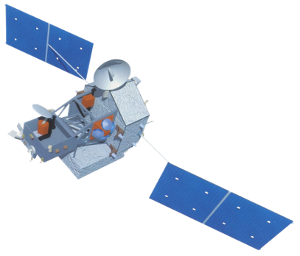
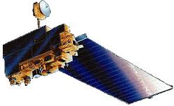
NASA Earth Observations
Satellite: Tropical Rainfall Measuring Mission (TRMM)
Sensor: TRMM Microwave Imager (TMI)
Data: Rainfall
Satellite: Shuttle Radar Topography Mission (SRTM)
Sensor:
Data: Topography
Satellite: Terra
Sensor: Advanced Spaceborne Thermal Emission and Reflection Radiometer (ASTER)
Data: Digital Elevation Model (DEM)
Notes:
Image source: DEVELOPedia

Slide 8
Results

Slide 9
Future Work

Slide 10
Advisors
Dr. DeWayne Cecil, (Global Science and Technology, Inc.)
Dr. Kenton Ross, (NASA DEVELOP/Langley Research Center)
Partners
Mark Duey and Francisco Soto, Water for People
Miguel Angel Saldarriaga Jiran, Instituto Nacional de Defensa Civil del Peru
Others
Lance Watkins, Geoinformatics Team (NASA DEVELOP)
Jordan Bates, Center Lead (NASA DEVELOP WC)
Ms. Melanie Salyer, Principal Investigator (NASA DEVELOP WC)
Dr. Xinyi Shen, Hydrometeorology and Remote Sensing Laboratory (University of Oklahoma)
Manabendra Saharia, Graduate Research Assistant (University of Oklahoma)

Slide 11
Peru Project Team

