Slide 1
DEVELOP National Program
[Texas Water Resources]
[Langley Research Center]
Summer 2015
Final Imagery

Slide 2
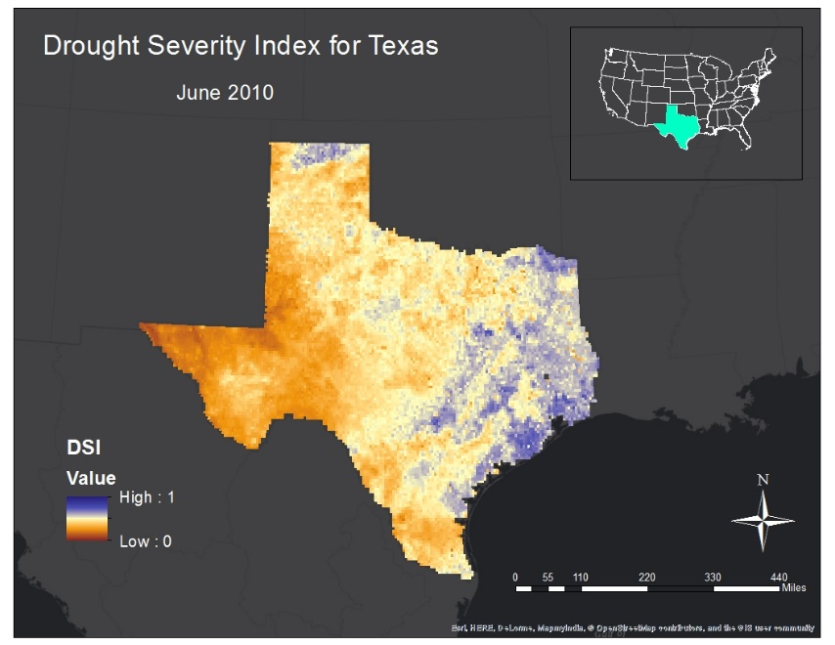
Langley Research Center
Texas Water Resources: Utilizing NASA Earth Observations to Monitor Drought Severity in Texas for Wildfire Mitigation Support
Our Drought Severity Index images for June 2010 and June 2011 were created by a modified equation consisting of four variables: Aqua/Terra MODIS for Land Surface Temperature and Normalized Difference Vegetation Index(NDVI), Soil Moisture data from NASA’s North American Land Data Assimilation System(NLDAS), and daily precipitation data from NOAA’s Multi-sensor Precipitation Estimator (MPE).
The classifications, ranging in numerical values from zero to one, identify areas low in value and dry, as well as areas high in value and wet. Blue areas reflect adequate to slightly lacking moisture levels while the pale yellow to brown colors indicate areas of concern and potential wildfire risk
In the images shown, the DSI reflects the increase in drought conditions within the state from June 2010 to June 2011

Slide 3
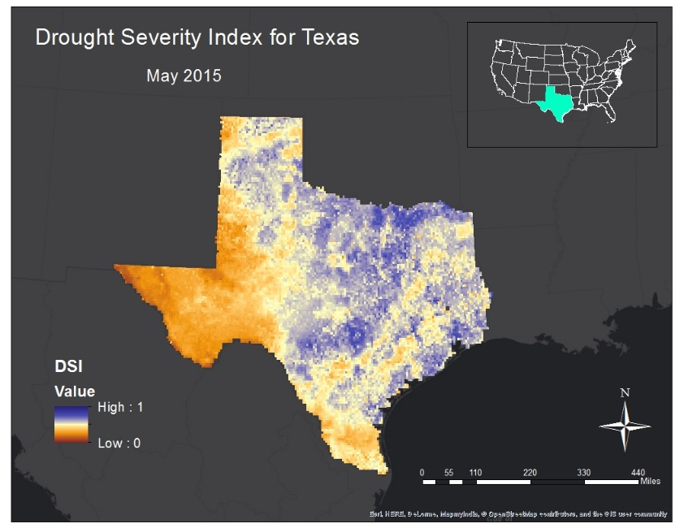
Langley Research Center
Texas Water Resources: Utilizing NASA Earth Observations to Monitor Drought Severity in Texas for Wildfire Mitigation Support
Our Drought Severity Index images for May 2014 and May 2015 was created by a modified equation consisting of four variables: Aqua/Terra MODIS for Land Surface Temperature and Normalized Difference Vegetation Index(NDVI), Soil Moisture data from NASA’s North American Land Data Assimilation System(NLDAS), and daily precipitation data from NOAA’s Multi-sensor Precipitation Estimator (MPE).
The classifications, ranging in numerical values from zero to one, identify areas low in value and dry, as well as areas high in value and wet. Blue areas reflect adequate to slightly lacking moisture levels while the pale yellow to brown colors indicate areas of concern and potential wildfire risk
From May 2014 to May 2015 however, the western and northern regions were greatly alleviated of their dry spell after the rainstorms that occurred during May of 2015. In consideration of these results, it is clear that the DSI mirrors the environmental circumstances affecting Texas historically

Slide 4
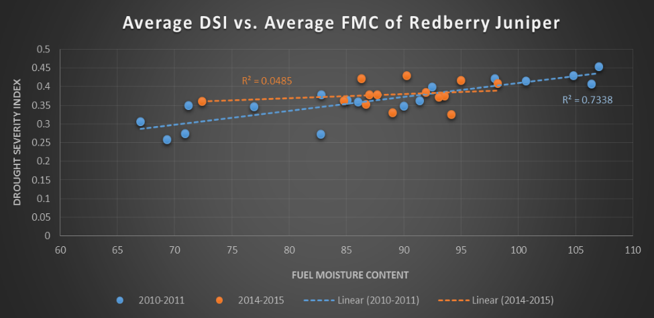
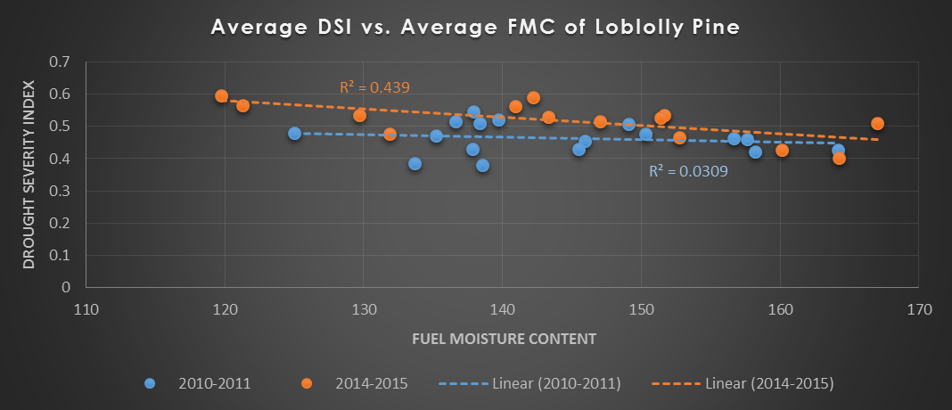
Langley Research Center
Weight 1
30% NDVI + 10% LST + 30% MPE + 30% NLDAS
Texas Water Resources: Utilizing NASA Earth Observations to Monitor Drought Severity in Texas for Wildfire Mitigation Support
Scatter plots and correlation coefficient r figures were calculated with three different weight values applied to Redberry Juniper and Loblolly Pine FMC measurements.
After applying Weight 1, the resulting r values from Redberry Juniper were quite high from 2010-2011 at 73%, however, the latter years of 2014-2015 were quite low at 0.04% due to what could be various reasons.
The FMC stations in central and west Texas seem to indicate that they received wet conditions, although this is not portrayed in the DSI imagery until spring of 2015.
Loblolly Pine on the other hand, also suffered inconsistent results within the study periods with values averaging 3% and 44%. Weight 3, however, produced results at slightly higher correlations. We believe the reason for this is due to the weight emphasis placed on vegetation and soil moisture.

Slide 5
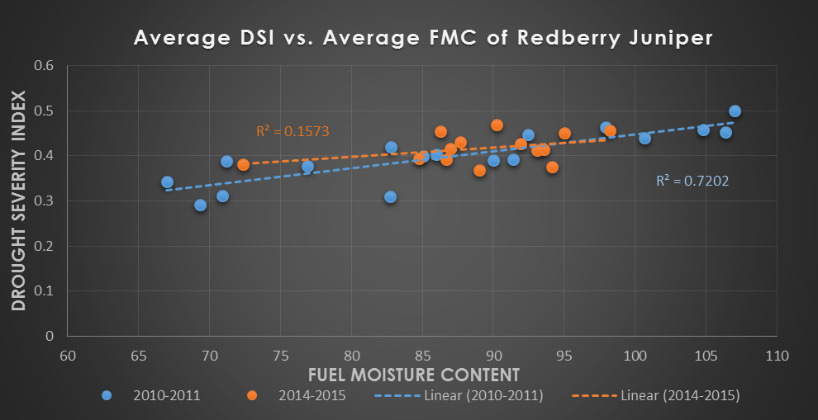
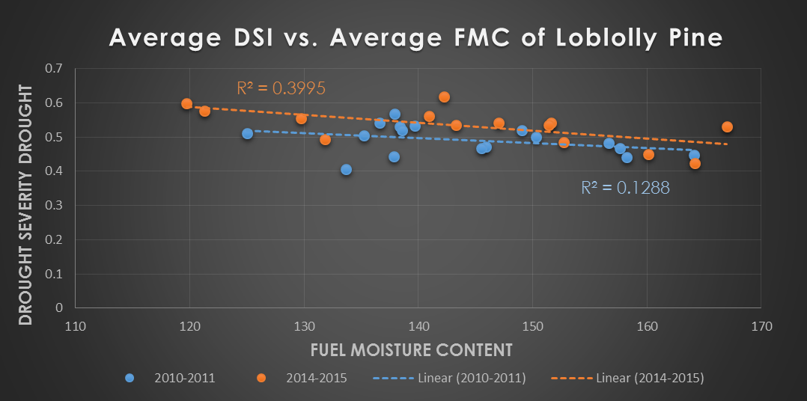
Langley Research Center
Weight 3
30% NDVI + 10% LST + 20% MPE + 40% NLDAS
Texas Water Resources: Utilizing NASA Earth Observations to Monitor Drought Severity in Texas for Wildfire Mitigation Support
Scatter plots and correlation coefficient r figures were calculated with three different weight values applied to Redberry Juniper and Loblolly Pine FMC measurements.
Weight 3 produced results at slightly higher correlations than Weight 1 and 2. We believe the reason for this is due to the weight emphasis placed on vegetation and soil moisture.

